Slide 1
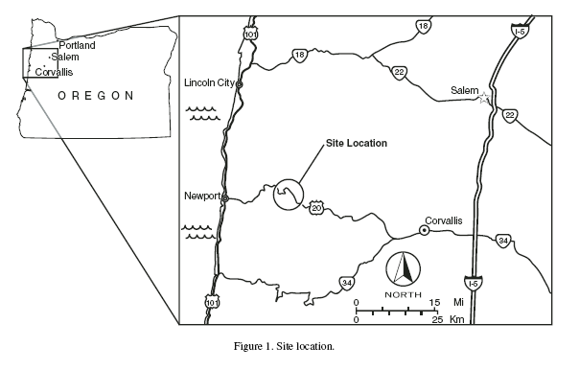
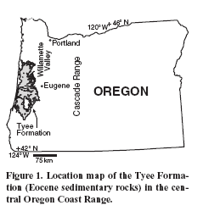
Lithologic Controls on Landslide Activity in the Central Oregon Coast Range
ES322 Geomorphology Field Guide
Paleo-Landslides in Tyee Formation
US20-Pioneer Mtn-Eddyville Project
Fall 2012 – Dr. Taylor
Earth & Physical Science Dept.
Western Oregon University

Slide 2
Introduction to Mass Wasting

Slide 3
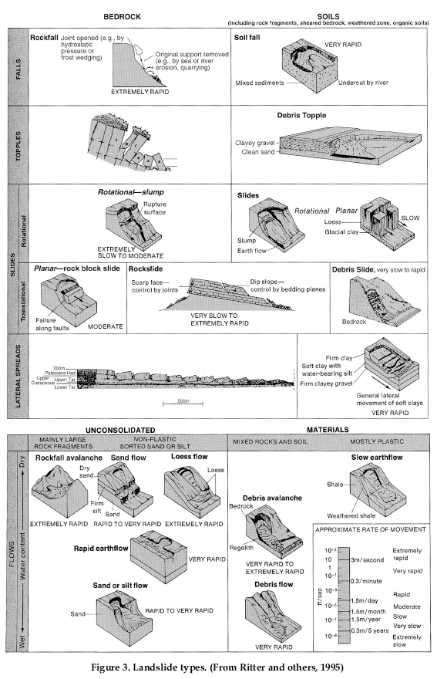
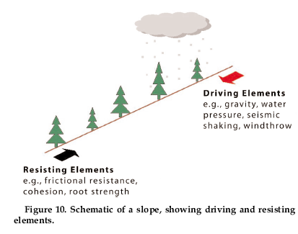
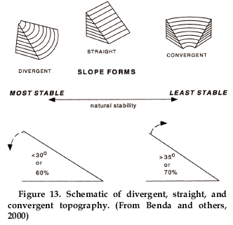

Slide 4
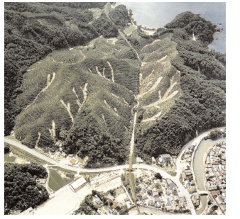
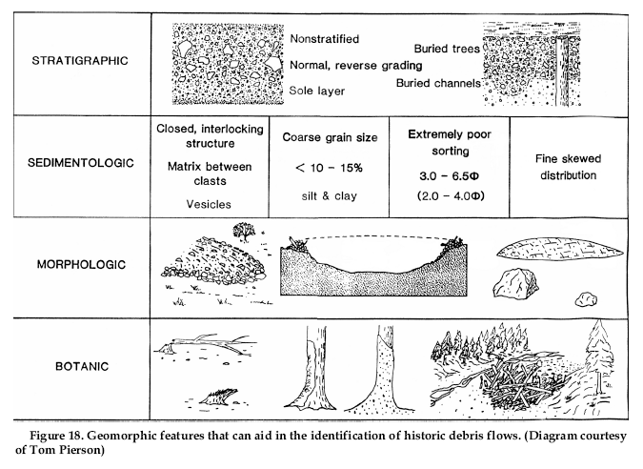
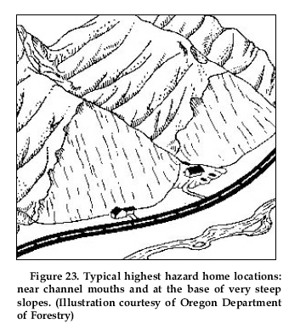

Slide 5
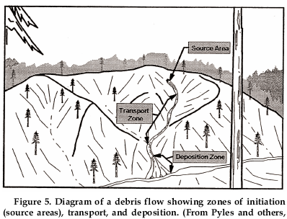
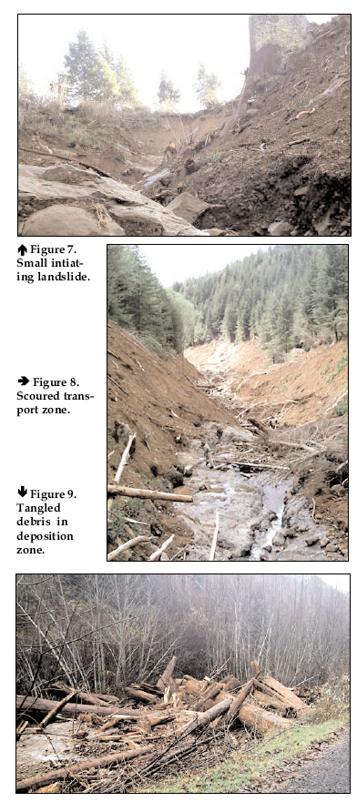
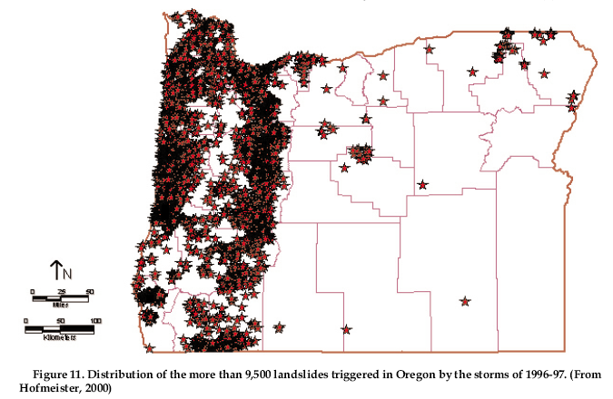

Slide 6
Tectonic Setting of the Central Oregon Coast Range

Slide 7
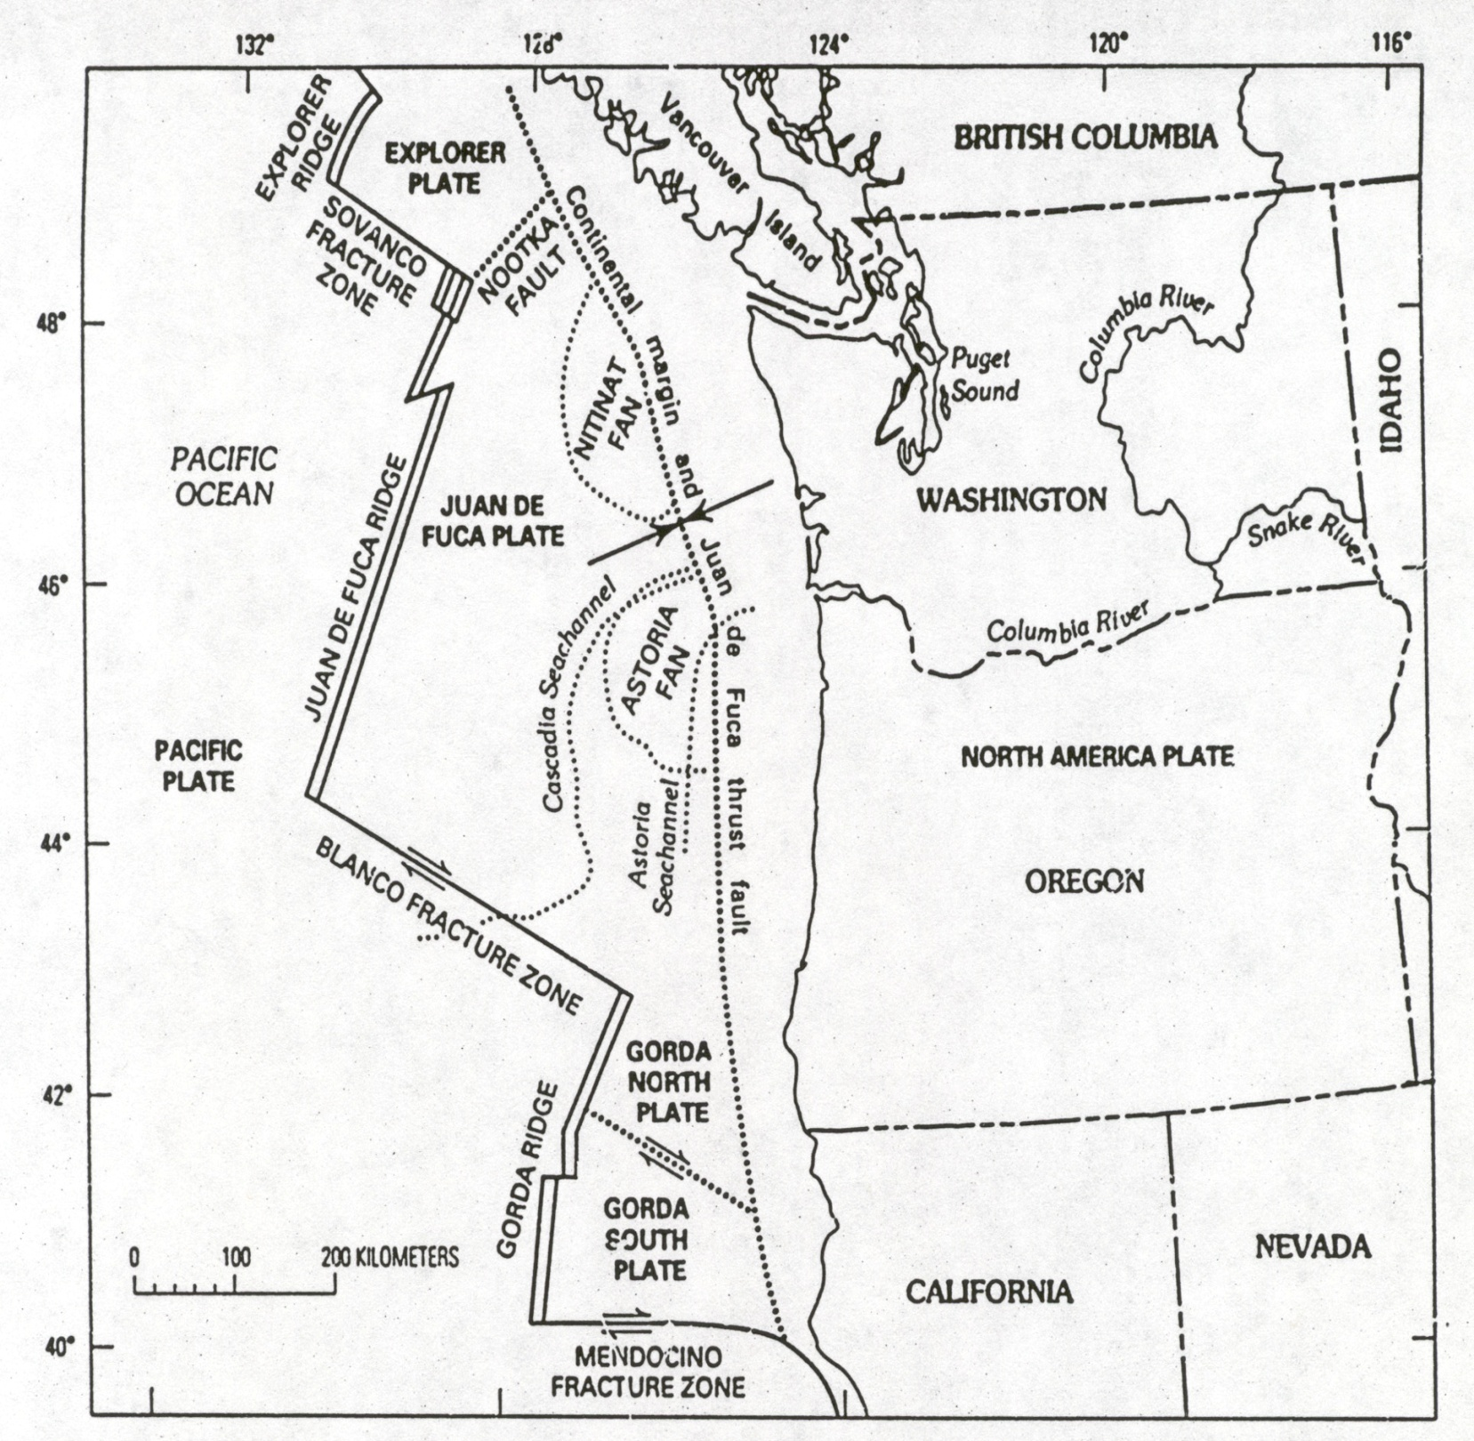
Yeats and others, 1996

Slide 8
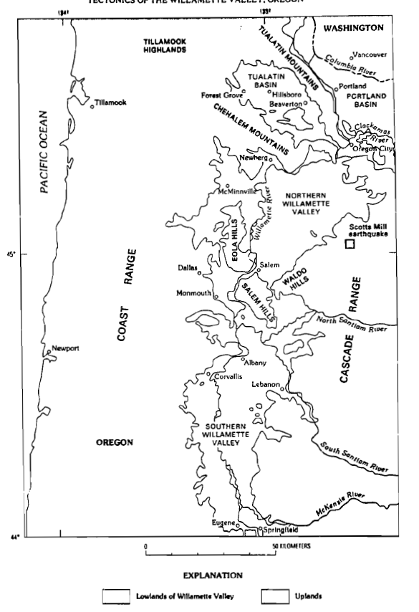
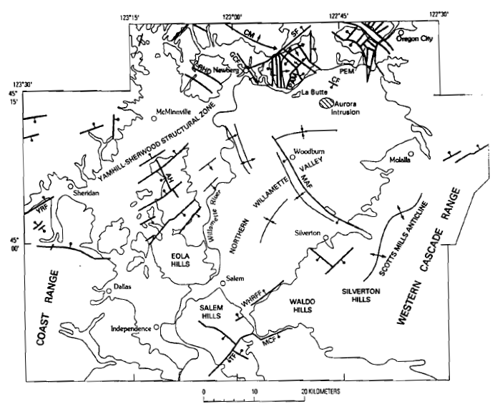
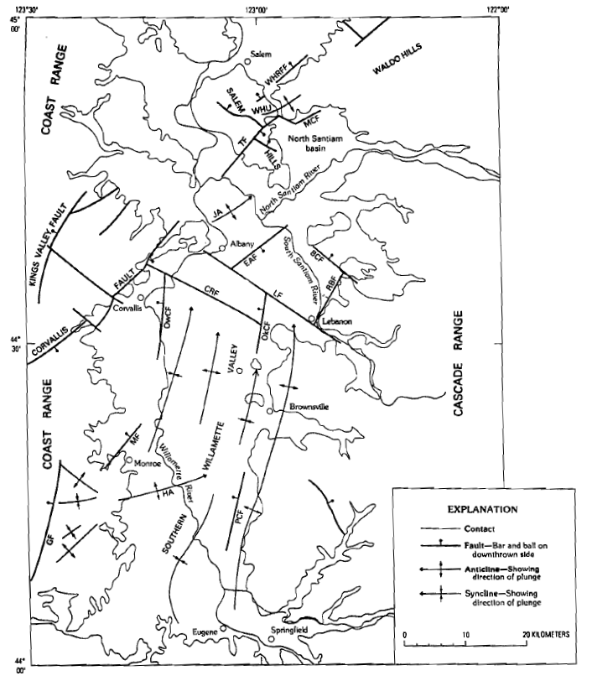

Slide 10
Inboard
Luckiamute
Latitude

Slide 11
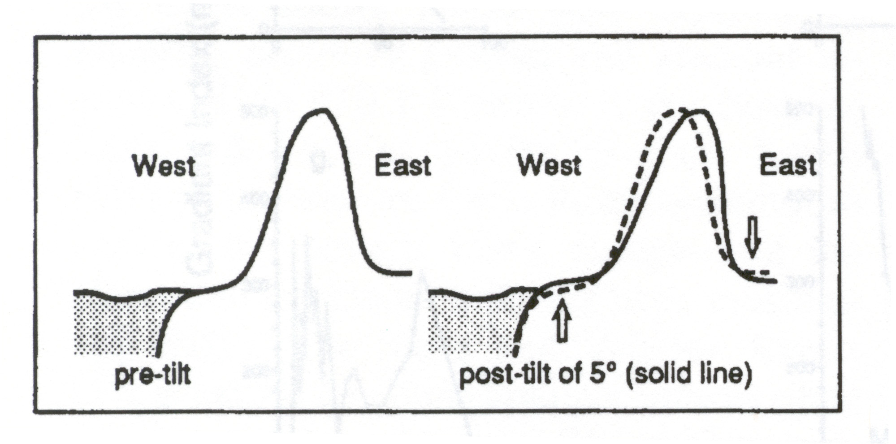
Coast Range Uplift Model (Rhea, 1993)

Slide 12
Oregon Coast Range
Unglaciated, forested landscape
Paleogene-Neogene marine volcanic and sedimentary rocks (Walker and MacLeod, 1991)
Long history of oblique convergence and tectonic accretion (Wells et al., 1984)
Active mountain building during the past 10-15 Ma (Snavely et al., 1993)
Pleistocene uplift rates = 0.1-0.3 mm/yr (Kelsey et al., 1996)
Historic uplift rates = 1-3 mm/yr (Mitchell et al., 1994)
Eastward tilting = 1 x 10⁻⁸ rad/yr (Adams, 1984)
Holocene erosion rates = 0.05-0.33 mm/yr (Roering et al., 2005)

Slide 13
Central Oregon Coast Range Bedrock Stratigraphy

Slide 16
Qal – Quaternary Alluvium
Ti – Oligocene Mafic Intrusives: Sheets, sills, and dikes of massive gabbro.
Tss – Spencer Formation: Thick- to thin-bedded marine tuffaceous sandstone, siltstone, and mudstone.
Ty – Yamhill Formation: Massive to thinly bedded marine silstone and sandtone interbeds. Locally includes interlayered basalt lava flows.
Tt – Tyee Formation: Rhythmically bedded, medium-grained feldspathic sandstone and carbonaceous siltstone. Interpreted as deposits of submarine turbidity currents and fans.
Tsr – Siletz River Volcanics: Aphanitic to porphyritic, vesicular pillow flows, tuff breccia, and lava flows. Local interbeds of basaltic siltstone and sandstone. Prevasively zeolitized and veined with calcite. Marine origin interpreted as accreted oceanic crust and seamounts.

Slide 17
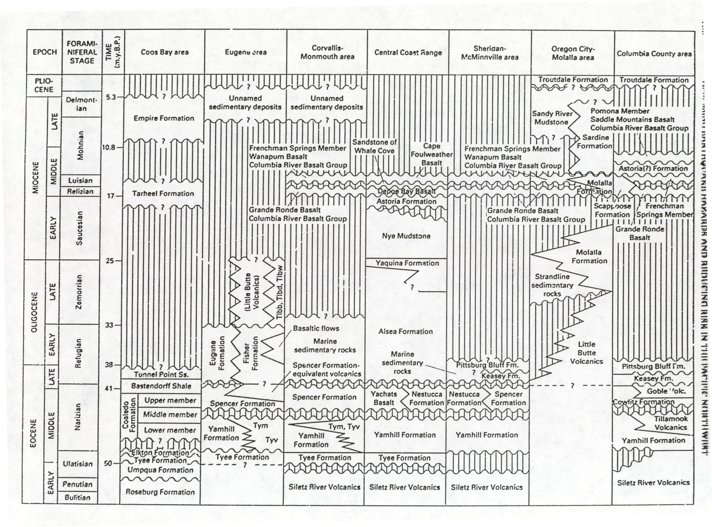
Yeats and others, 1996

Slide 18
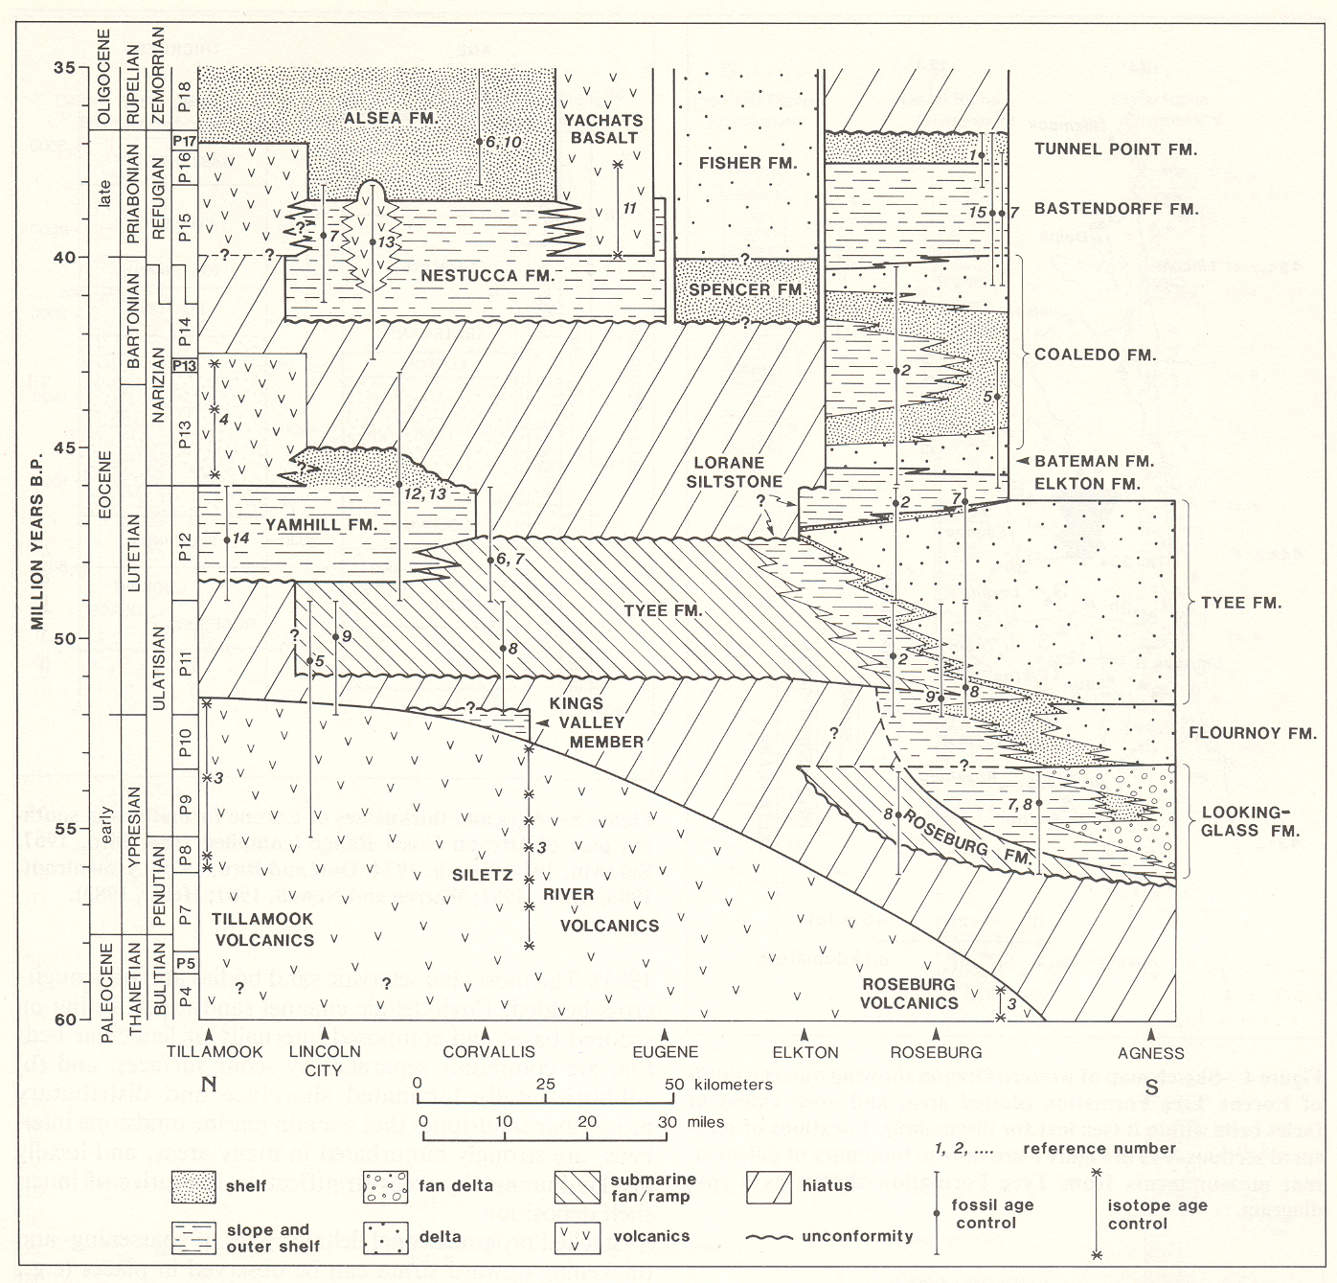
Stratigraphic correlation chart of Tyee-domain (from Heller and Dickinson, 1985)

Slide 19
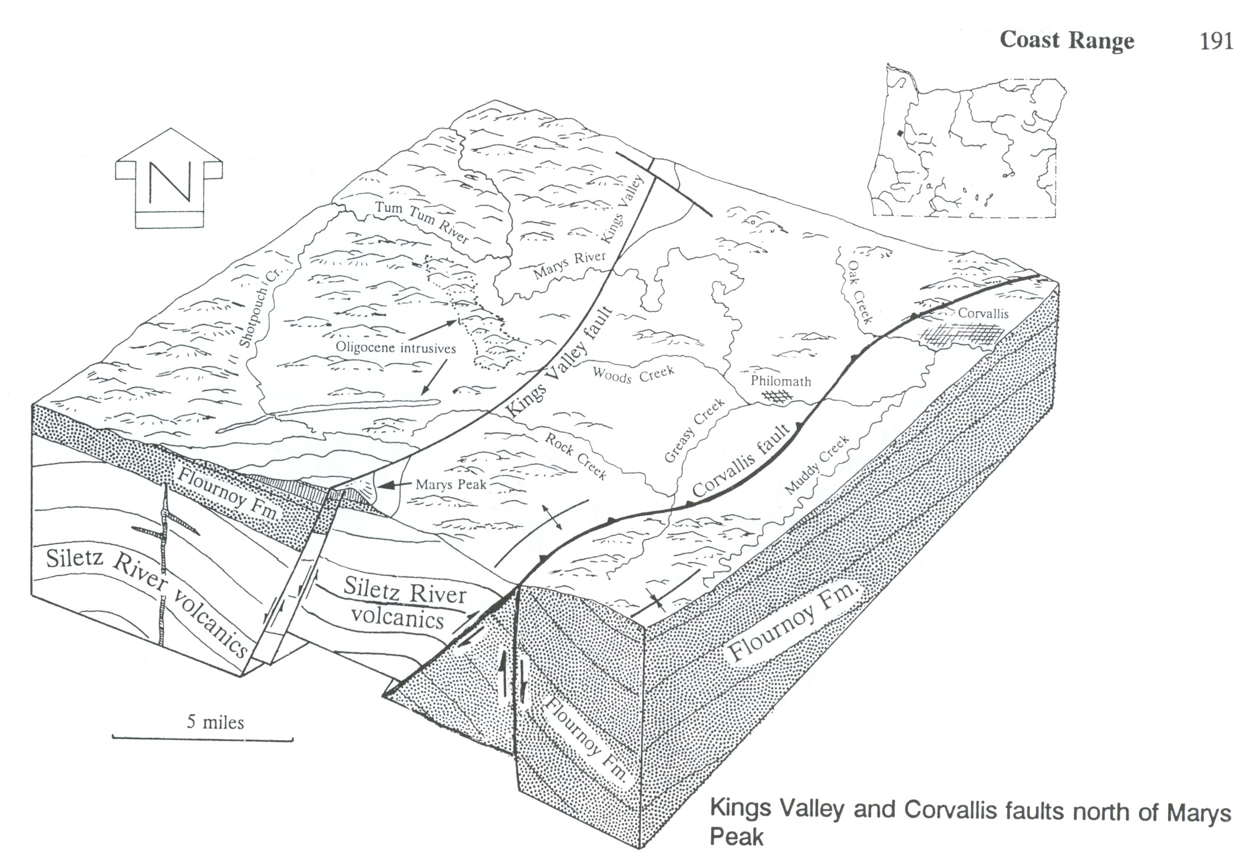
Orr and Orr, 1999

Slide 20
Siletz River Volcanics – “Basement”
Lower Eocene

Slide 21
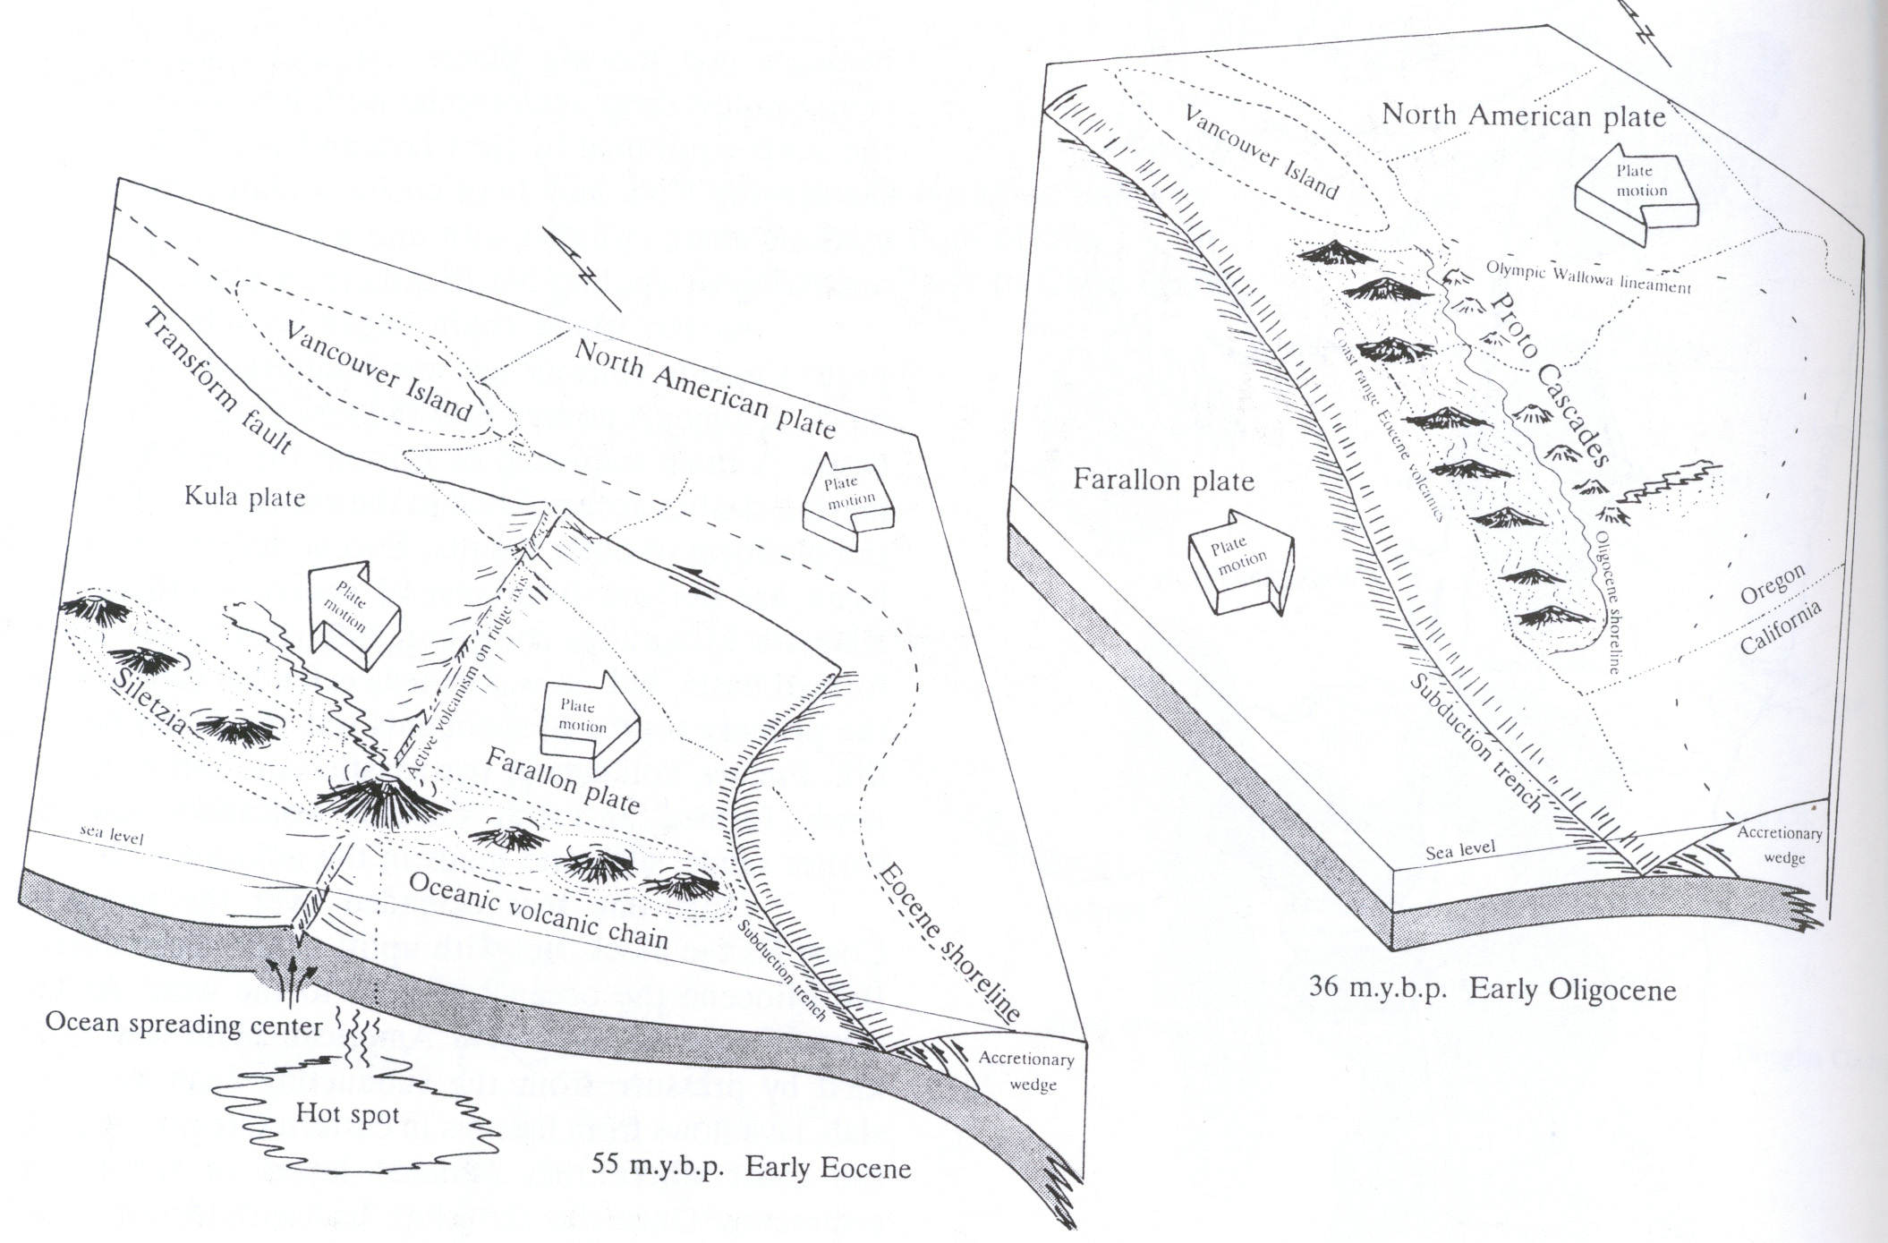
Orr and Orr, 1999

Slide 22
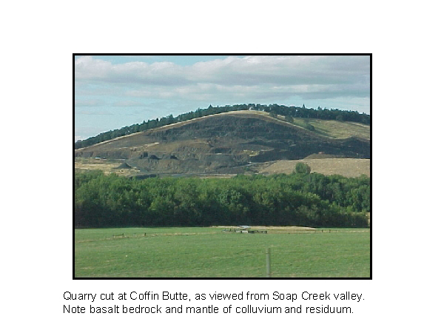

Slide 23
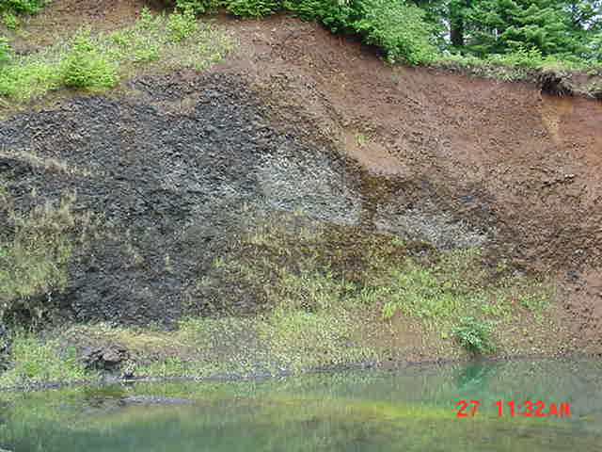

Slide 24
Marine Sandstone – Spencer Fm
Middle-Upper Eocene

Slide 25
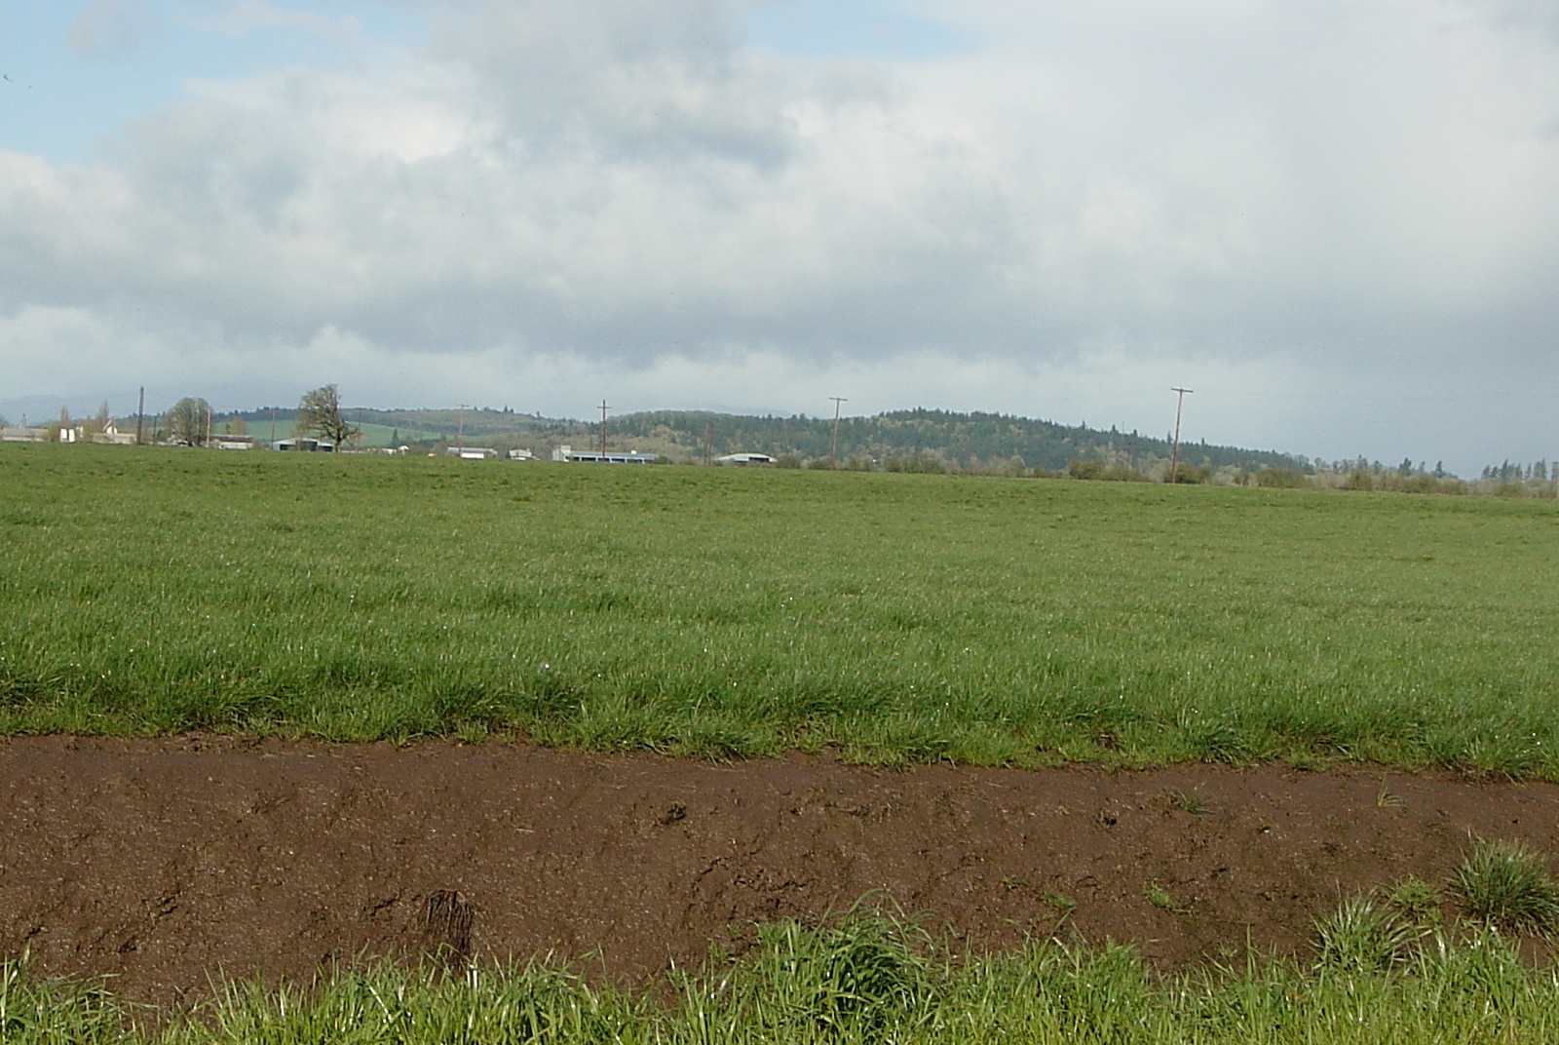
Spencer-Valley Fill Domain
el 470 ft
Ts
Max Missoula Flood El. = 400 ft)
el 220 ft
Qtm (Bela, 1981)
Qff2 (O’Connor et al., 2001)
Willamette Silt

Slide 26
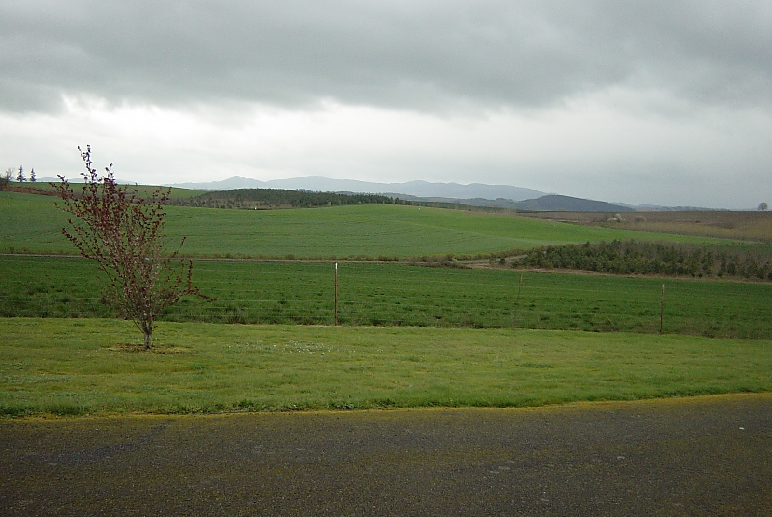
Siletz Domain
Spencer Domain

Slide 27
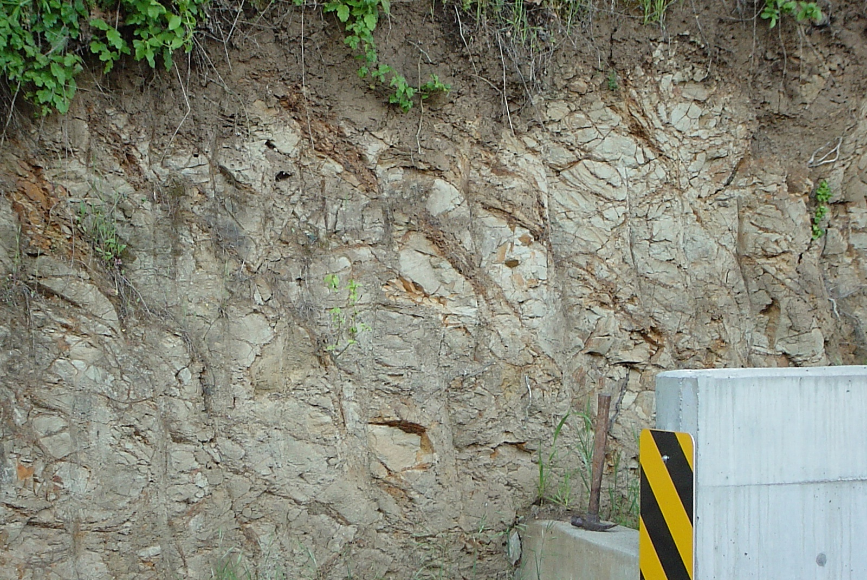

Slide 28
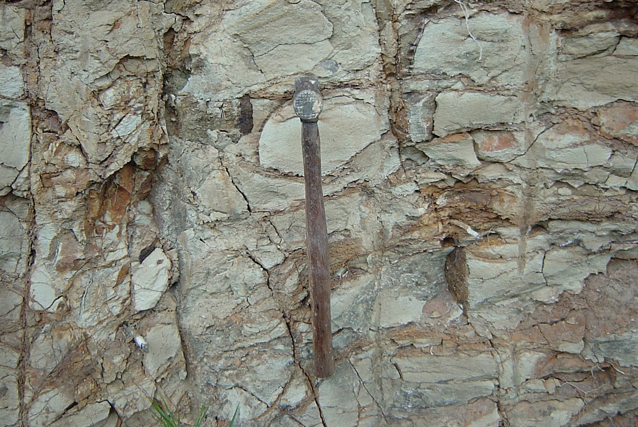

Slide 29
Middle Eocene Sedimentary
Upper Oligocene Intrusives

Slide 30
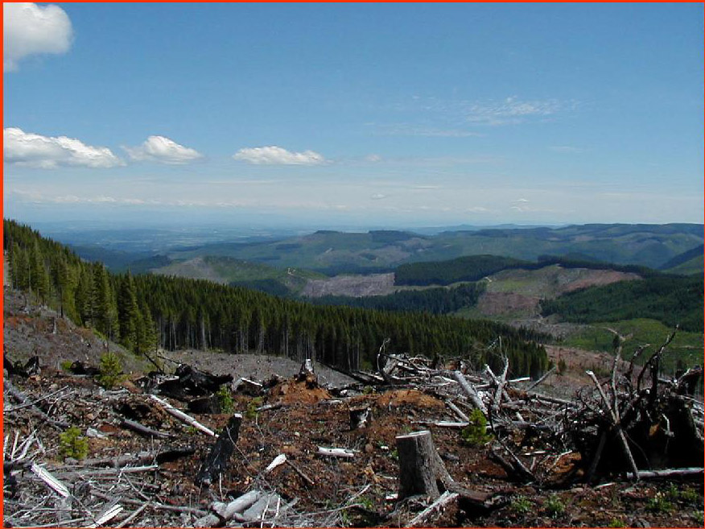
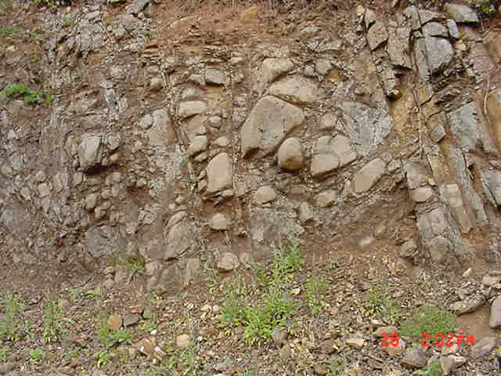
Willamette Valley
Yamhill-Intrusive Domain

Slide 32
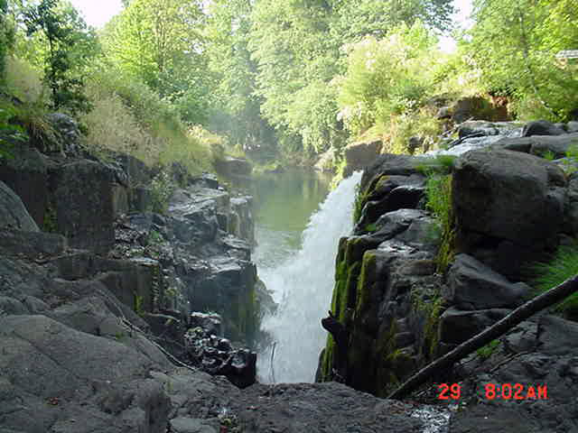

Slide 33
Early-Middle Eocene Tyee Formation

Slide 34
Orr and Orr, 1999

Slide 35
Stratigraphic correlation chart of Tyee-domain (from Heller and Dickinson, 1985)

Slide 36
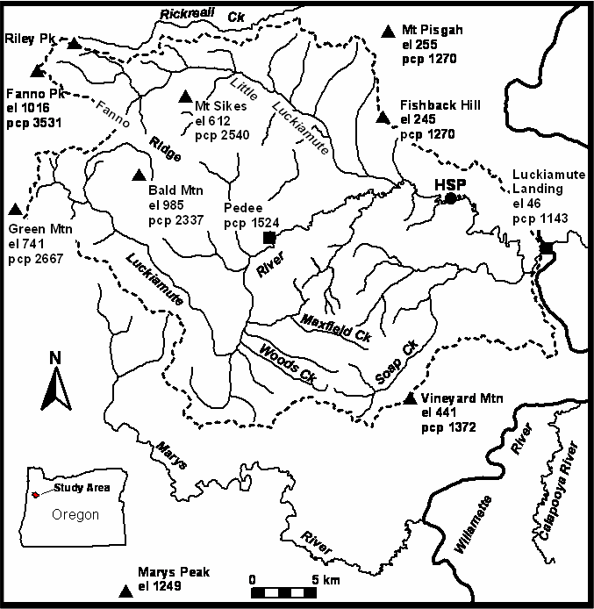
Study Area
Salem
Oregon
Luckiamute
Study Area
Oregon Coast Range
-Unglaciated
-Humid-Mountainous
-Tectonic Convergence
Eugene
Focus of Existing
Coast Range
Studies (27+ yrs)
Coos Bay
Tyee Fm
Outcrop Belt
0 50 km

Slide 37
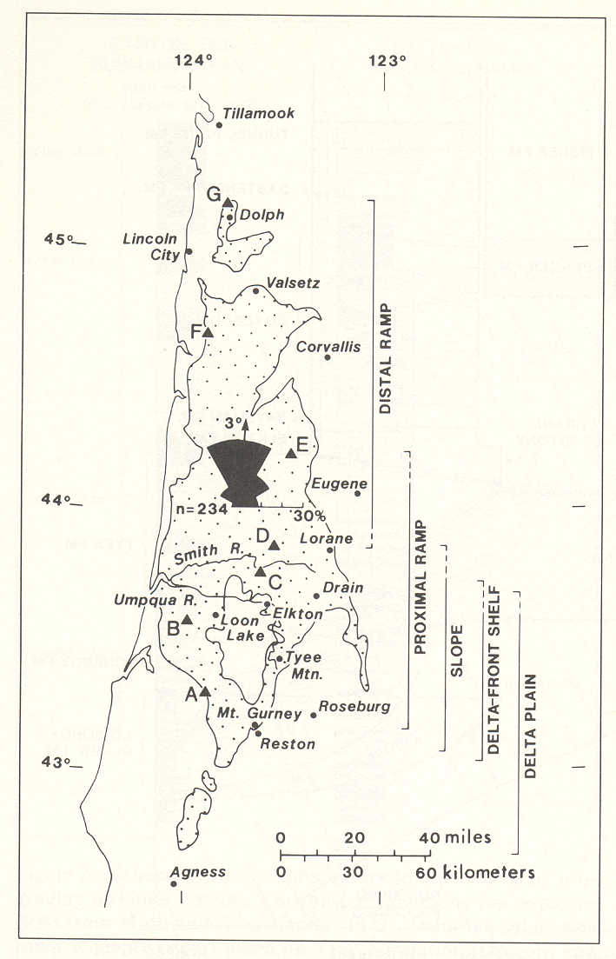
Paleocurrent analysis of Tyee-
domain (from Heller and Dickinson, 1985)

Slide 38
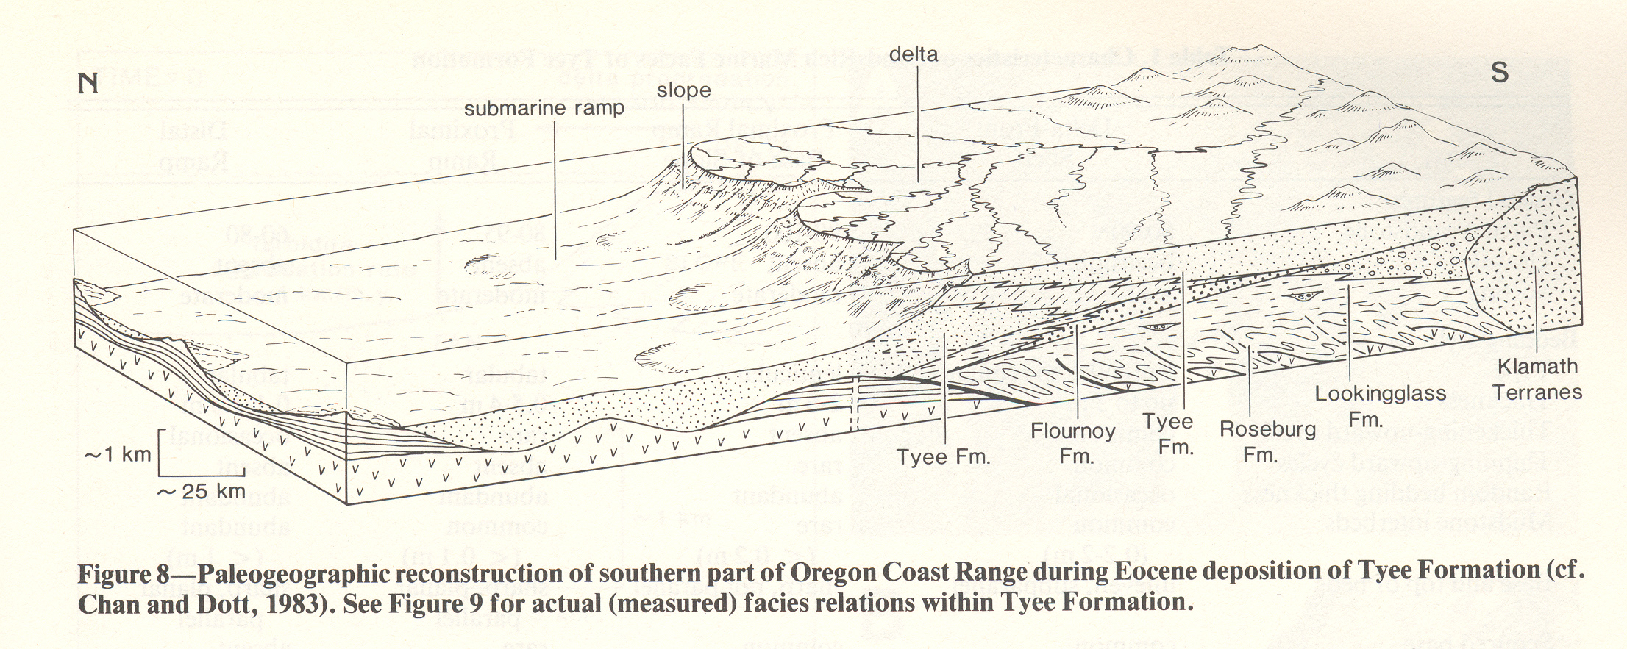
Paleogeographic reconstructions of Tyee-
domain (from Heller and Dickinson, 1985)

Slide 39
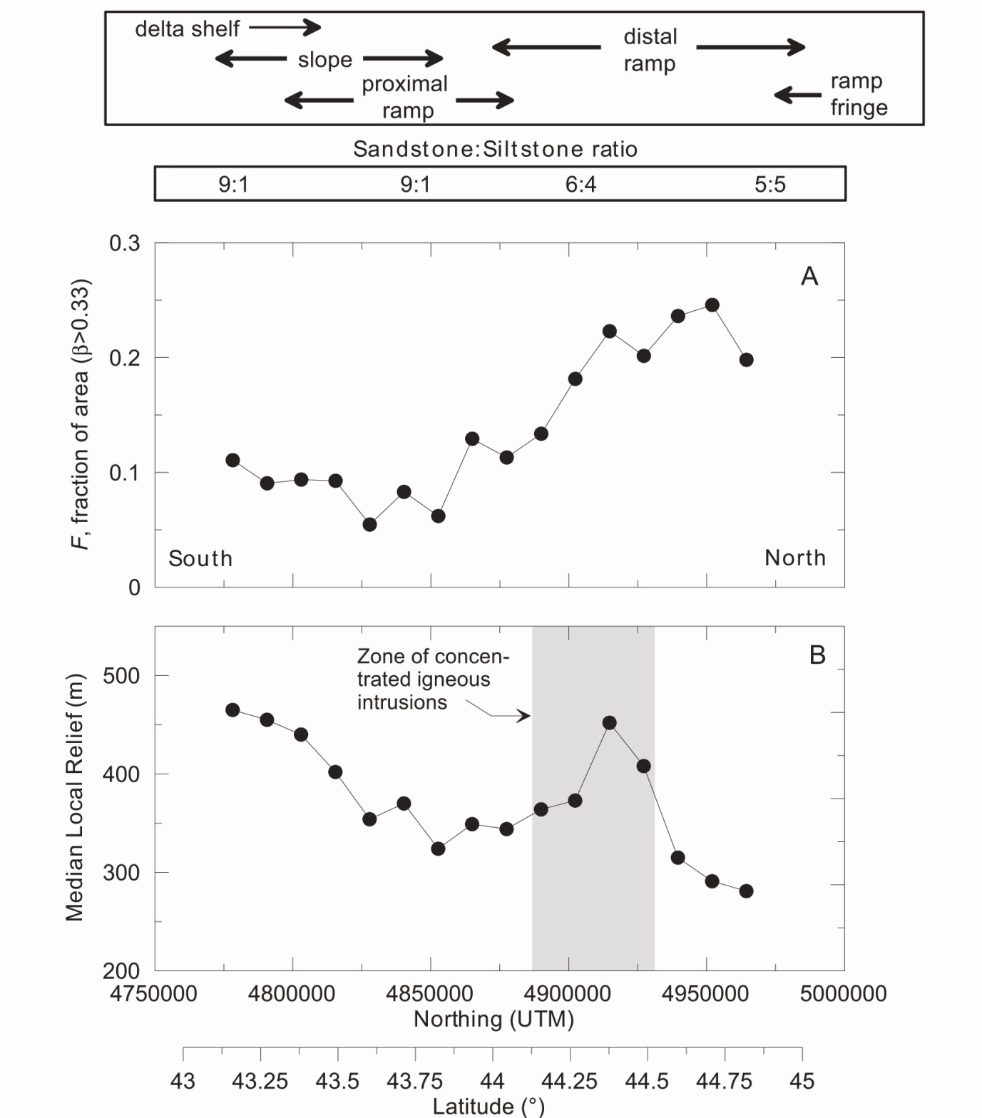
South-north distribution of Tyee- domain topography as a function of lithofacies variation
(from Roering et al., 2005)
Luckiamute Basin

Slide 40
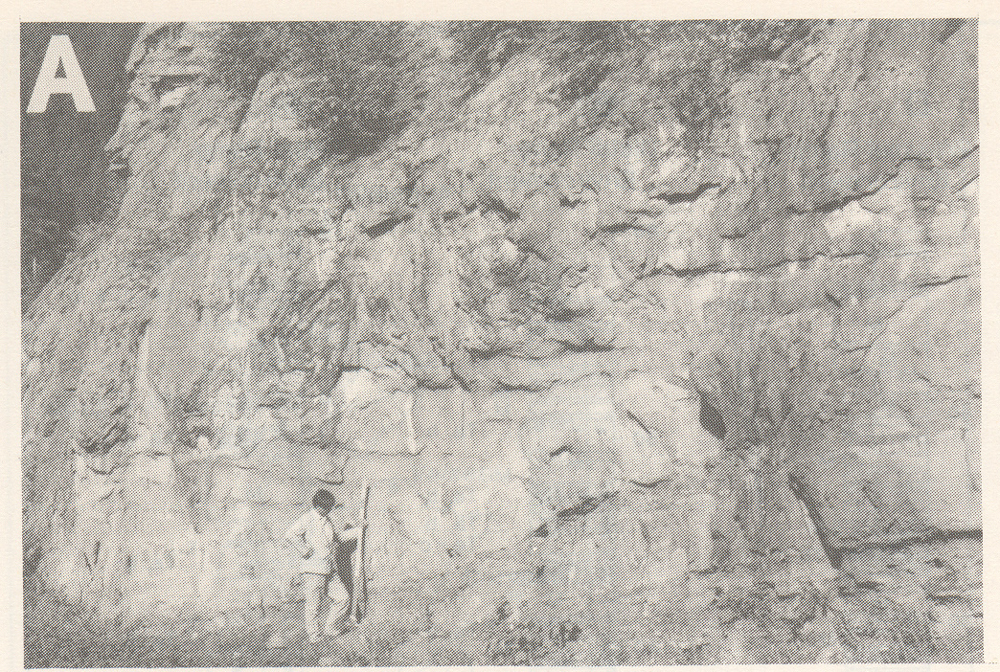
Coarsening upward, sandy facies, southern Tyee, Moon Creek (T26S,R10W,Sec20) from Heller and Dickinson, 1985)

Slide 41
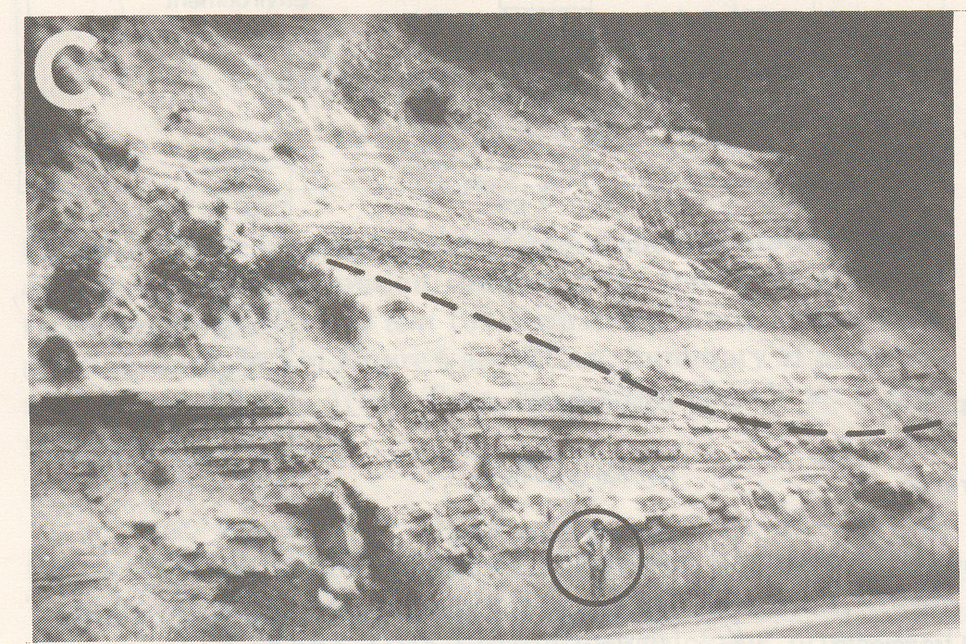
Mud-filled slope channel, muddy facies, central Tyee, (T28S,R8W,Sec4) from Heller and Dickinson, 1985)

Slide 42
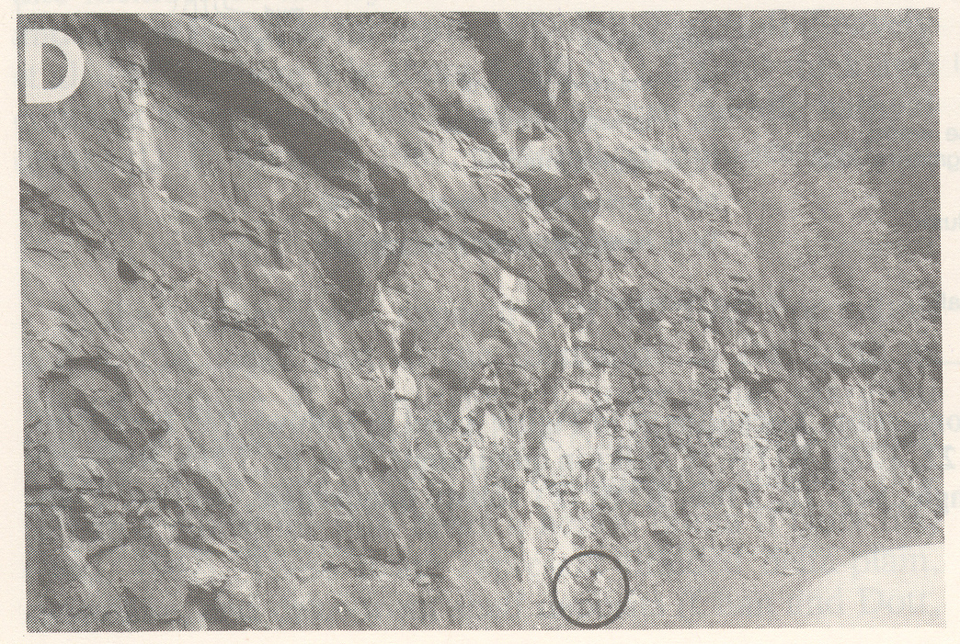
Proximal ramp facies, thick-bdd massive ss, northern sandy facies Tyee, (T20S,R10W,Sec36) from Heller and Dickinson, 1985)

Slide 43
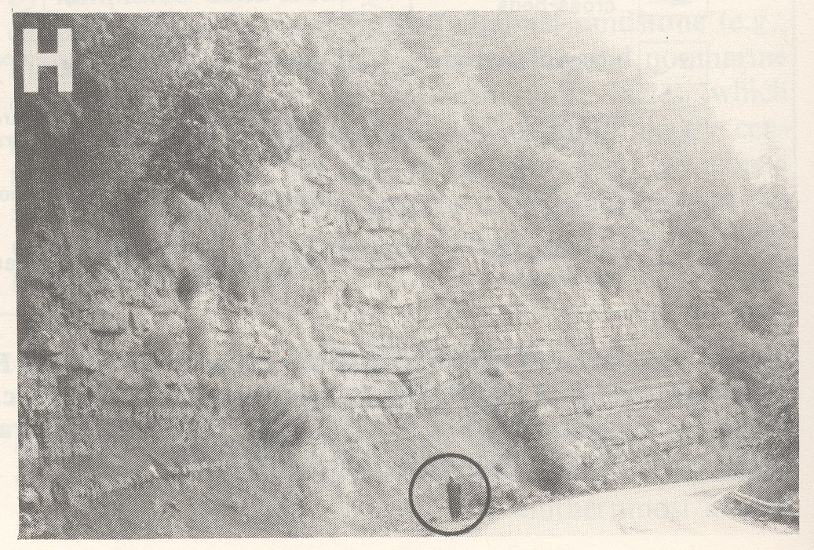
Distal ramp deposits in rhythmically bedded subfacies of northern sandy facies Tyee, (T9S,R10W,Sec10) from Heller and Dickinson, 1985)

Slide 44
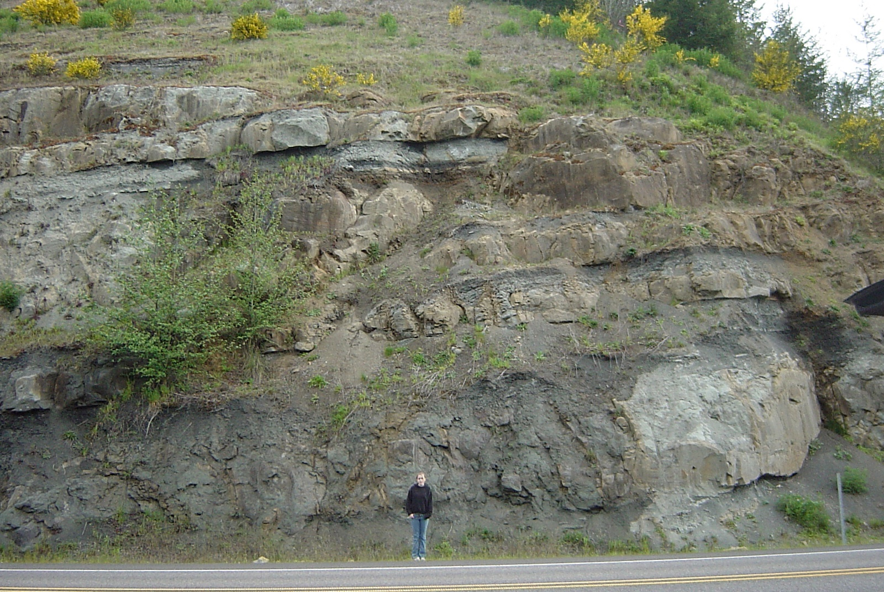

Slide 45
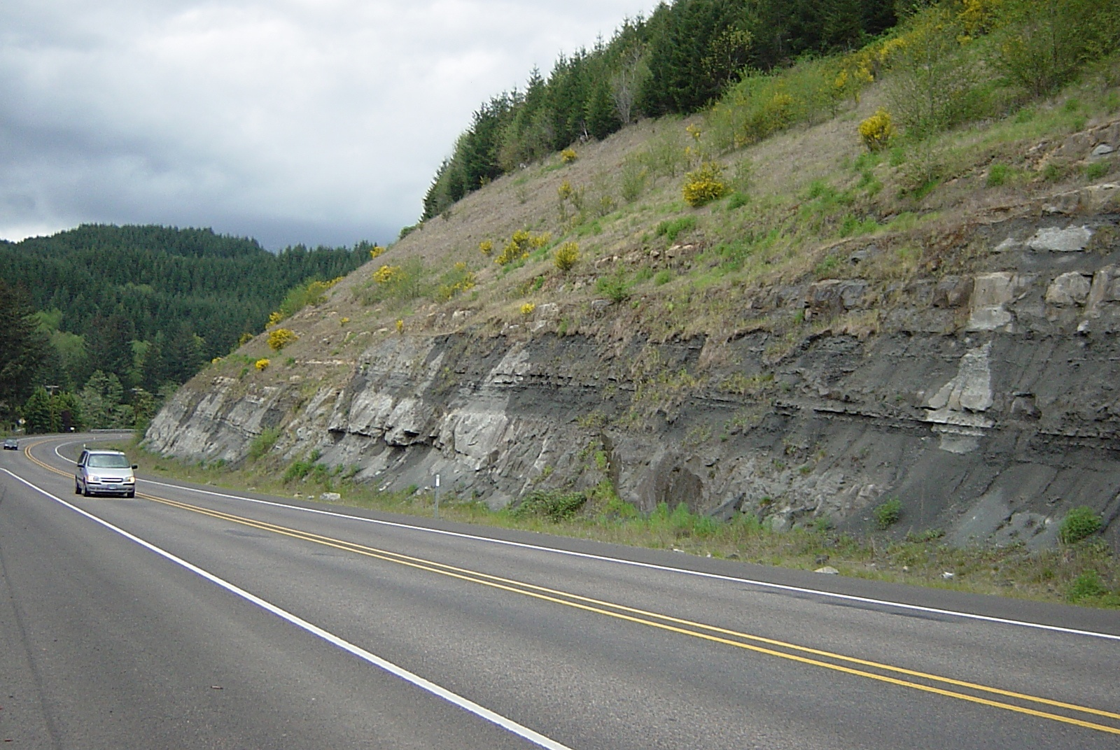

Slide 46
Tyee Formation – Oregon Coast Range
Debris Flows and Landslides

Slide 47
SAMPLINIG OF PREVIOUS WORK IN TYEE LANDSCAPES OF “THE OCR”
University of Washington – UC Berkeley Geomorphic Offspring and Related Cousins
Pierson (1977) Debris flow processes
Dietrich and Dunne (1978) Sediment budgets
Jackson and Beschta (1982) Bedload transport
Burroughs (1985) Landslide modeling
Dietrich and others (1986) Hillslope processes
Montgomery and Dietrich (1988) Landscape evolution
Benda (1990) Debris flow processes
Benda and Cundy (1990) Debris flow processes
Reneau and Dietrich (1990) Debris flow processes
Reneau and Dietrich (1991) Landscape evolution
Personius and others (1993) Terrace chronologies
Montgomery and Dietrich (1994) Landslide modeling
Benda and Dunne (1997) Debris flow processes
Montgomery and others (1997) Hillslope process experiments
Roering and others (1999) Hillslope process experiments
Montgomery and others (2000) Landslide modeling
Heimsath and others (2001) Weathering processes
Schmidt and others (2001) Slope stability
Anderson and others (2002) Weathering processes
May (2002) Debris flow processes
Casebeer (2003) Sediment budgets
Lancaster and Hayes (2003) Debris flow processes
May and Gresswell (2003) Sediment production
Roering and others (2003) Slope stability
Schmidt and others (2003) Slope Stability
Kobor and Roering (2004) Bedrock-channel processes
Roering and others (2005) Slope processes / Landscape Evolution

Slide 48
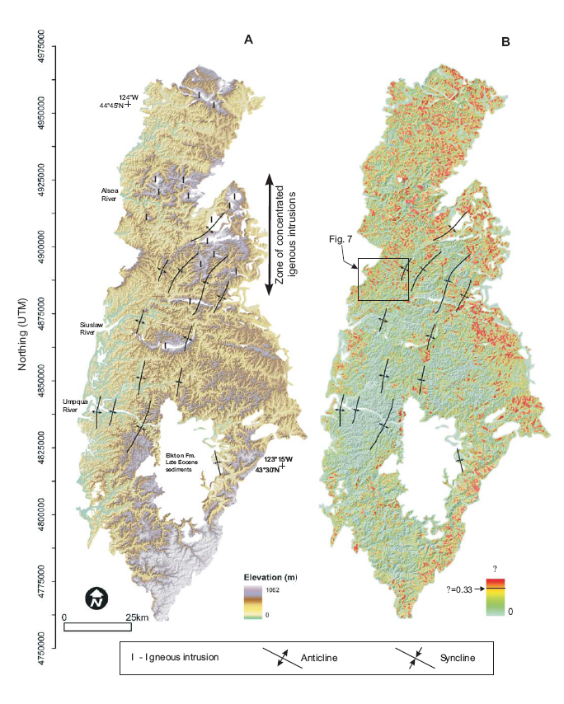
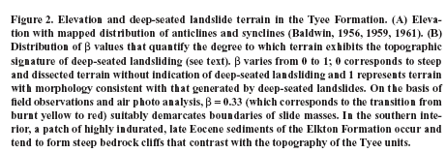

Slide 49
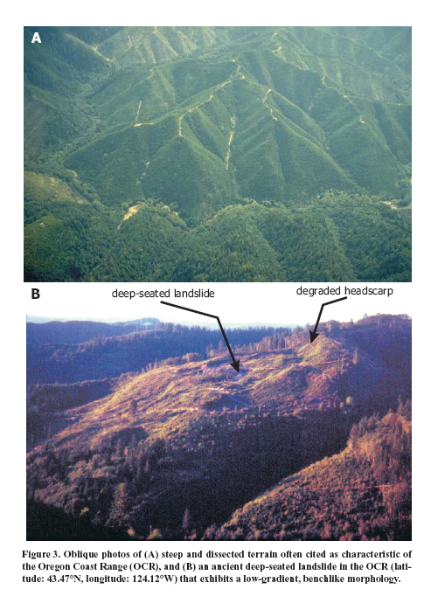

Slide 50
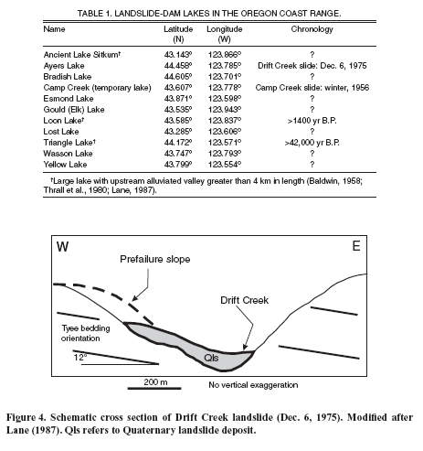

Slide 51
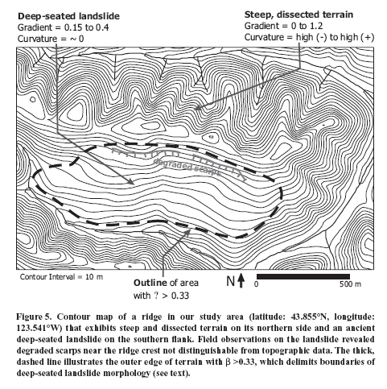

Slide 52
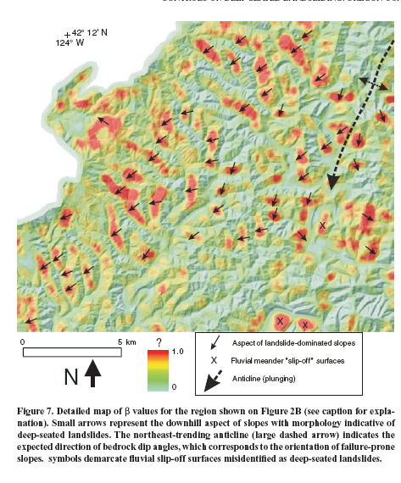

Slide 53
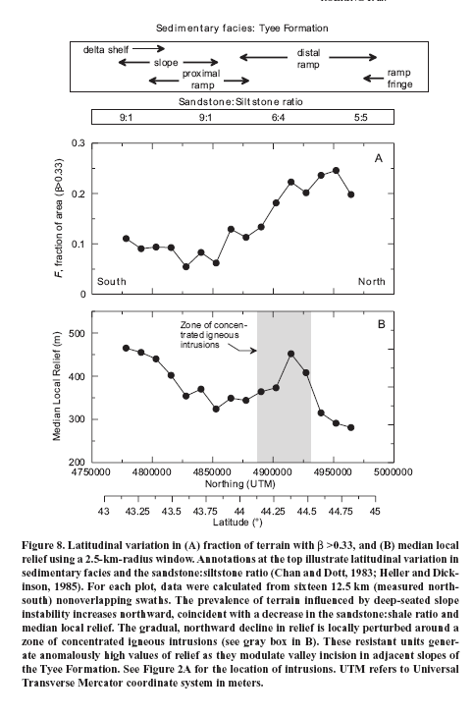

Slide 54
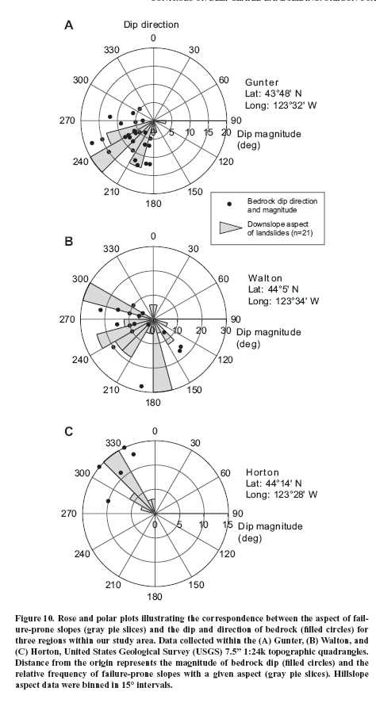

Slide 55
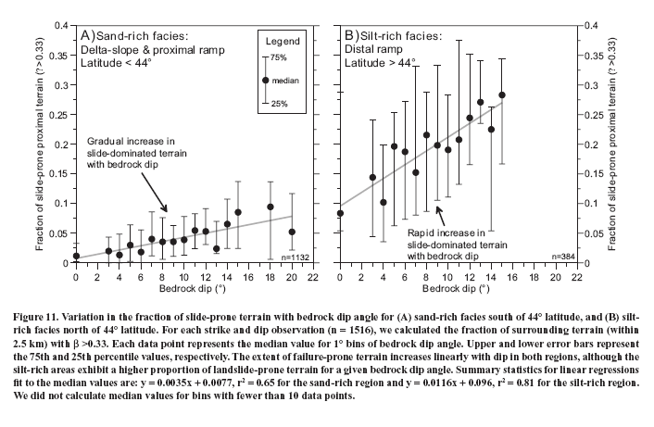

Slide 56
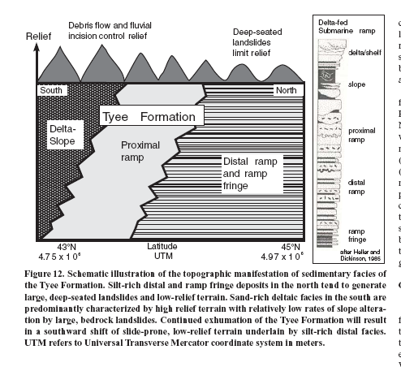
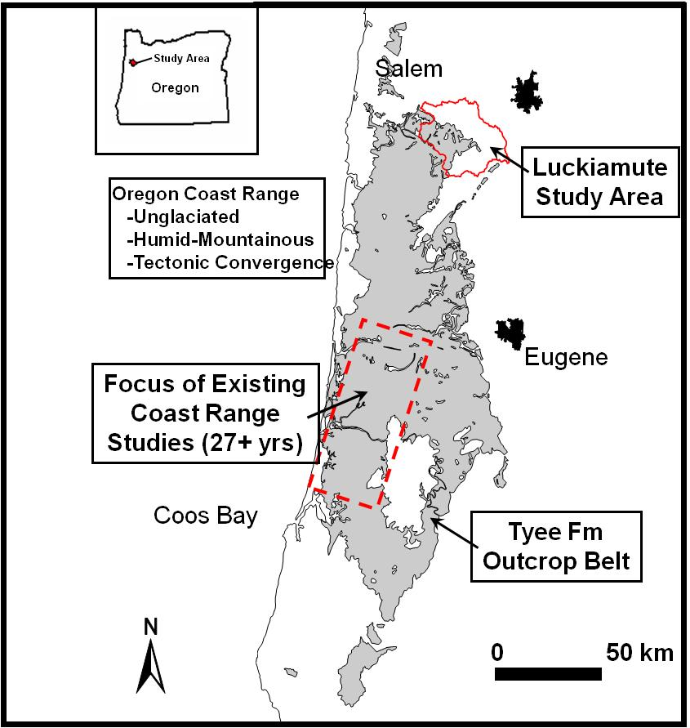

Slide 57
PIONEER MOUNTAIN-EDDYVILLE LANDSLIDE TERRAIN
HIGHWAY 20 CONSTRUCTION PROJECT

Slide 58


Slide 59


Slide 60

Project Goal: The project will construct a 5.5 mile new alignment, replacing a 10 mile stretch of old US 20, west of Eddyville, with a safer, straighter highway that will offer wide shoulders and miles of passing lanes.

Slide 61


Slide 62


Slide 63



Slide 64


Slide 65


Slide 66



Slide 67


Slide 68


Slide 69


Slide 70


Slide 71


Slide 72


Slide 73


Slide 74


Slide 75



Slide 76


Slide 77


Slide 78


Slide 79


Slide 80


Slide 81


Slide 82


Slide 83


Slide 84



Slide 85


Slide 86


Slide 87


Slide 88


Slide 89

Project Status – Fall 2012
The project broke ground as a Design Build project in 2005.
Design Build is a method of contracting that gives the responsibility of project design and construction to the contractor.
No significant construction had occurred since February, 2010, after the Design Builder notified ODOT that out of plumb movement had occurred on two bridge bents.
By October, 2010, continued ground movement had been recorded near four bridge locations where the Design Builder had constructed buttresses to mitigate the landslides.
A dispute between the Design Builder and ODOT over responsibility for the continued landslide movement, the failed landslide mitigation, and the project delay led to a negotiated settlement.
On May 2, 2012 the Design Builder agreed to pay ODOT $15 million. ODOT agreed to release the Design Builder from its contract.
ODOT took immediate control of the project and began designing the project to replace bridges with engineered fills and culverts, mitigate the continued landslide activity, mitigate environmental impacts and complete the project.
Work resumed on the former US 20: Pioneer Mountain to Eddyville project during the week of June 25, 2012.
Nine bridges were originally planned for construction. Six bridges have been completed.

Slide 90

Project Status – Fall 2012
Due to the continued landslide activity at four drainage locations, the project has decided not to complete three bridges in various stages of construction.
Bridge columns at the three locations have been demolished.

