Slide 1
G322 Geomorphology – Introduction to Landscape Interpretation - ANSWER KEY: SEE SLIDES FOR NOTES
For each of the 11 slides of landscape features, make observations and interpretations of 3 fundamental criteria: landform description, material composition (what is the landform made of? rock or sediment?), process (what surface processes shaped or created the landform.
Slide 2
Landform:
Material:
Process:
Slide 3
Landform:
Material:
Process:
Slide 4
Landform:
Material:
Process:
Slide 5
Landform:
Material:
Process:
Slide 6
Landform:
Material:
Process:
Slide 7
Landform:
Material:
Process:
Slide 8
Landform:
Material:
Process:
Slide 9
Landform:
Material:
Process:
Slide 10
Landform:
Material:
Process:
Slide 11
Landform:
Material:
Process:

Slide 2
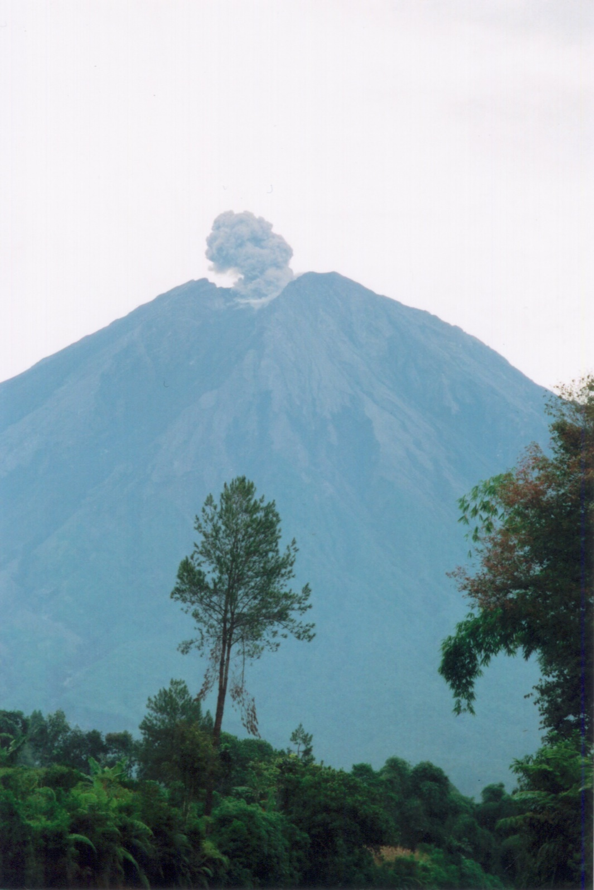
Landform: Hillslope, upland, mountain
Material: volcanic bedrock, pyroclastic deposits
Process: primary igneous, hillslope/mass wasting, lahar, debris flow
Age: relatively young, active slopes and volcanism
Punchline: this is an active stratovolcano; a mixture of internal igneous process and hillslope / colluvial process

Slide 3
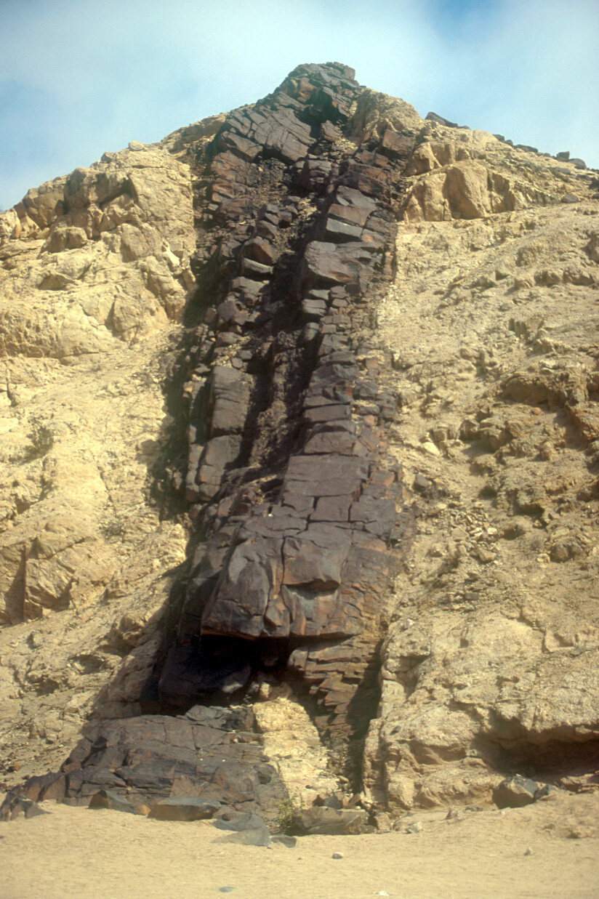
Landform: ridge top, hillslope (cross section profile)
Material: bedrock (light looks like sandstone, dark = basalt dike)
Process: igneous intrusion into sedimentary rock, with
subsequent weathering to form an erosionally resistant ridge line held up by the basalt (common mappable feature)
Age: the sandstone is older than the basalt which cross cuts it; the hillslope is developing, immature, note lack of soils and vegetation

Slide 4
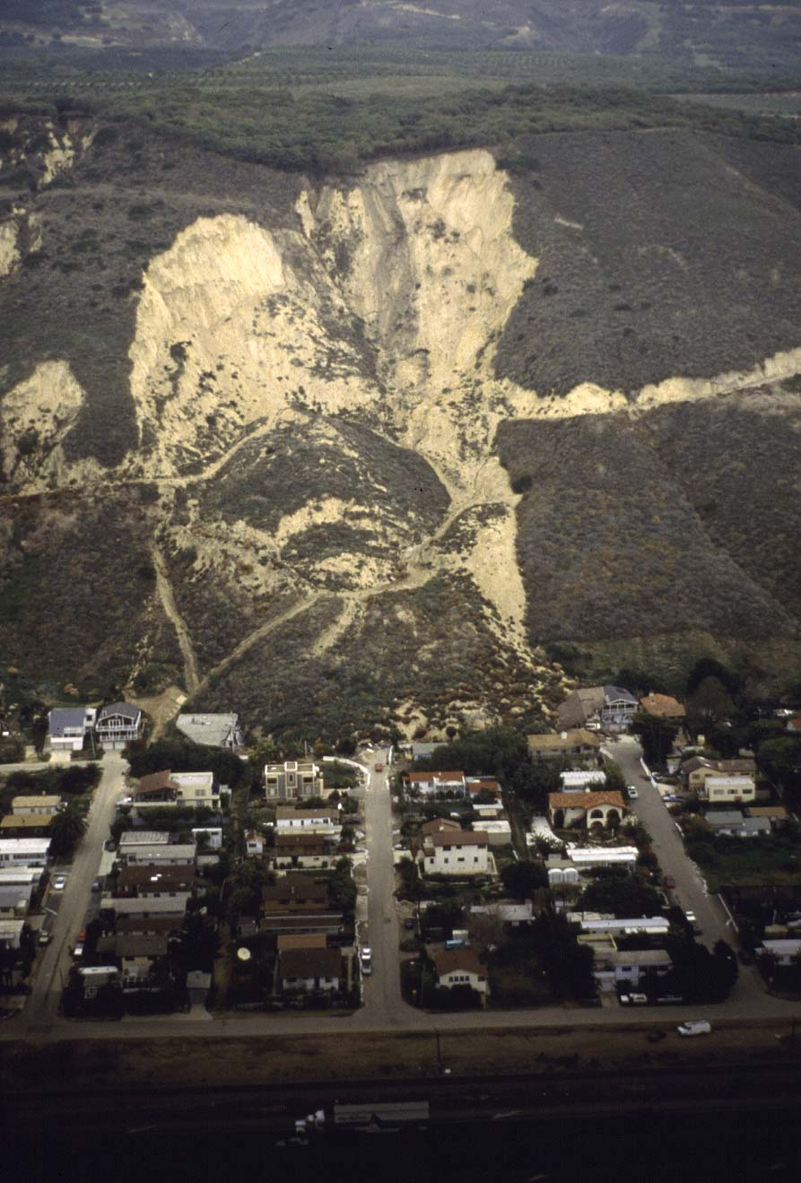
Landform: hillslope, terrace, head scar, landslide lobe
Material: bedrock on hillslope, regolith in slide deposit
Process: gravity, landslide, colluvial
Age: very recent, deposits cover modern houses and roads

Slide 5
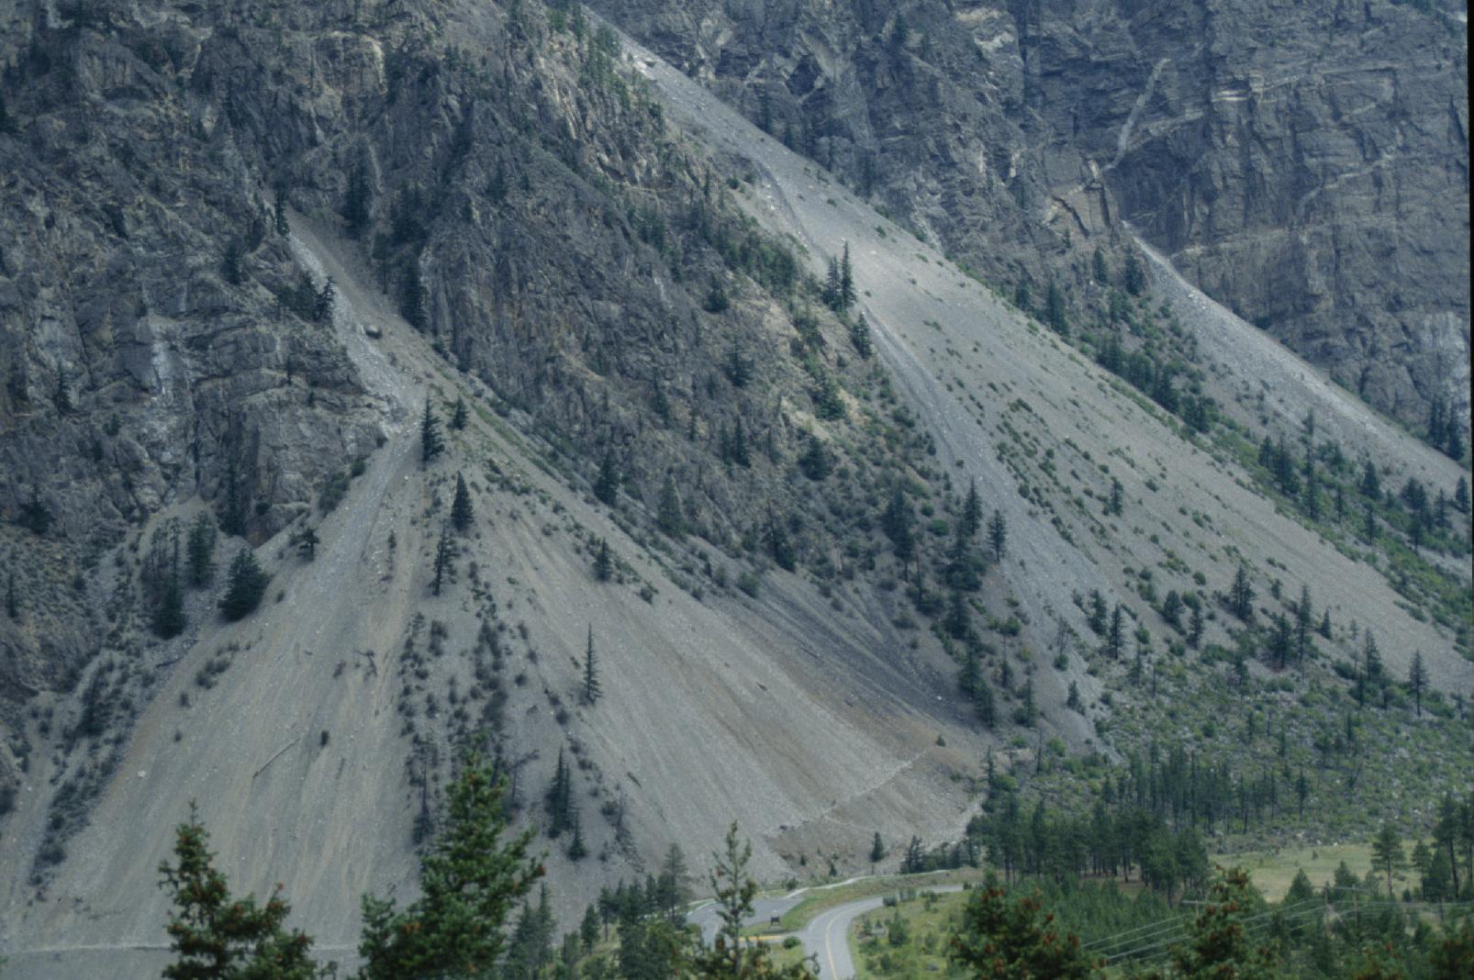
Landform: fans (colluvial fans, along bedrock mountain front)
Material: regolith, sand-gravel-silt-class
Process: gravity, maybe debris flow (colluvial)
Age: active, recent… now (lack of soils and vegetation)

Slide 6
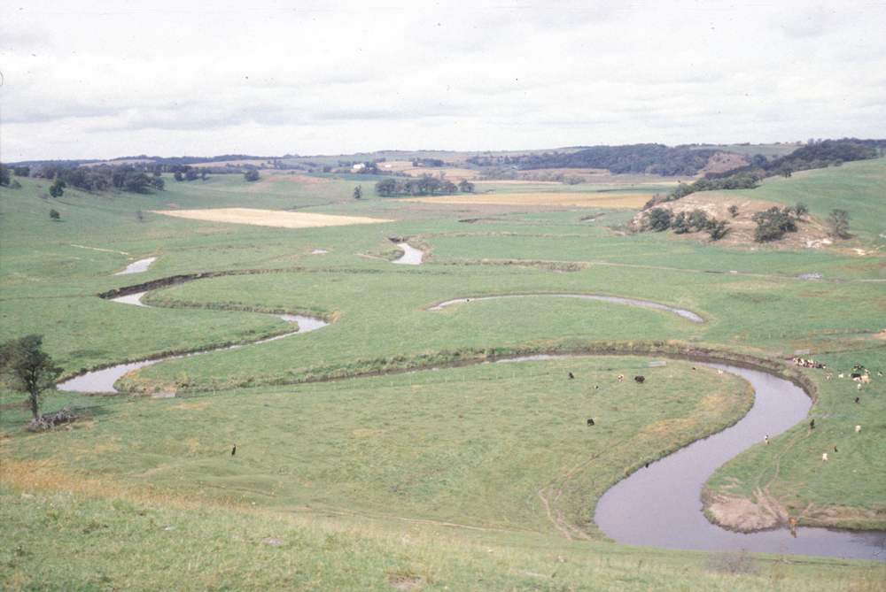
Landform: meandering river channel, oxbox lake, low-angle hillslopes
Material: Regolith: main valley = sand, gravel, silt, clay (likely) = alluvium / river deposits; hillslopes held up by bedrock
Process: fluvial, alluvial in valley bottom (channel transport and flooding); colluvial / gravity on hillslopes
Age: fluvial processes very young, active, ongoing; no terraces evident

Slide 7
Landform: river terraces (stair step features), strath terraces (uplifted, river carved, elevated flood plains stranded above channel)
Material: bedrock strath terraces covered in thin veneer of river alluvial; bedrock holding up mountain slopes; thin veneer of regolith
Process: active neotectonic uplift and erosion with concomitant river incision and down-cutting
Age: hard to tell, but some time is involved with that much uplift and terrace development… a couple million years?

Slide 8
Landform: alluvial fan at bedrock mountain front
Material: regolith, sand and gravel in fan; bedrock on mountain front
Process: fluvial transport, debris flow on to fan surface; fan deposit on top of playa flats in desert
Age: relatively young, light colored deposits on fan younger than darker colored, desert varnished deposits

Slide 9
Landform: dunes, barchanoid shape
Material: regolith, sand
Process: Aeolian wind blown dune sand on top of fluvial / tidal / coastal deposits; note ocean waves in distance; wind direction from right to left in photo
Age: young, now, ongoing, note lack of vegetation, lack of soil development

Slide 10
Landform: U-shape valley, lateral moraine
Material: mixed bedrock and regolith; thin veneer of regolith deposits on top of glacier carved bedrock
Process: glacial
Age: young, ongoing, recent, now; not lack of vegetation and soils

Slide 11
Landform: hillslope
Material: regolith (loose sediment, colluvium); angular boulders indicate gravity, and not fluvial transport
Process: gravity / downslope transport, including slope wash
Age: young, ongoing

