Slide 1
Breaching of Condit Dam
Wilcox et al.
Prepared by: Dylan Castle

Slide 2
Overview of Condit Dam
White Salmon River, Washington
5.3 km upstream from Columbia River
Drains a 990 km² area in Cascade Range
Reservoir trapped 1.6 million m³ of water and 1.8 million m³ of sediment
Sediment yield ~30 tonnes km⁻² yr⁻¹
Breached by explosives at bottom of dam

Slide 3
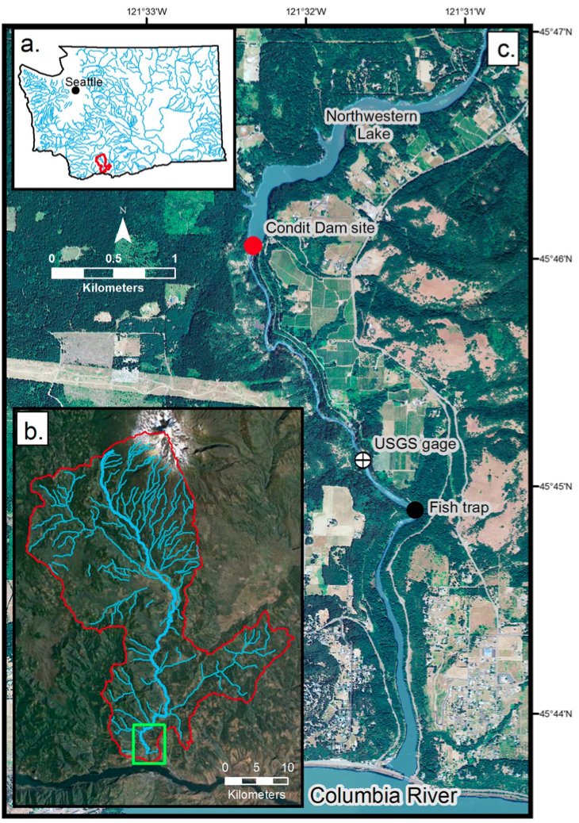

Slide 4
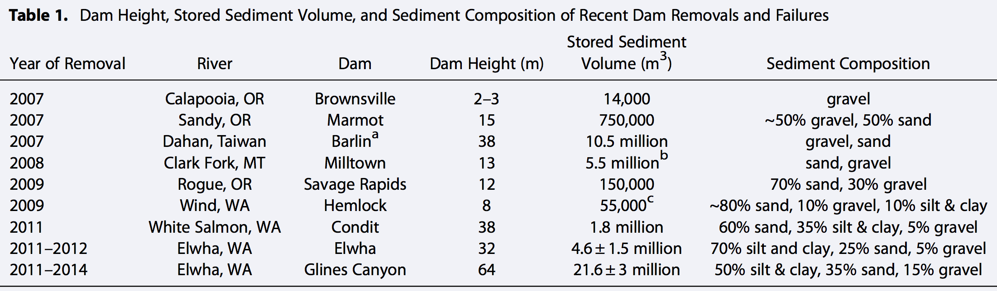
- Largest intentional abrupt breaching of a dam, at time of removal
- Sediment made of 60% sand, 35% silt and clay, and 5% gravel

Slide 5
Breaching
Most water flowed out within 90 minutes of breach, surface dropped 30 meters.
Initial drawdown exposed saturated, fine-grained sediment on 30-55 degree slopes.
Exposure triggered slope failures
Failures liquefied to form slurries

Slide 6
High Intensity Flows
Typical base flow was ~20 m³ s⁻¹
Flow reached peak discharge of 421 m³ s⁻¹
Hour after peak discharge flow was down to 55 m³ s⁻¹
After only two hours, 1260,000 m³ of sediment had evacuated from the reservoir, equaling about 10% or total volume
1.1 million m³ had flowed after 92 minutes

Slide 7
Sediment Transport
Base transport between 5 and 15 mg/L
Concentrations increased to 3000 mg/L at peak discharge
53 minutes after breach concentrations increased to 850,000 mg/L (0.85 kg)
92 minutes after breach, 260,000 tonnes of suspended sediment had been transported

Slide 8
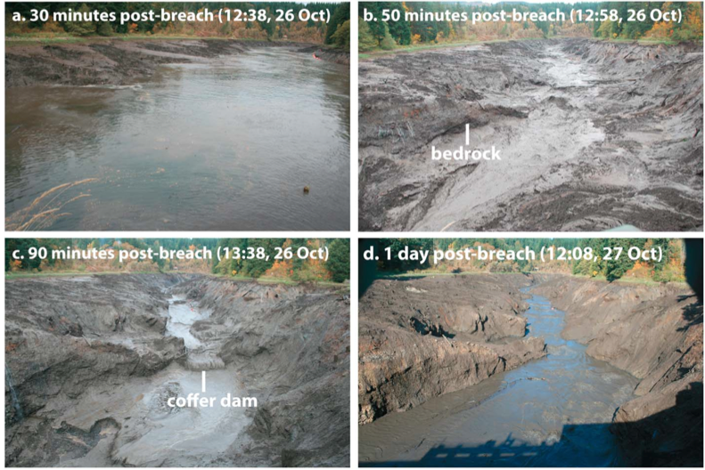

Slide 9
Aggradation
Very little net aggradation from breach
Base aggradation was 1.5 m before breach
Maximum aggradation reached a stage height of 2.4 m
6 hours after breach, flow stage had dropped to 1.3 m, almost base levels.

Slide 10
Conclusion
https://www.youtube.com/watch?v=4LxMHmw3Z-U

