Slide 1
Timing of Retrogressive Thaw Slump Initiation in Noatak Basin
Northwest Alaska, USA
Balser et al
Brianna Young

Slide 2
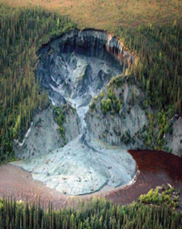
Introduction
Retrogressive thaw slumping:
  Thaw of ice-rich permafrost on bluffs/hillslopes
    Soil instability
    Mass wasting subsidence
Degradation of arctic permafrost
  Due to carbon release during melting?
  Linked with decade-scale warming trends
    Compare this with local weather events

Slide 3
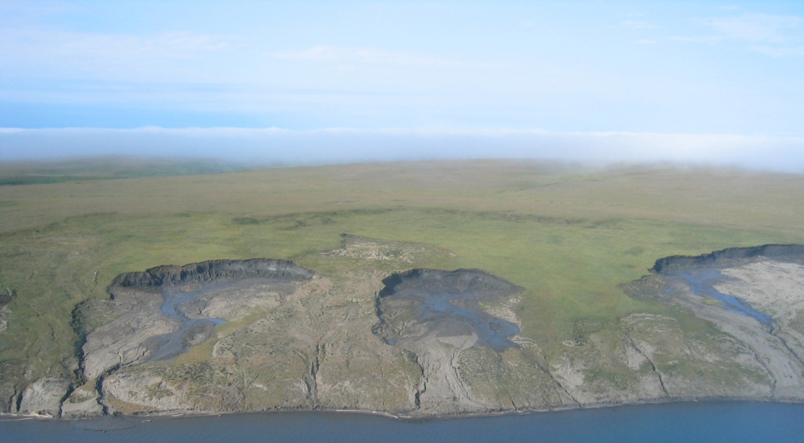
Thoughts
Long term climate warming may be preconditioning agent
Short-term weather patterns (or local events) likely necessary for triggering thaw slump formation

Slide 4
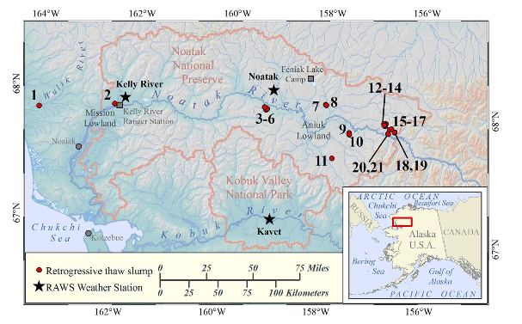
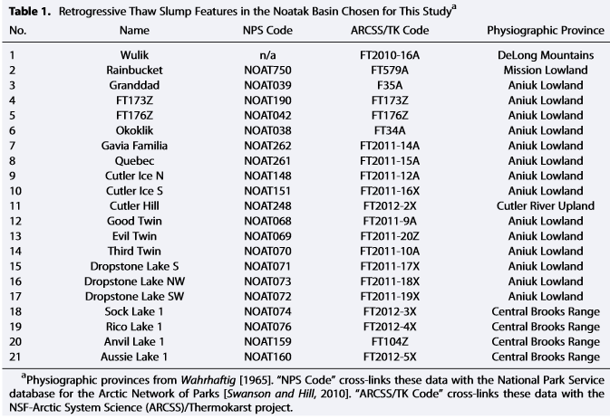
Study Area
Noatak River Basin: Alaska
  Continuous permafrost between continuous and discontinuous zones
  Field Surveys/Airphotos from 2006, 2007, 2010, 2011 ID/map slumps
  ID-ed 21 of 326 in
  area to study
    Large, active, low relief

Slide 5
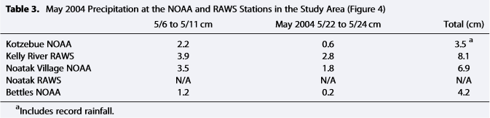
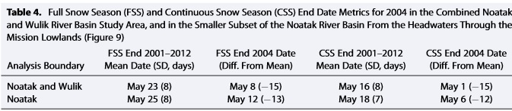
Interannual Weather
Temp. and rain data from two stations measured overall and seasonal temp for 1992-2011
Ave. thawing season temp., thawing index, number of days above 0C, seasonal thawing degree day distribution plotted for 1992-2011
Compared this with NOAA stations for better context
Moderate Resolution Imaging Spectroradiometer used to examine variation in snow cover

Slide 6
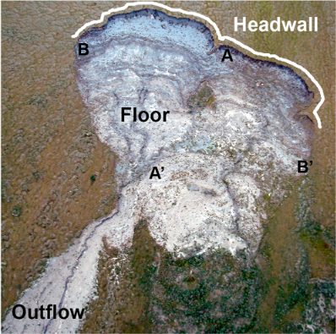
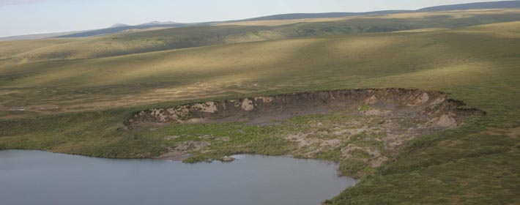
Results
Of 21 slumps: 8 confirmed to be polycyclic
  Alternating b/t stabilized dormancy and active degradation
  Visible, adjacent, restabilized scars

Slide 7
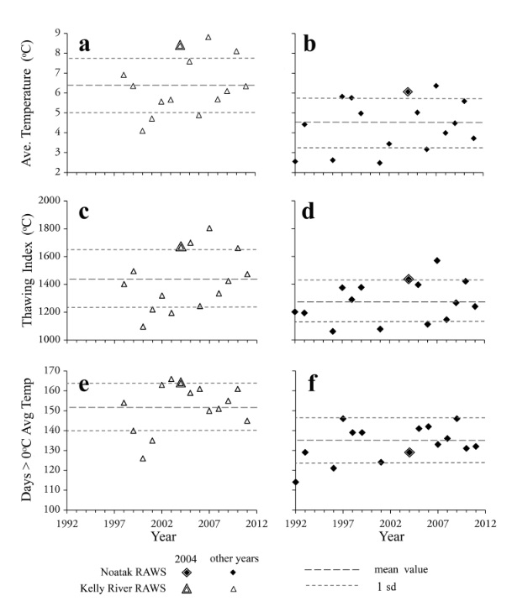
More Results!
Overall summer temp.
in 2004 - warmer than
average
  Early seasonal distrib.
  of thawing degrees
  High precip in May.
  Snow cover seasonal
  shift (started/ended
  early)

Slide 8
Discussion
Early thawing temp and precip. events in 2004:
  Drove early snowmelt
  Increased intensity of energy transfer to ground
  Extended thawing season
Warm temp. coincided with first intense precip.
  Rainwater important energy transfer (thermal erosion)
    Penetrates soil, transfers heat by advection
Cloud cover, early snow melt, low plant cover, and summer solstice (sun angle at highest) may accelerate thaw slumping

Slide 9
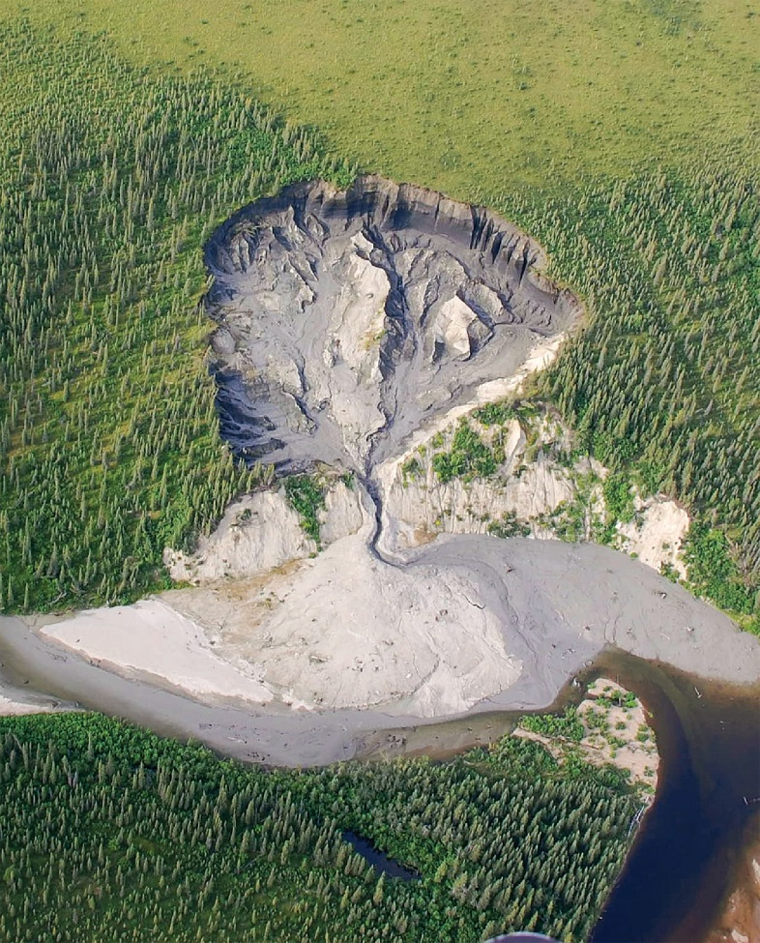
Conclusion
Retrogressive thaw slump initiation in Noatak Basin heavily influenced by:
  Early thawing season (warming)
  Snowmelt
  Precipitation
Lengthens thaw season
Timing and magnitude of
weather events critically
influence slump initiation

