Slide 1
CCOASTAL PROCESSES OF OREGON
SUNSET BAY – CAPE ARAGO FIELD TRIP PRIMER ES322 GEOMORPHOLOGY

Slide 2
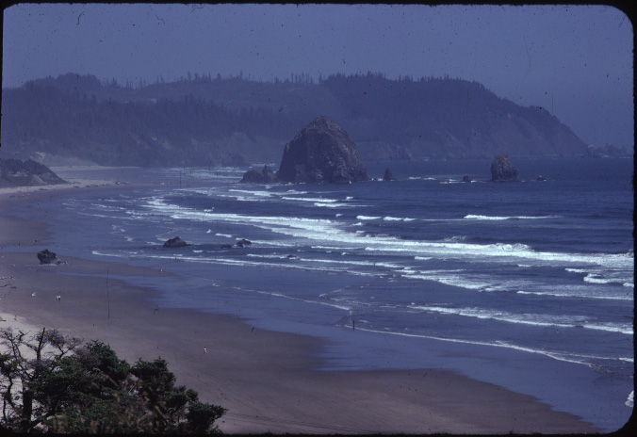

Slide 3
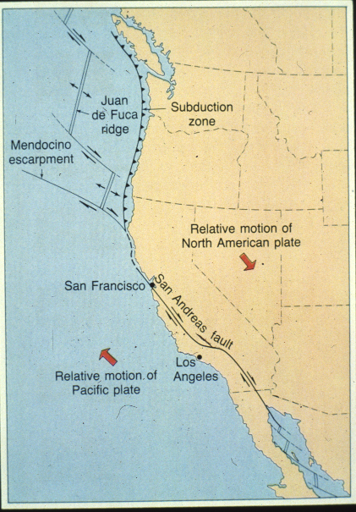

Slide 4
Pacific Northwest Climate and Tectonics: Linked System Drivers
“Wet”
“Dry”
Westerly cyclonic storm systems
Deschutes
High Cascades
Western Cascades
HJA

Slide 5
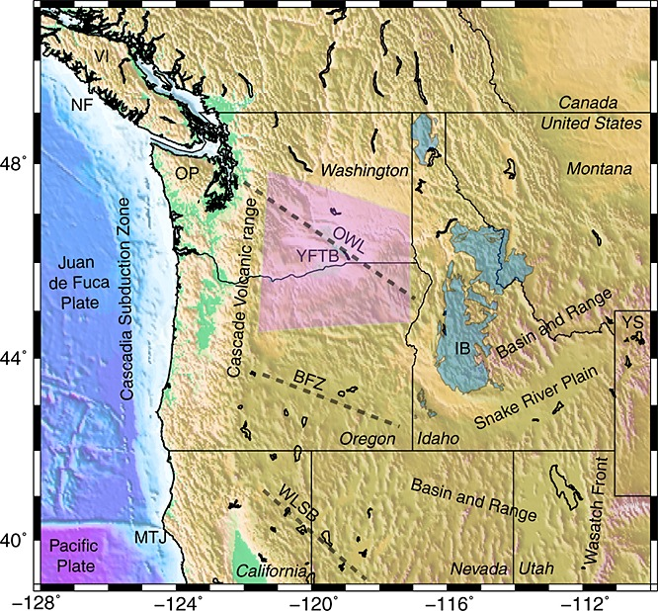
Physiographic map of the U.S. Pacific Northwest. Gray dashed lines show the Brothers Fault zone (BFZ), Olympic-Wallowa Lineament (OWL) and Walker Lane Shear Belt (WLSB). MTJ – Mendocino Triple Junction, YS – Yellowstone, OP – Olympic Peninsula, VI – Vancouver Island, NF – Nootka fault. Shaded regions are the Yakima fold-thrust belt (YFTB) and Idaho Batholith (IB).
Journal of Geophysical Research: Solid Earth, Volume: 118, Issue: 2, Pages: 709-723, First published: 14 February 2013, DOI: (10.1029/2012JB009473)

Slide 6
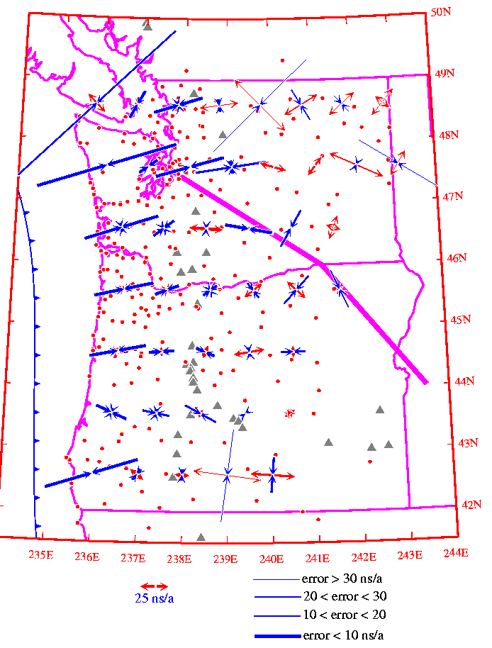
PNW Stress Map

Slide 7
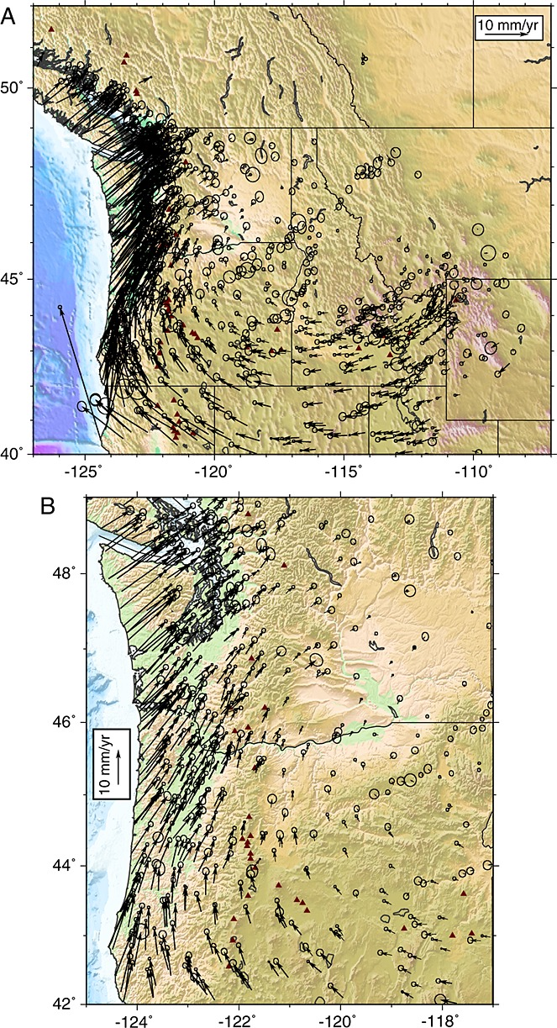
Active tectonics of northwestern U.S. inferred from GPS‐derived surface velocities
(a) The 1993–2011 GPS velocity field of the western U.S. relative to North America. Error ellipses are 70% confidence. Triangles denote volcanoes [Siebert and Simkin, 2002]. (b) Close-up of the Cascadia margin.
Journal of Geophysical Research: Solid Earth, Volume: 118, Issue: 2, Pages: 709-723, First published: 14 February 2013, DOI: (10.1029/2012JB009473)

Slide 8
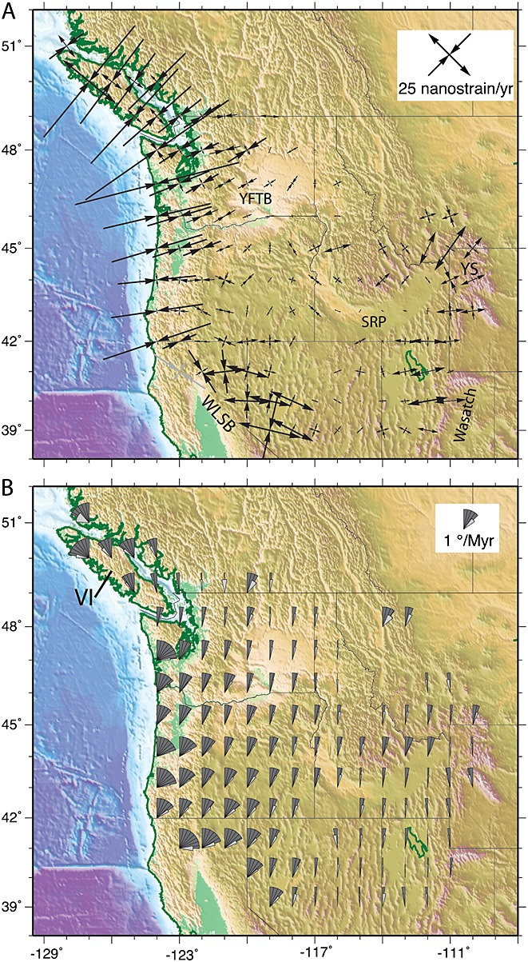
Principal strain and rotation rates derived from GPS velocities. Area is divided into bins of 2° (157 km) in longitude by 1.6° (178 km) in latitude in which the uniform strain and rotation rates are calculated from the GPS velocities contained within (minimum of 6 velocities). (a) Principal strain rates; scale is in nanostrain/yr (1 nanostrain/yr = 10–9 /yr). (b) Rotation rates for same regions. Fan symbols show the rate and sense of rotation (a fan opening 45° clockwise indicates 1°/Myr of clockwise rotation). The smaller attached fans show the one-sigma uncertainty in the rotation rate.

Slide 9
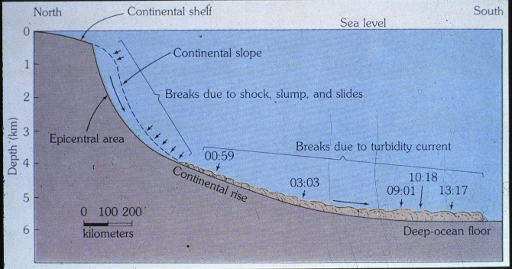

Slide 10
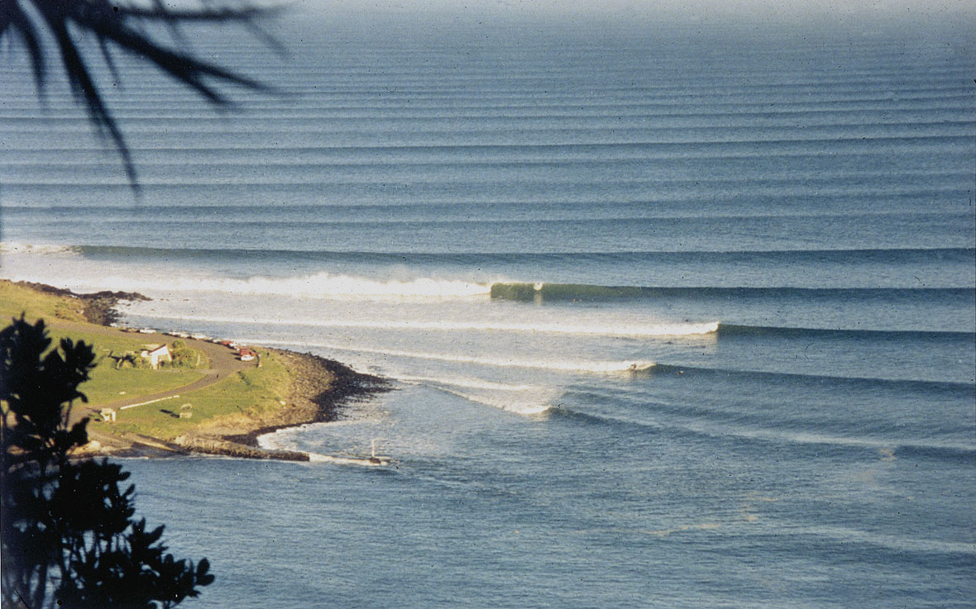

Slide 11
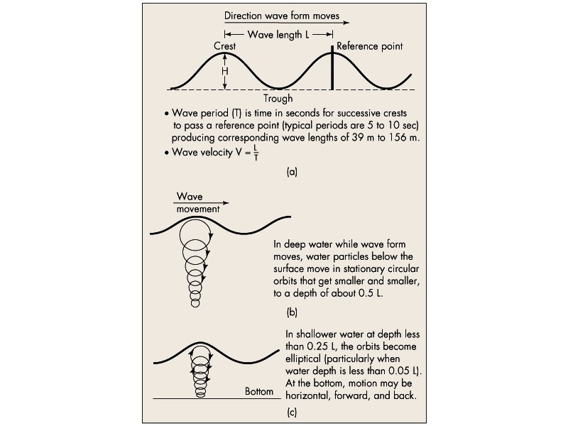

Slide 12
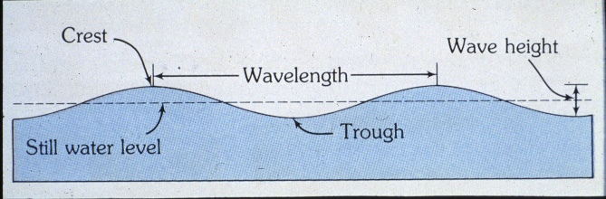

Slide 13
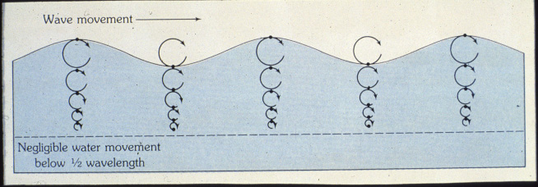

Slide 14
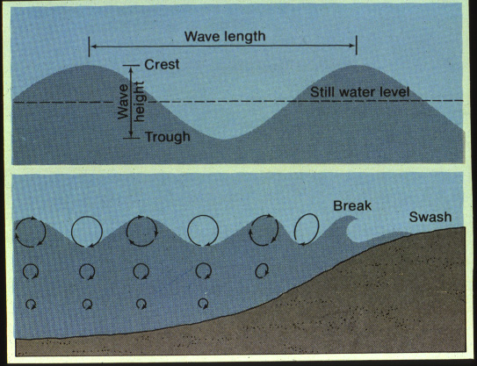

Slide 15
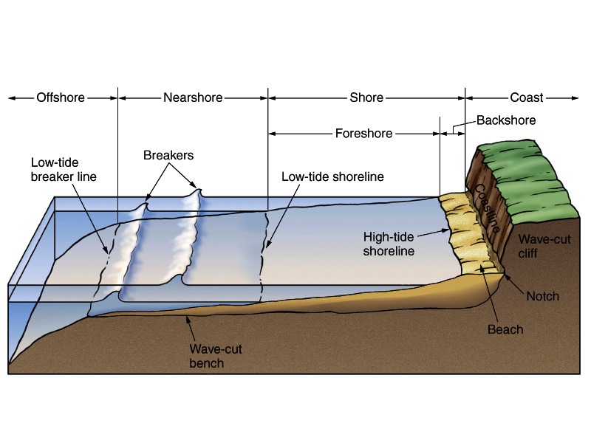

Slide 16
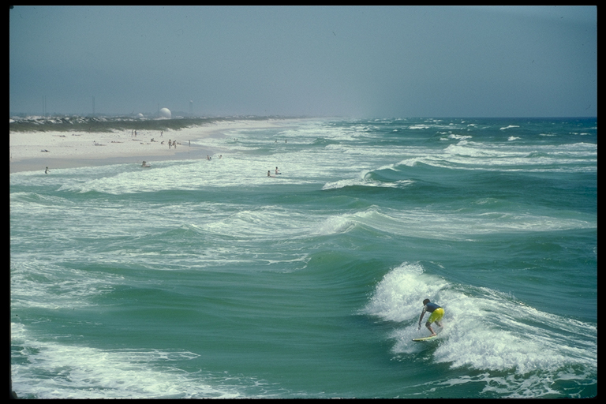

Slide 17
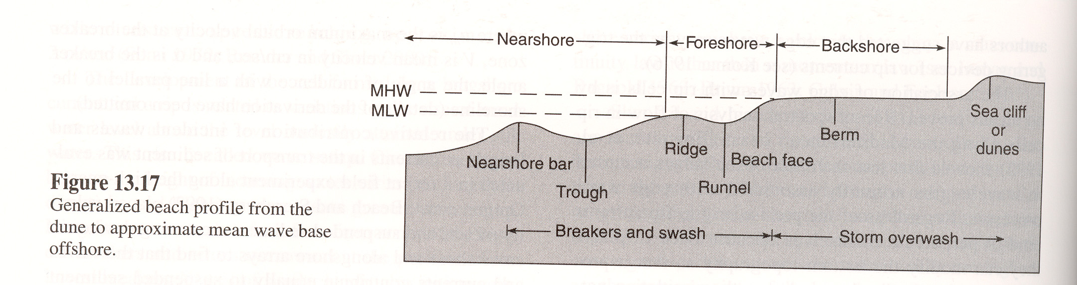

Slide 18
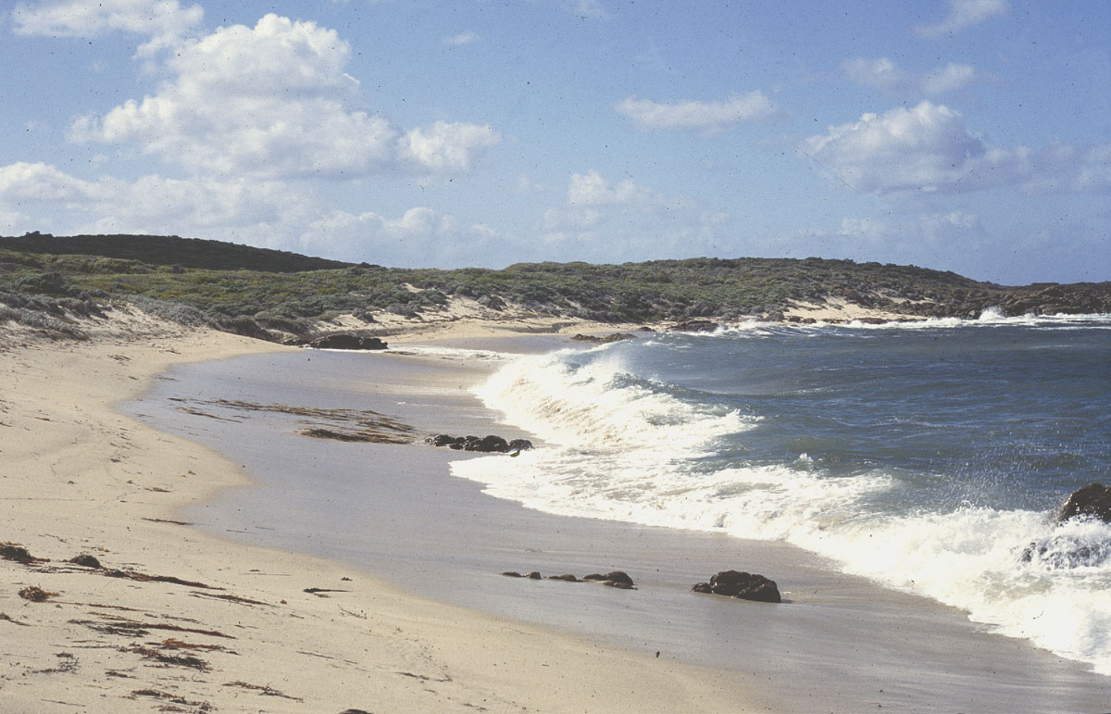

Slide 19
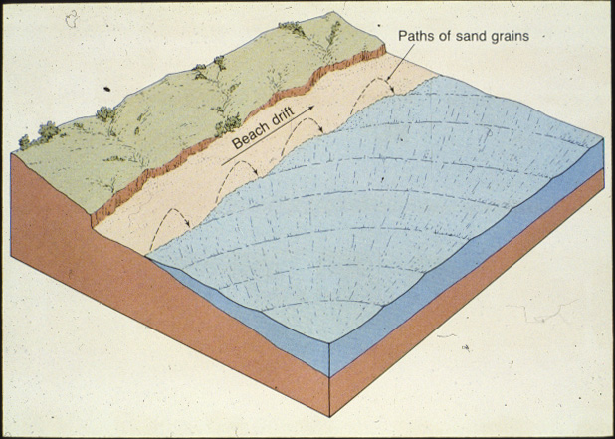

Slide 20

Beach Drift and Longshore Currents
Longshore Drift Animation
Notes:
To view this animation, click “View” and then “Slide Show” on the top navigation bar.

Slide 21
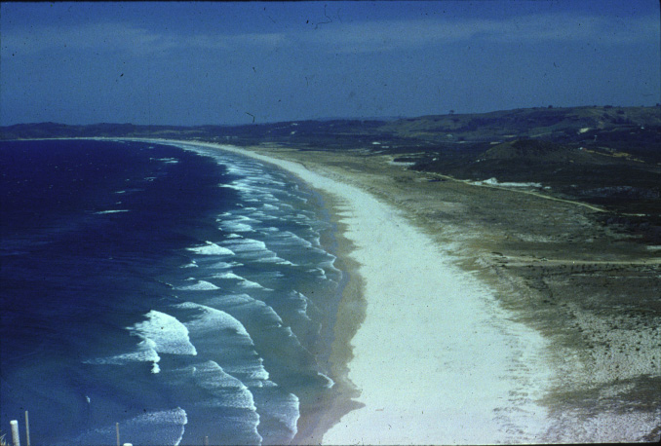

Slide 22
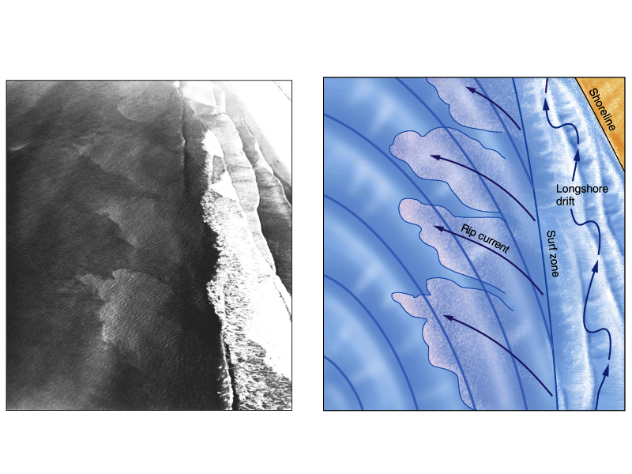

Slide 23
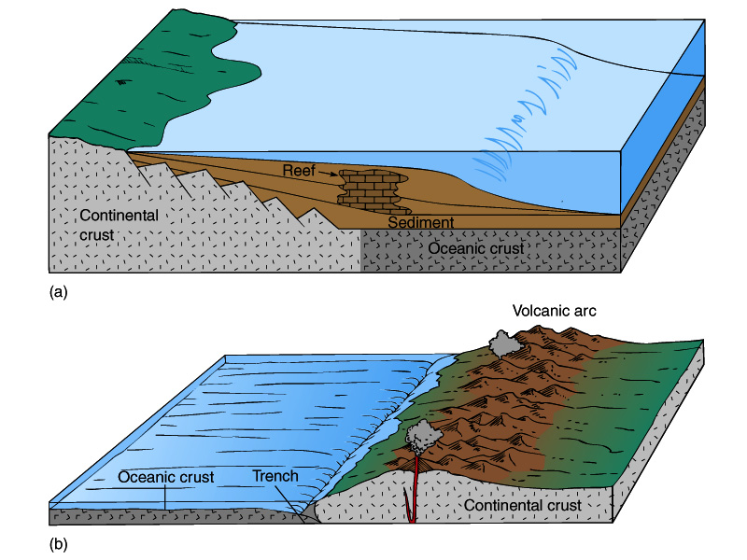

Slide 24
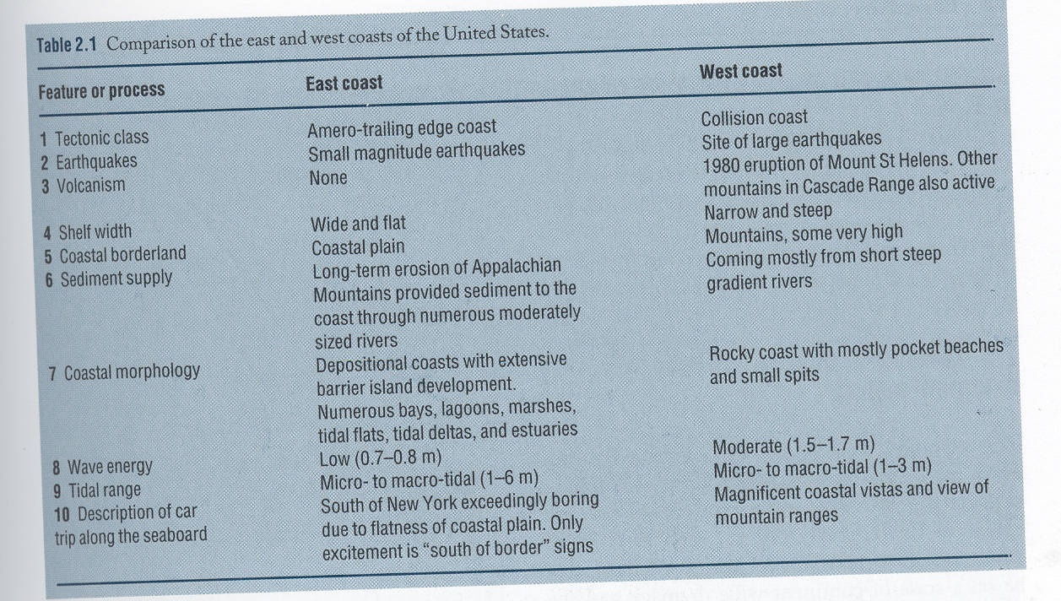

Slide 25
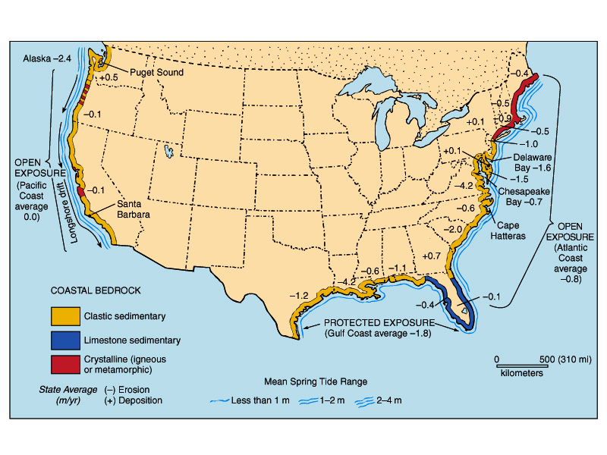

Slide 26
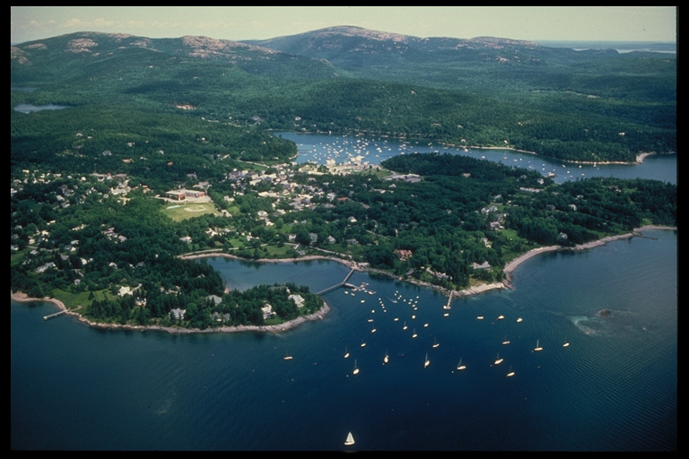

Slide 27
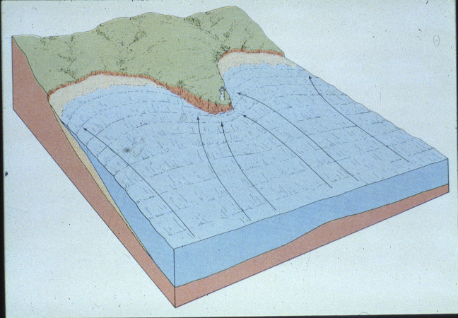

Slide 28
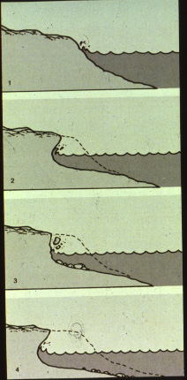

Slide 29
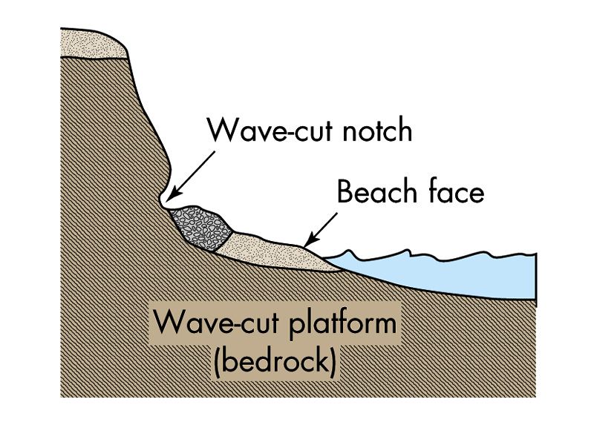

Slide 30
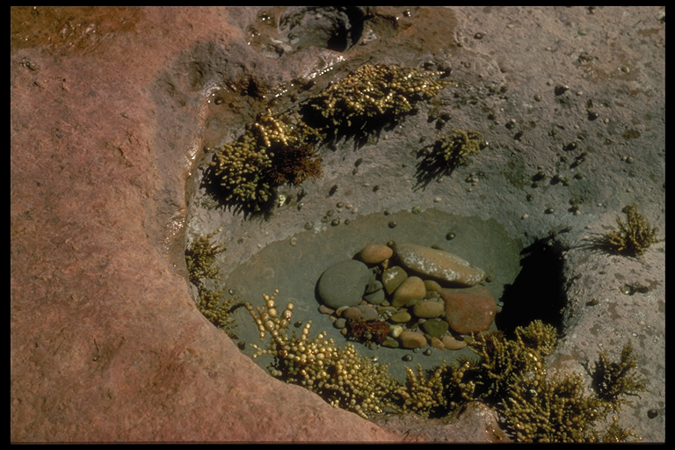

Slide 31
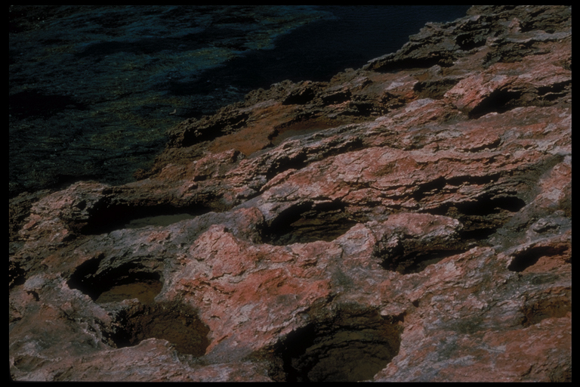

Slide 32
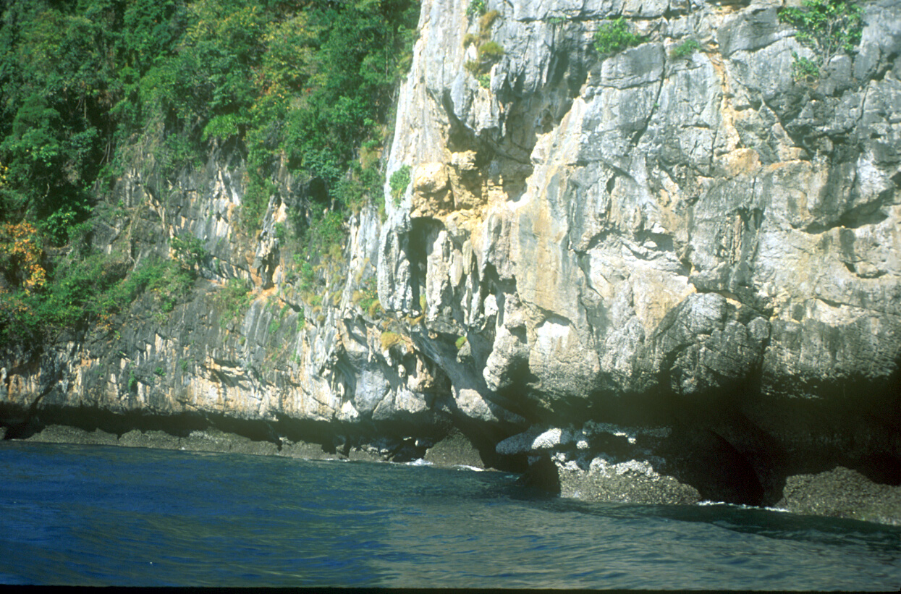

Slide 33
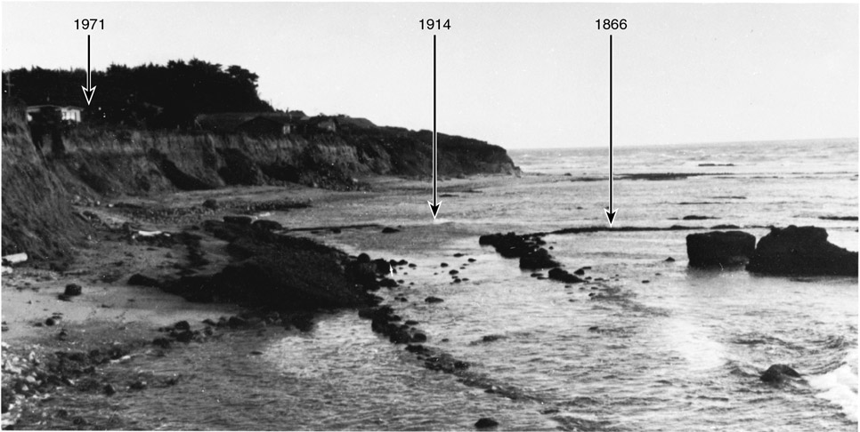
Cliff Erosion
Figure 7.23

Slide 34
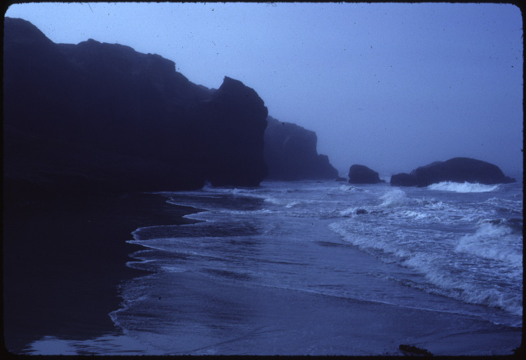

Slide 35
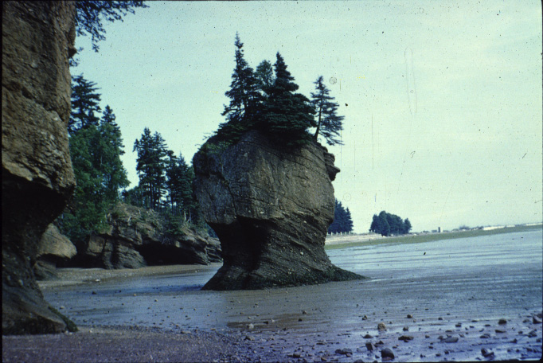

Slide 36
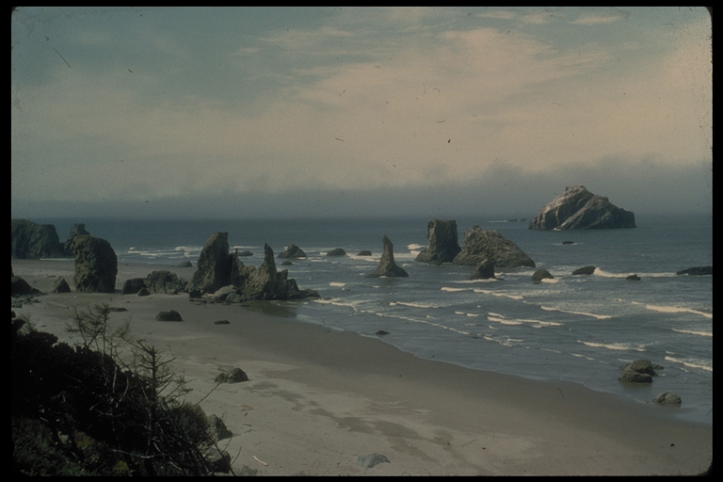

Slide 37
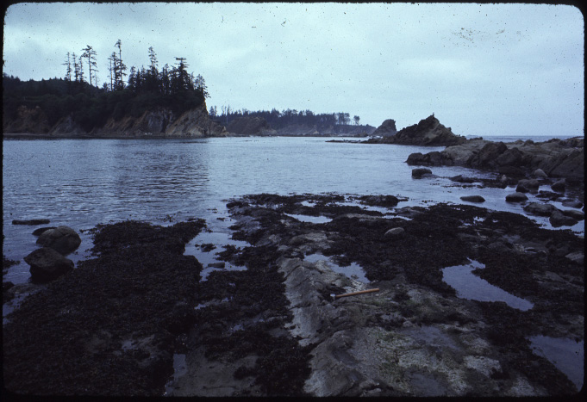

Slide 38
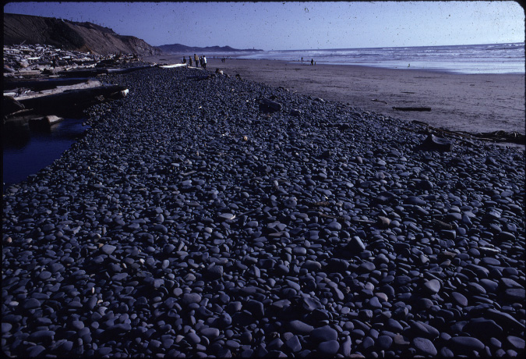

Slide 39
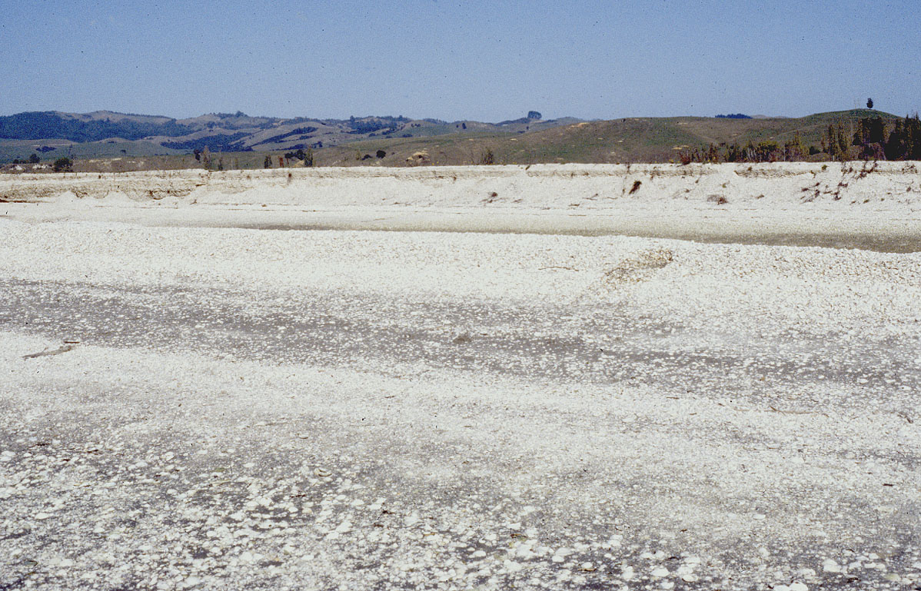
Seasonal beach topography

Slide 41
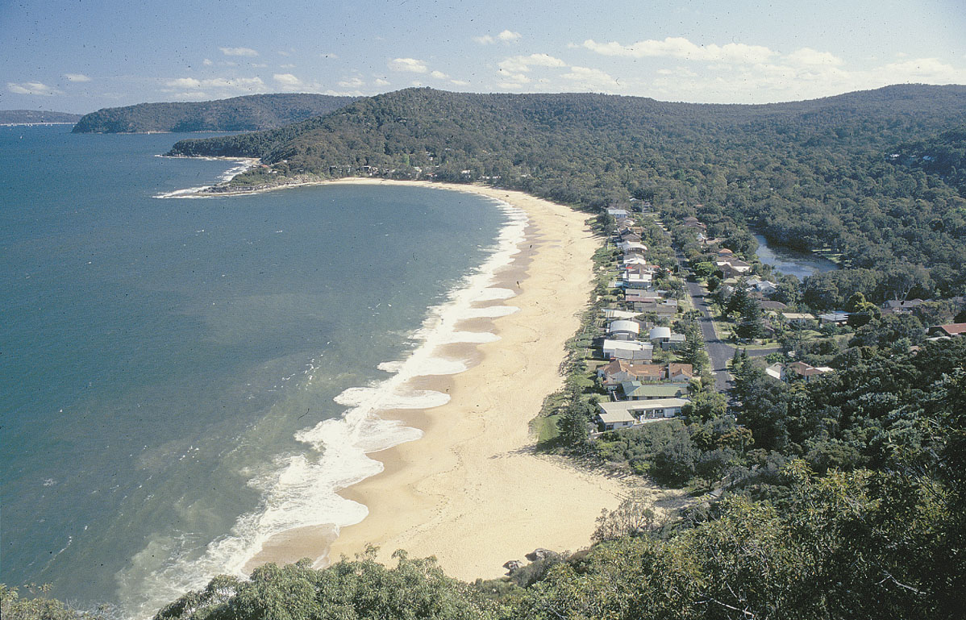
Pocket Beach

Slide 42
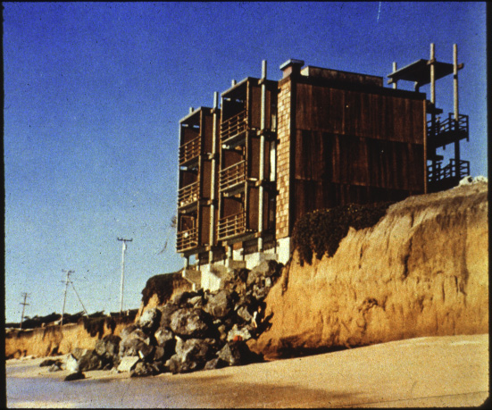

Slide 43
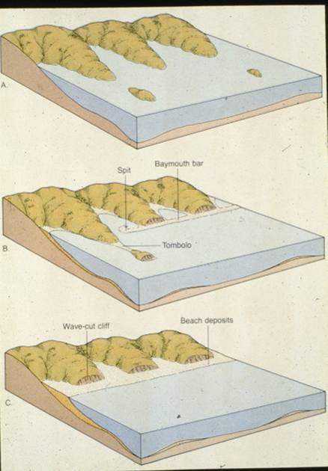

Slide 44
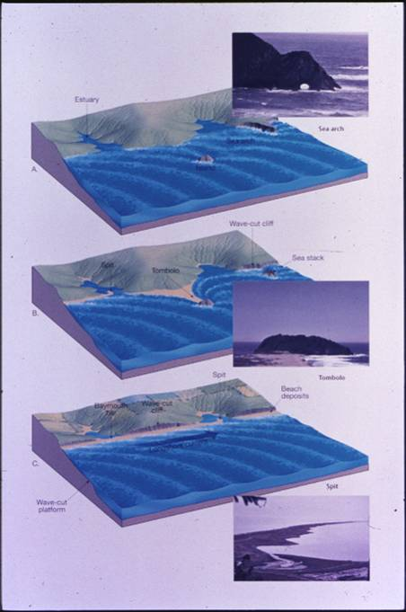

Slide 45
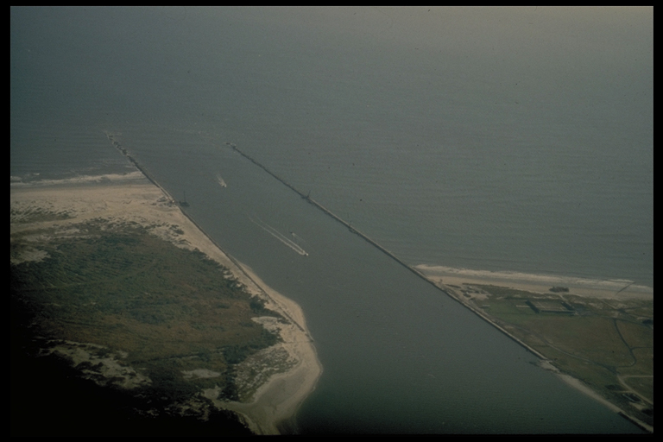

Slide 47
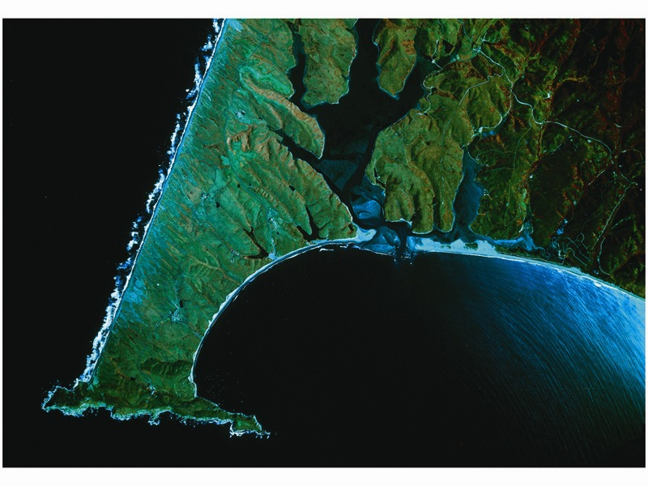

Slide 48
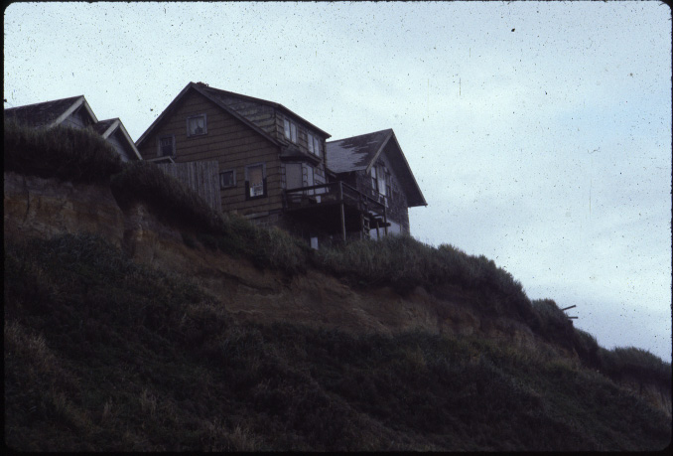

Slide 49
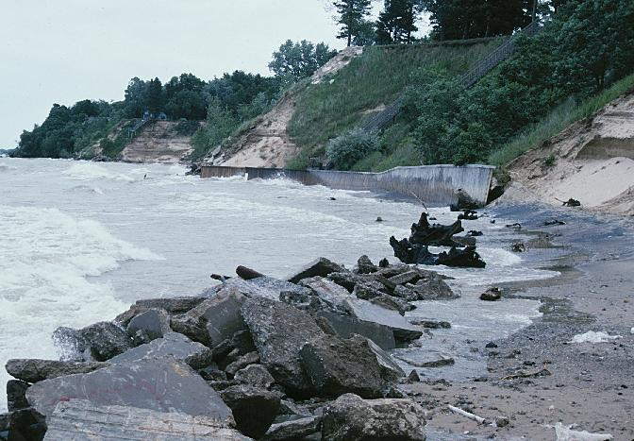

Slide 50
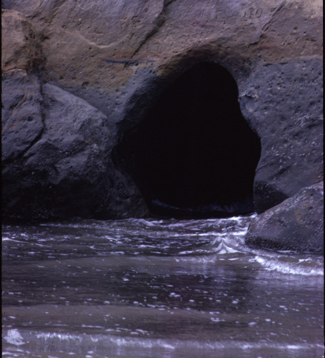

Slide 51
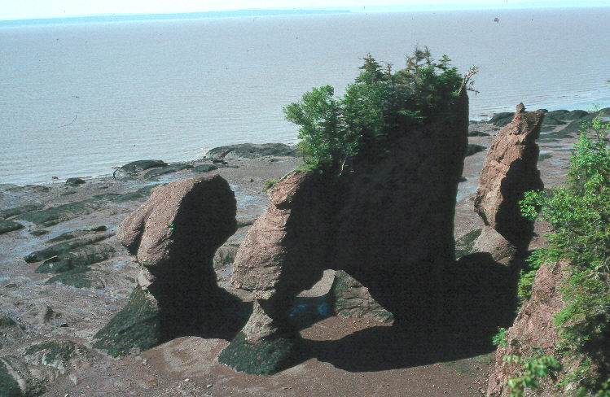

Slide 52
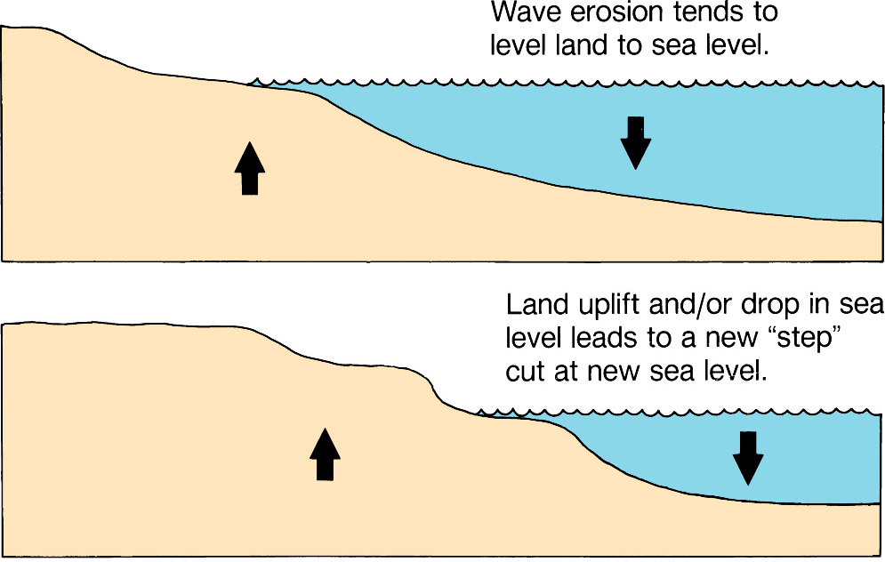
Wave-Cut Platforms
Figure 7.8a

Slide 53
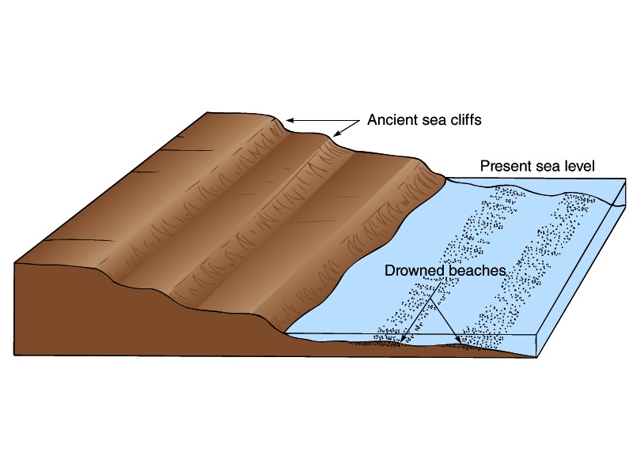

Slide 54
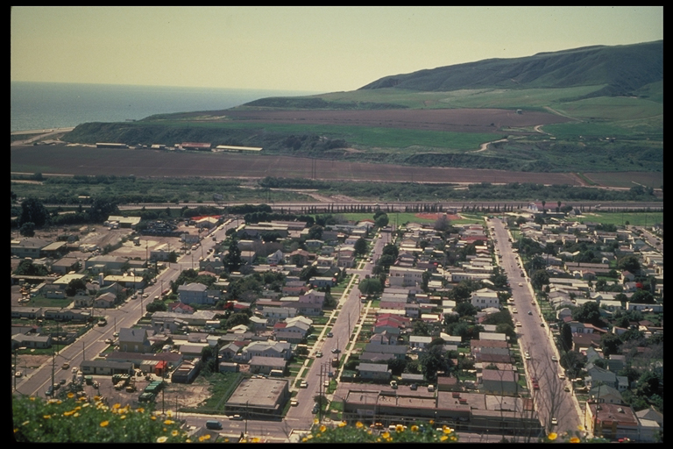

Slide 57
Principal strain and rotation rates derived from GPS velocities. Area is divided into bins of 2° (157 km) in longitude by 1.6° (178 km) in latitude in which the uniform strain and rotation rates are calculated from the GPS velocities contained within (minimum of 6 velocities). (a) Principal strain rates; scale is in nanostrain/yr (1 nanostrain/yr = 10–9 /yr). (b) Rotation rates for same regions. Fan symbols show the rate and sense of rotation (a fan opening 45° clockwise indicates 1°/Myr of clockwise rotation). The smaller attached fans show the one-sigma uncertainty in the rotation rate.

Slide 58
PNW Stress Map

Slide 64
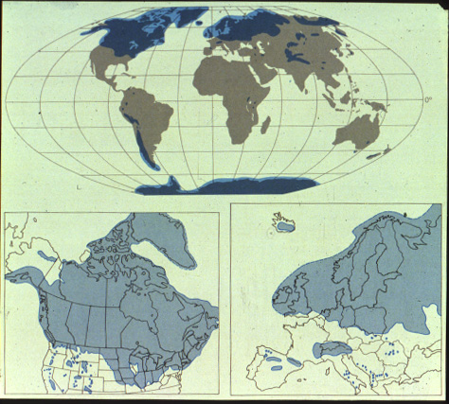

Slide 65


Slide 66


Slide 67

Small Rises in Sea Level
Figure 7.20a, b
A
B

Slide 68


Slide 69

Extension
of North
America
Shoreline
Figure 9.28

Slide 70


Slide 71

Fig. 23.09 c
W. W. Norton

Slide 72


Slide 73


Slide 74


Slide 75


Slide 76


Slide 77
STRUCTURAL GEOLOGY OVERVIEW

Slide 78


Slide 79


Slide 80


Slide 81
Pacific Northwest Climate and Tectonics: Linked System Drivers
“Wet”
“Dry”
Westerly cyclonic storm systems
Deschutes
High Cascades
Western Cascades
HJA

Slide 82


Slide 83


Slide 84

Landslide
Box 4.3 Figure 3

Slide 85


Slide 86


Slide 87

Flooding in Portage, Alaska
Figure 4.16

Slide 88

Property Damage in Anchorage, Alaska
Figure 4.23d

Slide 90

Canadian
Earthquake
Activity
Figure 4.28b
From the Geological Survey of Canada

Slide 91


Slide 92




Slide 93


Slide 94


Slide 96


Slide 97




Slide 98

Copyright © Nicolaus Kuhn 2002
Notes:
Table mountain near Mitzpe Ramon, central Negev, Israel.

Slide 99

Fig. 11.05b
Stephen Marshak

Slide 100

Fig. 11.29
W. W. Norton

Slide 101

Copyright © Frank Eckardt 2002
Notes:
Sedimentary rocks, England.

Slide 102

Fig. 11.20a
Stephen Marshak

Slide 103

Fig. 11.20b
Stephen Marshak

Slide 105

Fig. 11.13b
Stephen Marshak

Slide 106

Fig. 11.14a
W. W. Norton

Slide 107
Fig. 11.14b
W. W. Norton

Slide 108
Fig. 11.14cd
W. W. Norton

Slide 109


Slide 110

Fig. 11.15c
Stephen Marshak

