Slide 1
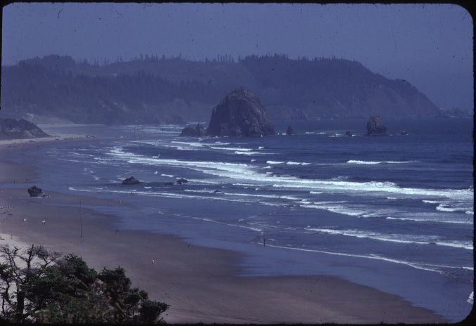

Slide 2
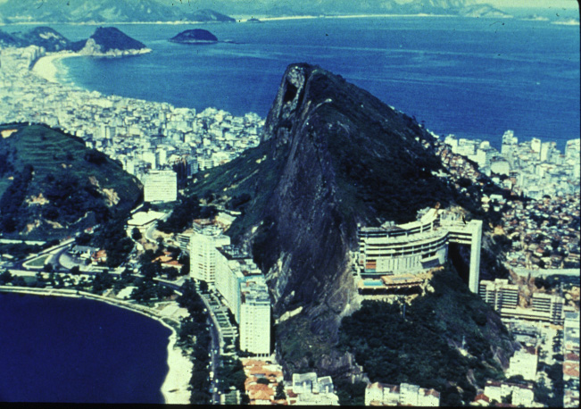

Slide 3
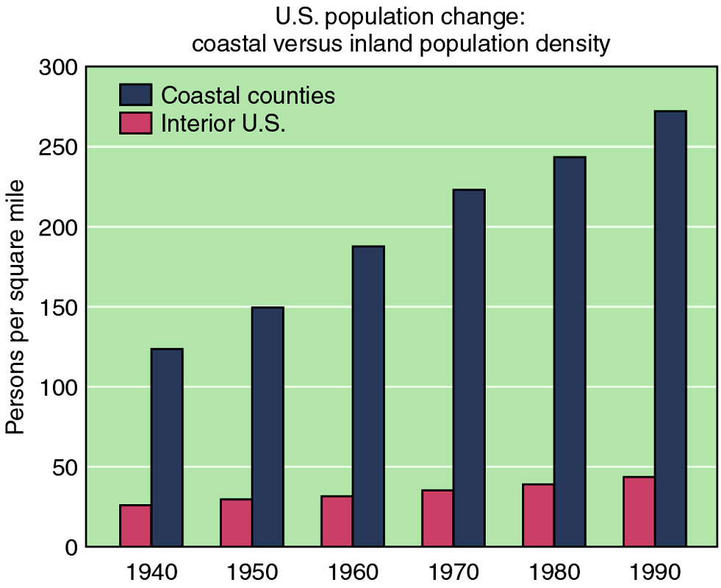

Slide 4
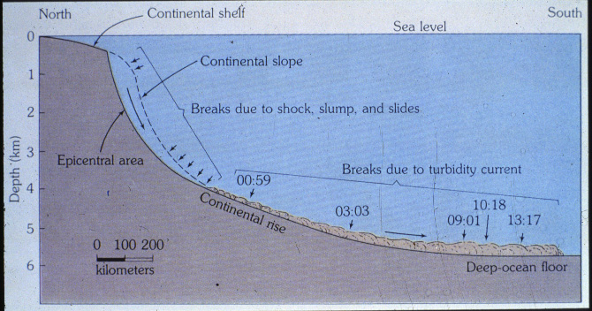

Slide 5
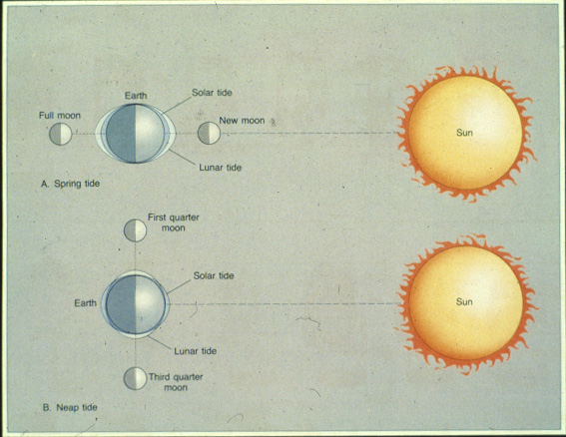

Slide 6
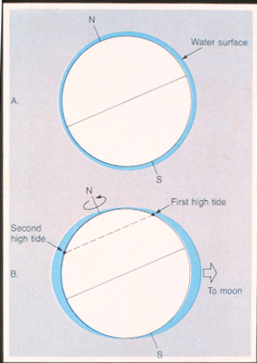

Slide 7
Monthly Tidal Cycle
Tidal Cycle Animation
Notes:
To view this animation, click “View” and then “Slide Show” on the top navigation bar.

Slide 8
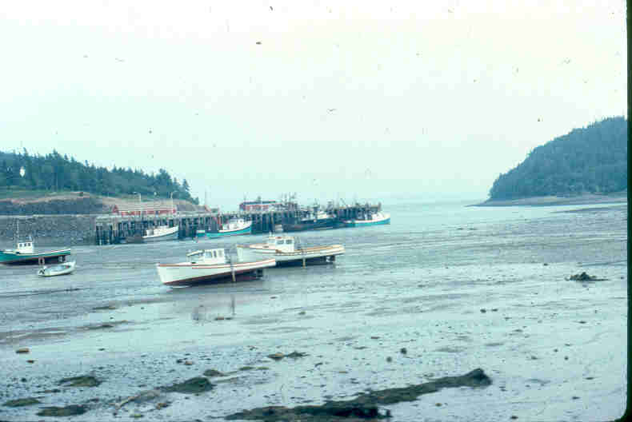

Slide 9
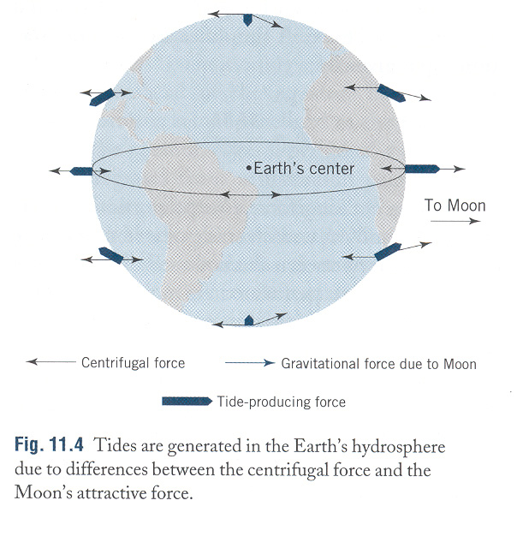

Slide 10
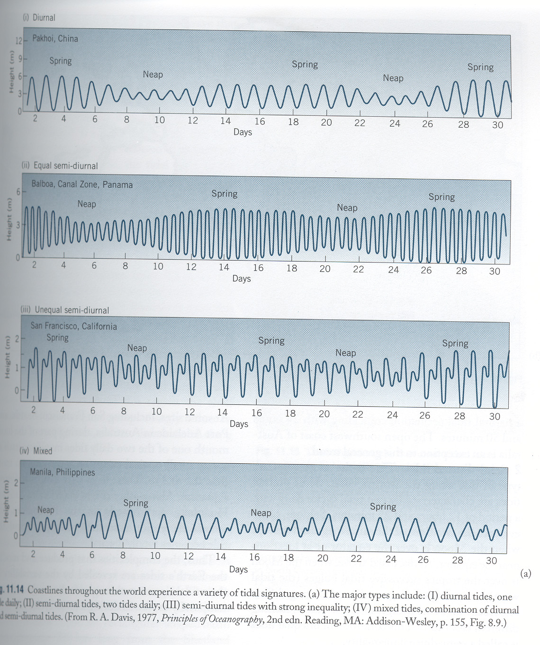

Slide 11
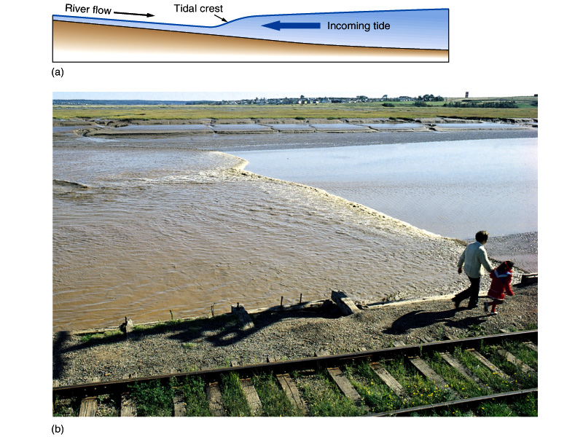

Slide 12
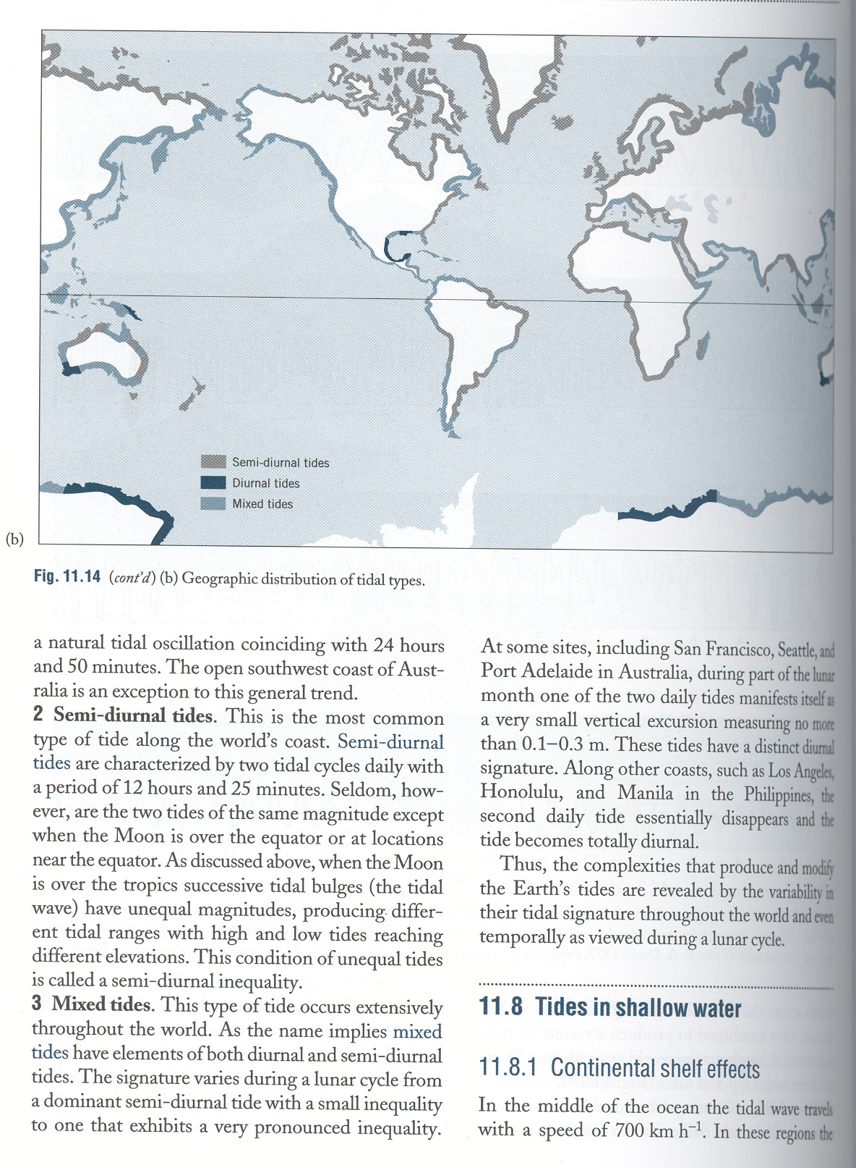

Slide 13
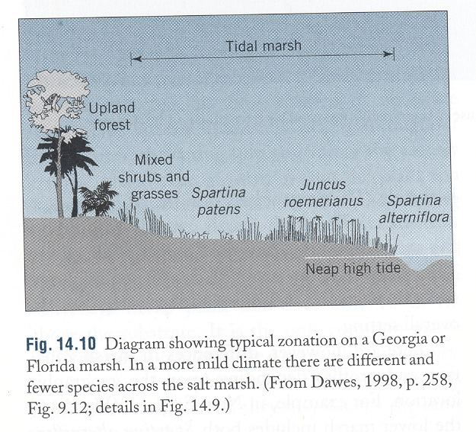

Slide 14
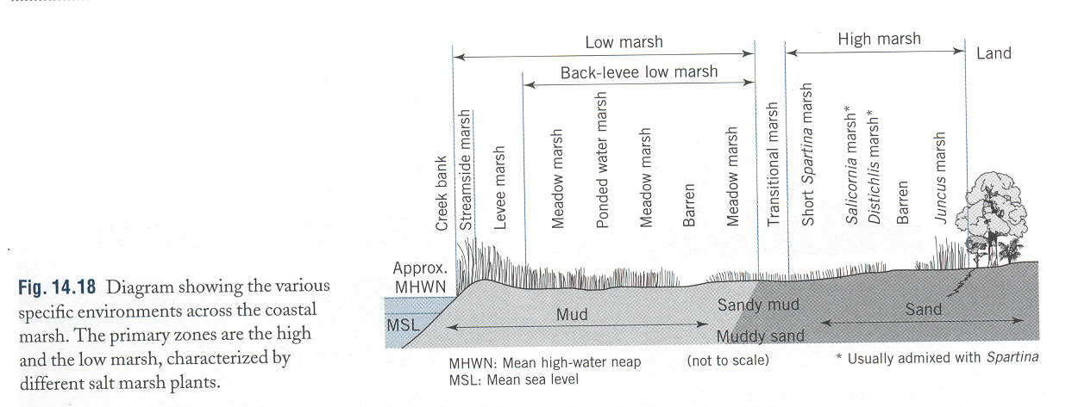

Slide 15
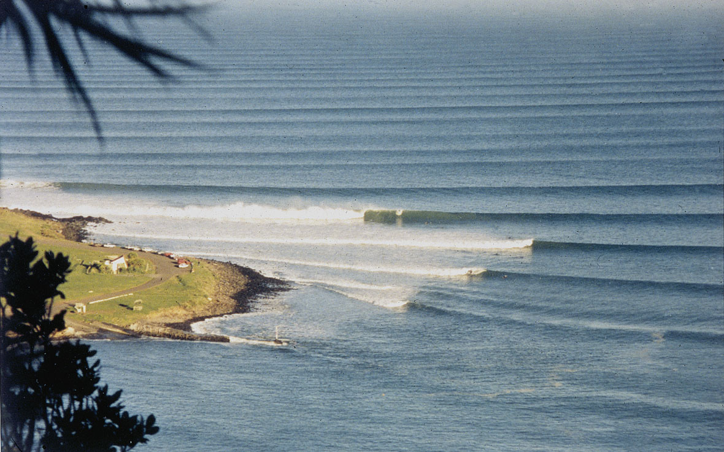

Slide 16
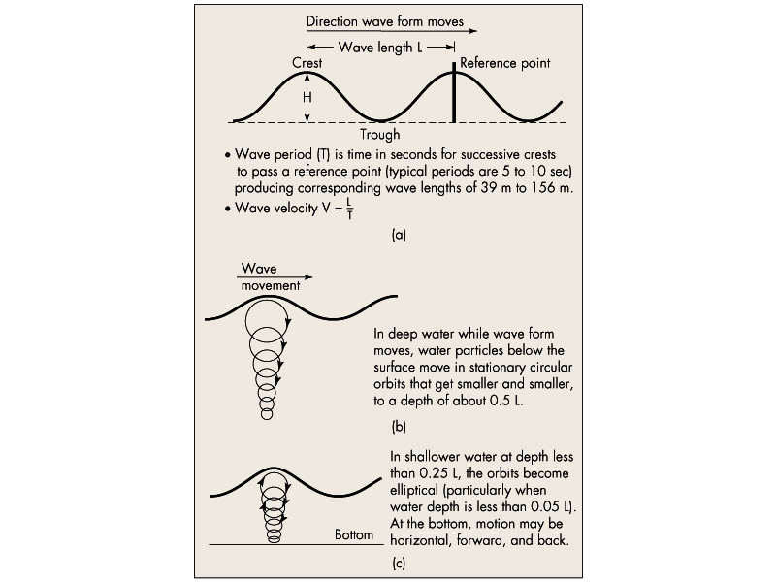

Slide 18
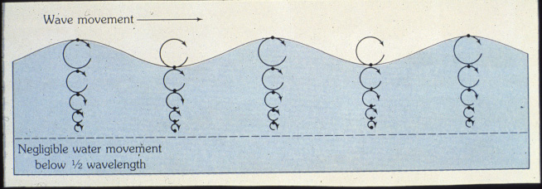

Slide 19
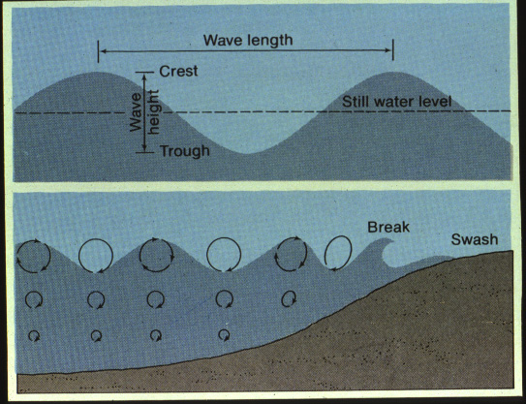

Slide 20
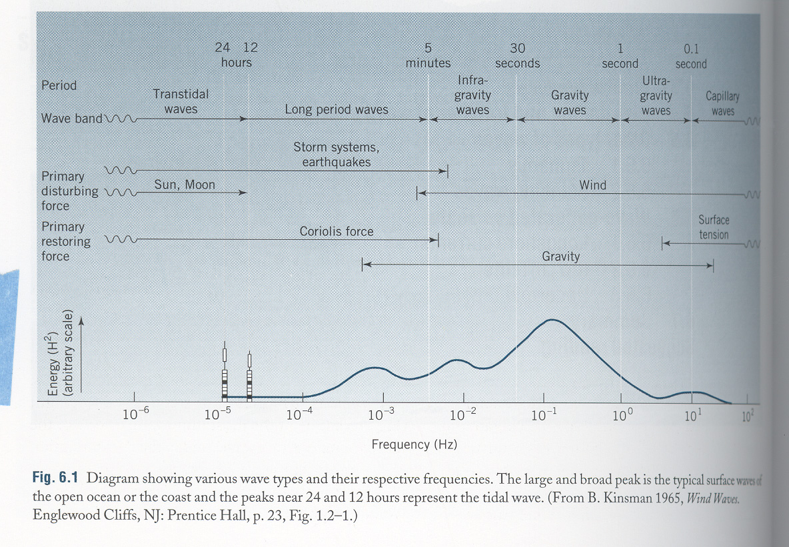

Slide 21
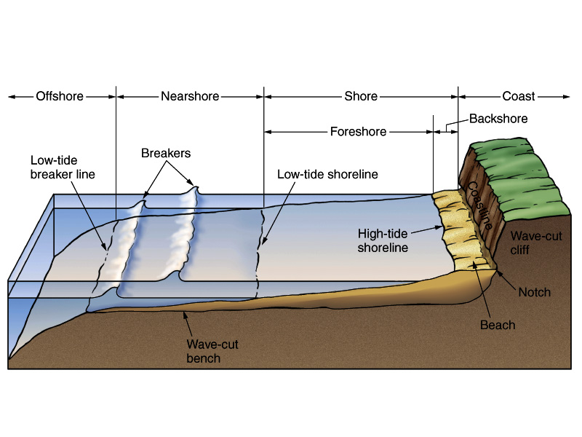

Slide 22
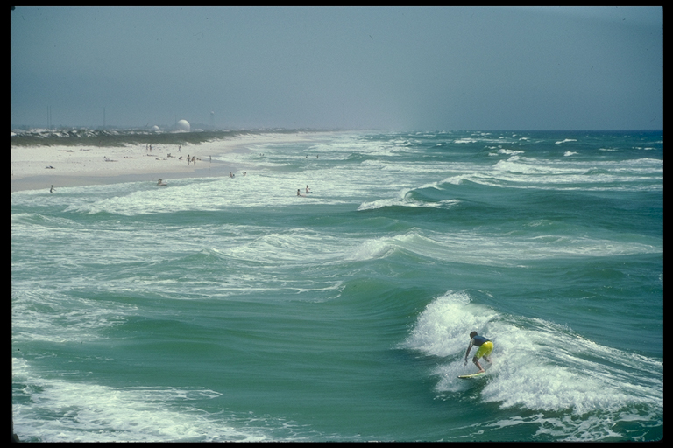

Slide 26
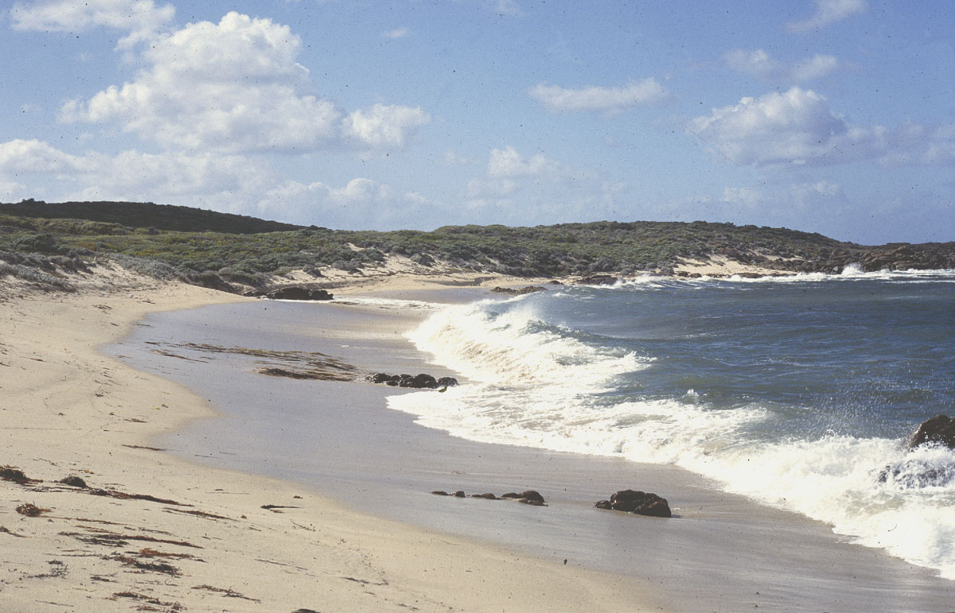

Slide 27
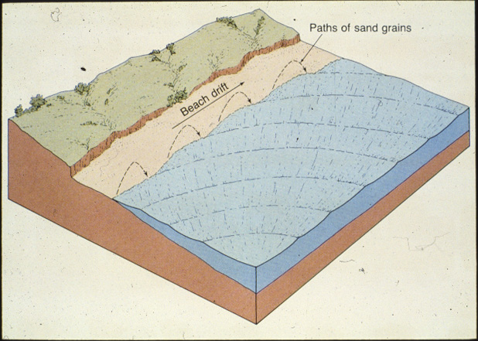

Slide 28
Beach Drift and Longshore Currents
Longshore Drift Animation
Notes:
To view this animation, click “View” and then “Slide Show” on the top navigation bar.

Slide 29
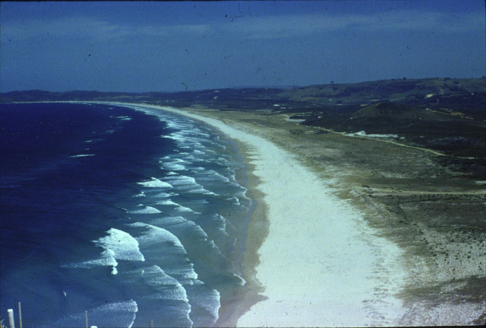

Slide 30
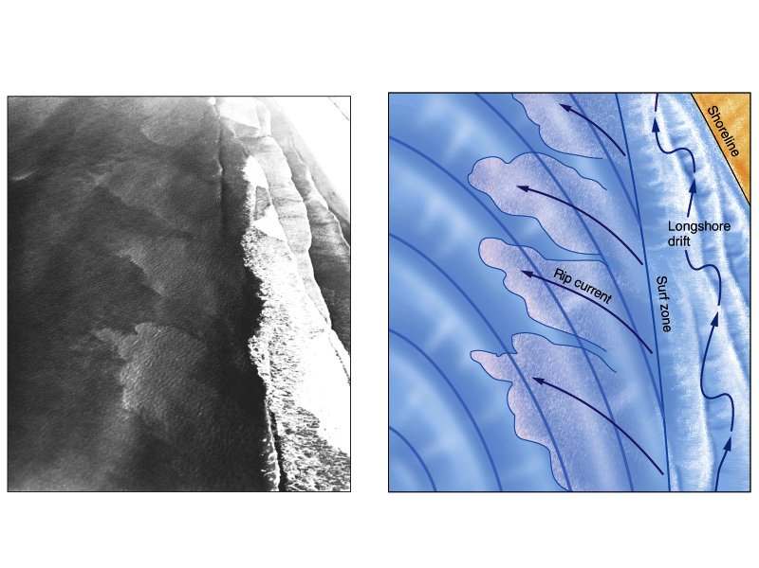

Slide 31
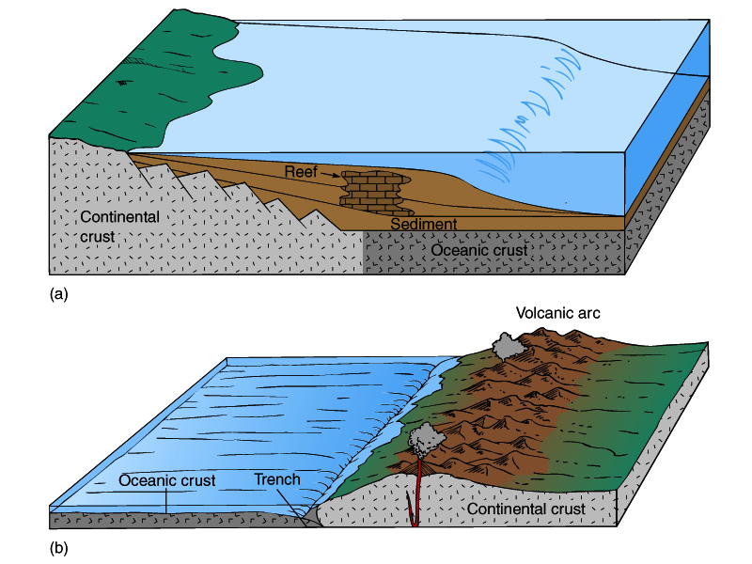

Slide 32
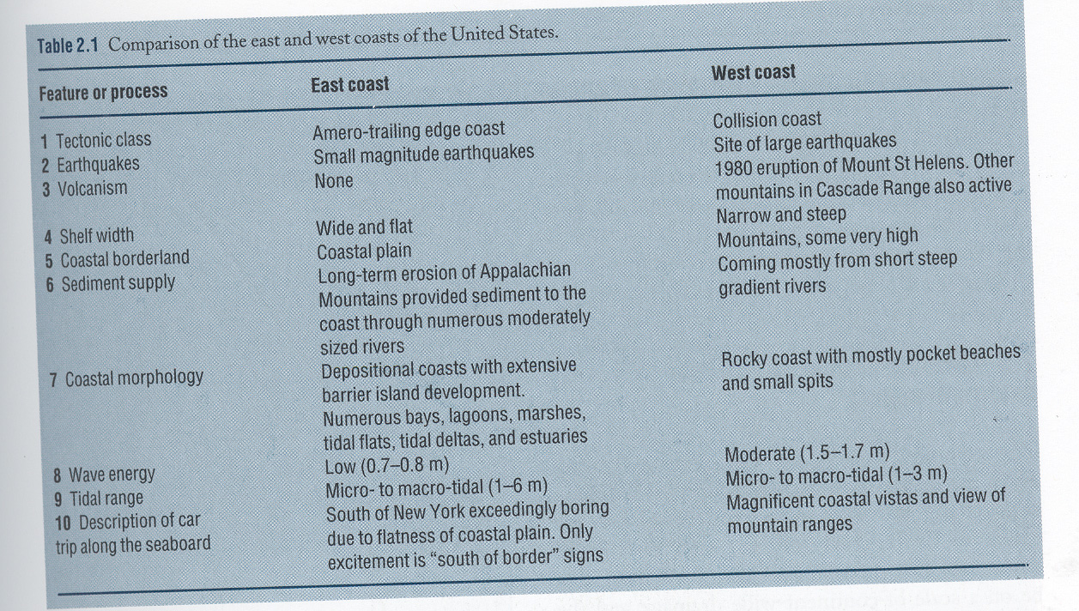

Slide 33
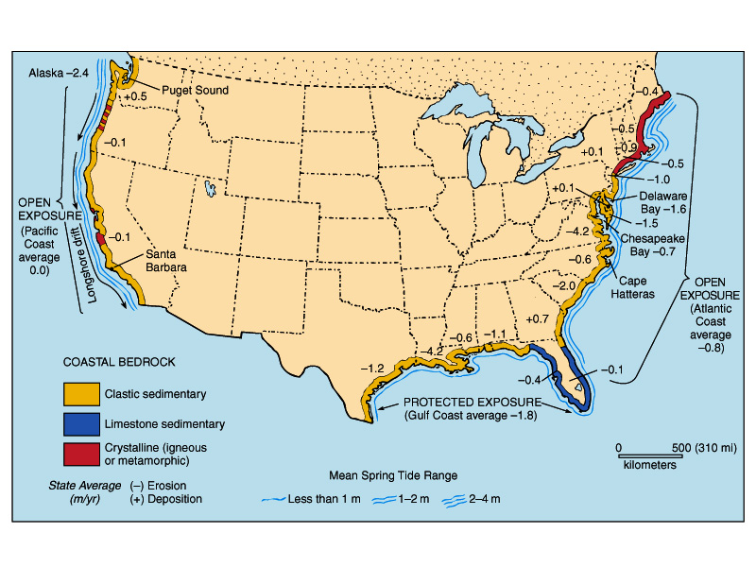

Slide 34
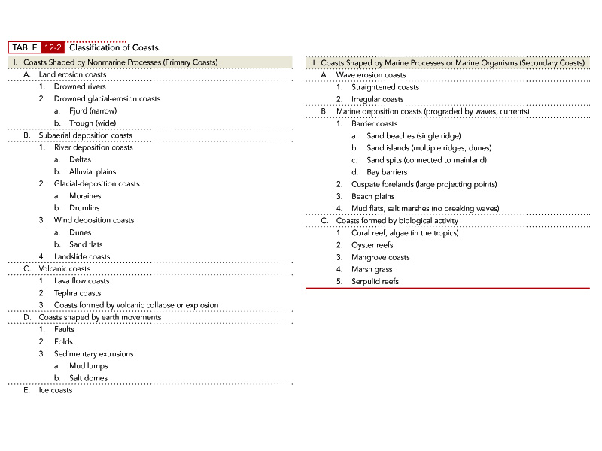

Slide 35
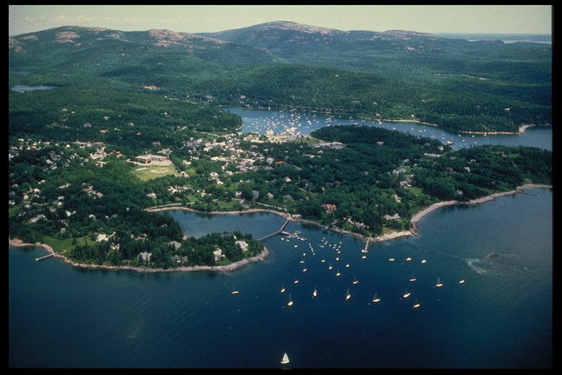

Slide 36
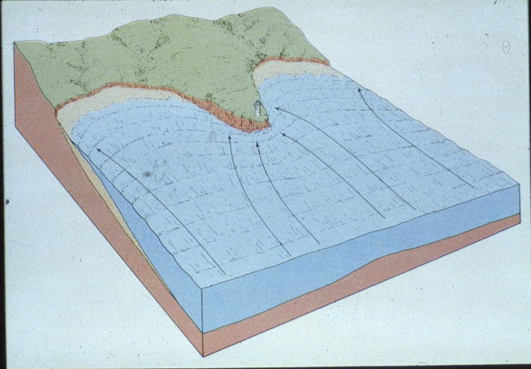

Slide 37
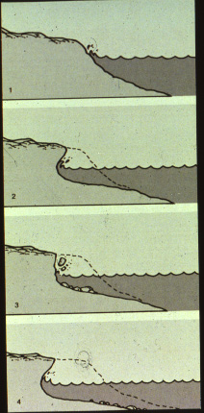

Slide 38
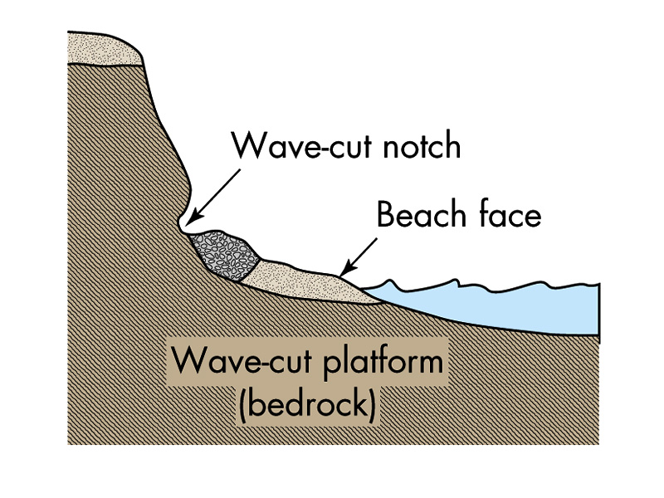

Slide 39
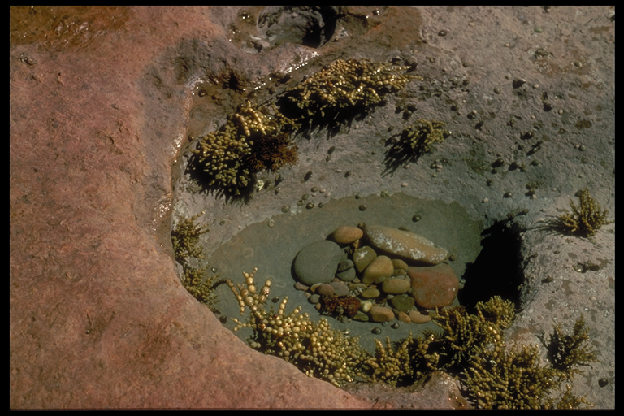

Slide 40
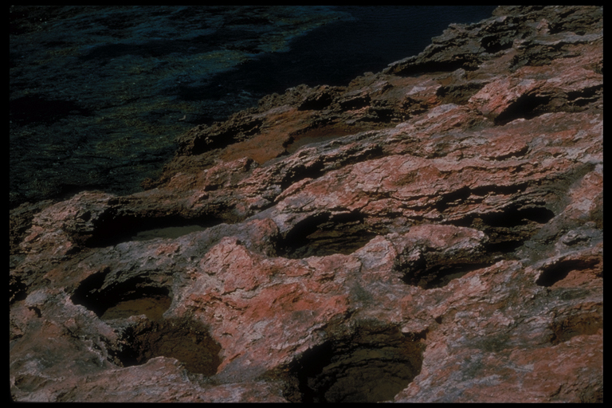

Slide 41
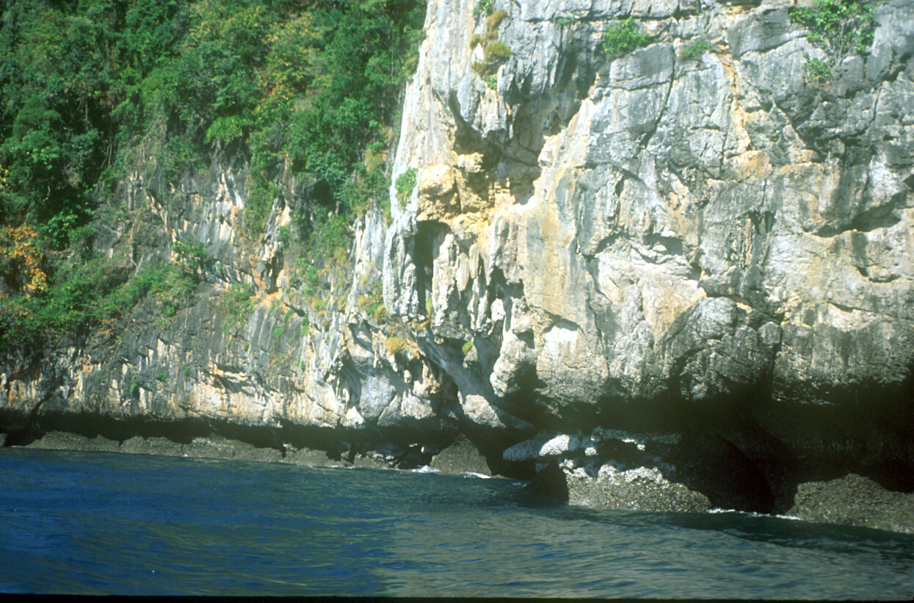

Slide 42
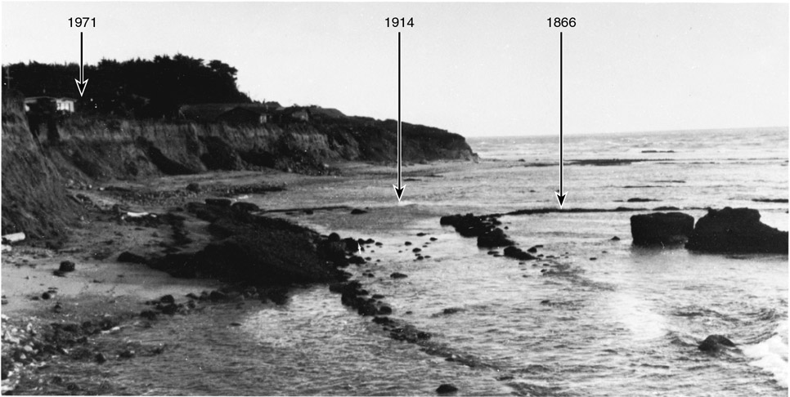
Cliff Erosion
Figure 7.23

Slide 43
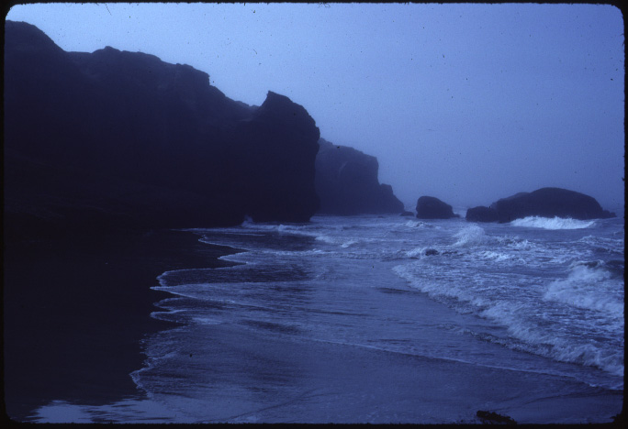

Slide 44
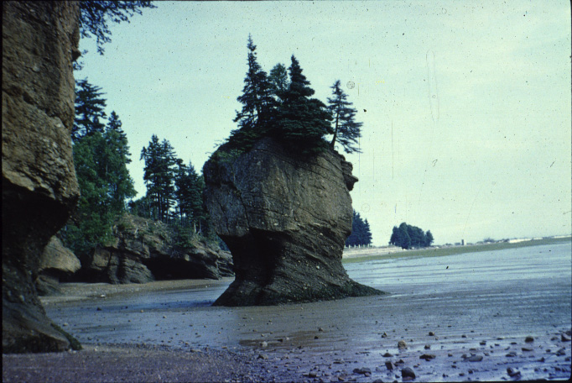

Slide 45
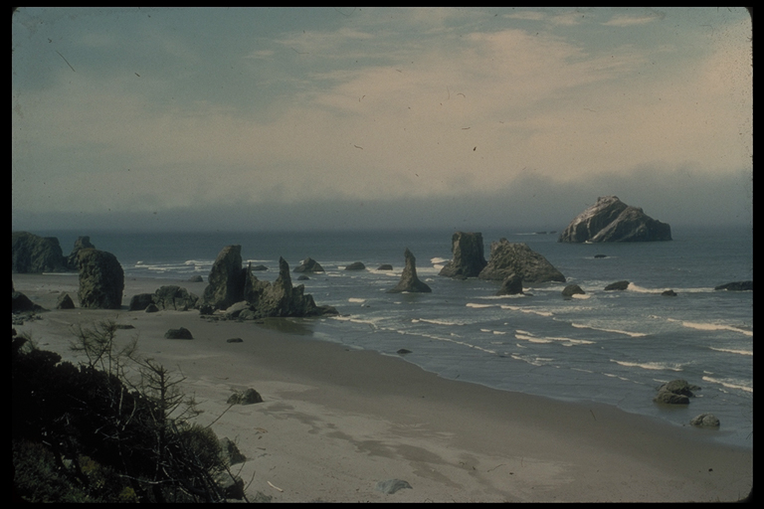

Slide 46
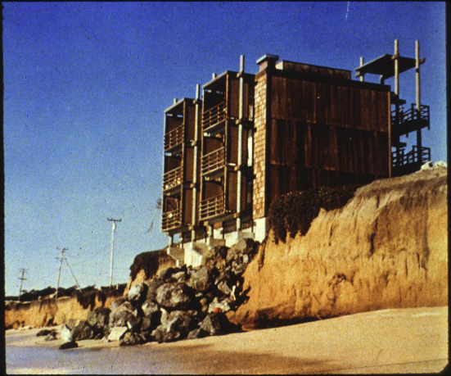

Slide 47
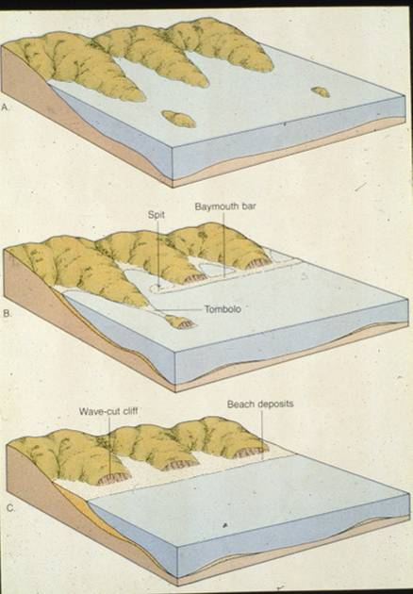

Slide 48
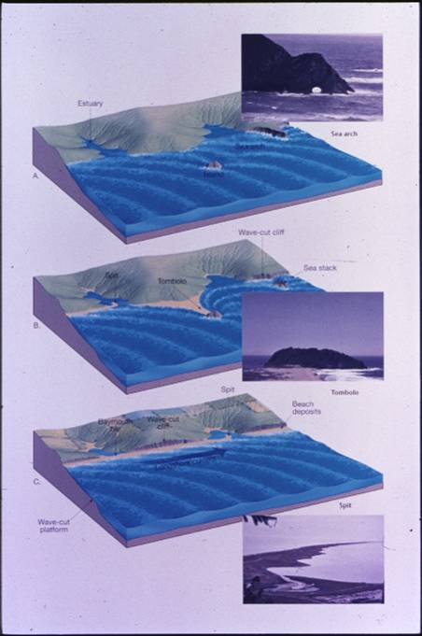

Slide 49
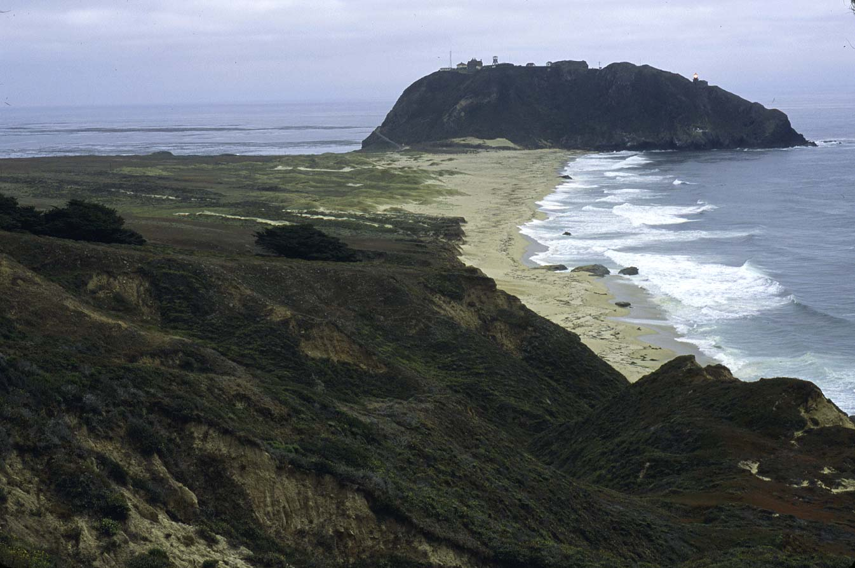

Slide 51
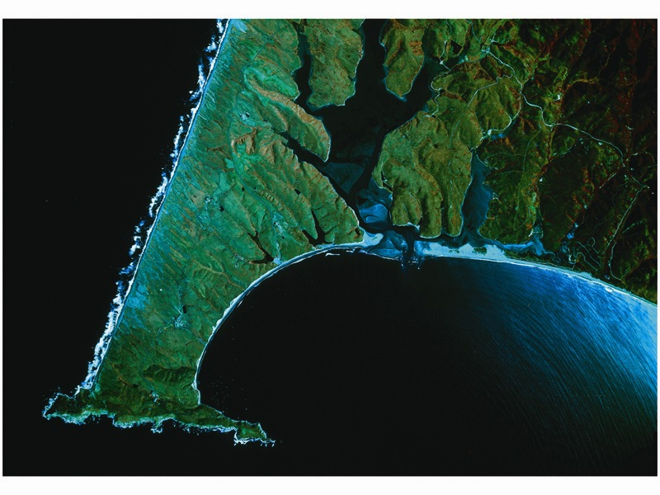

Slide 52
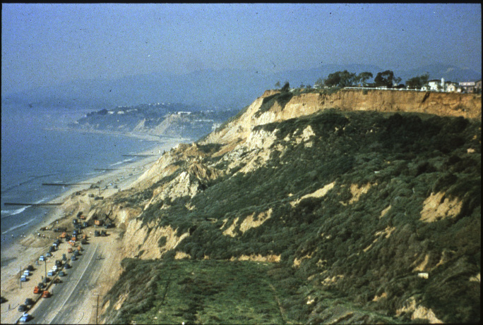

Slide 53
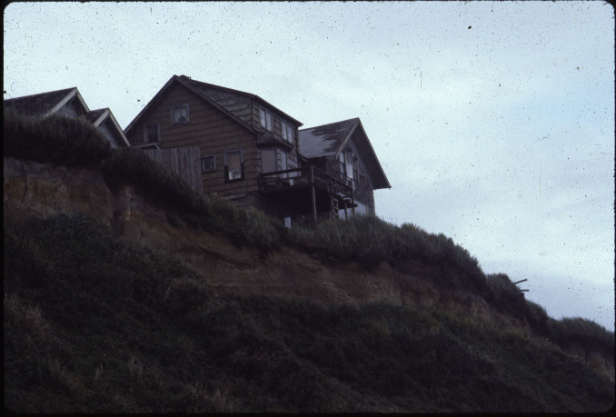

Slide 54
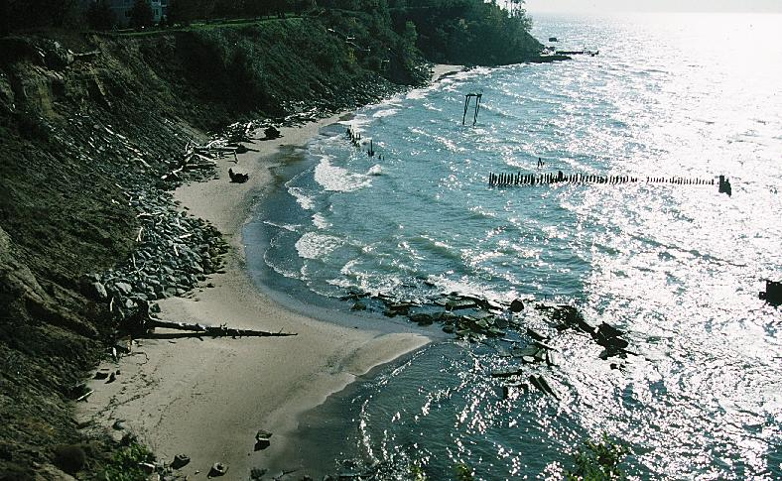

Slide 55
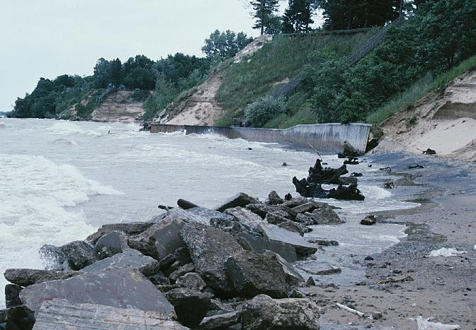

Slide 56
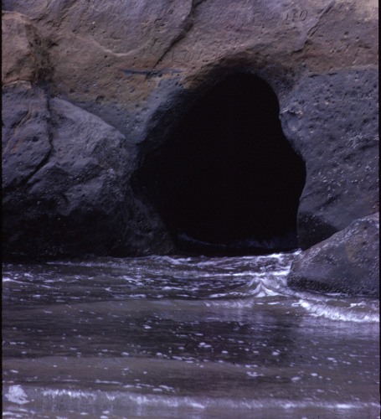

Slide 57
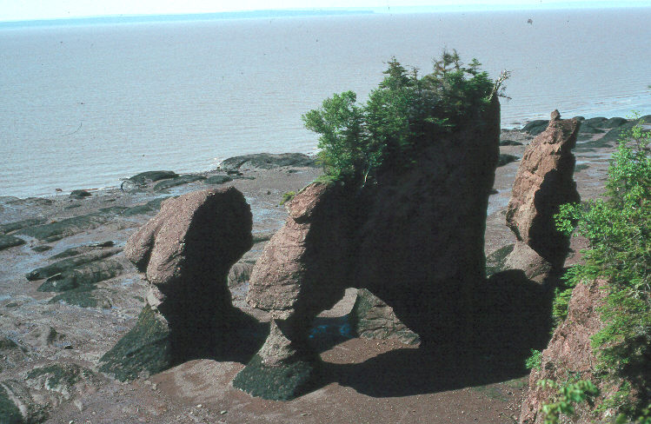

Slide 59
Wave-Cut Platforms
Figure 7.8a

Slide 68
Seasonal beach topography

Slide 80
Coastal Stabilization Structures
Shore Erosion Animation
Notes:
To view this animation, click “View” and then “Slide Show” on the top navigation bar.

Slide 88
Pocket Beach

Slide 98
Small Rises in Sea Level
Figure 7.20a, b
A
B

Slide 112
Hurricane Wind Patterns
Hurricane Animation
Notes:
To view this animation, click “View” and then “Slide Show” on the top navigation bar.

Slide 115
Ocean Circulation
Ocean Circulation
Notes:
To view this animation, click “View” and then “Slide Show” on the top navigation bar.

Slide 116
El Niño and La Niña
0
El Nino Animation

Slide 117
El Niño and La Niña
El Nino Animation
Notes:
To view this animation, click “View” and then “Slide Show” on the top navigation bar.

