Slide 1
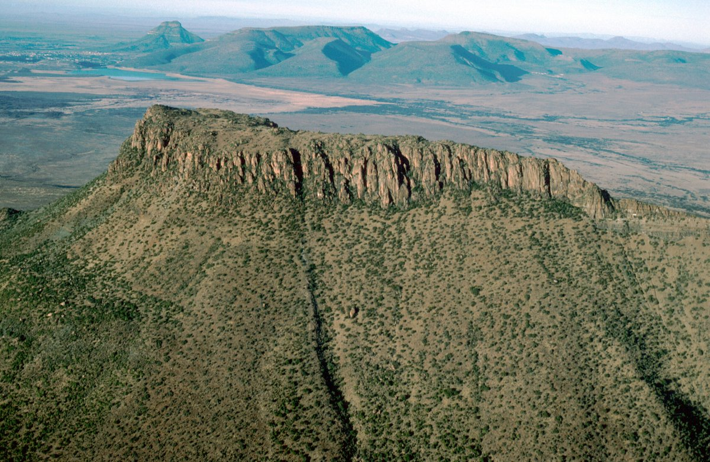
Copyright © Frank Eckardt 2002
Notes:
Mesa in the Karoo, South Africa.

Slide 3
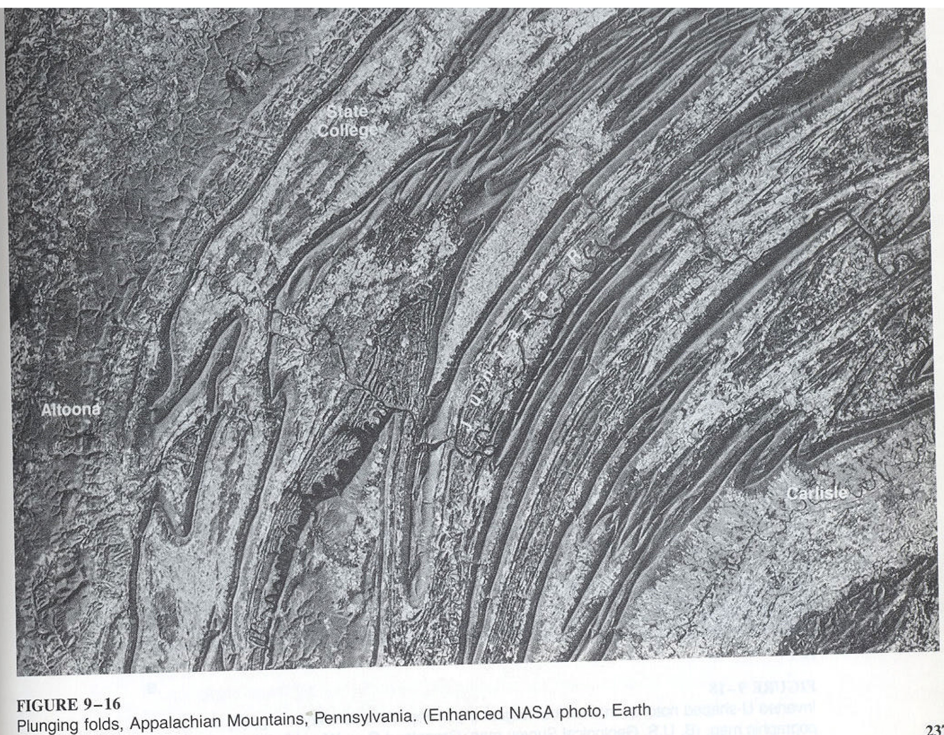

Slide 4
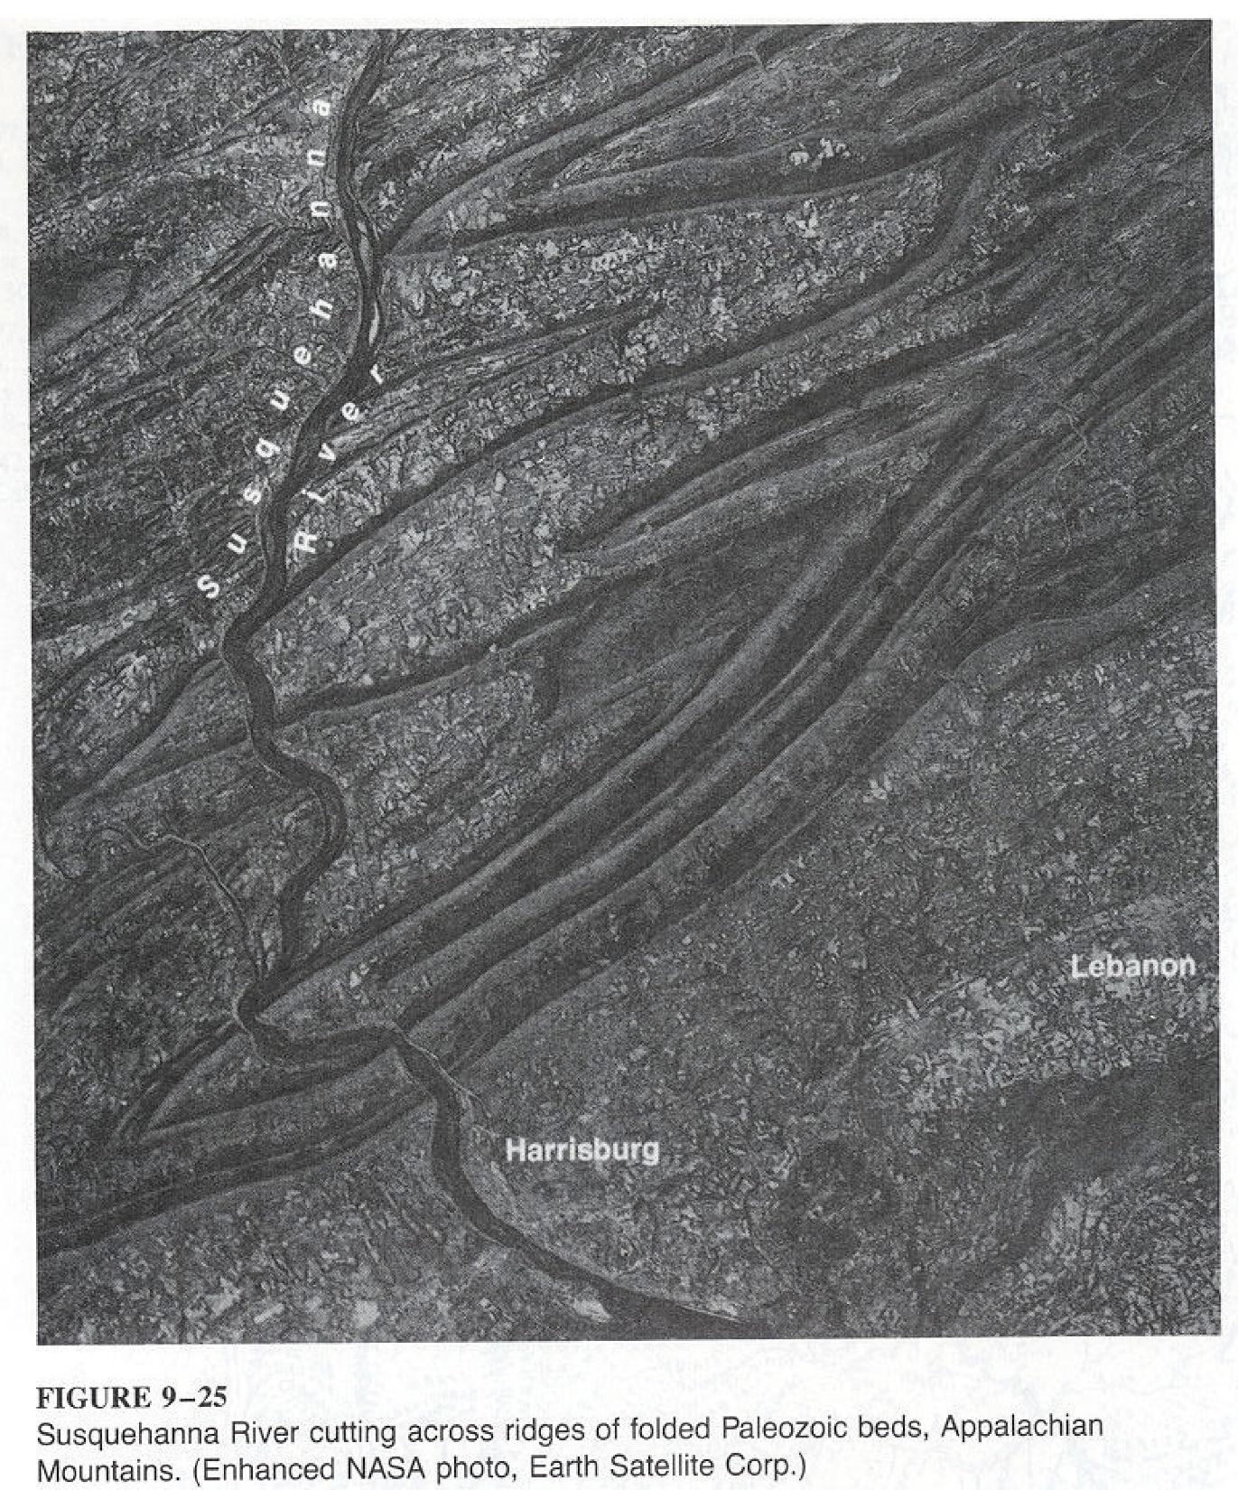

Slide 5
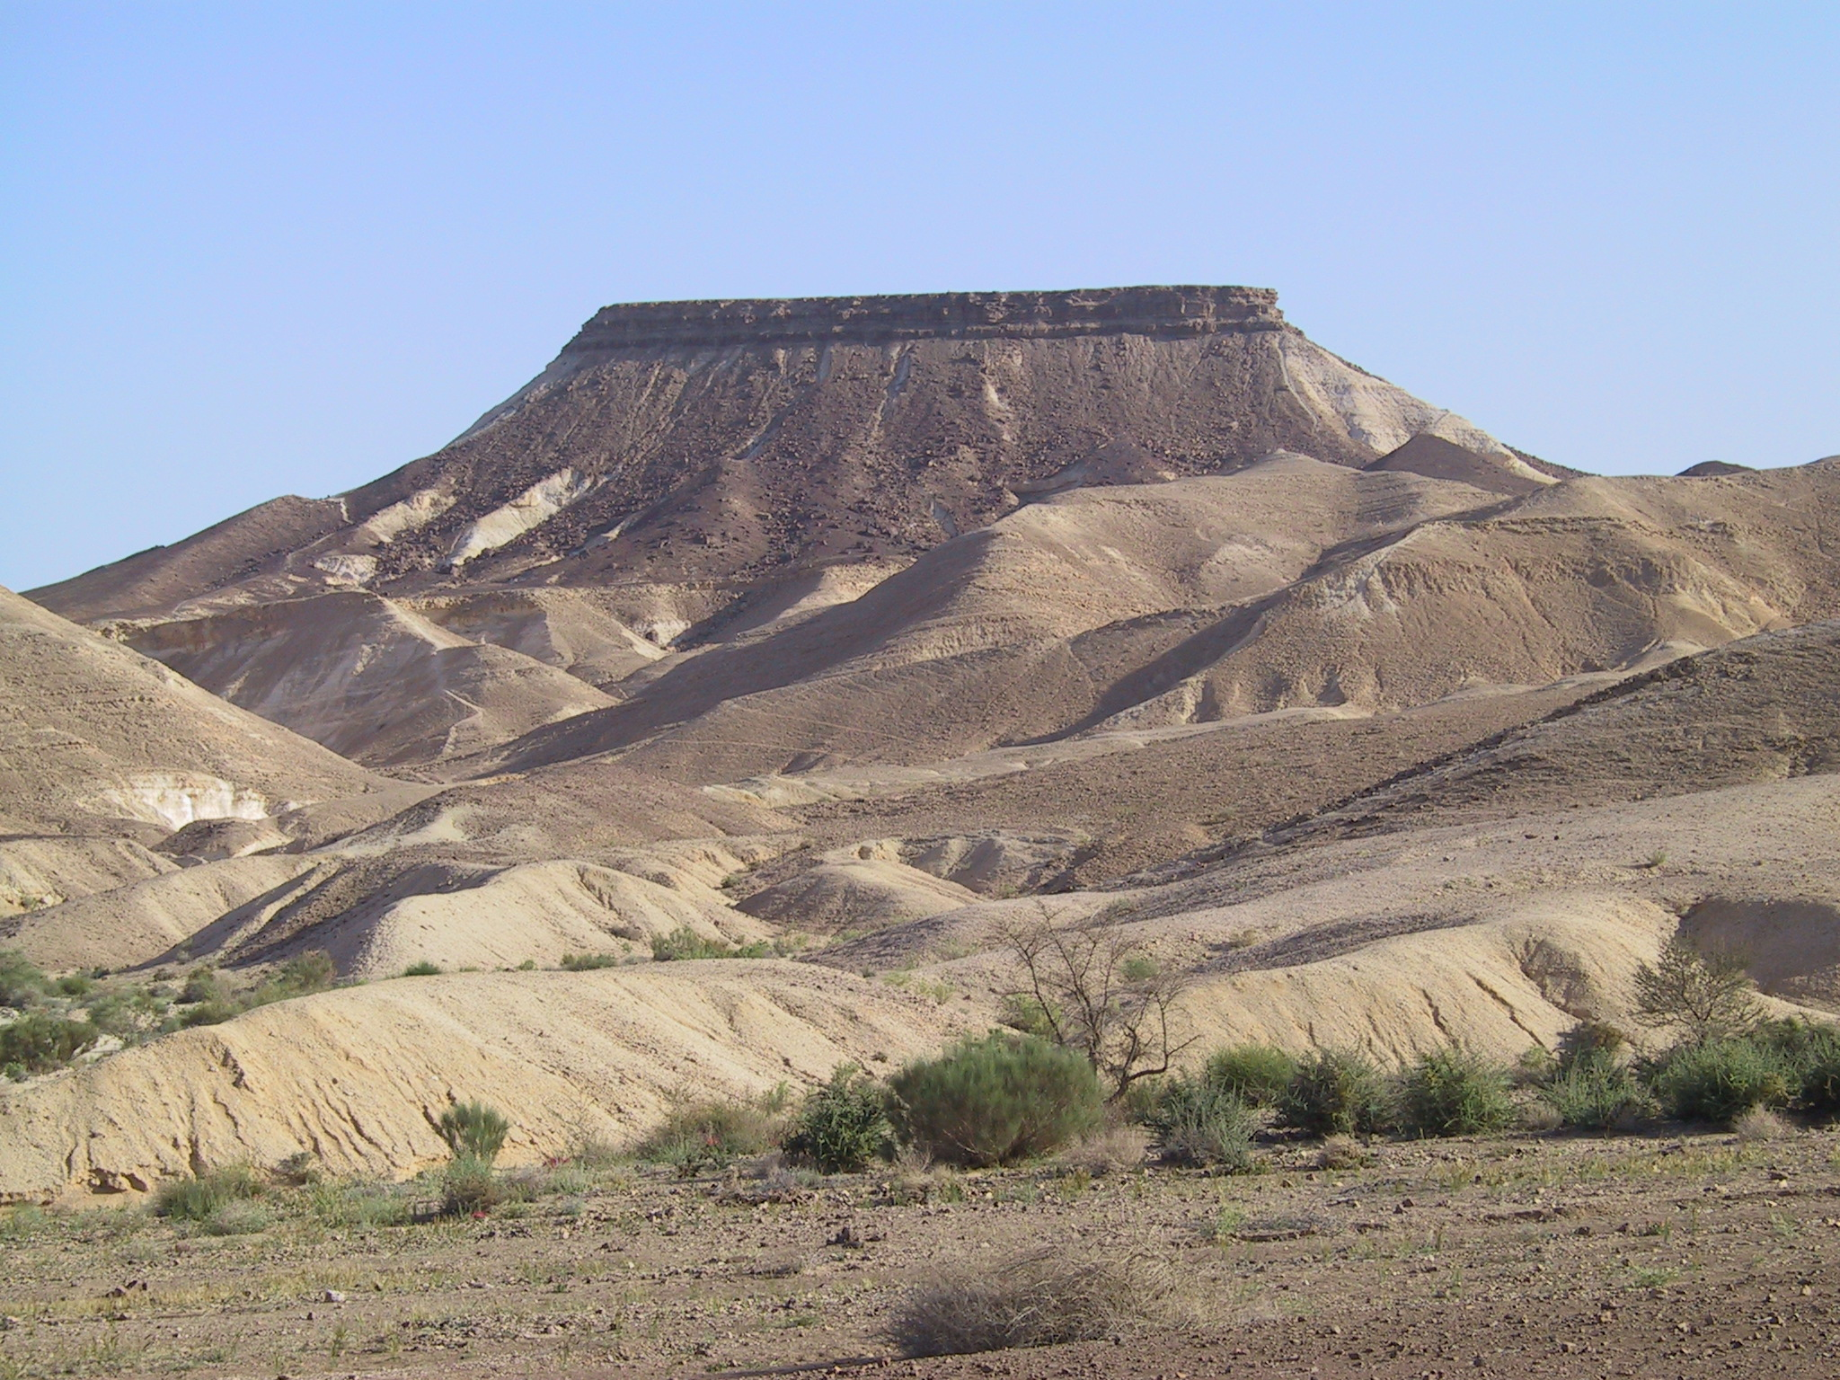
Copyright © Nicolaus Kuhn 2002
Notes:
Table mountain near Mitzpe Ramon, central Negev, Israel.

Slide 6
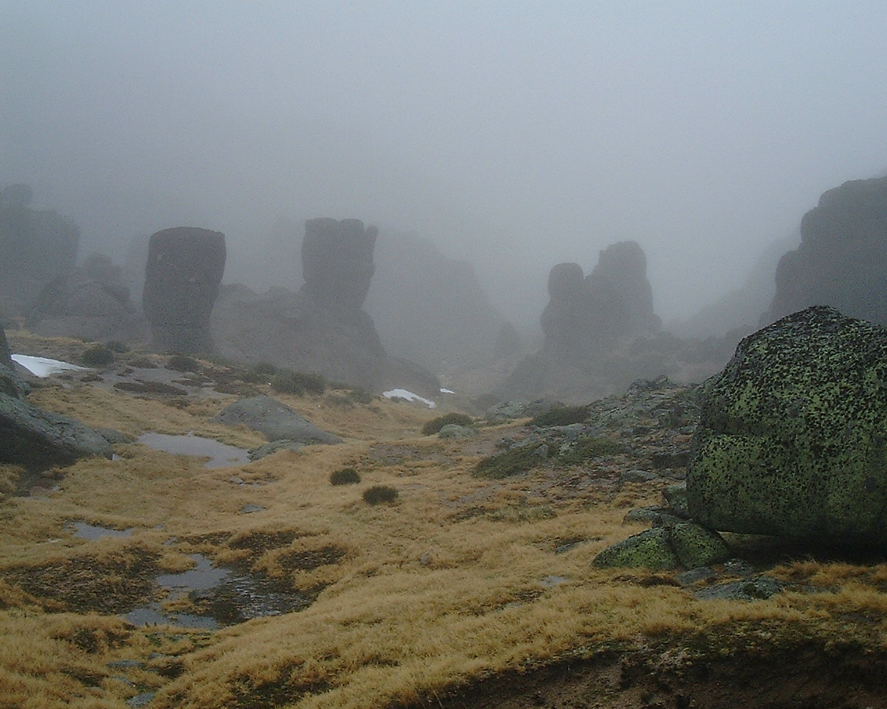
Copyright © Goncalo Vieira 2002
Notes:
Granite columns, Serra da Estrela (Portugal), Granite landforms.

Slide 7
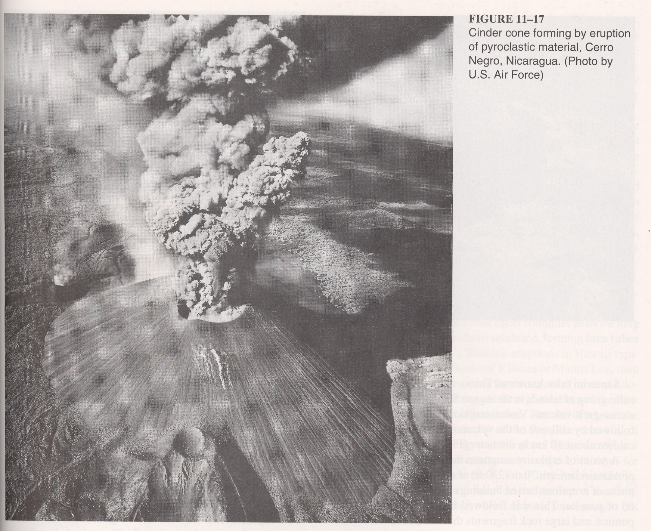

Slide 8
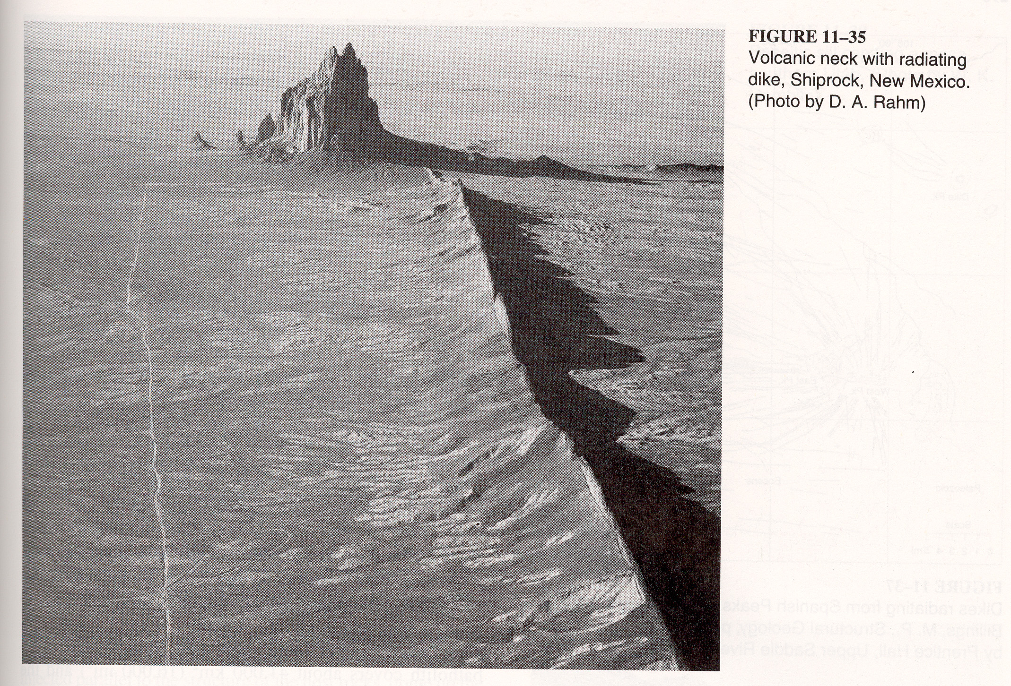

Slide 9
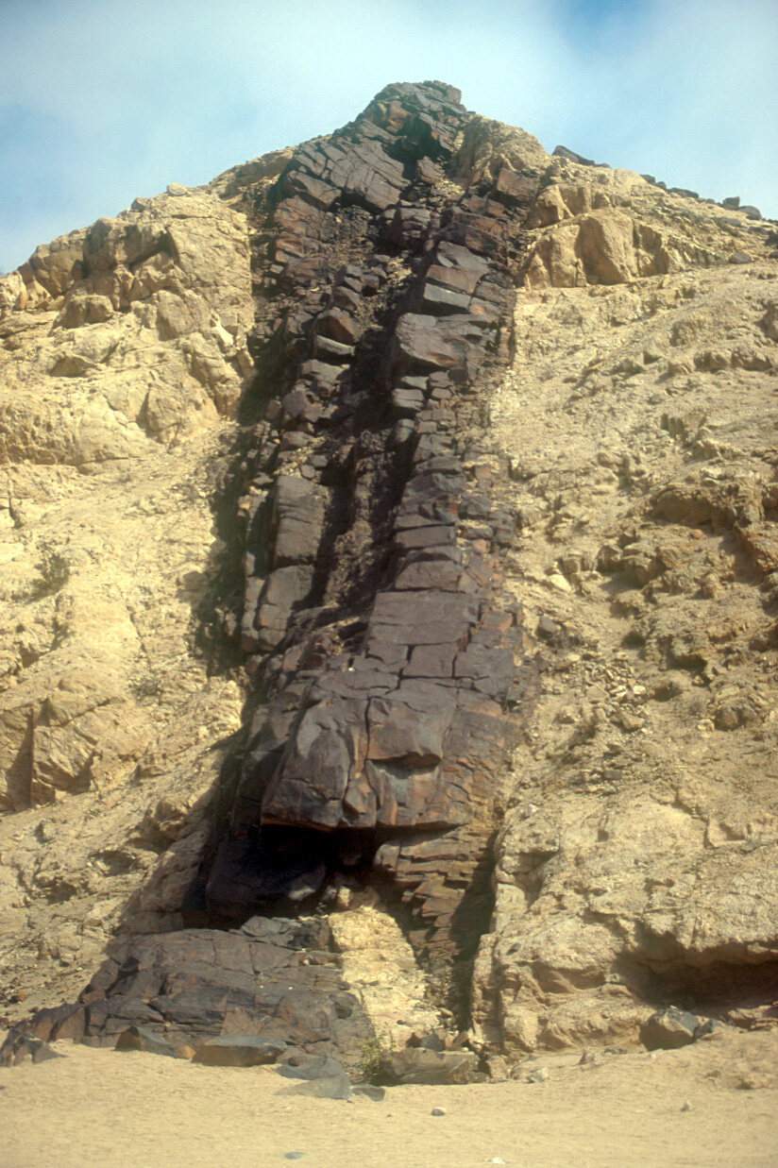
Copyright © Frank Eckardt 2002
Notes:
Dolerite, Namibia.

Slide 10
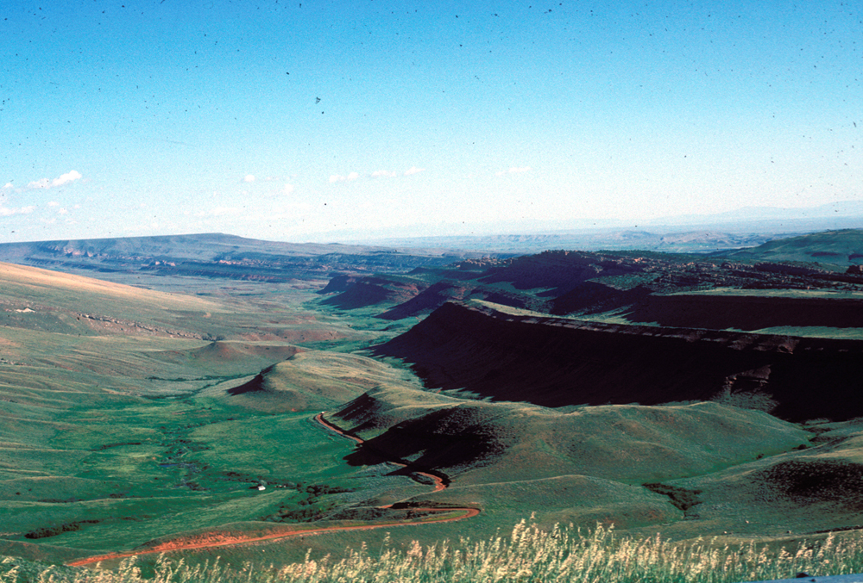
Copyright © J. Michael Daniels 2002
Notes:
Structurally-controlled valley, northern South Pass City, Wyoming.

Slide 11
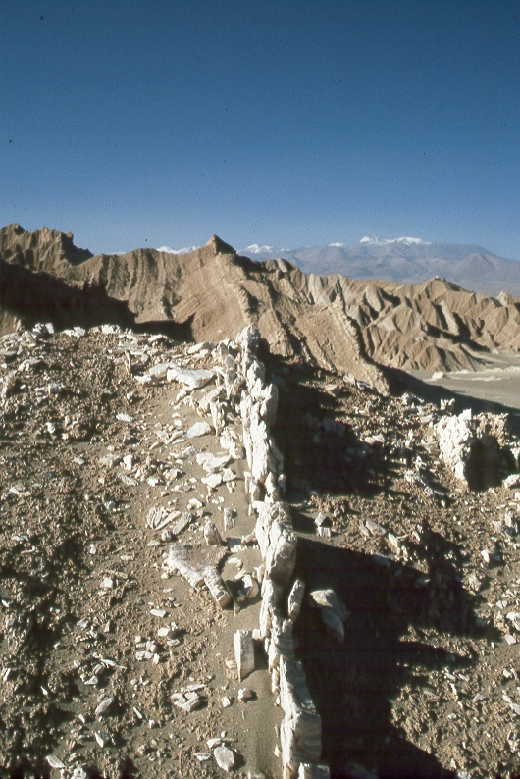
Copyright © Christopher Hauser 2002
Notes:
Playa, La Grand Salar in northeastern Chile, near the Bolivian Border. Small variations in lithology lead to differing rates of weathering and erosion. The feature is not a dyke but rather part of a folded structure.

Slide 12
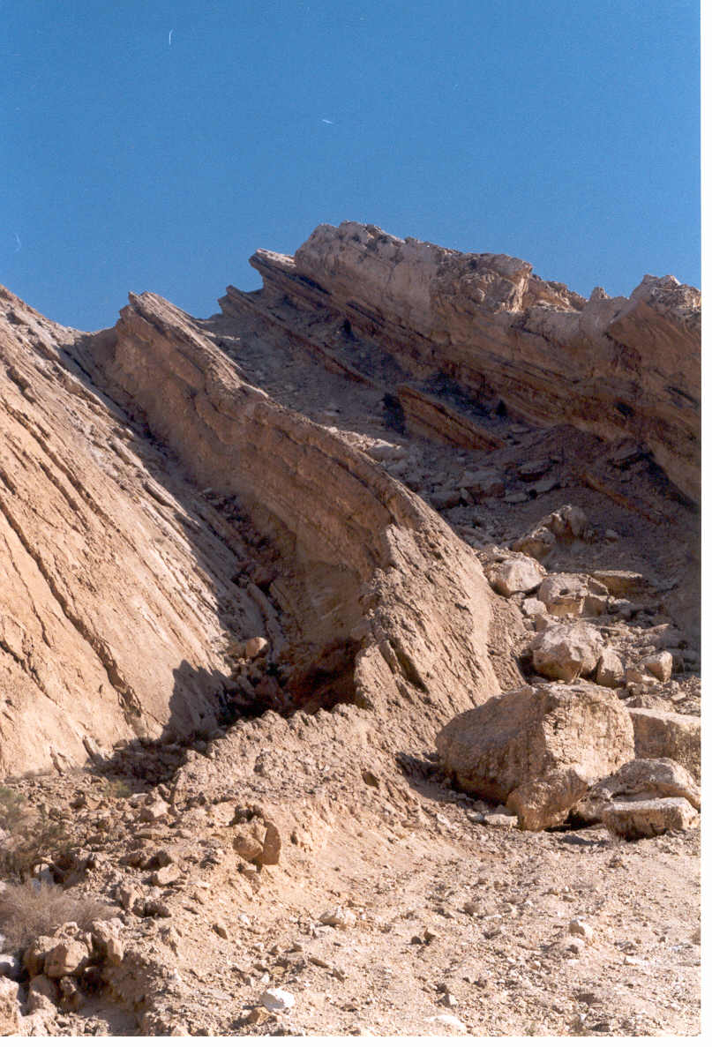
Copyright © Nicolas Waldmann 2002
Notes:
In the southern Israel’s Negev desert, there are several craters from fluvial origin. This picture shows the opening of the Hazera Crater towards the Dead Sea basin in the east. The Lower Cretaceous Formations that forms the walls of the crater are folded as part of the monocline. The Hazera monocline is one of several monoclines forming an “s” shape from Palmyra in northern Syria to north of the Sinai desert. The monoclines are known as the Syrian Arc, and are related to the formation of the Taurus Mountains in Turkey.

Slide 13
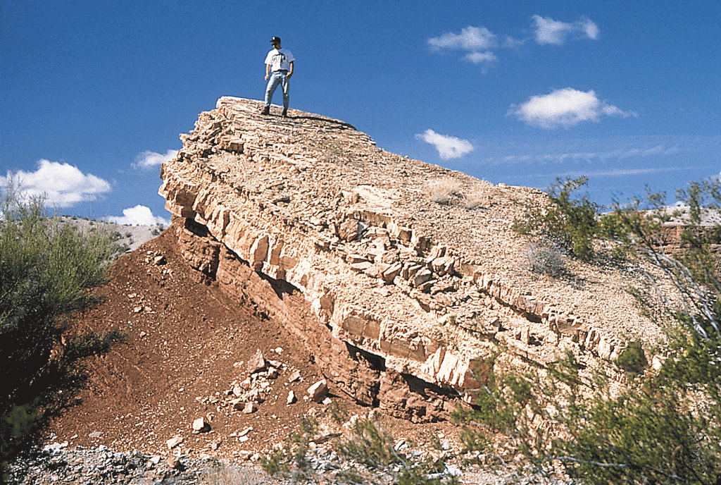
Fig. 11.05b
Stephen Marshak

Slide 14
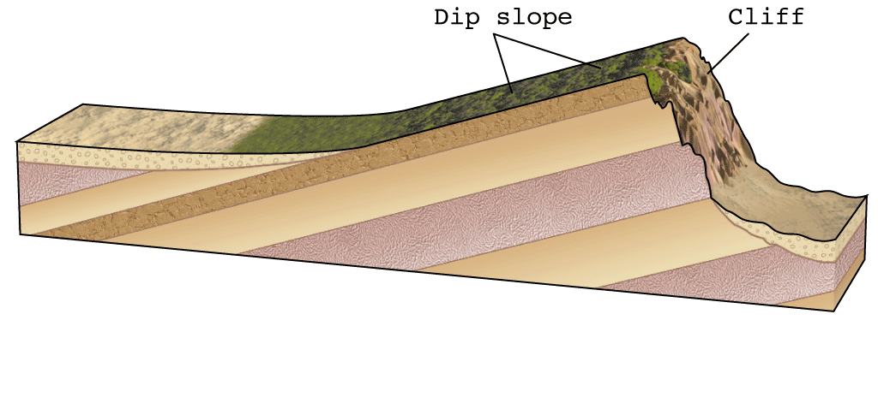
Fig. 11.29
W. W. Norton

Slide 15
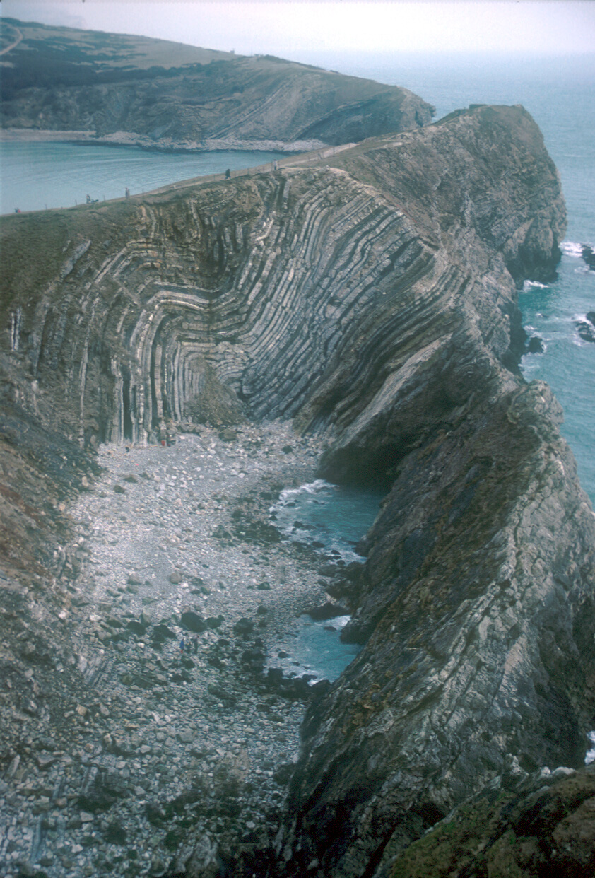
Copyright © Frank Eckardt 2002
Notes:
Sedimentary rocks, England.

Slide 16
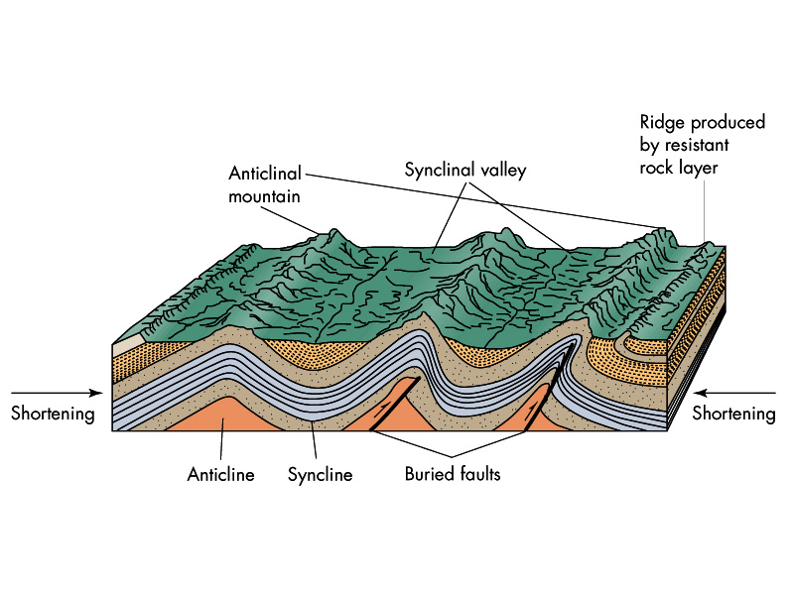

Slide 17
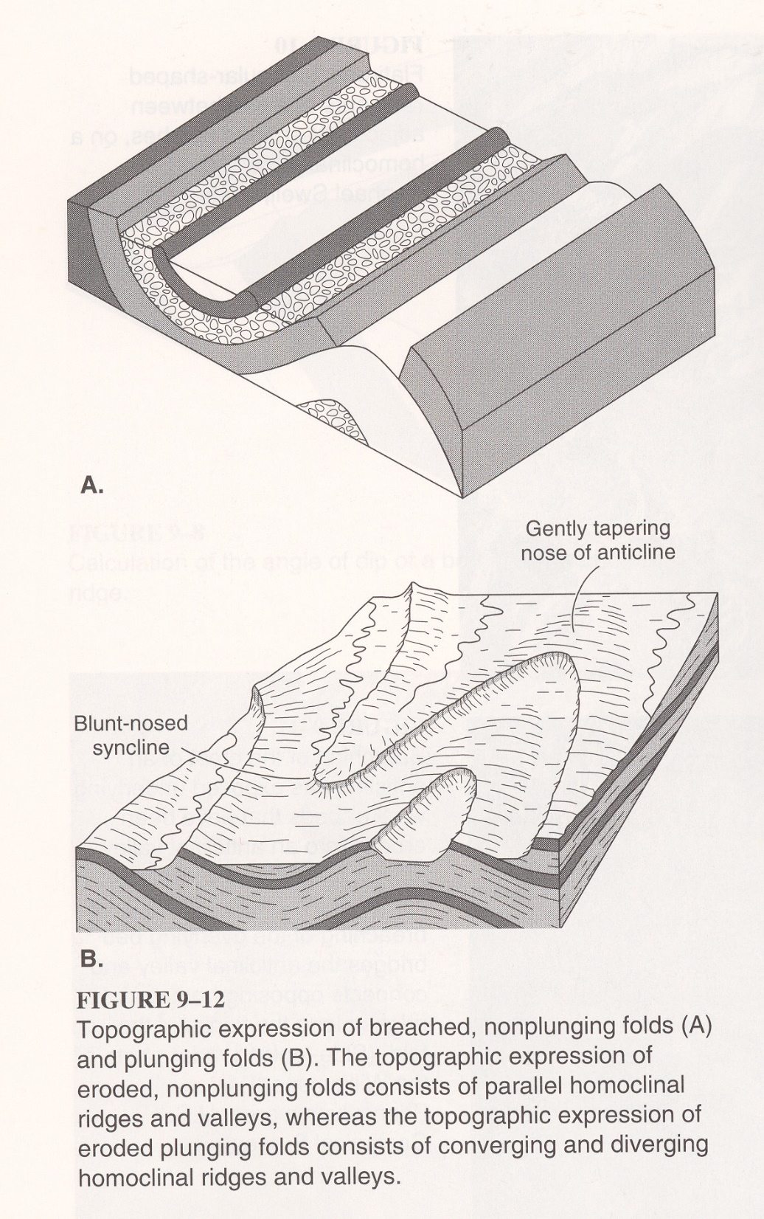

Slide 18
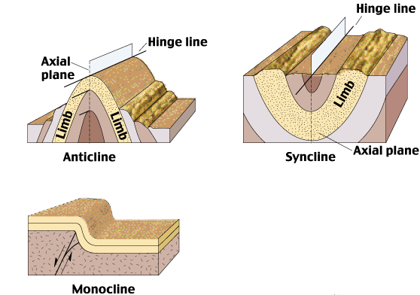
Fig. 11.19abc
W. W. Norton

Slide 19
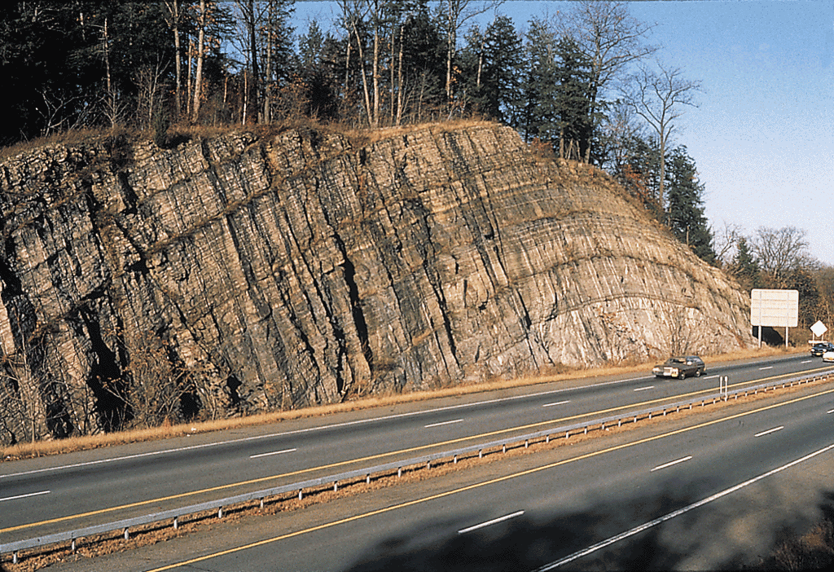
Fig. 11.20a
Stephen Marshak

Slide 20
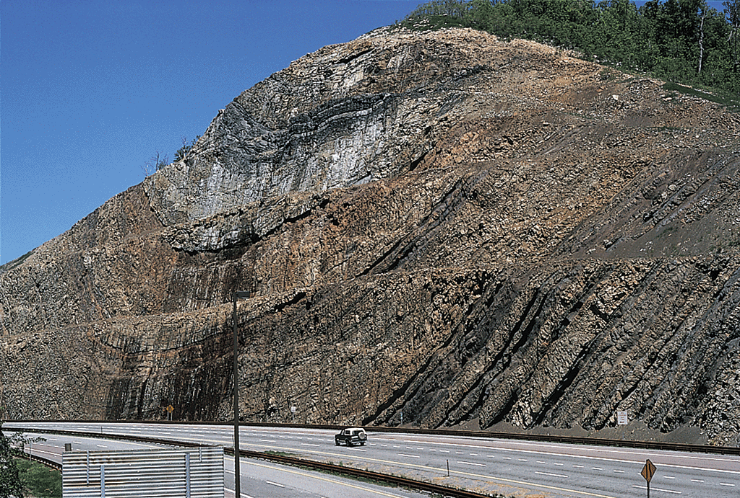
Fig. 11.20b
Stephen Marshak

Slide 21
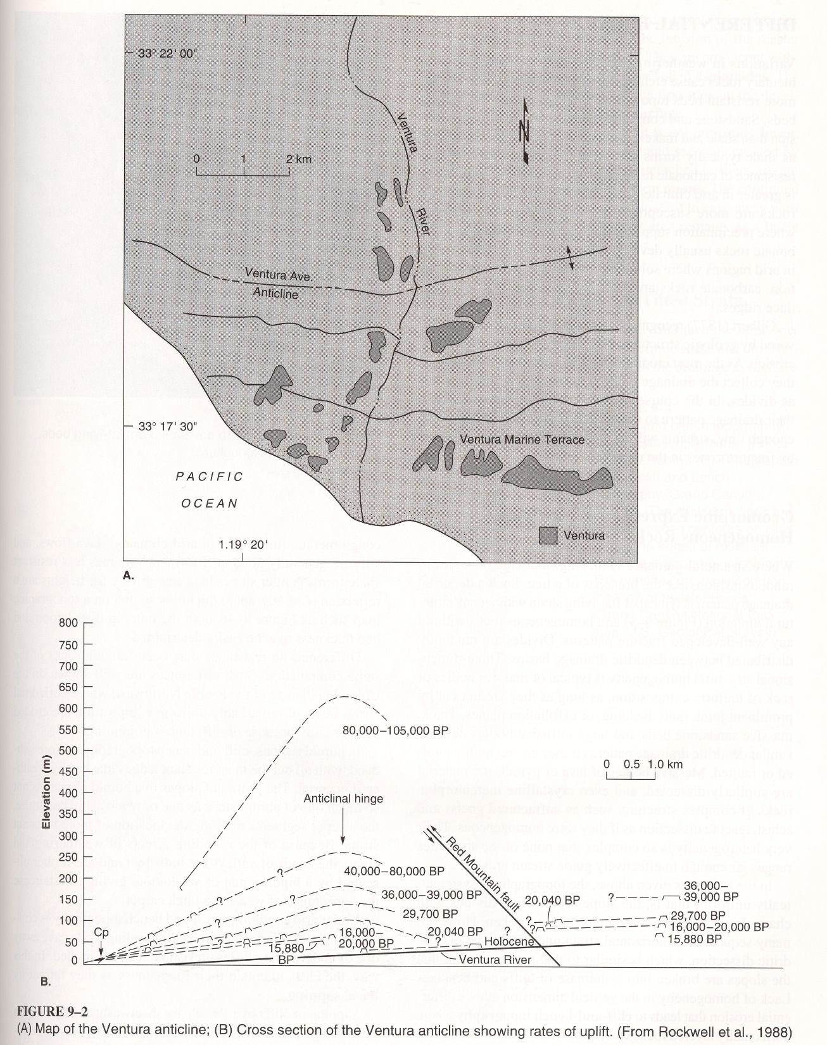

Slide 22
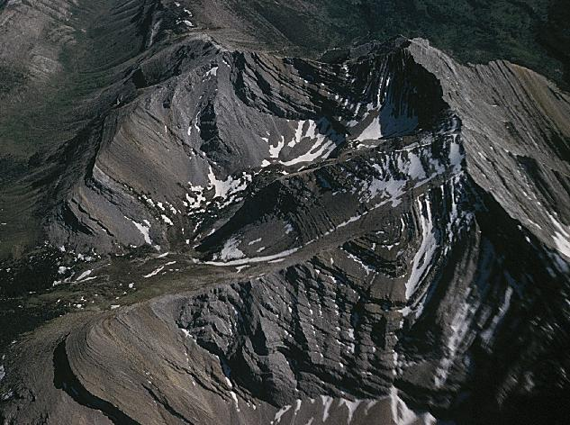
Copyright © Charles Higgins 2002
Notes:
Synclinal drag fold beneath a thrust fault in the glaciated east front of the Canadian Rockies north of Glacier National Park.

Slide 23
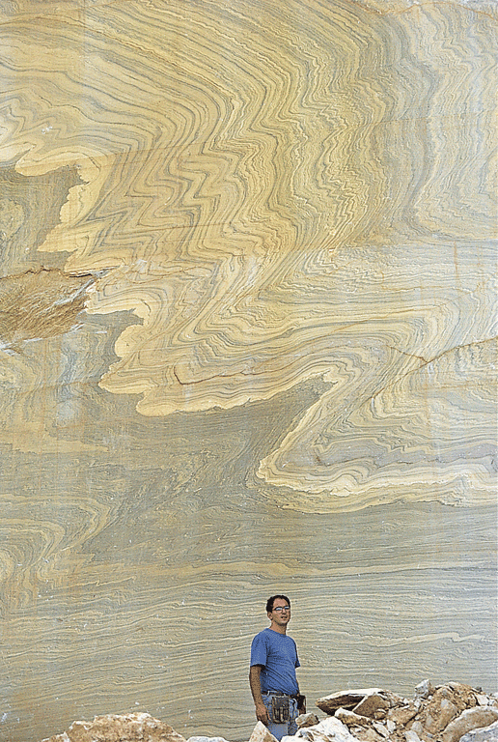
Fig. 11.08d
Stephen Marshak

Slide 24
Copyright © Alan Arbogast 2002
Notes:
Hogback ridge somewhere in the Great Basin.

Slide 25
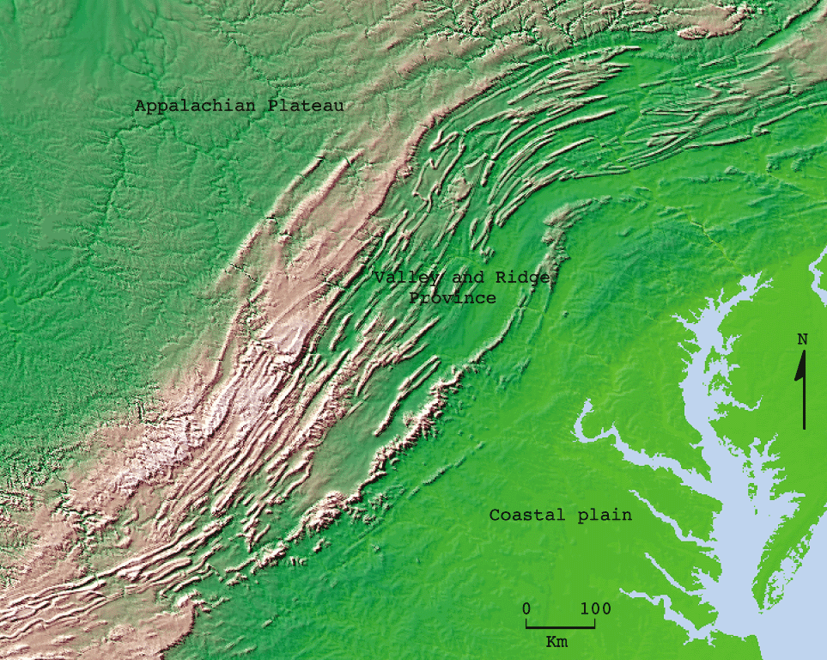
Fig. 11.37
W. W. Norton

Slide 26
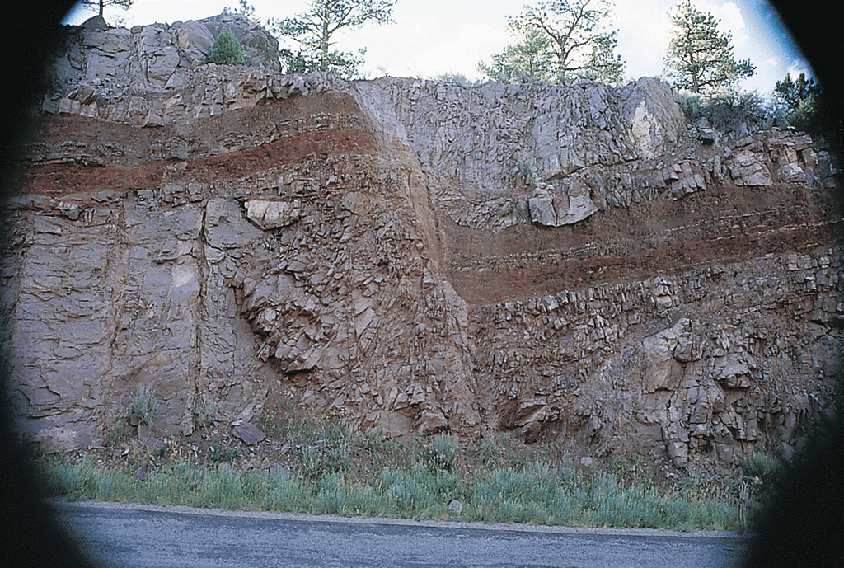
Fig. 11.13b
Stephen Marshak

Slide 27
Fig. 11.14a
W. W. Norton

Slide 28
Fig. 11.14b
W. W. Norton

Slide 29
Fig. 11.14cd
W. W. Norton

Slide 30
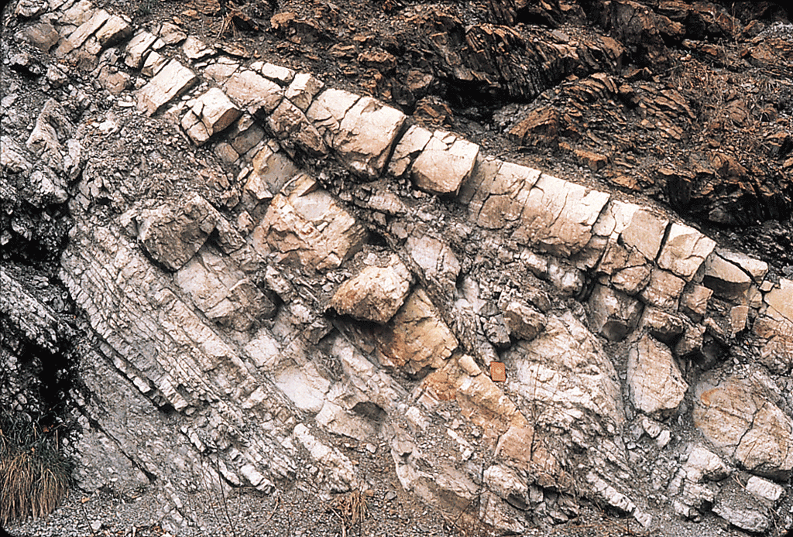
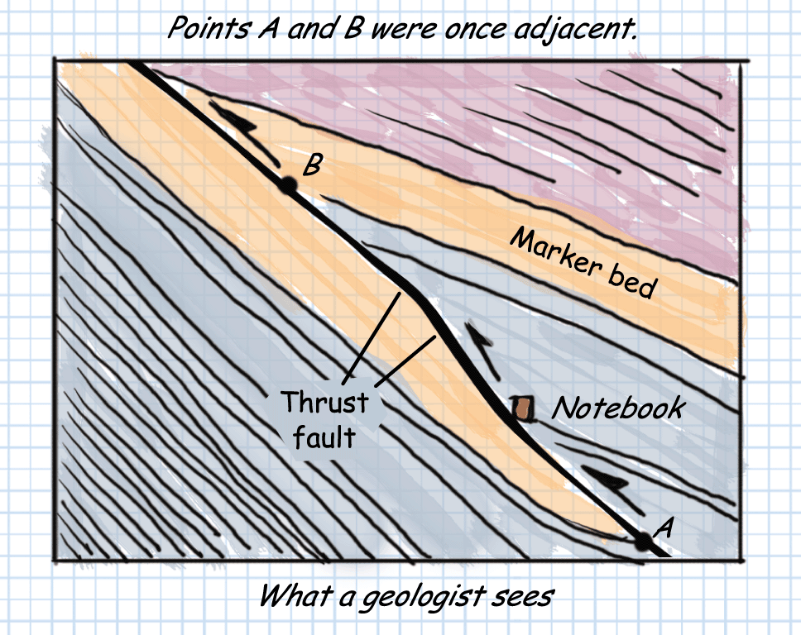
Fig. 11.15ab
Photo © Stephen Marshak W. W. Norton

Slide 31
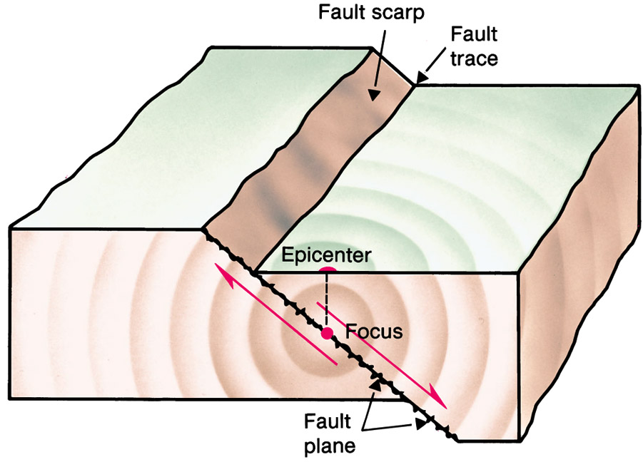

Slide 32
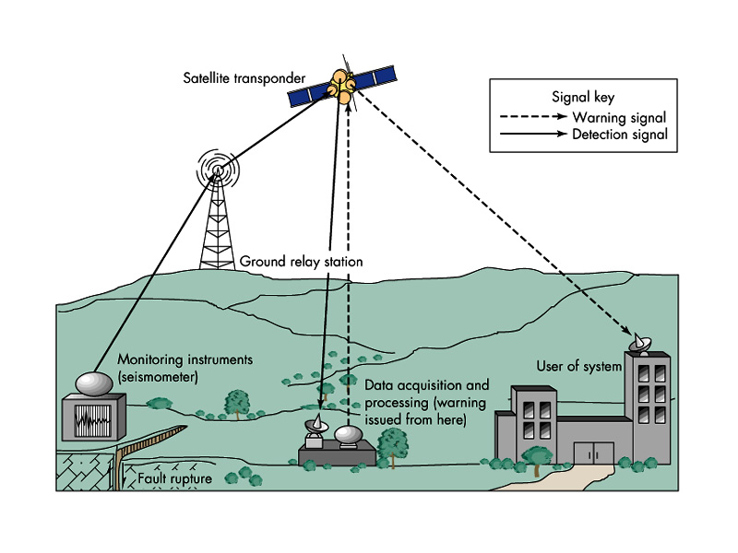

Slide 33
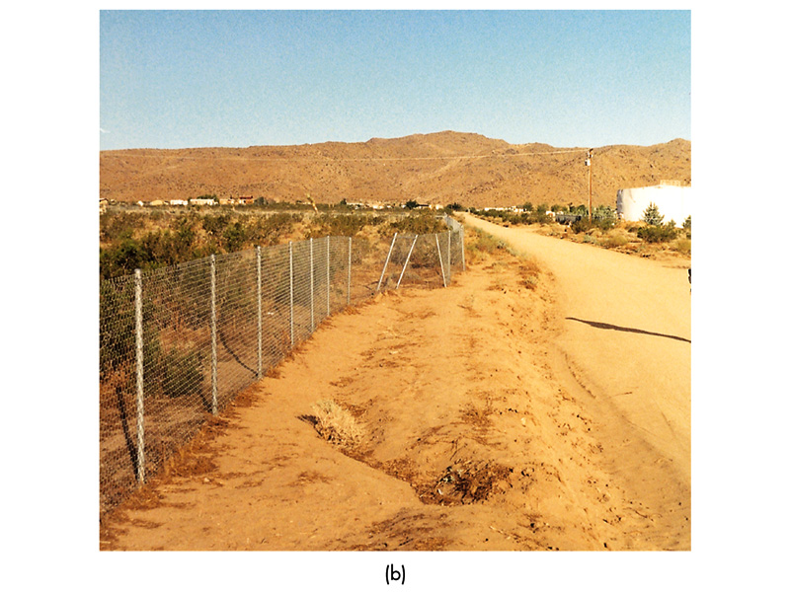

Slide 34
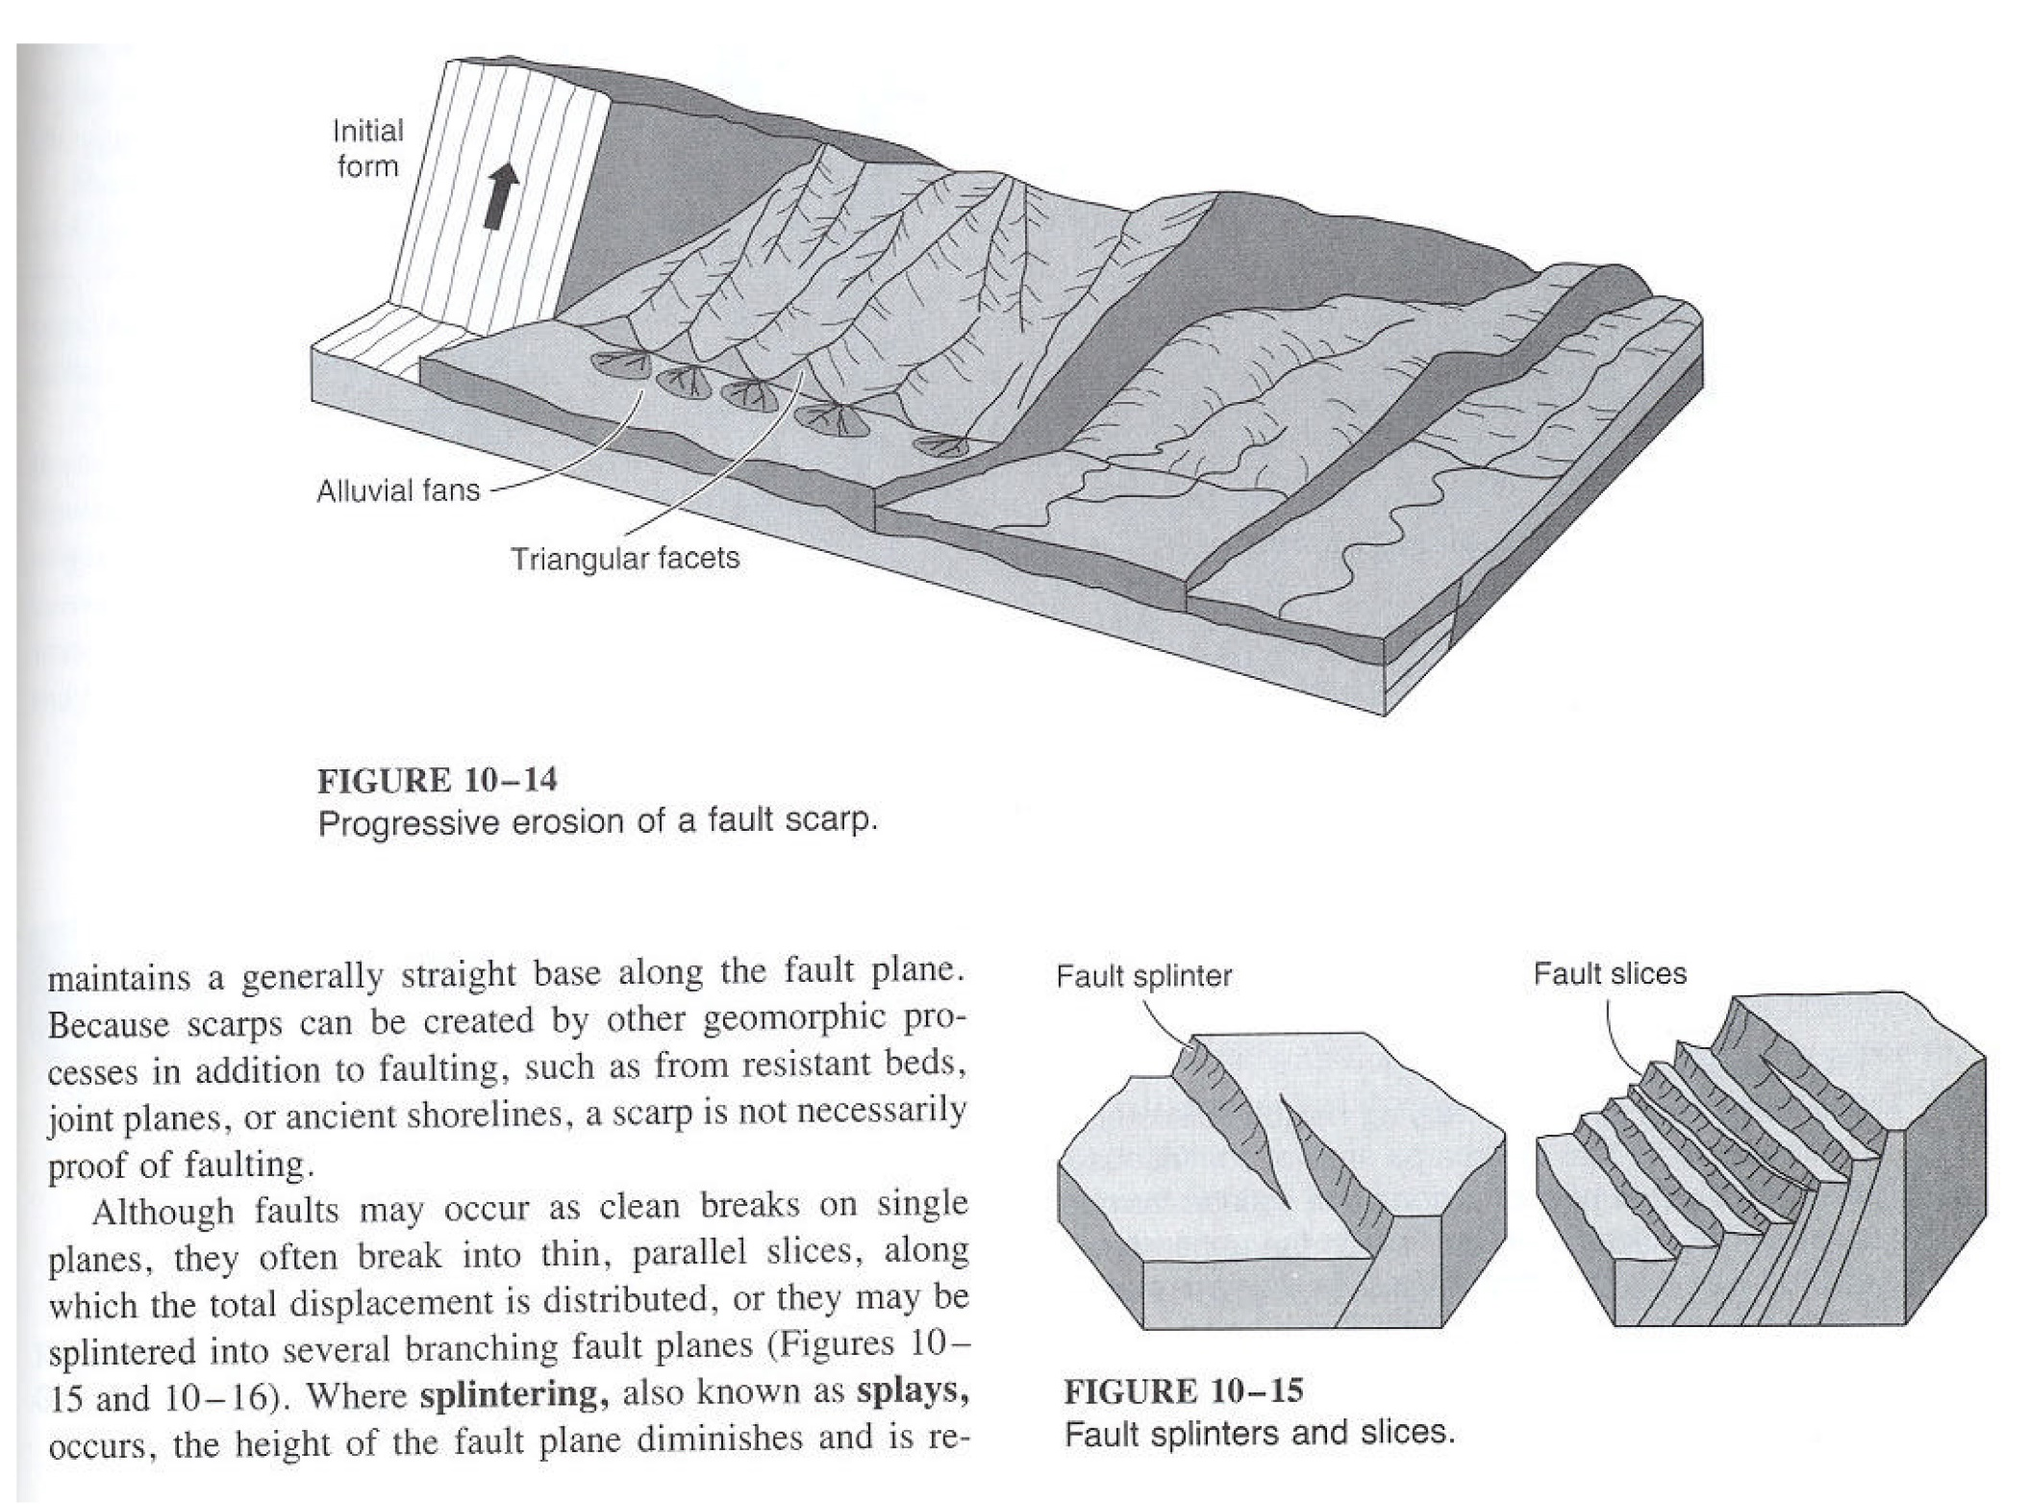

Slide 35
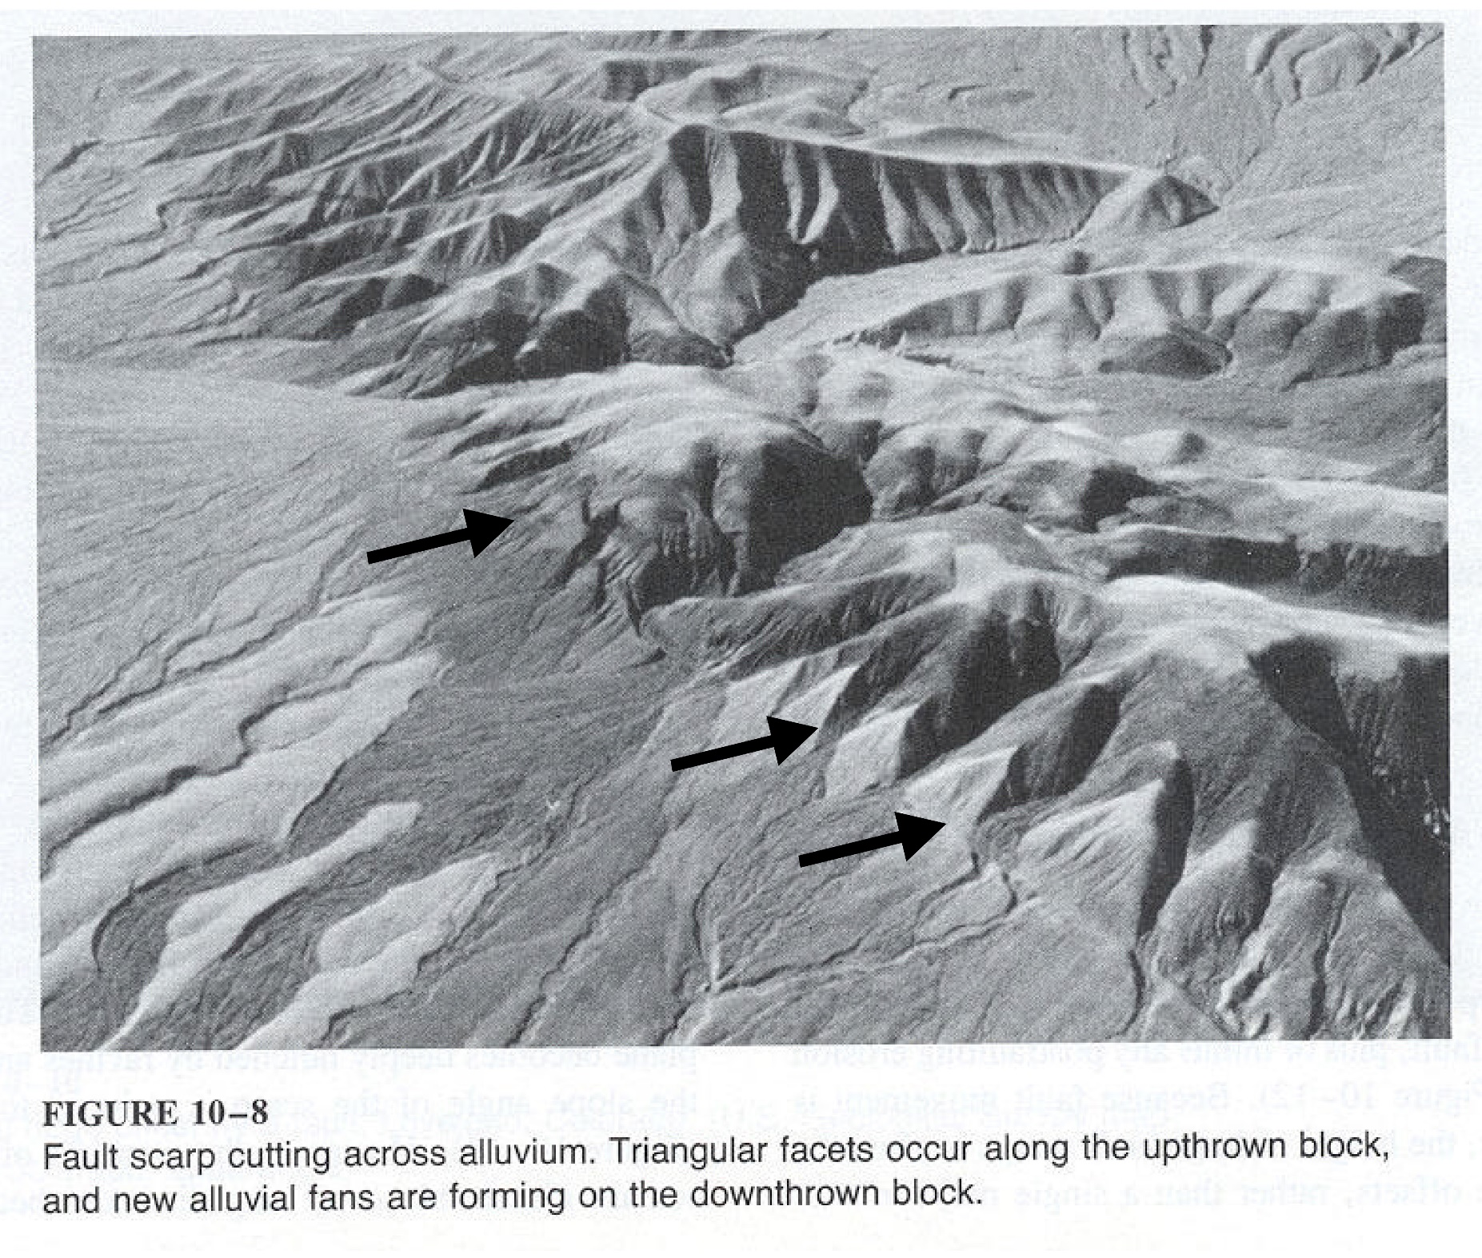

Slide 36
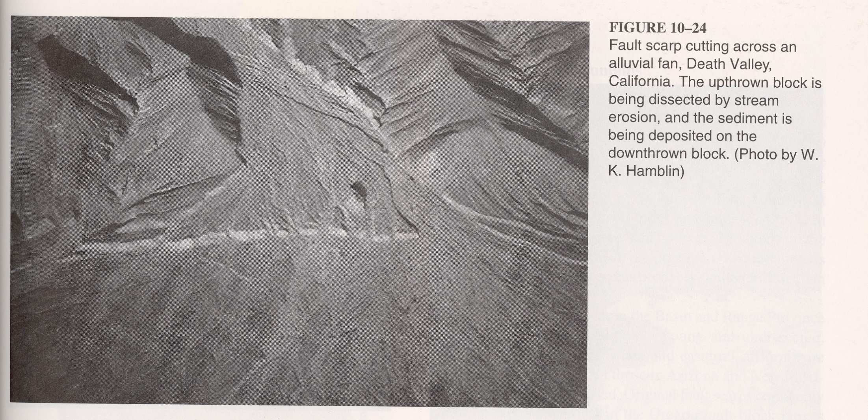

Slide 37
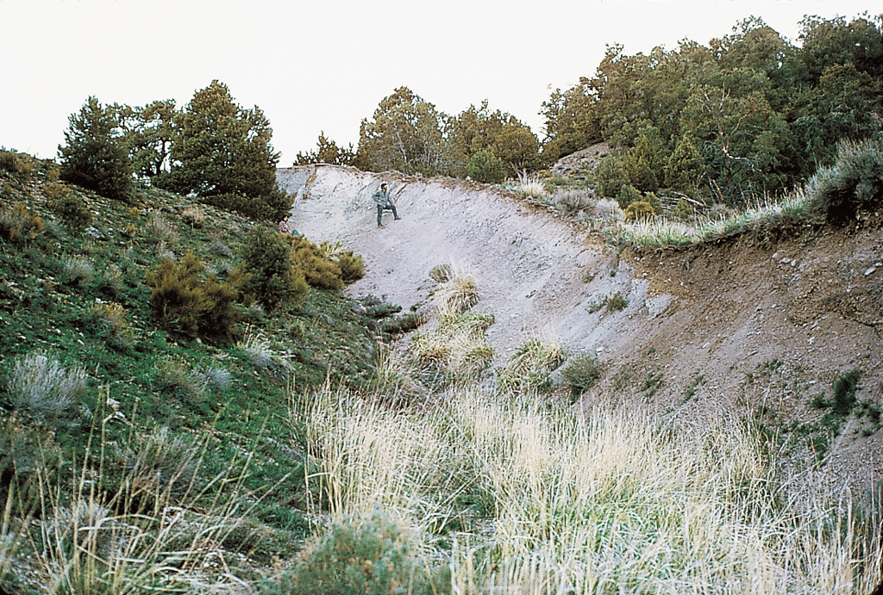
Fig. 11.15c
Stephen Marshak

Slide 38
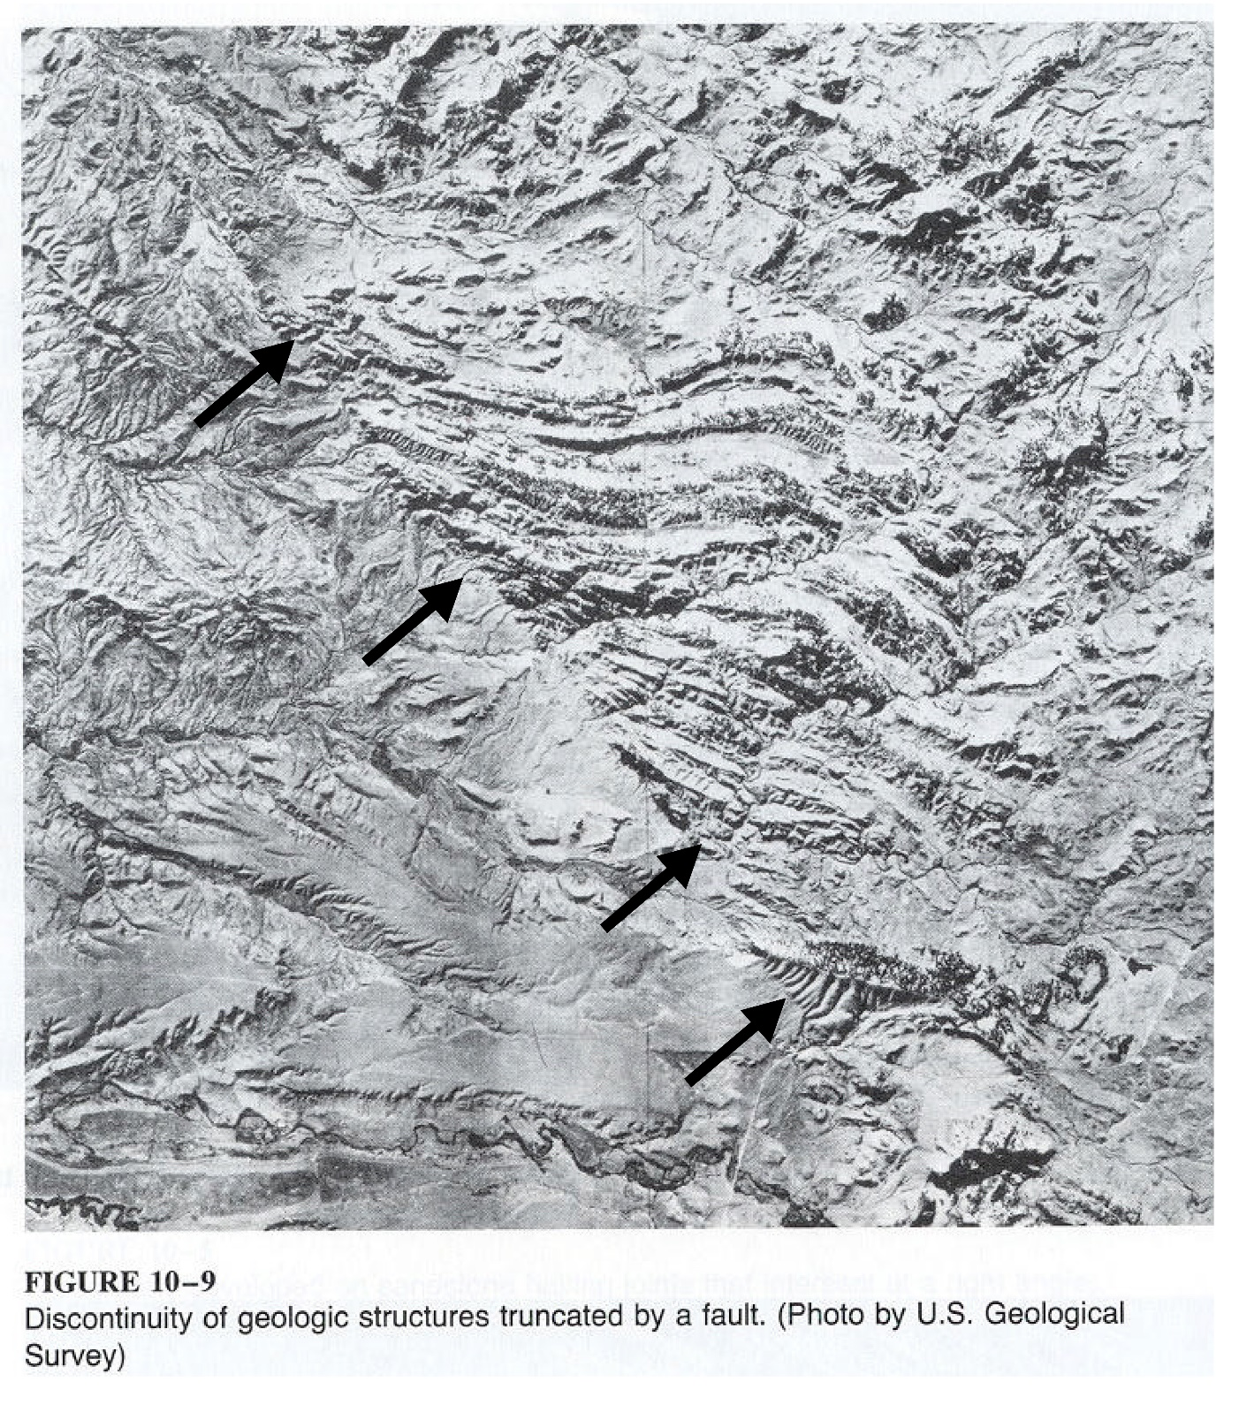

Slide 39
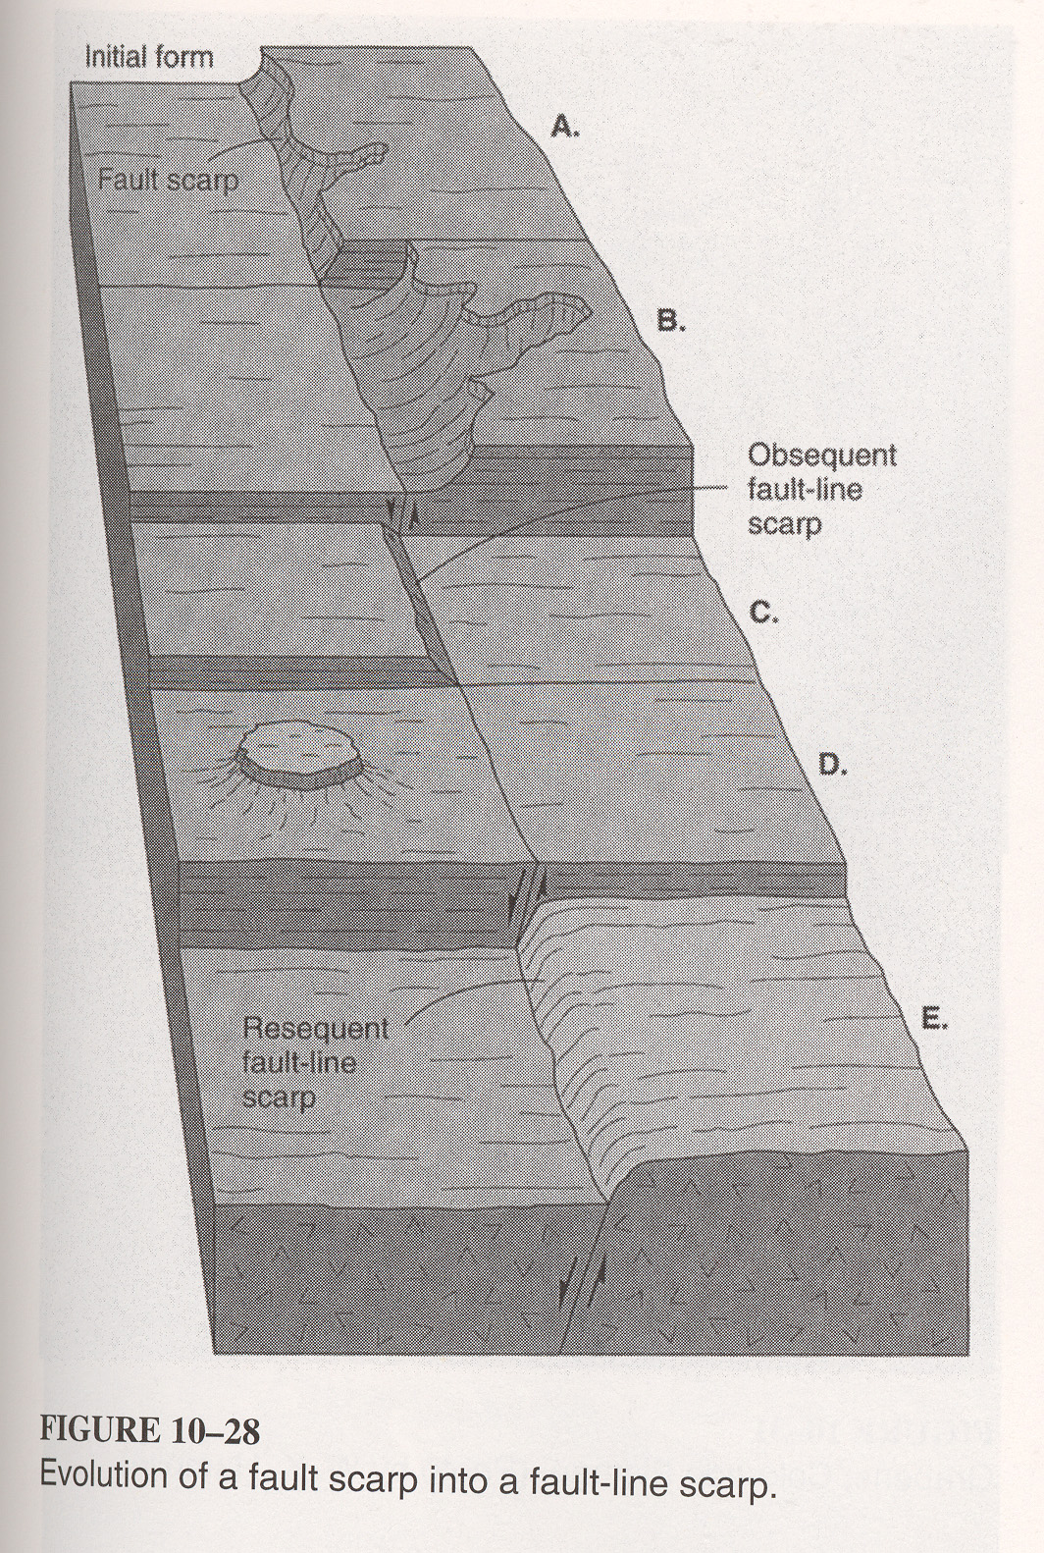

Slide 40
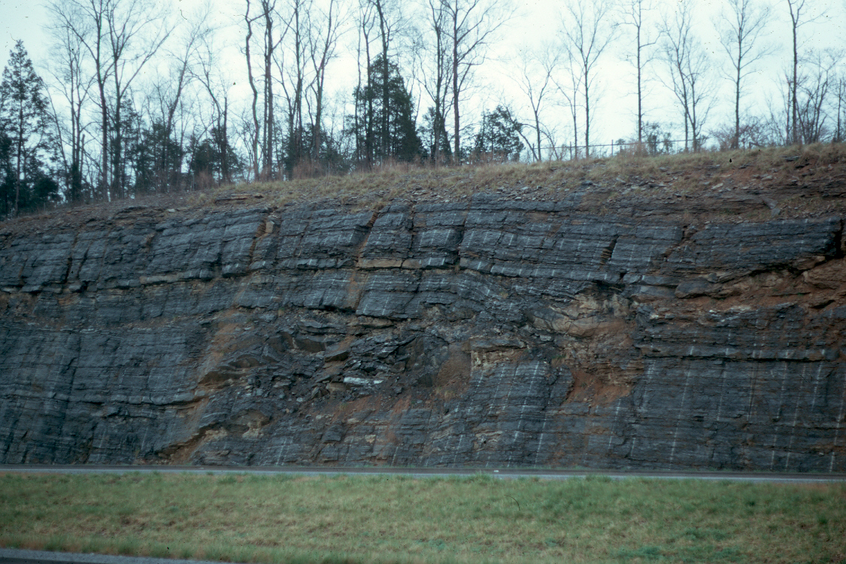
Copyright © Richard Kesel 2002
Notes:
Overthrust fault in limestone, western Pennsylvania.

Slide 41
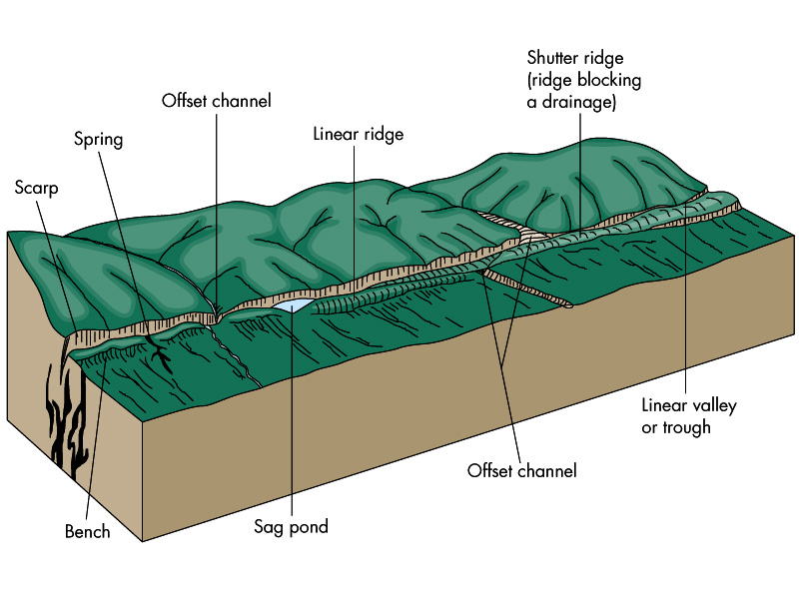

Slide 42
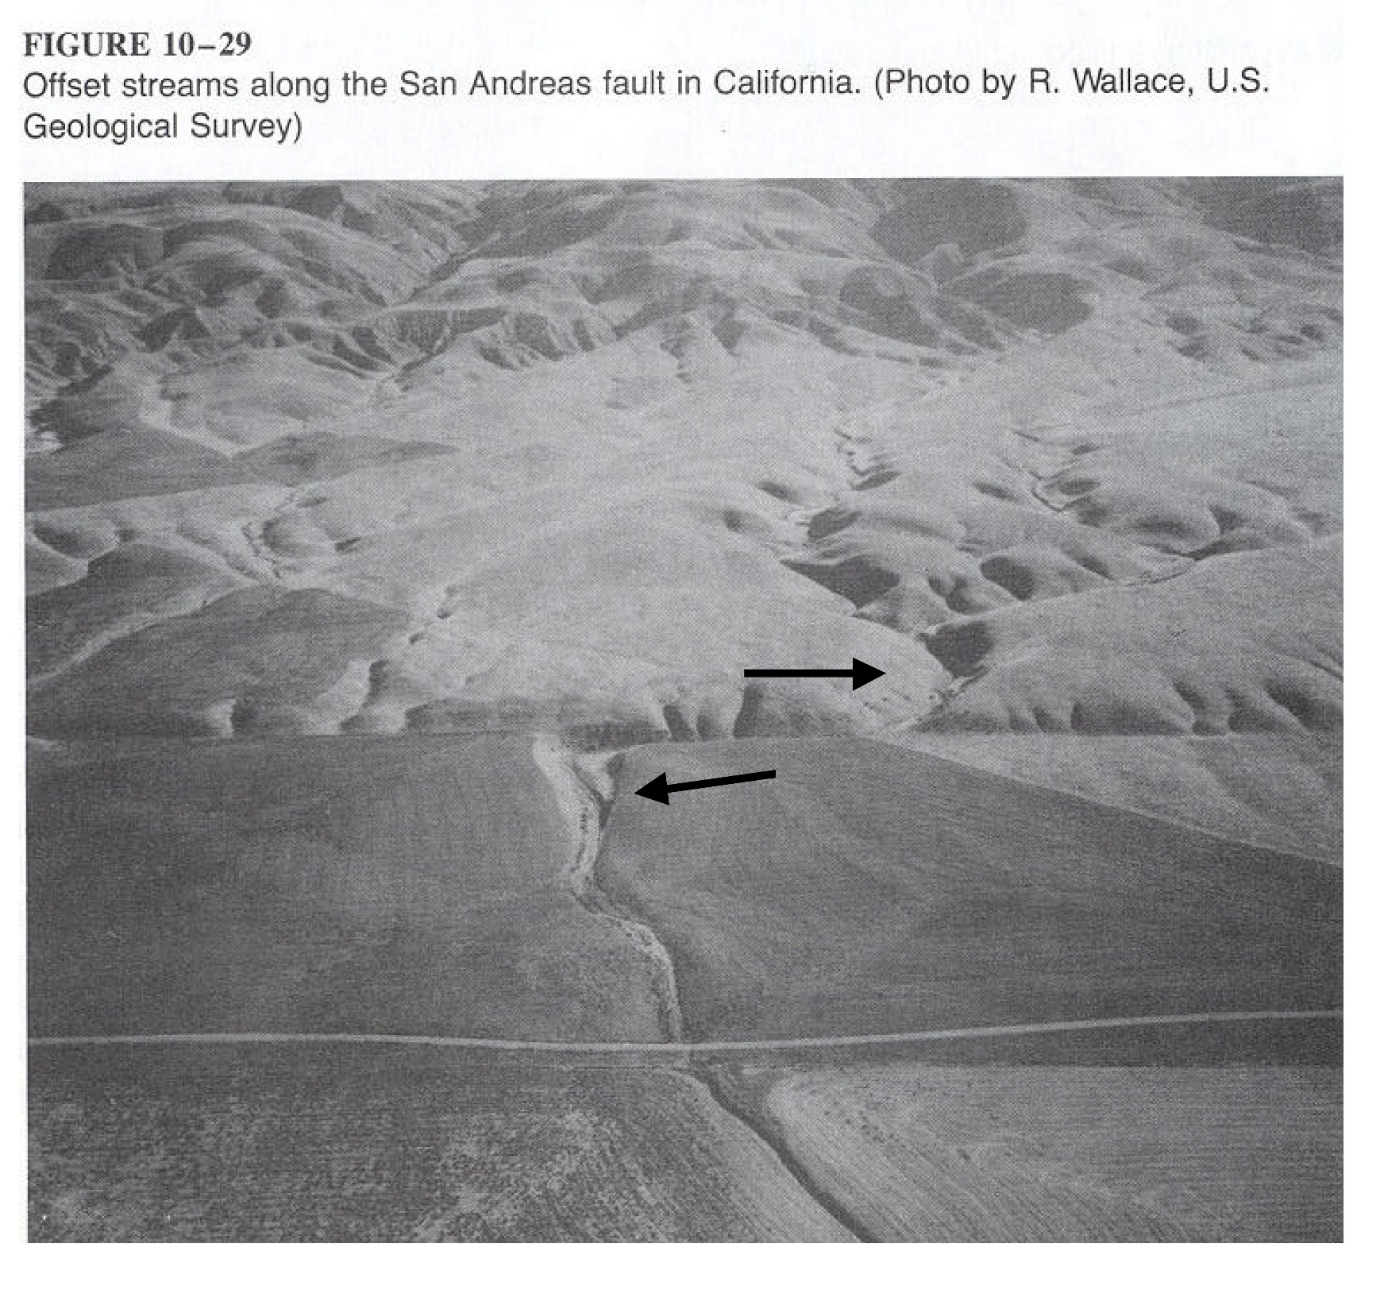

Slide 43
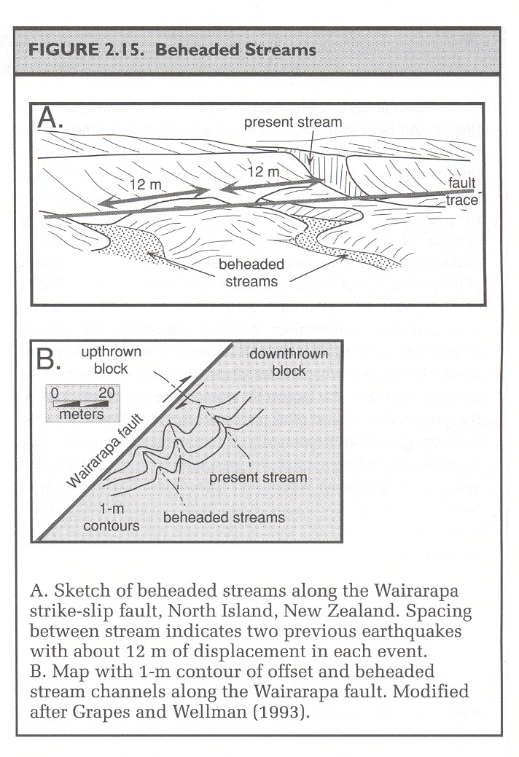

Slide 49
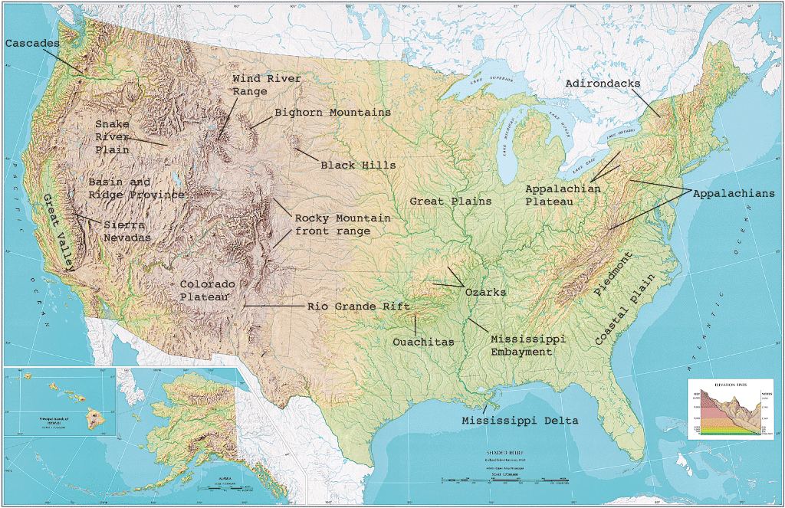
Fig. 11.34
U.S. Geological Survey

Slide 50
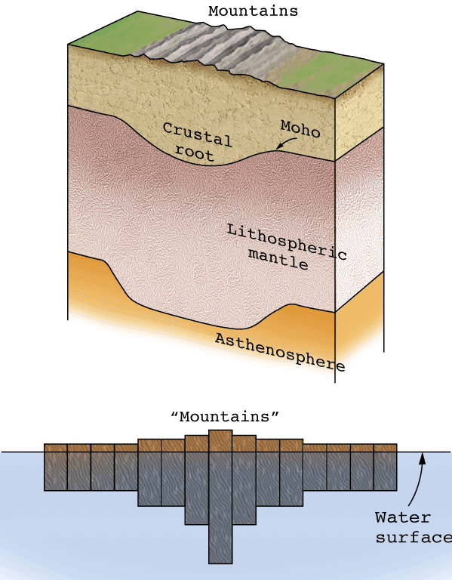
Fig. 11.27
W. W. Norton

Slide 51
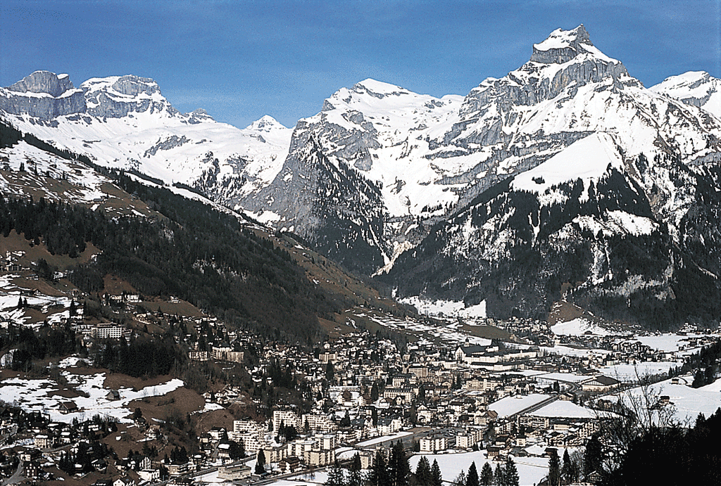
Fig. 11.28a
Stephen Marshak

Slide 52
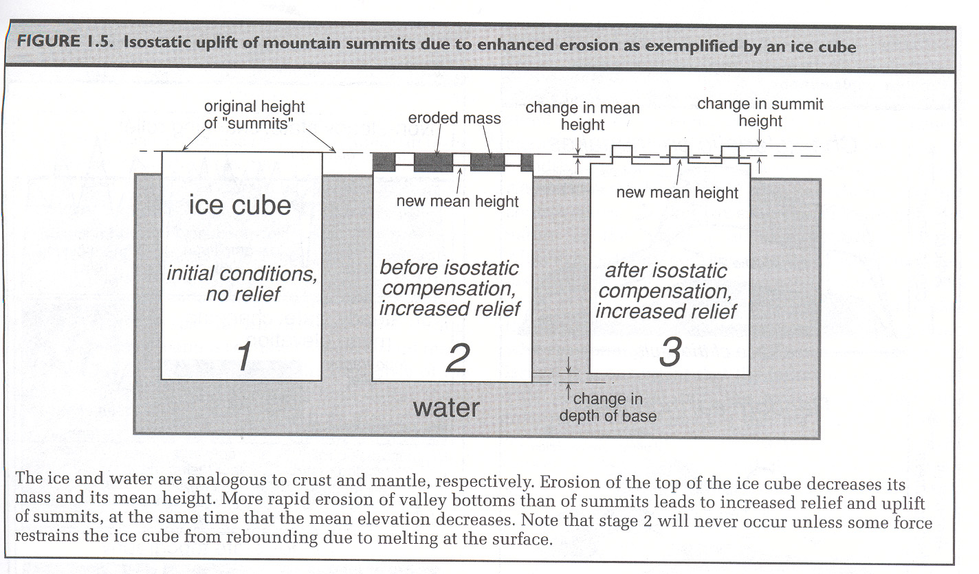

Slide 53
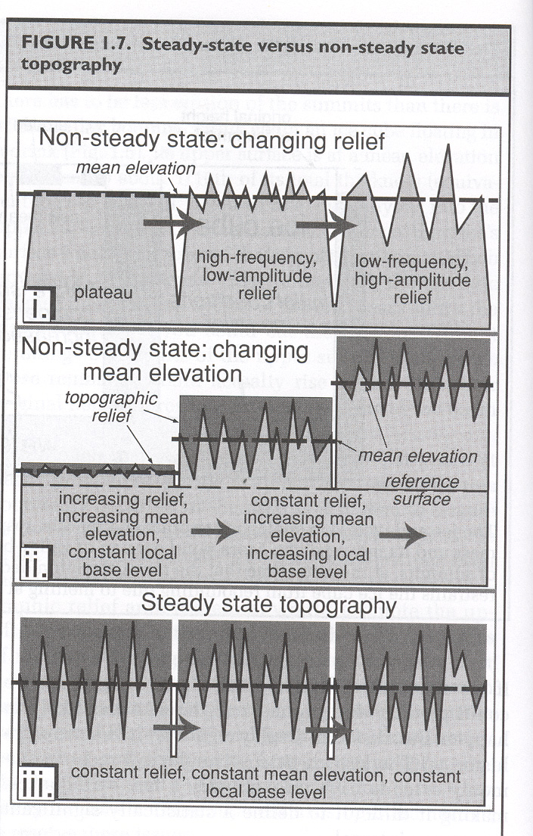

Slide 54
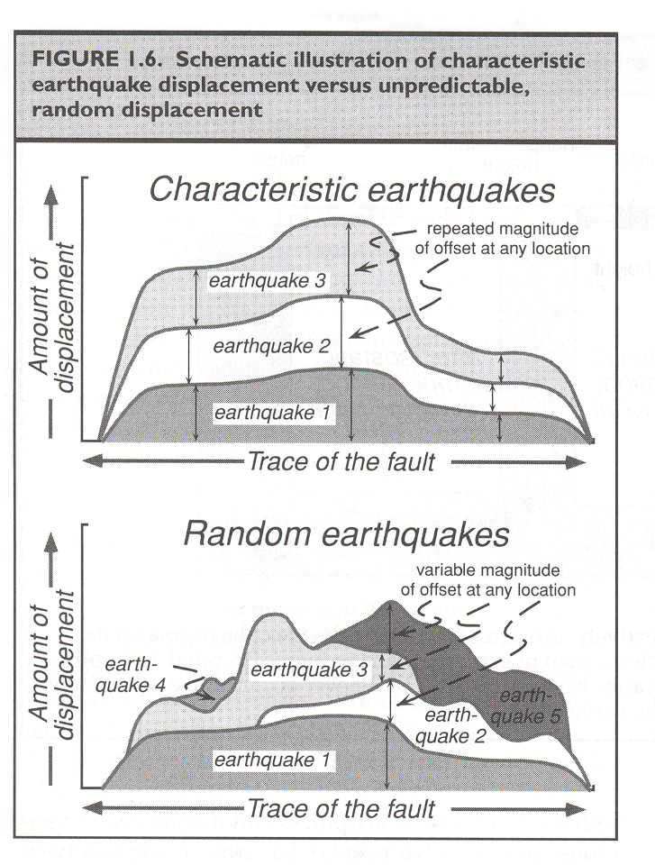

Slide 55
