Slide 1
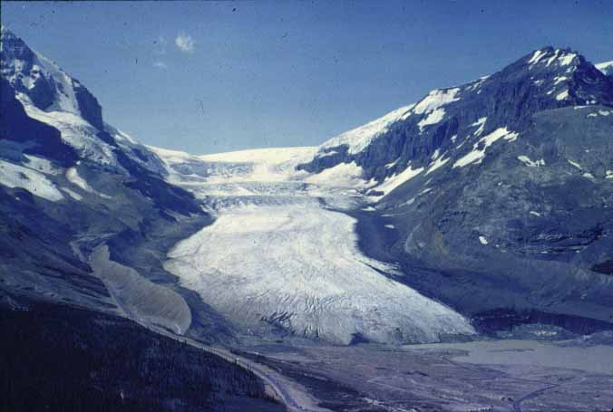

Slide 2
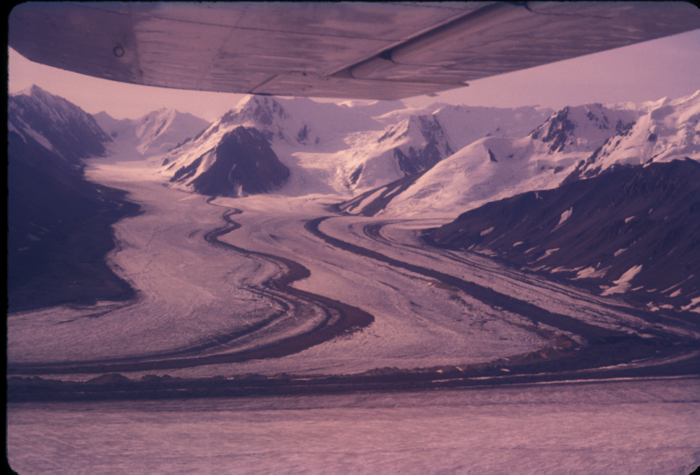
Copyright © Carol Harden 2002
Notes:
The south arm of the Kaskawulsh Glacier, Yukon Territory, Canada shows the joining of tributary valley glaciers and the location of medial moraines.

Slide 3
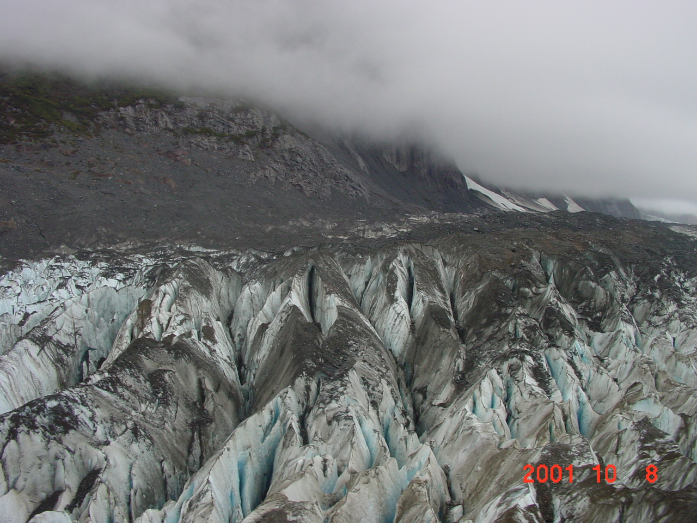
Copyright © Martin Geertsema 2002
Notes:
Crevasses on the Tulsequah glacier.

Slide 4
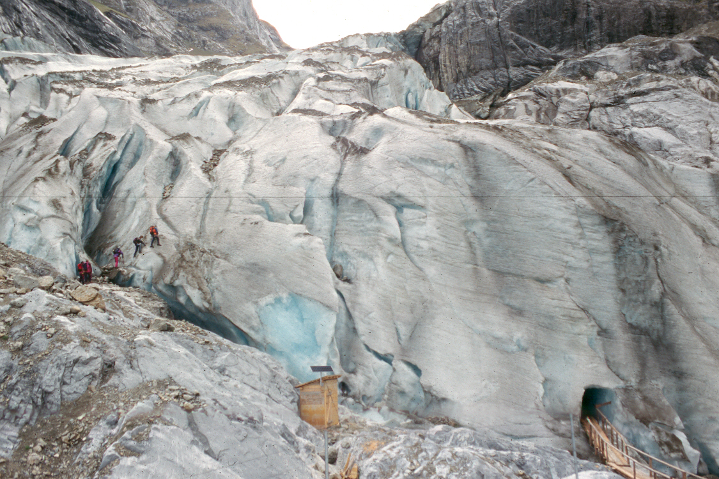
Copyright © Richard Kesel 2002
Notes:
Valley glacier in the Swiss Alps. The light blue is the base of the glacier (note cave).

Slide 5
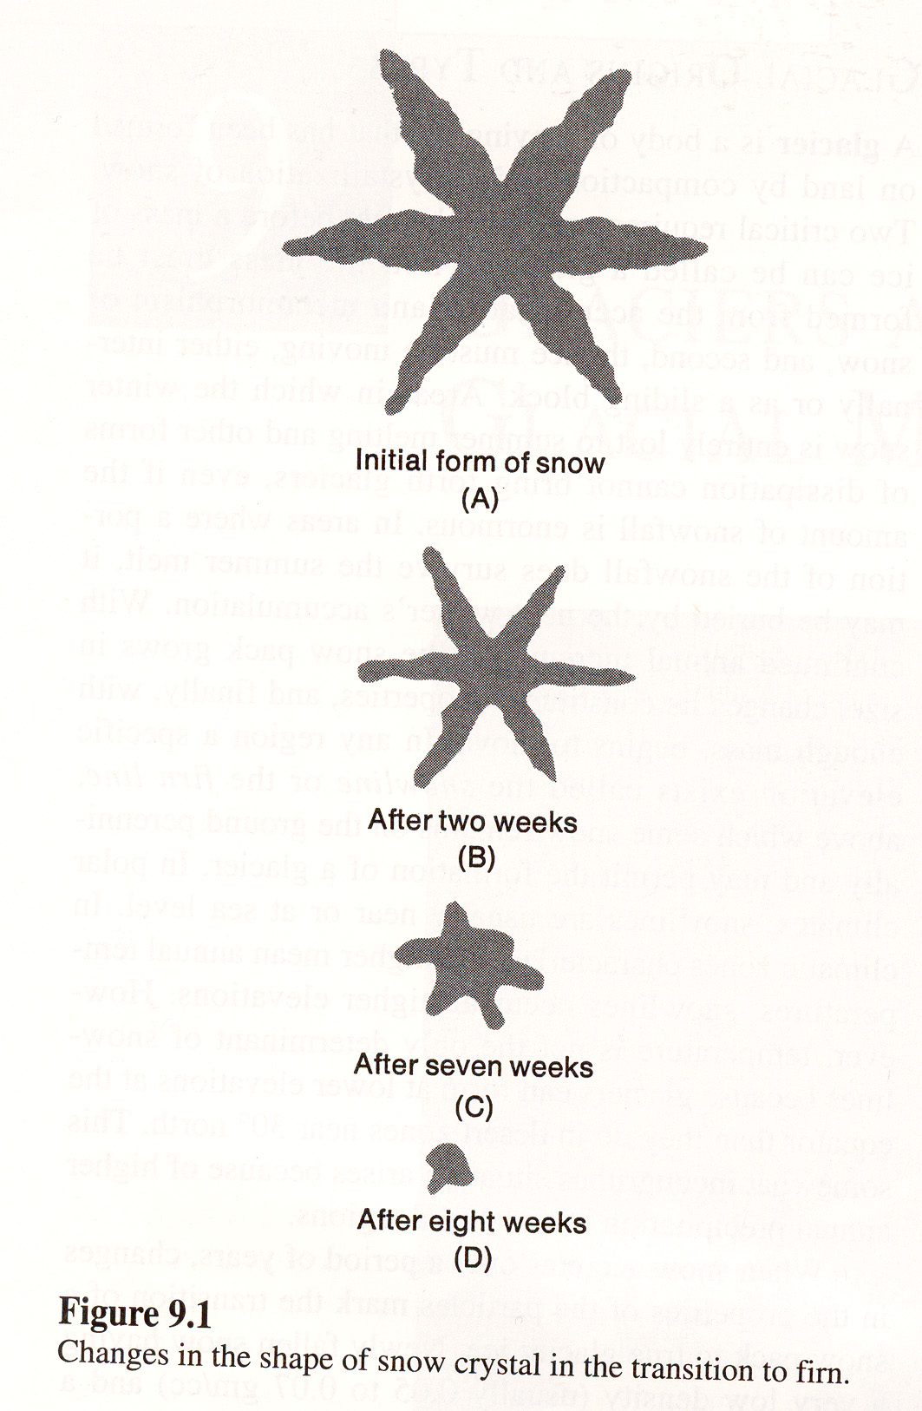

Slide 6
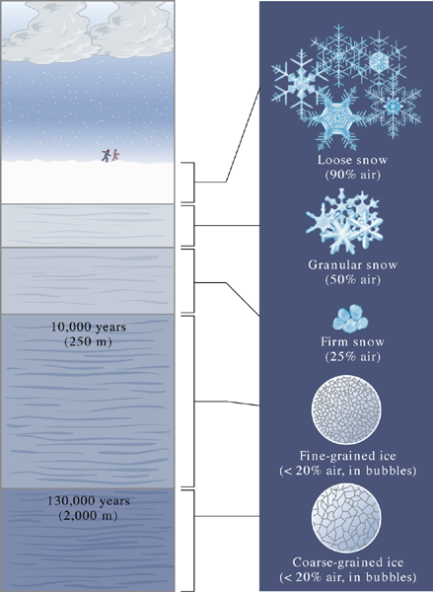
Fig. 22.07 a b
W. W. Norton

Slide 7
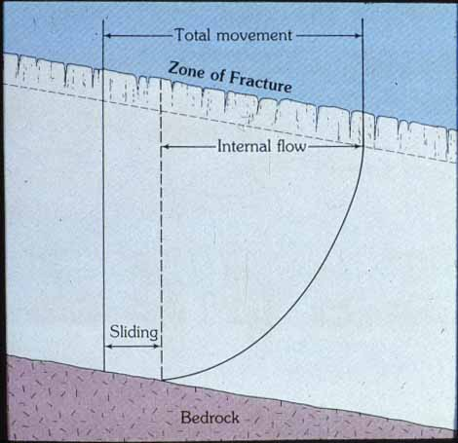

Slide 8
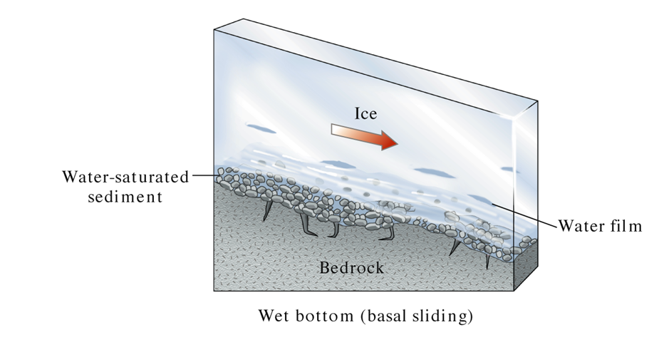
Fig. 22.08 a
W. W. Norton

Slide 9
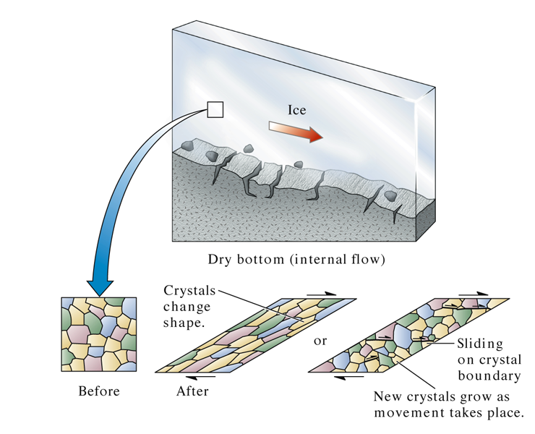
Fig. 22.08 b
W. W. Norton

Slide 10
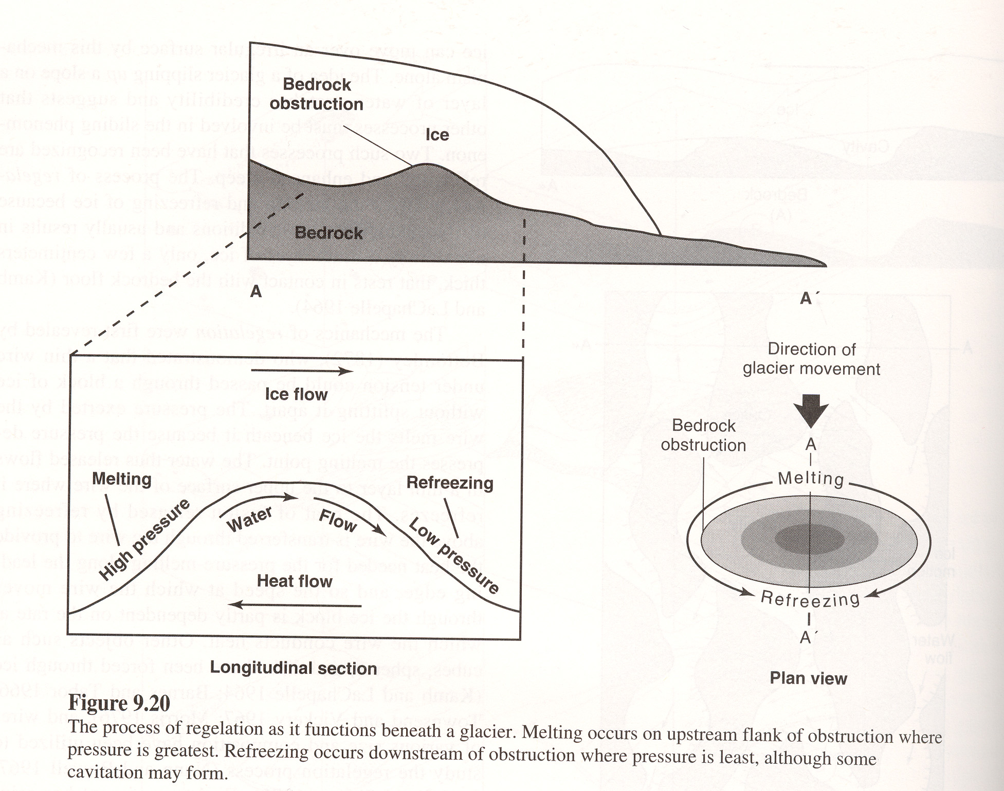

Slide 11
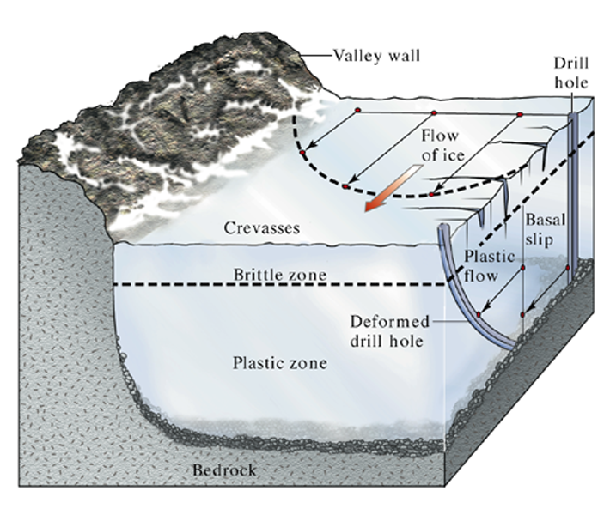
Fig. 22.10 a
W. W. Norton

Slide 12
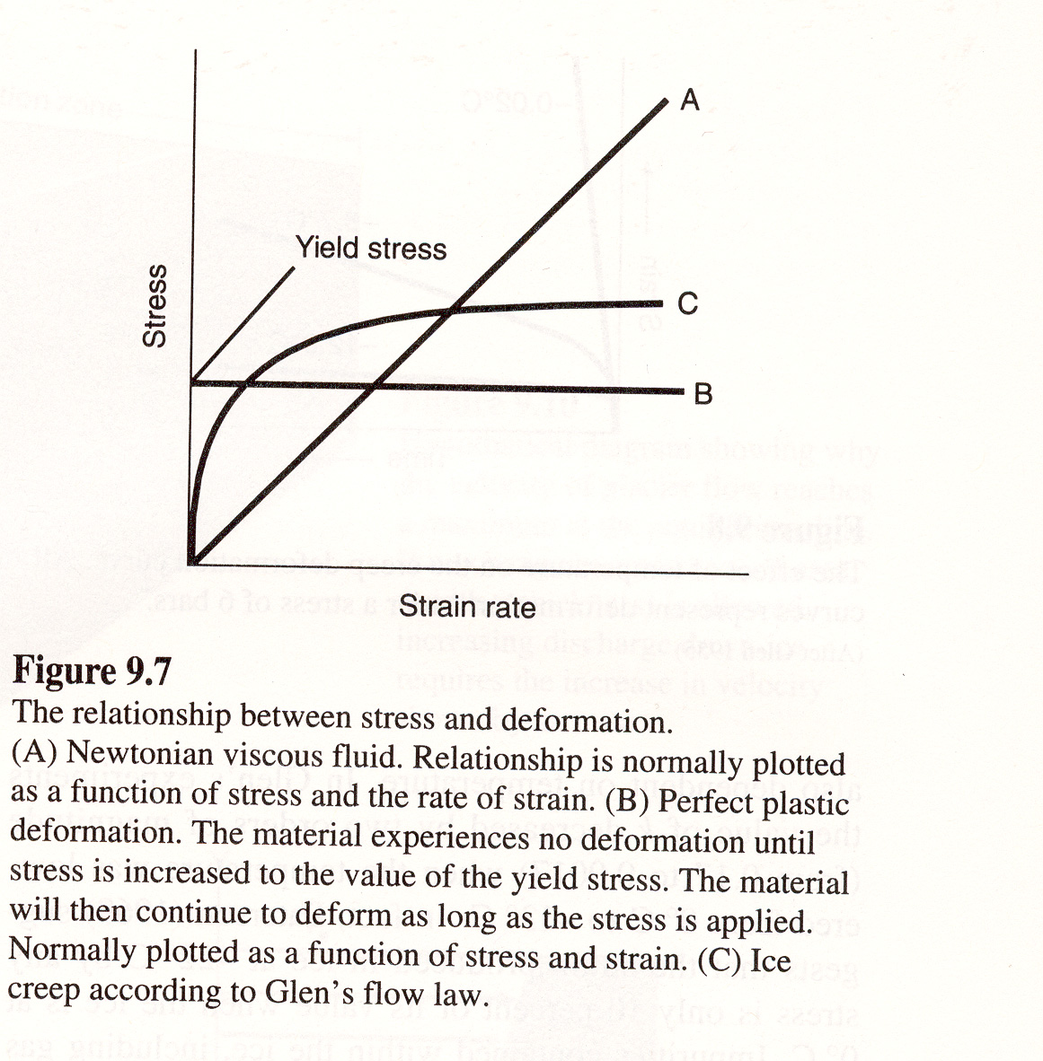

Slide 13
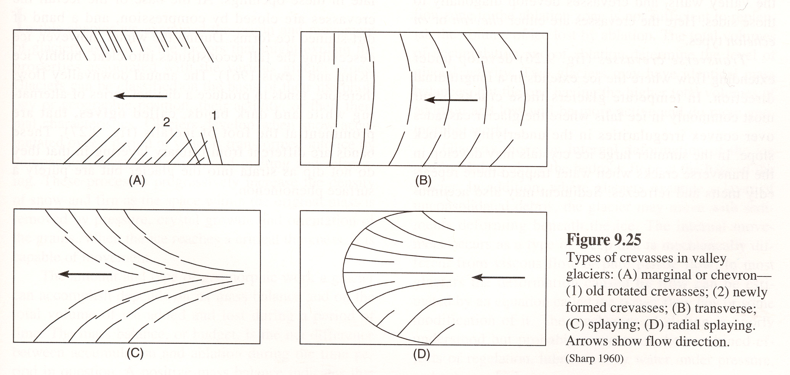

Slide 14
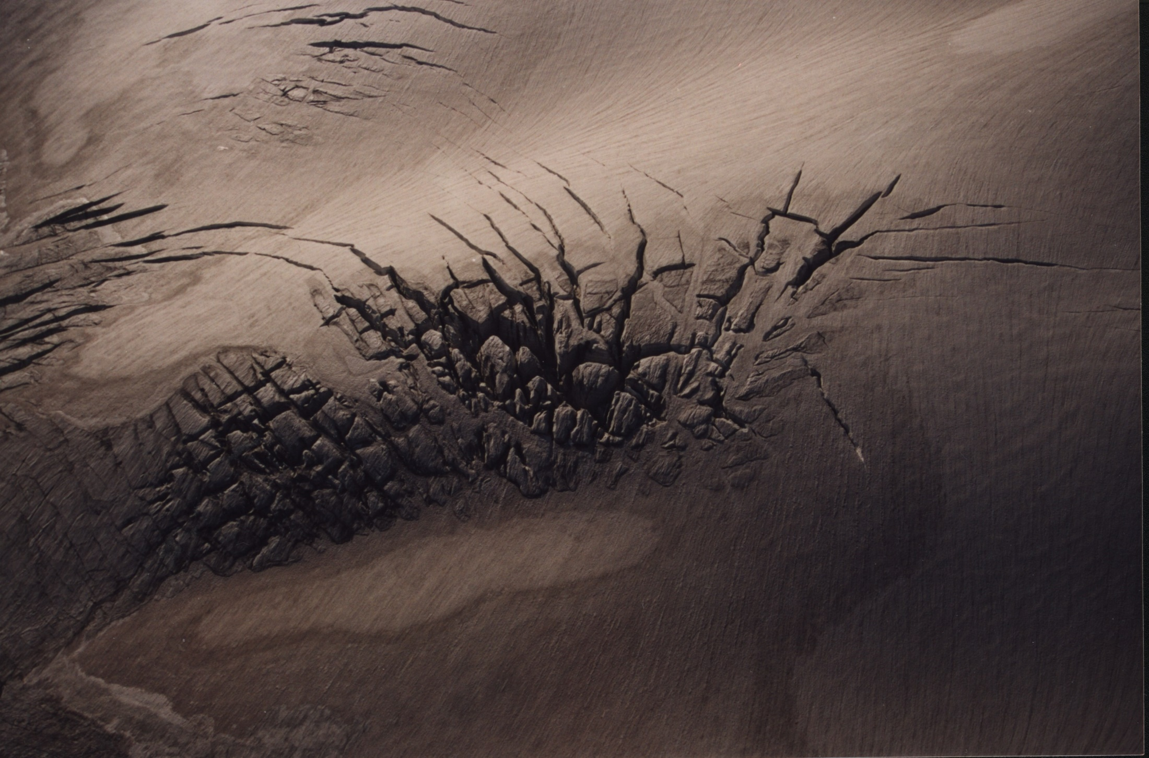
Copyright © Mariette Prent 2002
Notes:
Surficial crevasses – Kokanee Glacier, B.C.

Slide 15
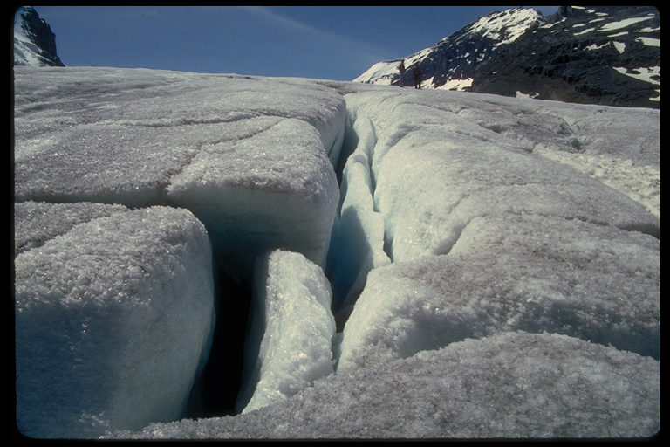
Crevasse

Slide 16
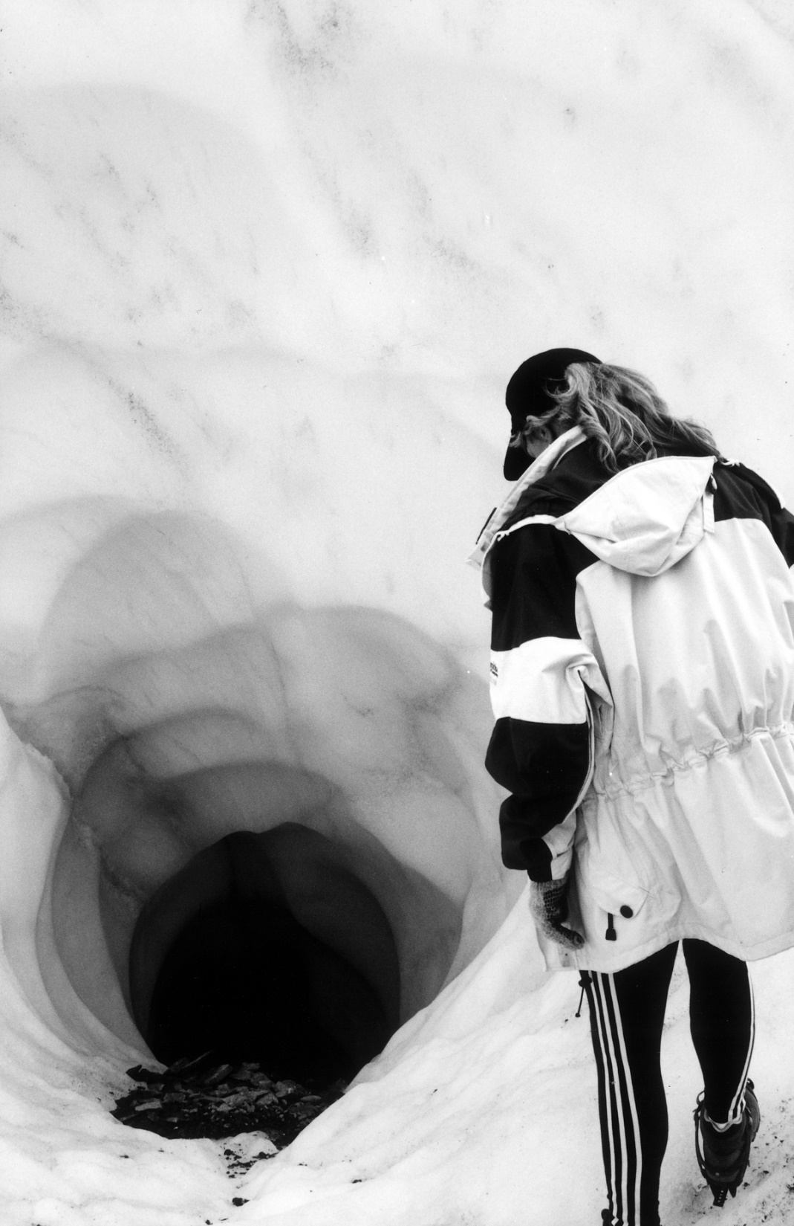
Copyright © Lynne Beatty 2002
Notes:
Moulin on the Matanuska Glacier near Palmer, Alaska.

Slide 17
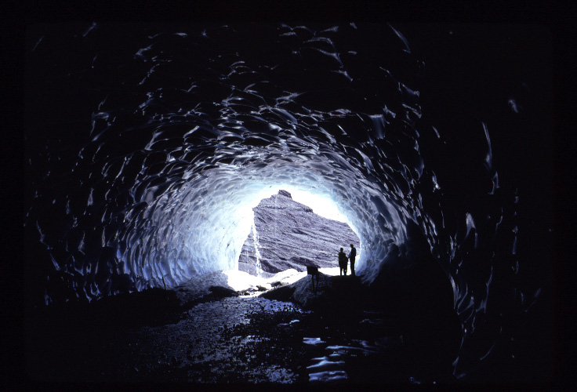

Slide 18
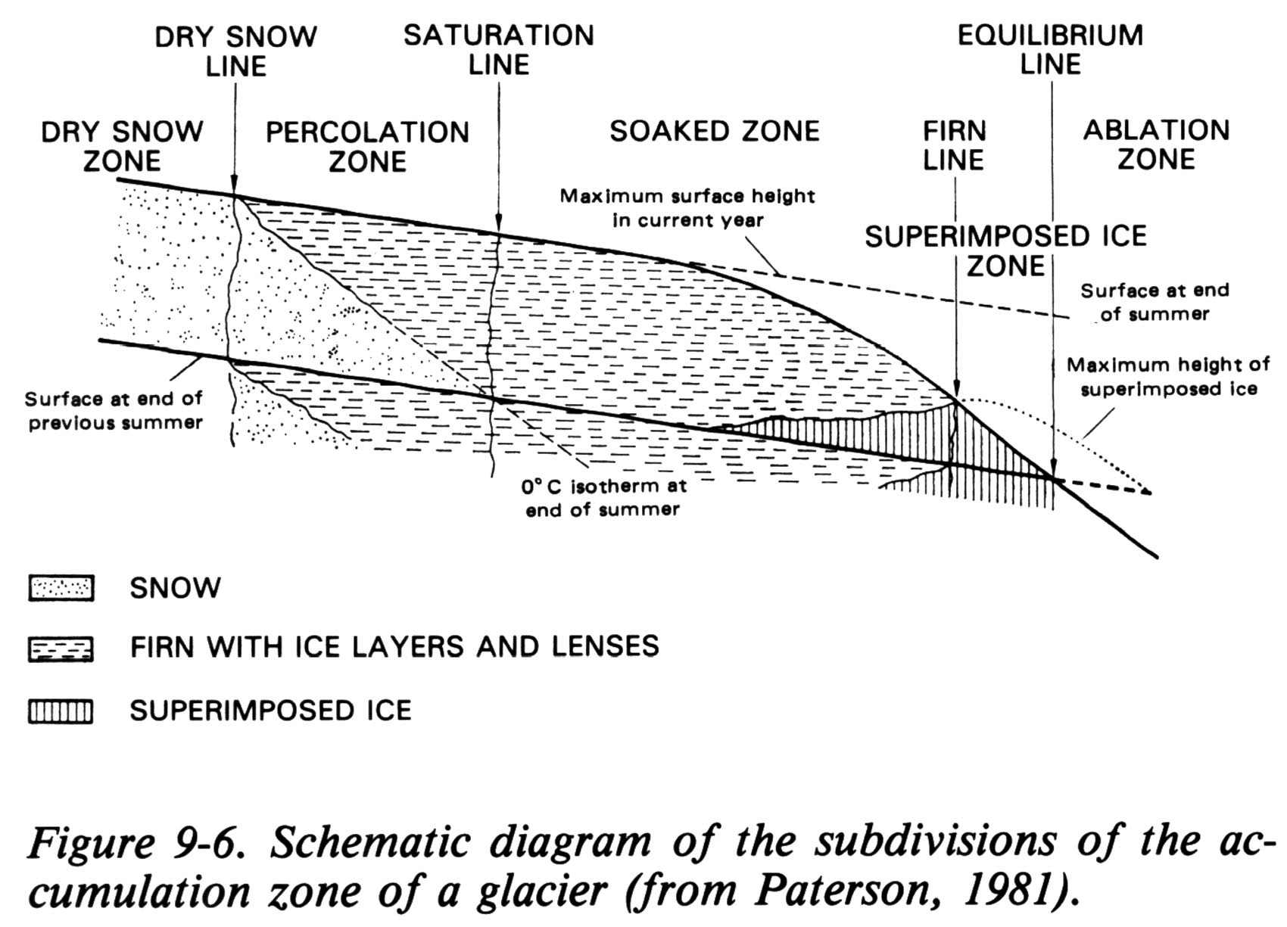

Slide 19
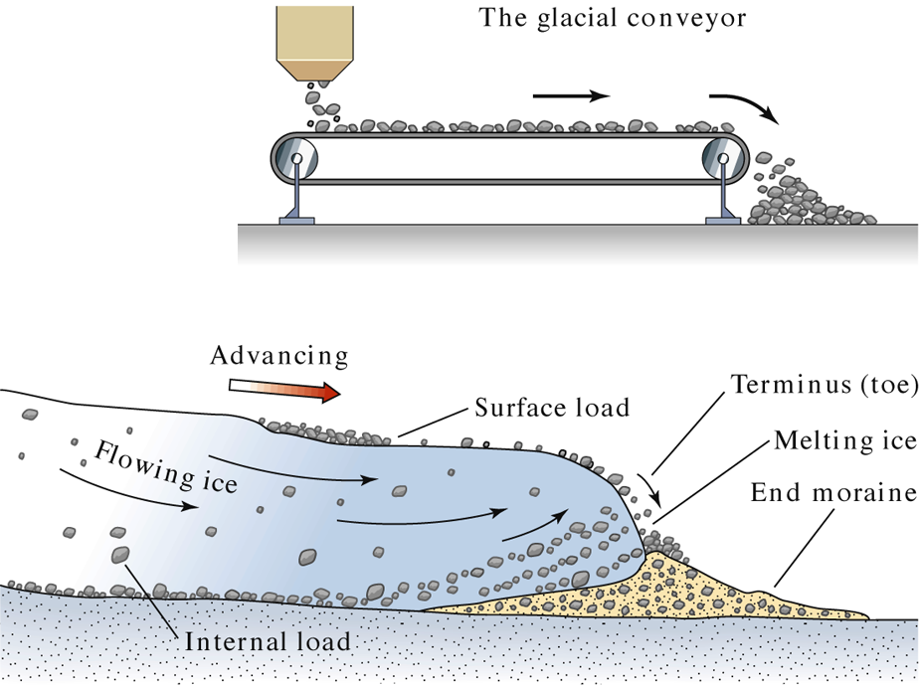
Fig. 22.21 c
W. W. Norton

Slide 20
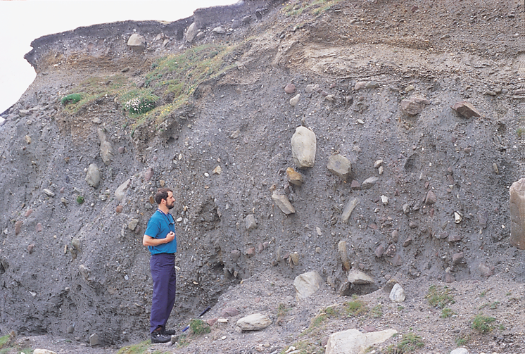
Fig. 22.22 a
Stephen Marshak

Slide 21
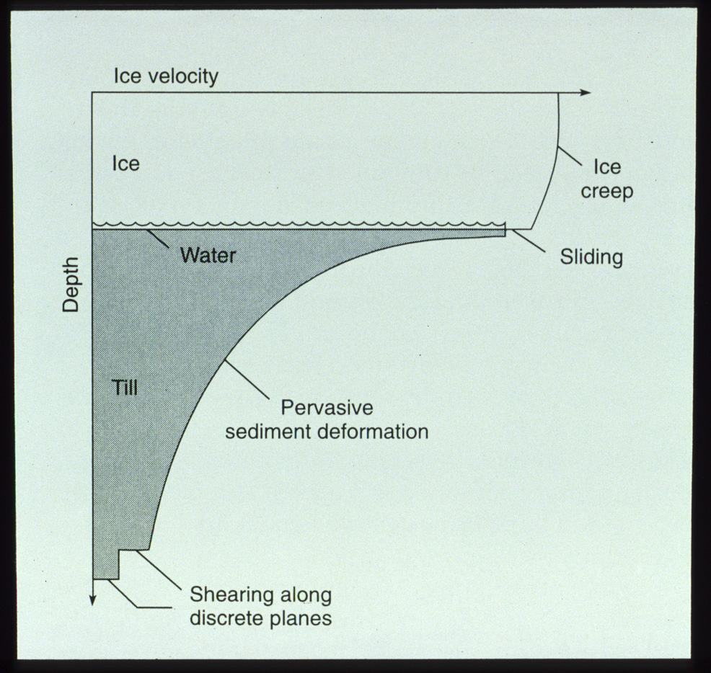
Fig 9-20

Slide 22
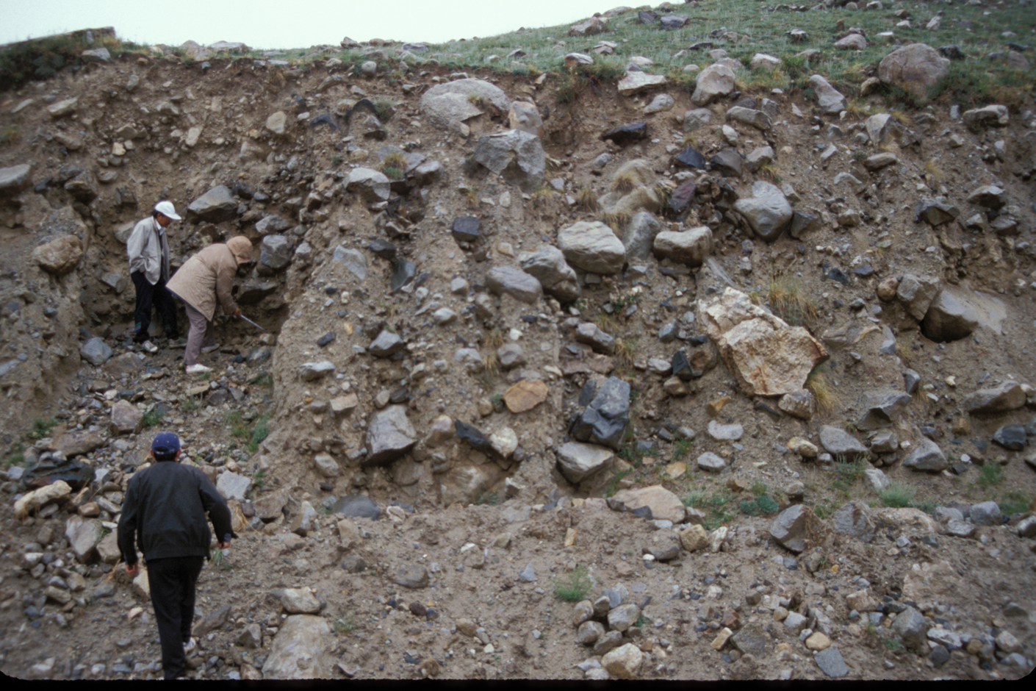
Copyright © Jeff Munro 2002
Notes:
Till exposed in lateral moraine, Tian Shan, northwestern China.

Slide 23
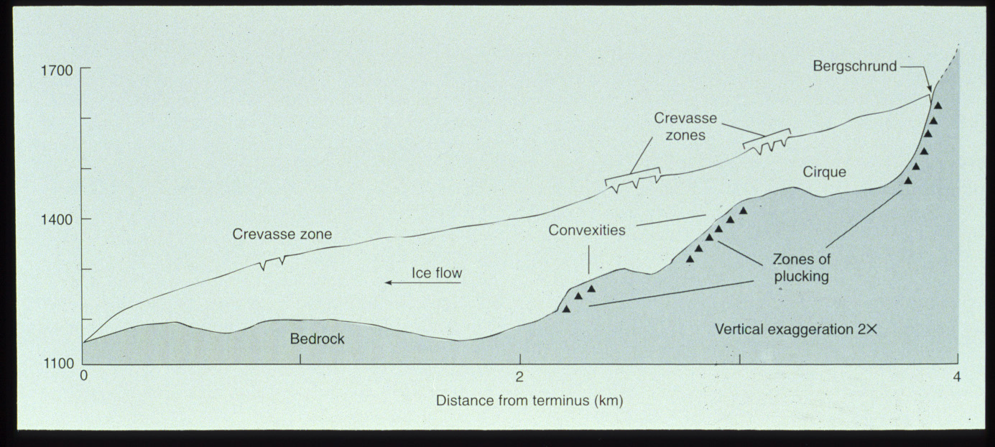
Fig 10-9

Slide 24
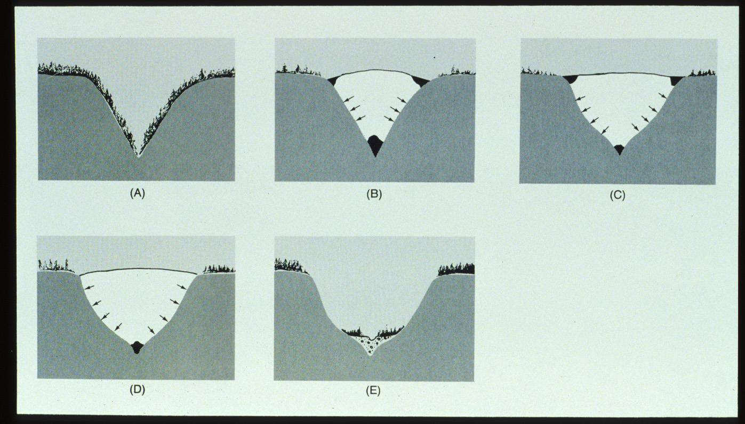
Fig 10-11

Slide 25
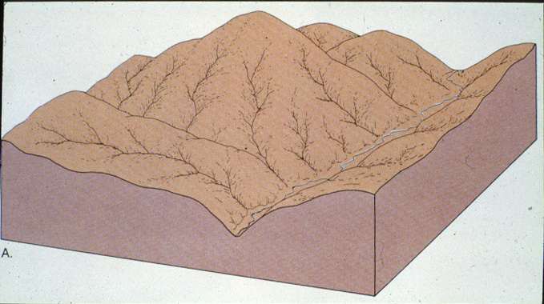

Slide 26
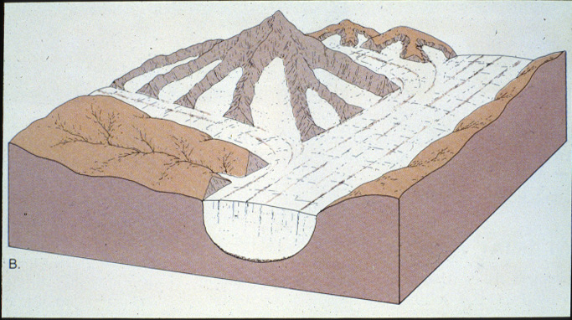

Slide 28
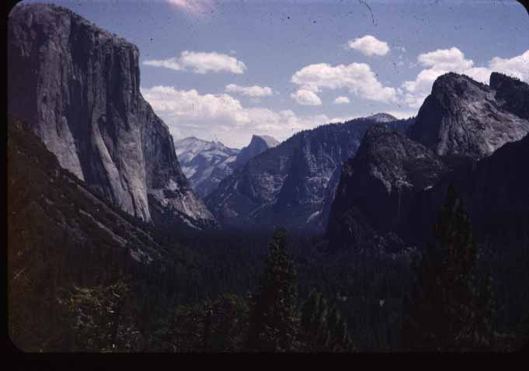

Slide 29
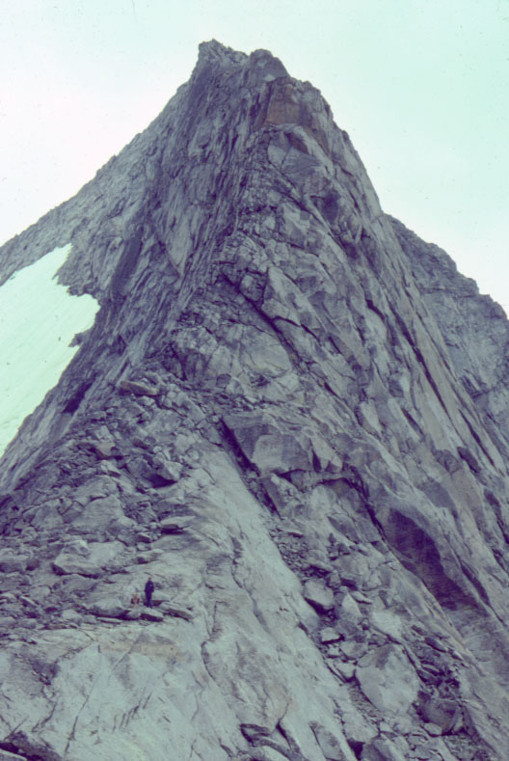
Copyright © William Locke 2002
Notes:
Arête - Side view of arête - Angel Pass, Wind River Range, WY. Note intersecting exfoliation joints with greater spacing inward. Person and dog in lower left for scale.

Slide 30
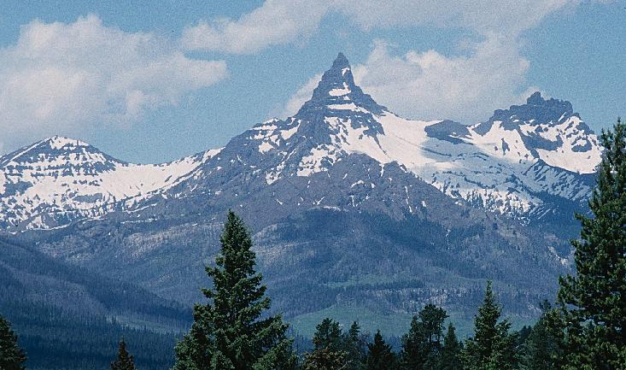
Copyright © Randy Schaetzl 2002
Notes:
Horn, Canadian Rockies near Banff, Alberta.

Slide 31
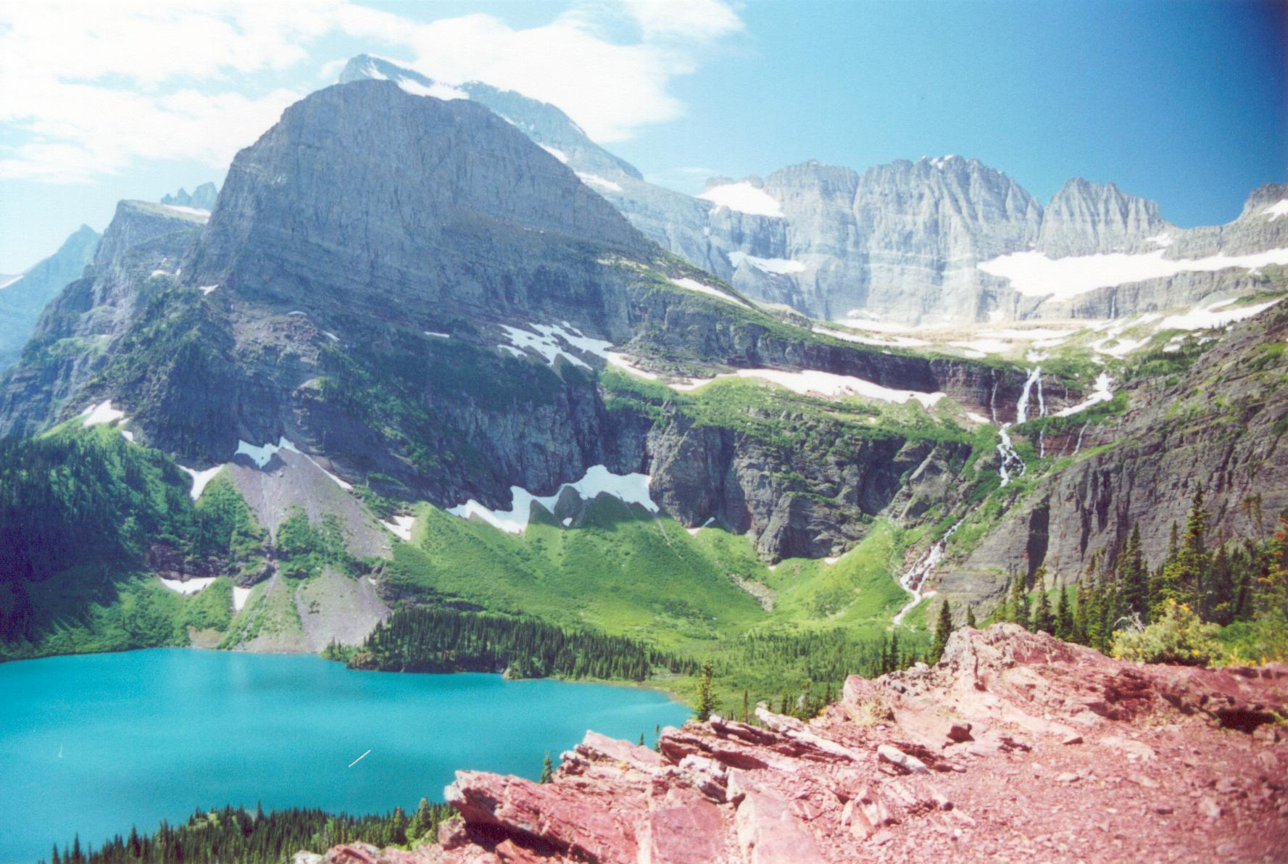
Copyright © Bob Andrle 2002
Notes:
Grinnell Lake with the Grinnell Glacier rock step, cirque, and headwall in the upper right, view from Grinnell Glacier Trail, Glacier NP.

Slide 32
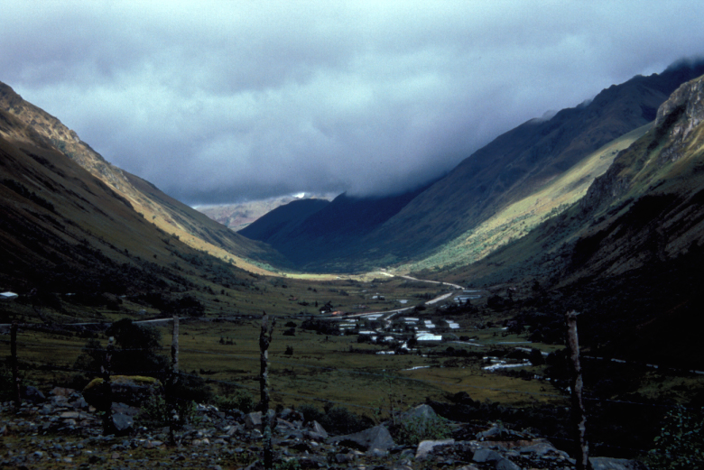
Copyright © Carol Harden 2002
Notes:
U-shape of the valley of the Tomebamba River, upstream and west of Cuenca, Ecuador. The valley shape (in addition to cirques and tarns and moraines upstream) provides evidence of glaciation, which occurred here during the Pleistocene. Active glaciers still exist at higher altitudes in Ecuador, including on the mountain Cayambe, which sits on the Equator.

Slide 33
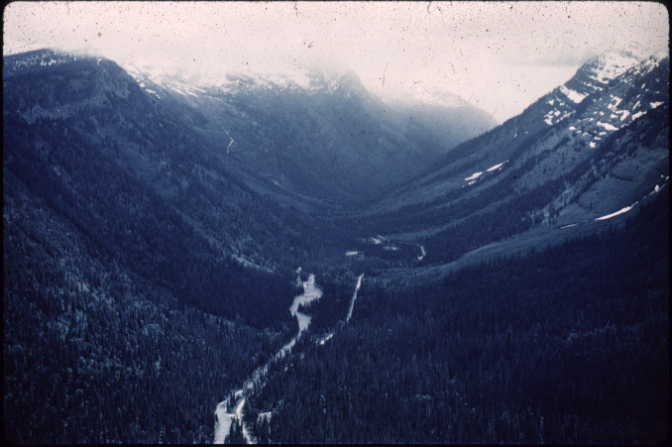

Slide 34
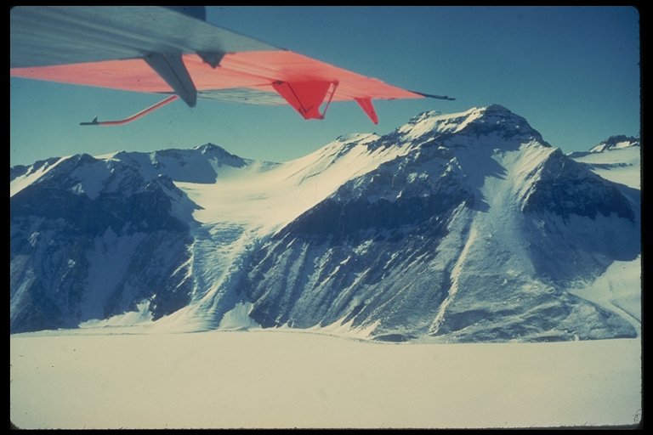
Hanging Valley

Slide 35
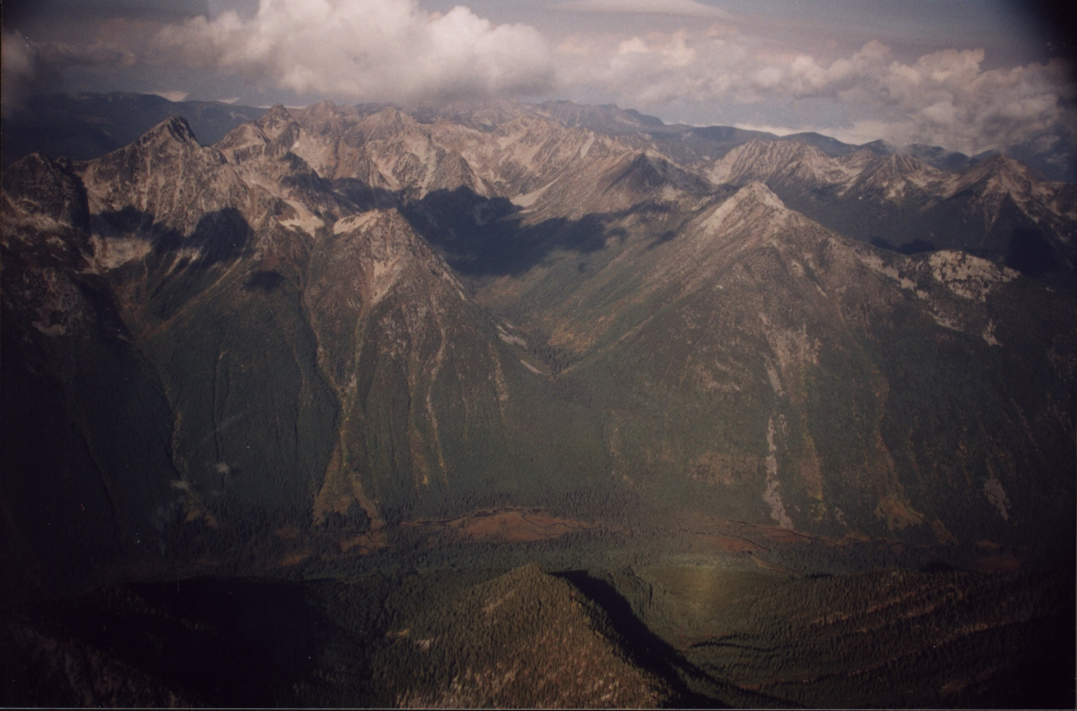
Copyright © Mariette Prent 2002
Notes:
Hanging valley – unknown valley, along Kootenay river, B.C

Slide 37
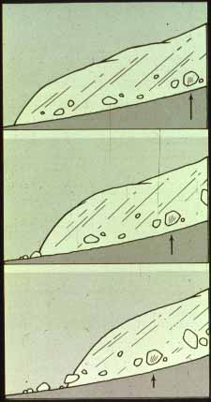

Slide 38
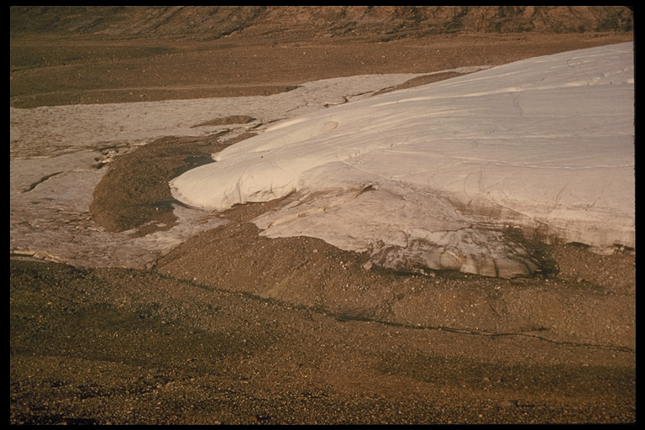
End Moraine 2

Slide 39
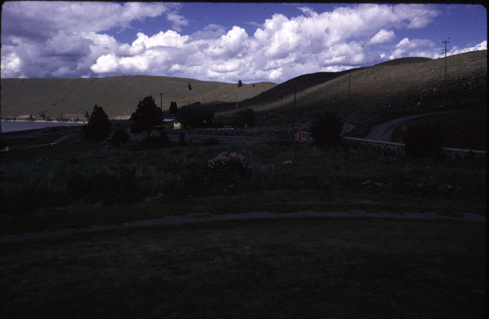

Slide 40
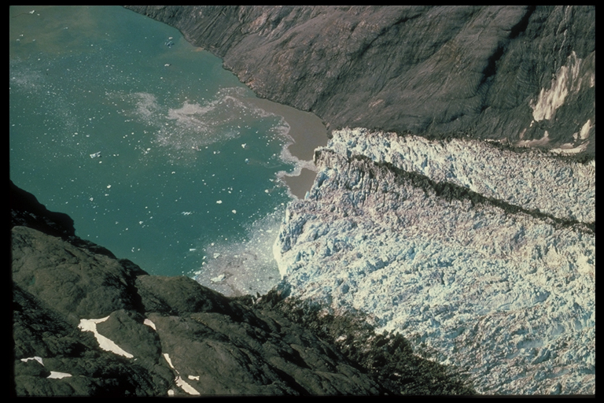
Icebergs

Slide 41
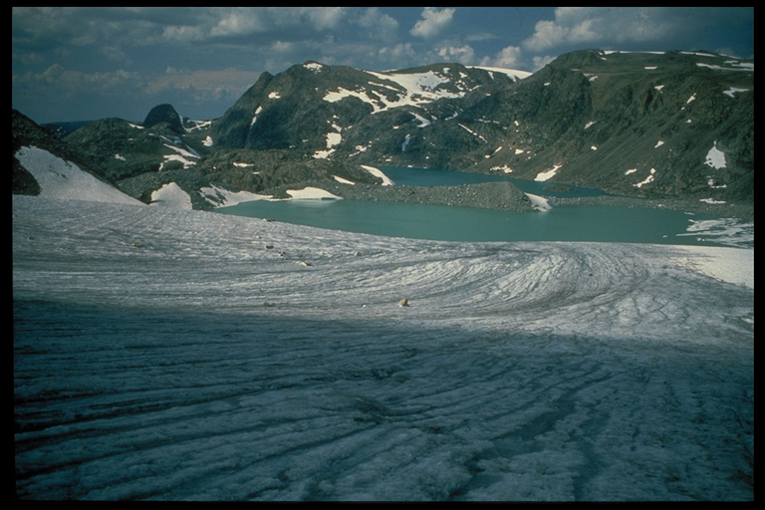
Melt Water lake

Slide 42
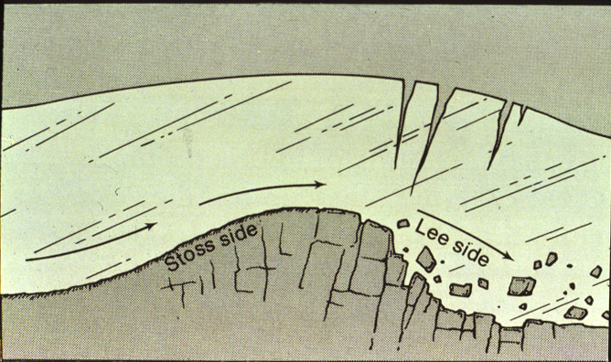

Slide 43
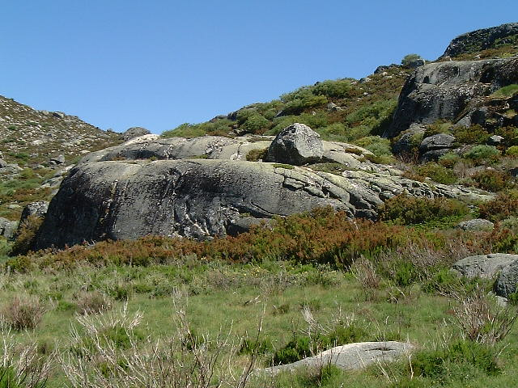
Copyright © Goncalo Vieira 2002
Notes:
Roches mouttounées (granite), Serra da Estrela (Portugal), Glacial geomorphology.

Slide 44
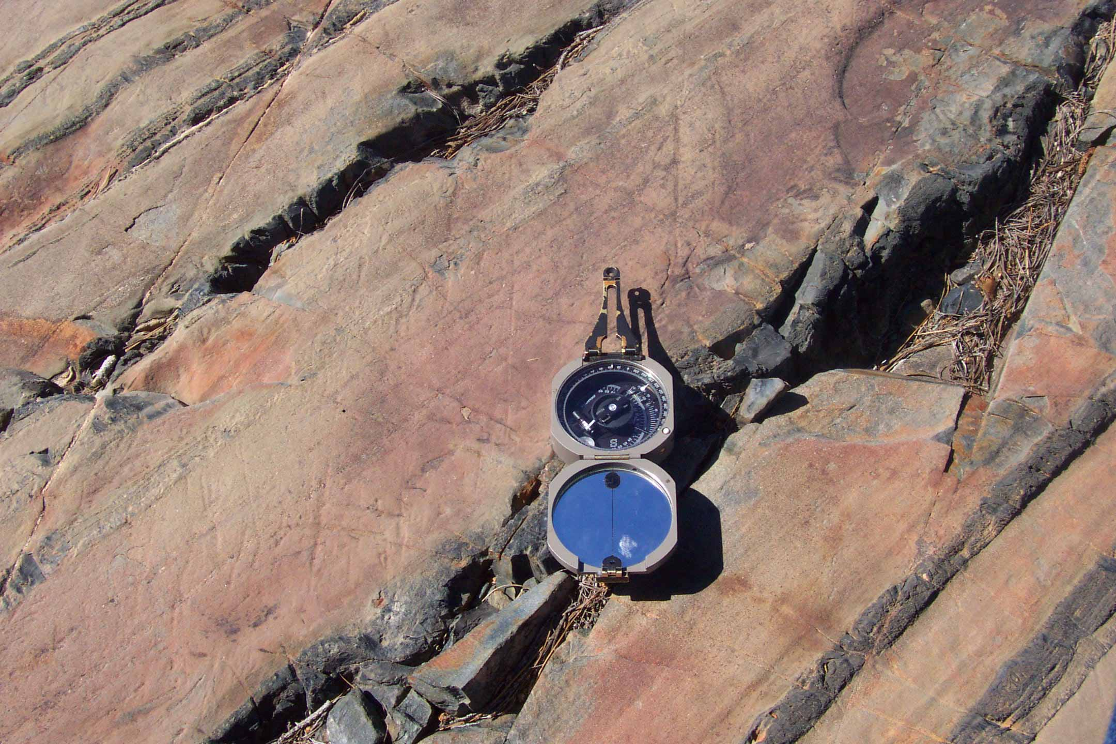
Copyright © Allan James 2002
Notes:
Fine striations on polished slate in Lake Valley near the South Yuba River, Sierra Nevada, California. The compass is pointing in the direction of ice flow down valley and the striae are parallel to this trend. Note that thin lines parallel to the bedding plane are not striae even though they have a similar appearance. This surface is on top of a bedrock bench which is at an elevation corresponding to the approximate ice surface elevation and is interpreted as an erosional remnant of an ice marginal channel.

Slide 45
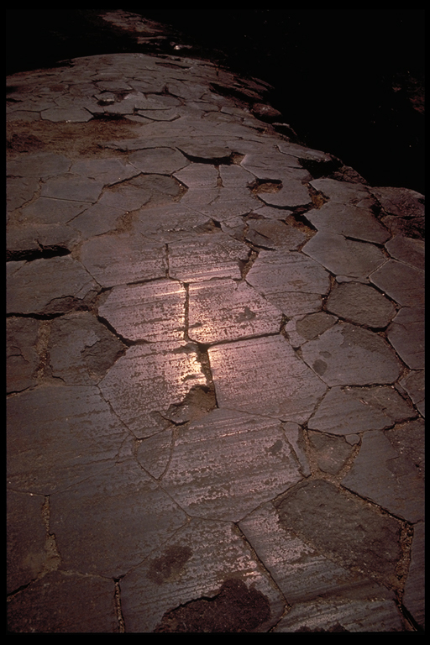
Glacial Polish
and Striations

Slide 46
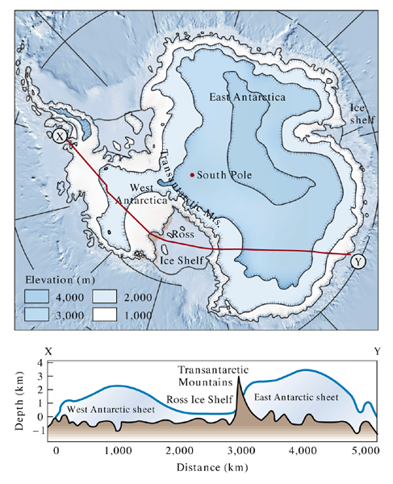
Fig. 22.05 b
W. W. Norton. Modified from Radok, 1985

Slide 47
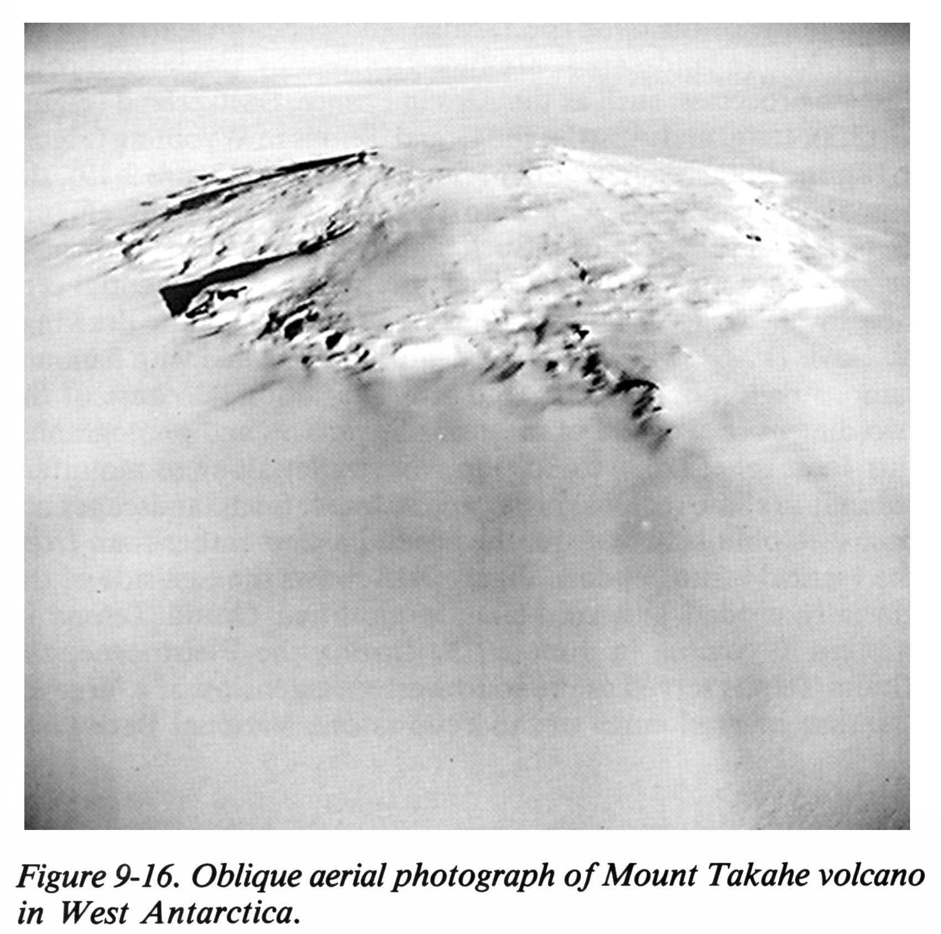

Slide 48
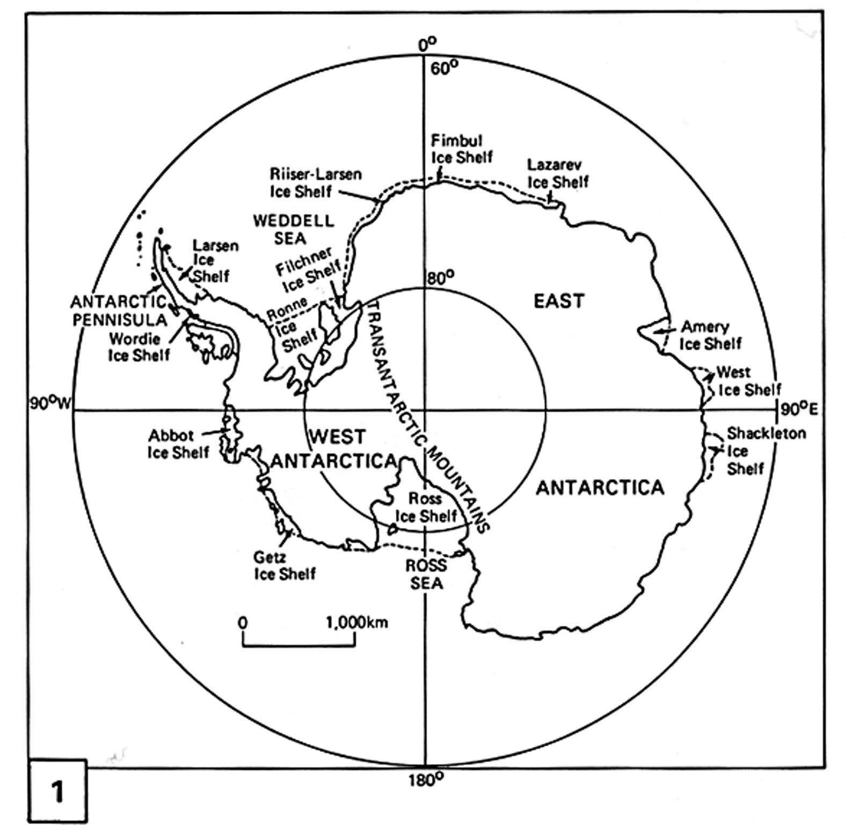

Slide 49
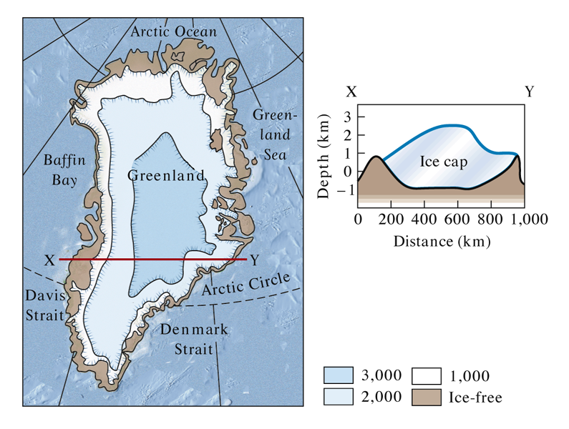
Fig. 22.05 a
W. W. Norton. Modified from Flint, 1971

Slide 50
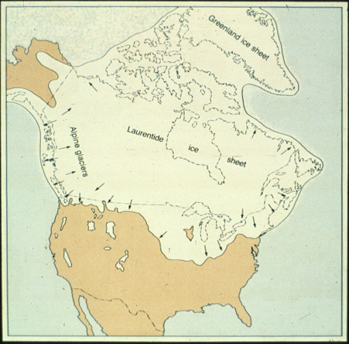

Slide 51
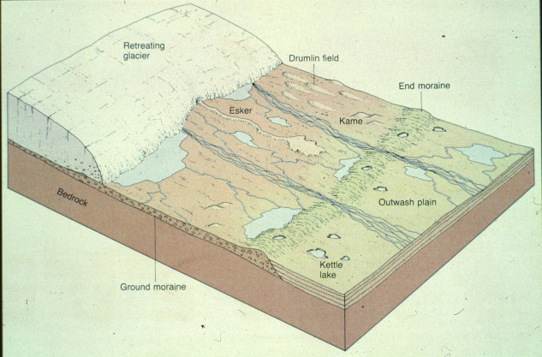

Slide 52
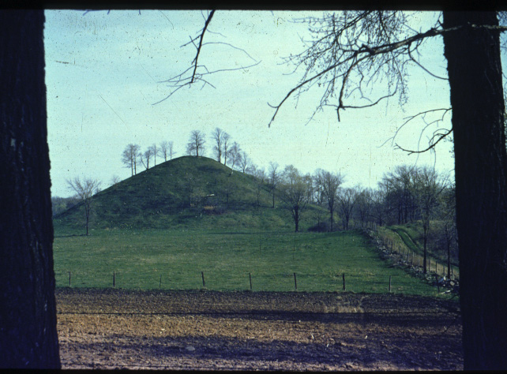

Slide 54
Kettle

Slide 55
Copyright © Jeff Munro 2002
Notes:
Growing kettle in outwash deposited by the 1996 Jokulhlaupfrom Breidamerkurjokull.

Slide 56
Fig. 22.25 a
W. W. Norton

Slide 58
Copyright © Daryl Dagesse 2002
Notes:
Drumlin, Flamborough, Ontario, Canada. The classic streamlined form of a drumlin is depicted in this photo. Although easily recognized, considerable debate remains regarding the origin of these glacial features.

Slide 60
Copyright © William Locke 2002
Notes:
Glacial table - shows strength of ice, rate of melt in ablation zone, angular glacial debris and rockfall source, and meltwater stream. Cape Dyer, Baffin Island, Nunavut, Canada.

Slide 61
Copyright © William Locke 2002
Notes:
Erratic - nicely labelled boulder of gneiss (from Beartooth Plateau ~ 50 km NE) on Pleistocene rhyolite; Grand Canyon of the Yellowstone, Yellowstone National Park, WY.

Slide 63
Copyright © Ken Grimes 2002
Notes:
Looking out of a meltwater tube in the Athabasca Glacier, Canada.

Slide 64
Copyright © Randy Schaetzl 2002
Notes:
Osmun Lake esker, northern Michigan.

Slide 65
Copyright © Norm Catto 2002
Notes:
Esker Terra Nova (NF) - cross-section through sandy esker, Terra Nova. Exposure is 10 m high.

Slide 67
Copyright © Randy Schaetzl 2002
Notes:
Outwash in kame, Grayling MI.

Slide 68
Copyright © Randy Schaetzl 2002
Notes:
Till over stratified gravel.

Slide 75
Fig 11-17

Slide 76
Fig 11-21

