Slide 1
Fluvial Introduction

Slide 2
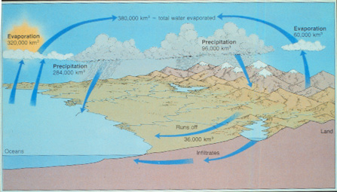
Hydrologic Cycle

Slide 3
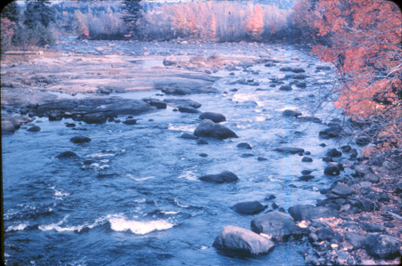

Slide 4
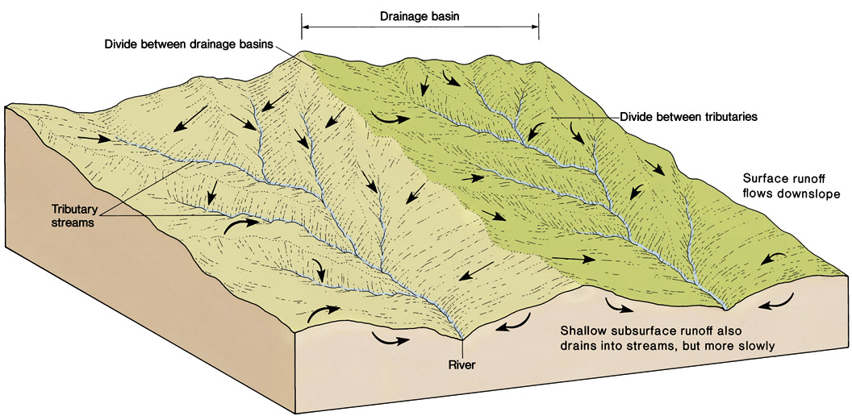
Streams and Drainage Basins
Figure 6.2

Slide 5
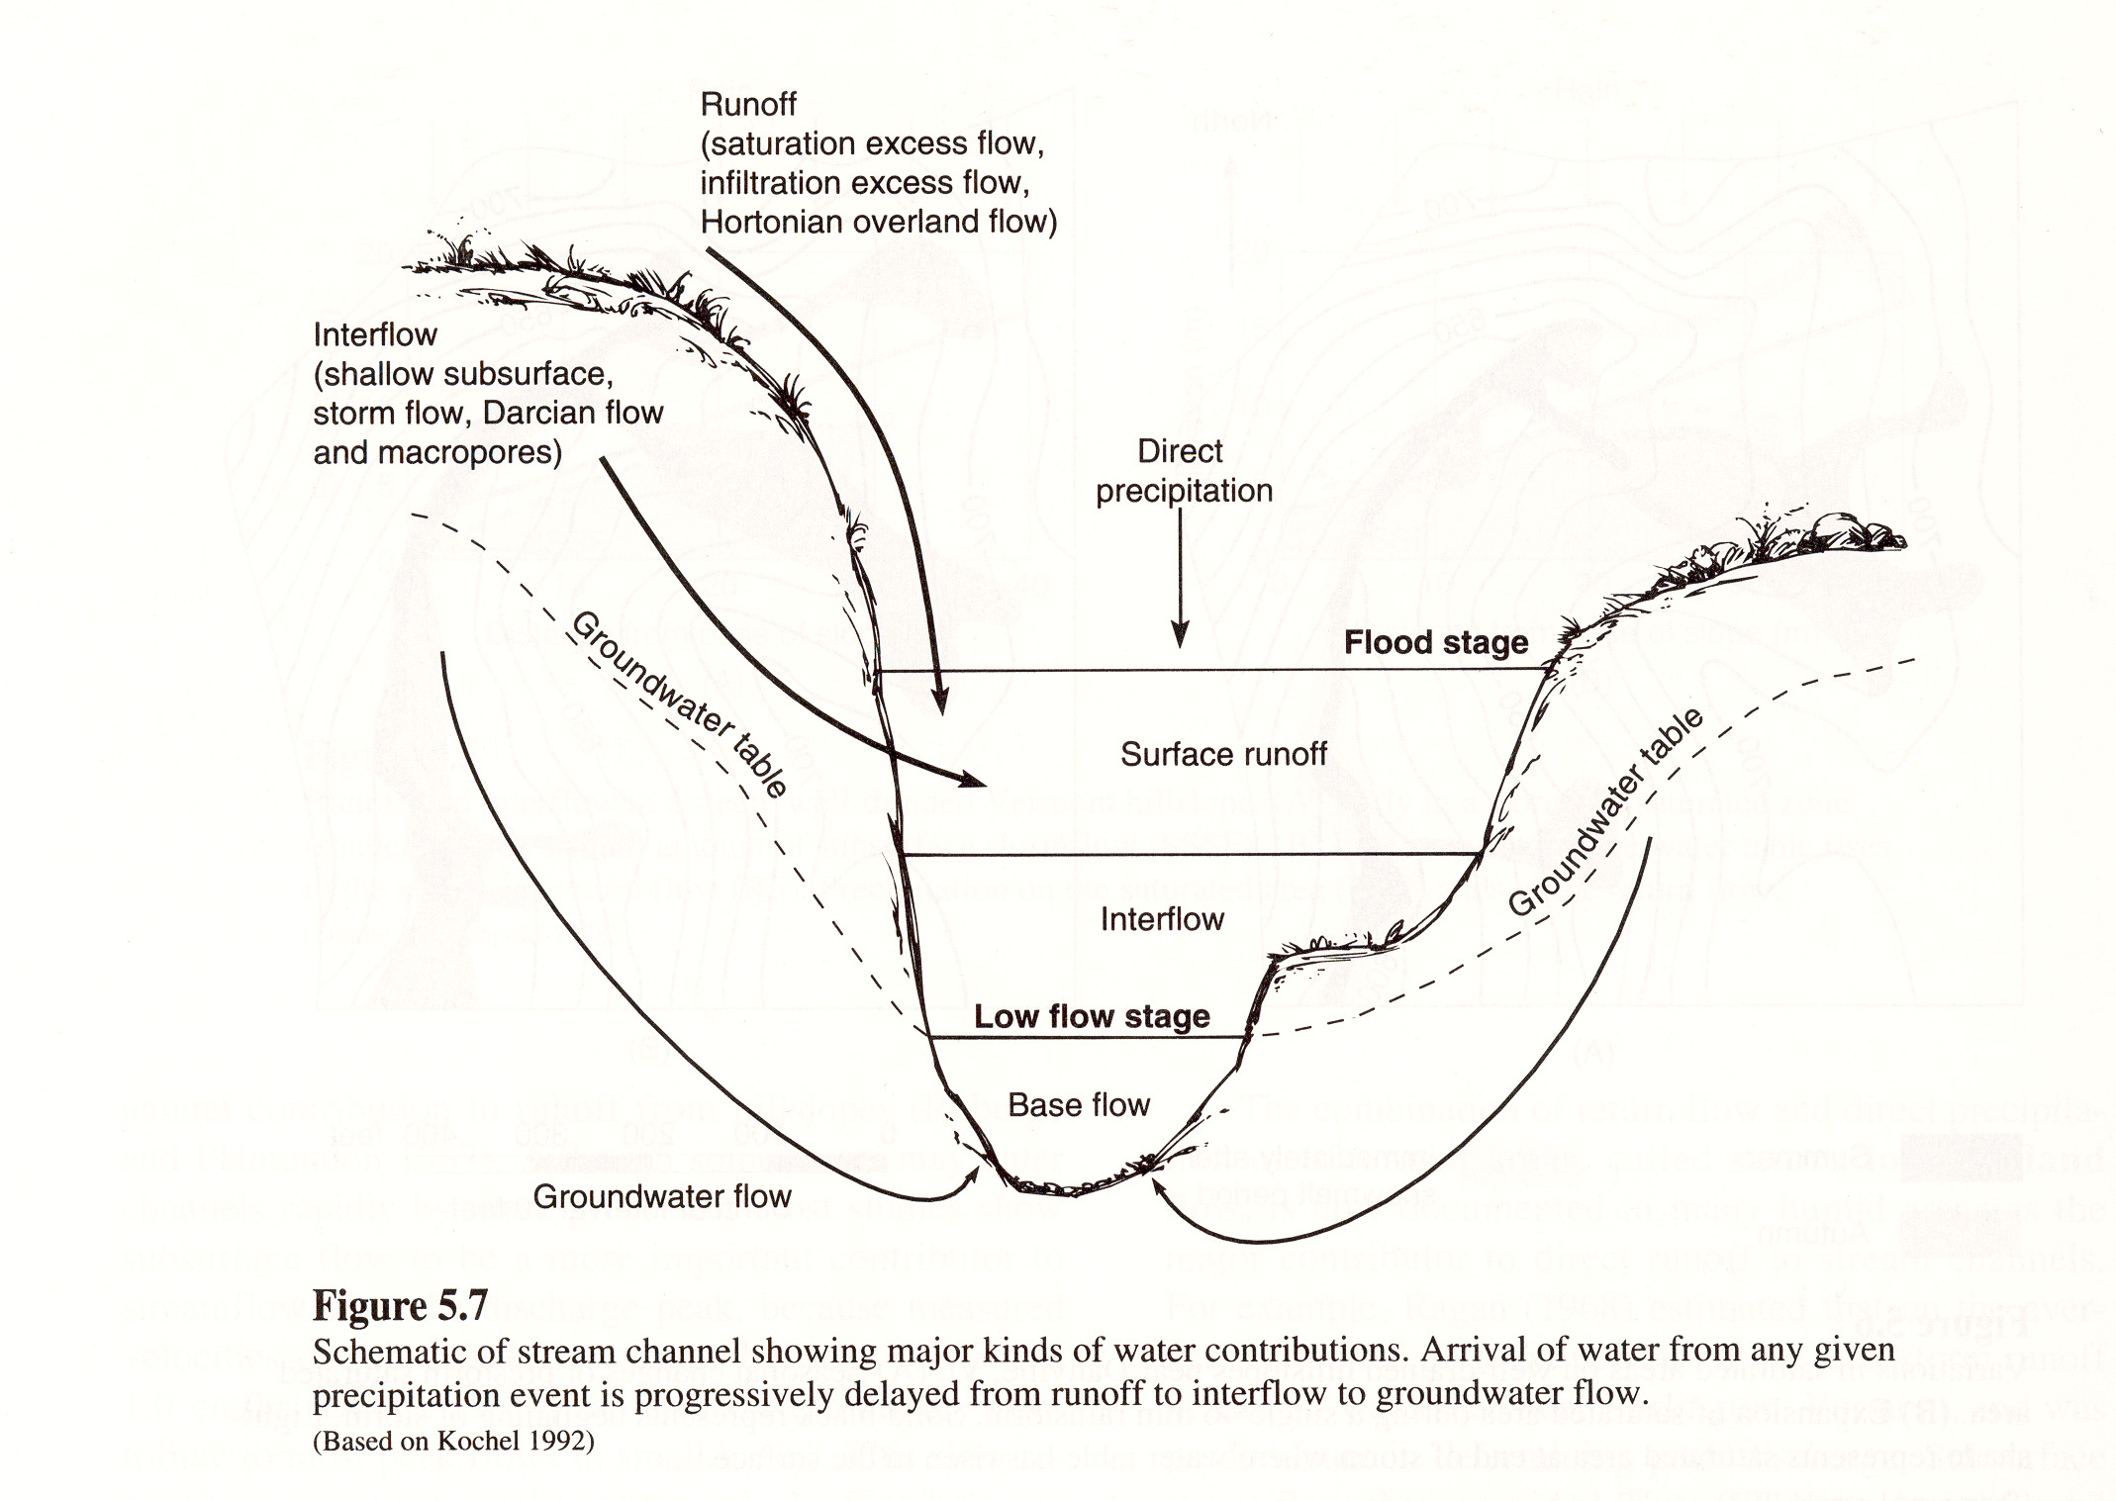

Slide 6
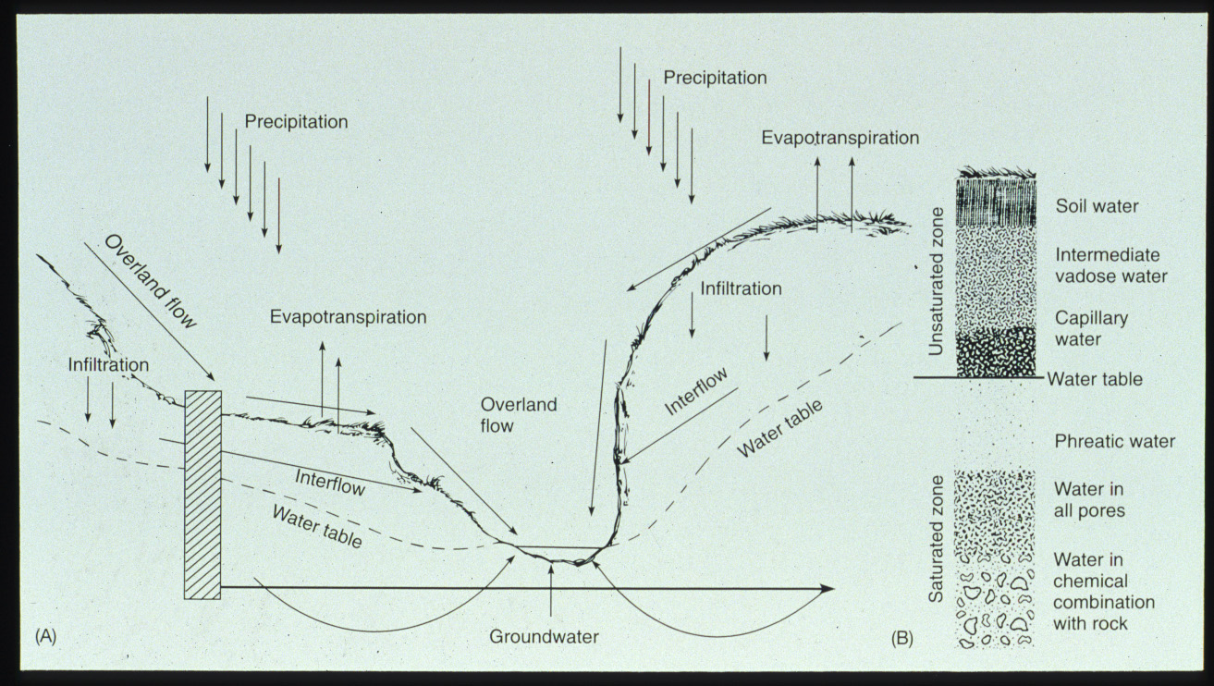

Slide 7
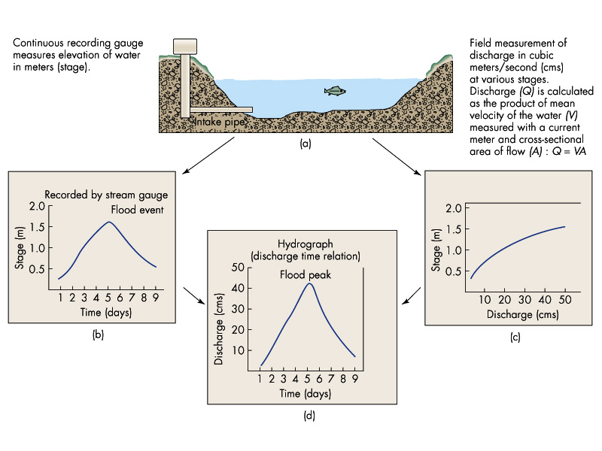

Slide 8
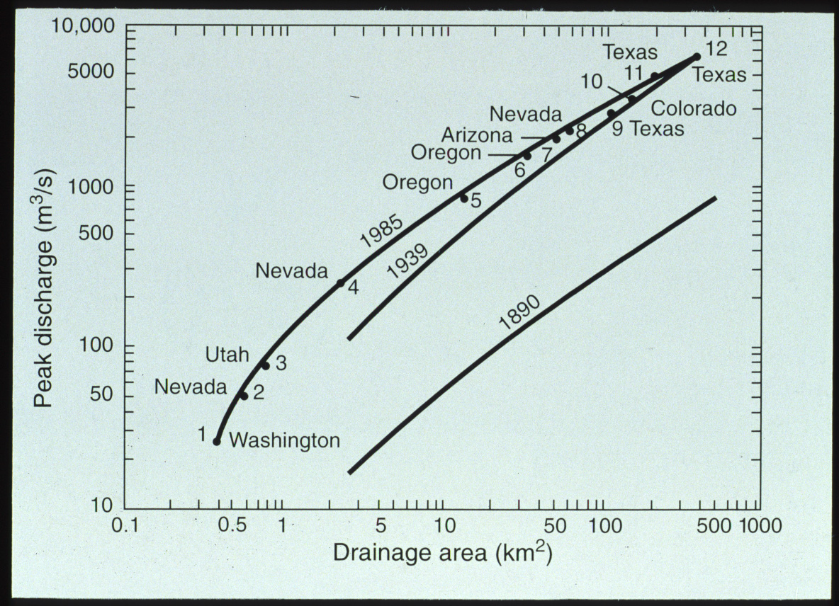

Slide 9
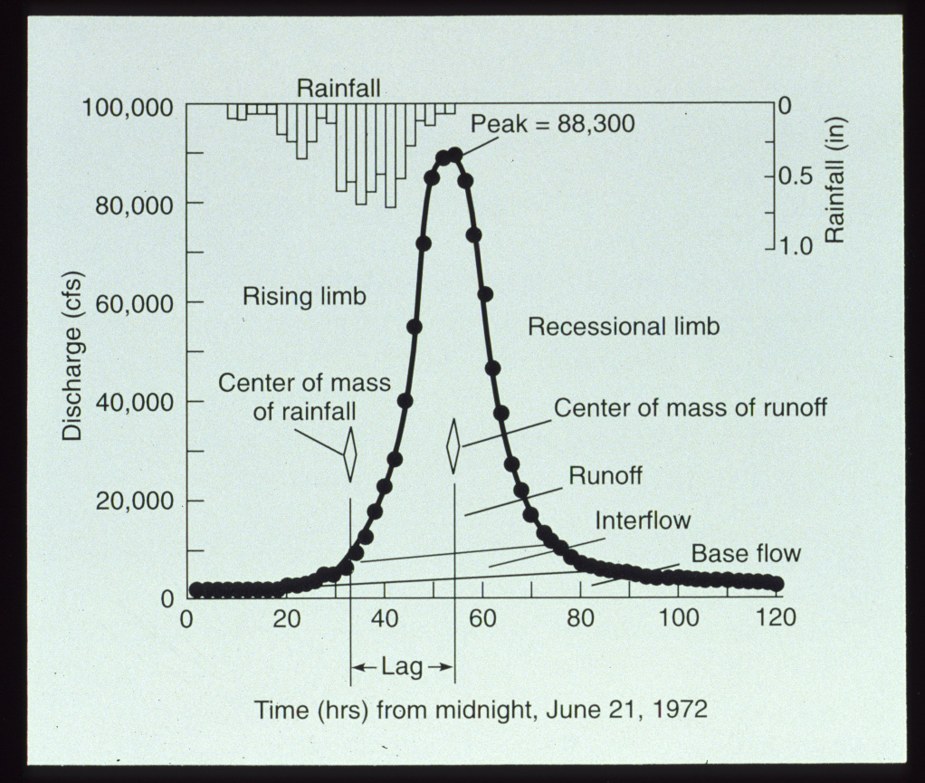

Slide 10
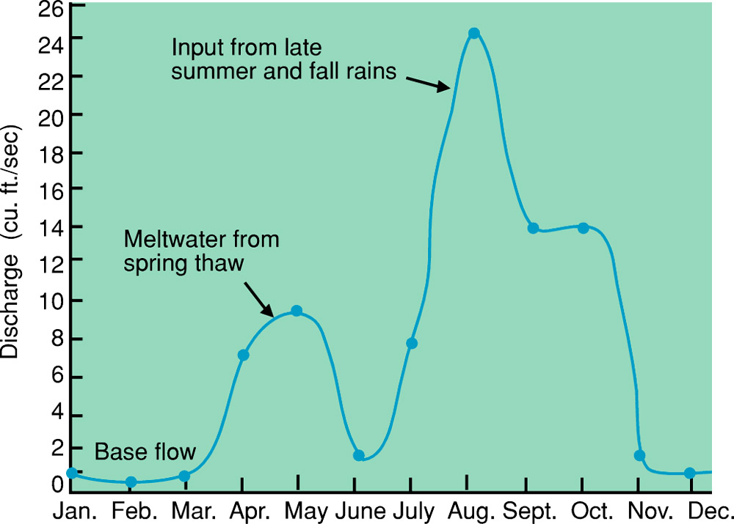
Hydrograph
Figure 6.11
U. S. Geological Survey Open-File Report 79-681

Slide 11
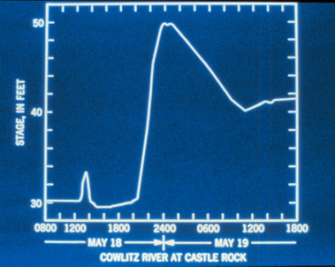

Slide 12
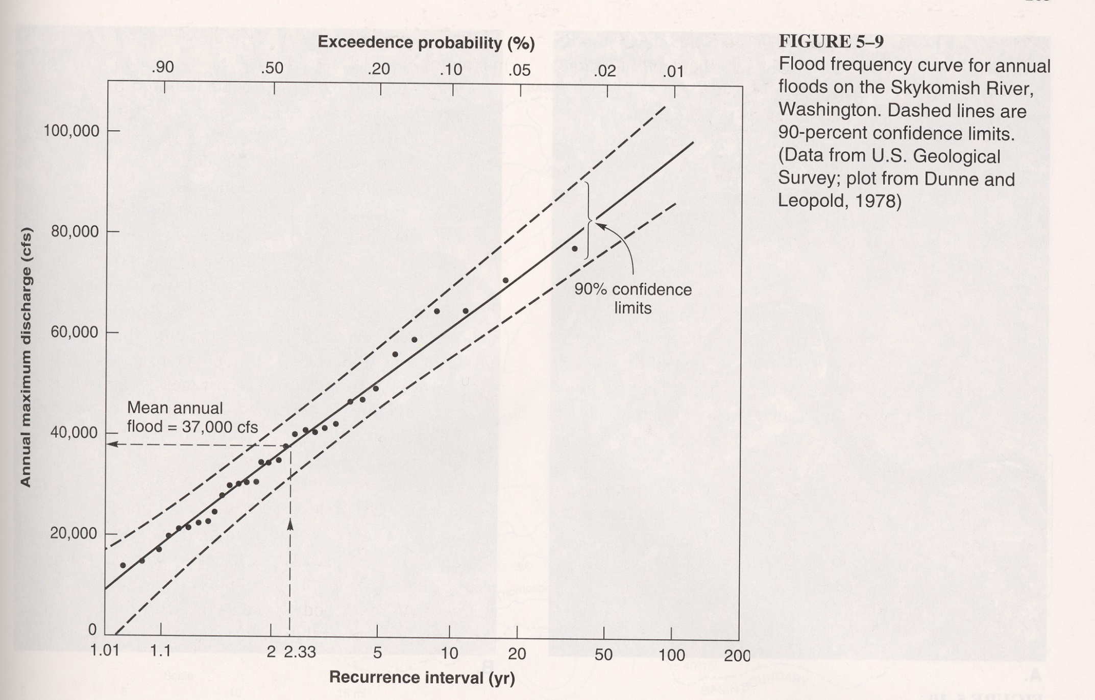

Slide 13
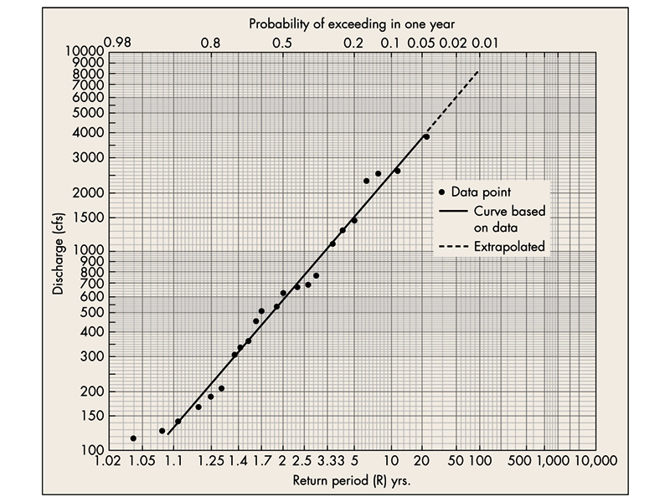

Slide 14
Fluvial Processes

Slide 15
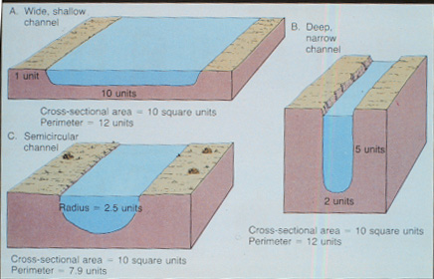
Q=AV

Slide 16
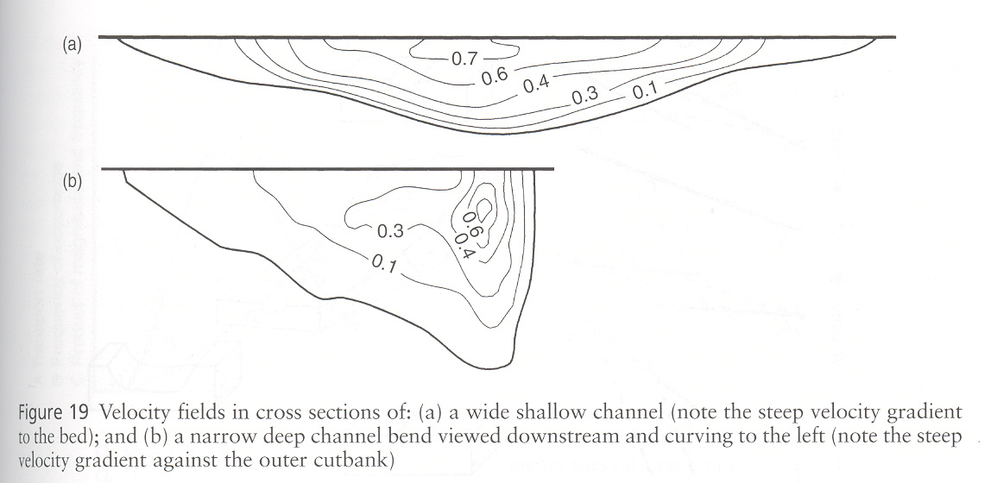

Slide 17
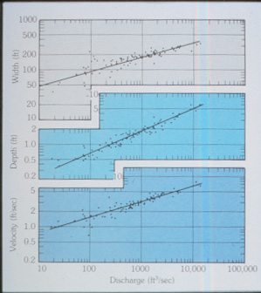

Slide 18
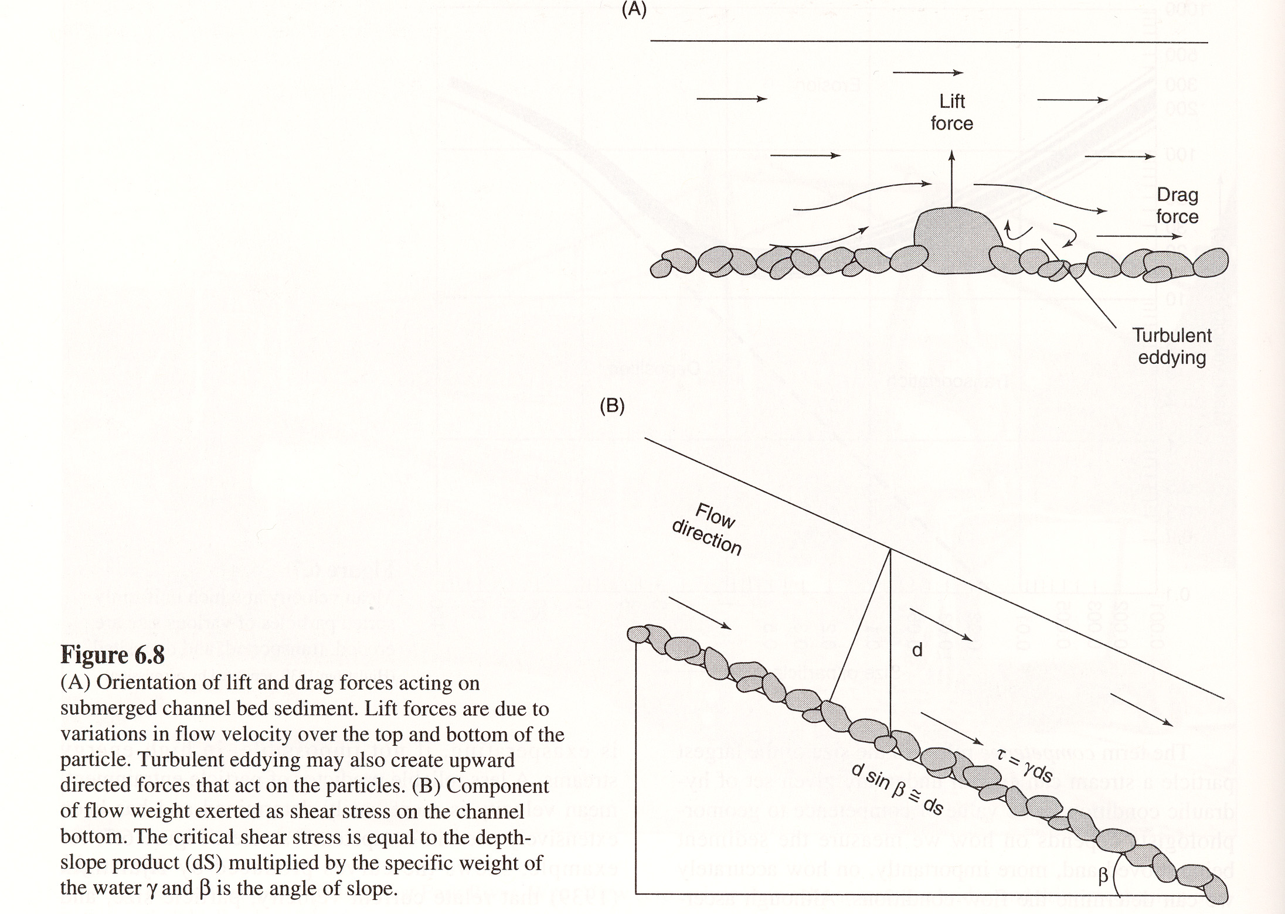

Slide 19
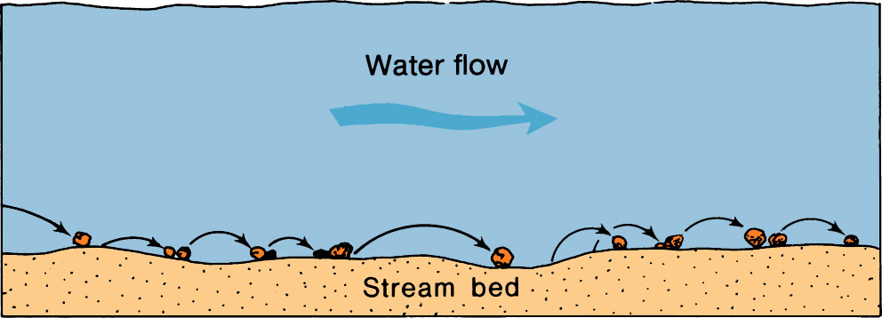
Schematic Diagram of Saltation
Figure 6.3

Slide 21
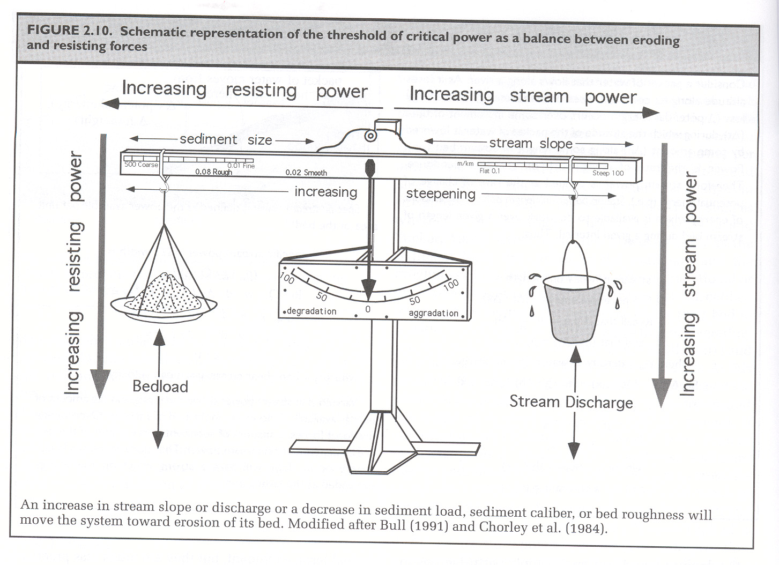

Slide 22
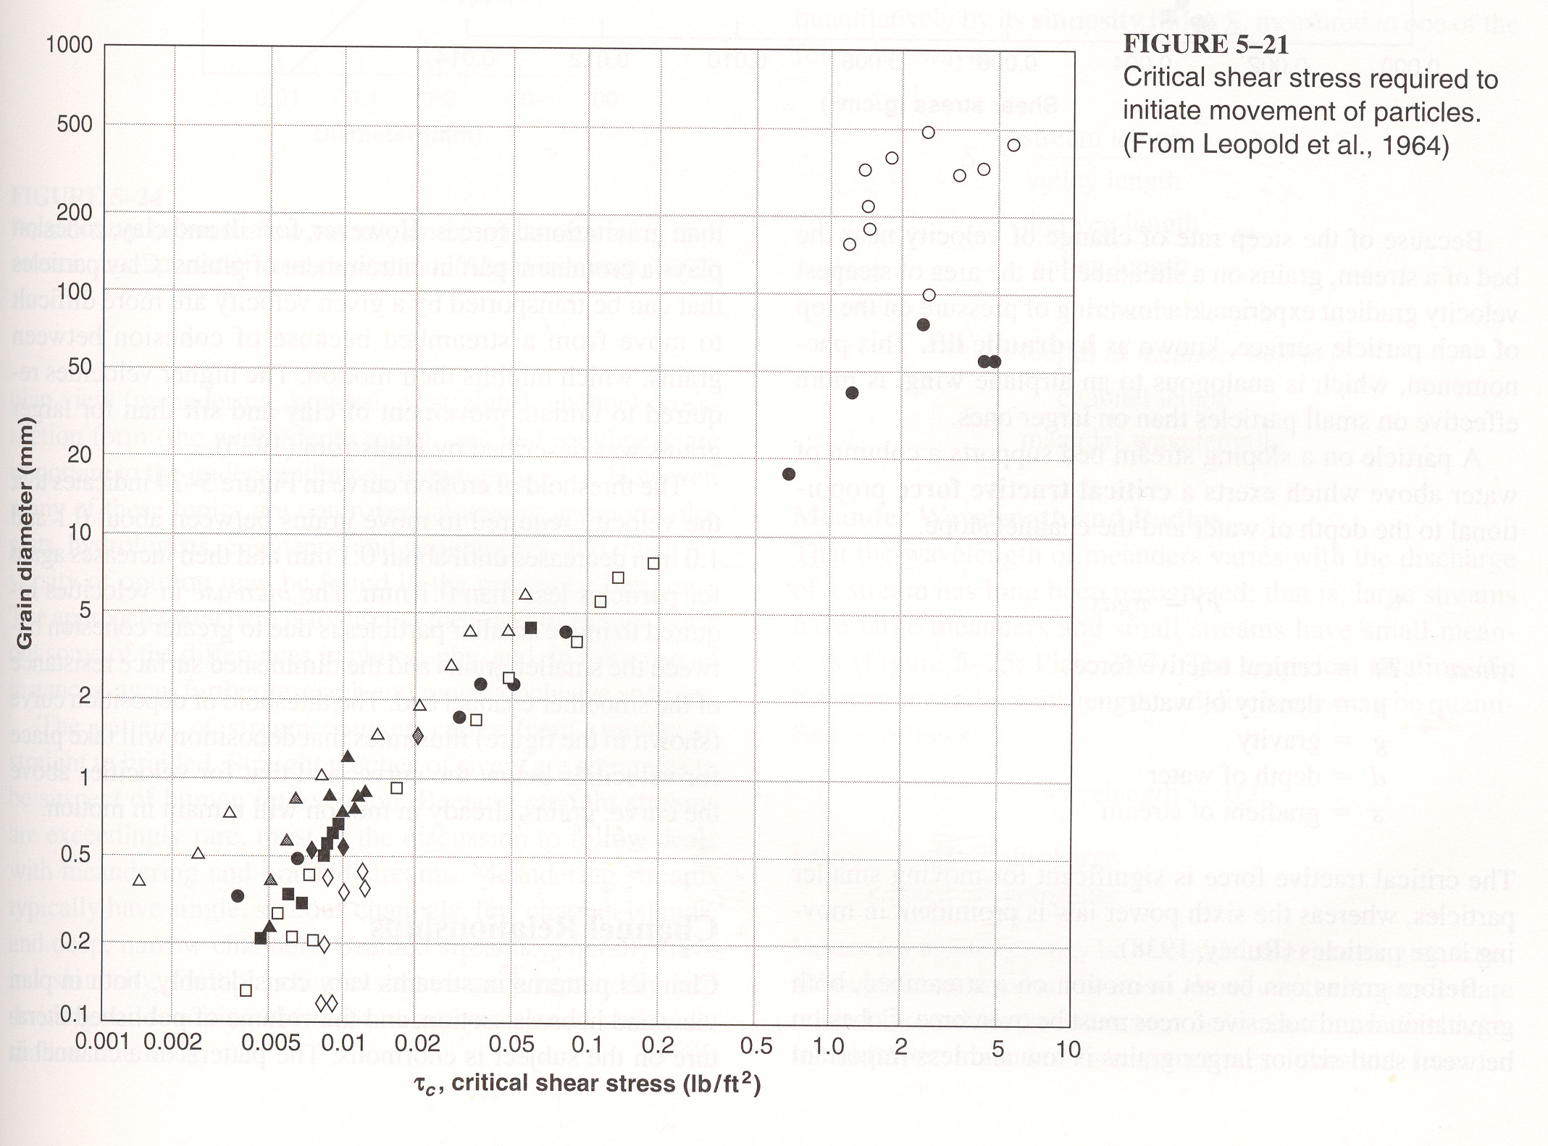

Slide 23
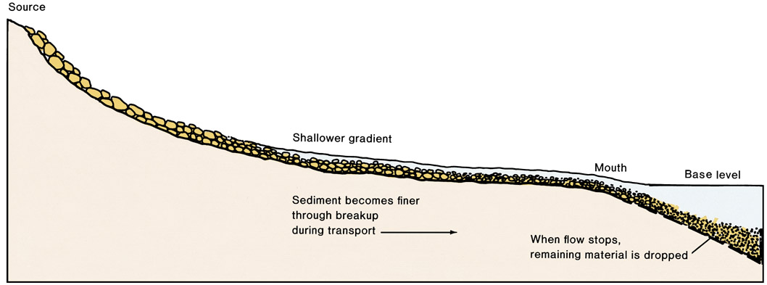
Longitudinal Profile of Stream
Figure 6.4

Slide 24
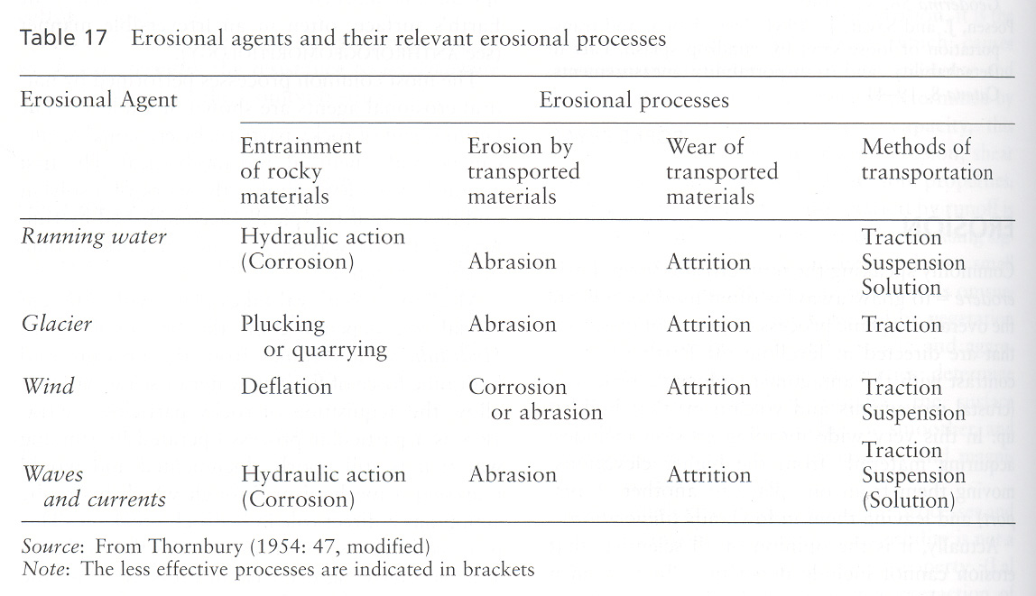

Slide 25
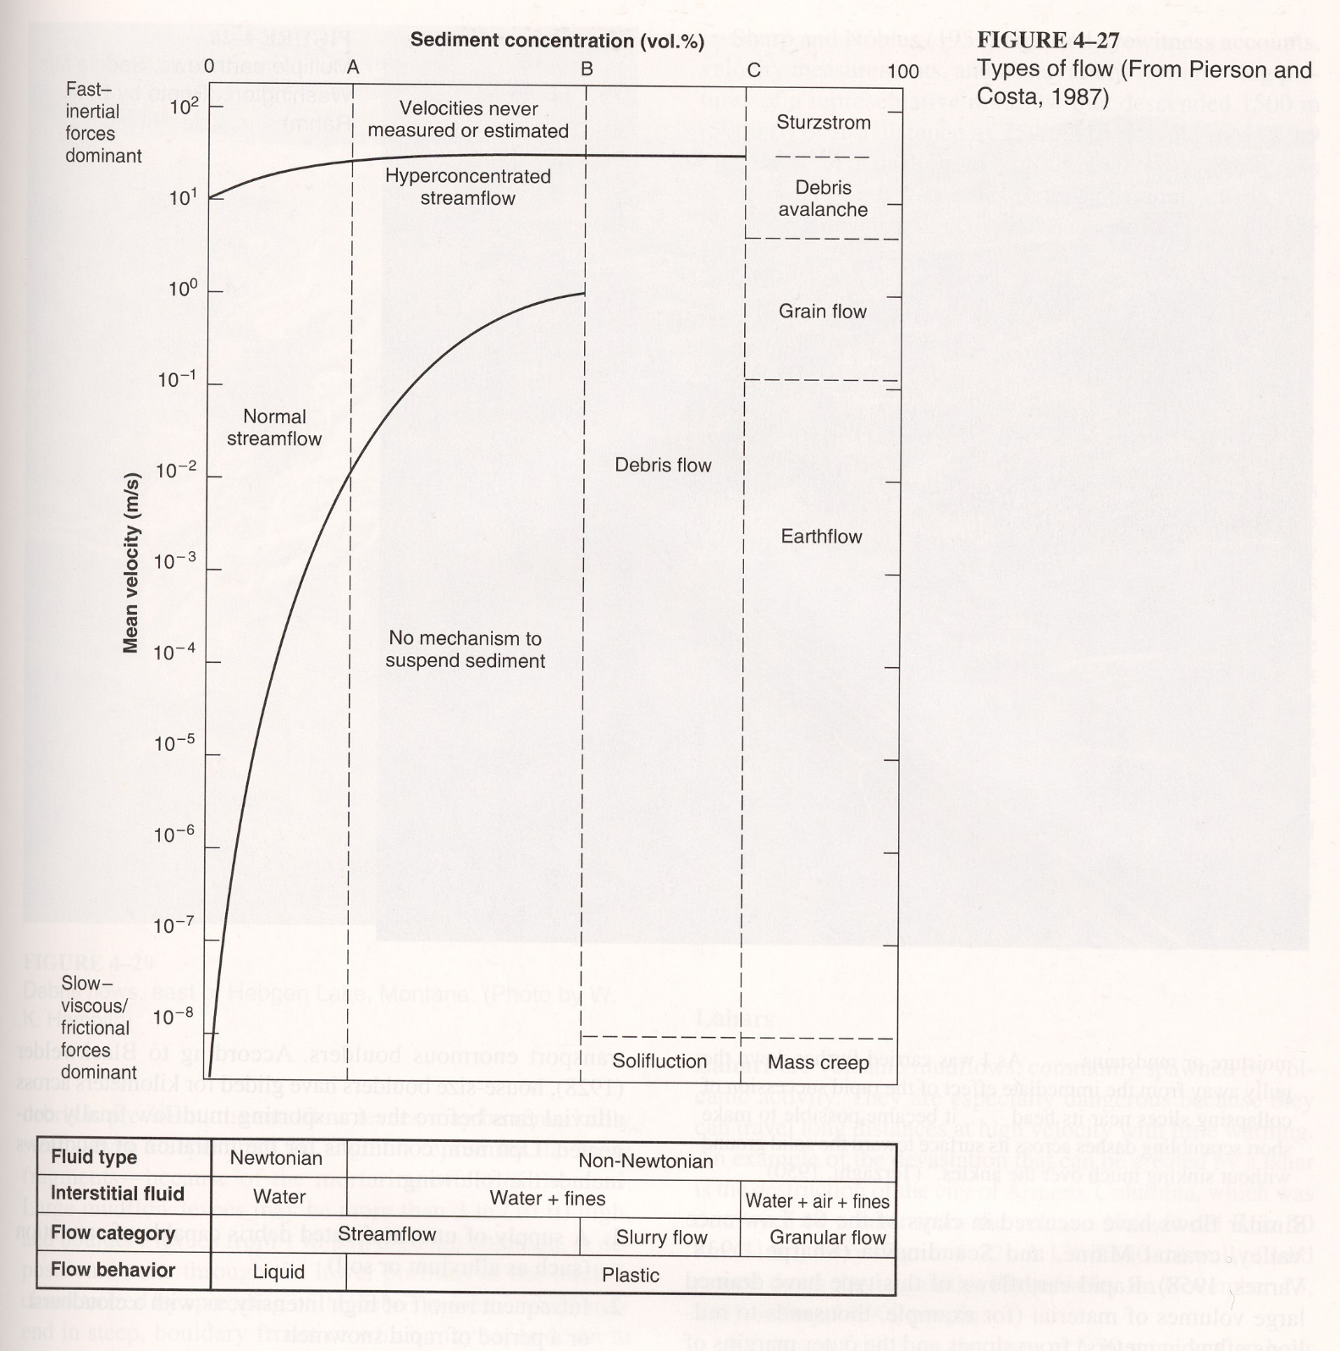
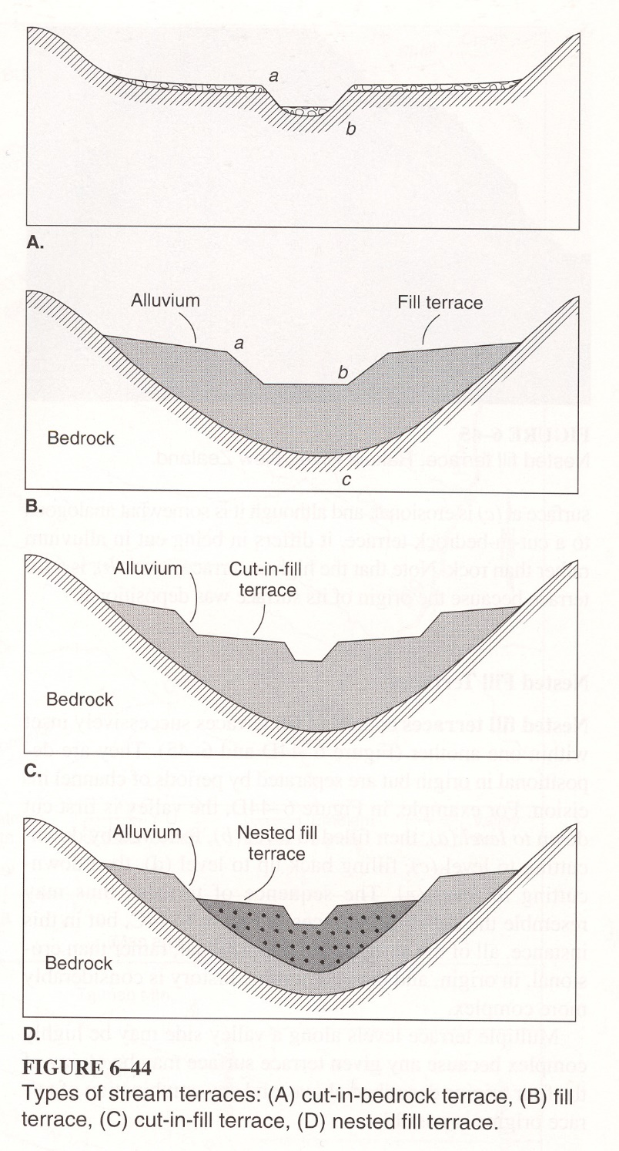

Slide 26
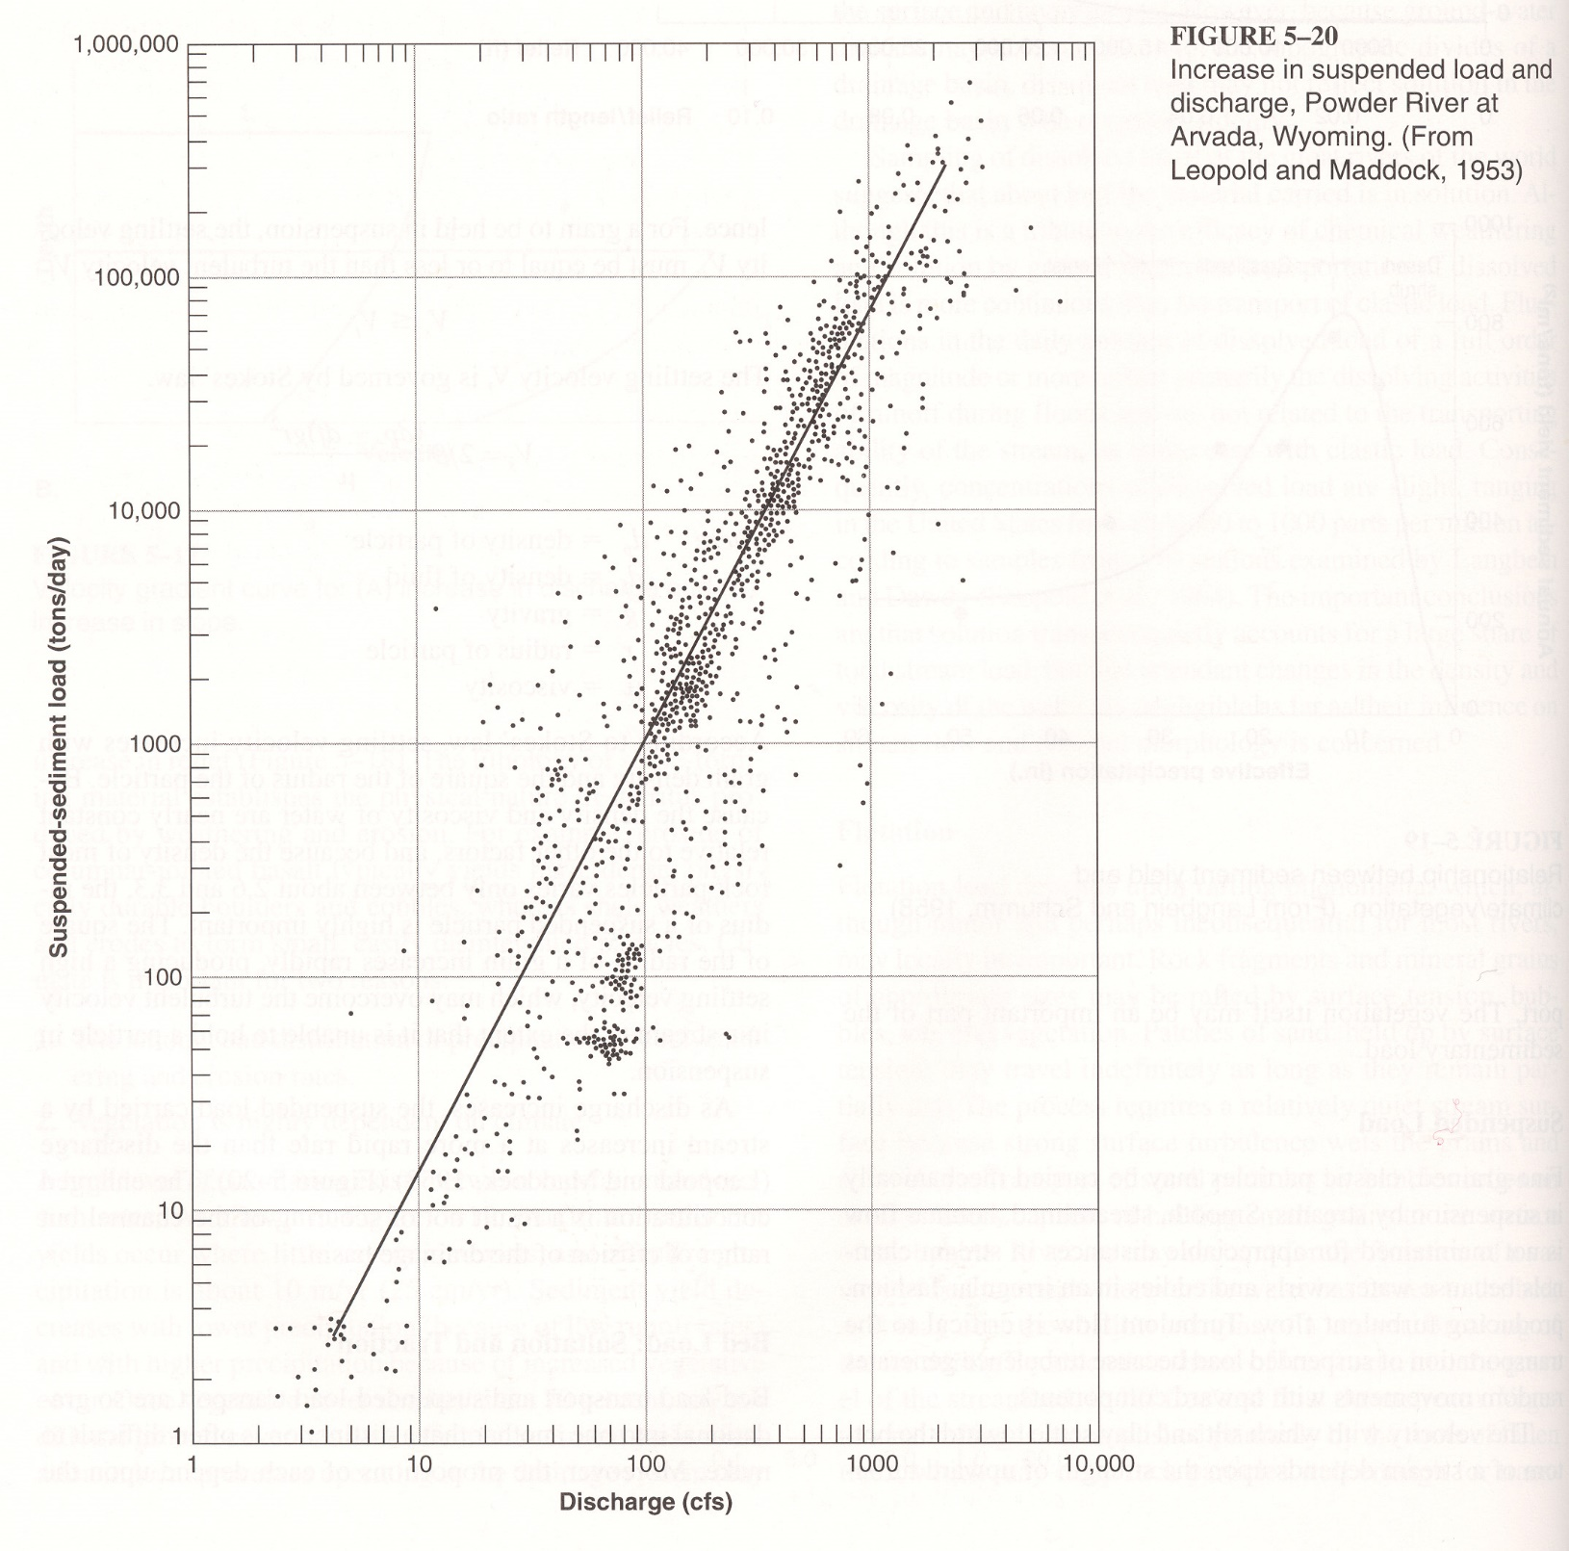

Slide 27
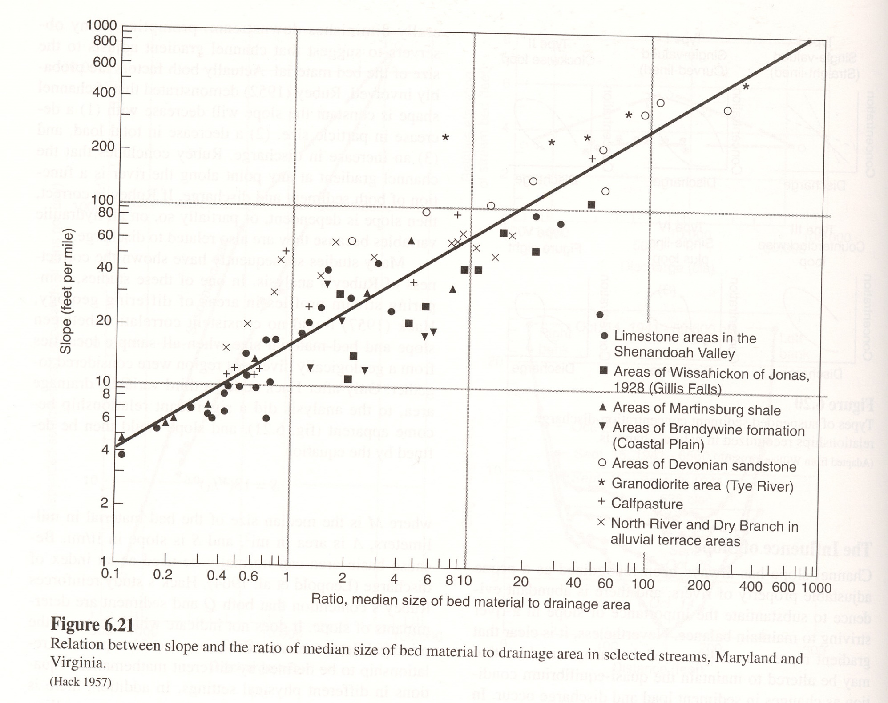

Slide 28
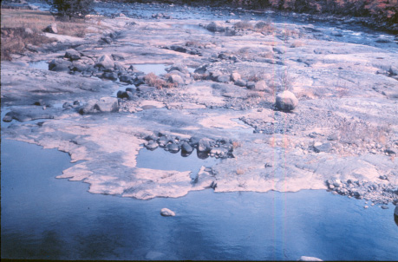
Tools

Slide 29
Fluvial Landforms

Slide 31
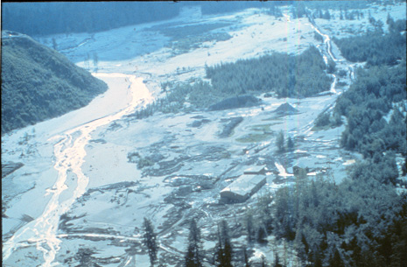
Braided Pattern - Over Capacity

Slide 32
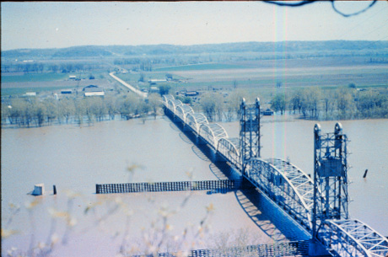
Suspended Load river , Flood Conditions

Slide 33
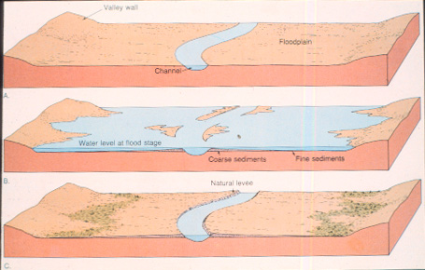
Floodplain Development

Slide 34
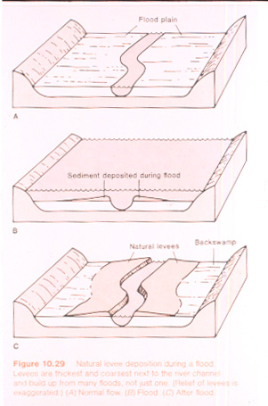

Slide 35
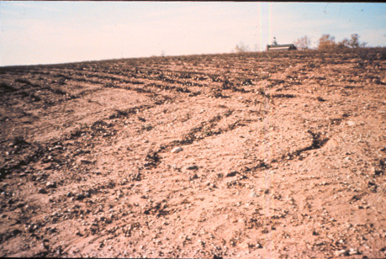
Rill Erosion

Slide 36
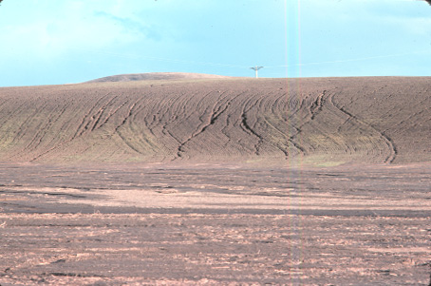
Rill and Gully Erosion on the Palouse

Slide 37
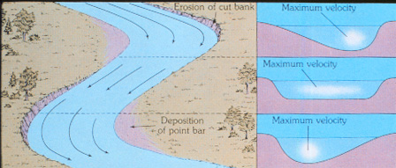
Meander Hydraulics

Slide 38
Oxbow Cutoff / Development

Slide 39
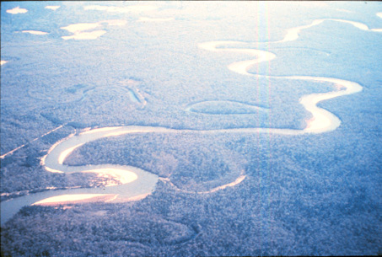
Meandering river
Oxbows
Point Bar

Slide 40
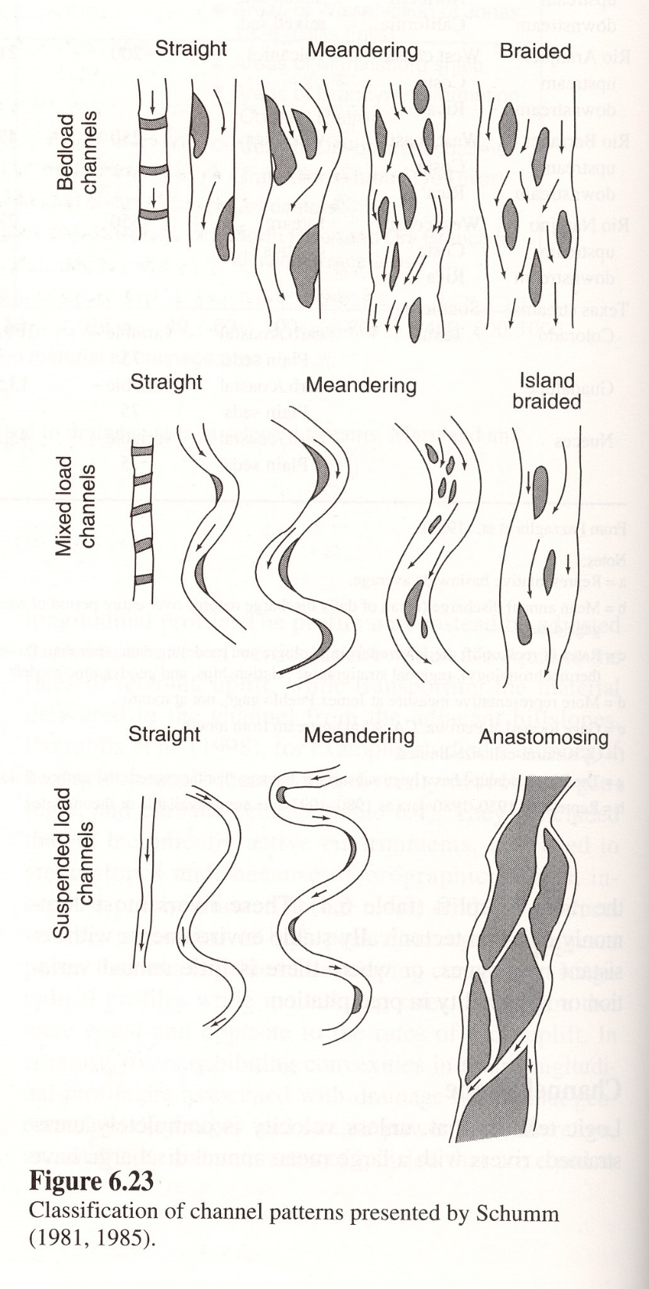

Slide 41
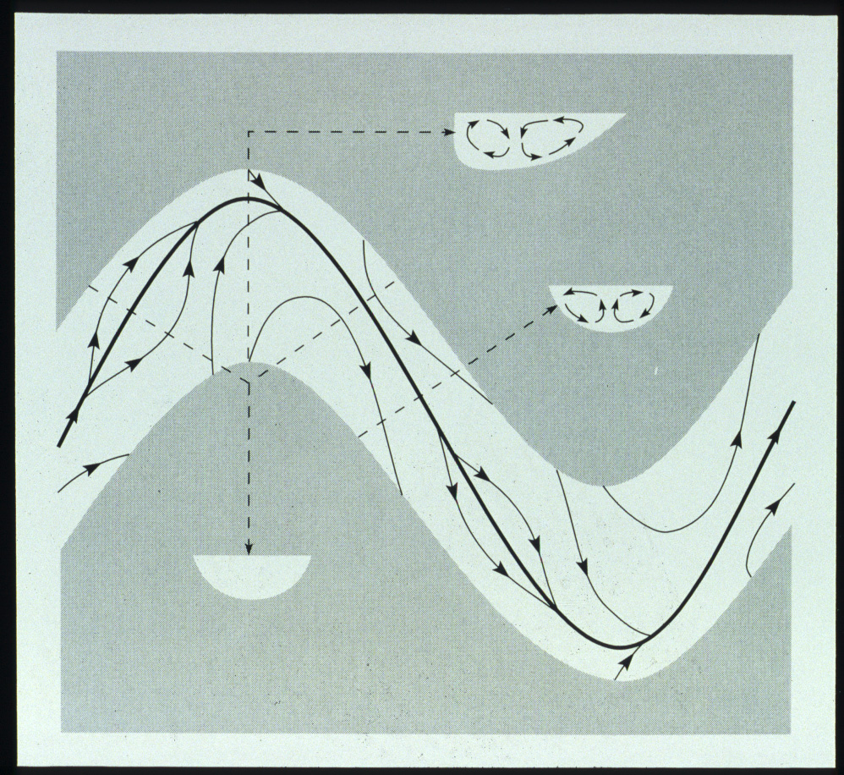

Slide 43
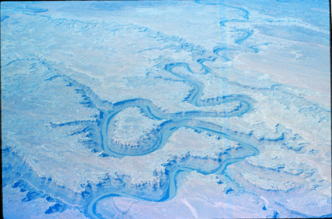
Entrenched Meanders

Slide 44
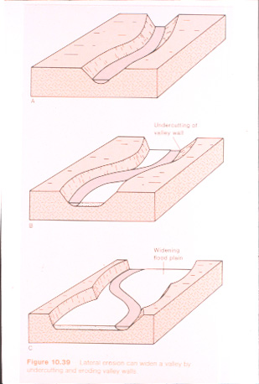
Floodplain Widening

Slide 45
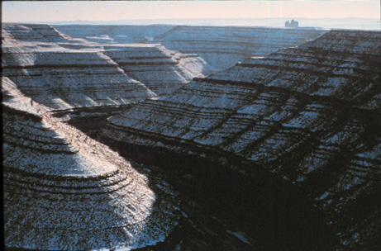
Entrenched Meanders - Colorado Plateau

Slide 46
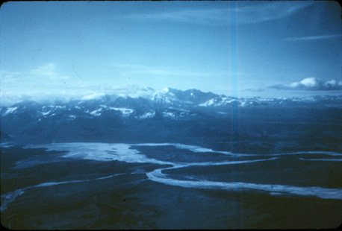
Braided Outwash -Glacial-Fluvial Processes

Slide 47
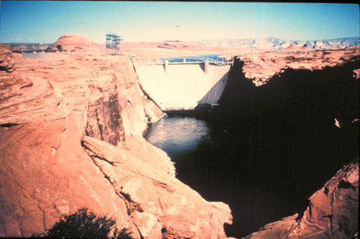

Slide 48
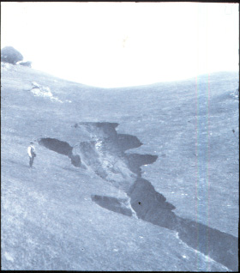
Gully Erosion

Slide 49
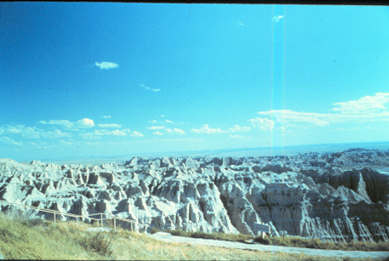
Badlands Erosion

Slide 50
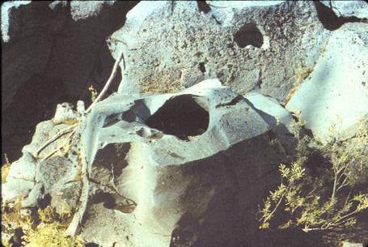
Potholes

Slide 51
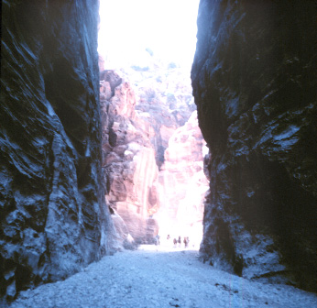
Slot Canyon

Slide 52
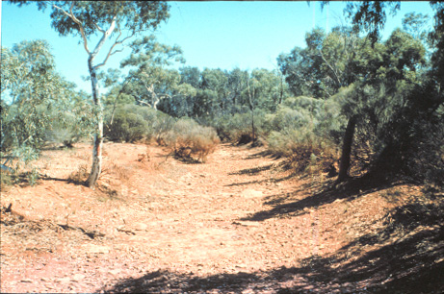
Arroyo (Wadi)

Slide 53
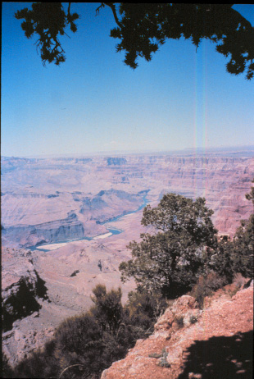
Grand Canyon

Slide 54
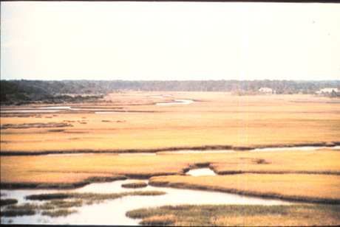
Low Gradient Coast Plain river

Slide 55
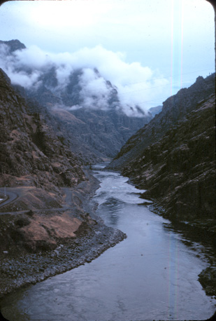

Slide 56
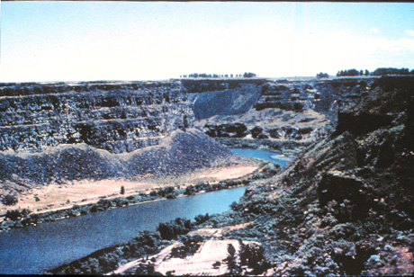
Snake river

Slide 63
Terraces

Slide 71
River Delta and Mountain Streams
Figure 6.5b

Slide 72
Knick Point

Slide 73
Yellowstone Falls

Slide 76
Watershed Dynamics

Slide 80
Drainage Network (watersheds)

Slide 85
Base Level Changes

Slide 86
Dendritic
Radial
Rectangular
Trellis

