Slide 1
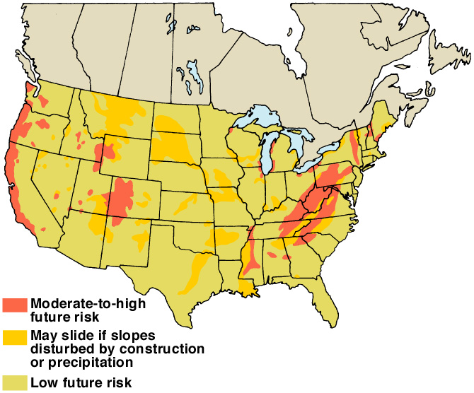
Landslide Potential
Figure 8.1
After U. S. Geological Survey Professional Paper 950, 1978

Slide 2
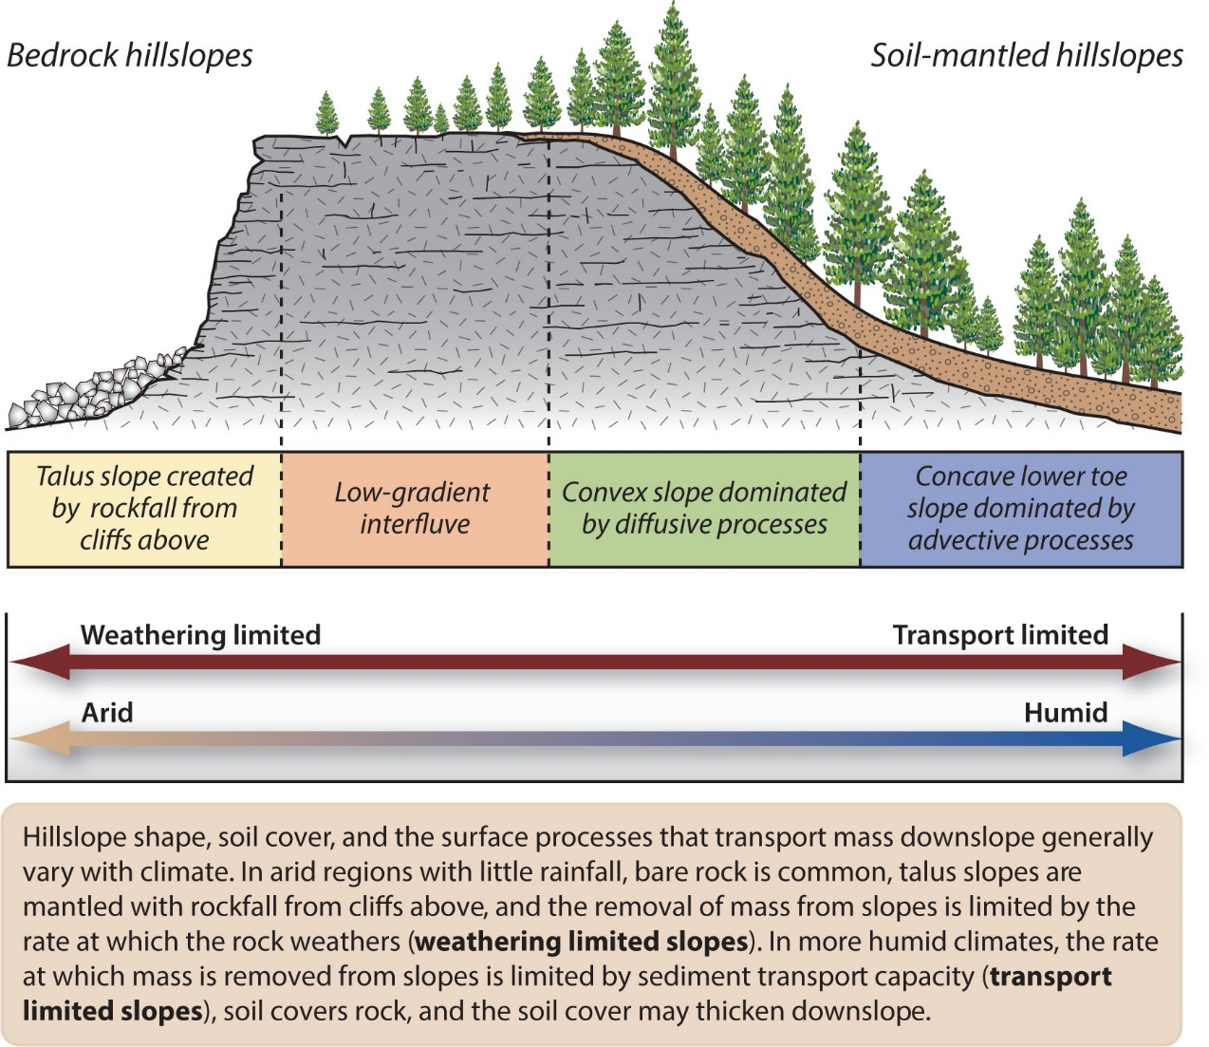

Slide 3
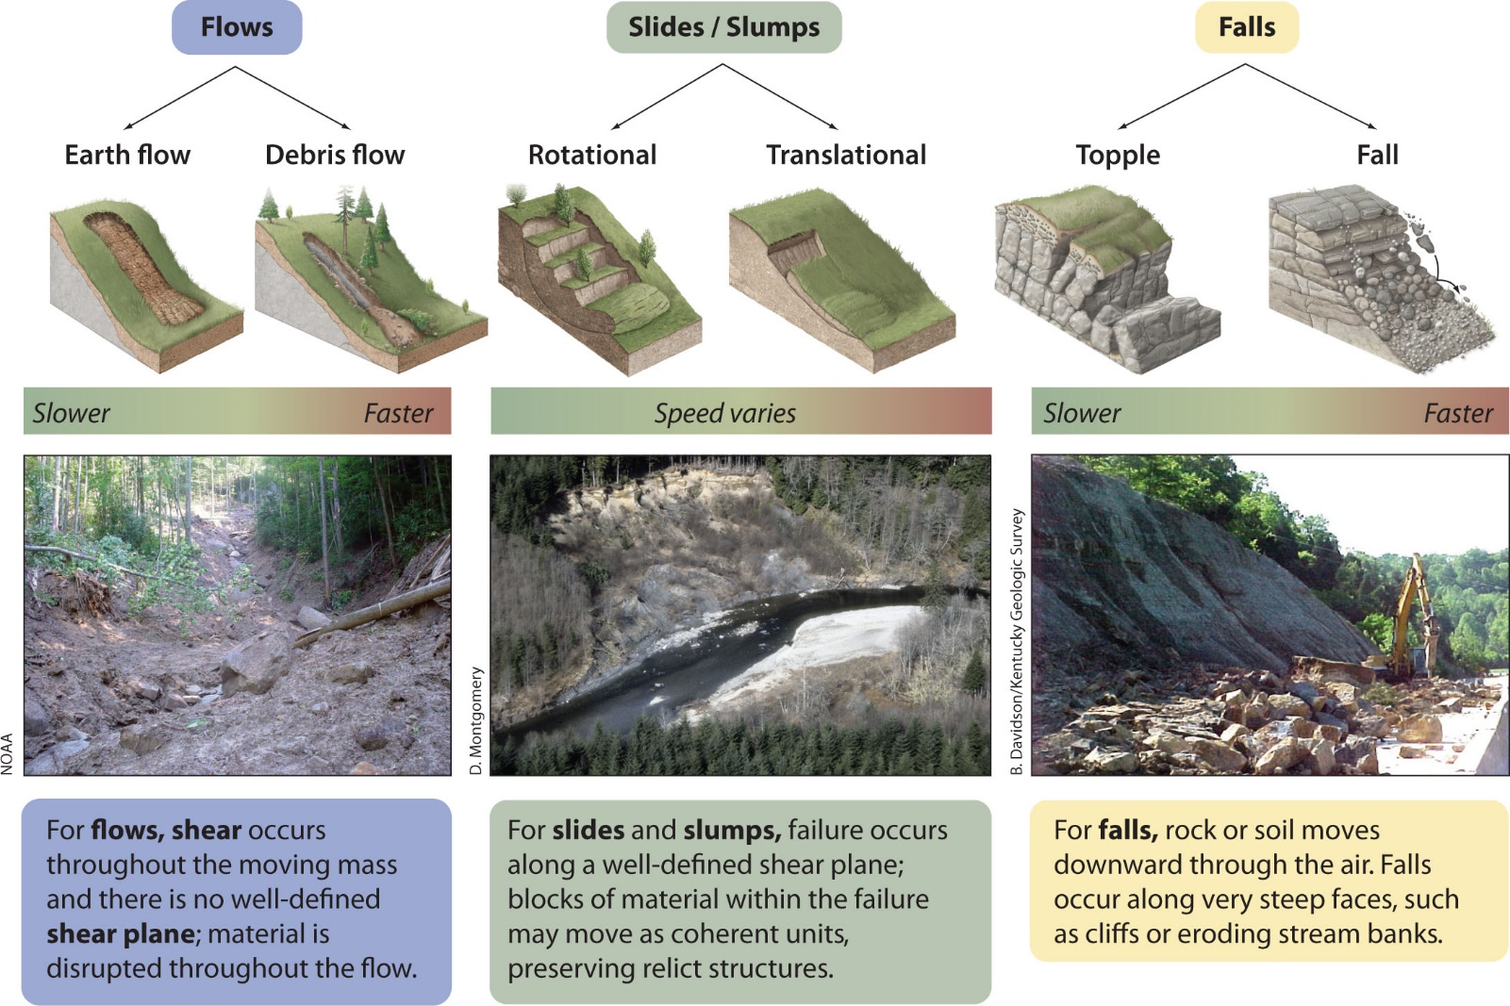

Slide 4
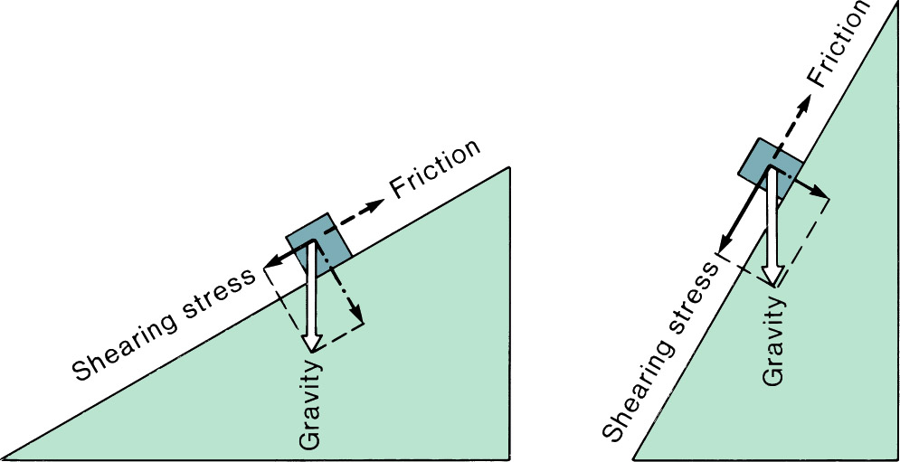
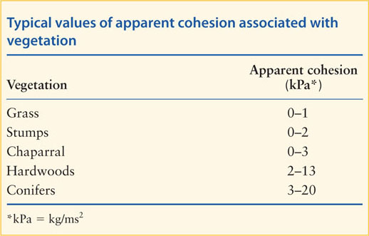
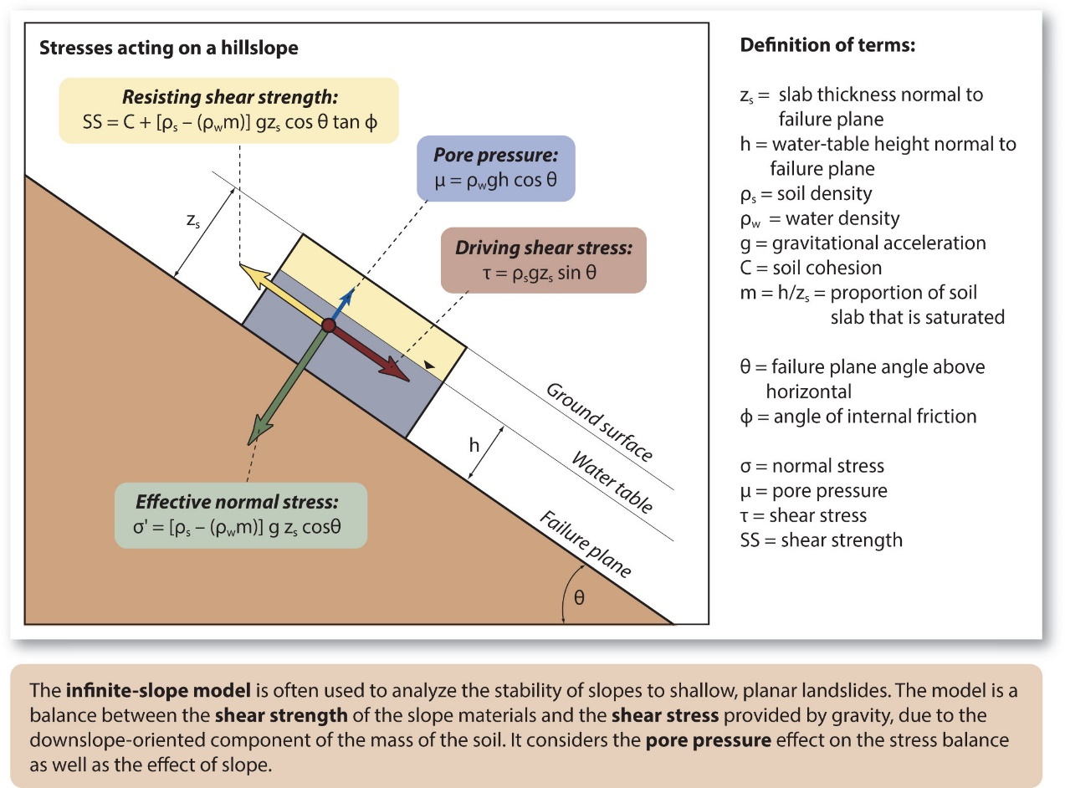
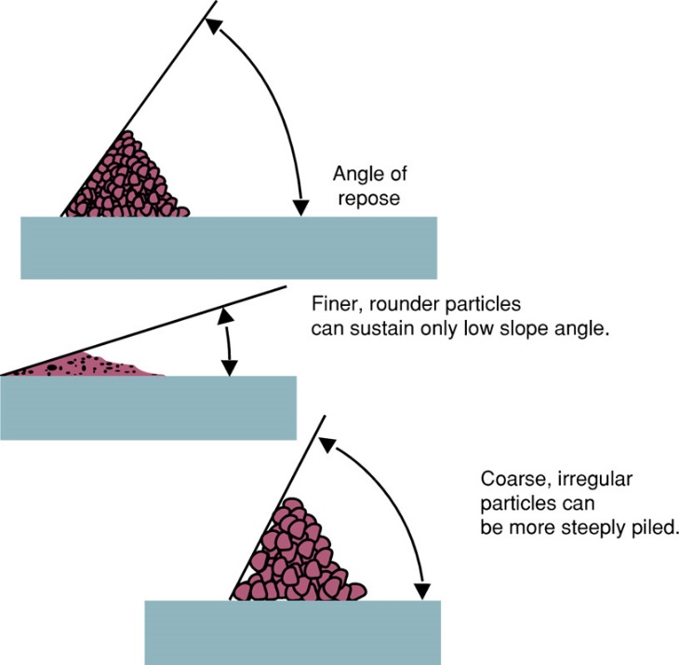
Effects of Slope Geometry
Figure 8.2

Slide 5
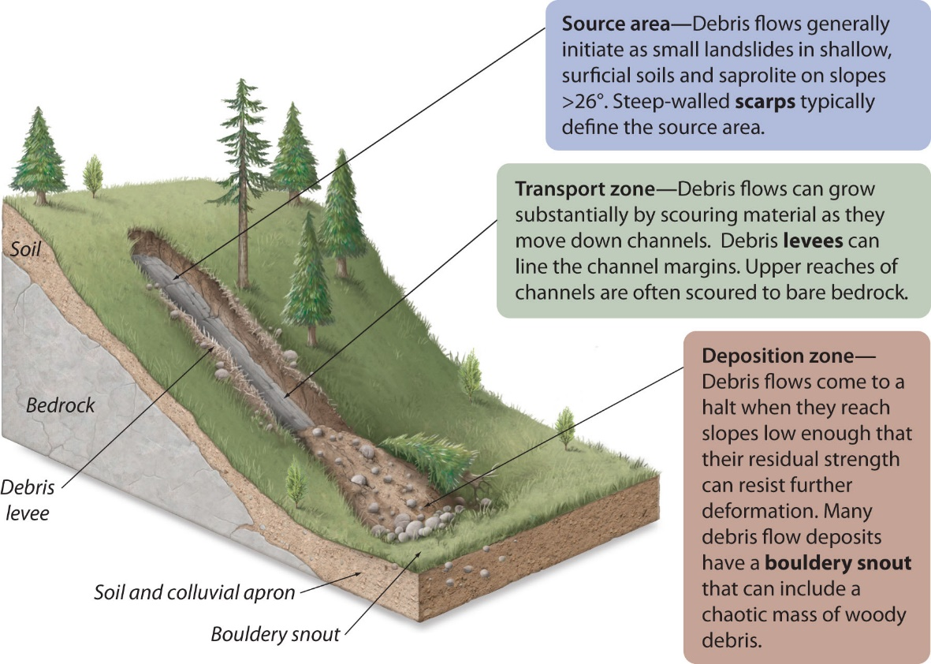
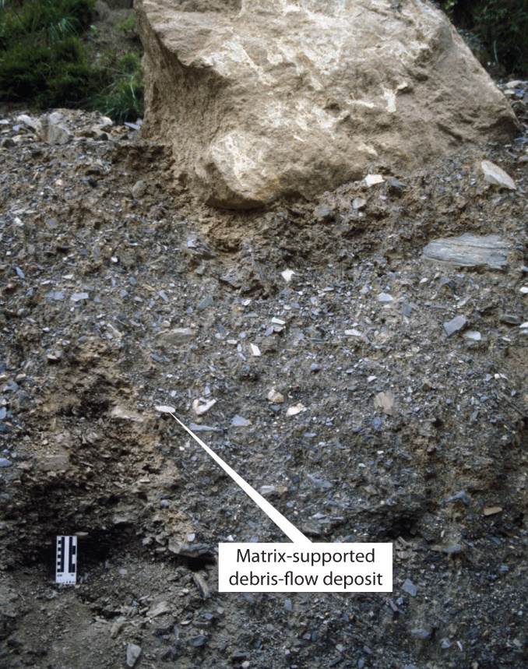
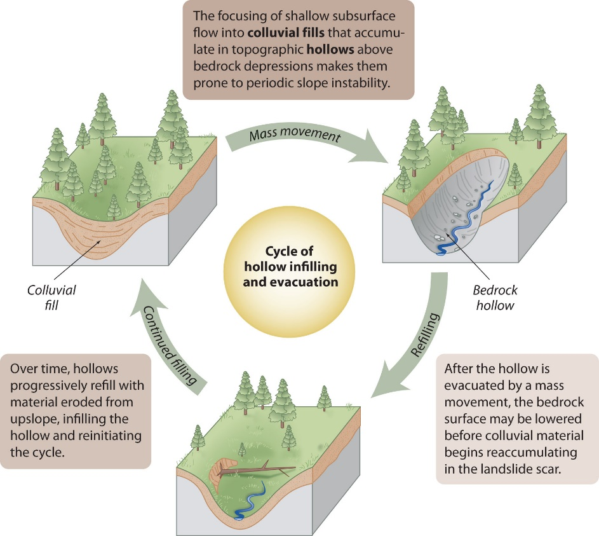
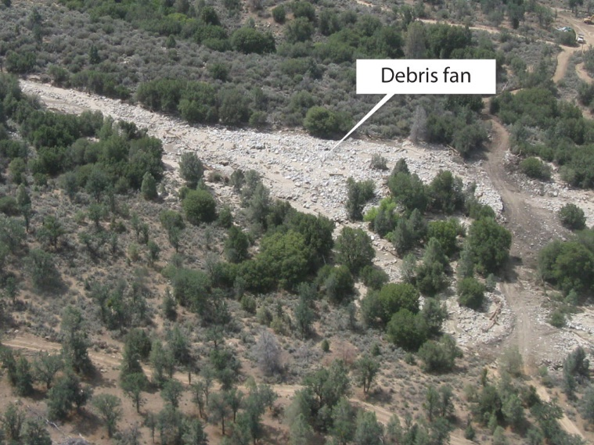
Angle
Of
Repose
Figure 8.3a

Slide 6
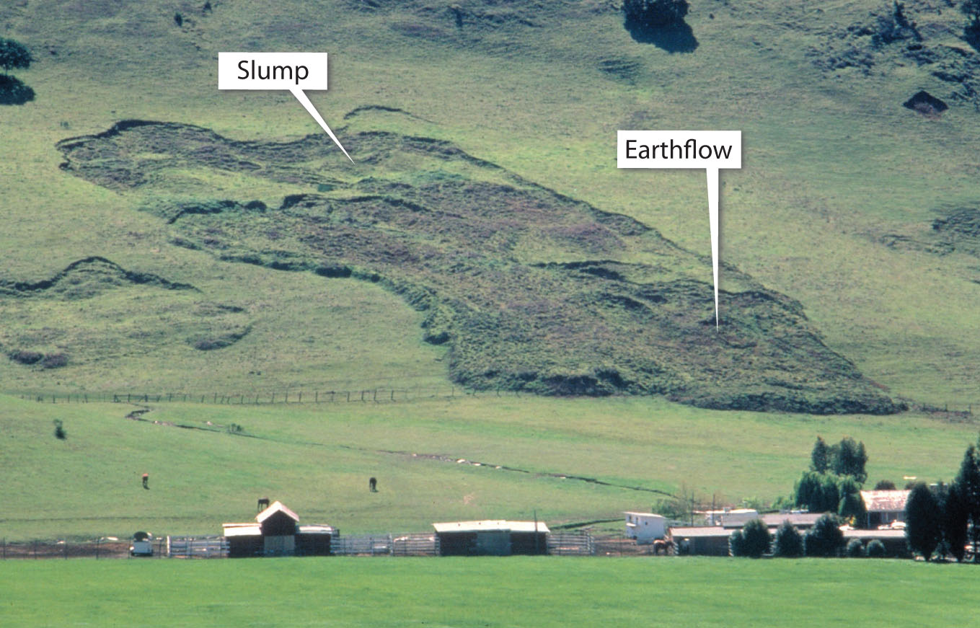
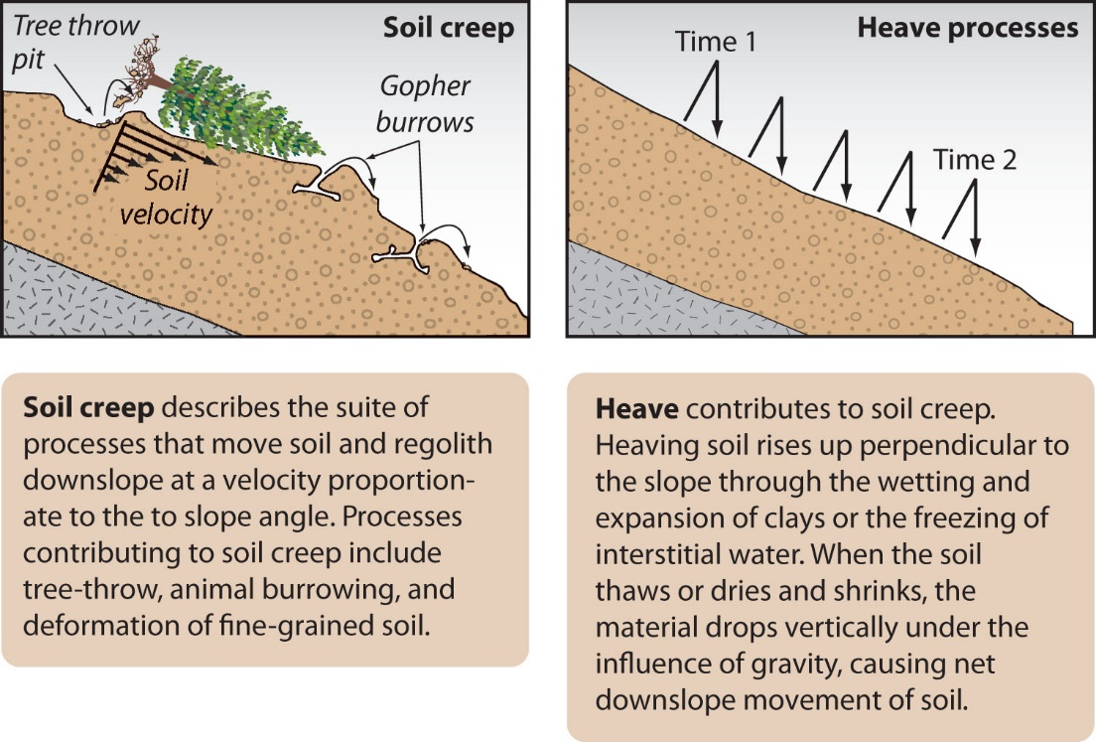
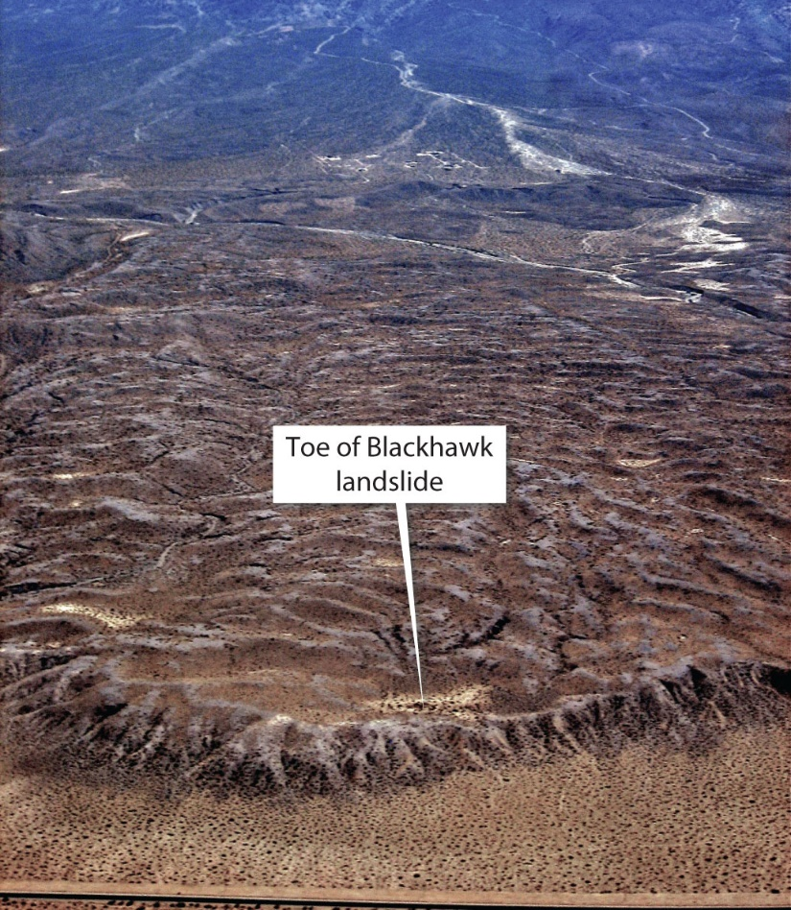
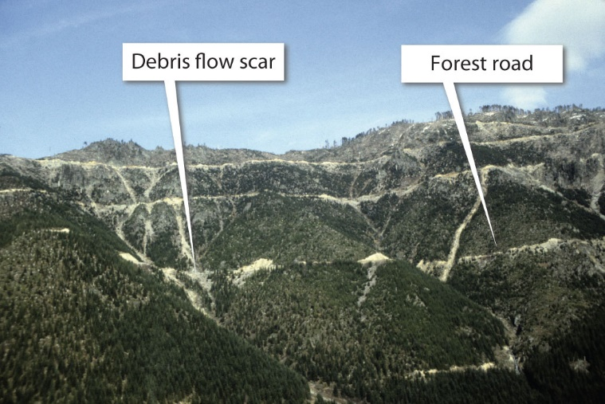

Slide 7
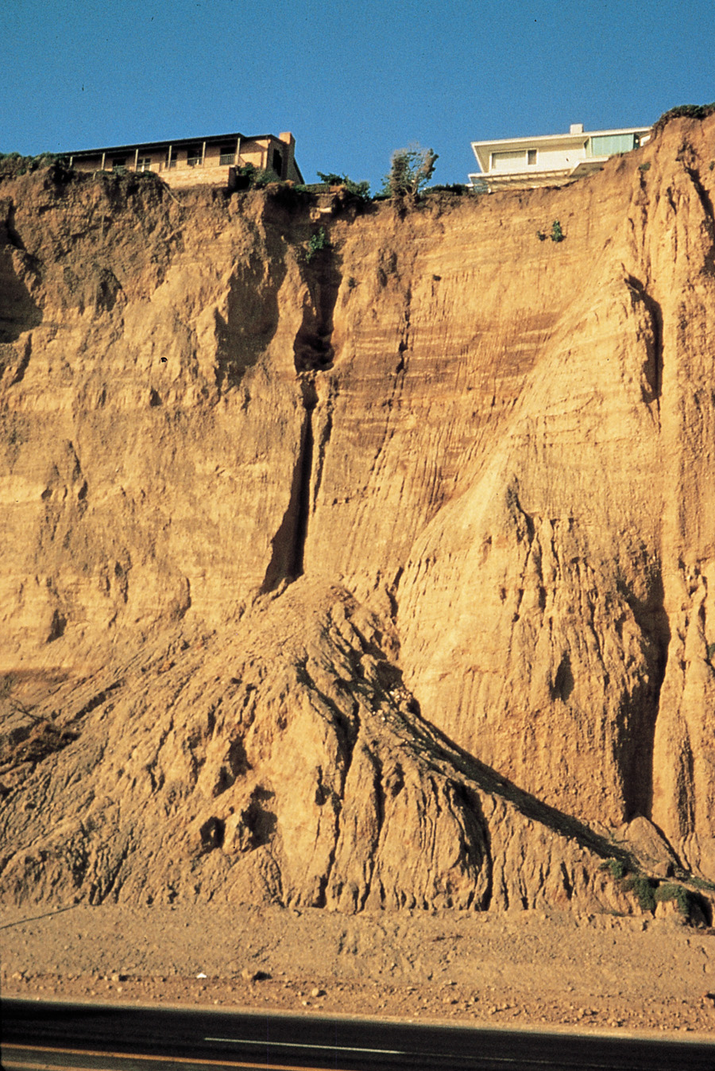
Angle
Of
Repose
Figure 8.3b

Slide 8
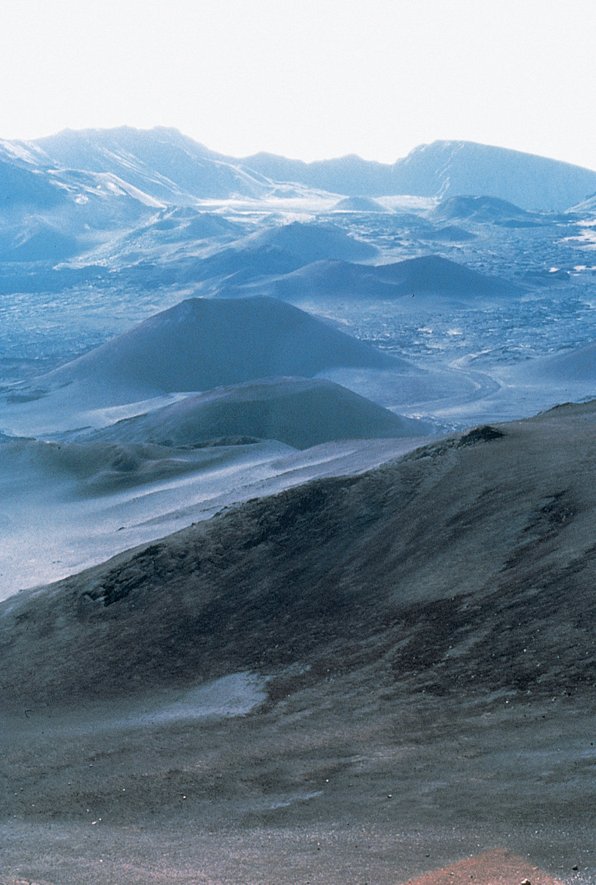
Volcano and
Sand Angle
of Repose
Figure 8.4a

Slide 9
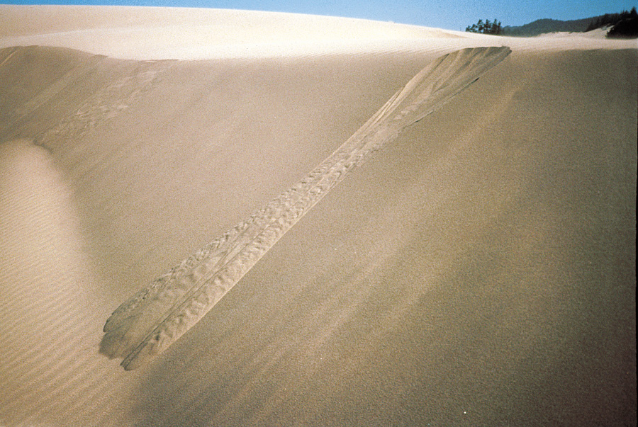
Volcano and Sand Angle of Repose
Figure 8.4b

Slide 10
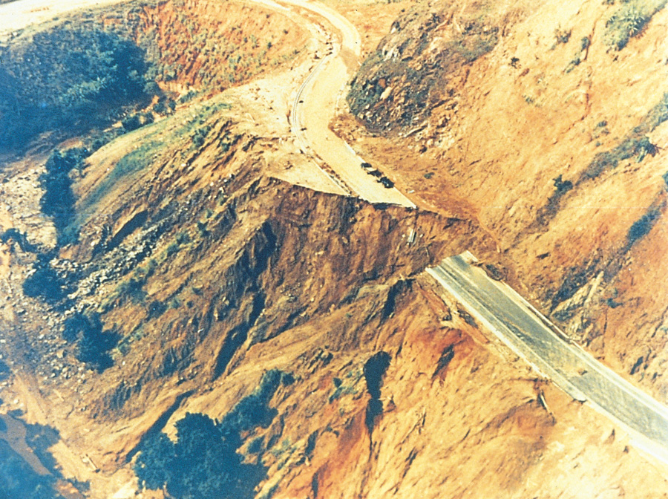
Slope Failure
Figure 8.5

Slide 11
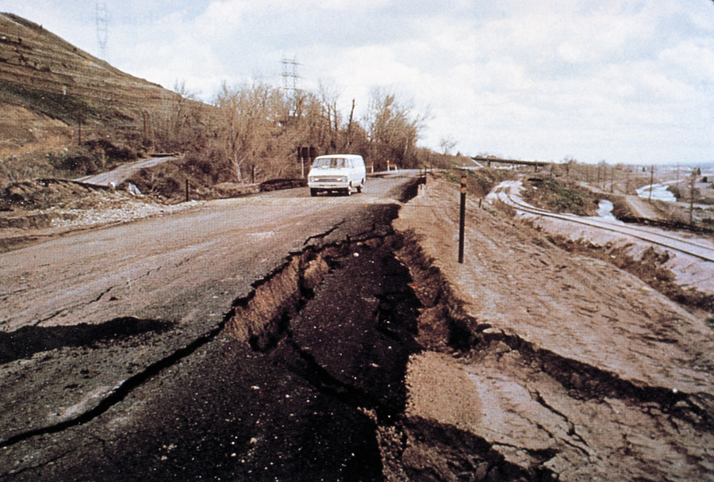
Instability of Expansive Clay
Figure 8.6

Slide 12
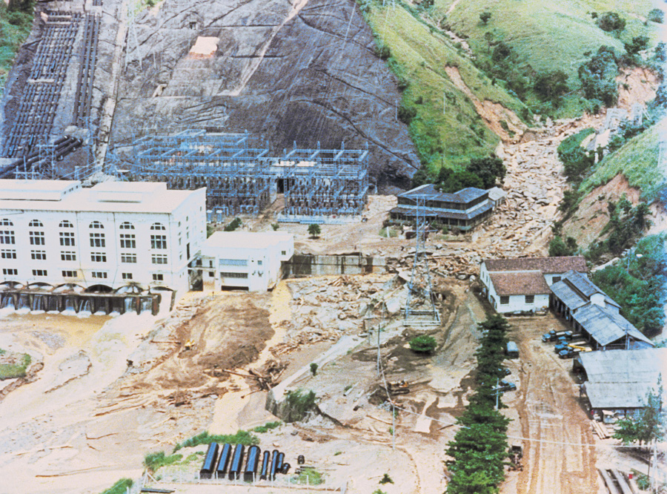
Landslide in Brazil
Figure 8.7

Slide 13
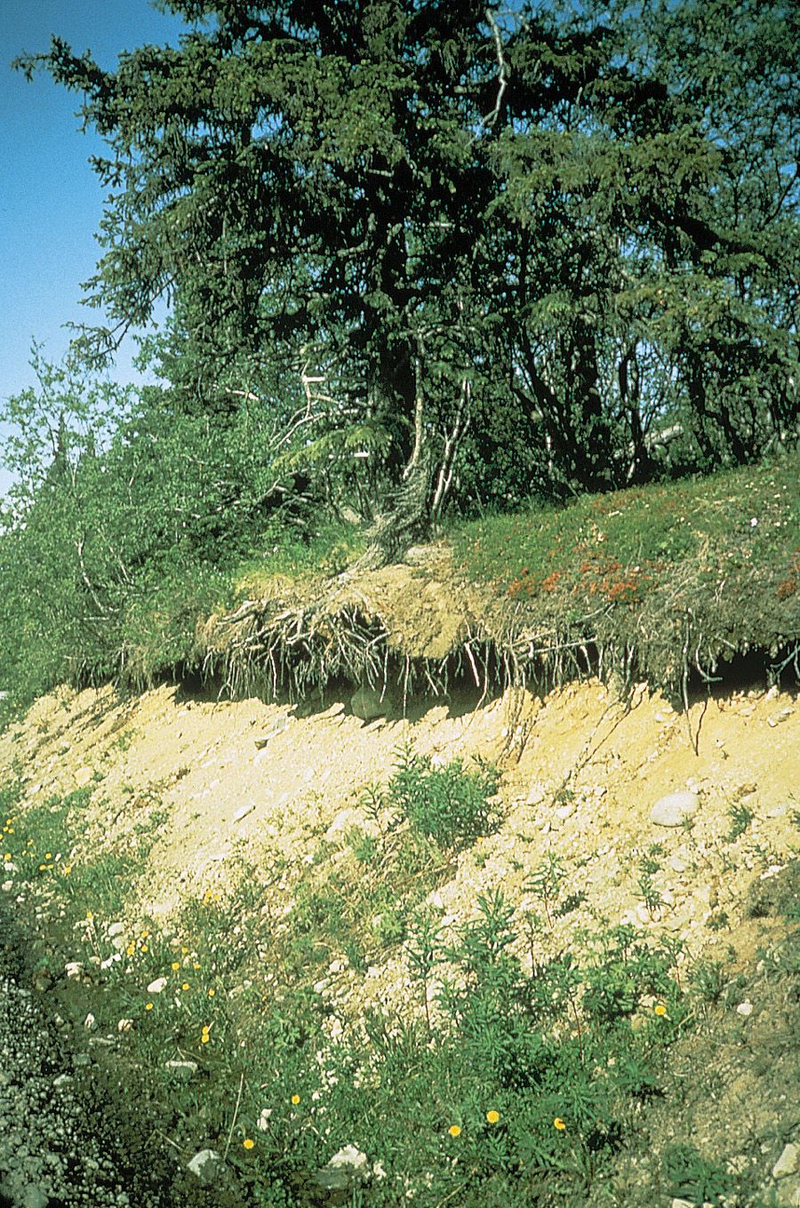
Erosion
and Slope
Failure
Figure 8.8

Slide 14
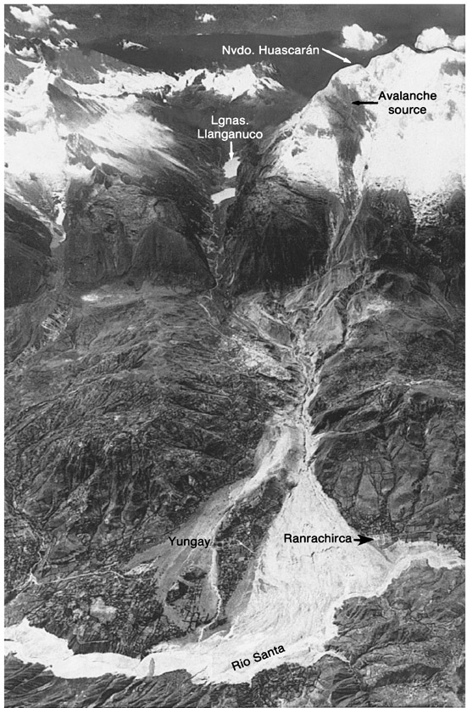
Avalanche
Figure 8.9a

Slide 15
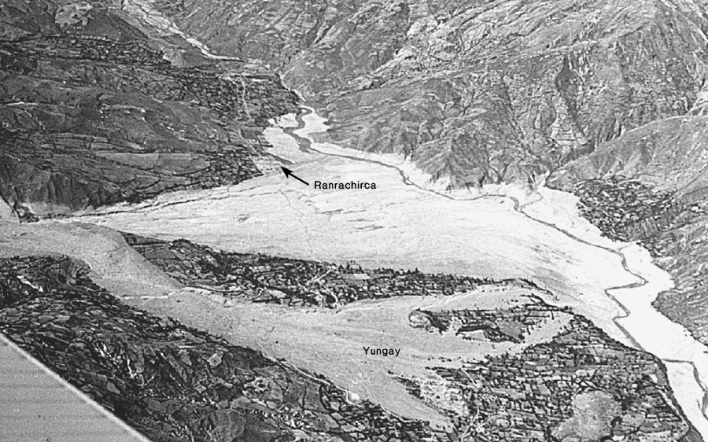
Avalanche
Figure 8.9b

Slide 16
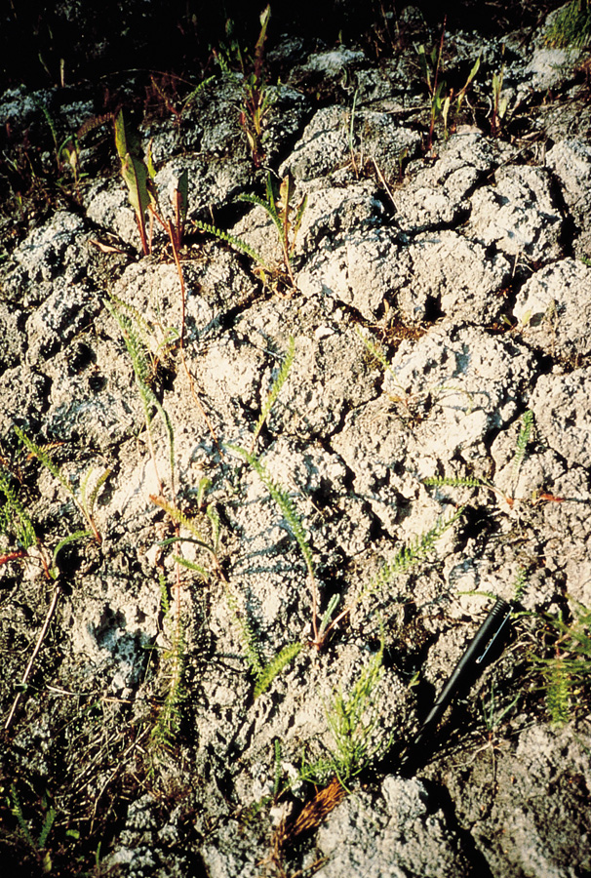
Quick Clay
Figure 8.10

Slide 17
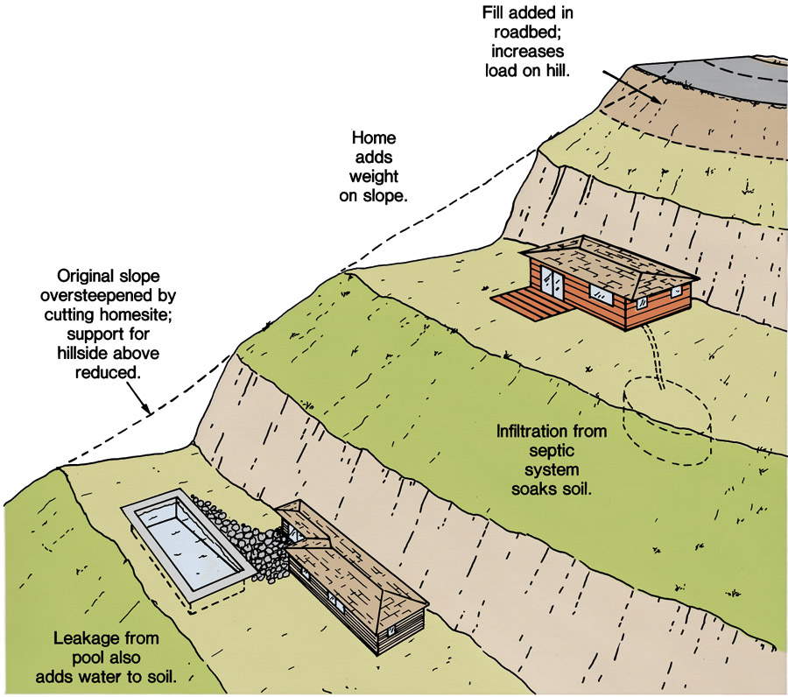
Construction and Human Habitation
Figure 8.11

Slide 18
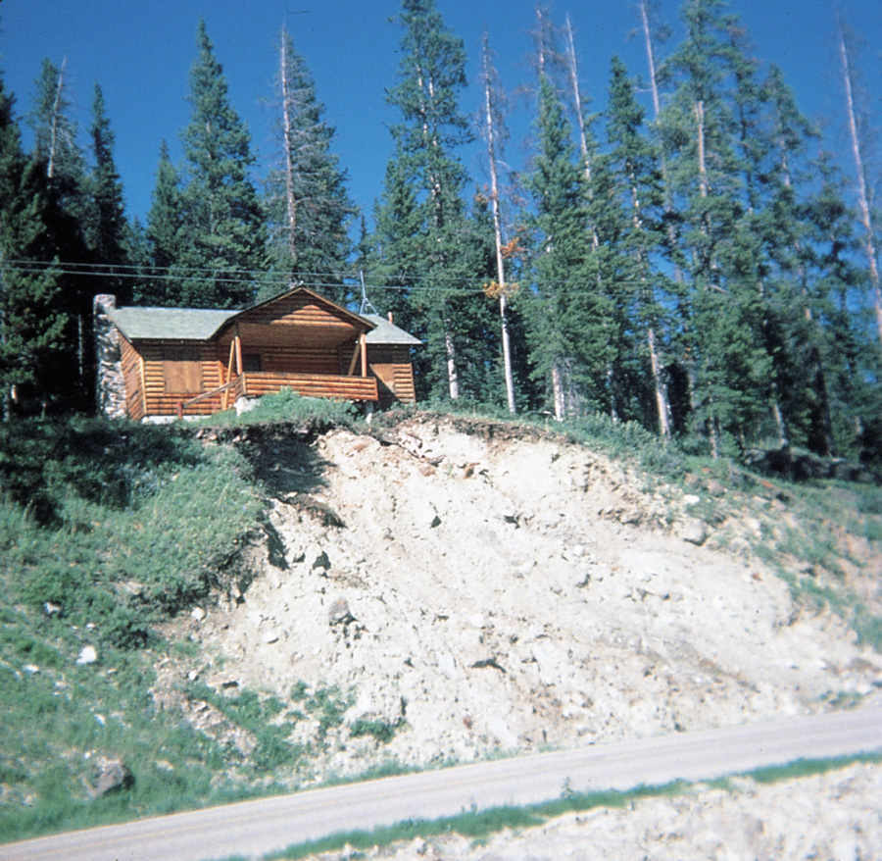
Failure of Steep, Unvegetated Slope
Figure 8.12

Slide 19
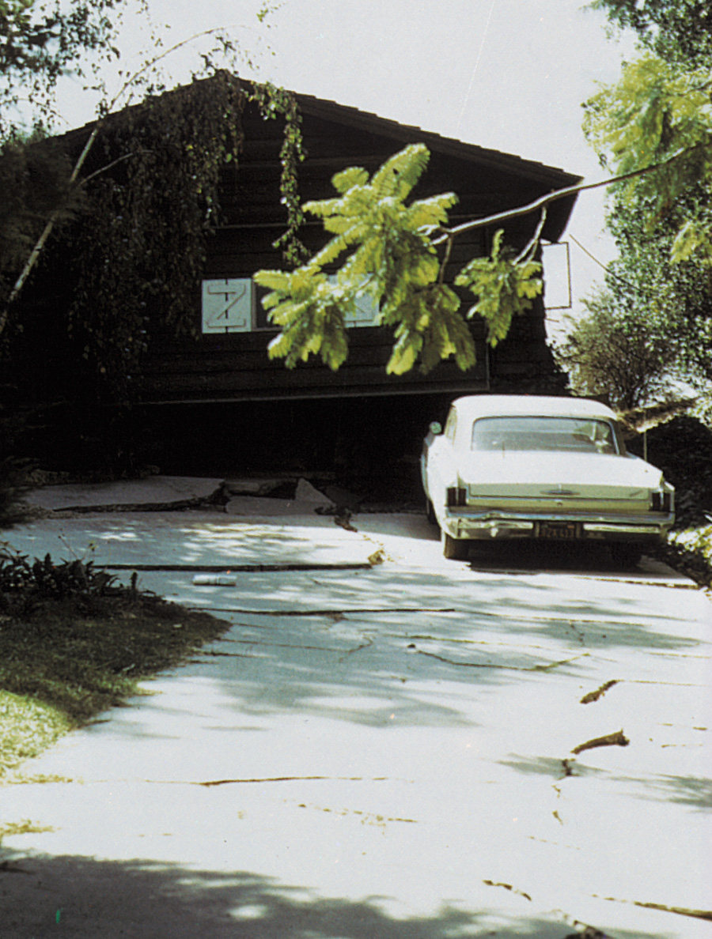
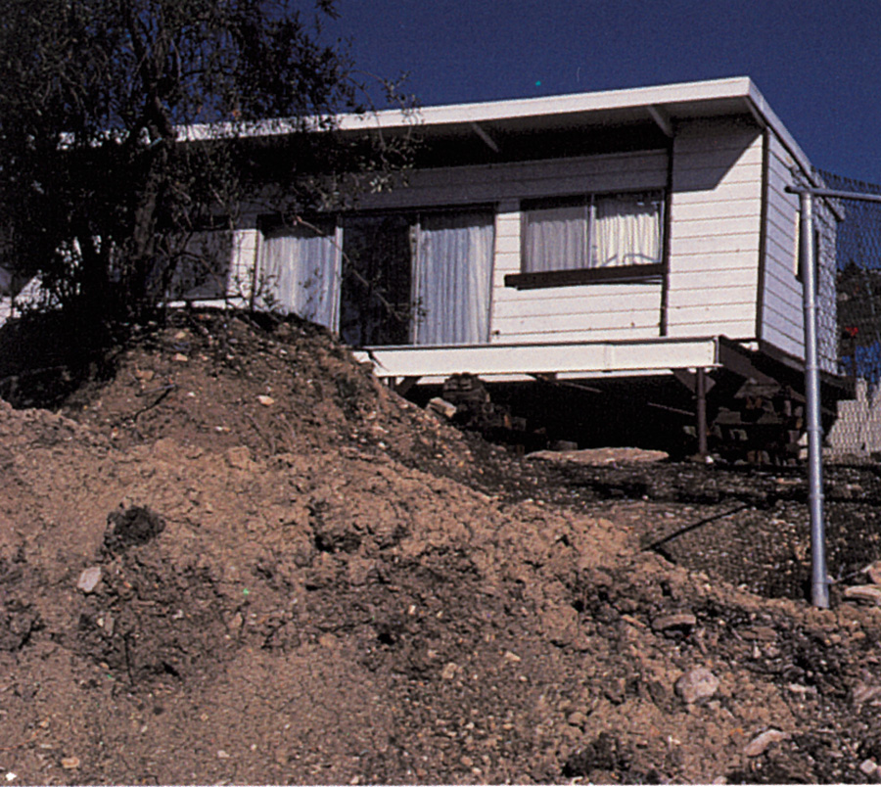
Damage from Portuguese Bend Landslide
Figure 8.13a, b
A
B

Slide 20
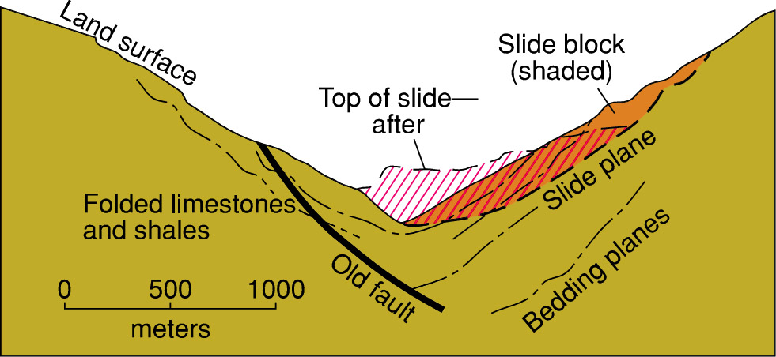
Geologic Cross Section
Box 8.1 Figure 1

Slide 21
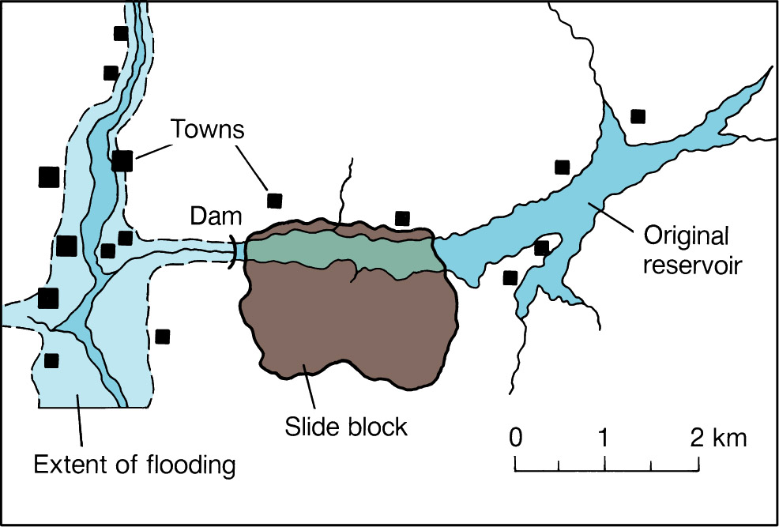
Landslide
Box 8.1 Figure 2

Slide 22
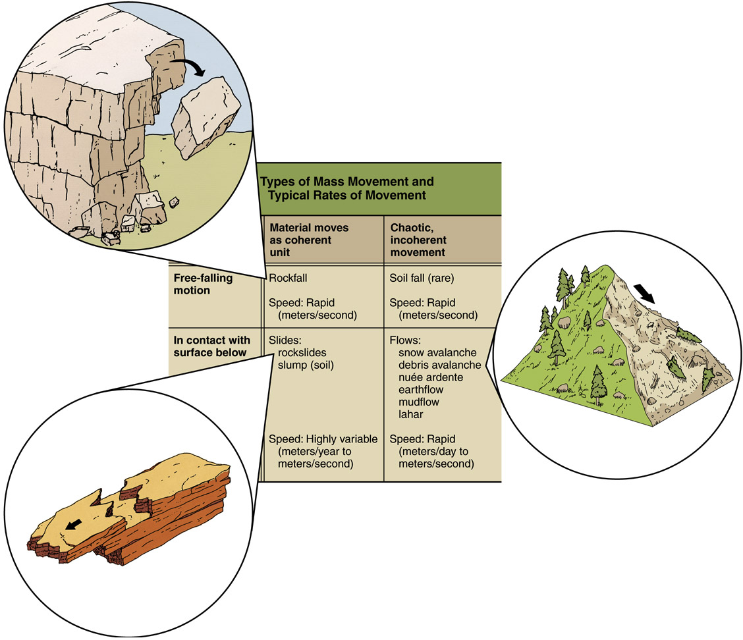
Types of Mass Movements
Figure 8.14

Slide 23
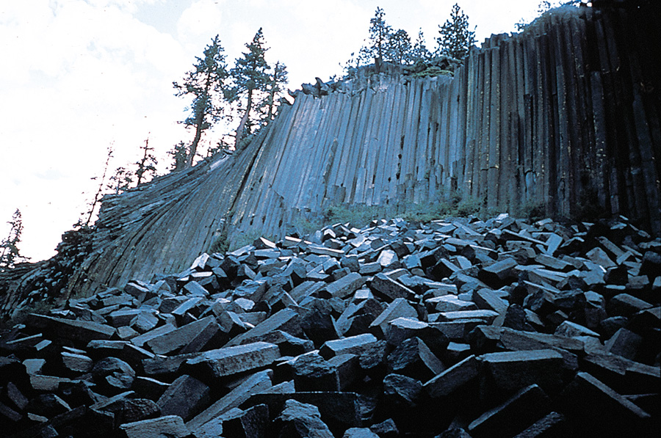
Devil’s Postpile National Monument
Figure 8.15

Slide 24
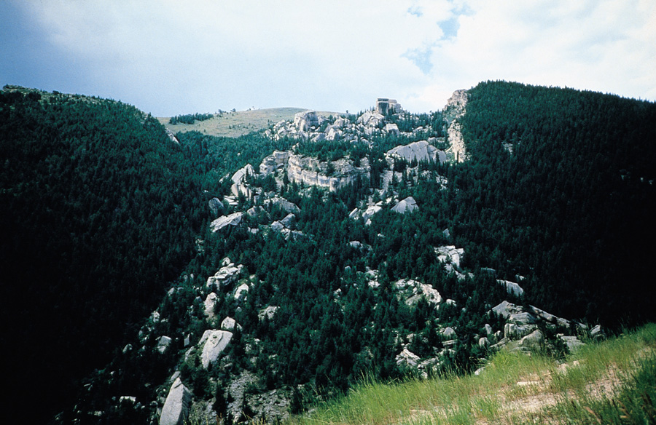
“Fallen City” Rockslide
Figure 8.16

Slide 25
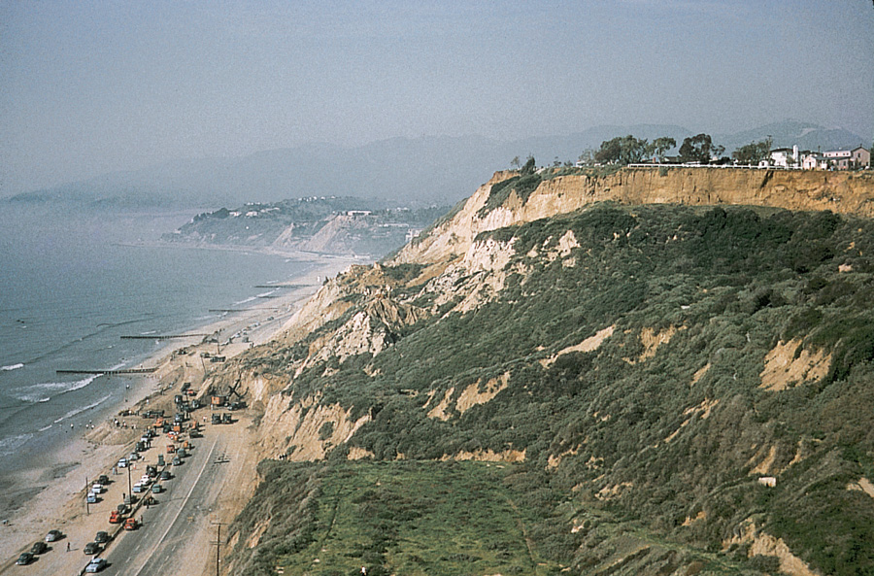
Slump in Pacific Palisades
Figure 8.17

Slide 26
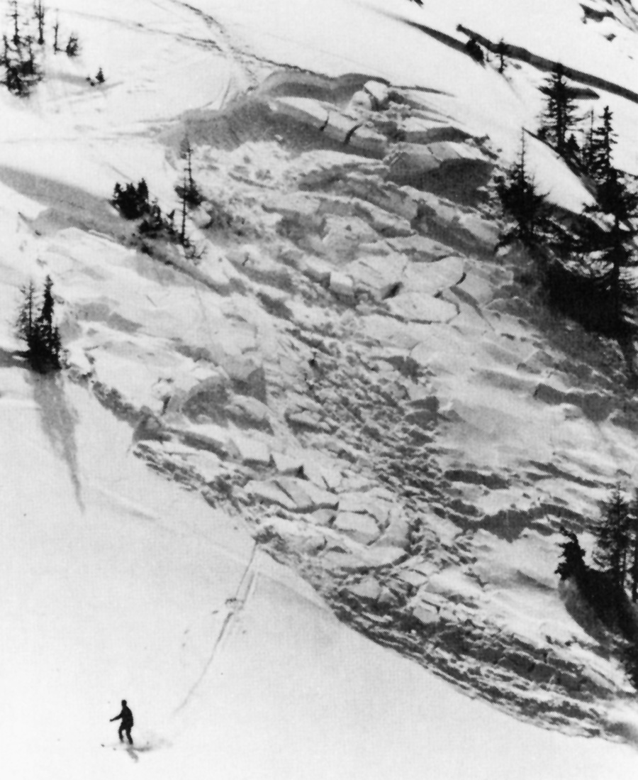
Snow
Avalanche
Figure 8.18

Slide 27
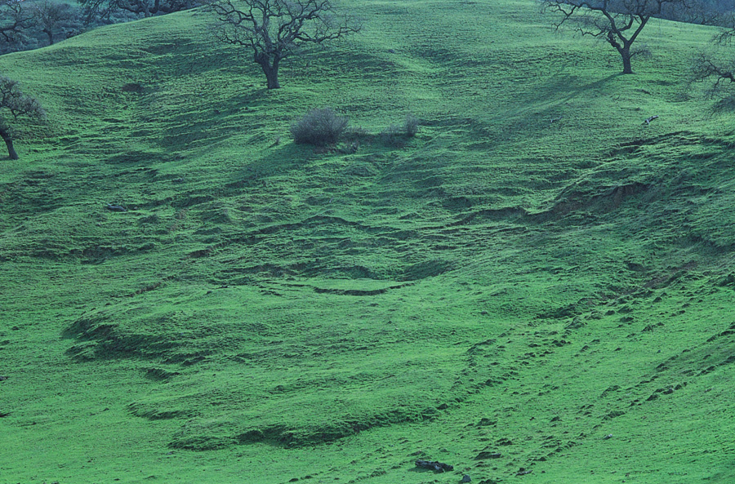
Earthflow
Figure 8.19

Slide 28
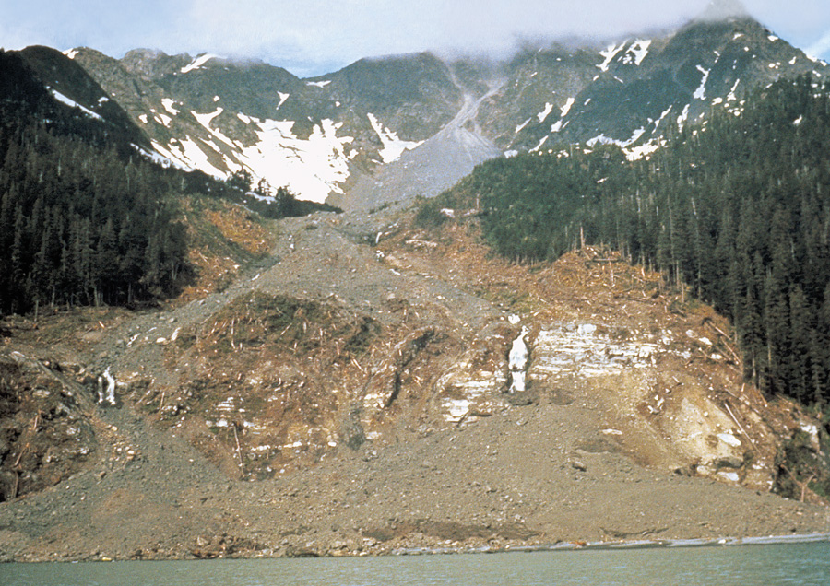
Puget Peak Debris Avalanche
Figure 8.20

Slide 29
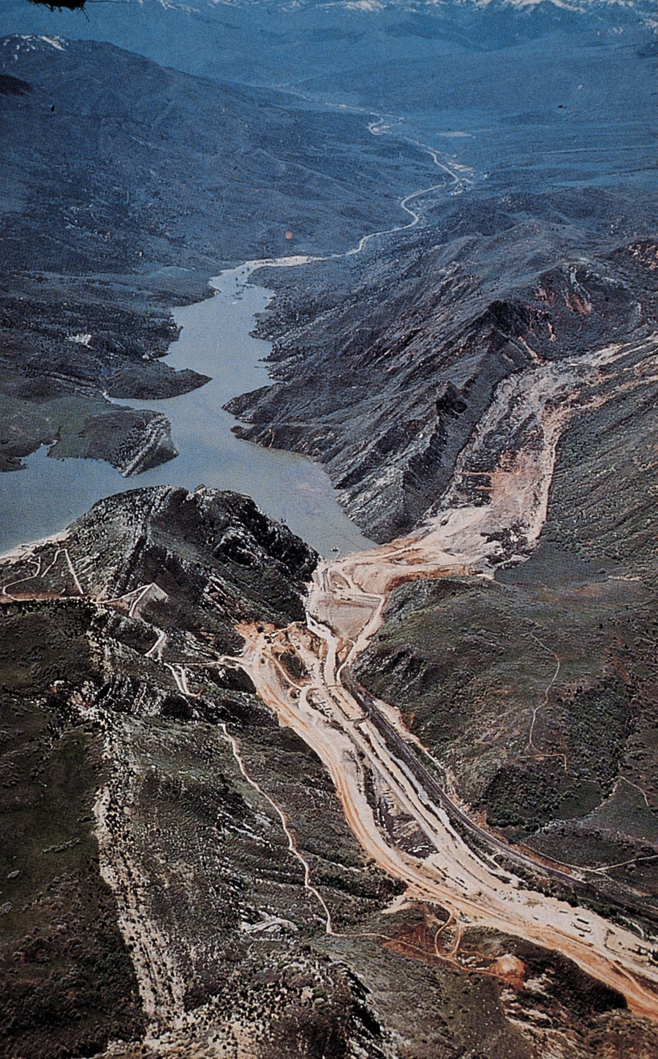
Slide near
Thistle, Utah
Figure 8.21

Slide 30
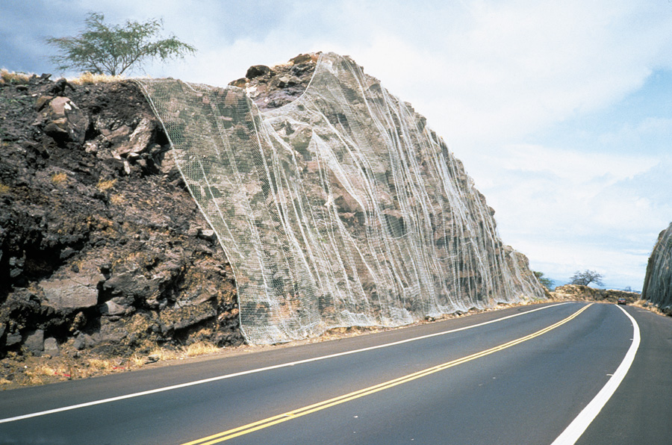
Reduce Consequences of Slope Instability
Figure 8.22a

Slide 31
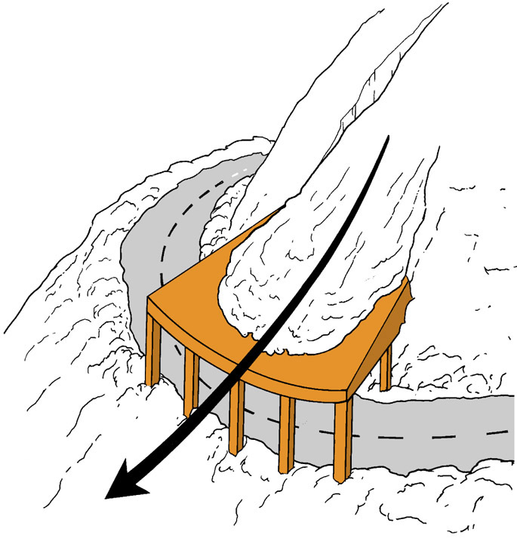
Reduce Consequences of Slope Instability
Figure 8.22b

Slide 32
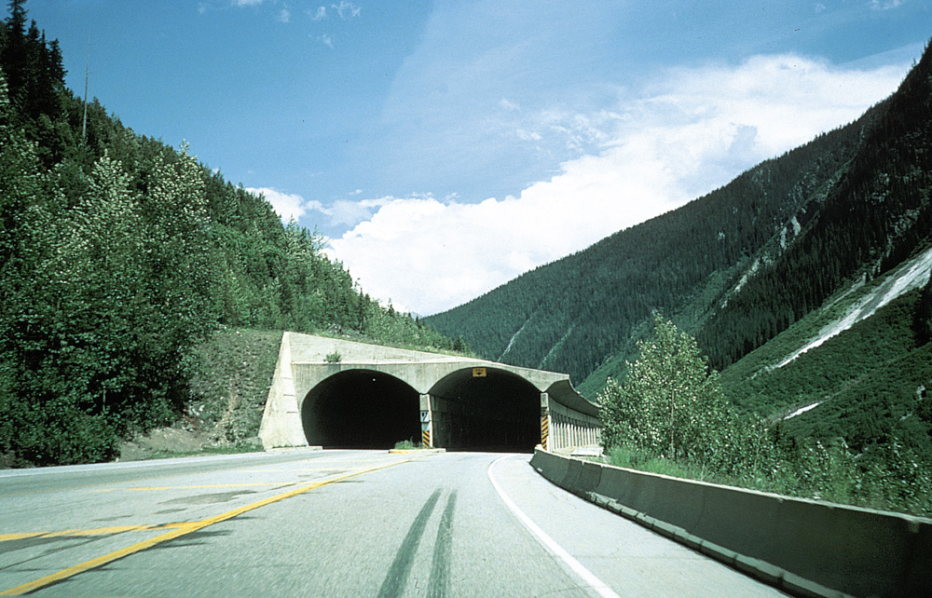
Reduce Consequences of Slope Instability
Figure 8.22c

Slide 33
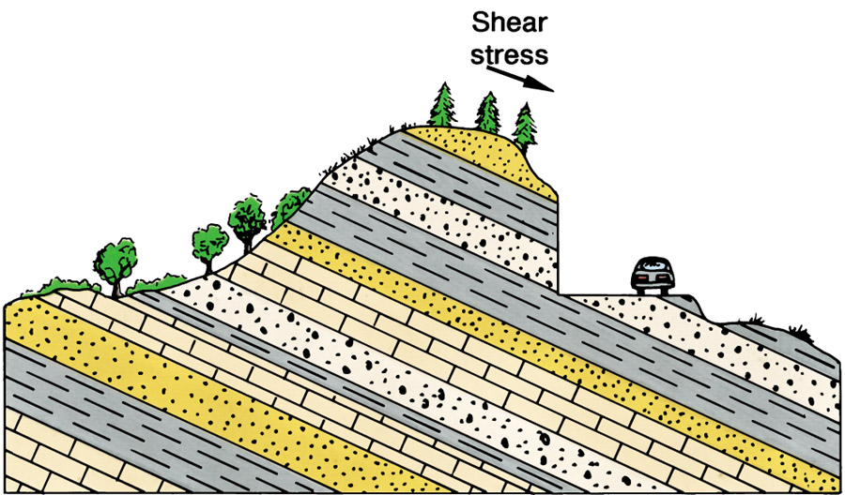
Slope Stabilization
Figure 8.23a

Slide 34
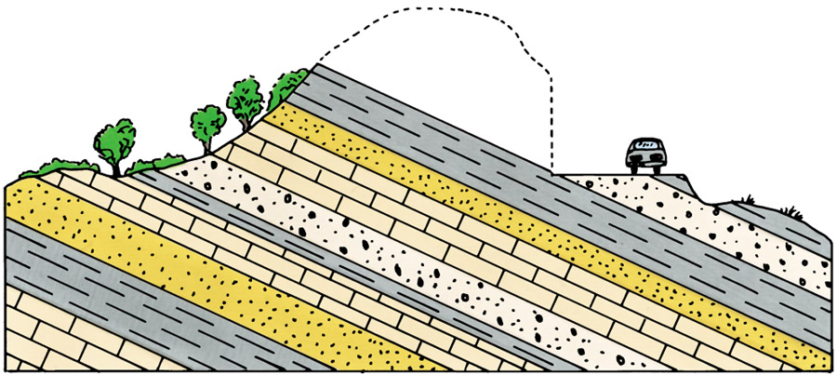
Slope Stabilization
Figure 8.23b

Slide 35
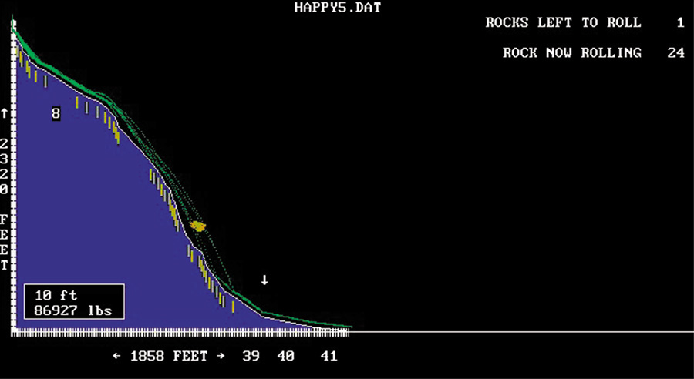
Rock Fall
Box 8.2 Figure 1

Slide 36
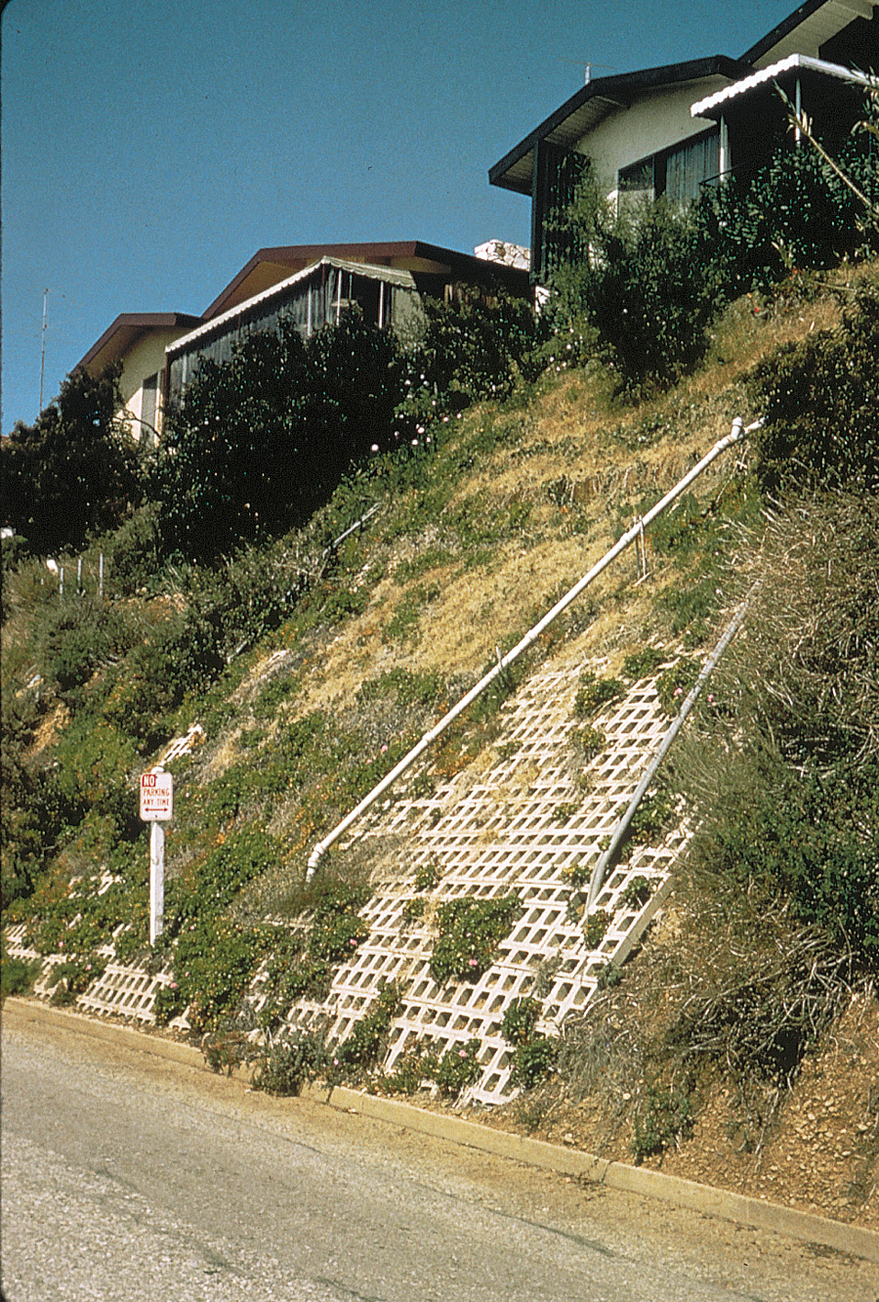
Retaining Wall
Figure 8.24

Slide 37
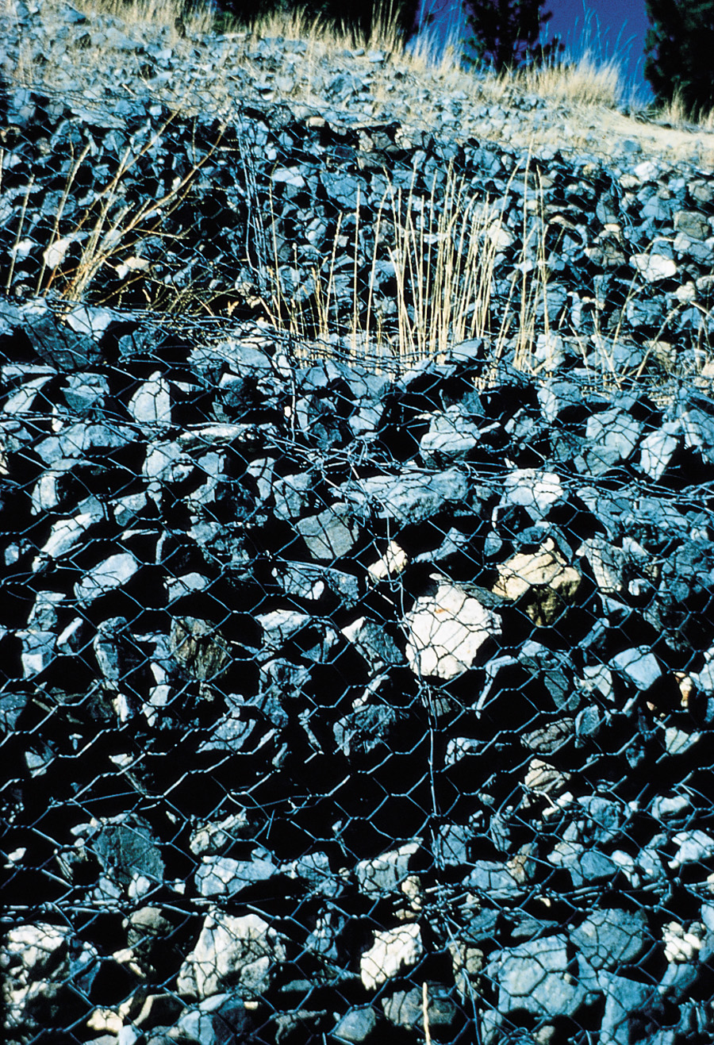
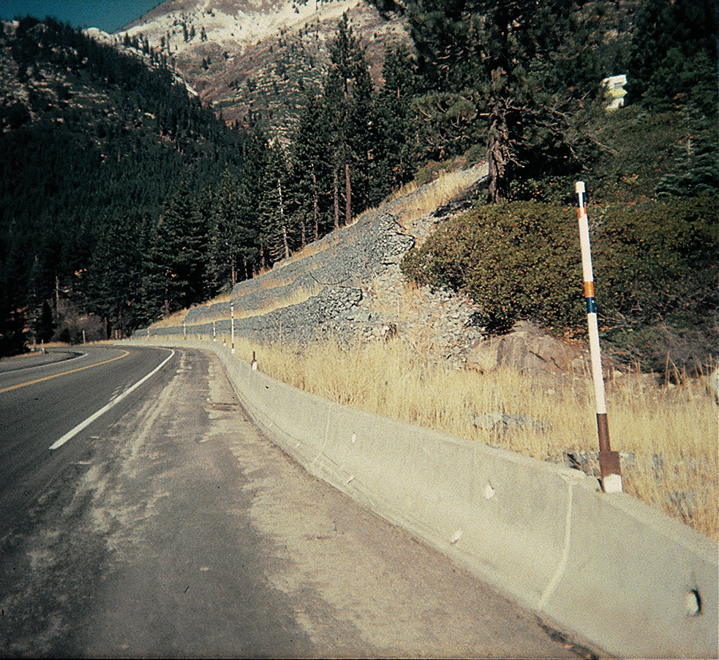
Stabilizing a Slope
Figure 8.25a, b
A
B

Slide 38
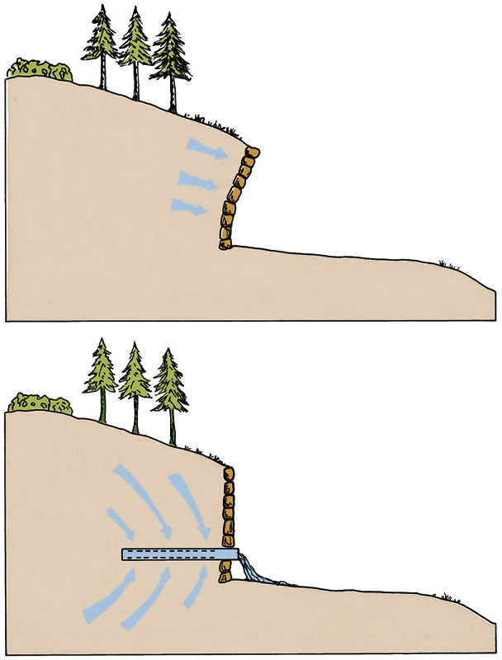
Improved
Drainage
Figure 8.26a, b
A
B

Slide 39
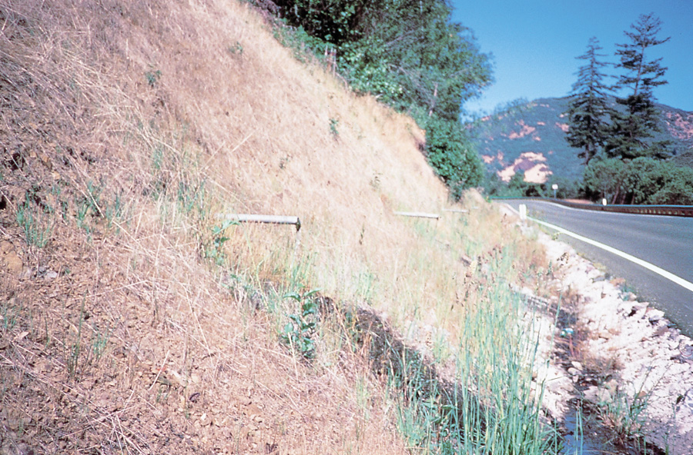
Improved Drainage
Figure 8.26c

Slide 40
Stabilizing a Slope
Figure 8.27a

Slide 41
Rock Block Slides

Slide 42
Stabilizing a Slope
Figure 8.27b

Slide 43
Failure of Vegetation on Slopes
Figure 8.28a, b
B
A

Slide 44
Signs of Creep
Figure 8.29a

Slide 45
Signs of Creep
Figure 8.29b

Slide 46
Slope Instability
Figure 8.30a

Slide 47
Slope Instability
Figure 8.30b

Slide 49
Spheroidal weathering

Slide 50
Exfoliation

Slide 52
Differential Weathering

Slide 53
Mass wasting
classification

Slide 54
Talus Slope
Scree
Rock Fall Mechanisms

Slide 59
Creep

Slide 60
Large-Scale Landslide

Slide 61
Terracettes

Slide 63
Landslide-Dammed
Lake

Slide 64
Don’t Buy Property Here

Slide 67
Sheeting / rock-block Slide

Slide 68
Rock Creep

