Slide 1
Weathering Processes

Slide 2
Weathering – Physical and chemical breakdown of bedrock at the Earth’s surface
Physical Weathering – cracking rocks
Frost Wedging (ice expansion)
Unloading / Pressure Release (differential rock expansion)
Thermal Heating (differential rock expansion)
Root Wedging (biologic growth / expansion)
Mineral Expansion (clay wetting, salt hydration)
Chemical Weathering – water-dominant decomposition at Earth’ surface
Hydrolosis:
alumino silicate + water --------- clay mineral + cations + acidic solution
Dissolution:
water dissolution of soluble halides (salts) and gypsum
carbonic acid + calcium carbonate = dissolution of limestone
Chelation: plant-related extraction of ionic nutrients
Oxidation: iron-mineral breaddown into FeOxyHydroxides (“rust”)

Slide 3
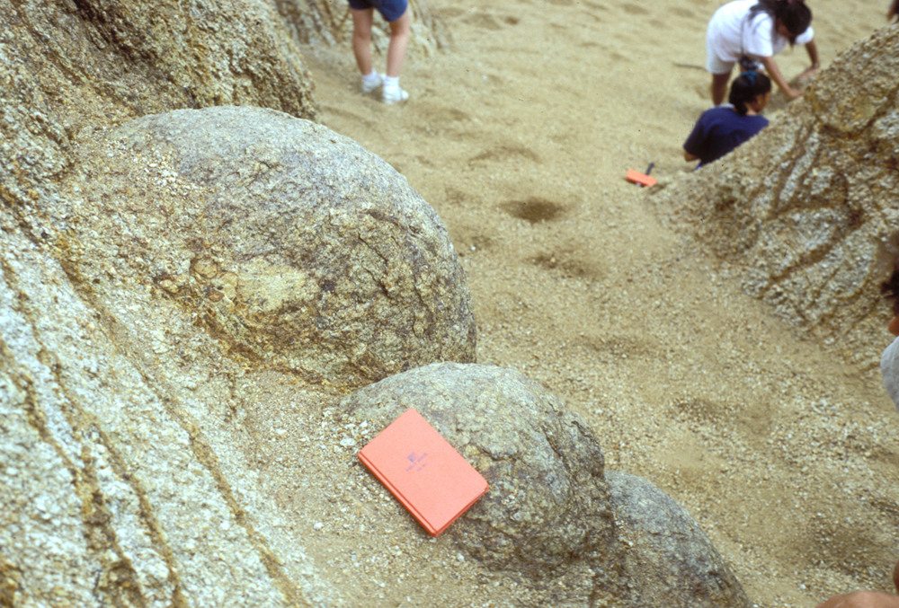
Weathered Granite + “Grus”

Slide 4
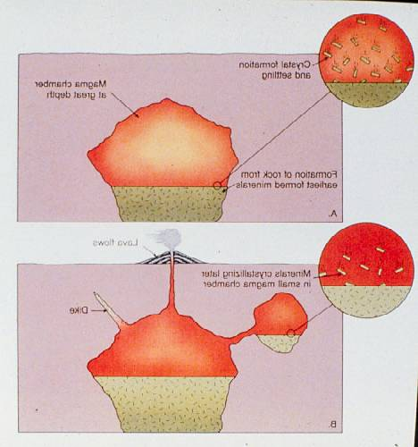

Slide 5
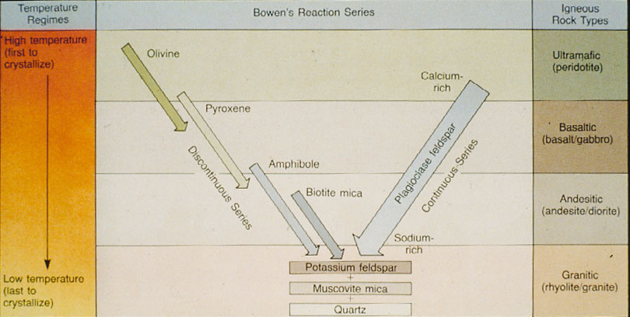

Slide 7
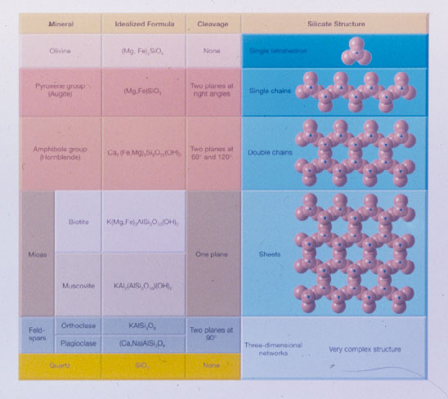

Slide 8
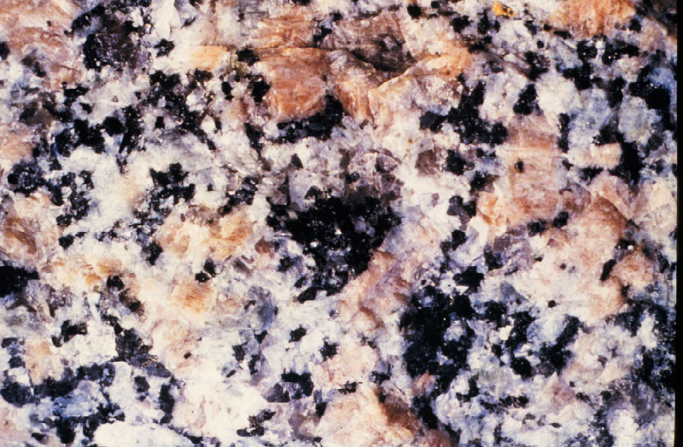

Slide 9
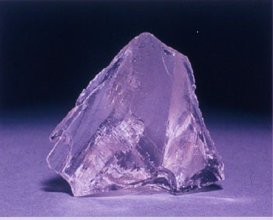

Slide 10
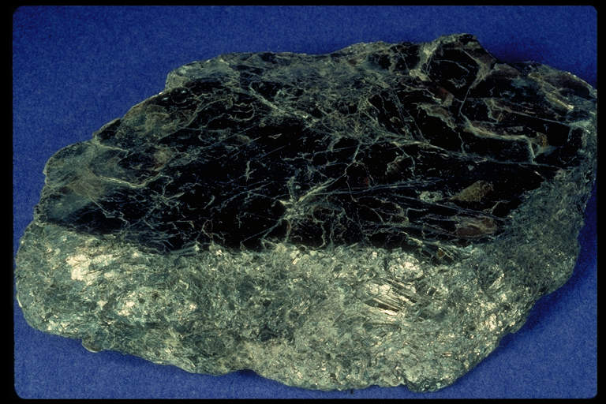
Biotite Mica

Slide 11
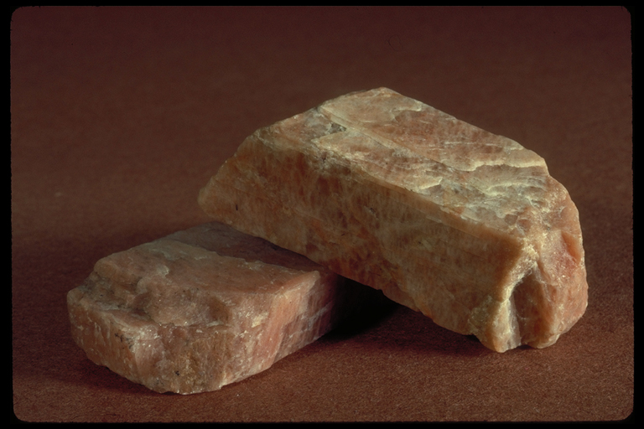
Orthoclase Feldspar

Slide 12
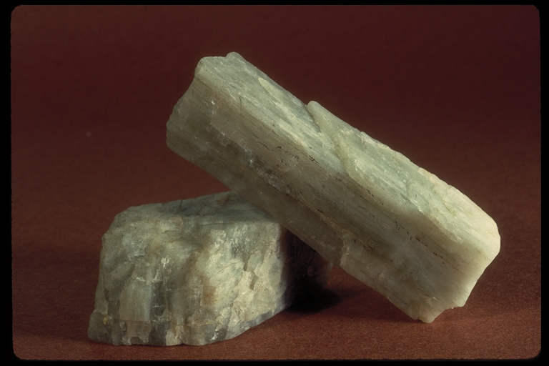
Plagioclas Feldspar

Slide 13
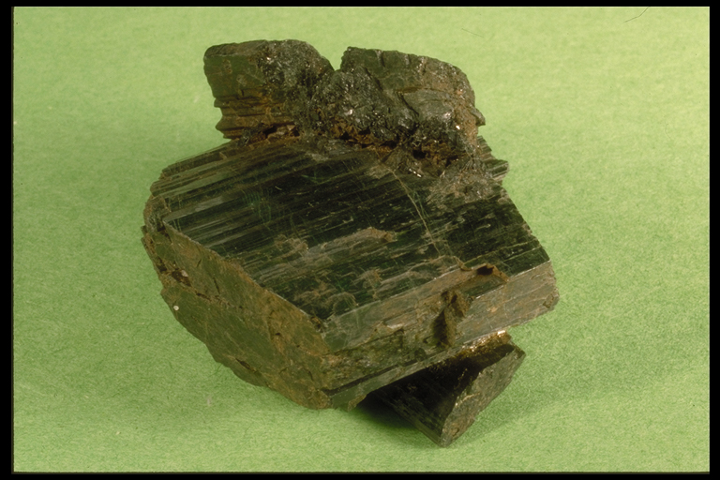
Hornblende

Slide 14
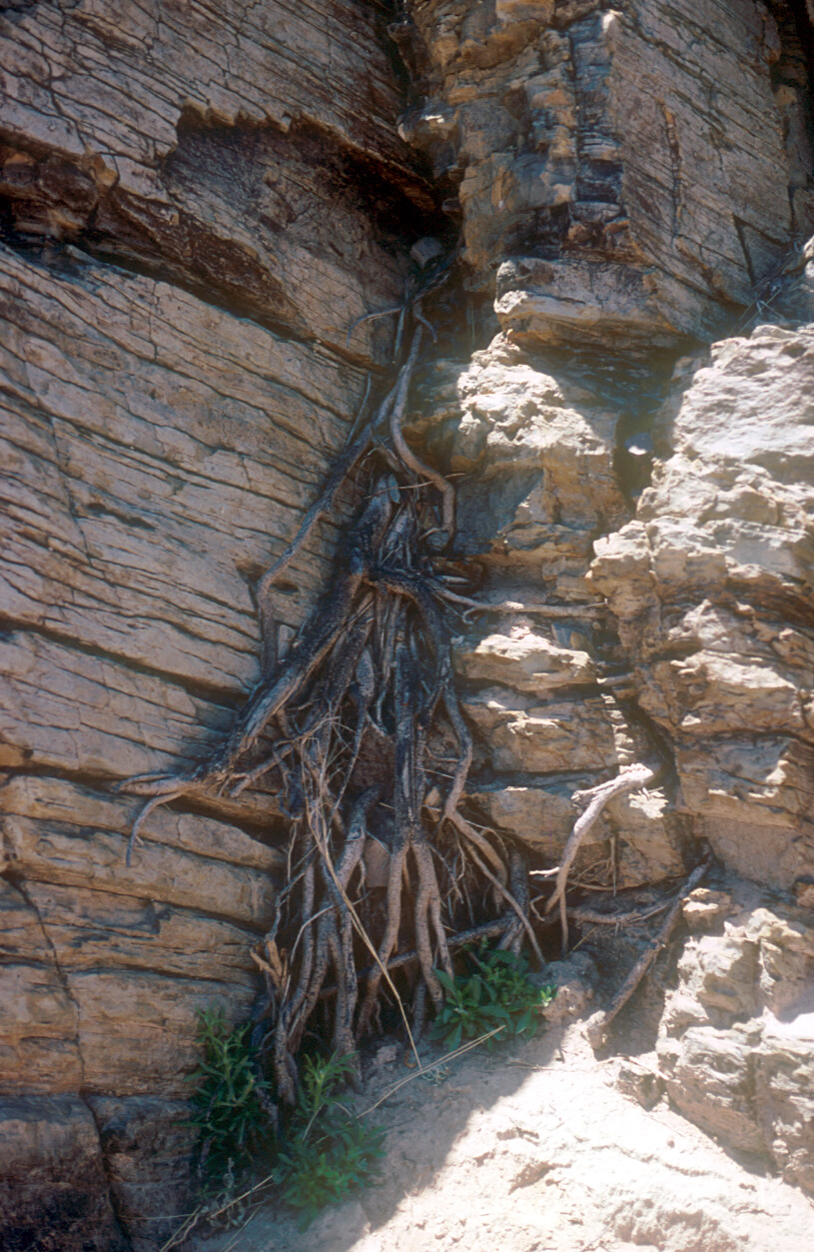

Slide 15
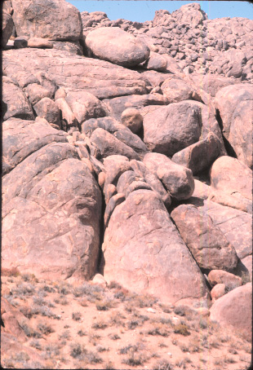
Spheroidal weathering

Slide 16
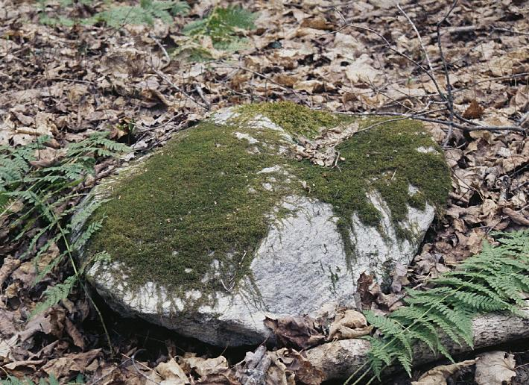
Copyright © Randy Schaetzl 2002
Notes:
An example of biotic weathering.

Slide 17
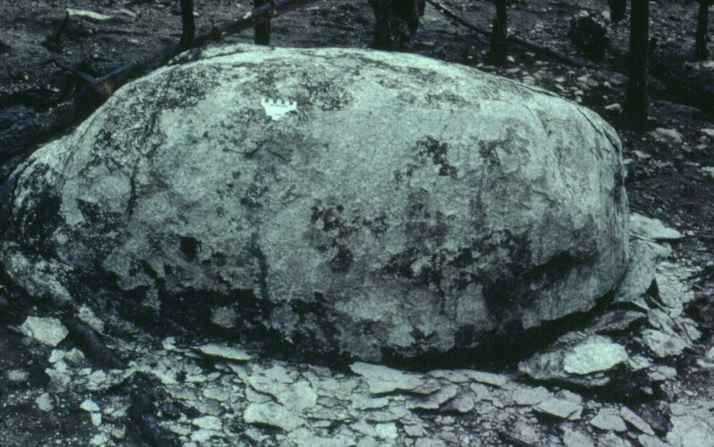

Slide 18
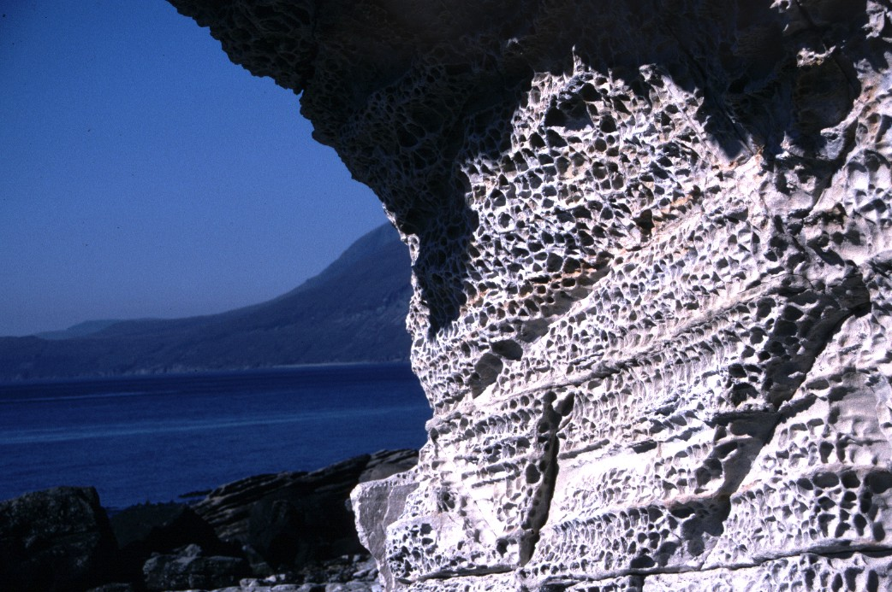

Slide 19
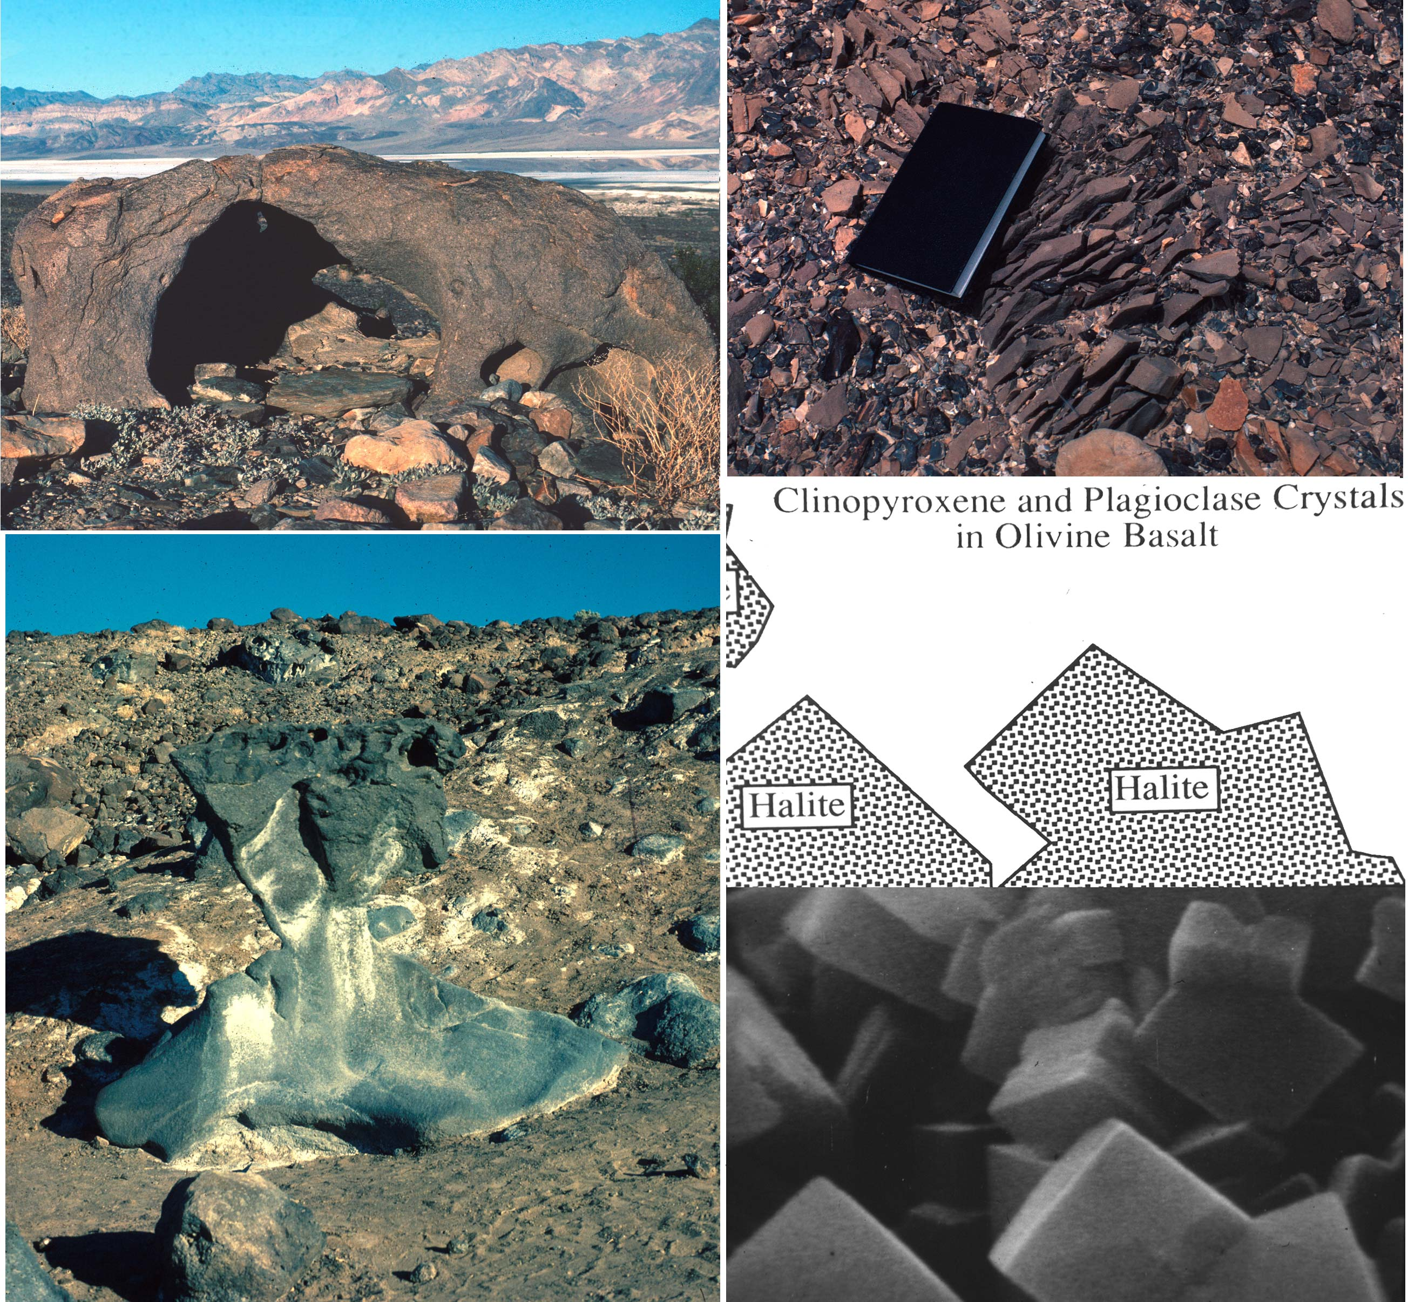
Copyright © Ron Dorn 2002
Notes:
Salt Weathering in Death Valley. The abundance of salts in Death Valley generate abundant evidence of salt weathering, such as cavernously weathered granodiorite boulder(upper left), en echelon break-up of a metamorphic clast (upper right), and mushroom rock (lower left). The lower right illustrates scanning electron microscope imagery (and corresponding map) of halite crystals precipitated in a fragment of mushroom rock.

Slide 20
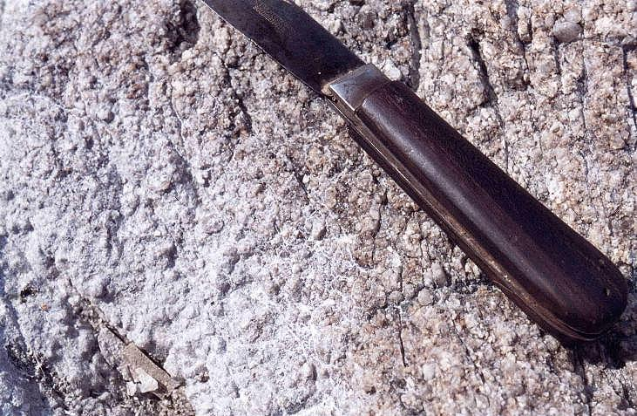
Copyright © Frans Kwaad 2002
Notes:
Weathering of granite by salt action, at the Mediterranean coast of S France, east of St. Tropez.

Slide 21
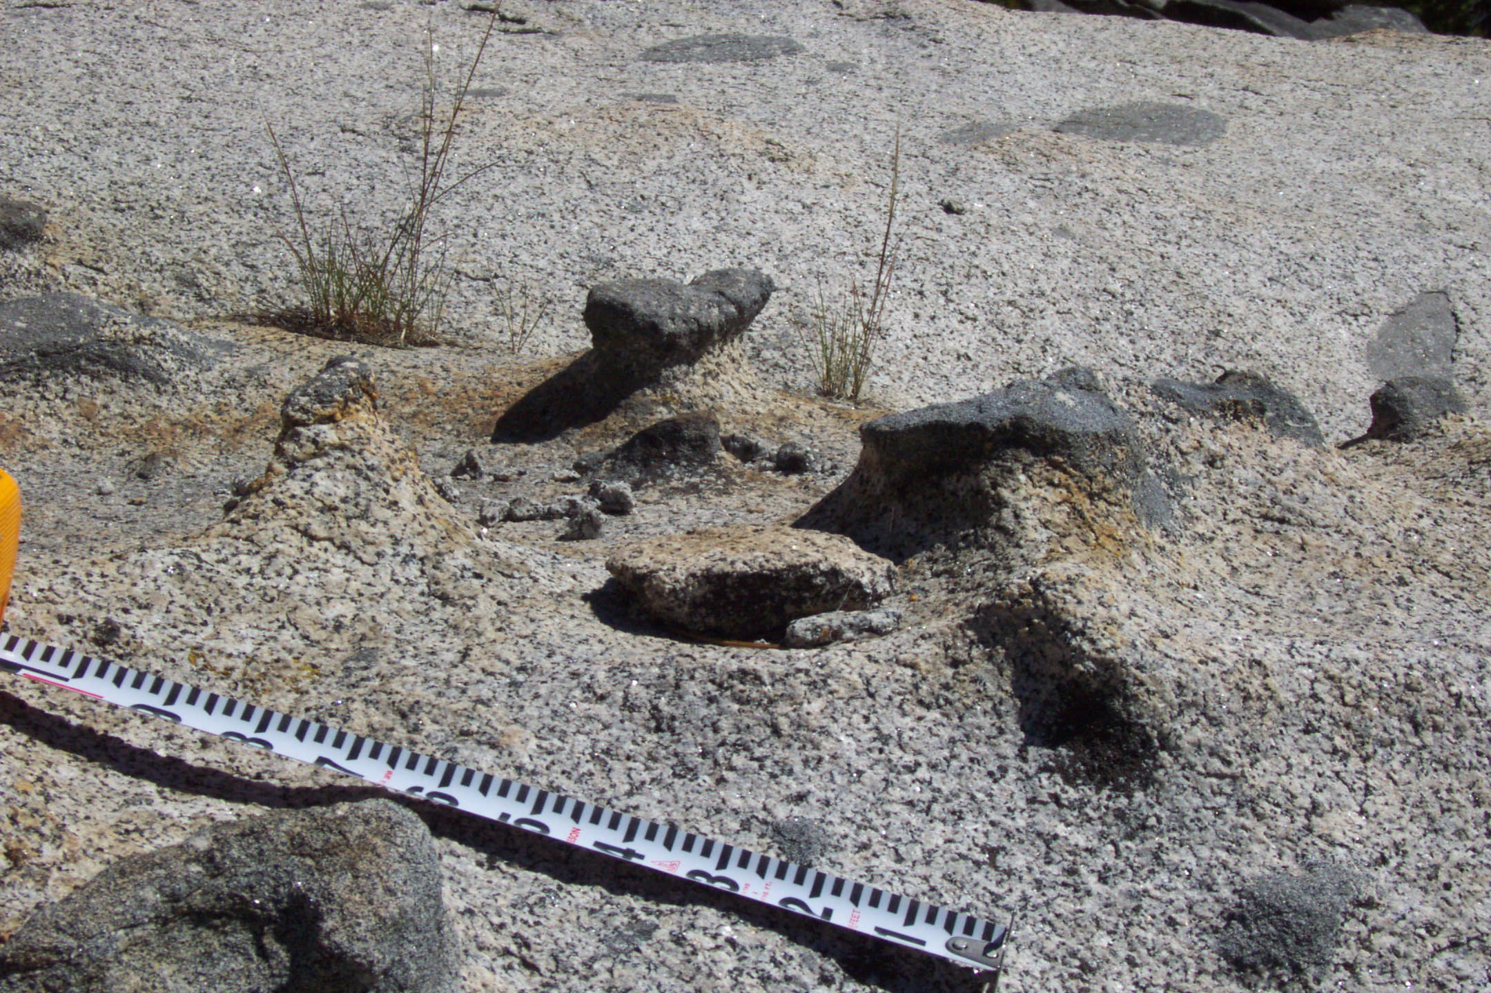
Copyright © Allan James 2002
Notes:
Weathering of granodiorite has been more rapid than weathering of relatively mafic xenoliths resulting in a positive relief of the later. Mapping indicates that these surfaces were glaciated during the late glacial maximum (Tioga) and these surfaces are presumably less than 25,000 years in age and possibly as young as 14,600 years B.P. Rattlesnake Canyon, South Yuba basin, northwestern Sierra Nevada, California.

Slide 22
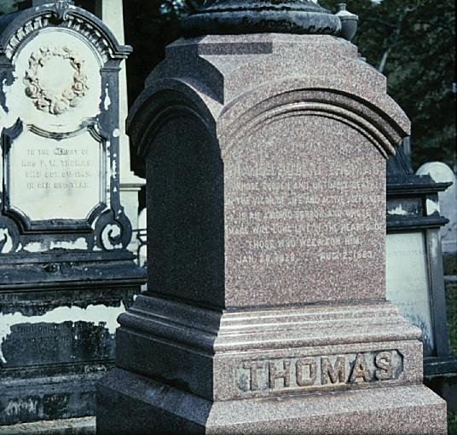

Slide 23
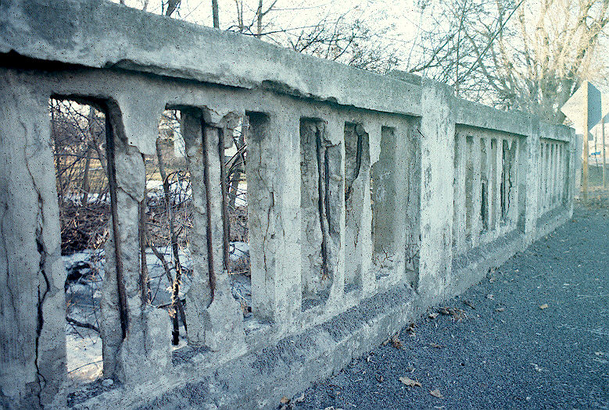

Slide 26
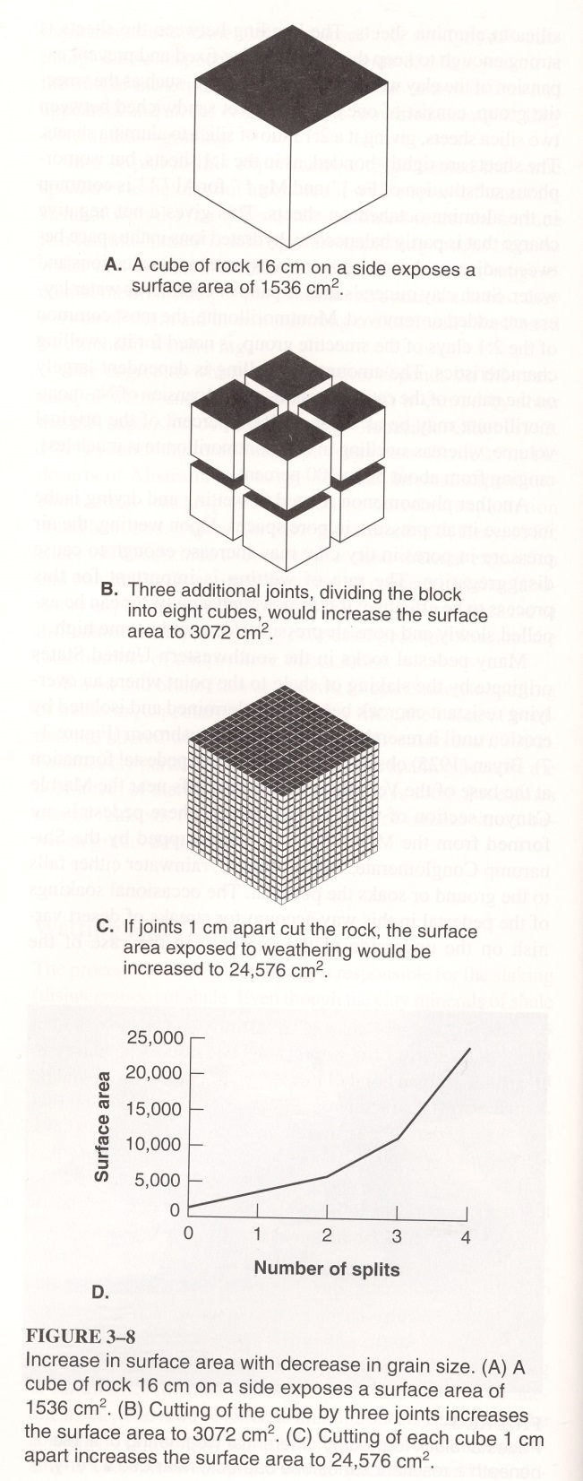

Slide 27
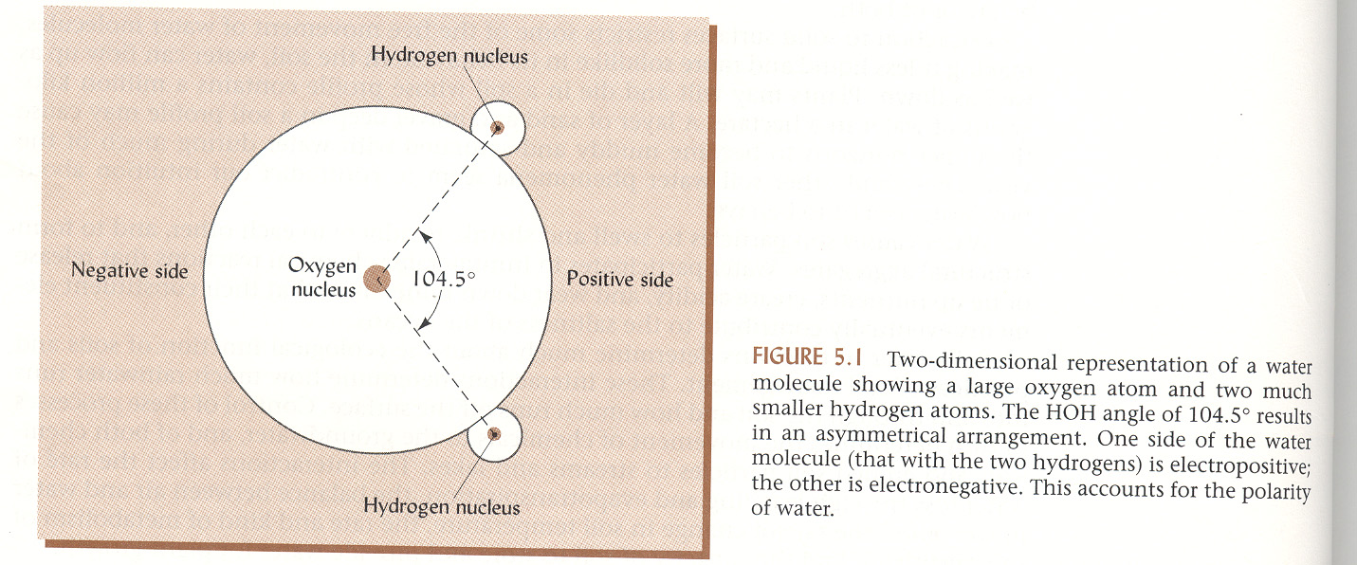

Slide 28
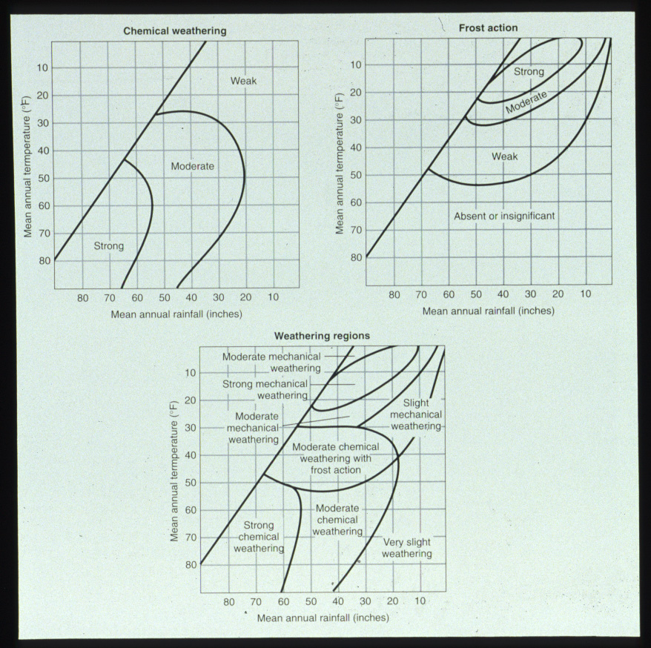
Fig 4-16

Slide 29
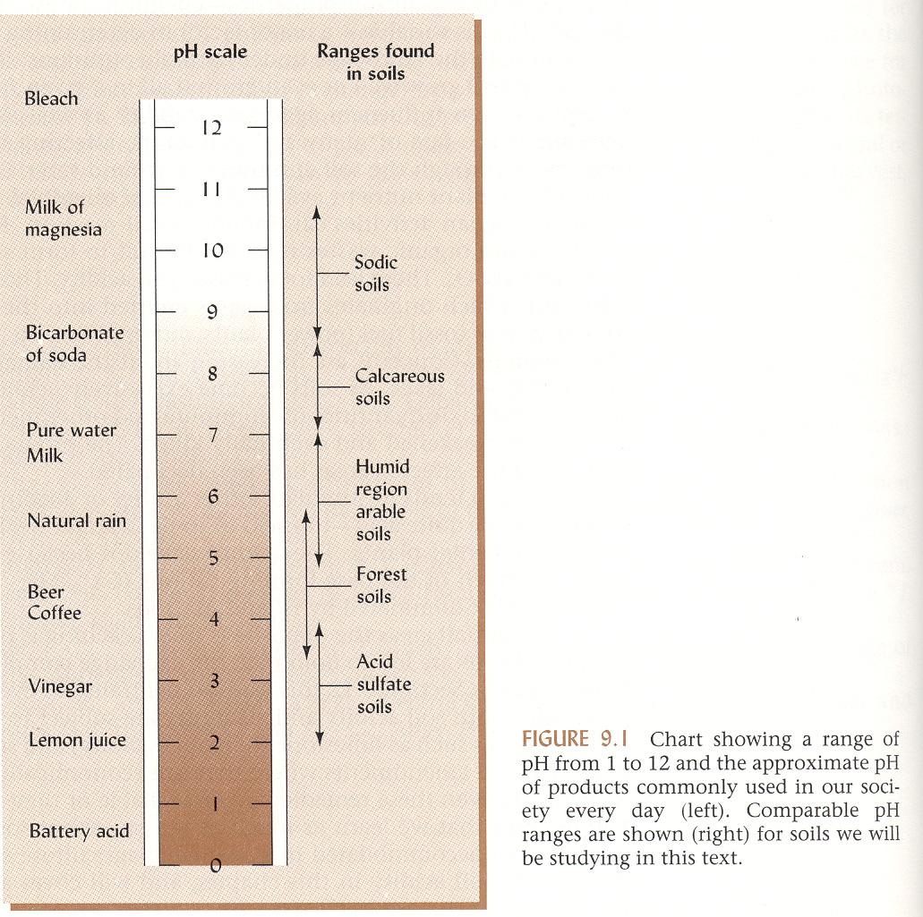

Slide 30
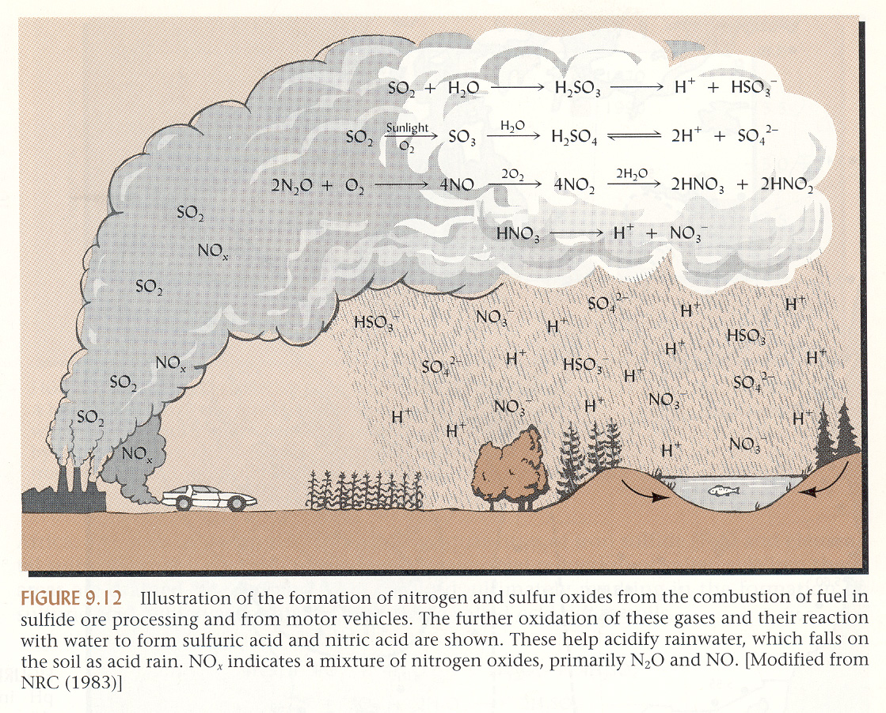

Slide 31
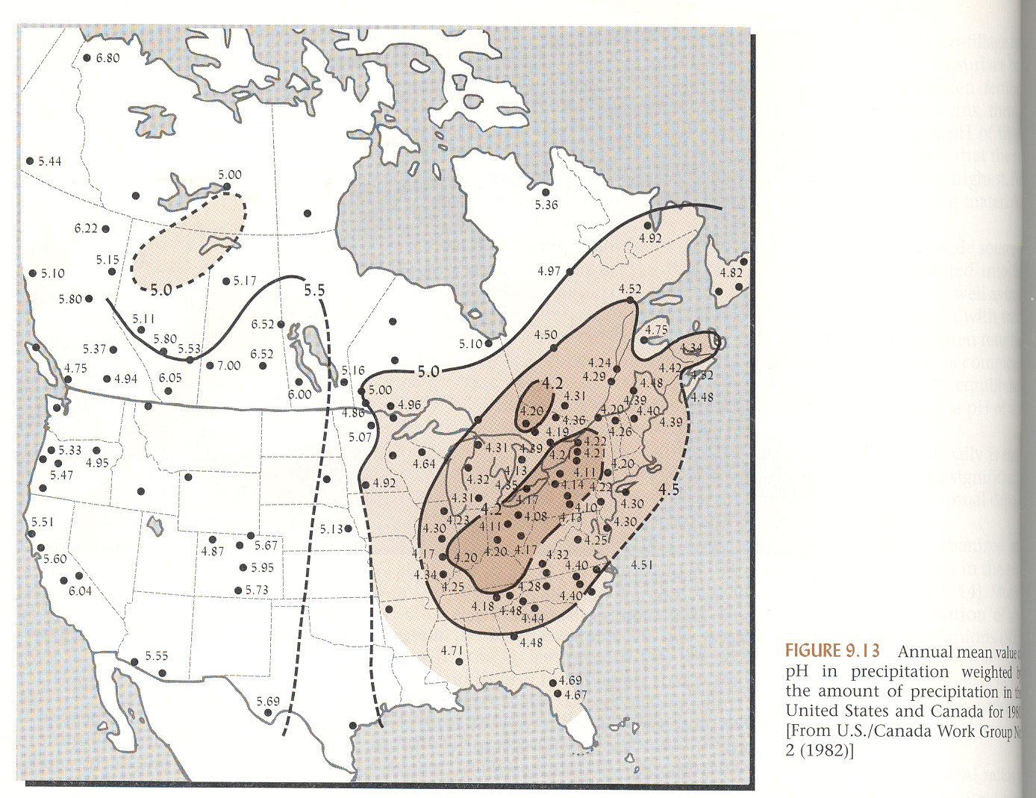

Slide 32
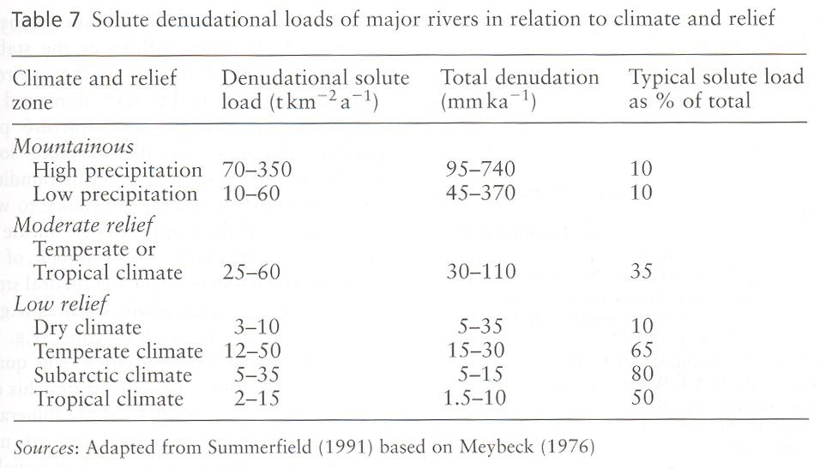

Slide 33
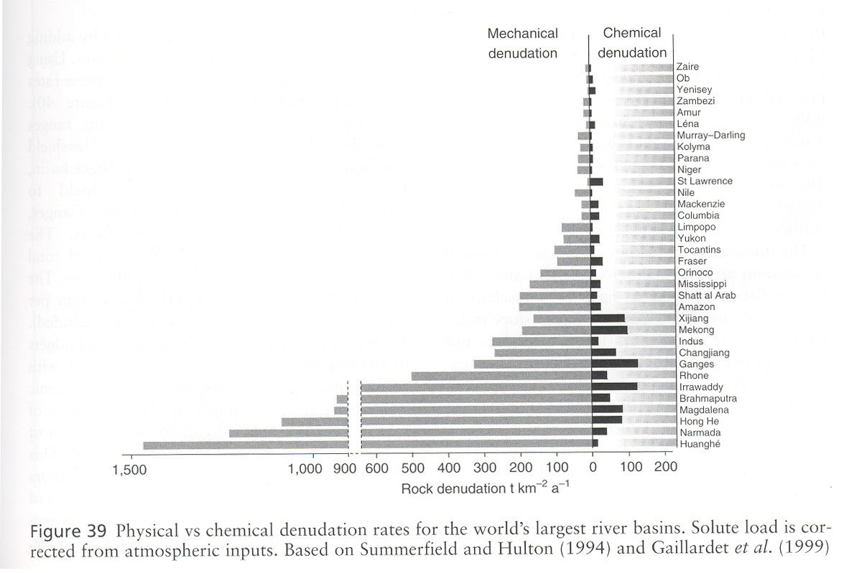

Slide 34
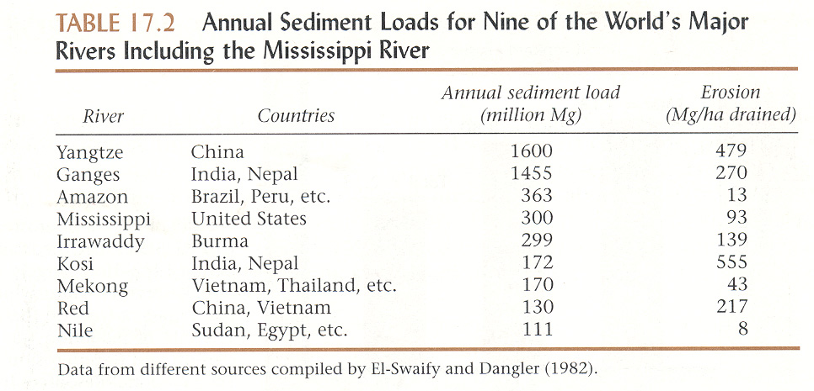

Slide 35
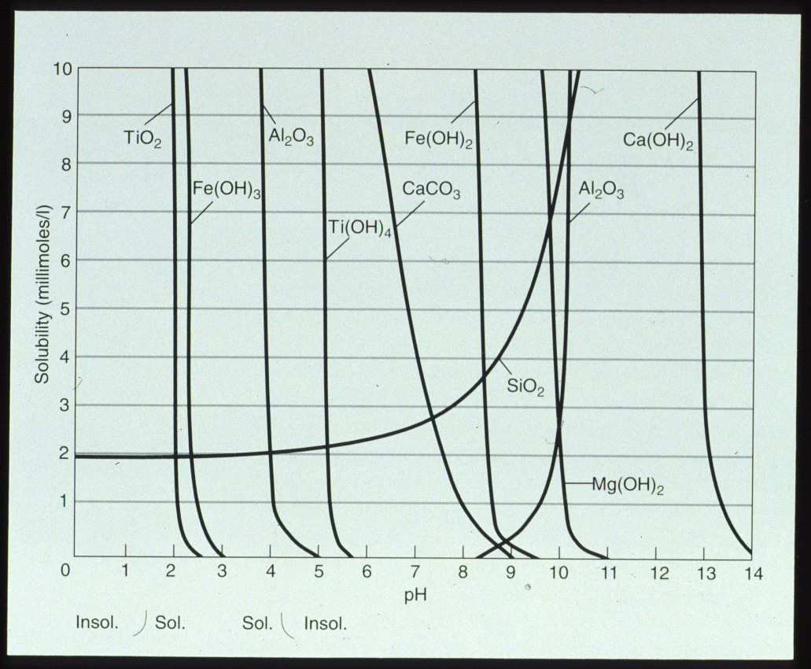
Fig 3-4

Slide 36
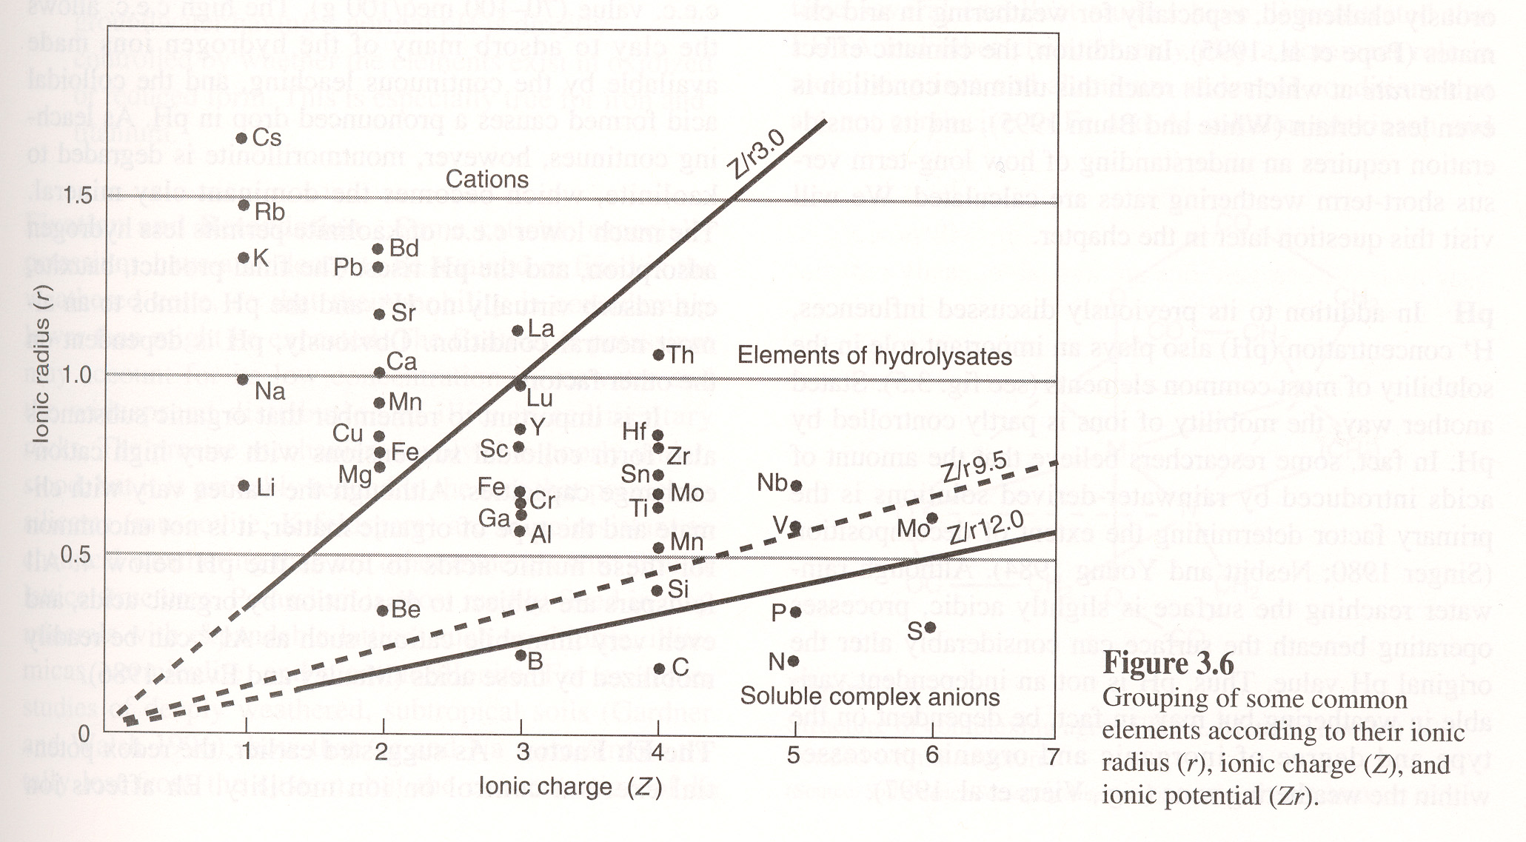

Slide 39
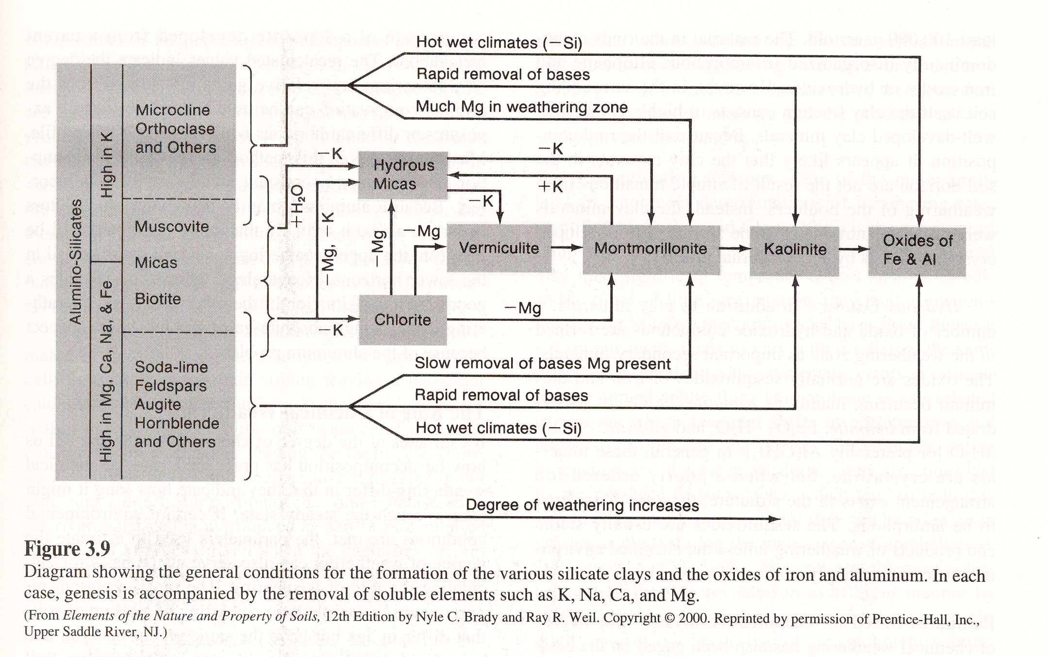

Slide 40
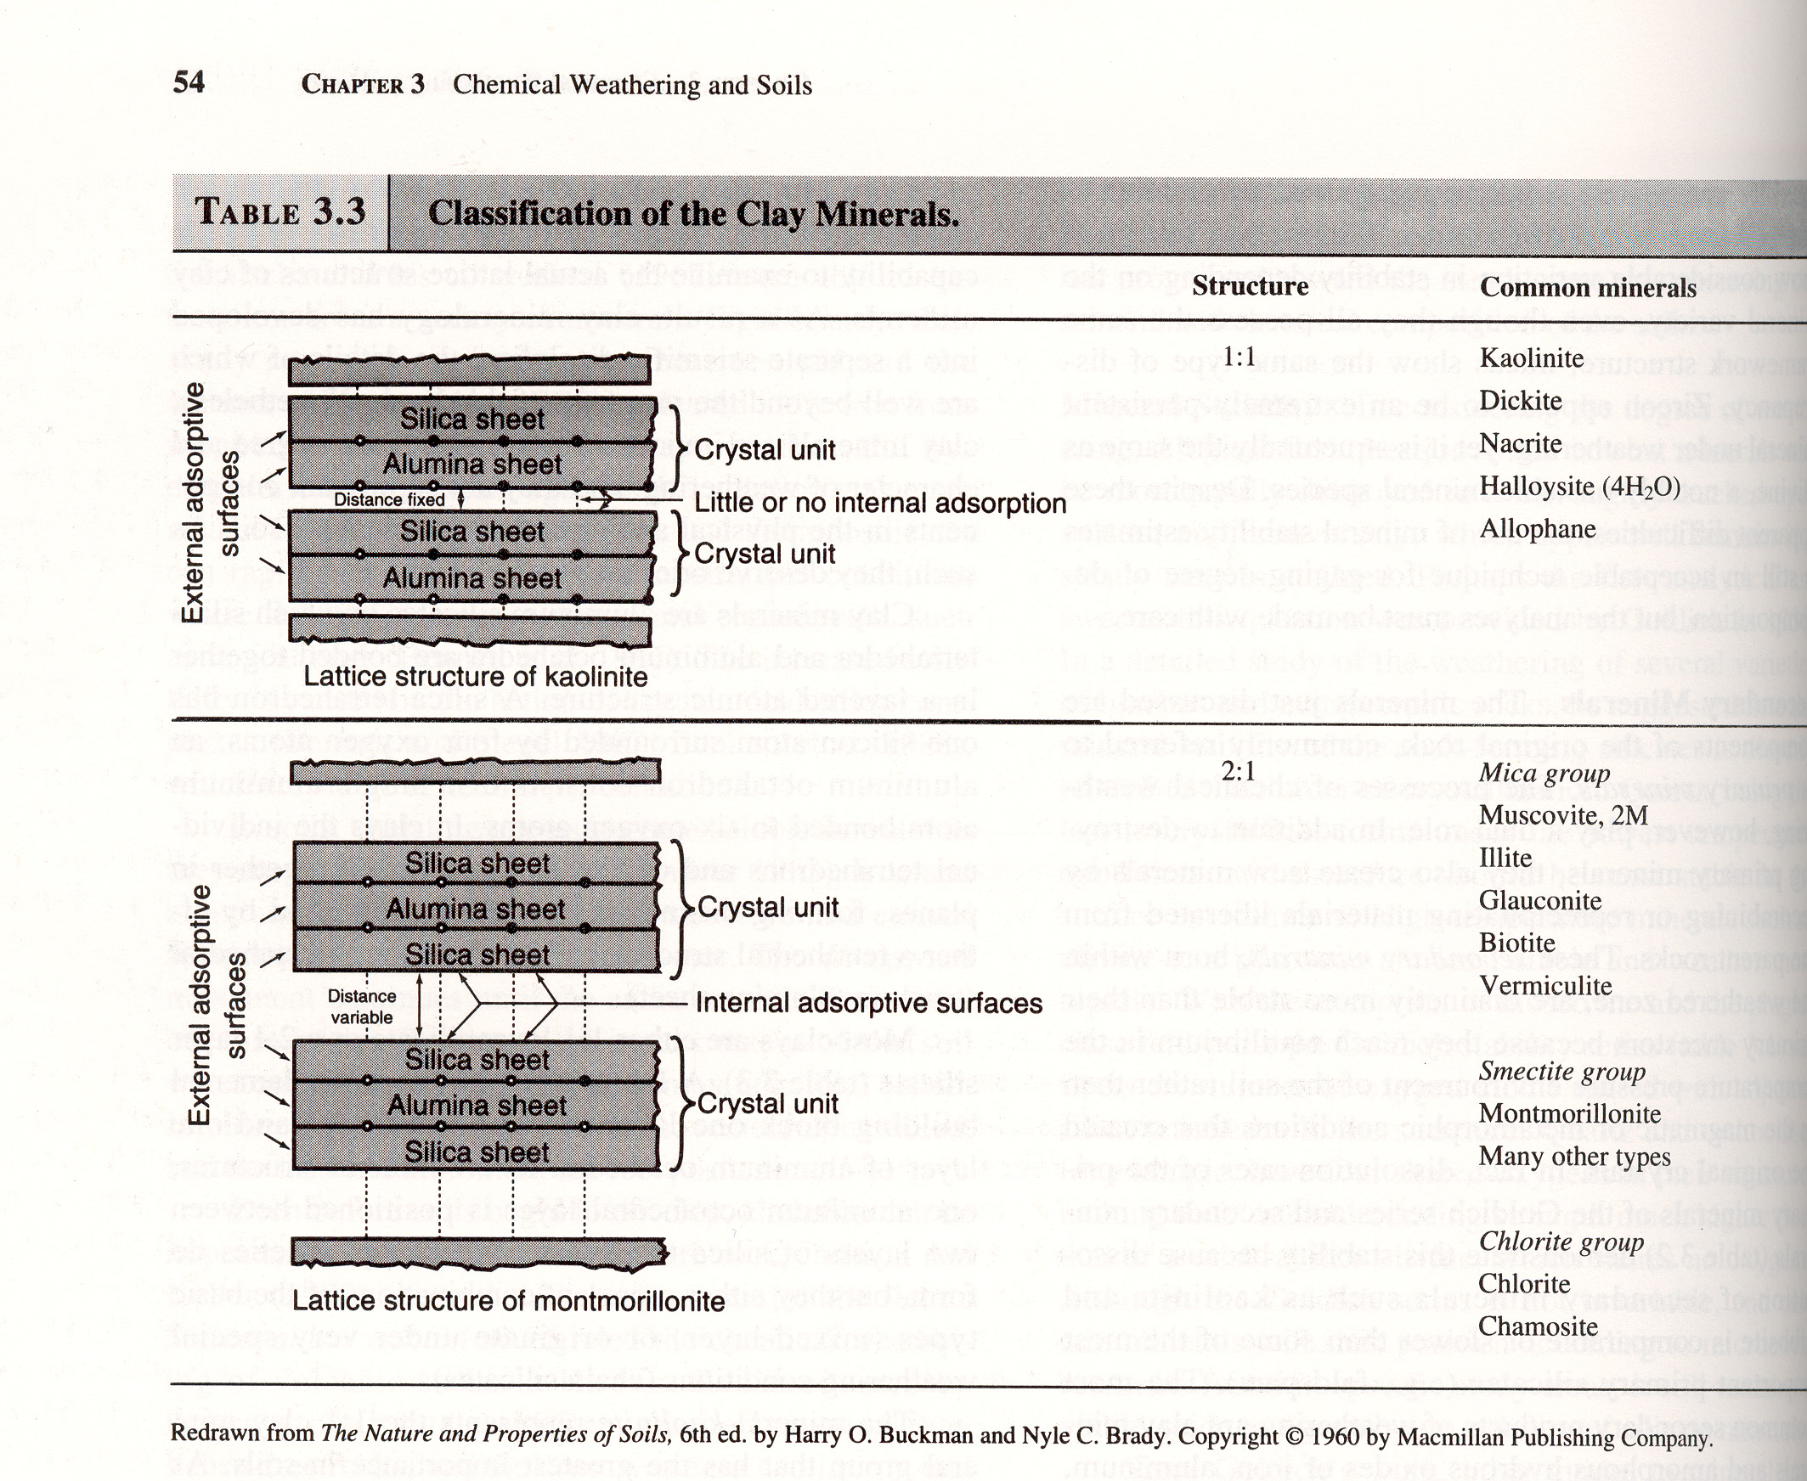

Slide 41
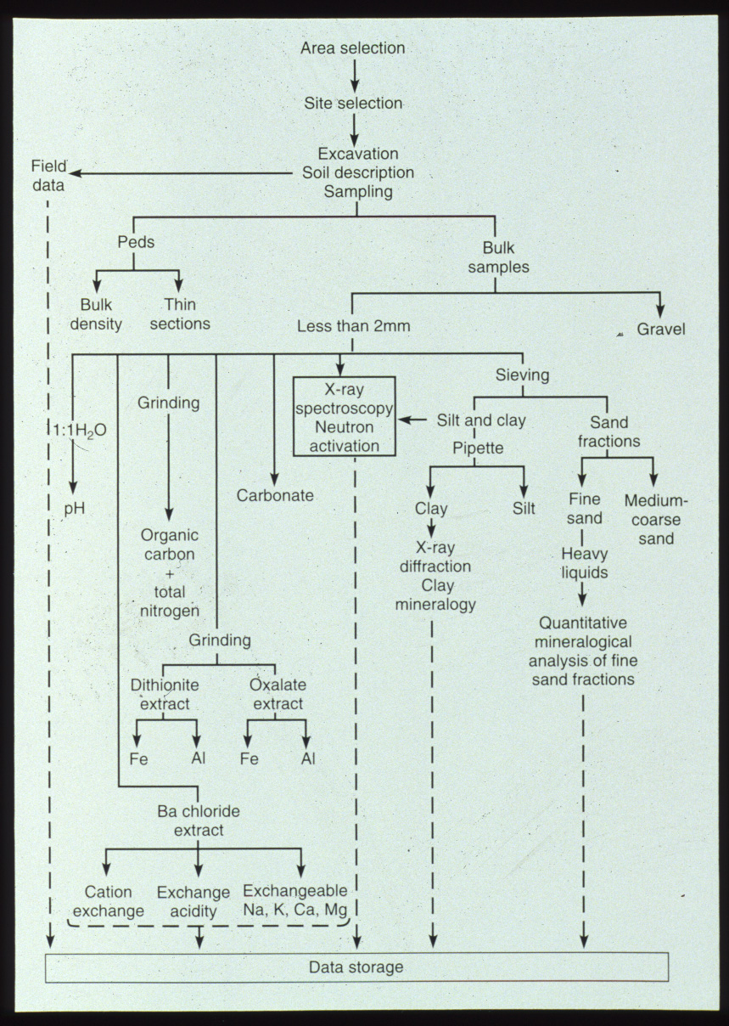
Fig 3-19

