Slide 1
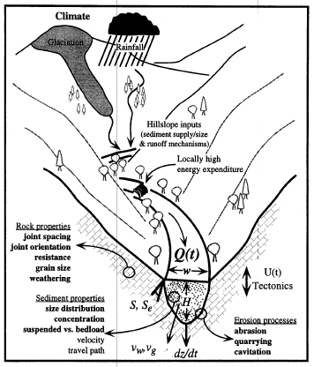
INTRODUCTION TO SURFACE PROCESSES
Energy Sources in the
Fluvial System
Gravitational
Solar (Climate)
Geothermal (Tectonics)
Work of the
Fluvial System
Transfer of Energy
Transfer of Mass
Water
Sediment
Rafting People

Slide 2
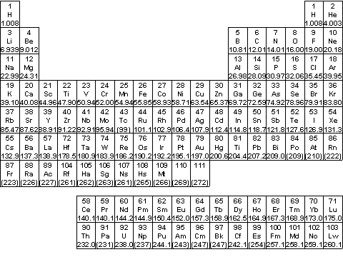
Fundamental Concept – Mass

Slide 3
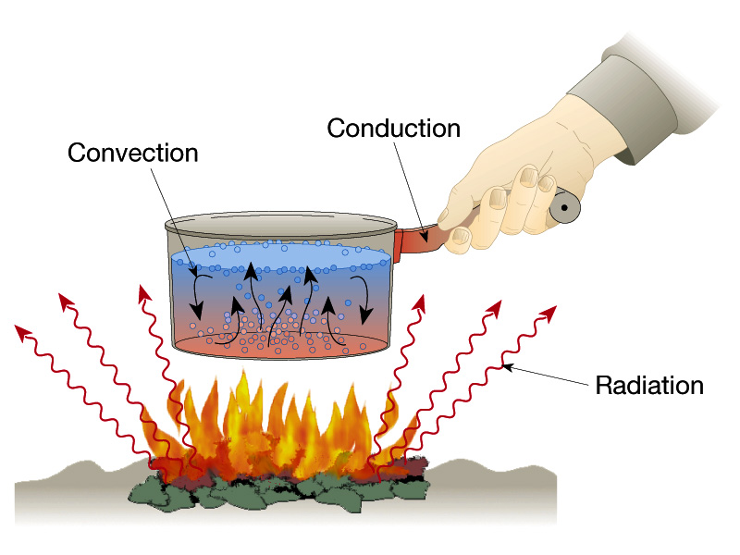
Mechanisms of Energy / heat transfer
(Oceans/Atmosphere)
(Geothermal)
(Solar)

Slide 4
Pacific Northwest Climate and Tectonics:
Linked System Drivers
“Wet”
“Dry”
Westerly cyclonic storm systems
Deschutes
High Cascades
Western Cascades
HJA

Slide 5
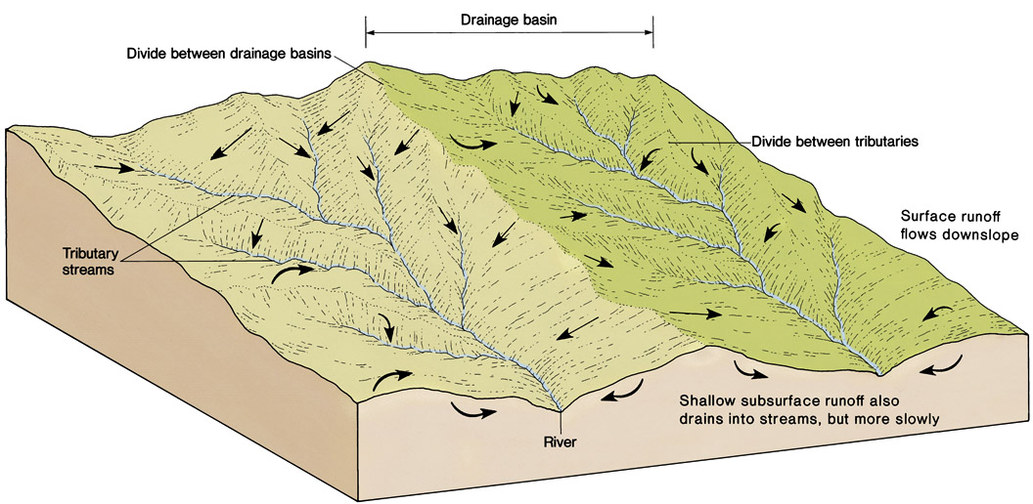
WATERSHEDS: Scalable Routing Networks

Slide 6
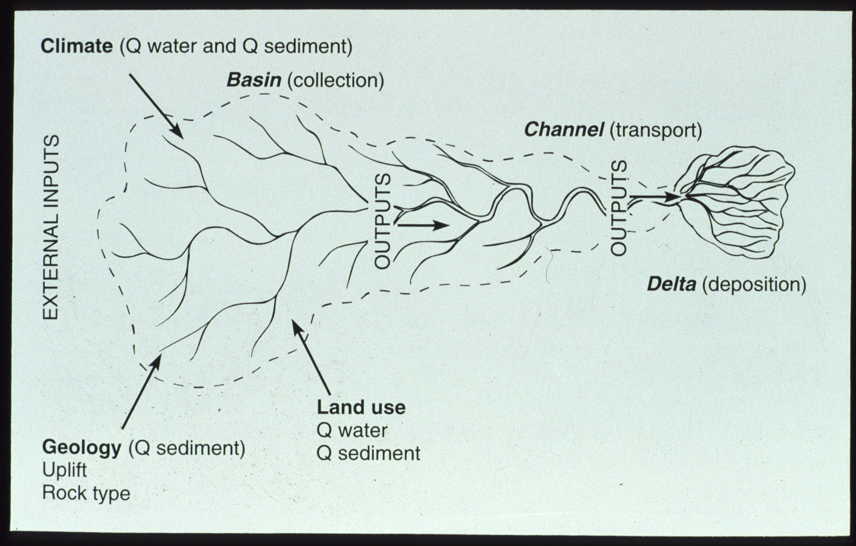
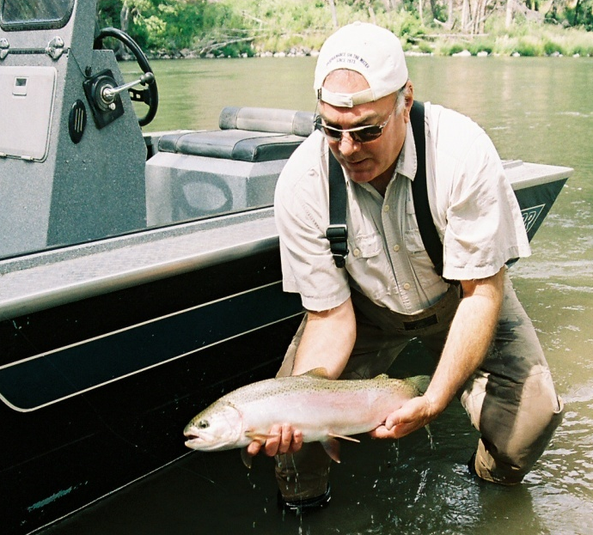
The physical work of rivers:
transport sediment and water
Ecological services
and riparian habitat
(Tectonics)

Slide 7
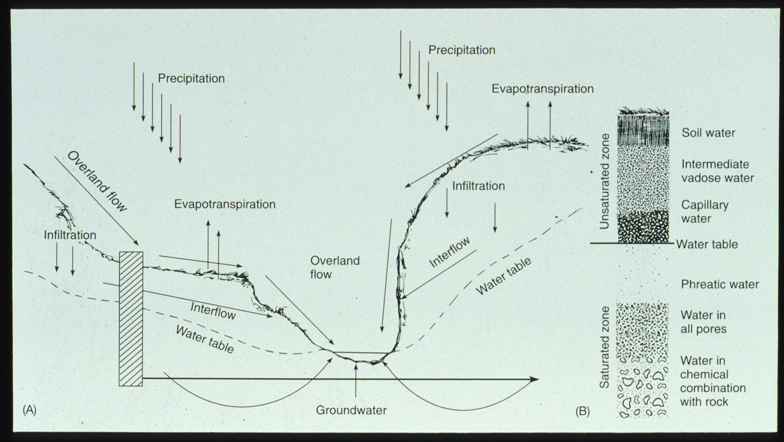

Slide 8
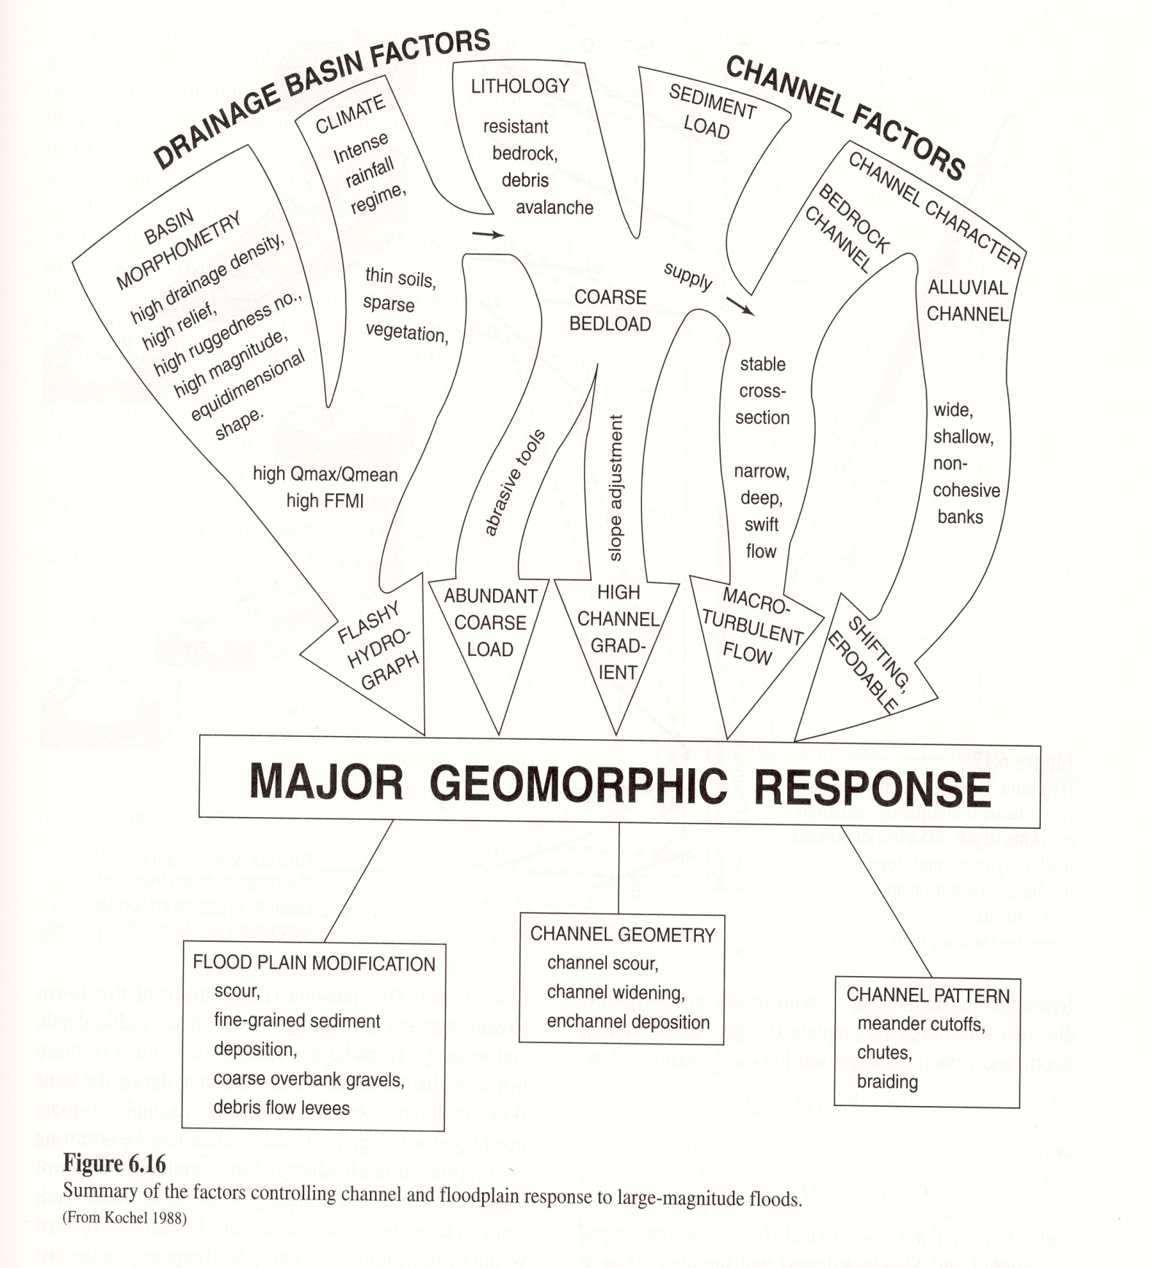

Slide 9
“Hey Taylor – note to self…now’s the time to show the video clip illustrating hillslope-valley bottom process-response mechanisms and the interaction between variables, including human impacts from geomorphic change…”
And now a message from our sponsor:
www.wou.edu/las/physci/taylor/g322/kayakers.wmv

Slide 10
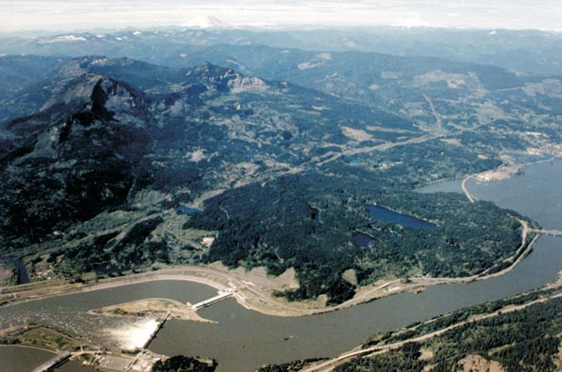
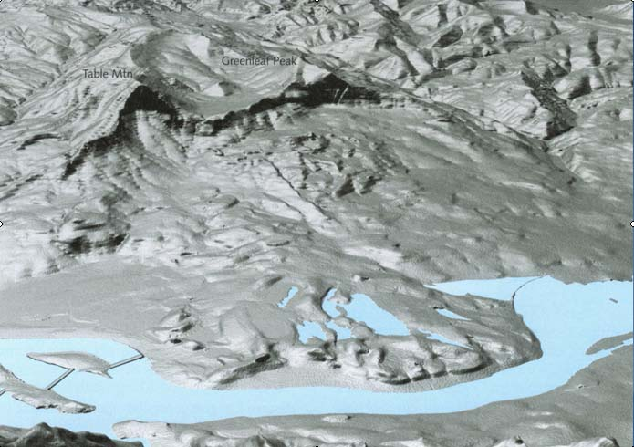
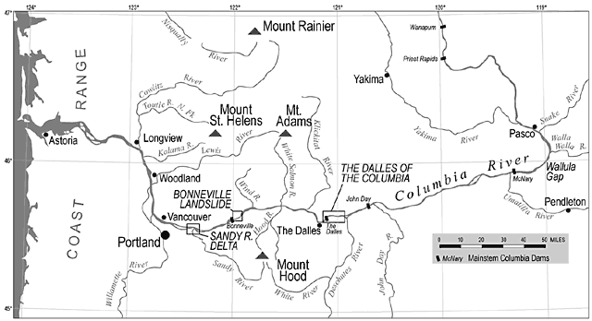
…increasing the scale of this example…
Columbia River Gorge: Bridge of
the Gods Landslide Complex
-Blocked river ca. 300 yrs ago
-Legacy effects on landscape

Slide 11
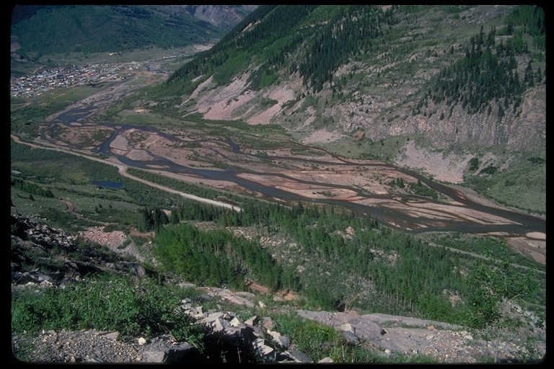
Landscape Analysis: Landform, Material, Process, Age
The record of past processes and tapestry of time…
Material: Sedimentary
Bedrock (Age = 20 m.y.)
Hillslope
Regime
Fault
Process:
Anthropogenic
Process: Colluvial
Transport
Process: Alluvial
Transport
Material: Igneous
Bedrock (Age = 100 m.y.)
Material: Gravel
(Age = 2000 yr)
Valley-Bottom
Regime
Material: Unconsolidated
Sandy Gravel (Age = last winter)
Material: Angular Cobbles
(Age = 10,000 yr)

Slide 12

Stream Processes and Floodplain Development
Notes:
To view this animation, click “View” and then “Slide Show” on the top navigation bar.

Slide 13
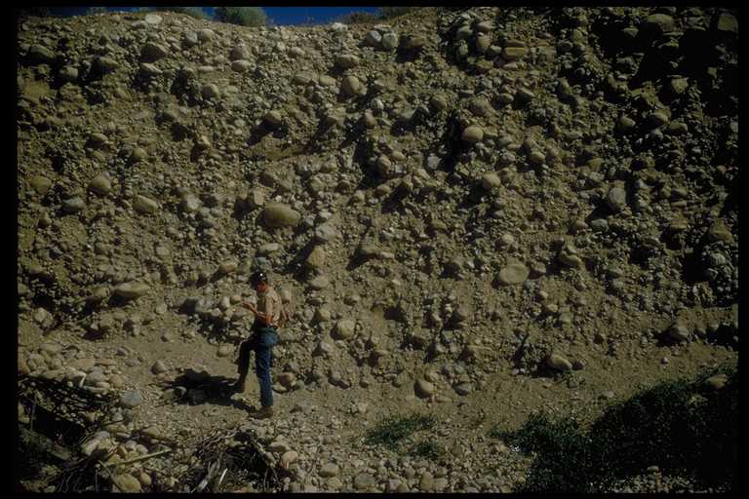
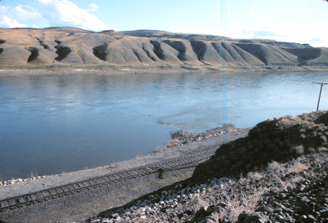
Age of landscape features and rates of processes: the most elusive facets of study.
Geologically Relevant Time Scales: 10⁻⁵ to 10⁹ Years
(minutes-hours-days-years-thousands-hundreds of thousands-millions-billions of years)
Engineering Time Scales? 10⁰ to 10² yrs (then build another one…)
Age of Landforms (Surfaces)
River Terrace
Age of Deposits (Terrace Deposits)
How long since these gravels were
last transported by channel processes?

Slide 14
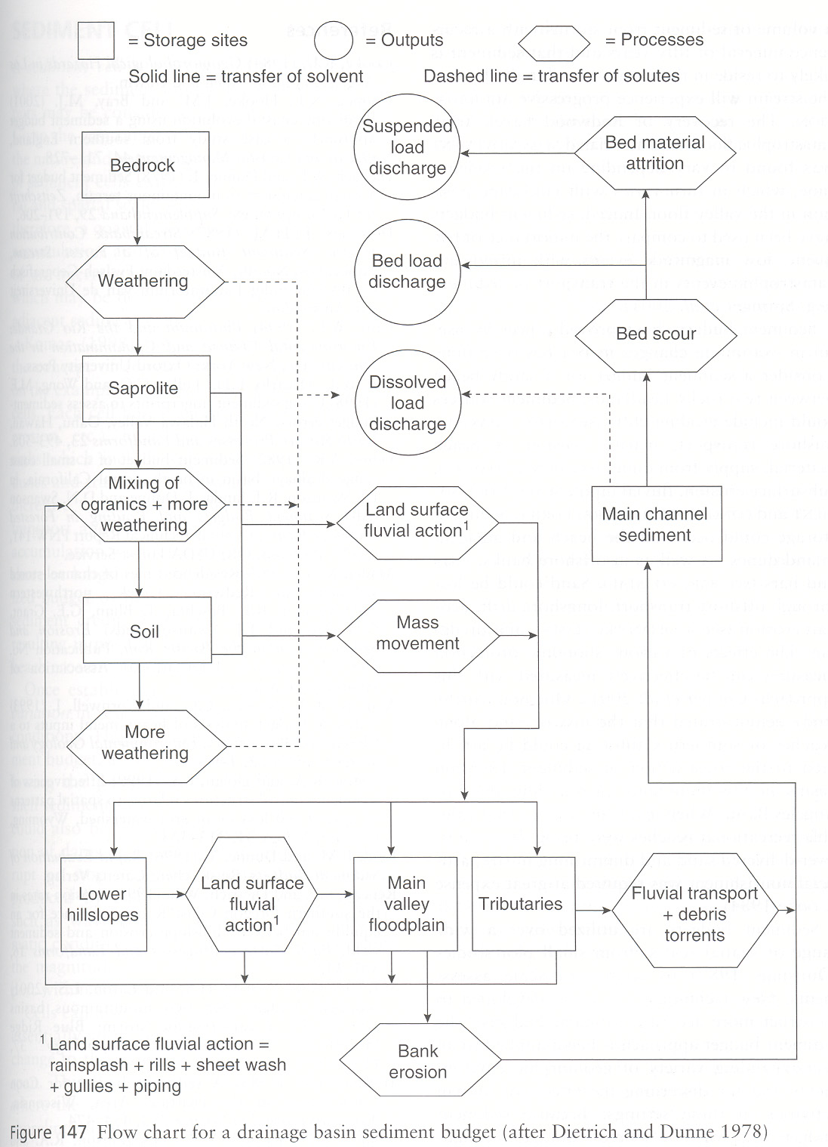
Mass and
Energy Transfer

Slide 15
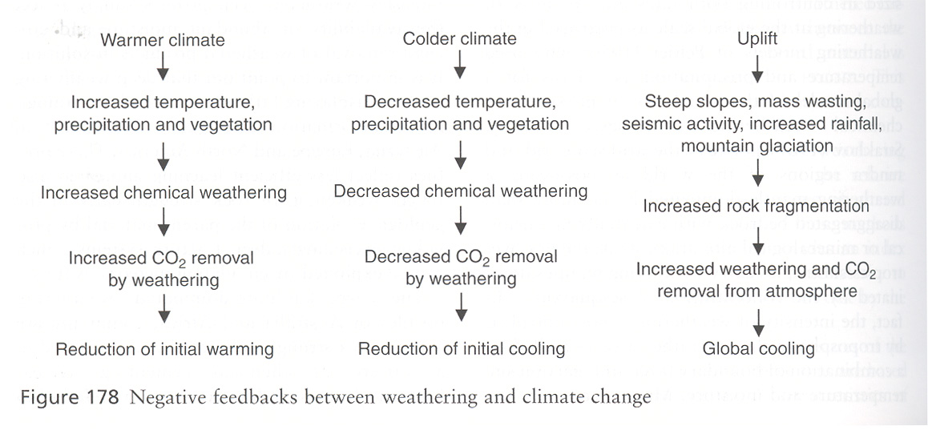

Slide 16
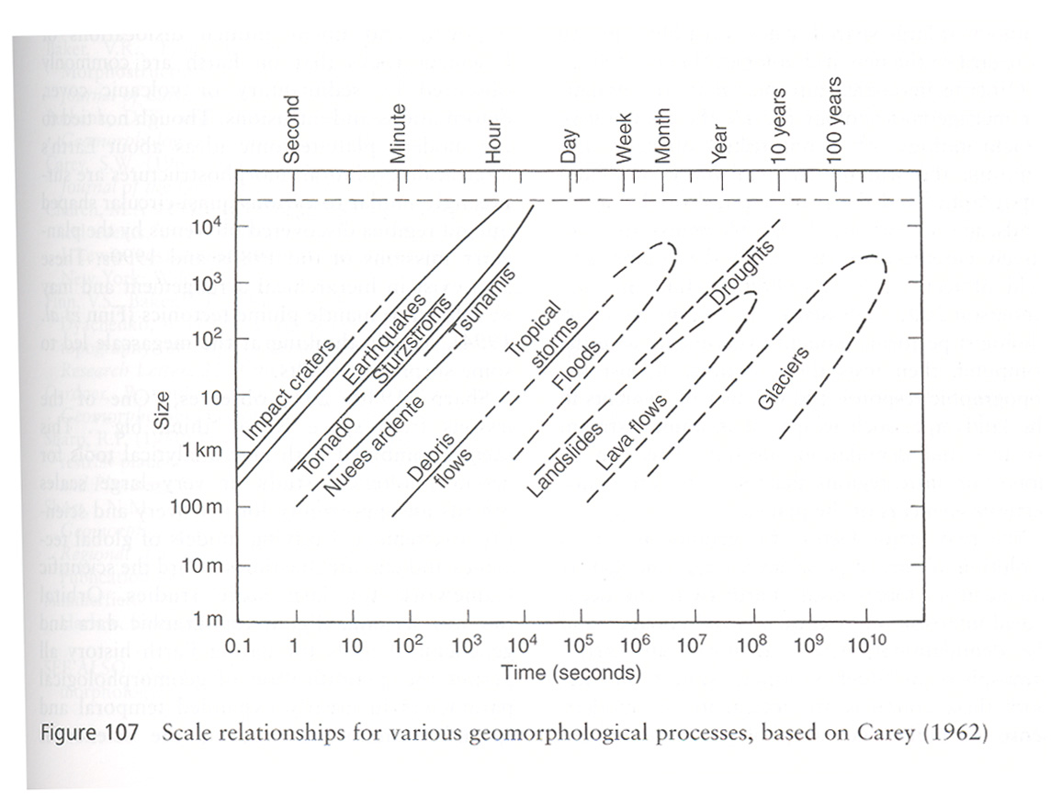

Slide 17
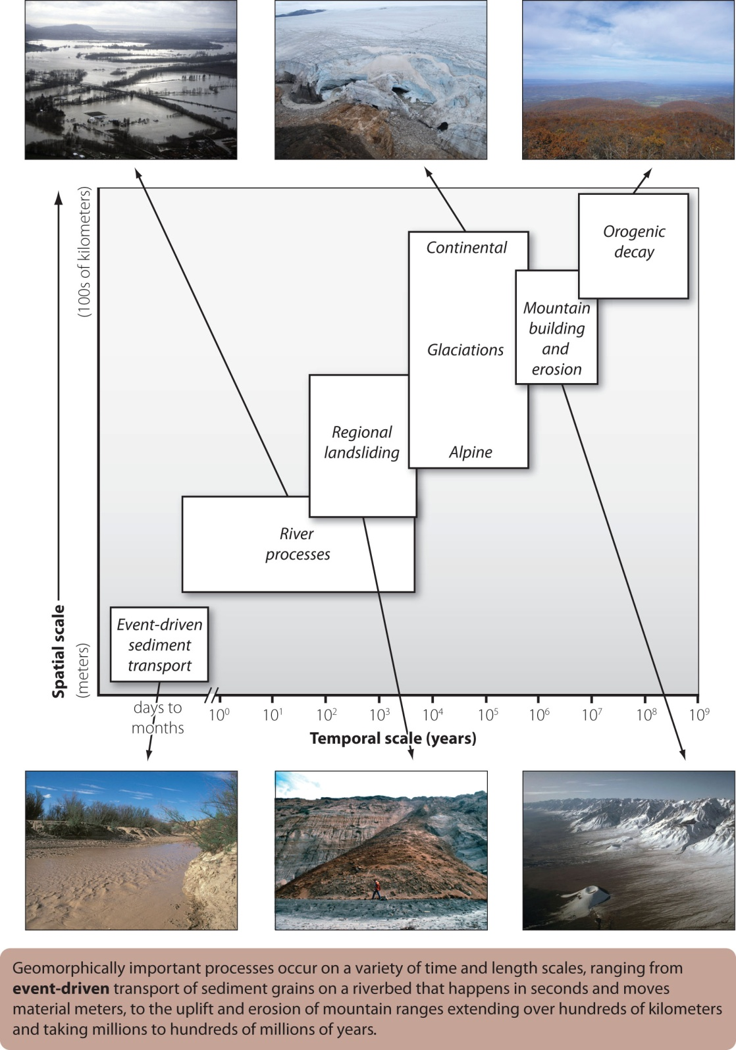

Slide 18
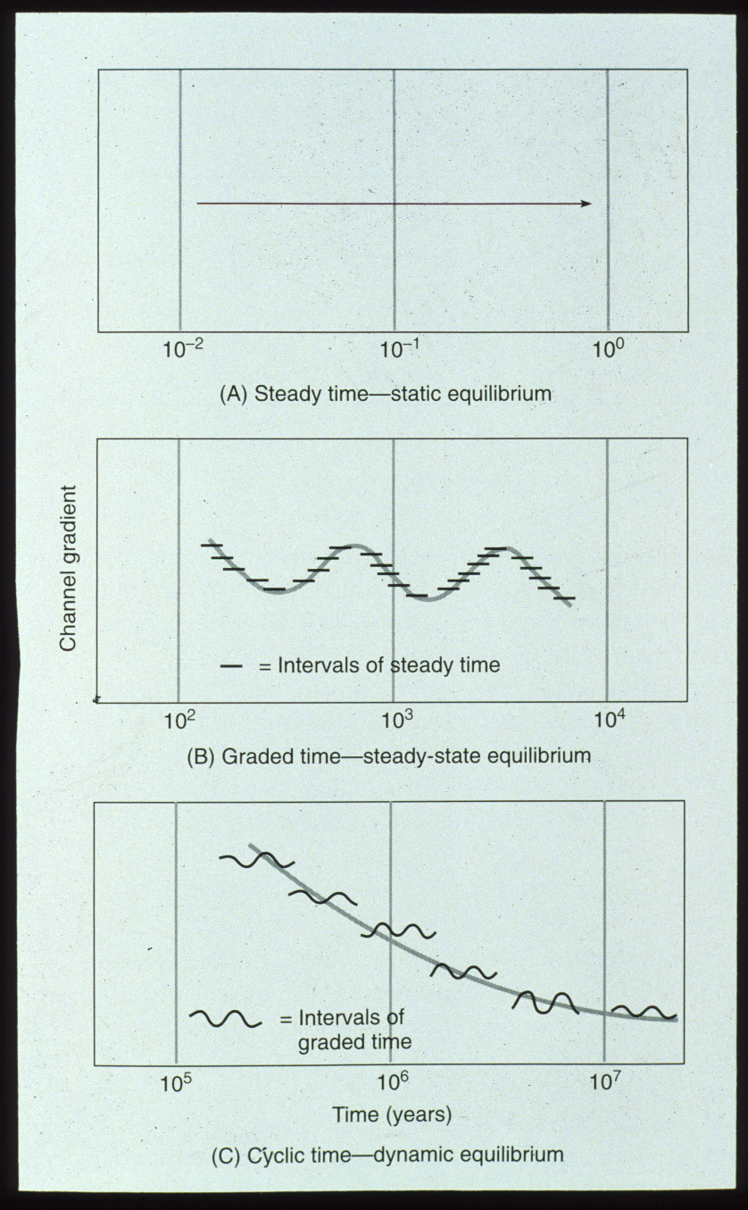

Slide 19
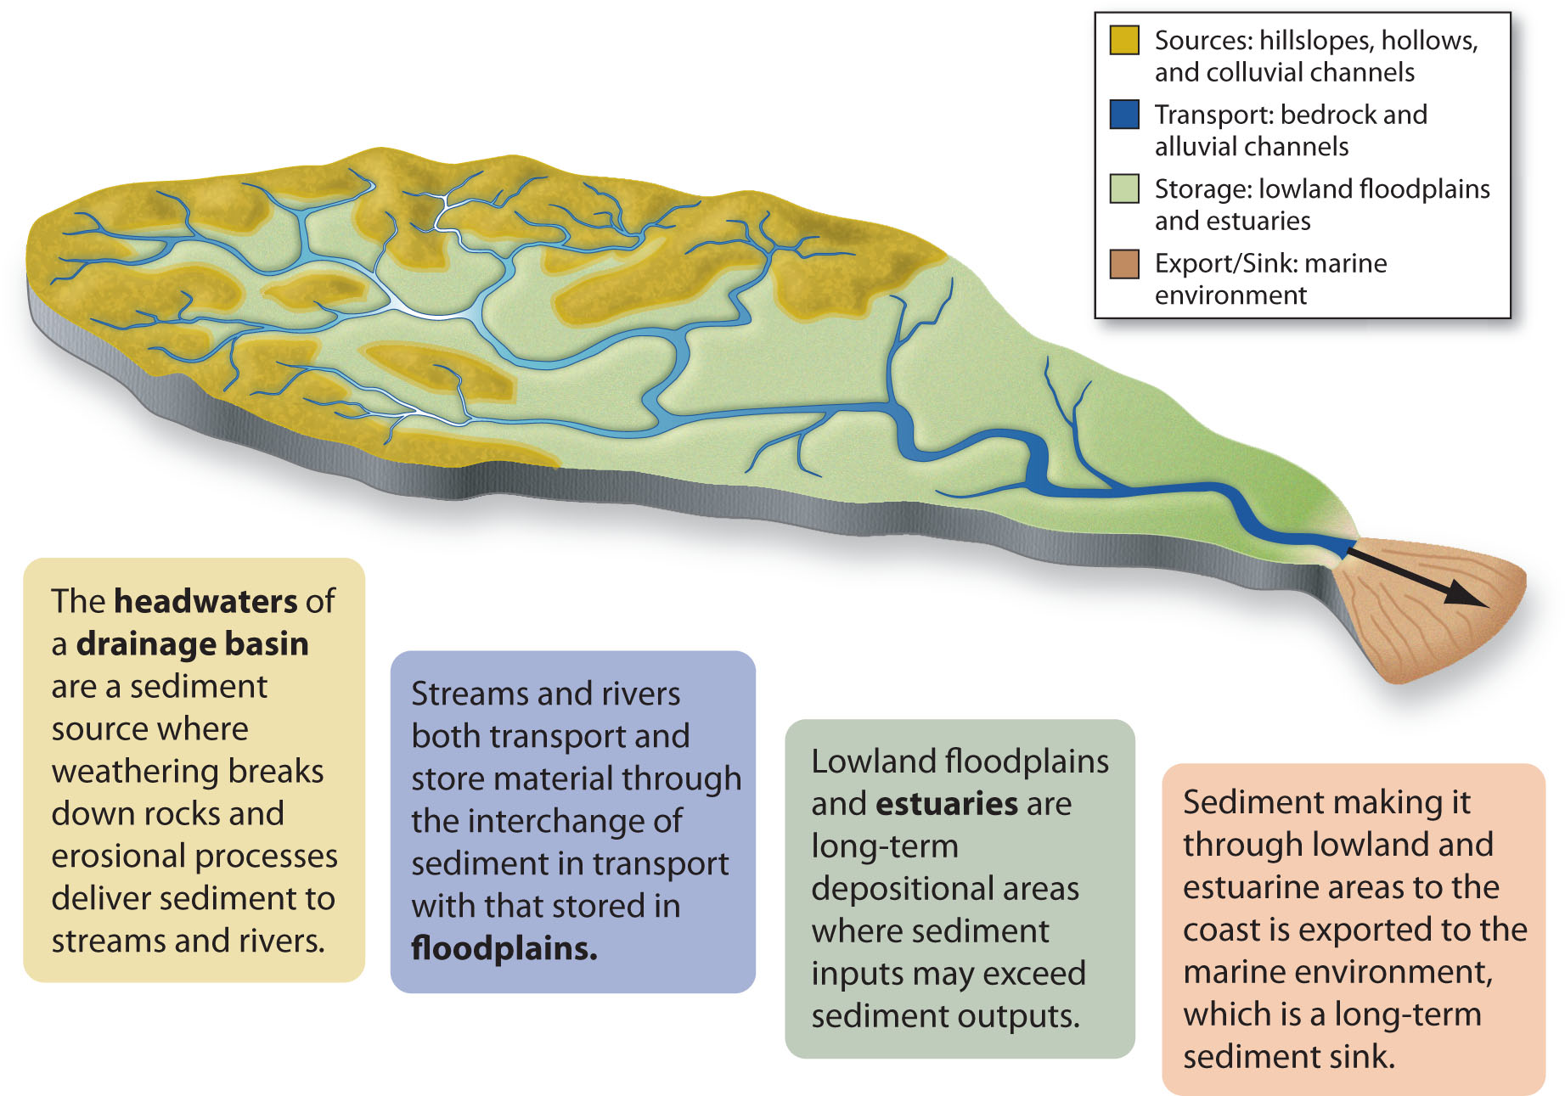

Slide 20
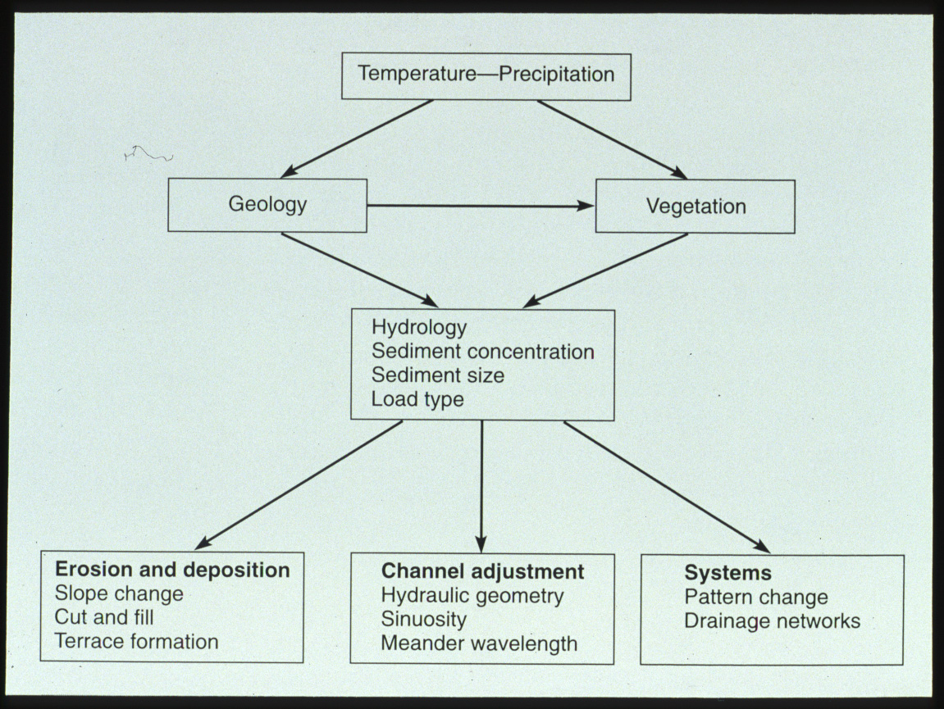
Fig 2-16

Slide 21
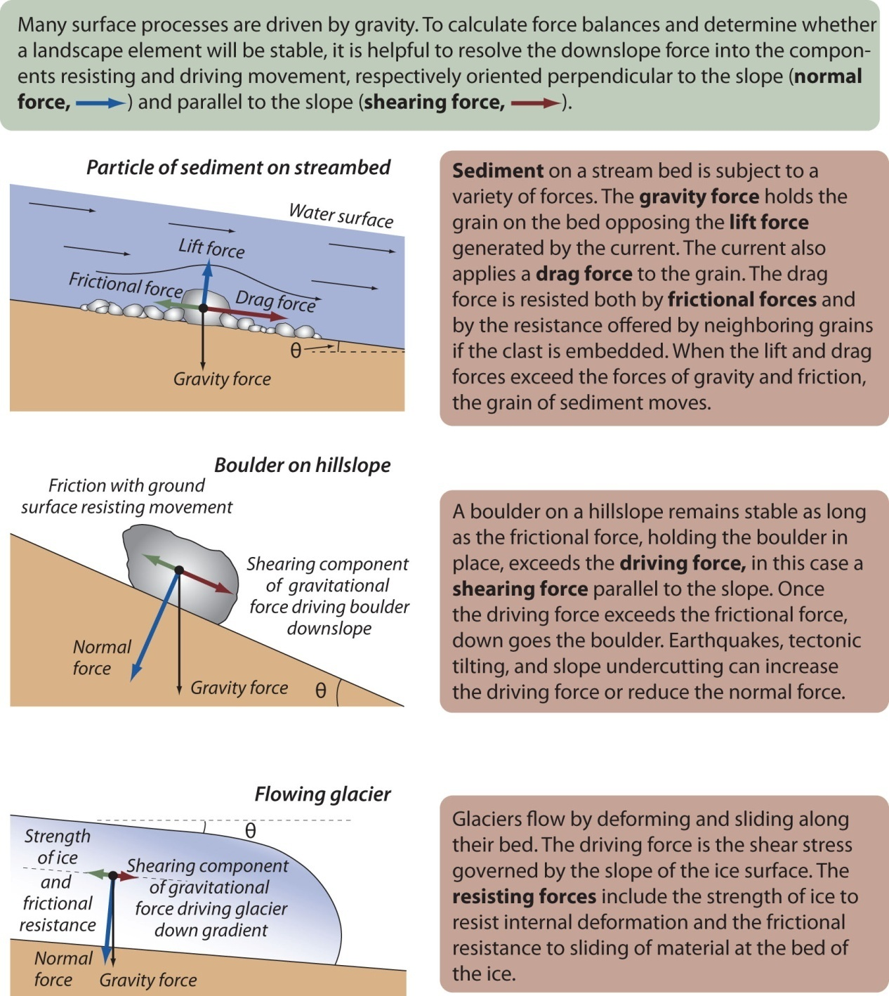

Slide 22
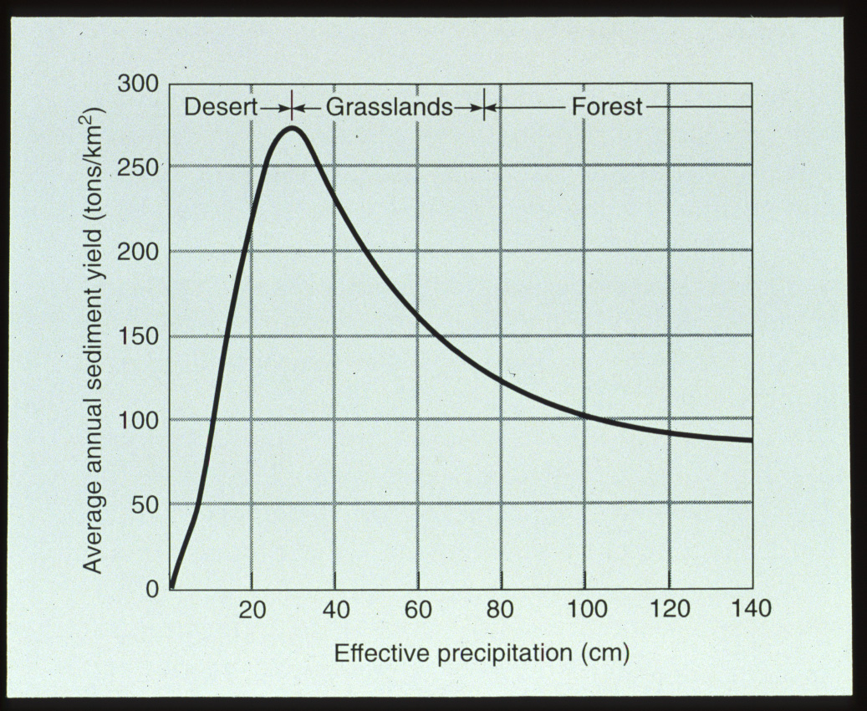
Fig 2-15

Slide 23
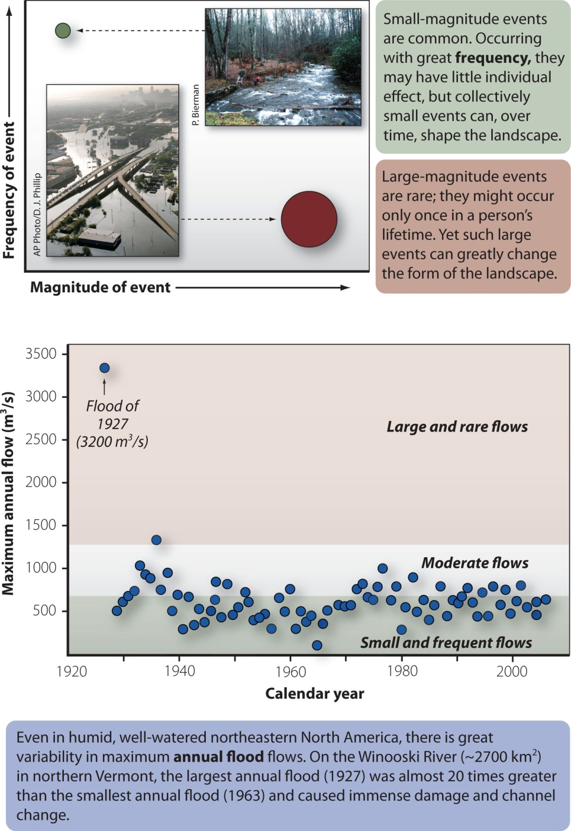

Slide 24
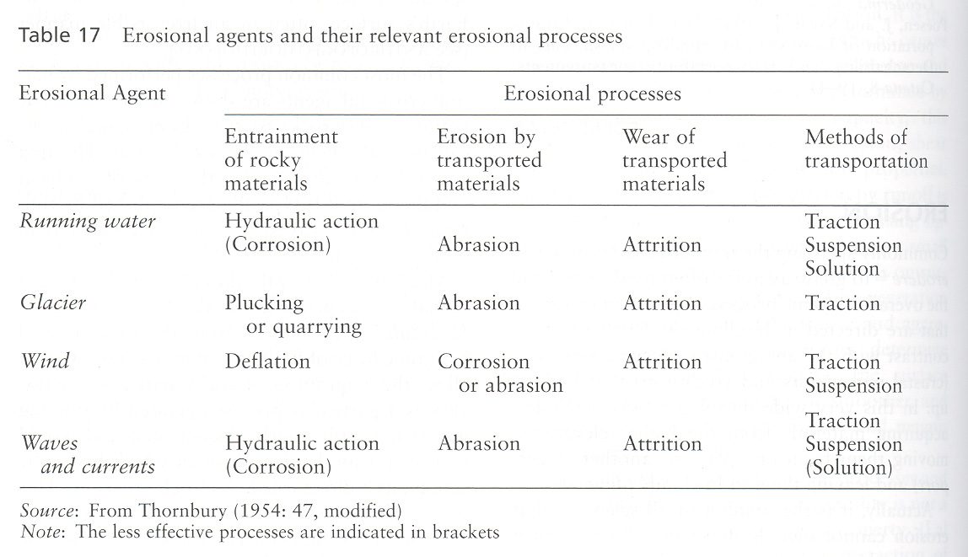

Slide 25
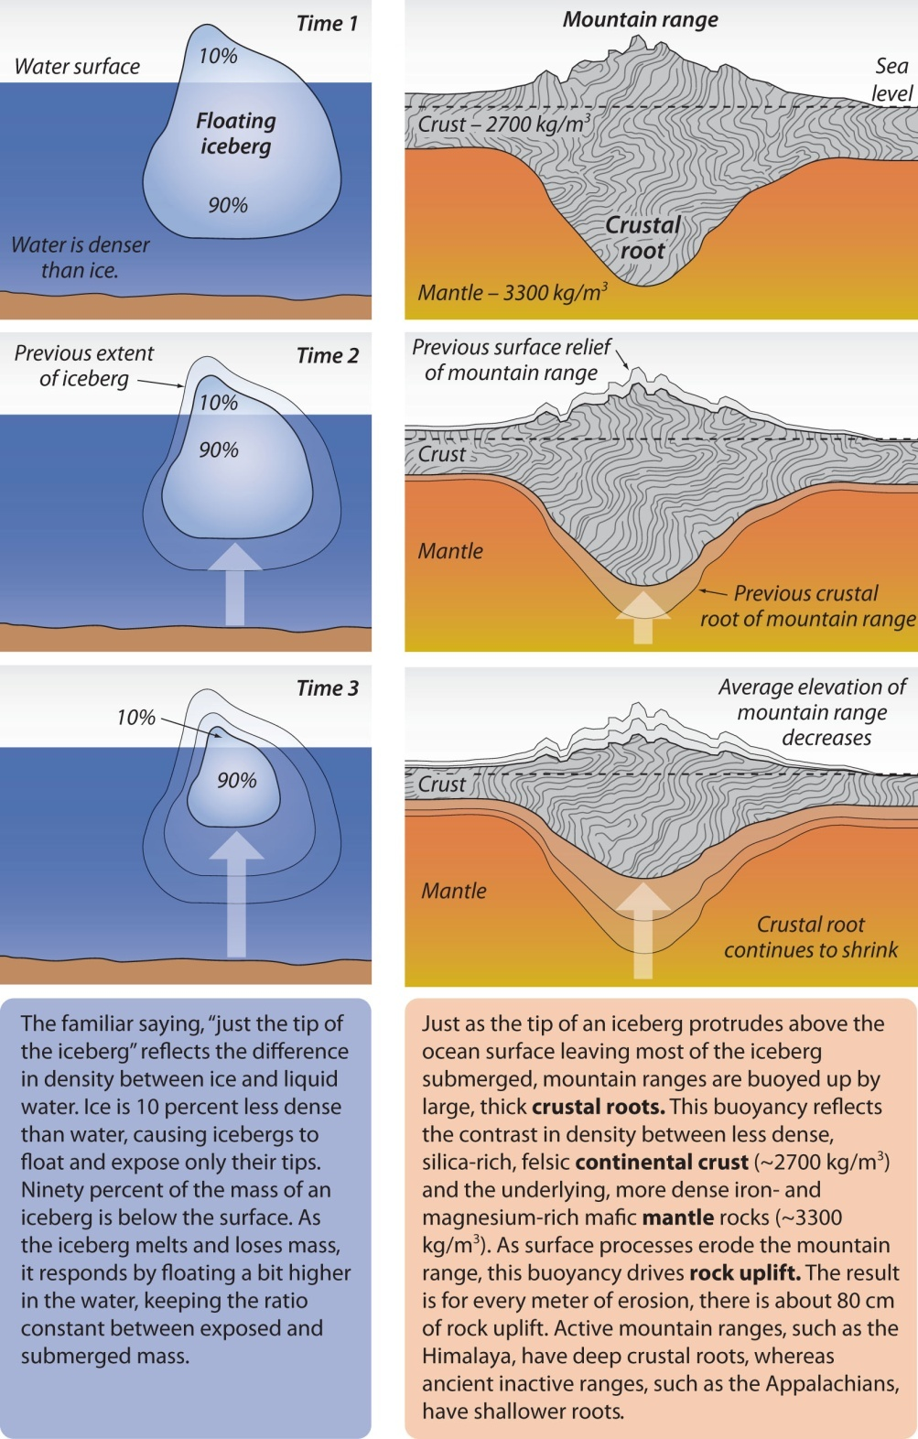

Slide 26
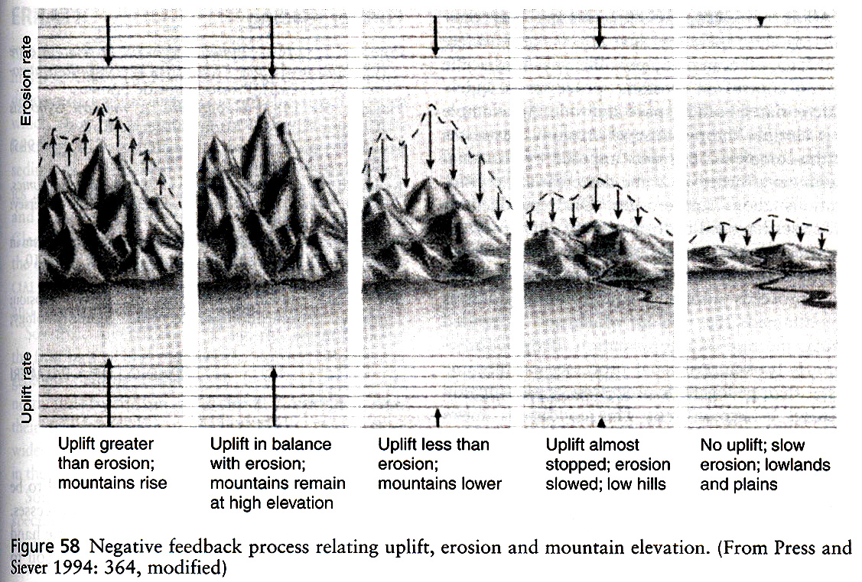

Slide 27
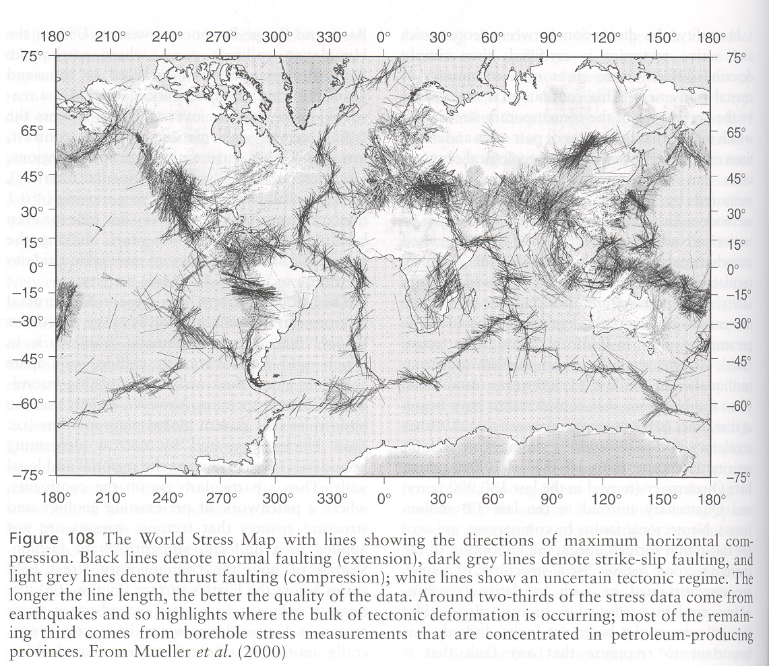

Slide 28
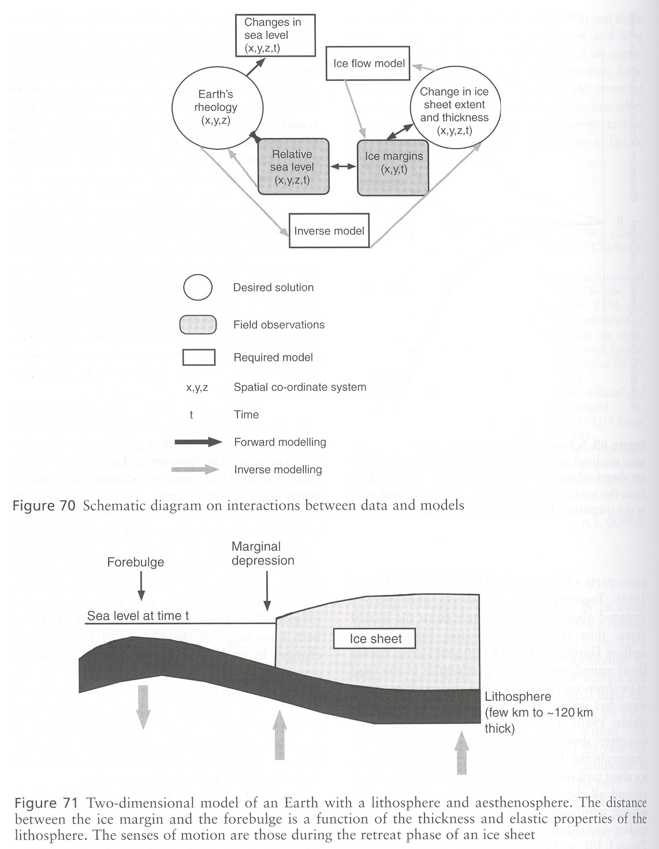

Slide 29
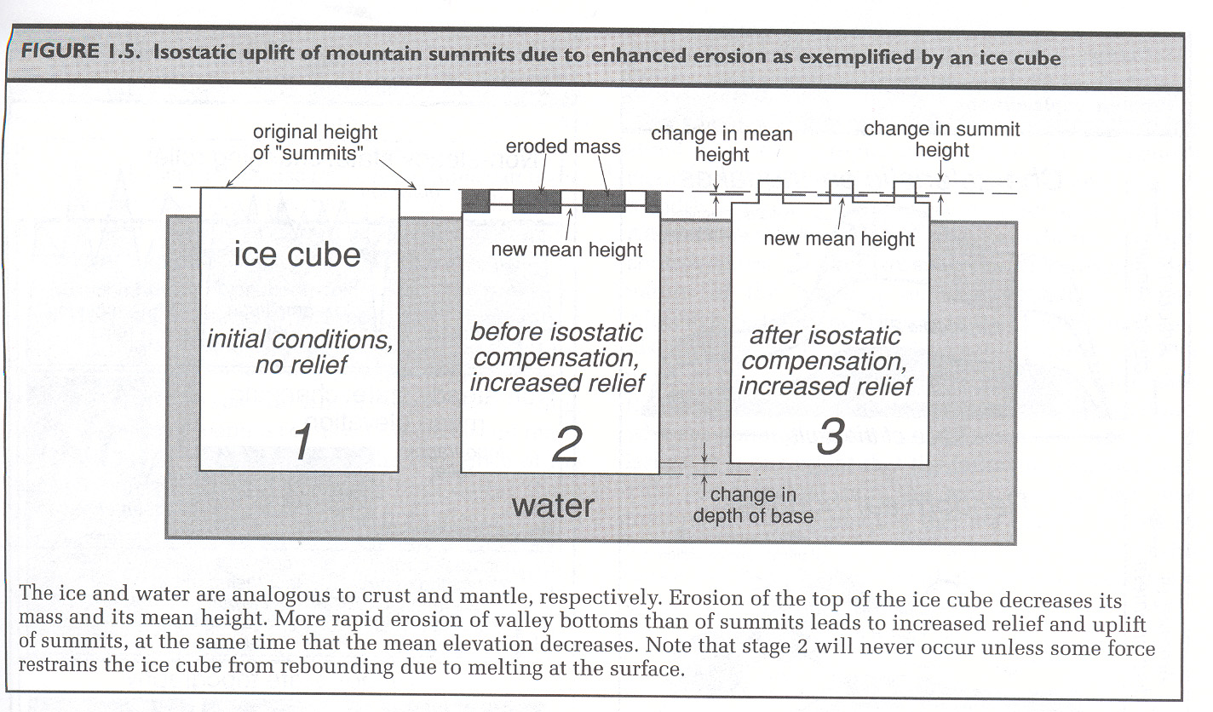

Slide 30
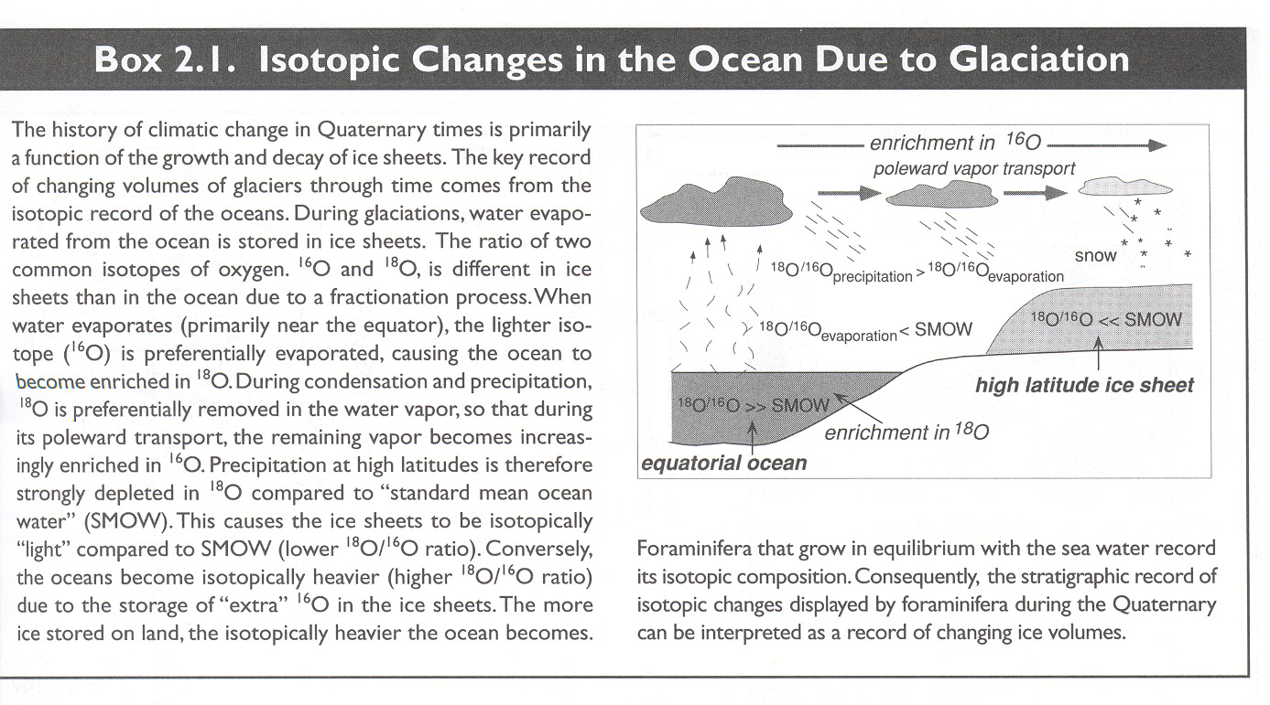

Slide 31
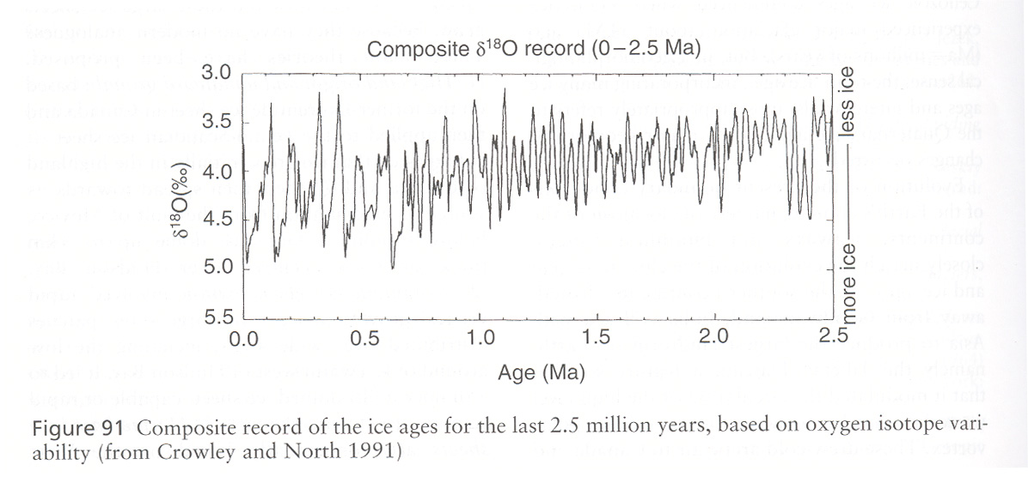

Slide 32
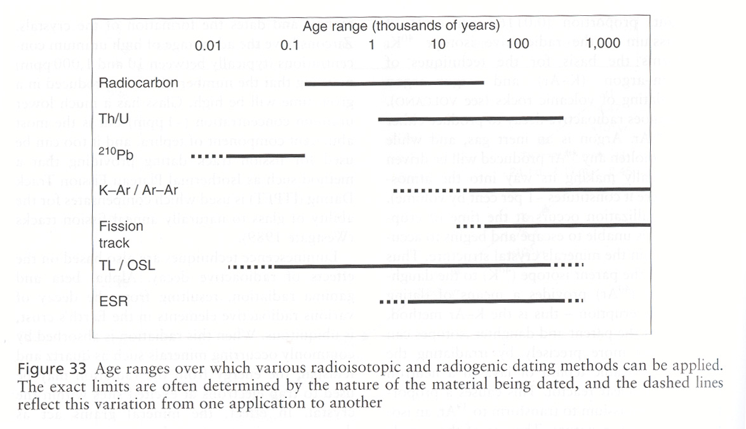

Slide 33
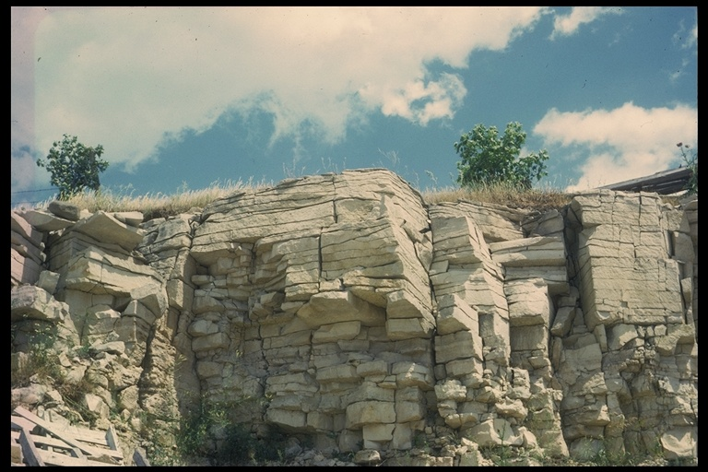

Slide 34
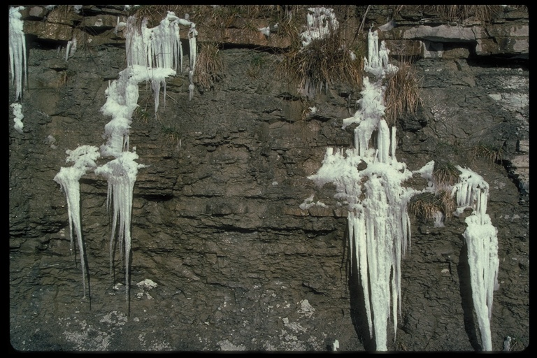

Slide 35
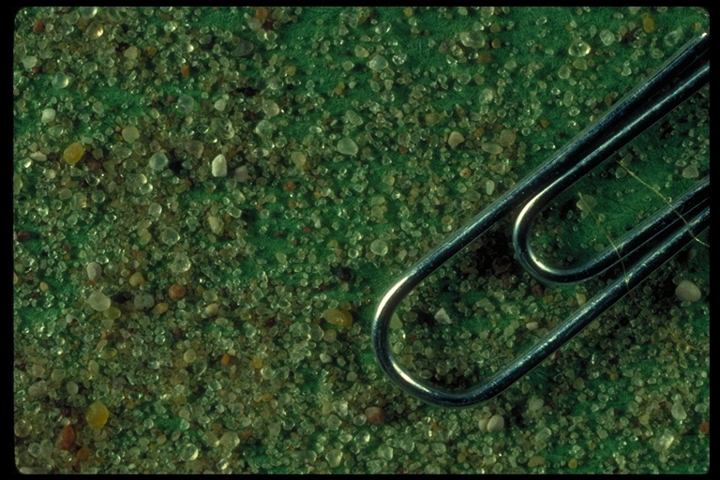

Slide 36
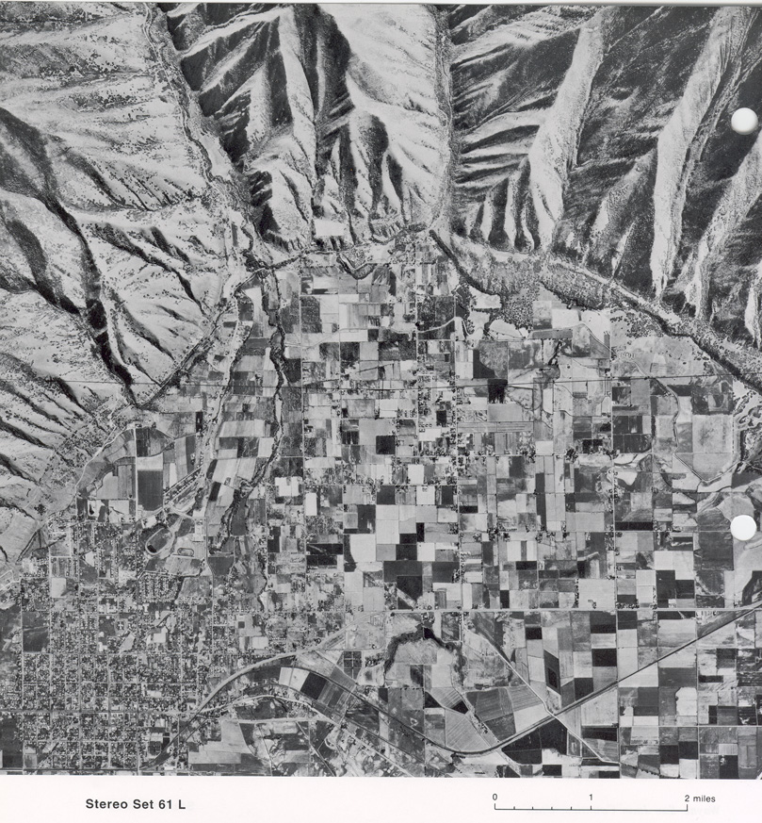

Slide 37
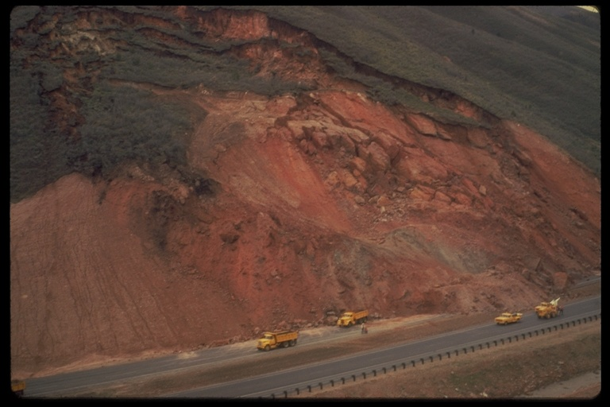

Slide 39
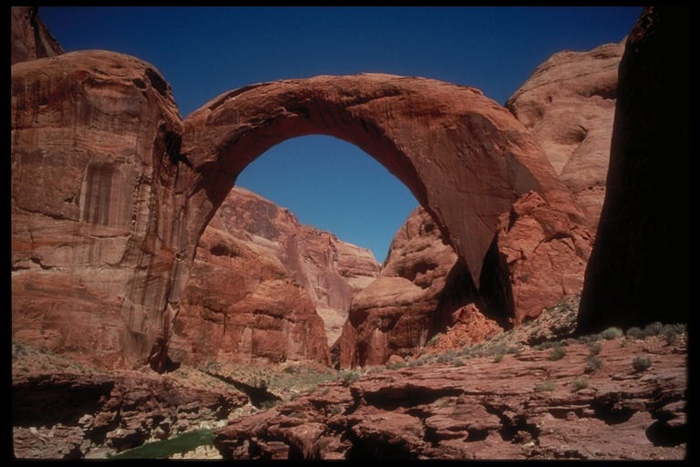

Slide 41
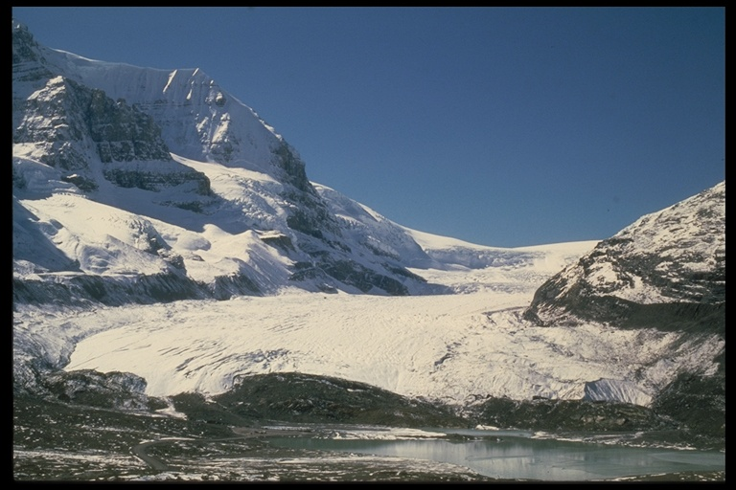

Slide 42
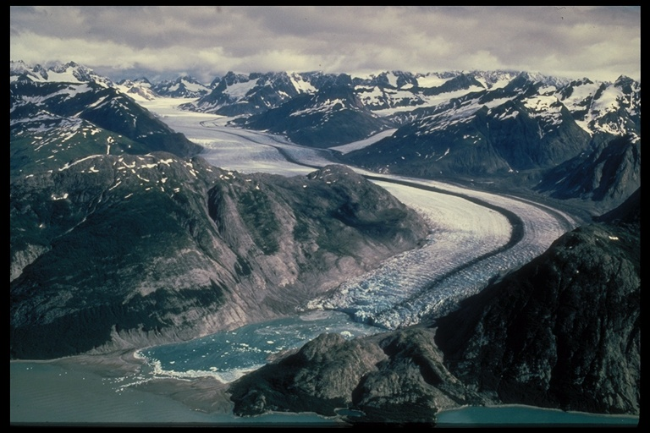

Slide 43
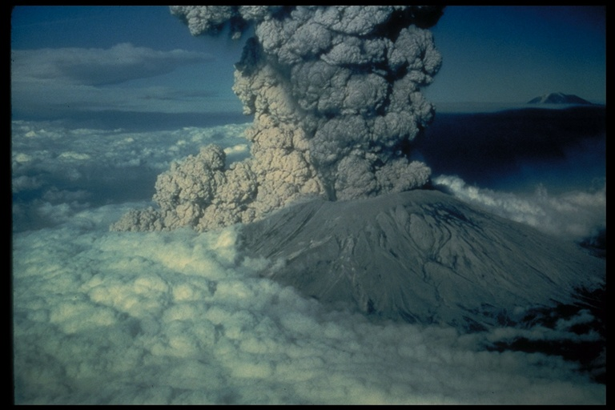

Slide 44
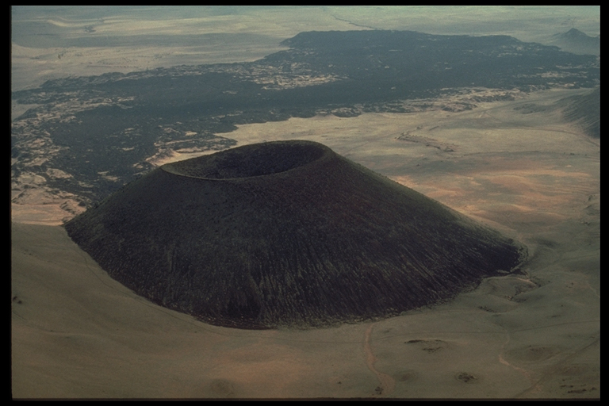

Slide 45
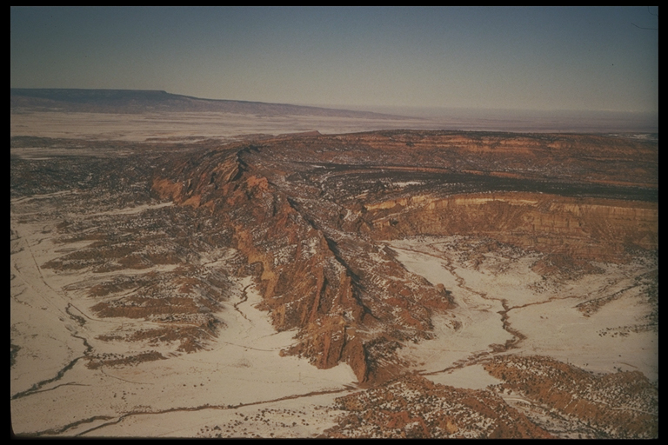

Slide 46
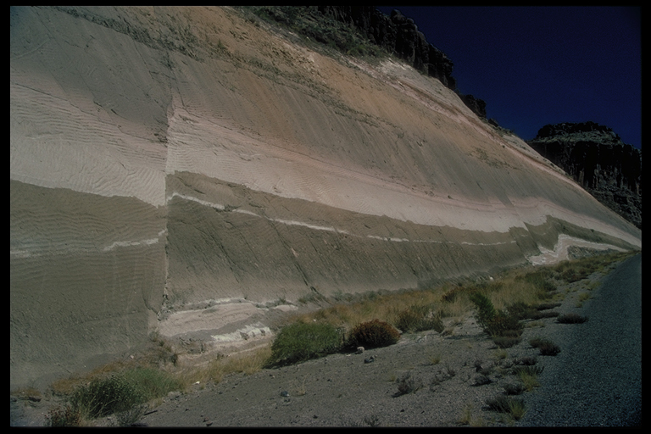

Slide 47
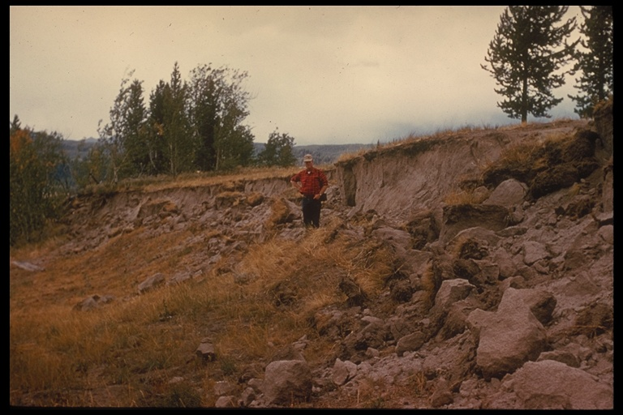

Slide 48
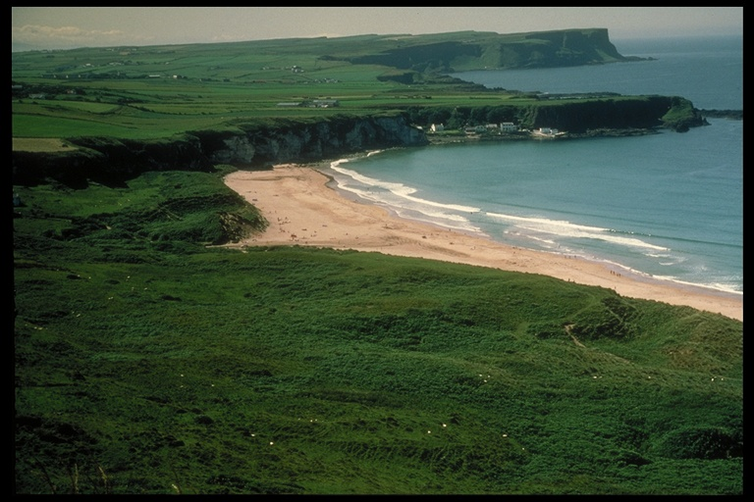

Slide 49
