Slide 1
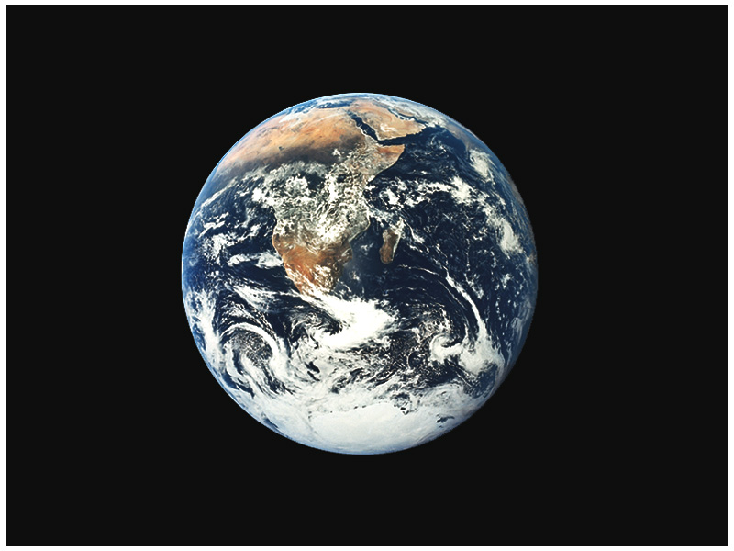

Slide 2
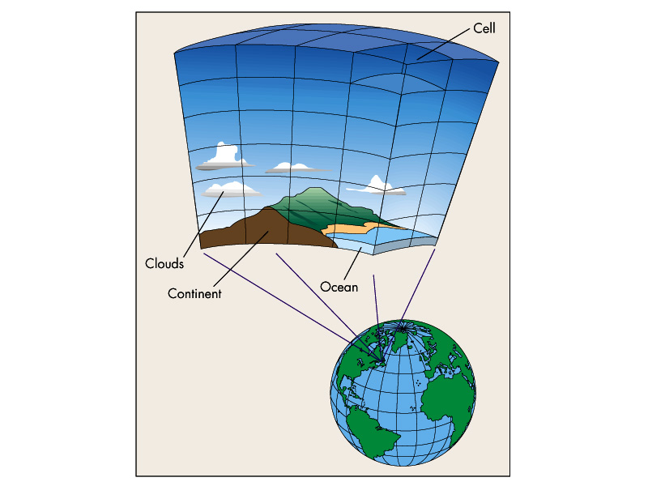

Slide 3
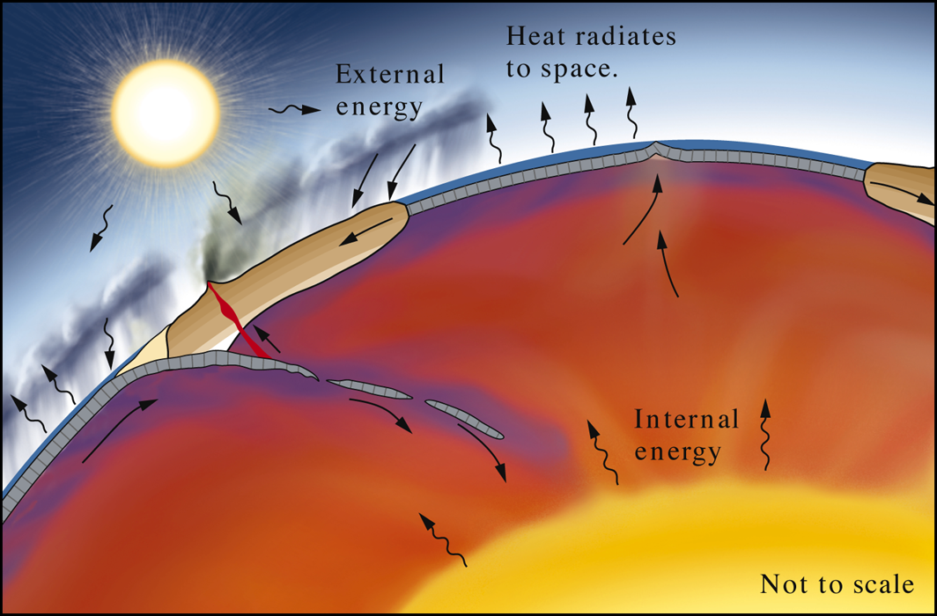
Fig. 23.02
W. W. Norton

Slide 4
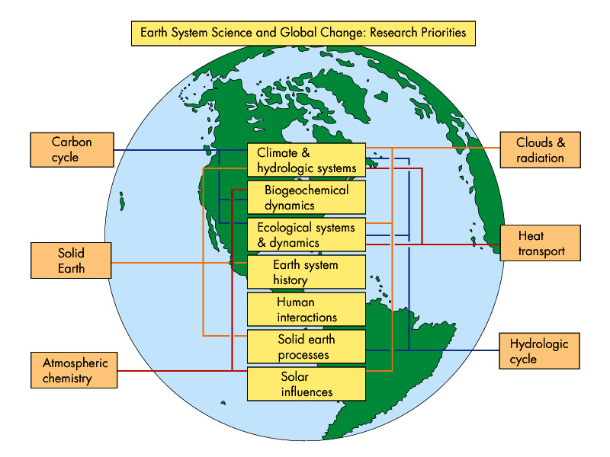

Slide 5
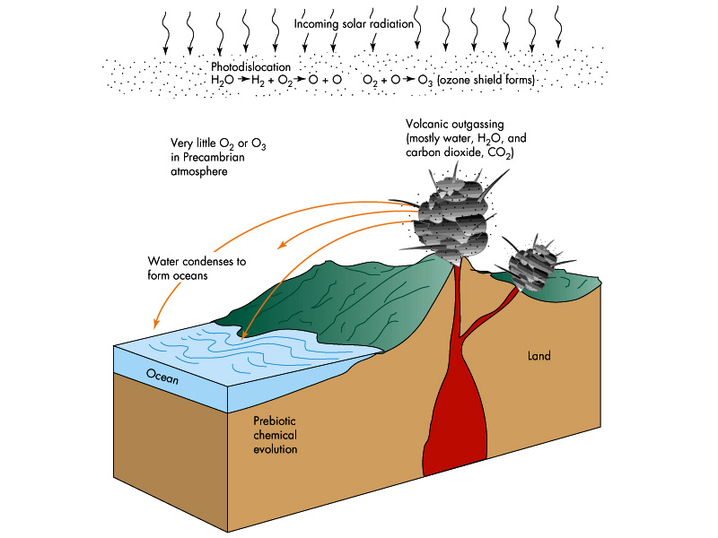

Slide 6
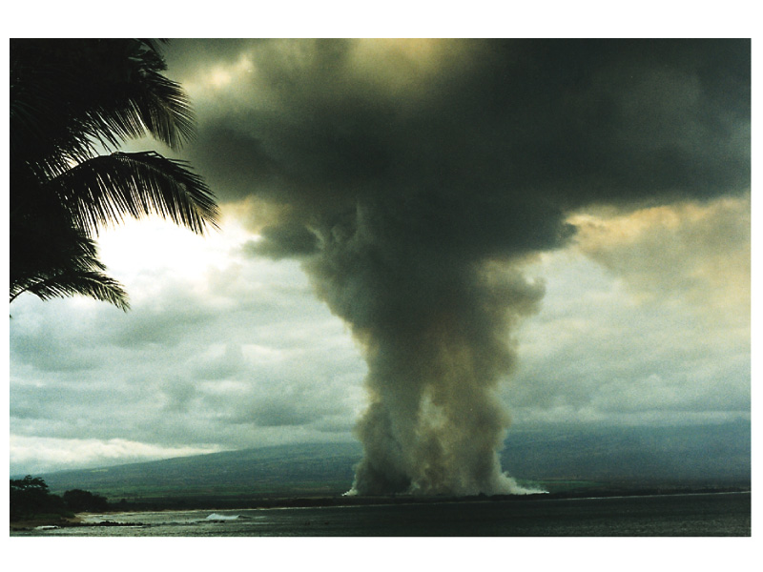

Slide 7
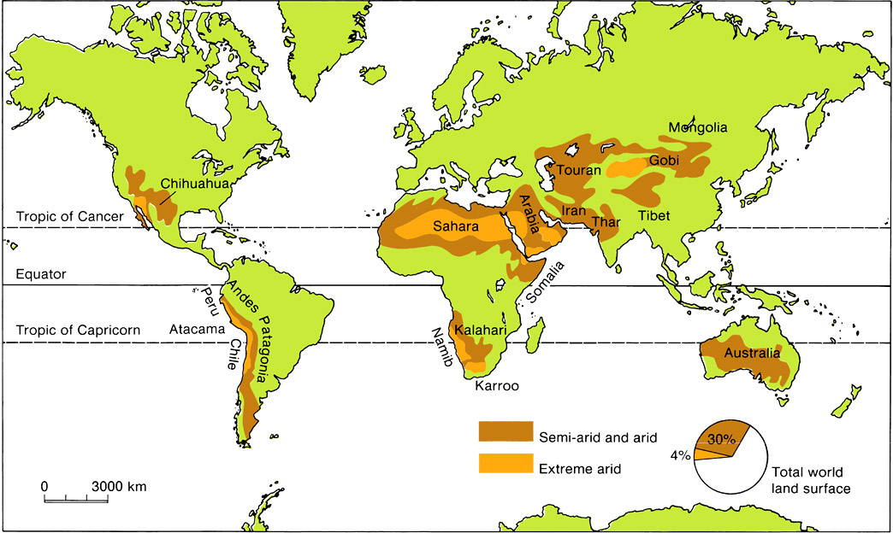

Slide 8
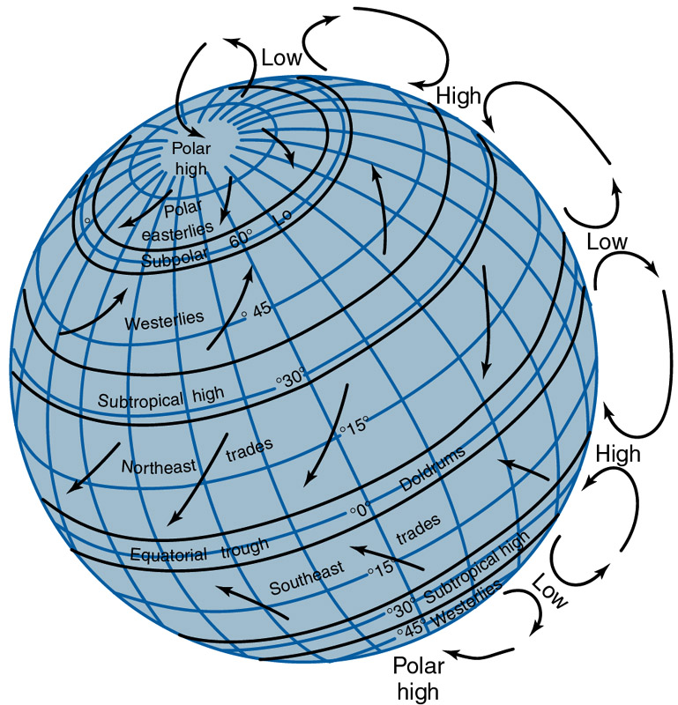

Slide 9
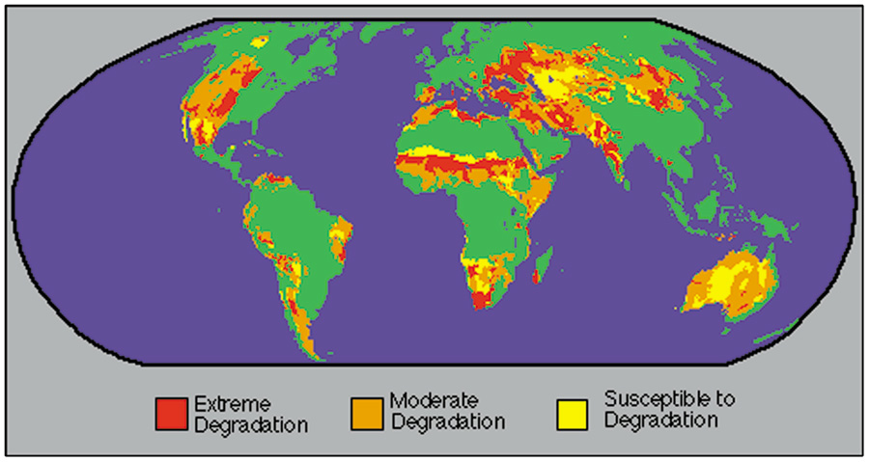

Slide 10
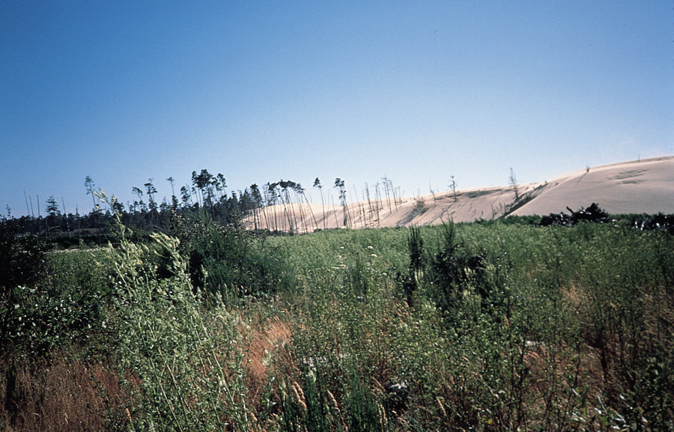

Slide 11
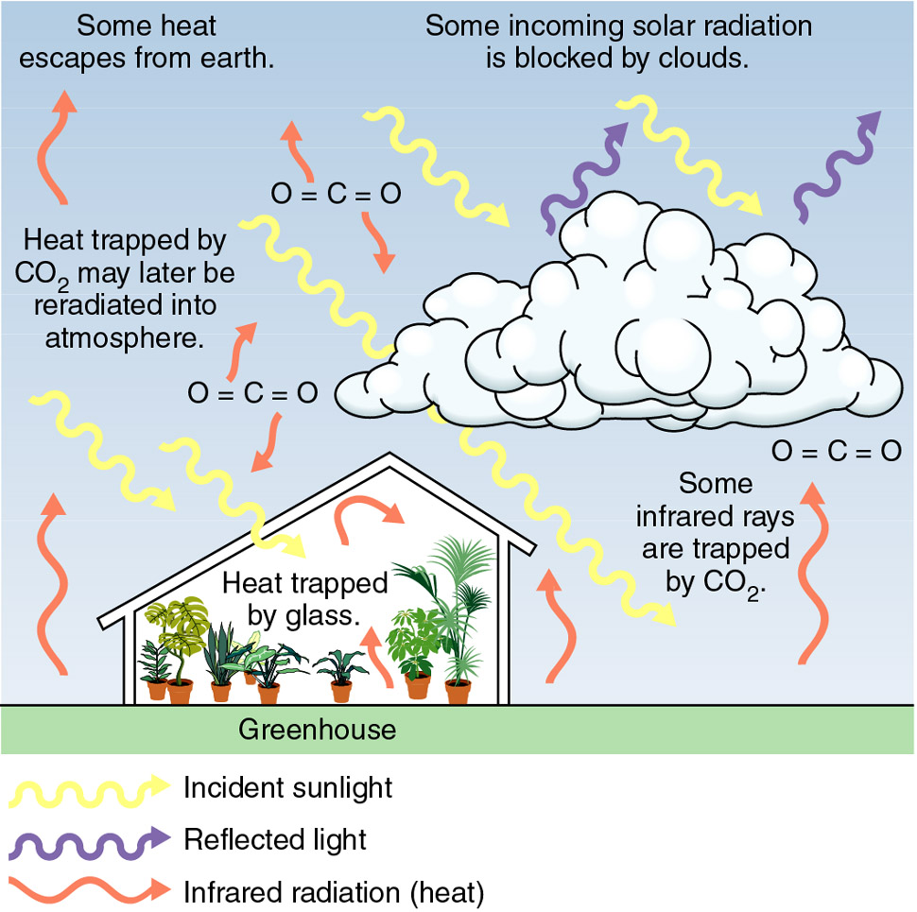

Slide 12
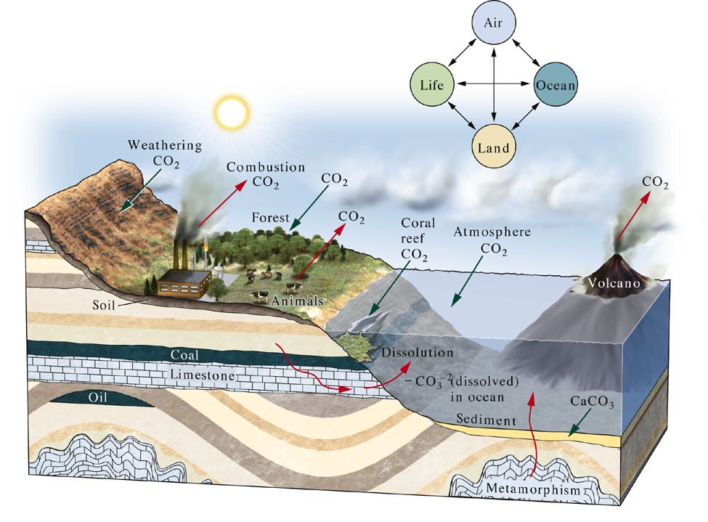
Fig. 23.08
W. W. Norton

Slide 13
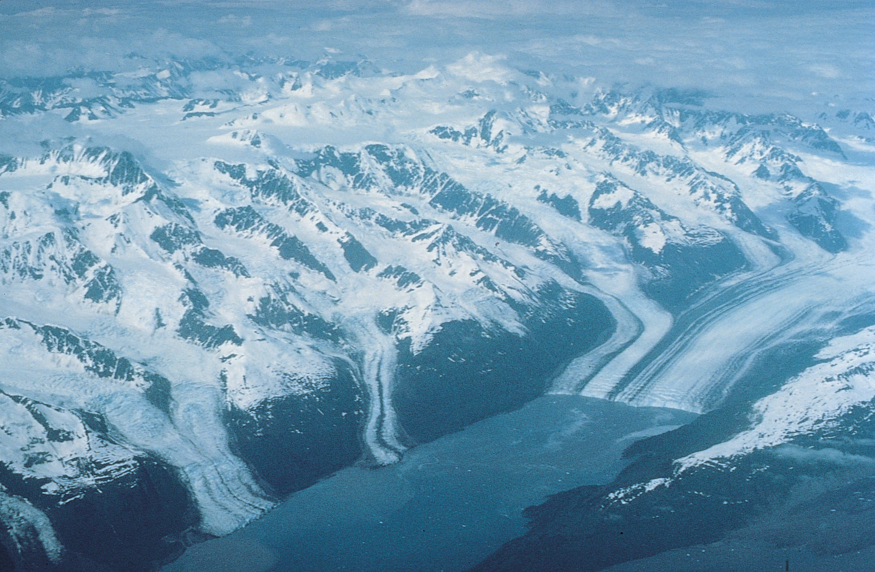

Slide 14
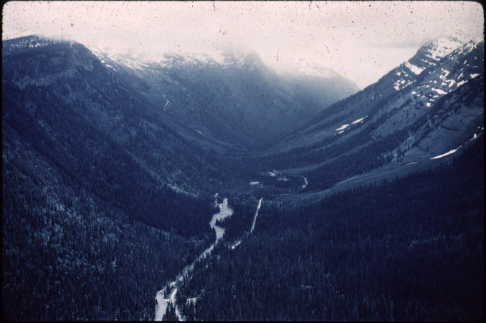

Slide 15
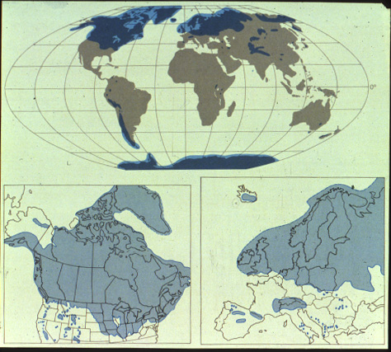

Slide 16
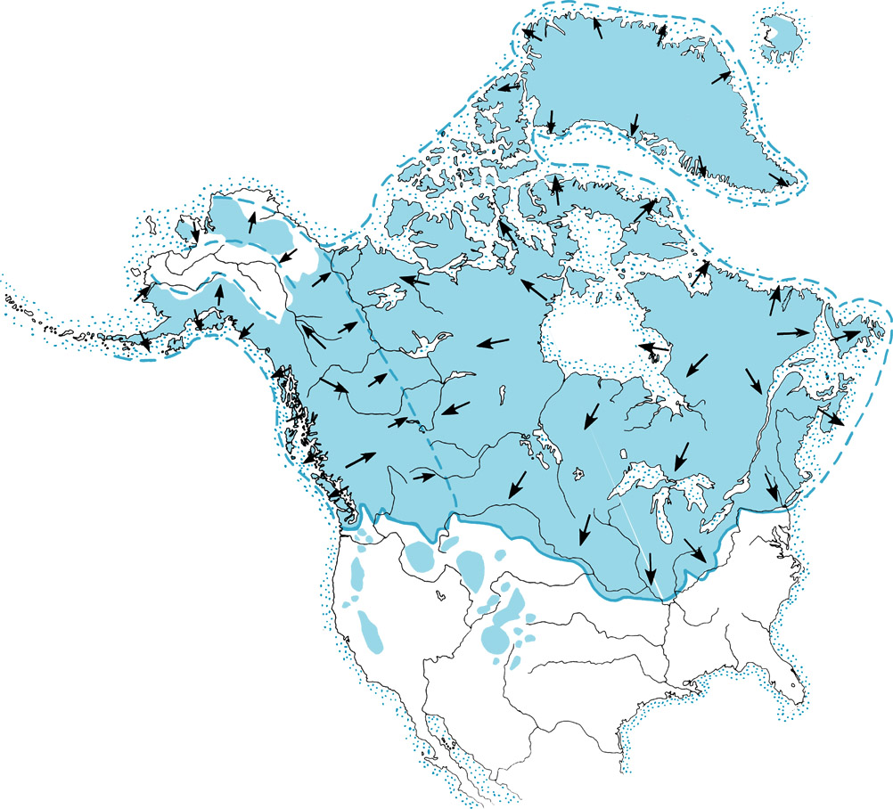

Slide 17
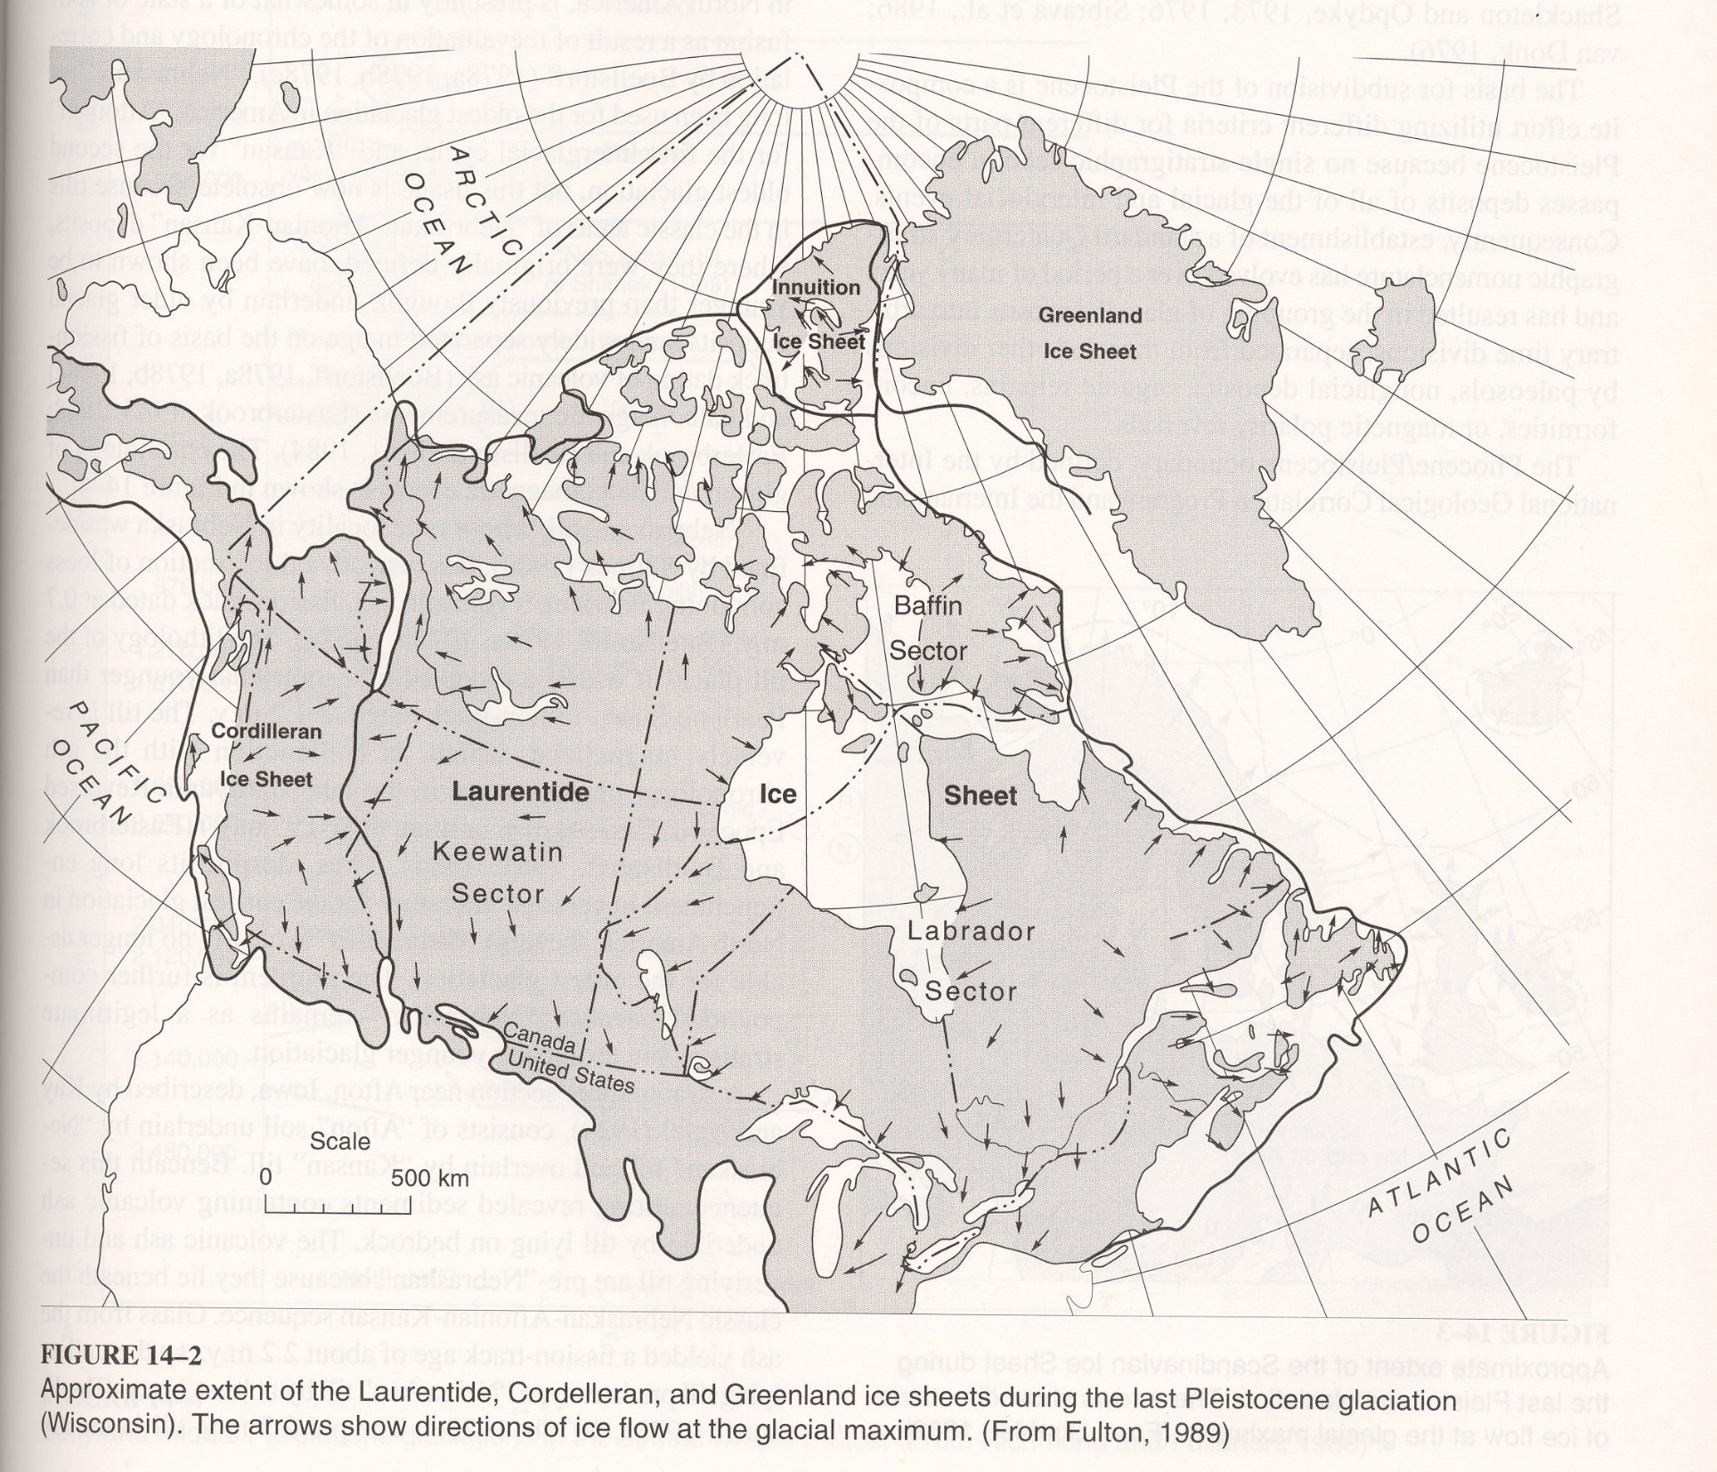

Slide 18
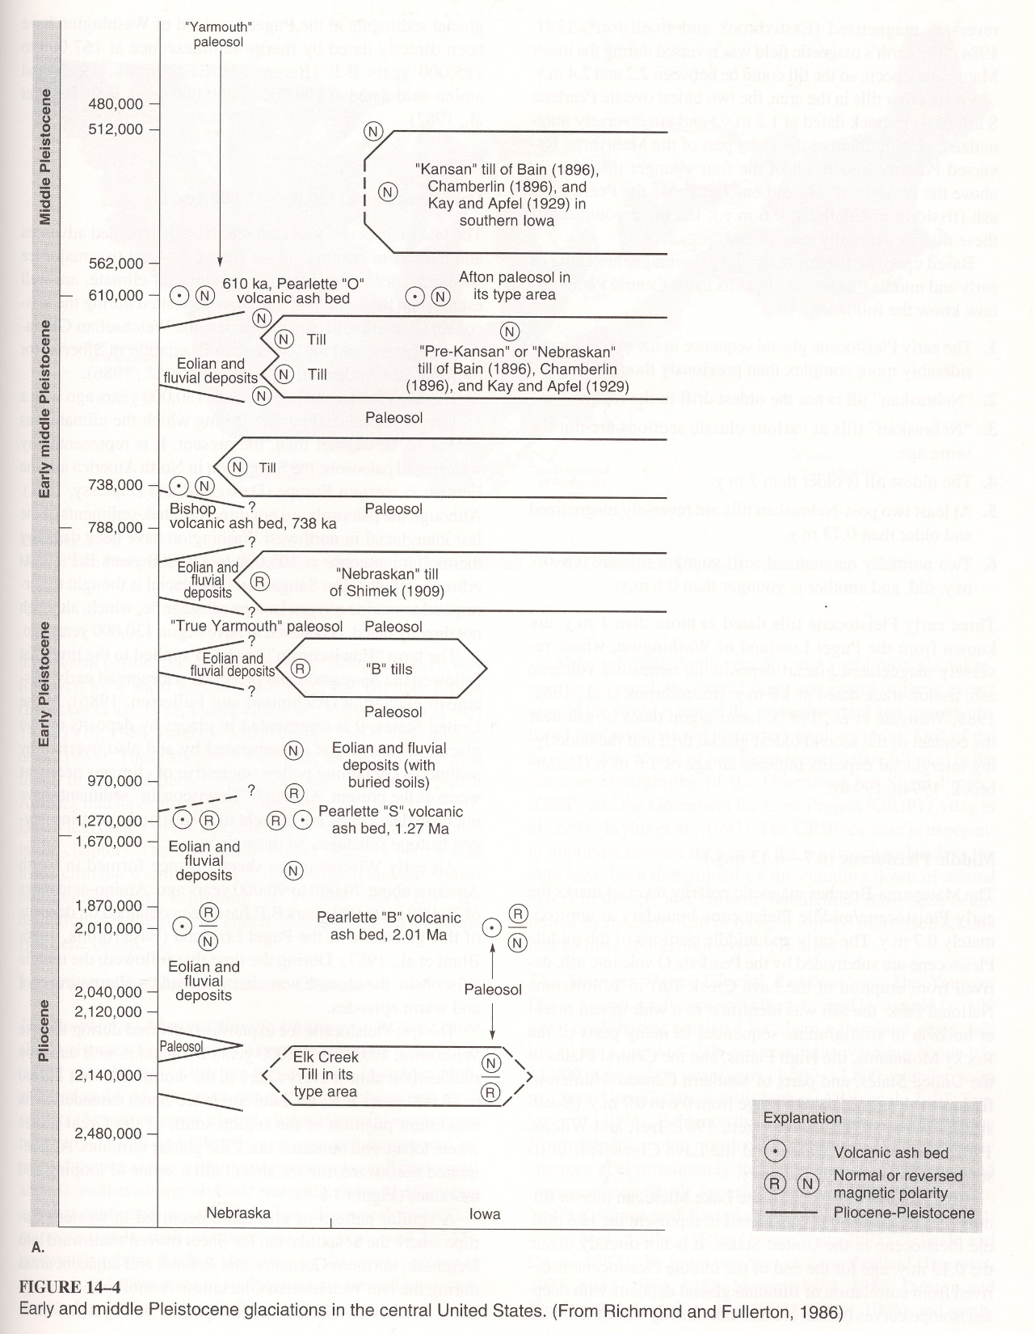

Slide 19
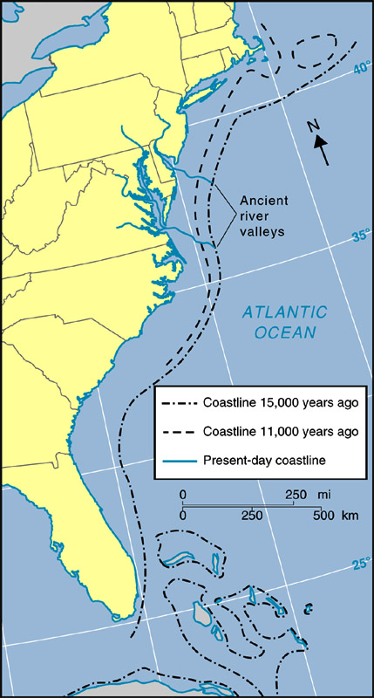
Extension
of North
America
Shoreline
Figure 9.28

Slide 20
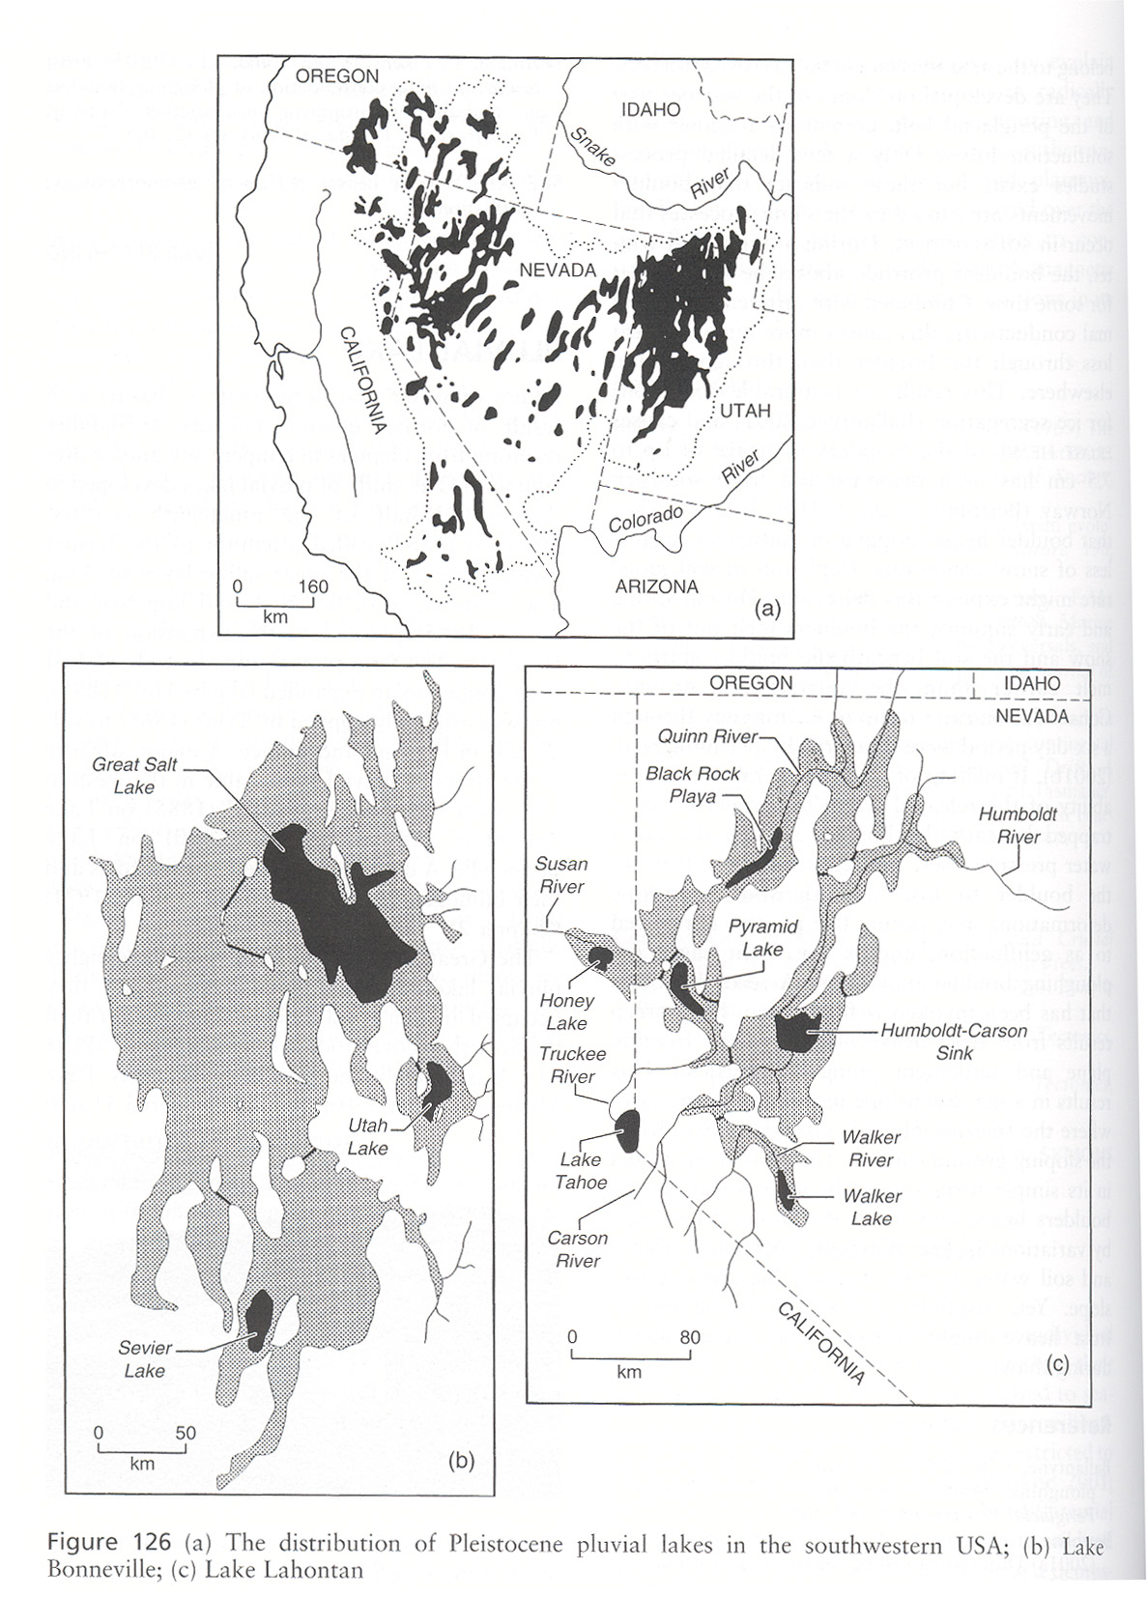

Slide 21
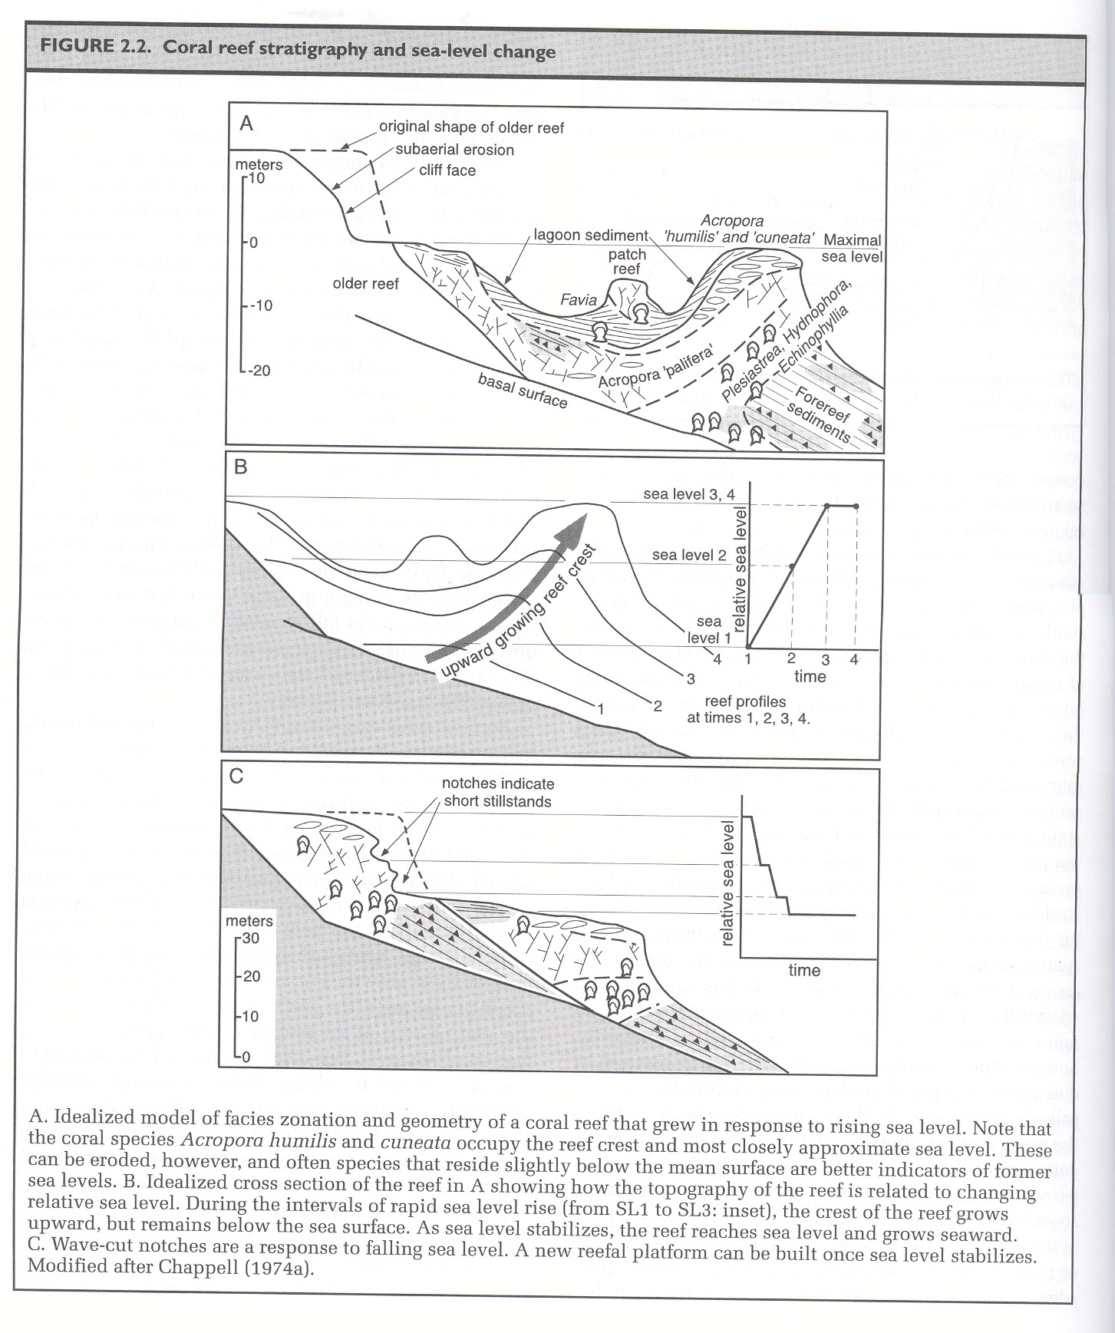

Slide 23
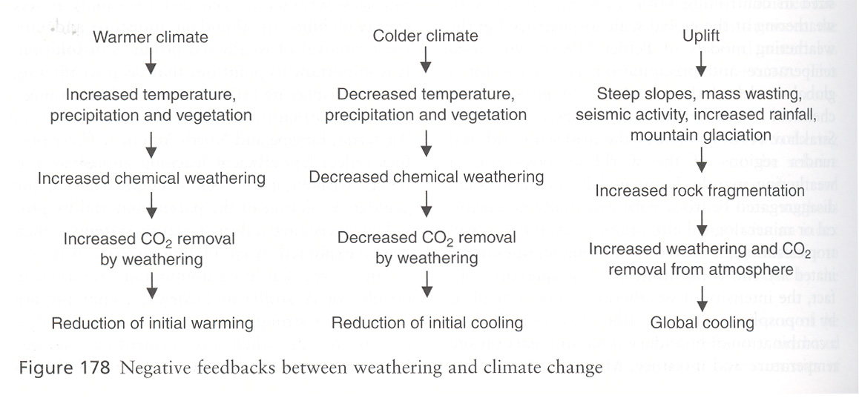

Slide 24
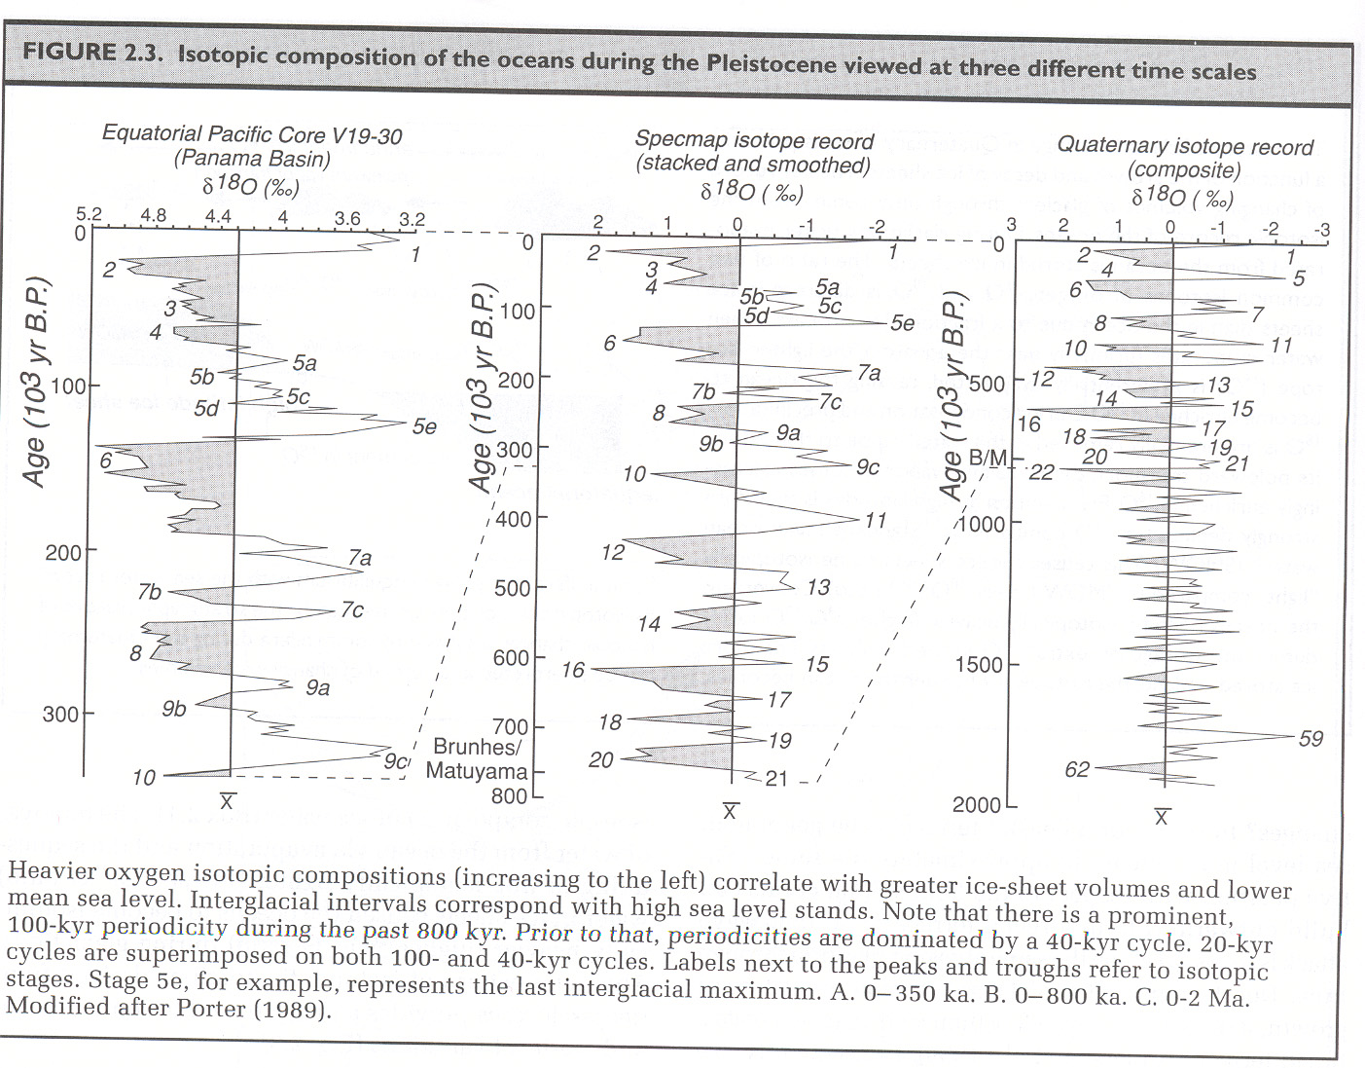

Slide 25
Fig. 23.07 e
W. W. Norton. After Van Andel, 1994

Slide 26
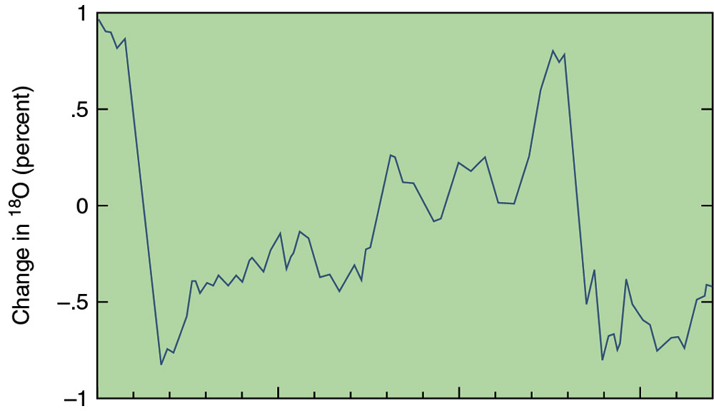
Ice Core and Past Temperature Fluctuations
Figure 9.26b
50,000
100,000
150,000
0

Slide 27
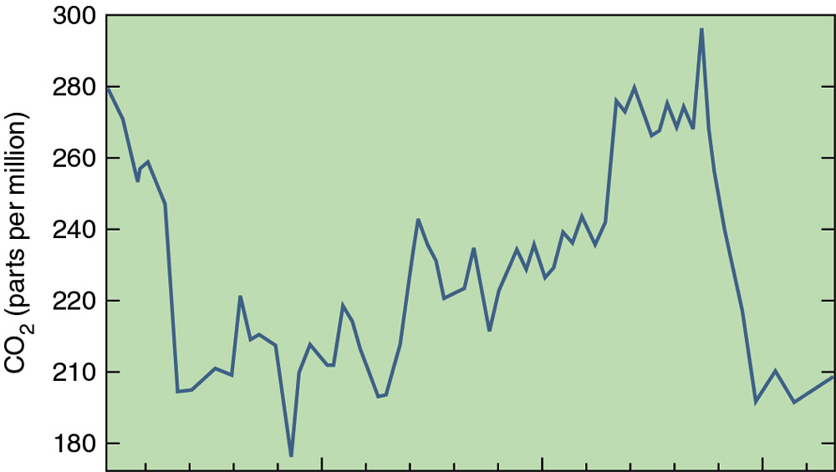
Ice Core and Past Temperature Fluctuations
Figure 9.26c
0
50,000
100,000
150,000

Slide 28
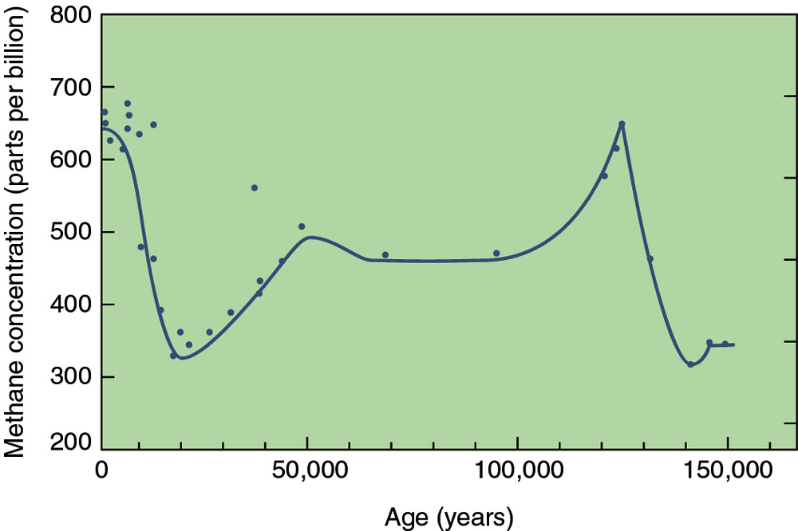
Ice Core and Past Temperature Fluctuations
Figure 9.26d

Slide 29
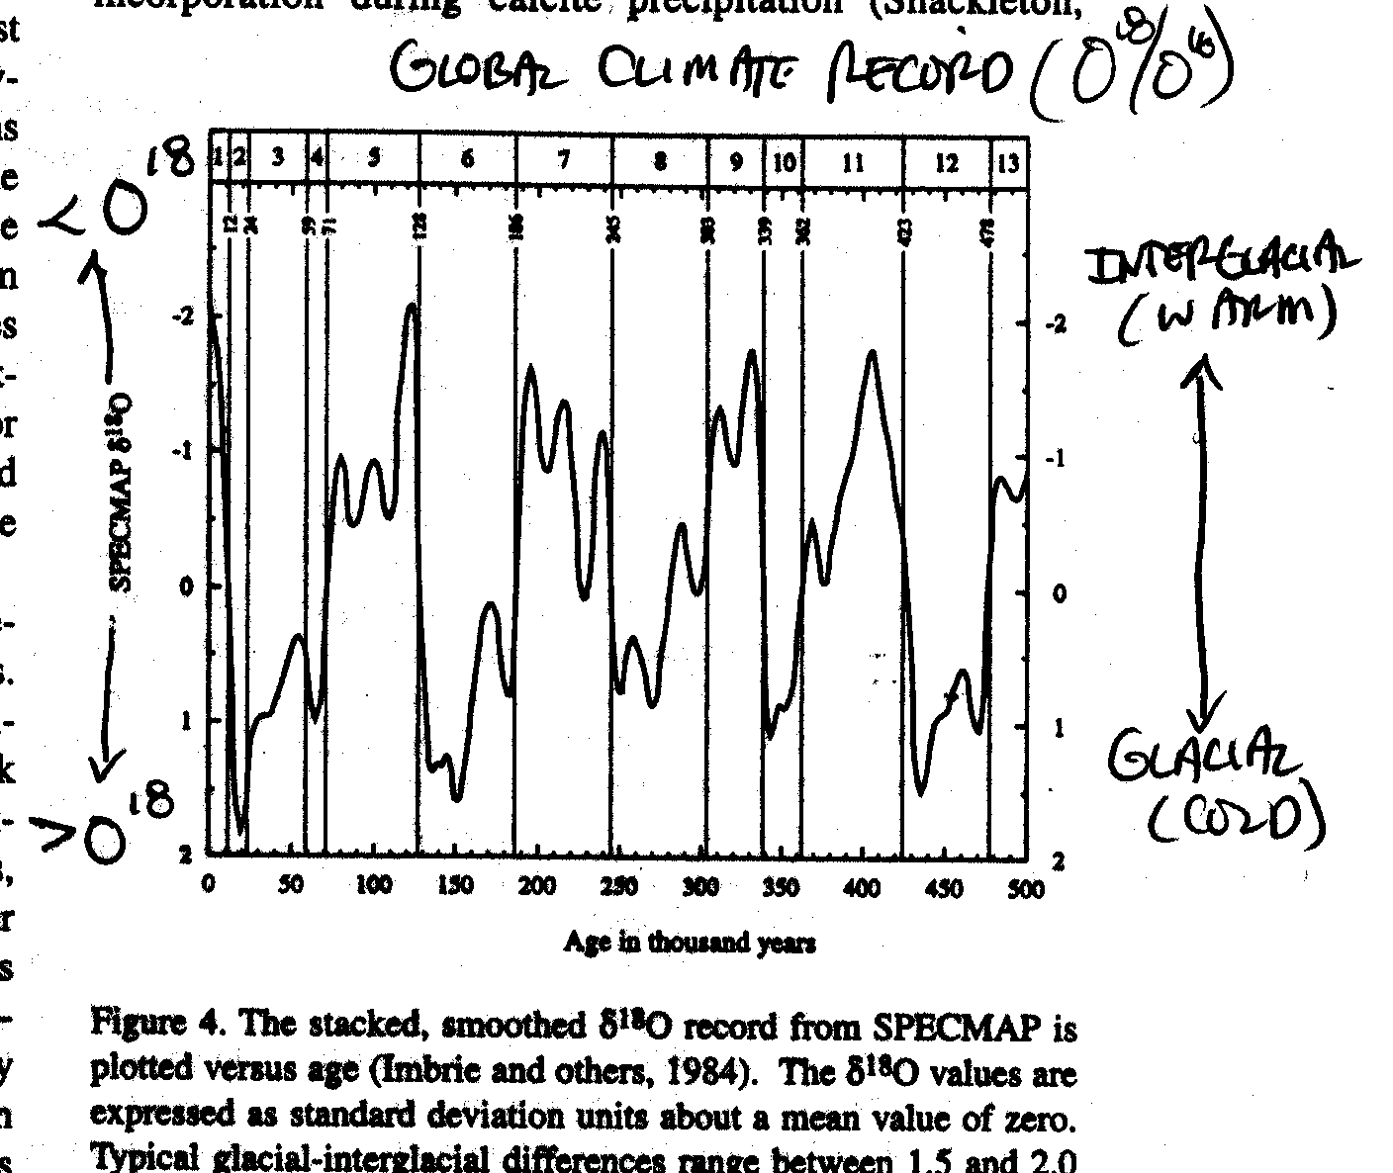

Slide 30
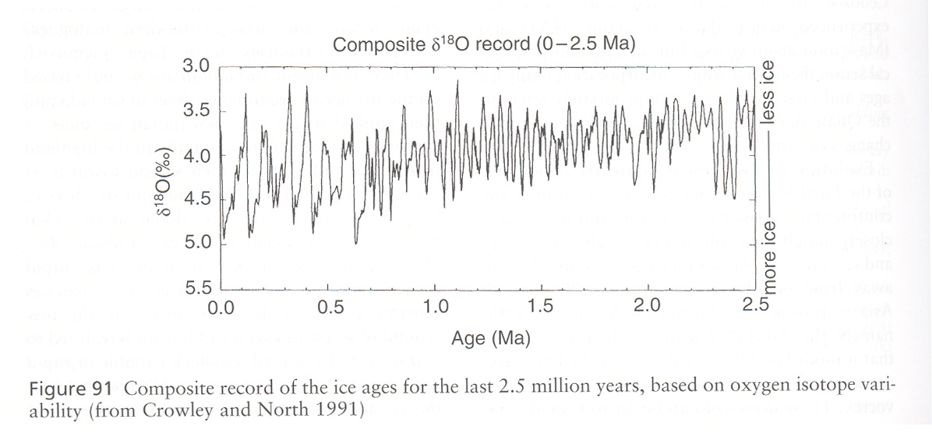

Slide 31
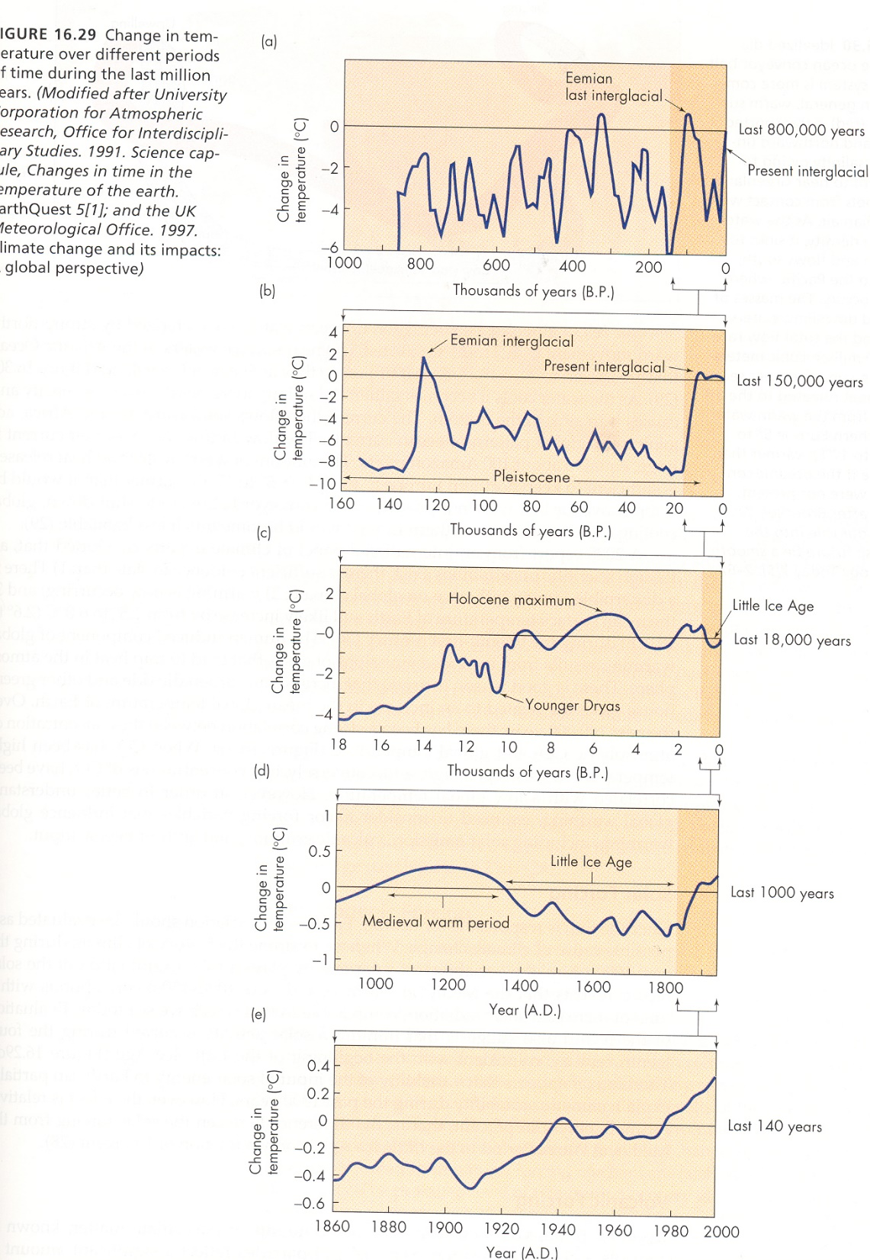

Slide 32
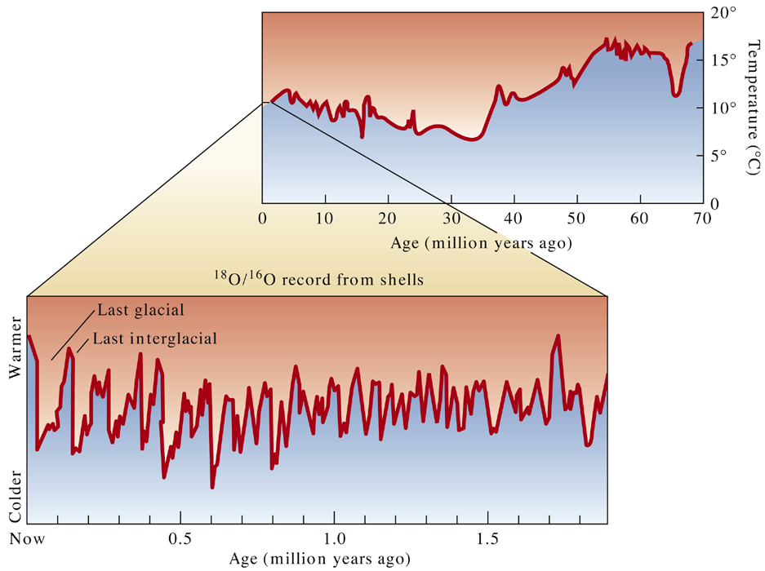
Fig. 23.11 b, c
W. W. Norton. After Van Andel, 1994

Slide 33
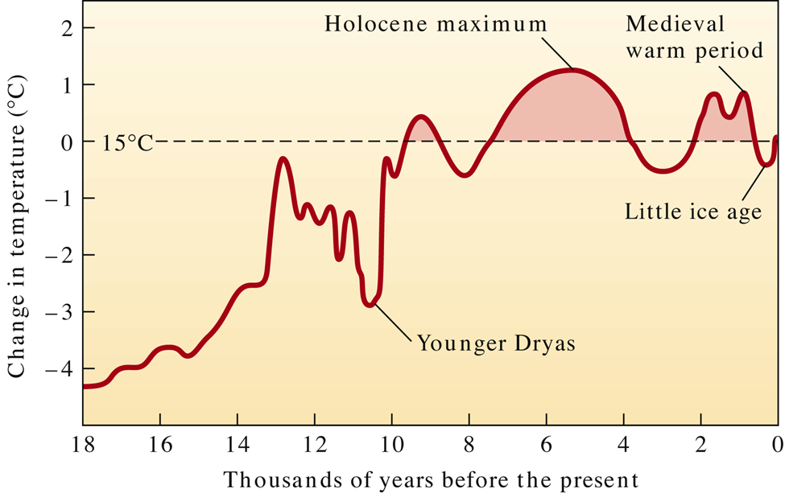
Fig. 23.14 a
W. W. Norton. After McKenzie, 1998

Slide 34
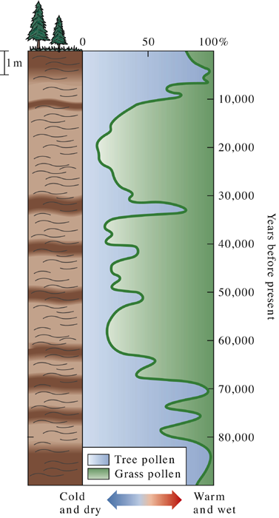
Fig. 23.09 c
W. W. Norton

Slide 35
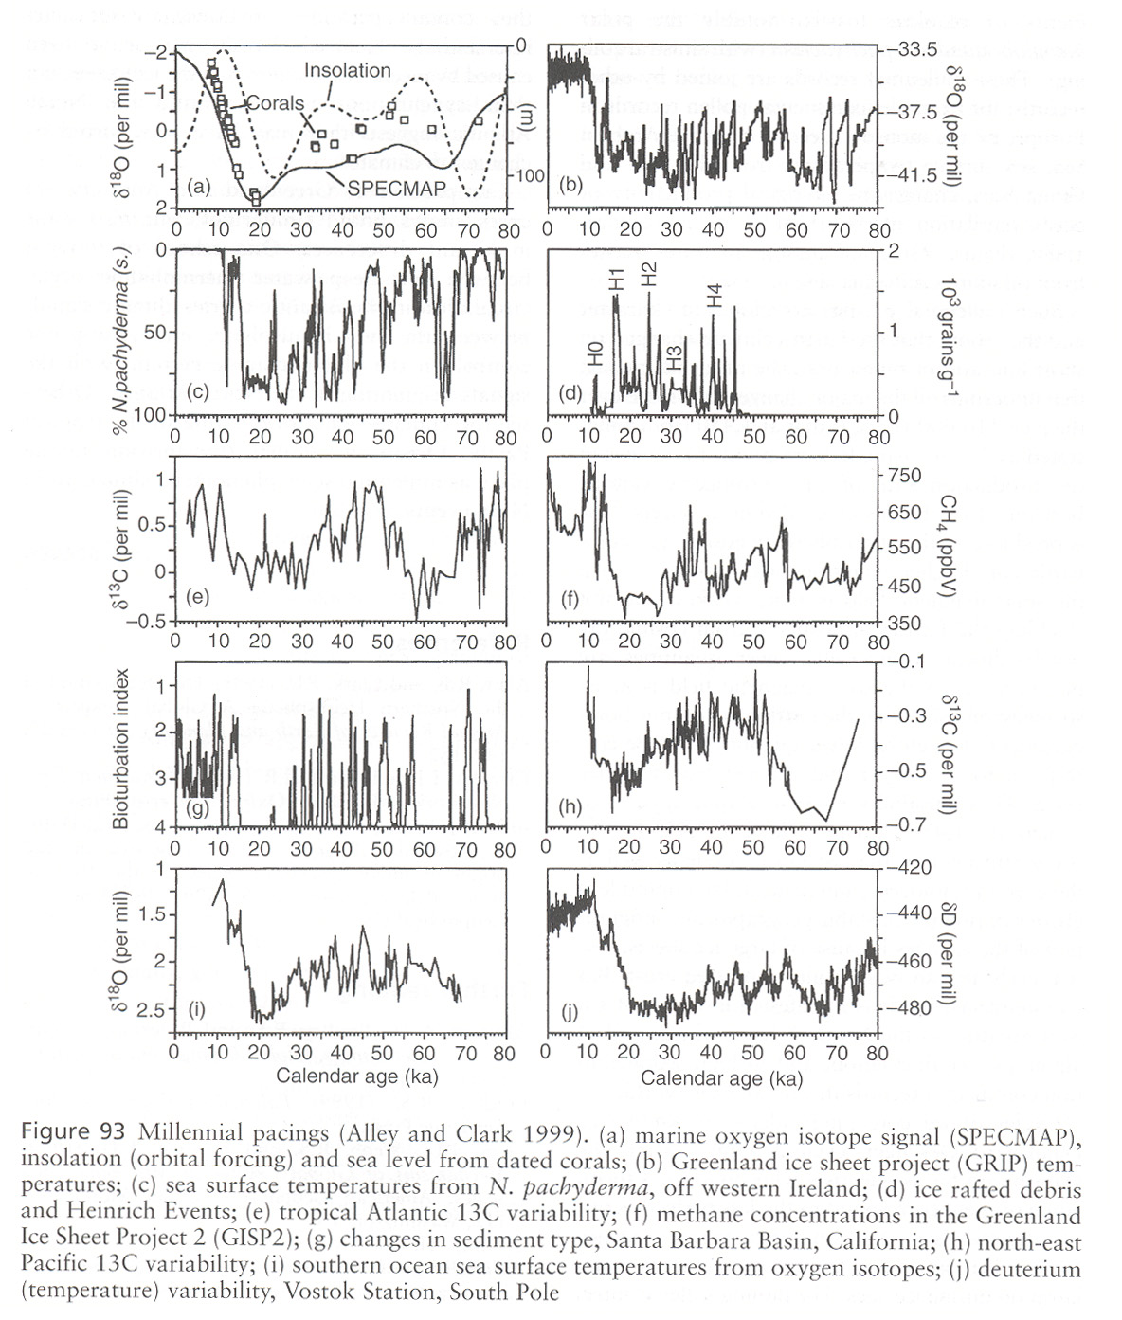

Slide 36
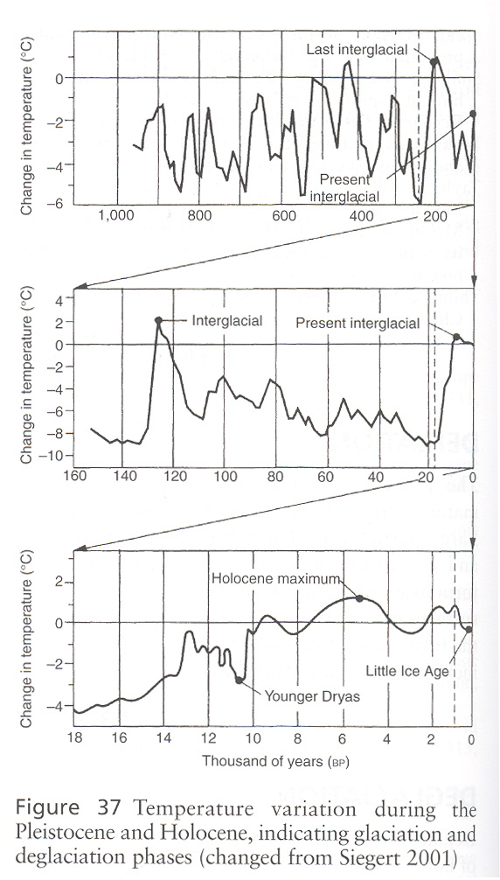

Slide 37
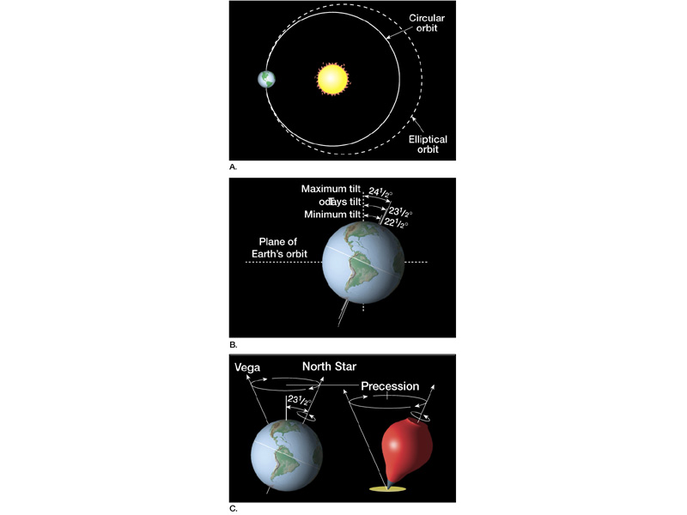
Eccentricity of
Orbit
(100,000 yr cycle)
Obliquity of Tilt
(21.4-24.5 deg)
(41,000 yr cycle)
Precession
(23,000 yr cycle)

Slide 38
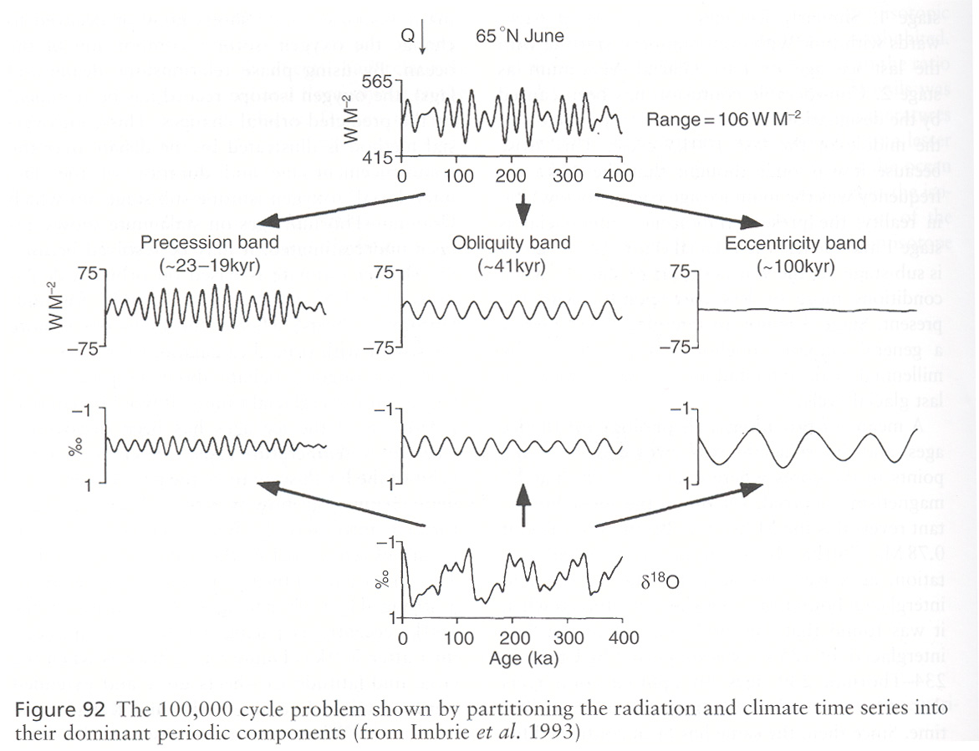

Slide 39
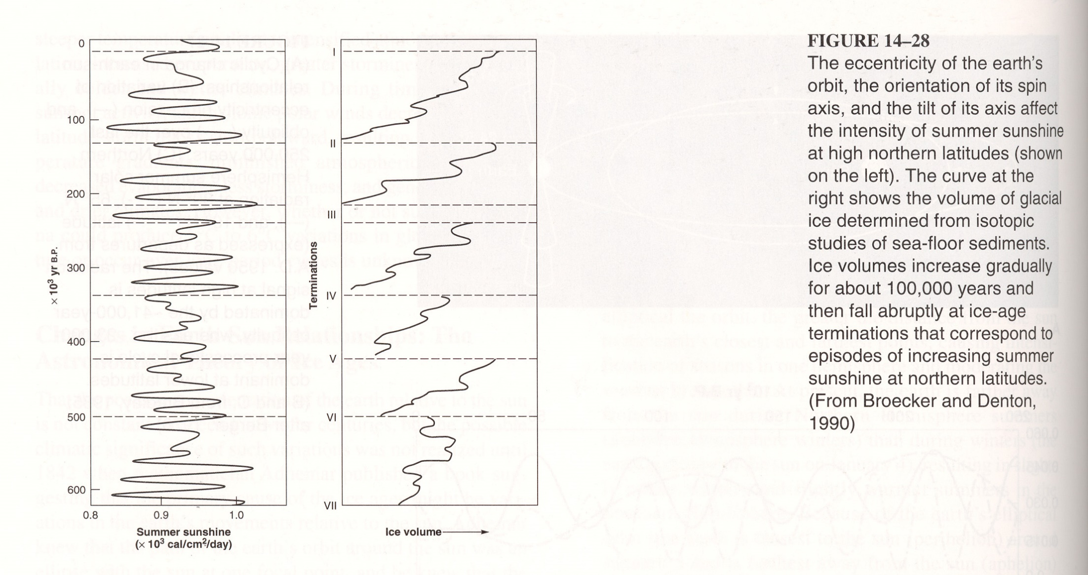

Slide 40
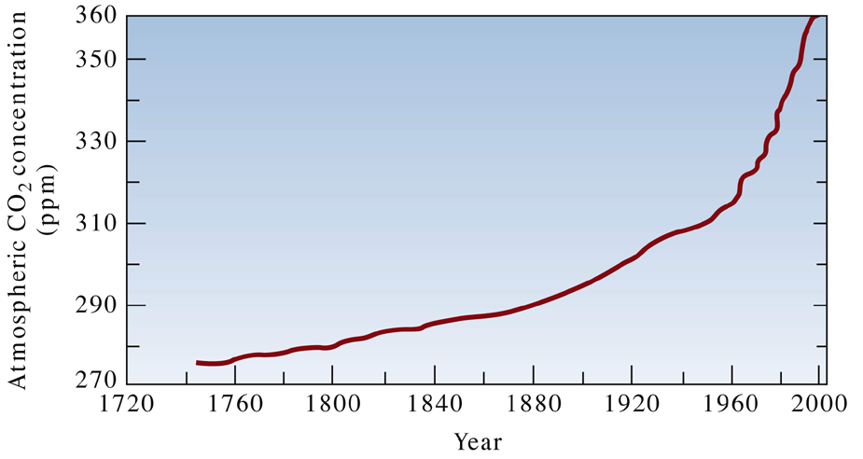
Fig. 23.23 a
W. W. Norton. Adapted from McKenzie, 1998

Slide 41
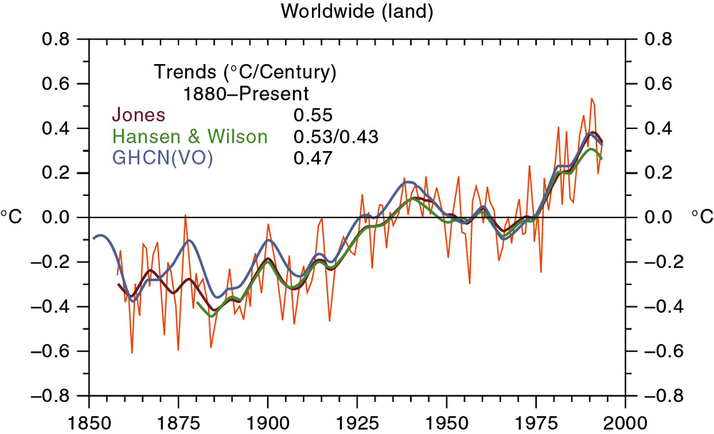
Global Temperature Rise
Figure 9.32

Slide 42
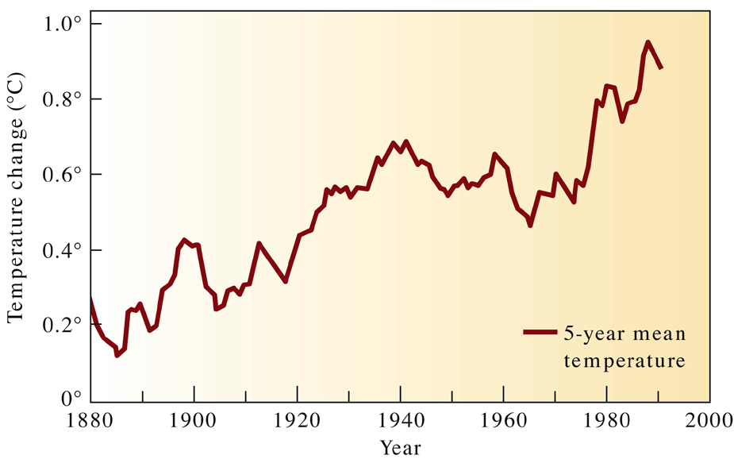
Fig. 23.24 a
W. W. Norton. Adapted from McKenzie, 1998

Slide 43
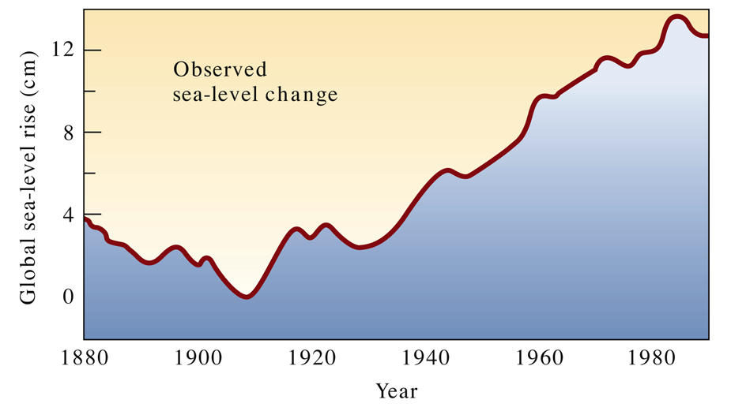
Fig. 23.26 a
W. W. Norton. Adapted from McKenzie, 1998.

Slide 44
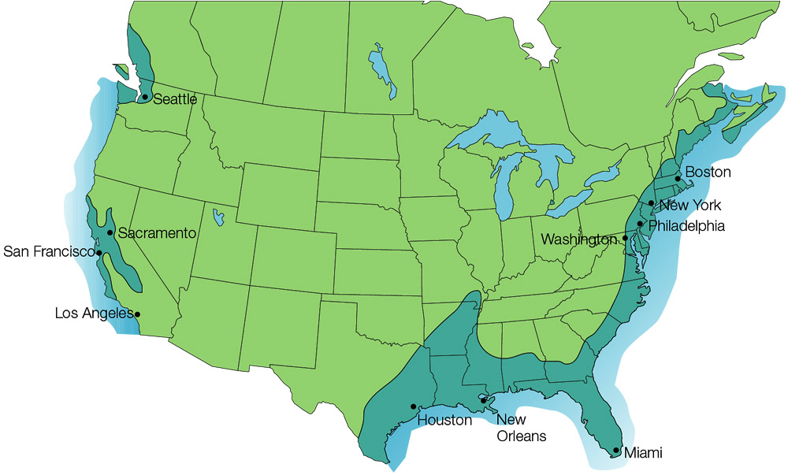
Flooding if Ice Sheets Melted
Figure 9.31

Slide 45
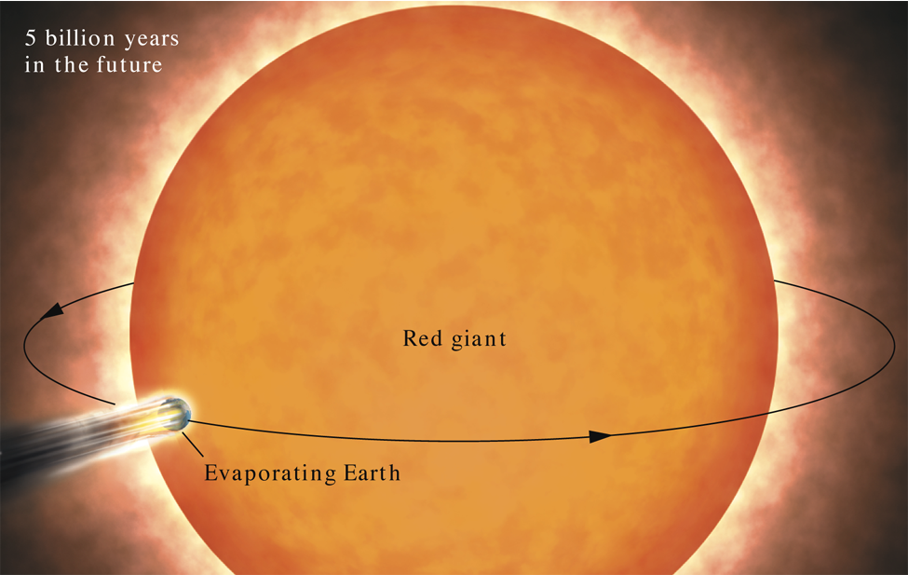
Fig. 23.27

