Slide 1
ES202 Global Climate Change

Slide 2
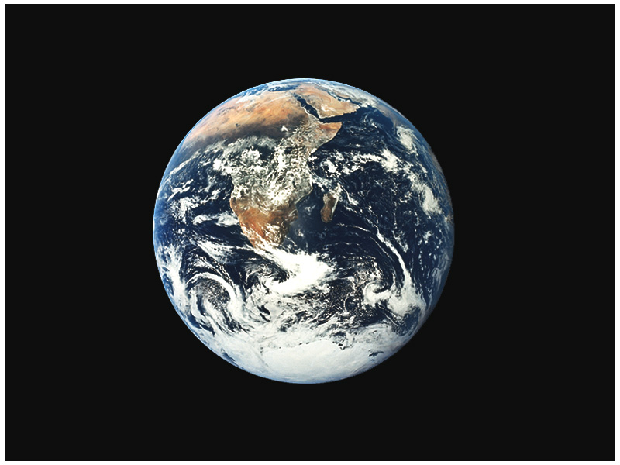

Slide 3
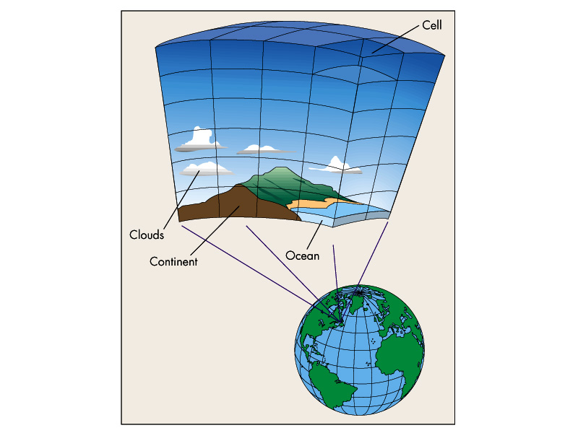

Slide 4
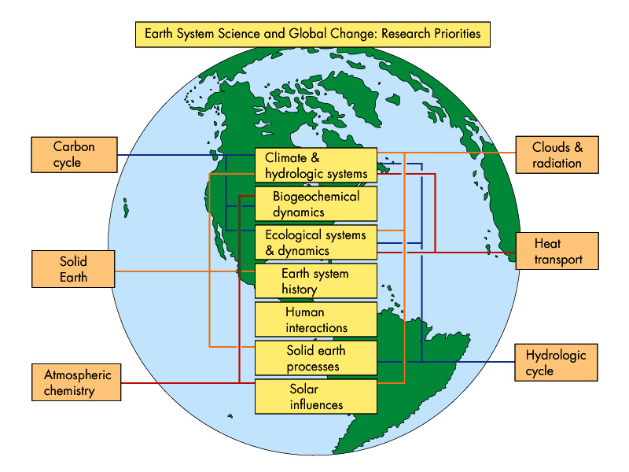

Slide 5
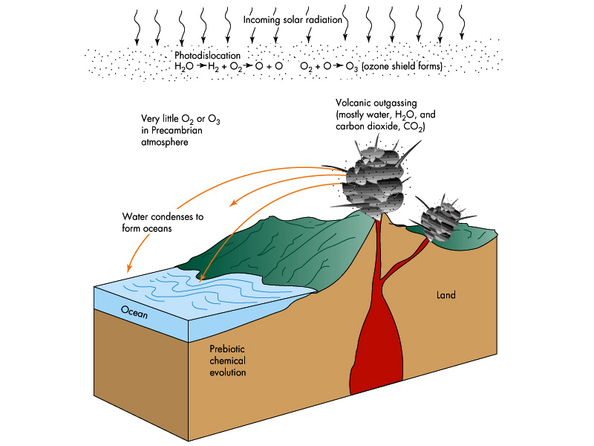

Slide 6
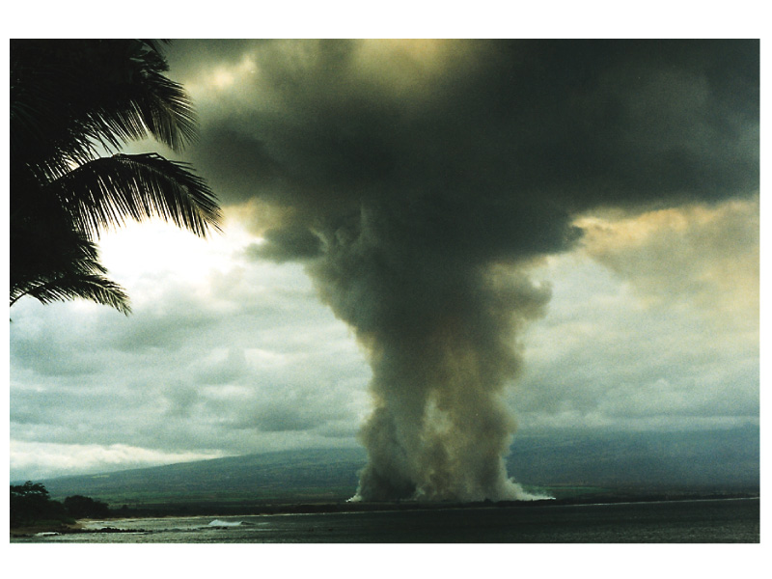

Slide 7
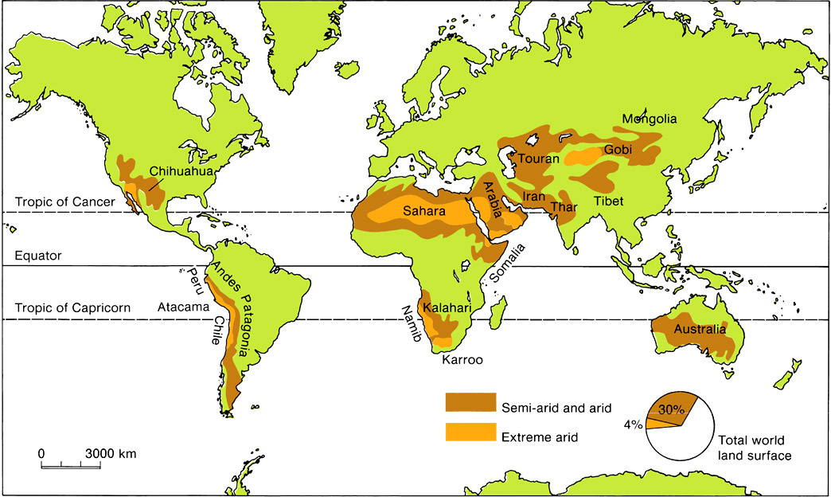

Slide 8
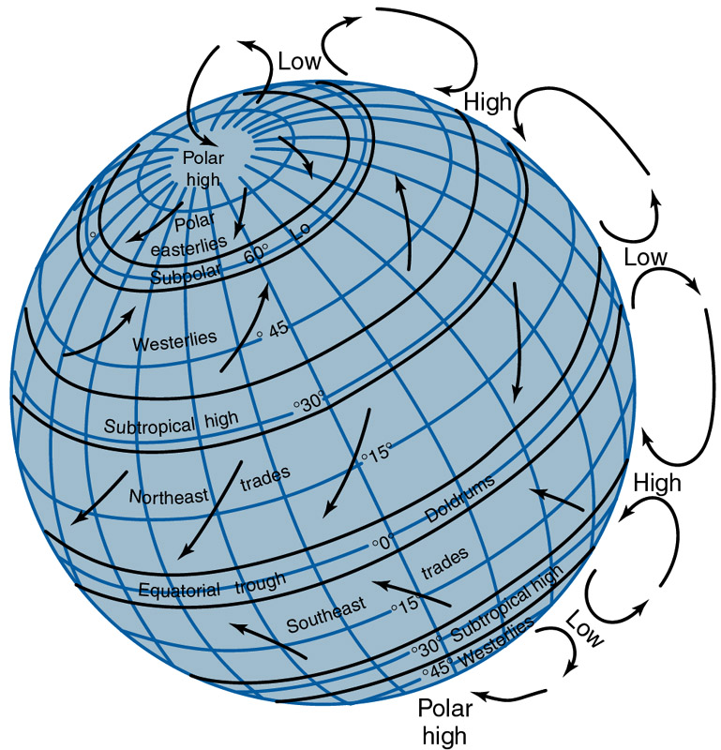

Slide 9
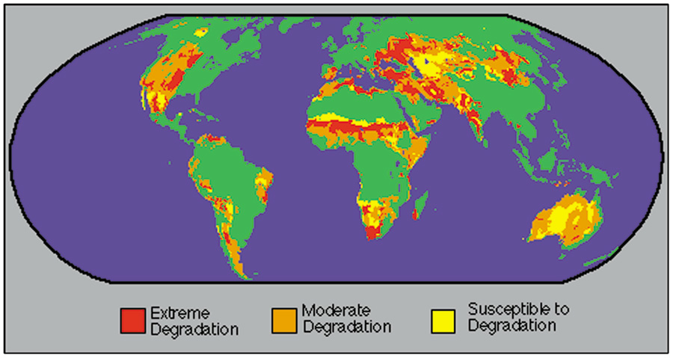

Slide 10
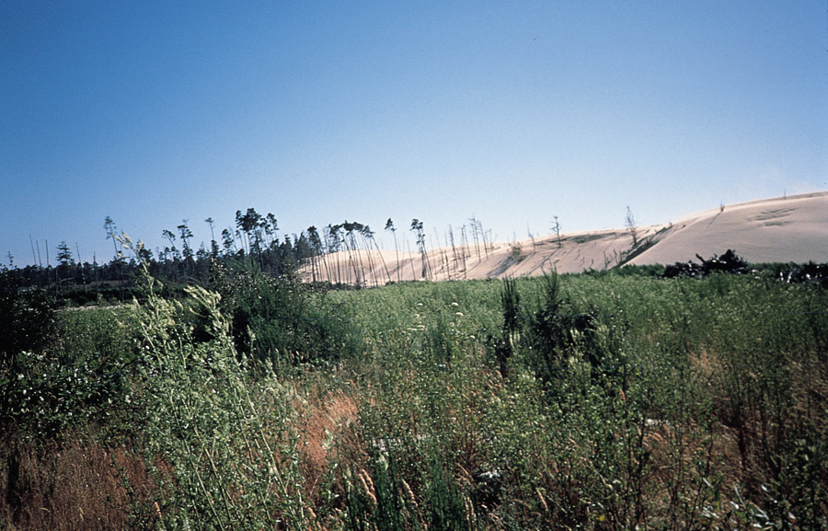

Slide 11
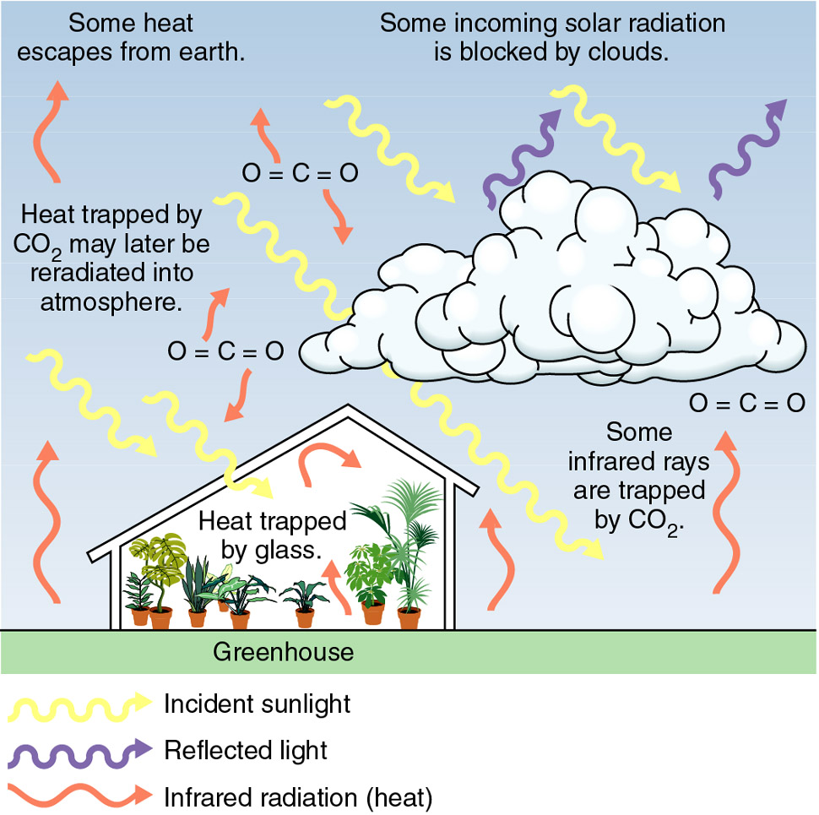

Slide 12
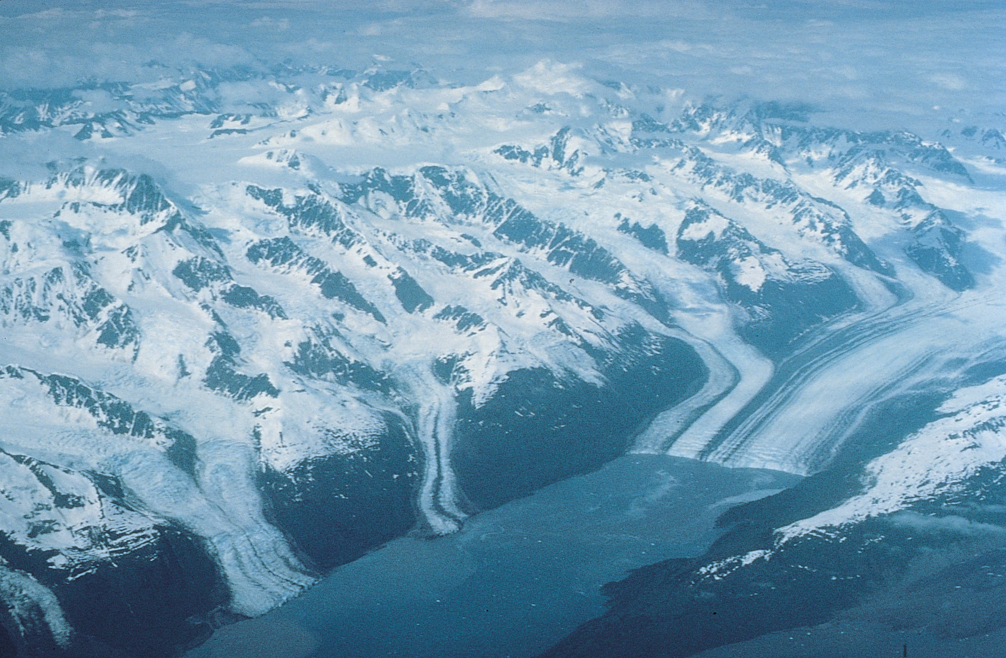

Slide 13
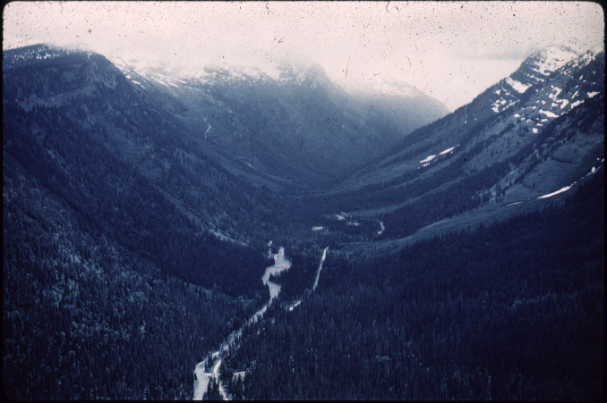

Slide 14
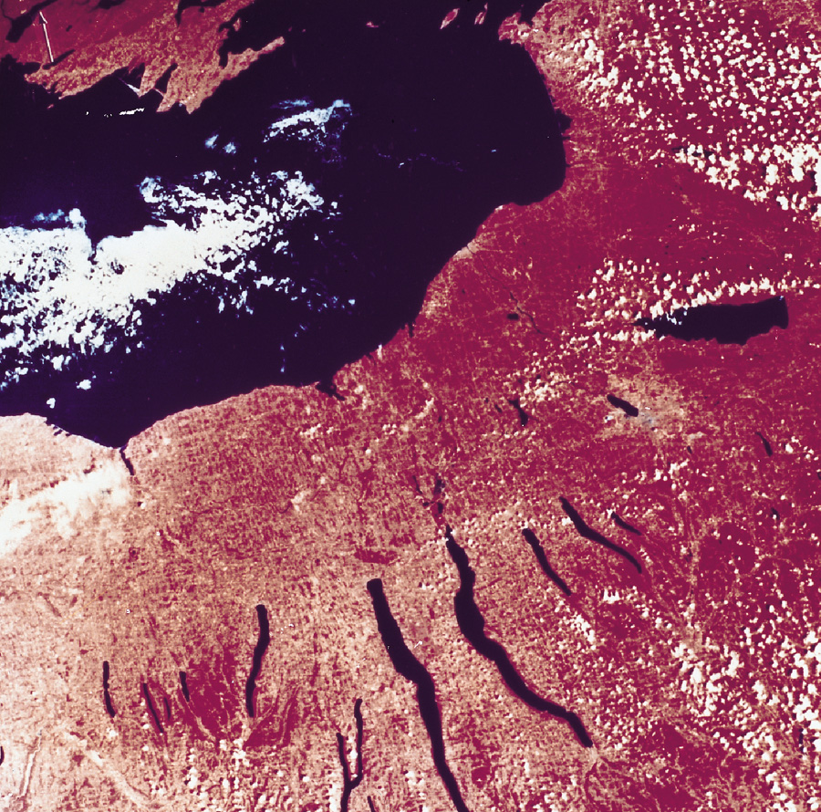

Slide 15
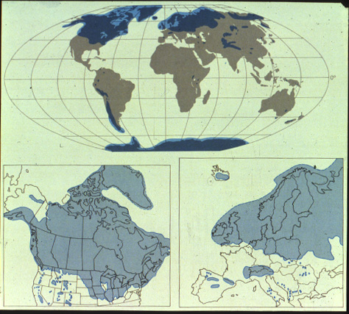

Slide 16
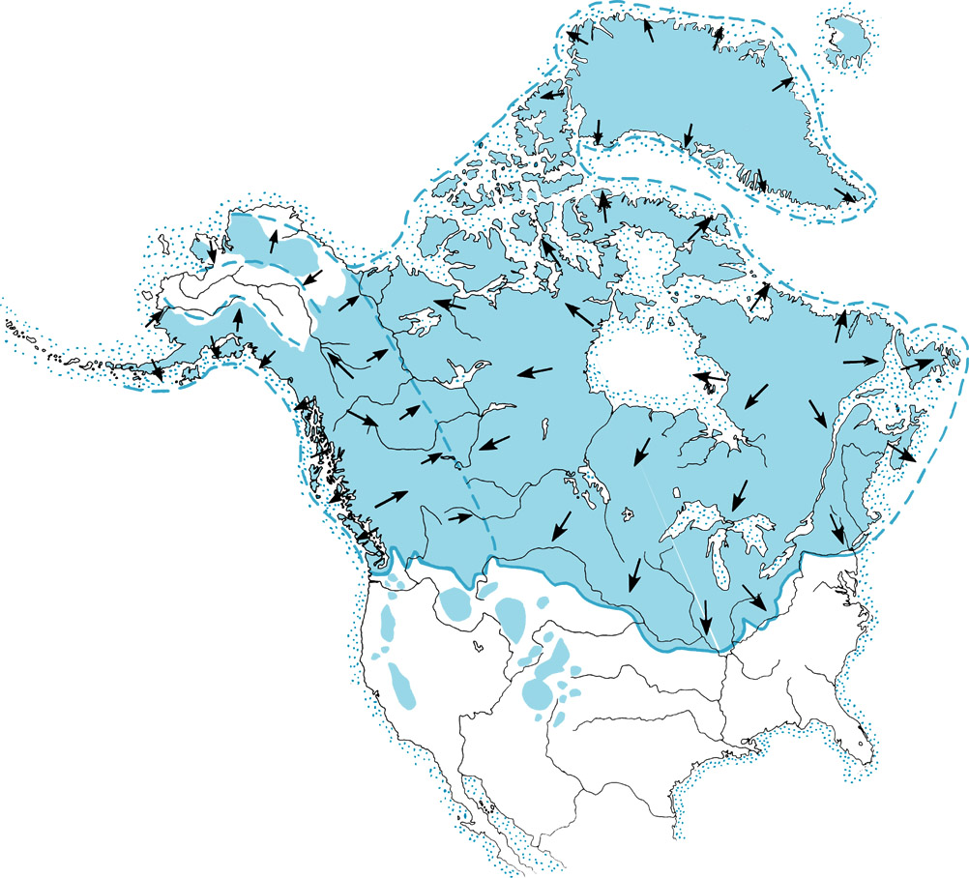

Slide 17
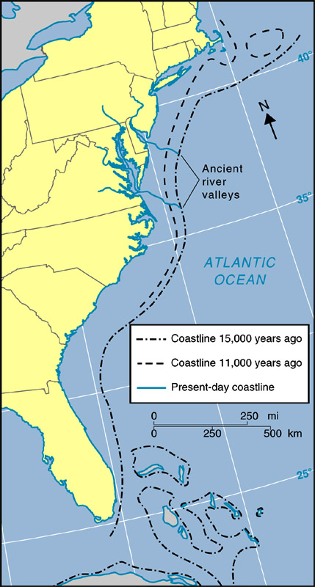
Extension
of North
America
Shoreline
Figure 9.28

Slide 18
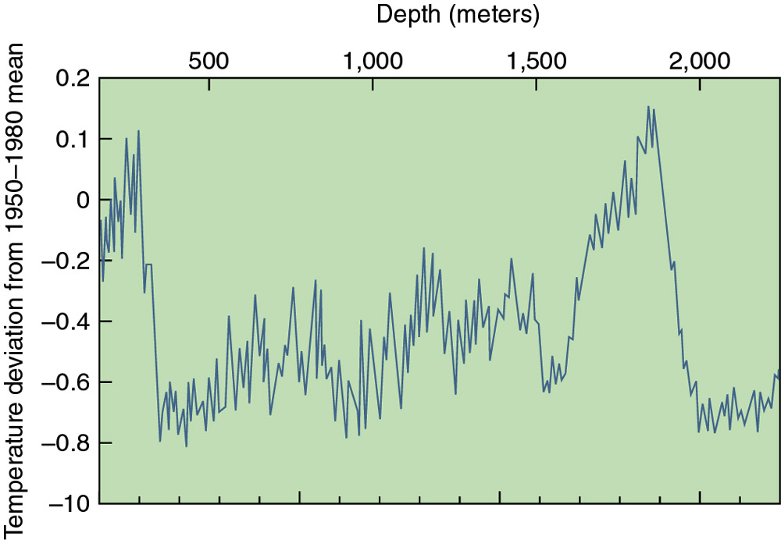

Slide 19
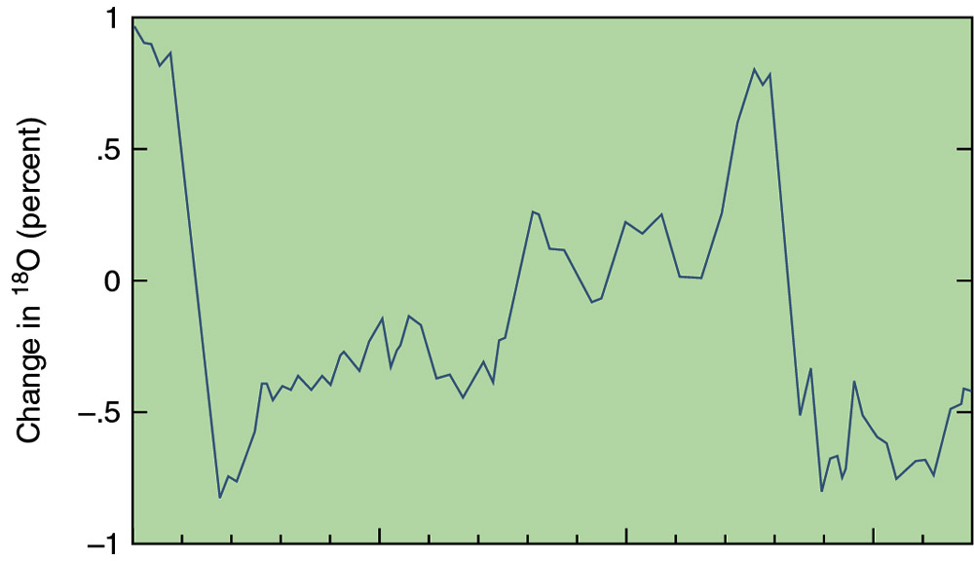
Ice Core and Past Temperature Fluctuations
Figure 9.26b
50,000
100,000
150,000
0

Slide 20
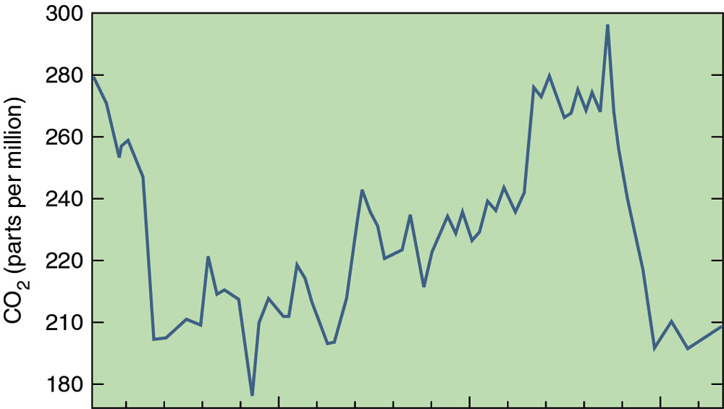
Ice Core and Past Temperature Fluctuations
Figure 9.26c
0
50,000
100,000
150,000

Slide 21
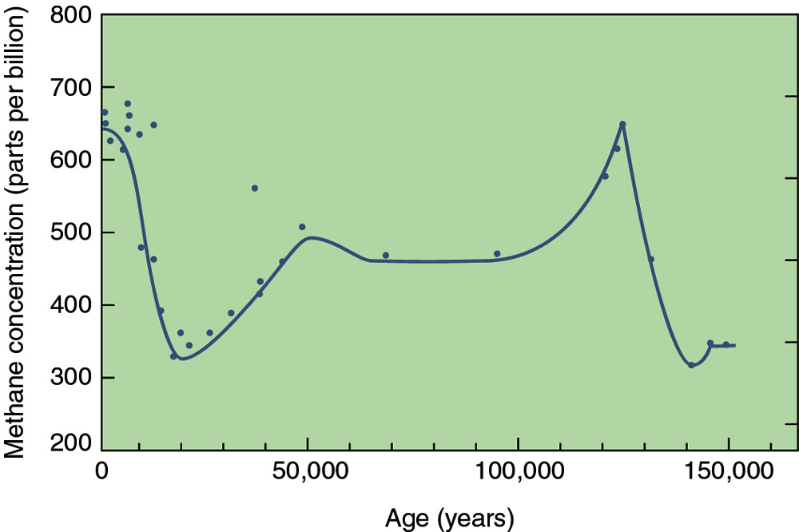
Ice Core and Past Temperature Fluctuations
Figure 9.26d

Slide 22
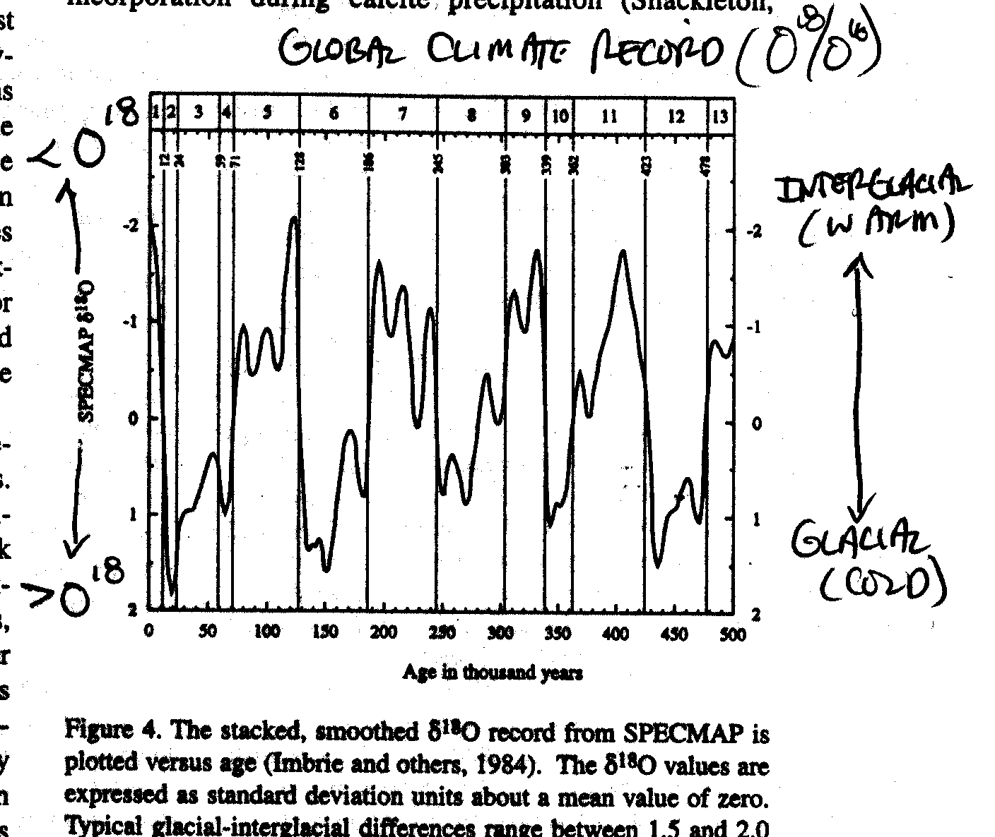

Slide 23
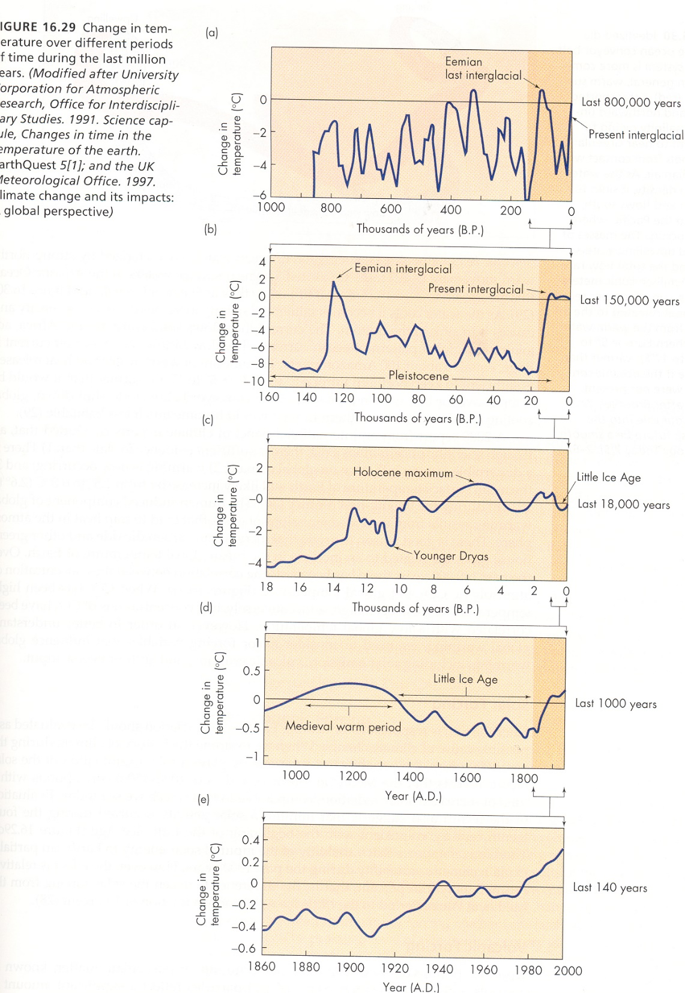

Slide 24
Some possible causes of glaciation
Milankovitch hypothesis
Shape (eccentricity) of Earth’s orbit varies
Angle of Earth’s axis (obliquity) changes
Earth’s axis wobbles (precession)
Changes in climate over the past several hundred thousand years are closely associated with variations in the geometry of Earth’s orbit
Other factors are probably also involved
Any successful theory must account for
What causes the onset of glacial conditions
What caused the alteration of glacial and interglacial stages that have been documented for the Pleistocene epoch

Slide 25
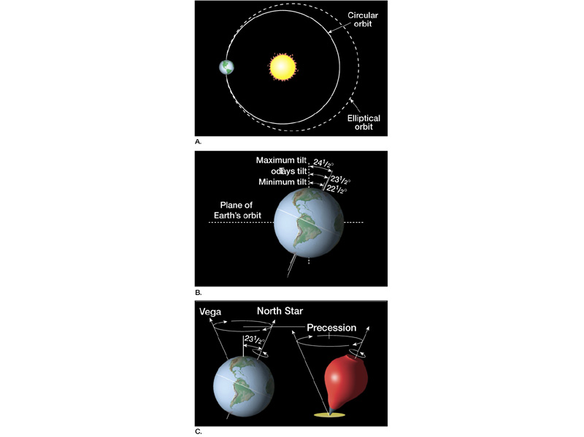
Eccentricity of
Orbit
(100,000 yr cycle)
Obliquity of Tilt
(21.4-24.5 deg)
(41,000 yr cycle)
Precession
(23,000 yr cycle)

Slide 26
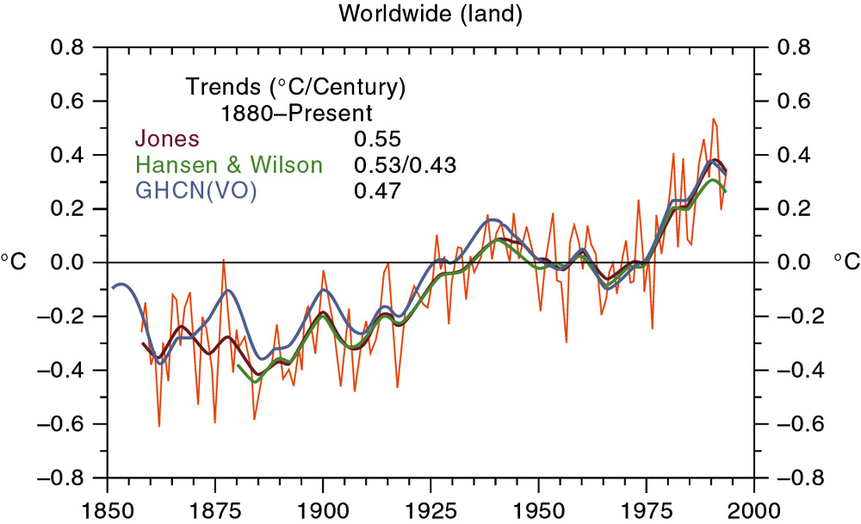
Global Temperature Rise
Figure 9.32

Slide 27
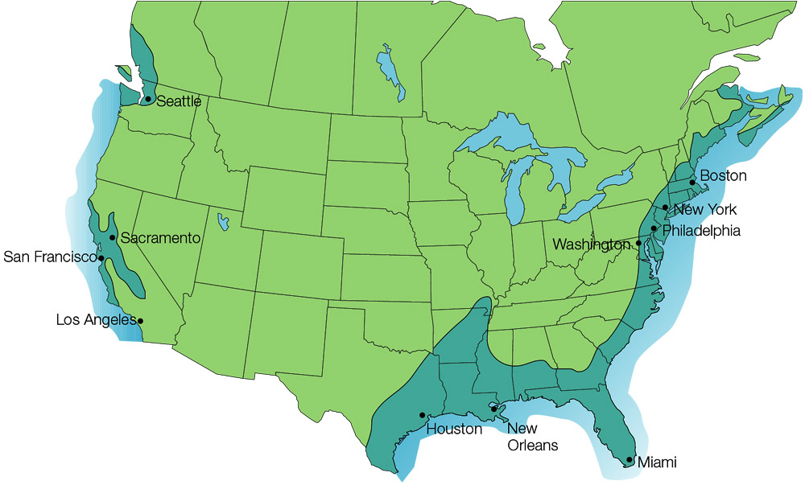
Flooding if Ice Sheets Melted
Figure 9.31

