Slide 1

Tectonic subsidence history and source-rock maturation in the campos Basin, Brazil

Slide 2
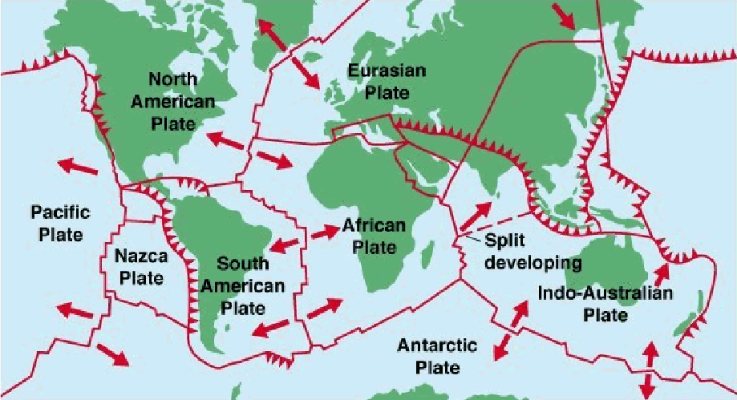
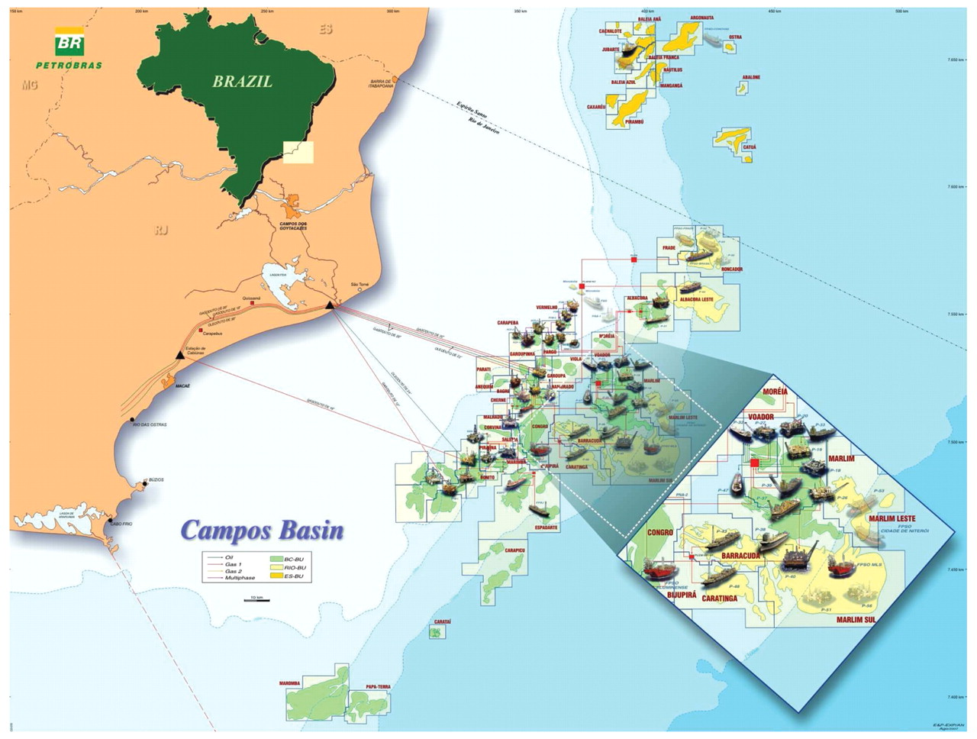
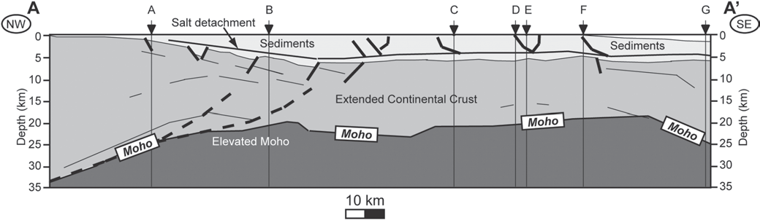
Location and tectonic setting
Marginal Sag Basin
The Campos Basin is located on the passive continental margin offshore the state of Rio de Janeiro
Area of approximately 100 000 km2
Produces more than 85% of Brazils crude oil.

Slide 3
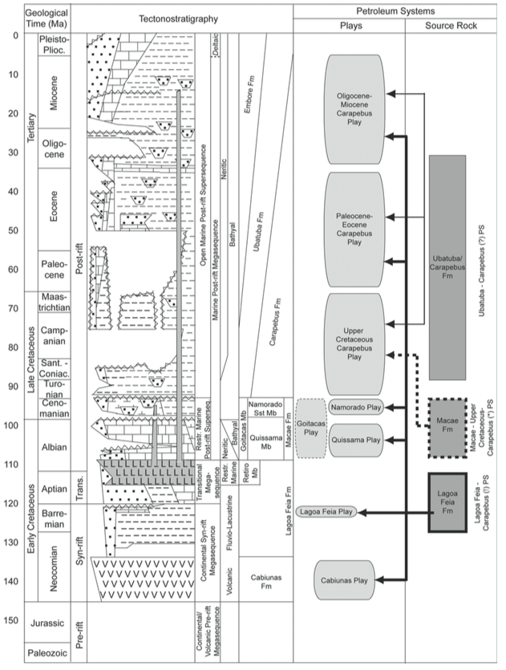
Topics discussed
Geologic history of basin
Comparison of different subsistence models
Halokinesis implications.
The possibility of future oil and gas deposits.
Source rocks, primarily shale, and salt based. Some carbonates mentioned.
Hydrocarbon maturity.
Halokinesis: The study of salt tectonics, which includes the mobilization and flow of subsurface salt, and the subsequent emplacement and resulting structure of salt bodies.

Slide 4
Basin history
The continental/volcanic pre-rift megasequence:
The continental/volcanic pre-rift megasequence: crustal uplift and the development of peripheral depressions associated with hot spot volcanism, preceding rifting of the continental crust.
The continental syn-rift megasequence:
associated with basement-involved, block-rotated faulting in a rapidly subsiding crust together with widespread mafic volcanism.
- strata were deposited in a variety of palaeo-environments that were strongly influenced by rift tectonics, such as alluvial fans, fan deltas, carbonate banks and lacustrine environments ranging from fresh to hypersaline.
The transitional megasequence: represents a phase of tectonic quiescence (Aptian) at the beginning of the drift phase. It contains a lower sequence composed mostly of conglomerates and carbonates and an upper sequence of halite, representing the first seawater inflows from the north.
The marine post-rift megasequence:
- Albian shallow-marine carbonates, mudstones and marls strongly affected by halokinetic movements, causing the development of halokinetic features.
- The overlying Upper Cretaceous–Paleocene sequence consists of bathyal shales, marls and sandstone turbidites.
- The remaining Neogene section is characterized by a progradational sequence of siliciclastics

Slide 5
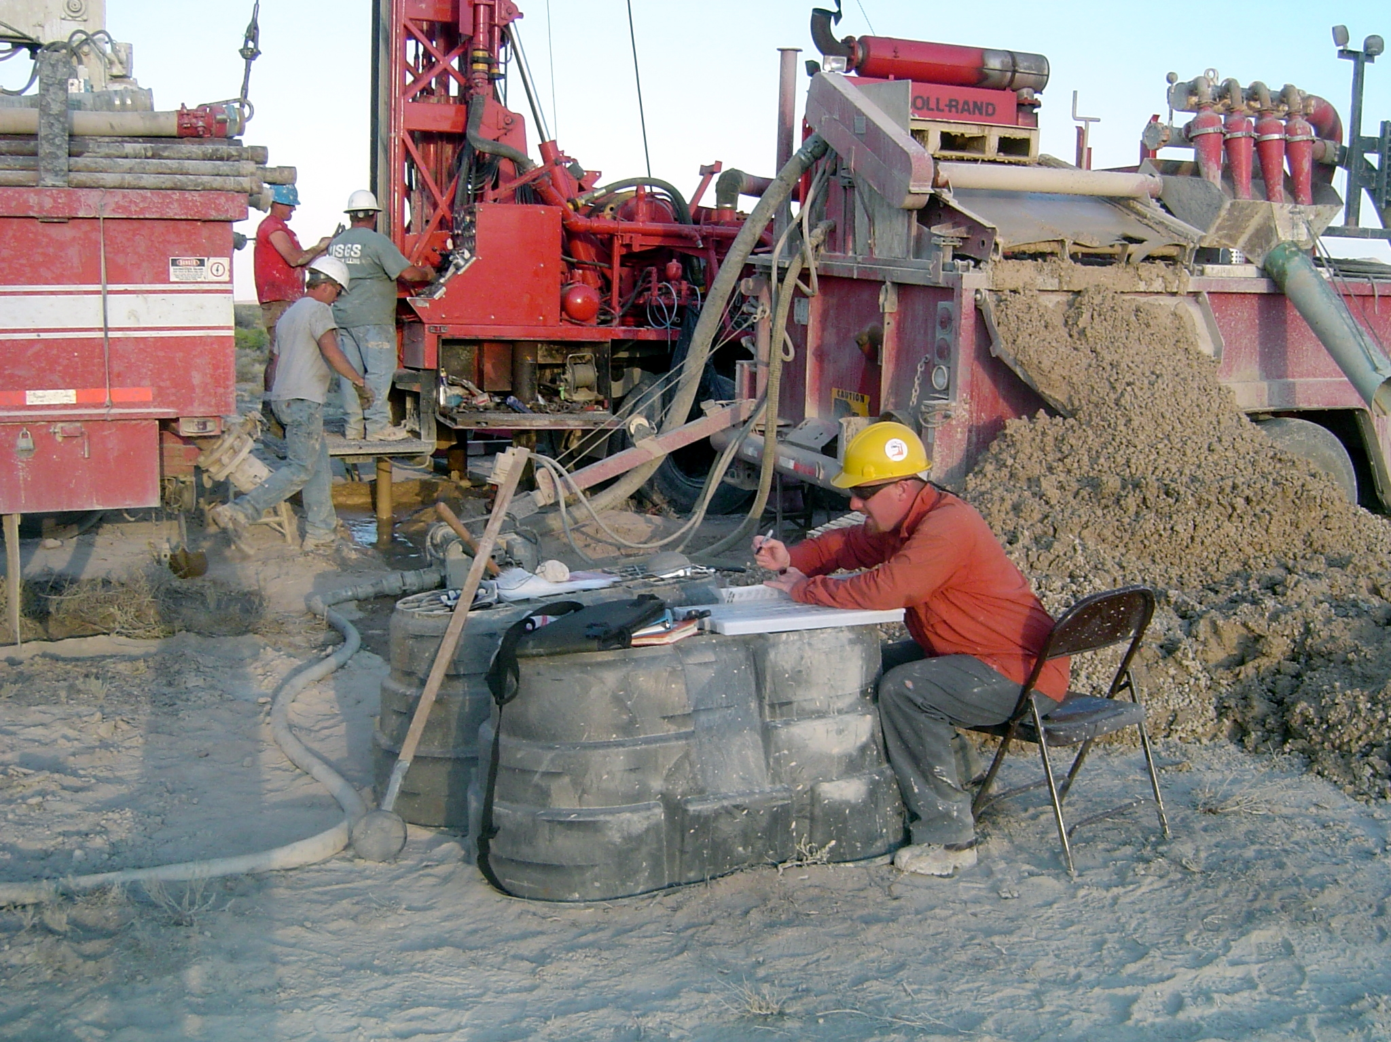
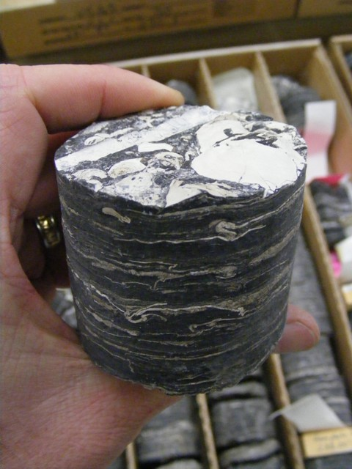
Methods used
Seismic probes
Well “Backstripping”
Backstripping is a geophysical analysis technique used on sedimentary rock sequences - the technique is used to quantitatively estimate the depth that the basement would be in the absence of sediment and water loading.
The aim of backstripping is to analyse the subsidence history of a basin by modelling a progressive reversal of the depositional process.
Commonly applied to extensional basins
Determines the magnitude of lithospheric stretching from post-rift subsidence rates

Slide 6
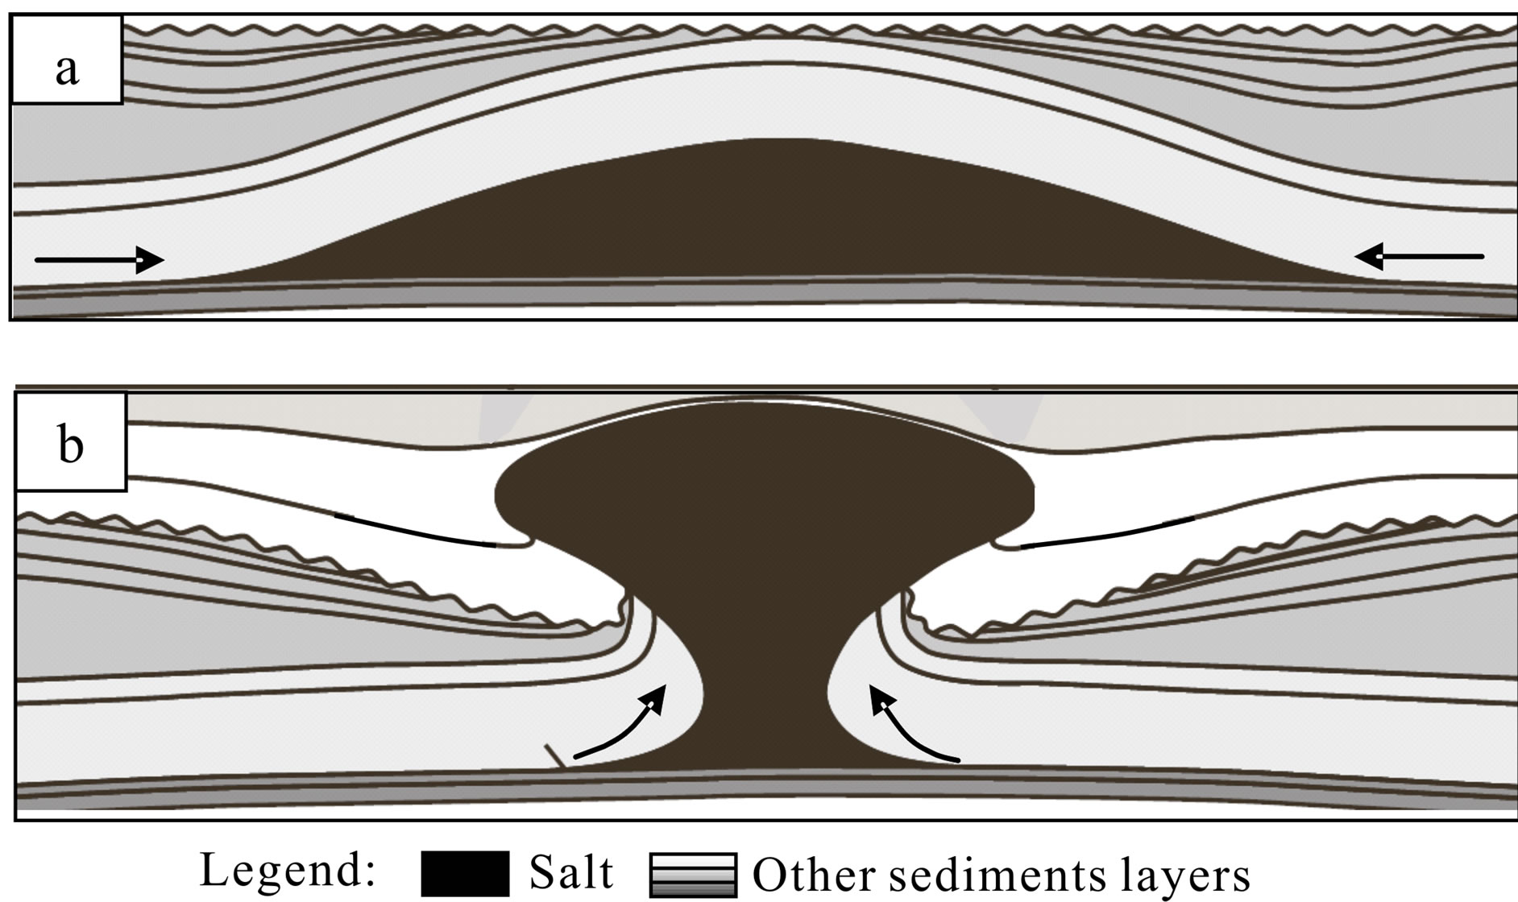
Results
Continued movement of salt bodies have the potential to move undiscovered hydrocarbon bodies.
They also have the potential to destroy existing hydrocarbon bodies.
The youngest rocks of the Campos Basin sequence are likely mature.

Slide 7
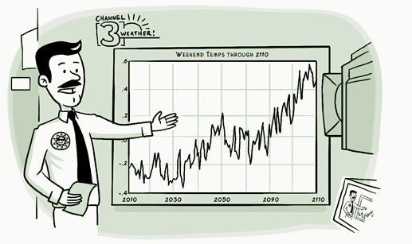
Modeling issues
There have been problems with modeling thickness of sediments.
Even with backstripping, some of the sediment samples are much more compact.
Also have problems modeling the influence halokinesis. Specifically salt dissolution.
Have some concerns about basin temperature increases, affecting old maturation.

Slide 8

Conclusion
Developed model that correlated closely with observed subsidence.
Estimated that the Campos Basin has yet more undiscovered oil reserves (kerogen Types I and II).
Suggests future exploration as much of the infrastructure is already in the Campos Basin.
Expect even more due to the organic rich facies within sequences of the Campos Basin.

