Slide 1
New Evidences for the Formation of and for Petroleum Exploration in the Fold-Thrust Zones of the Central Black Sea Basin of Turkey
Samil Sen et. al 2013
Carly O’Neal
Petroleum Geology
Winter 2015

Slide 2
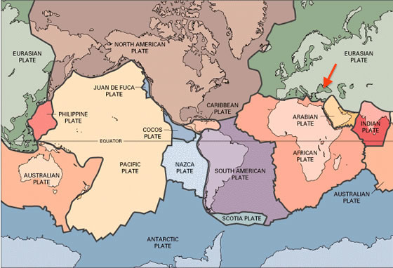
Black Sea
http://geology.com/plate-tectonics.shtml

Slide 3
Central Black Sea Basin Turkey
Complex geologic history
Two major offshore basins:
Western and Eastern sub-basins
Black Sea Basin filled by more than 9 km (6 mi) of sedimentary and volcanic rock
Anticlines and Sinclines
Notes:
Complex geologic history : rift basin → arc basin → retroarc foreland basin (Lots of basins!)
Pontides orogenic belt formed as a result of subduction and accretion (the process by which inorganic bodies grow larger by the addition of fresh material to the outside. A correlation to the basins.
Two major offshore basins: seperated by mid- Black Sea high
Basin analysis studies suggest the basins developed by both rift and compressional tectonics.
Sedimentary rock ~ Jurassic, Triassic, Cretaceous (MESOZOIC ERA → 50 – 200 mya) ~ A lot of time for hydrocarbon accumulation
Anticlines & Sinclines : Resulted from thrusting

Slide 4
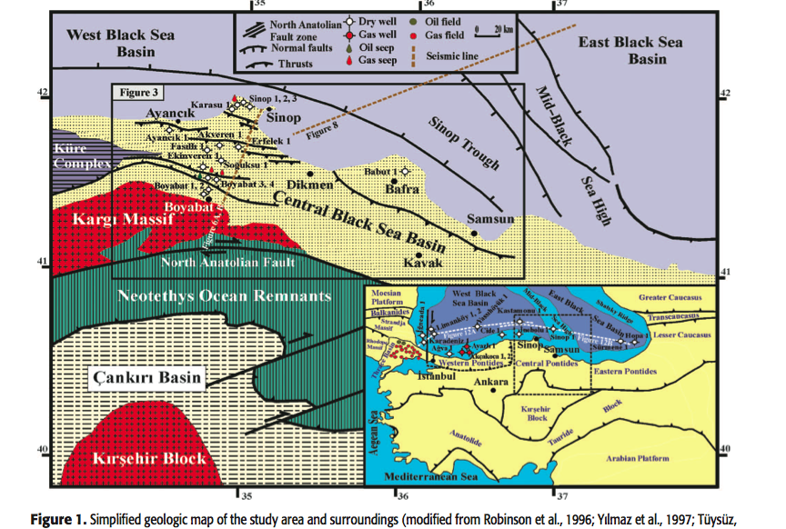

Slide 5
Exploration
15 Offshore exploration wells
Only gas has been discovered by two Akcakoca wells in 1970, and 1 Ayazli well in 2004
Researchers suggest:
Poor → Good source rock potential
Type II and Type III Kerogen
15 Onshore exploration wells
No economic oil or gas accumulation discovered
Notes:
15 offshore exploration wells → 2 in the 1970’s had gas (Akcakoca) → 1 in 2004 had gas (Ayazli)
Again: Cretaceous → Jurassic
Type II Kerogen (organic material) = zooplankton and phytoplankton ~ mix of oil and gas
Type III Kerogen (organic material) = woody land and plant materia; ~ produces gas

Slide 6
Petroleum Prospects of the Central Black Sea Basin
Organic-rich shales were collected from four different formations to determine source rock potential:
Akgol Formation
Caglayan Formation
Gursoku Formation
Kusuri Formation
Notes:
TOC: Total Organic Carbon: ~2% is what they are looking for
Overmaturity in source rocks may be related to the heating by volcanic rocks underlying the formation
Akgol Formation:
- Sandstone : Shale ratio of 1:3 → 1:5
- TOC randing from 0.08% → 0.75%
- Sediments are overmature
Caglayan Formation
- Sandstone : Shale ratio of 1:2 → 1:5
- TOC content ranging from 0.23% → 1.59%
Gursoku Formation:
-Limited source rock potential
- Mature → Overmature
Kusuri Formation
- Sandstone : Shale ratio 1:2 → 1:3
- TOC < 0.5%
- Early → middle maturity 425 C→ 437C

Slide 7
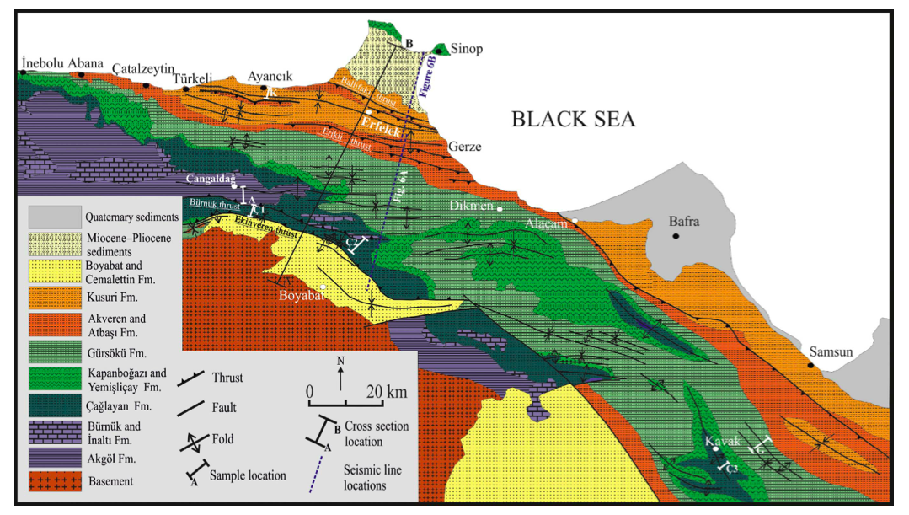
Notes:
Because of the complex history in this area, there has been a lot of research and interpretation of the formations.

Slide 8
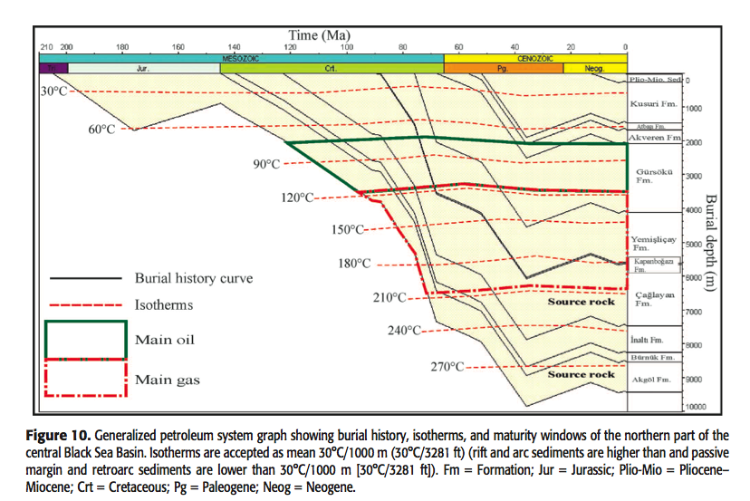
Notes:
According to oil source correlation the most probably source rock to the oil seep is the Caglayan
Kerogen Transformation
100 – 150 degrees C oil/gas mix
60 – 120 degrees C is oil generation
120 – 150 degrees C is gas generation (wet gas)
>150 = dry gas

Slide 9
Why is there no economic Petroleum?
Hydrocarbon generation began before traps were formed
Still determining where to drill
Not drilling deep enough to encounter any reservoirs defined in this particular study
Notes:
Drilling is expensive – very complex geologic formations, need to continue research to know if and where there may be oil
This sedimentary layer ~ 5000 feet
Not exploration wells have been drilled in the most prospect reservoirs in the Eastern Areas because of the thick sediments
Suitable seal rocks
Excellent prospects for future exploration
Best places for further exploration = Caglayan Formation and Inalti Formations in the fold traps

