Slide 1
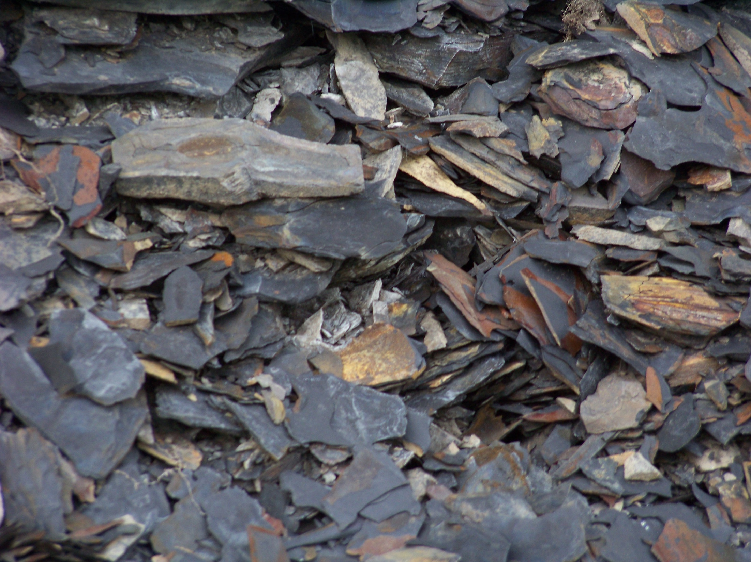
Marcellus Shale
Lee Lindley

Slide 2
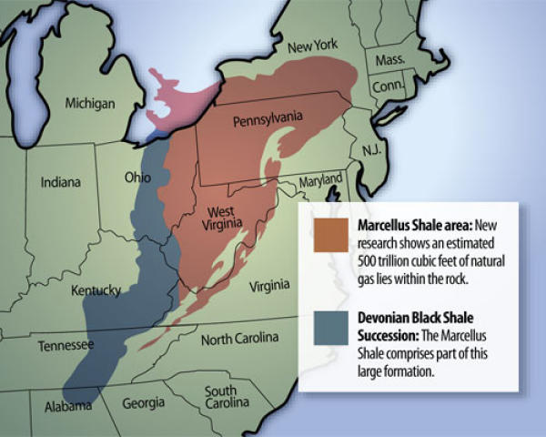

Slide 3
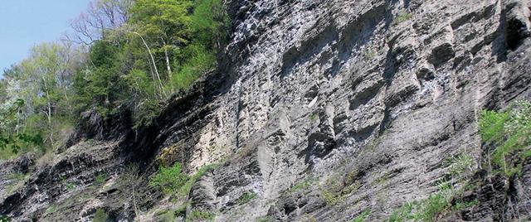
Intro
Marcellus shale contains estimated 489 tcf of recoverable hydrocarbons
Additional 84 tcf of undiscovered reserves
Reserves “trapped” in shale
Has to be fracked in order to be recovered
Covers four states

Slide 4

Onondaga Formation
Comprised of two tracts separated into four parasequences
Lowland systems tract and transgressive systems tract
Originally deposited during Middle Devonian Eifelian age
Models an inland sea covering the Appalachian basin with large amounts of carboniferous limestone created by reef life
Source rock

Slide 5
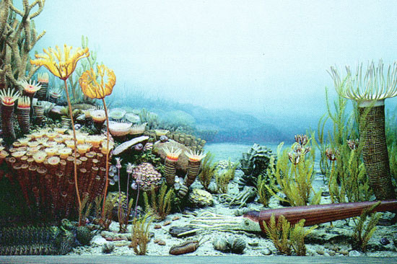
Onondaga Parasequences
(PS-1) Edgecliff member models the structures essential to help form reefs. Carbonate banks to the west moving east into mound and pinnacle reefs and into the center of the basin where basinal facies are seen
(PS-2, PS-3) Nedrow and Moorehouse members comprised of complex lithology including: crinoidal grainstones, interbedded argillaceous limestones, and dark grey calciliferous shales
Patterns of progradational stacking from west to east are observed insinuating deltaic environment.

Slide 6
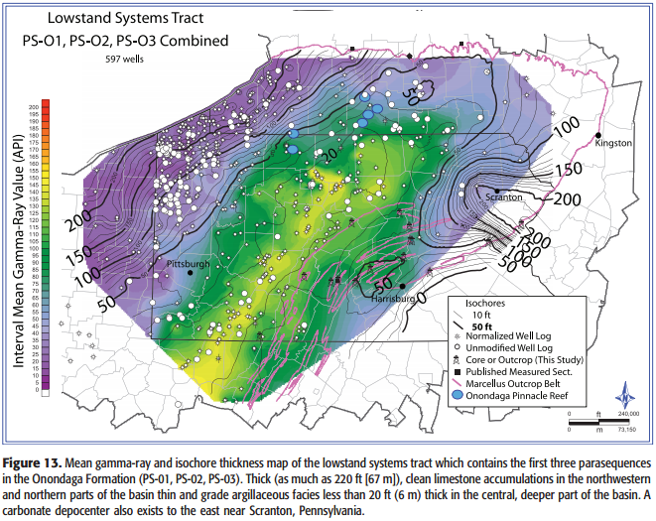

Slide 7

Final Parasequence of Onondaga
(PS-4) shows retrogradational deposition (it moves from grey wackestone and coeval limestone)
contains tioga ashbeds which provide detailed chronostratigraphy providing an excellent analysis of depositional environment
Gamma ray values increase upwards in sequence indicating a move from carbonates to more shaley rock
This all indicates a rapid increase in base level which the reef creatures couldn’t accommodate for which caused carbonate production to cease

Slide 8
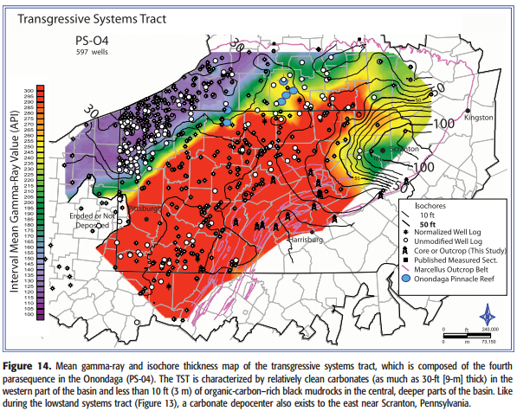

Slide 10
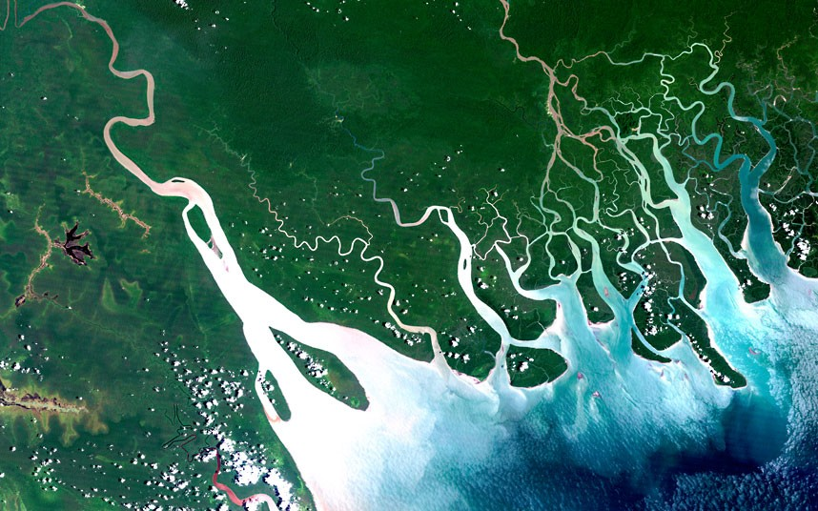
Mahantango Prograding Delta Complex
This delta complex is responsible for deposition of PS-US1 and PS-US2
These parasequences model the deposition of mudstone over the Onondaga formation in the Appalachian basin
From PS-US1 to PS-US2 the delta complex moved from west to more northwest which was then followed by a period of base level falling

Slide 11
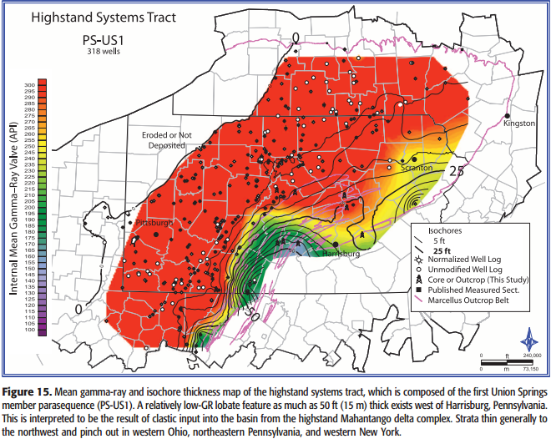

Slide 12
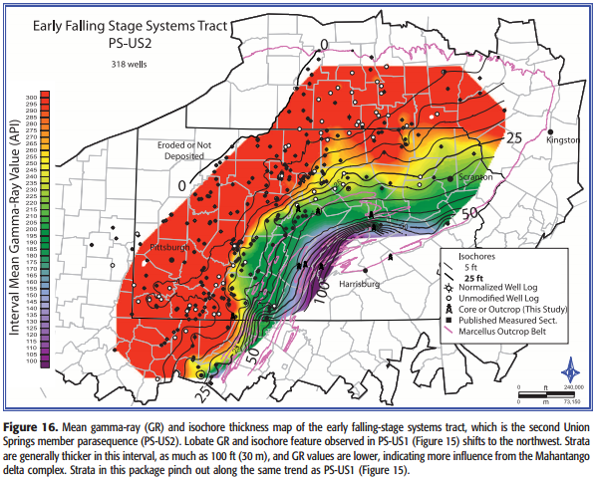

Slide 13
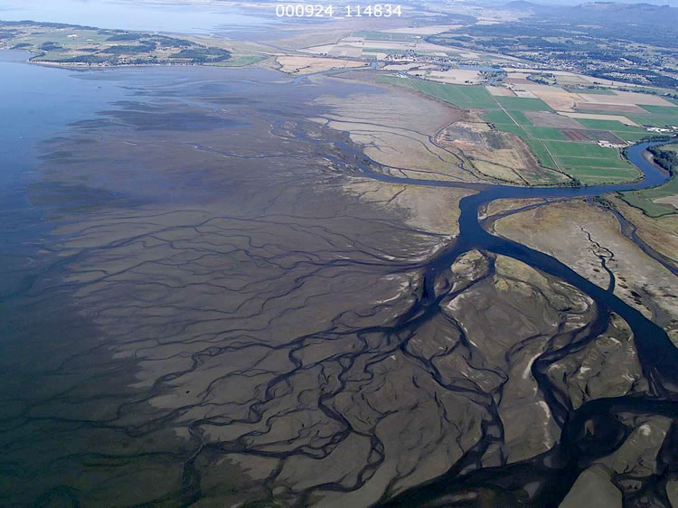
Base level fall and Progradation
A sudden change in the environment caused base level to fall which in turn caused the Mahantango delta to further prograde over the Ondaga formation
Deposition of clastic material from delta creates mudstone which acts as a seal and a source rock
This change in base level is modeled by the FSST or the late falling systems tract

Slide 14
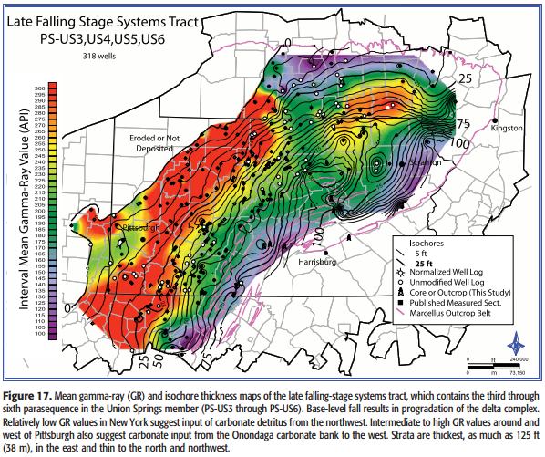

Slide 15
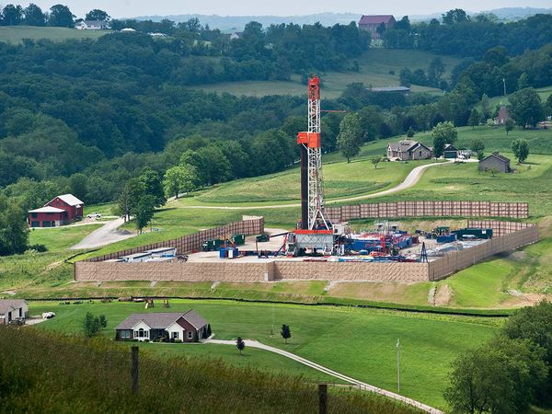
Methods
Previous studies utilized rock outcroppings across four states
Fracking allowed for increased recovery of hydro carbons and renewed interest in shale
New borehole data available due to fracking
GR (Gamma Ray) Well logs used heavily in this study
Ash layers and unconformitys utilized to aid correlation
Strata are separated into system tracts

Slide 16
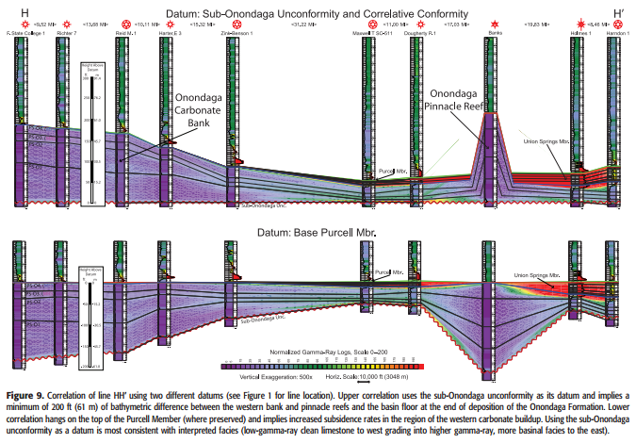

Slide 17
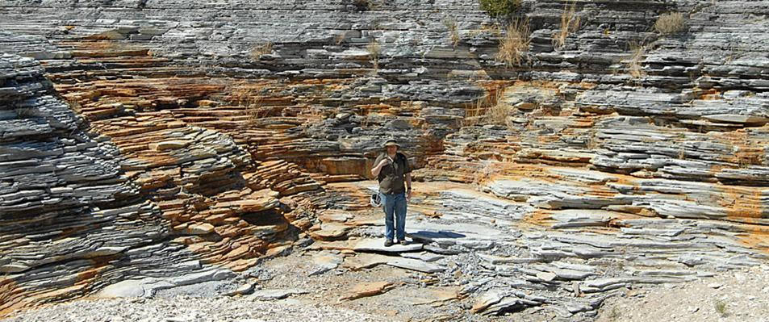
Results
Prior to applachians forming area of appalcian basin was an inland sea and a delta draining into it from the west of the basin
Lots of reef building organisms (eat, drink, make more)
Many base level changes altered environment
Transgression raised sea levels increasing reef production.
Organisms aided in producing large carbonate deposits which would later (with other previous deposits from LST) be termed Onondaga formation.

Slide 18
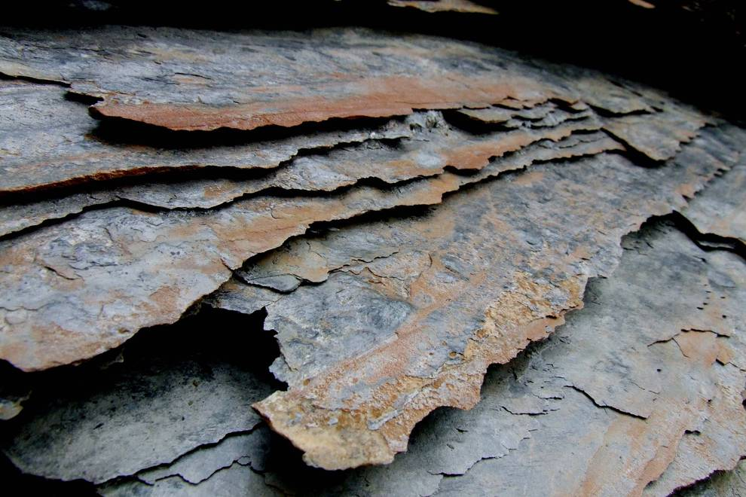
Results Cont..
Marcellus shale formed as result of prograding Mahantango delta complex which deposited mudstone over the top of Onondaga formation
Base level changes caused by eustacy resulted in euxinic (anaerobic environment)
Mudstone from Mahantango Delta acts as both a seal and reservoir rock for organic rich carbonates below
Fracking of shale adds permeability to mudstone

Slide 19
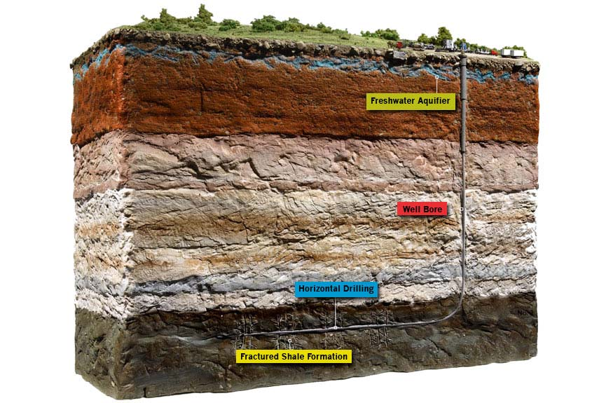

Slide 20
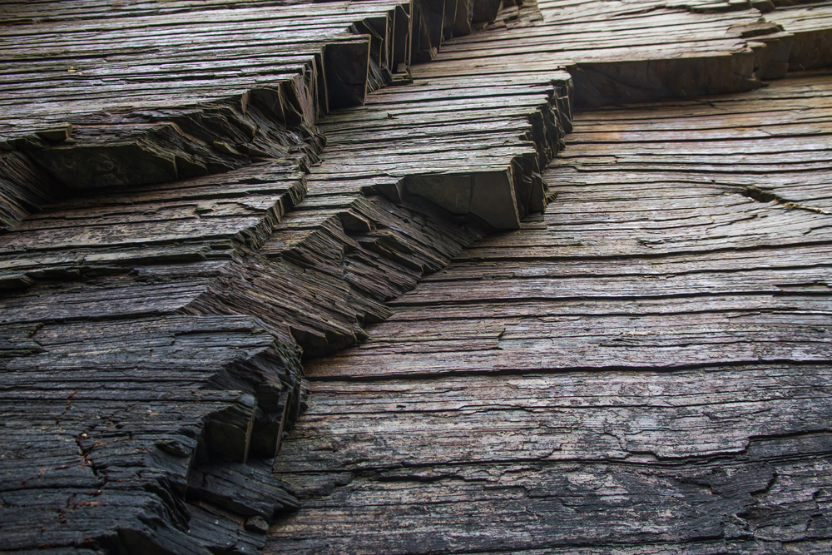
Conclusion
Deposition of Marcellus shale is a combination of topographic features and base level changes (eustatic and climactic change)
Environment started in middle Devonian with reef building organisms being primary source of organic carbons
After all base level changes environment was covered with enough water to remain Euxinic or anaerobic for hundreds of thousands of years
Created nearly 500 tcf of oil

Slide 21


