Slide 1

Western Greece and Ionian Sea Petroleum Systems
Summary by Thomas Licata

Slide 2


Slide 4
Ionian zone Stratigraphy

Slide 5
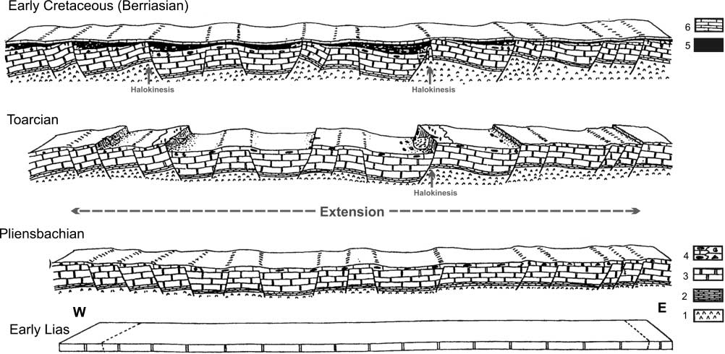
Formation of the Ionian

Slide 6
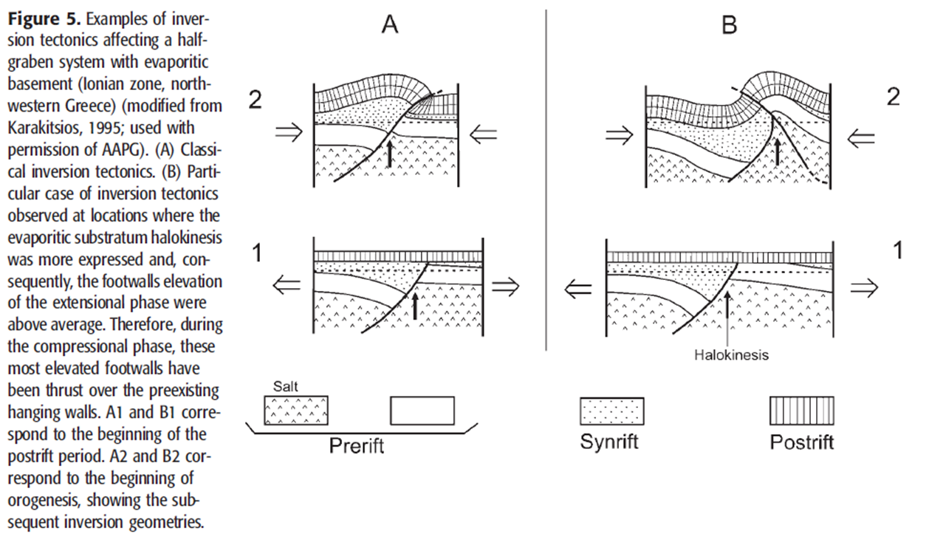

Slide 7
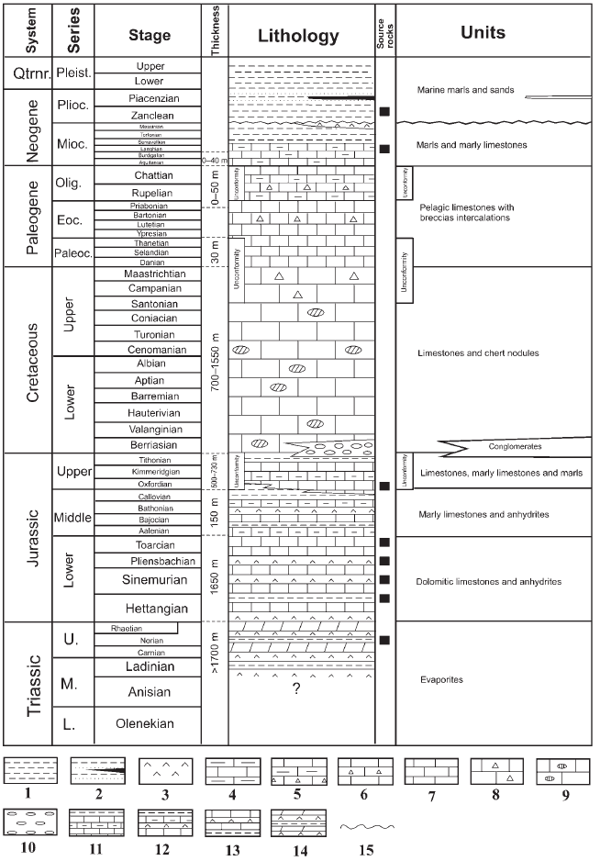
Apulian Zone Stratigraphy

Slide 8
Expected Source Rocks
Shale horizons in the Triassic Subsurface Evaporites (Apulian)
Lower Posidonia Beds (Ionian)
Upper Posidonia beds (Ionian)
Vigla Shale/Limestones (Ionian)
Oligocene-Miocene Immature organic matter

Slide 9
Resevoirs
Pantokrator Limestones (Ionian)
Senonian/Paleocene eocene limestones (Ionian)
Upper cretaceous chalk (Pre-apulian)
Lower Oligocene Calciturbidites
Pliocene Carbonate Platform formations/ undeformed Pliocene sediments.

Slide 10


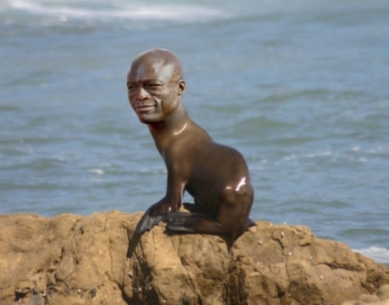

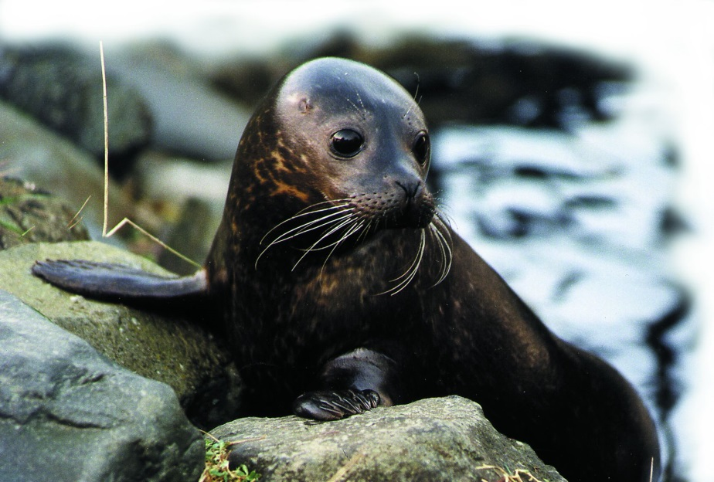
Seals/Traps
Oligocene Flysch (Ionian)
Upper Miocene and Pliocene rocks
Triassic Evaporites

Slide 11

Why do we expect oil here?
Aside from the abundance of organic matter and resevoirs these areas have an especially high chance of yielding oil because trap formation occurred prior to or during the maturity of the organic matter in most the source rocks.

Slide 12

Where they all come together
Pre-Apulian Structures
Neogene-Quaternary Deposits/Triassic Evaporites
Large Submarine Anticlines in the Greek domain of the Apulian Zone

Slide 15
Petroleum Systems of the Ionian summarized

Slide 17
Schematic duplex structures in the Ionian zone.

Slide 18
What About Unconventional Resevoirs?

Slide 19

Useless Slide with no Information

