Slide 1
Athabasca Oil Sands
Ryan Johnson

Slide 2
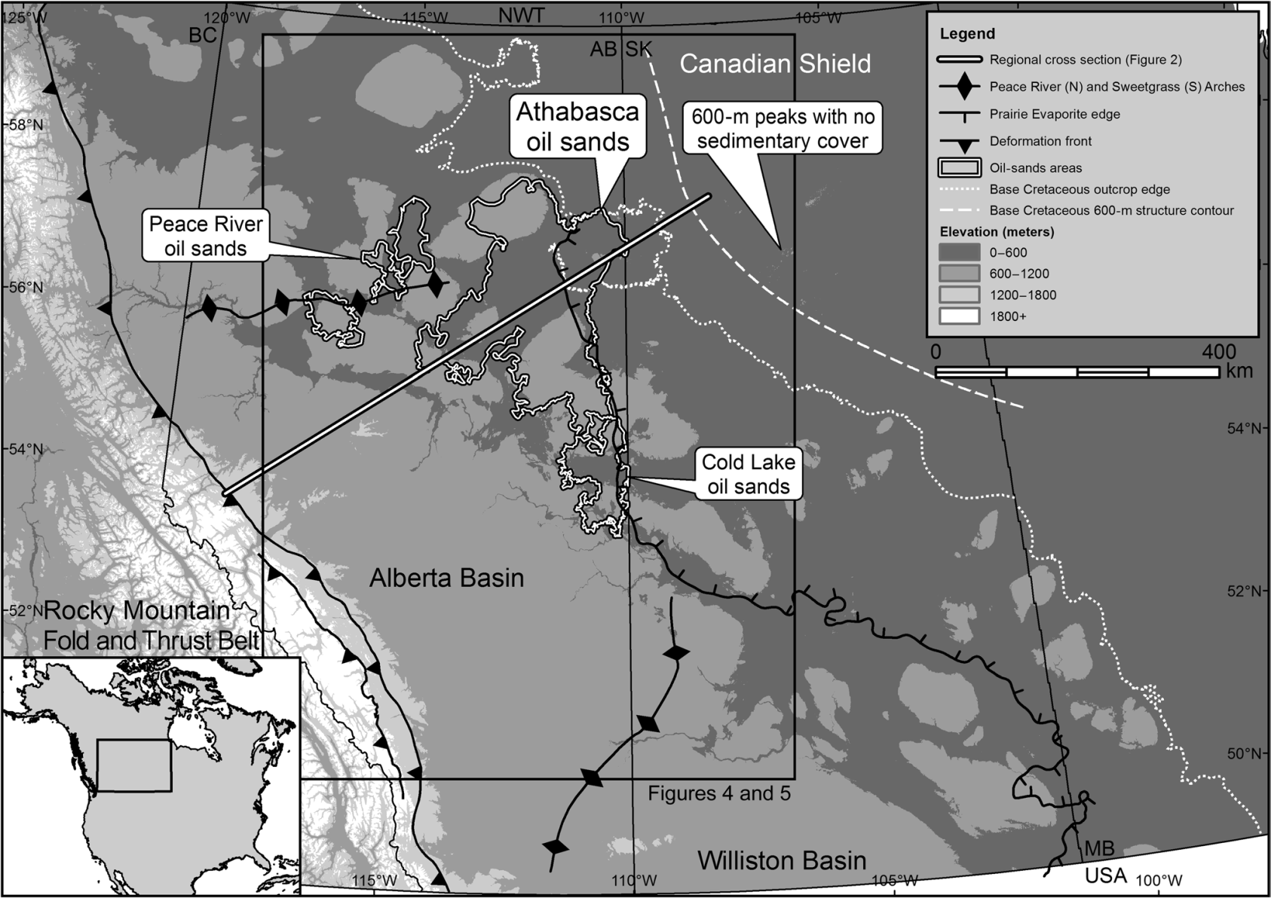
Where are the athabasca oil sands?
Northeast Alberta, Canada

Slide 3
What’s So Significant?
1.8 trillion bbl of resources in northeast Alberta
1 trillion bbl contained in Athabasca oil sands
Located at outcrop level or shallow depth
Location known from direct observation prior to Geological Survey of Canada descriptions
1875
Tar pits

Slide 4
What’s the problem?
Petroleum trap is elusive
Trap destroyed due to continued flexural loading
Uplift and erosion
Confusion as to how petroleum was held in place over such a large area

Slide 5
Approach
Use a paleohorizon to examine historical orientation of the layers during charge of oil
Well data (70,000+ well picks)
Identify charge timing of regions of the Athabasca oil sands
Use bitumen-water contact to further confirm orientation of the region
Use kimberlite age dating to correlate with charge timing of oil sands
Was used after study was finished, but good blind test

Slide 6
History
Western Canada Sedimentary Basin (location of Athabasca oil sands) formation
Precambrian rifting
Paleozoic thermal subsidence along passive margin (western NA)
Megasequences
Paleozoic carbonates, evaporates, and shales
Exshaw Formation (source rock)
Late Mississipian to Late Jurassic transitional meagsequence (subdued subsidence)
Siliciclastic-dominated succession
Gordondale (source rock)

Slide 7
History – Megasequences cont.
Late Jurassic shift to flexural subsidence by Rocky Mountain fold and thrust belt
Siliciclastic-dominated sequence
Mannville Group (reservoir rock)
McMurray Formation (fluvial-estuarine sands)
Wabiskaw Member (marine sands)
Capped by Clearwater Formation (shale)
Marine transgression
Overlain by Colorado Group (marine sediments) at Athabasca oil sands
Continuation of flexural subsidence through early Eocene

Slide 8
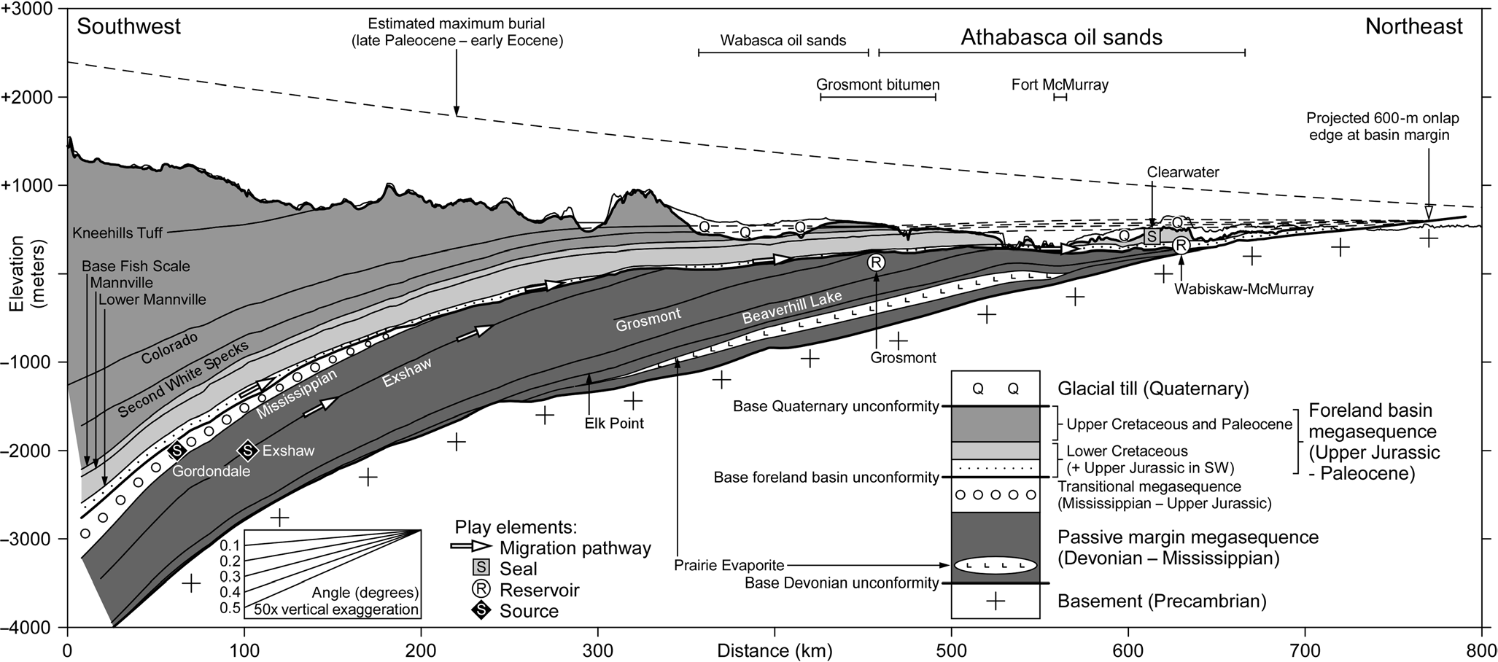
History

Slide 9
Petroleum formation
Source maturity peak at Late Cretaceous
Flexural loading led to maximum burial
Migration of oil hundreds of kilometers from west to east
Petroleum contained mostly in Mannville Group
Athabasca oil sands too shallow to pasteurize
Never exceeded 45°C
Biodegradation to bitumen
Coeval charge and biodegradation
Formation of bitumen before tilting

Slide 10
Reconstruction of trap
Colorado Formation used for reconstruction
Formed around 84 Ma
Presence of a major four-way anticline in central Athabasca area
285 km x 175 km
60 m amplitude (240-300 m depth)
Primary structural trap in Athabasca area
In addition to coeval charge and biodegradation, bitumen distribution controlled by structural and stratigraphic trap elements

Slide 11
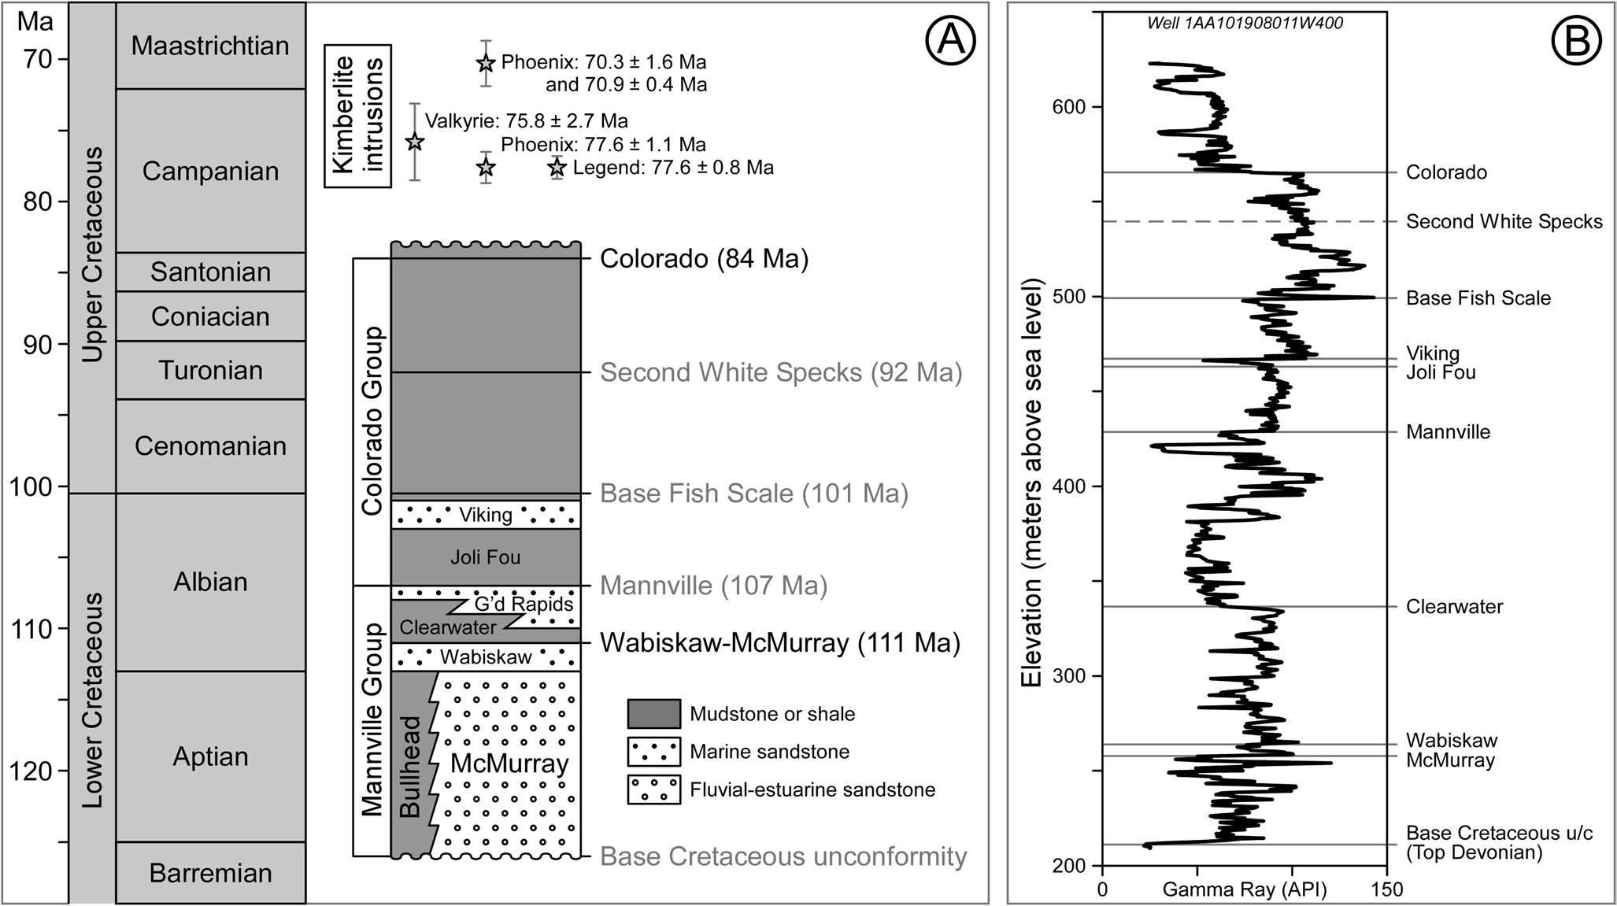

Slide 12
Trap domains
Athabasca area split into 6 distinct domains
Central Athabasca (structural trap)
44% of Athabasca oil sands by area
300 m closure
Northeastern Athabasca (onlap trap)
Shallowest trap edge (200m or less)
270 m lower limit
Tarry bitumen outliers
Leakage at pinch-out

Slide 13
Trap Domains Cont.
Northern Athabasca (bitumen trap)
Below 270 m
Late charge of oil contained by bitumen already emplaced
Other bitumen traps
Southern & Southwestern Athabasca, and Wabasca
Below 300 m spillpoint
Also represent late charge of oil

Slide 14
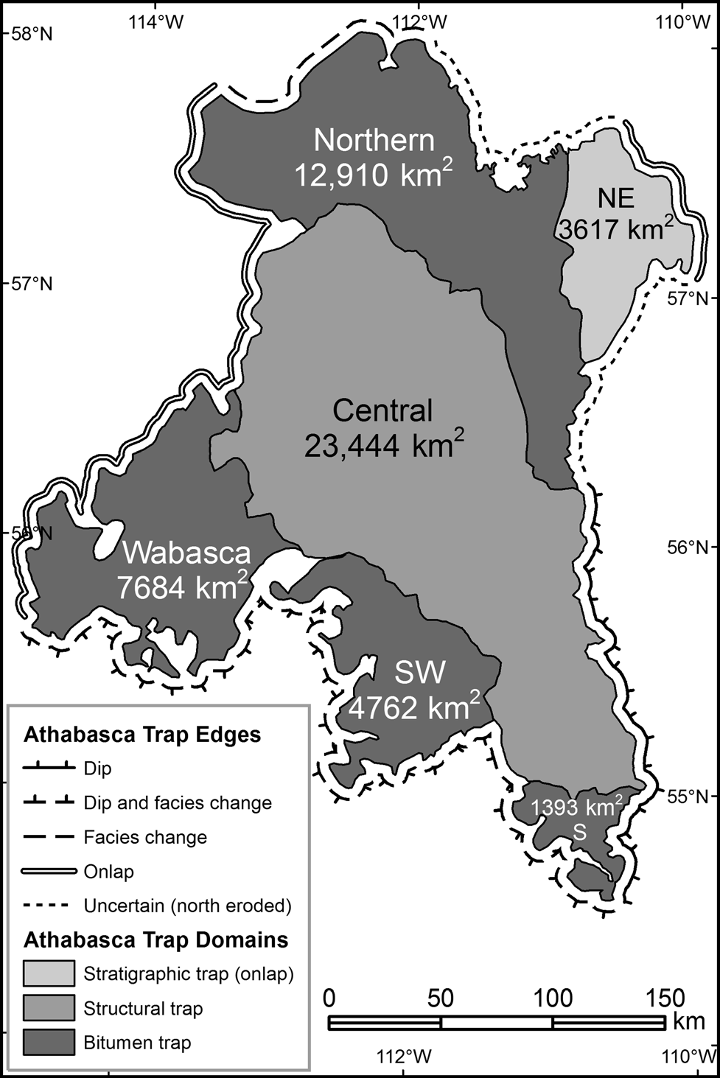
Trap domains

Slide 15
Bitumen-water contact
Defines contact line between bitumen and water separation due to density differences
Local variations in each trap domain
Conforms with paleostructure reconstruction
Differences in elevation back interpretations of charge order
Central filled first
Northeastern onlap trap second
Followed by deeper peripheral bitumen traps

Slide 16
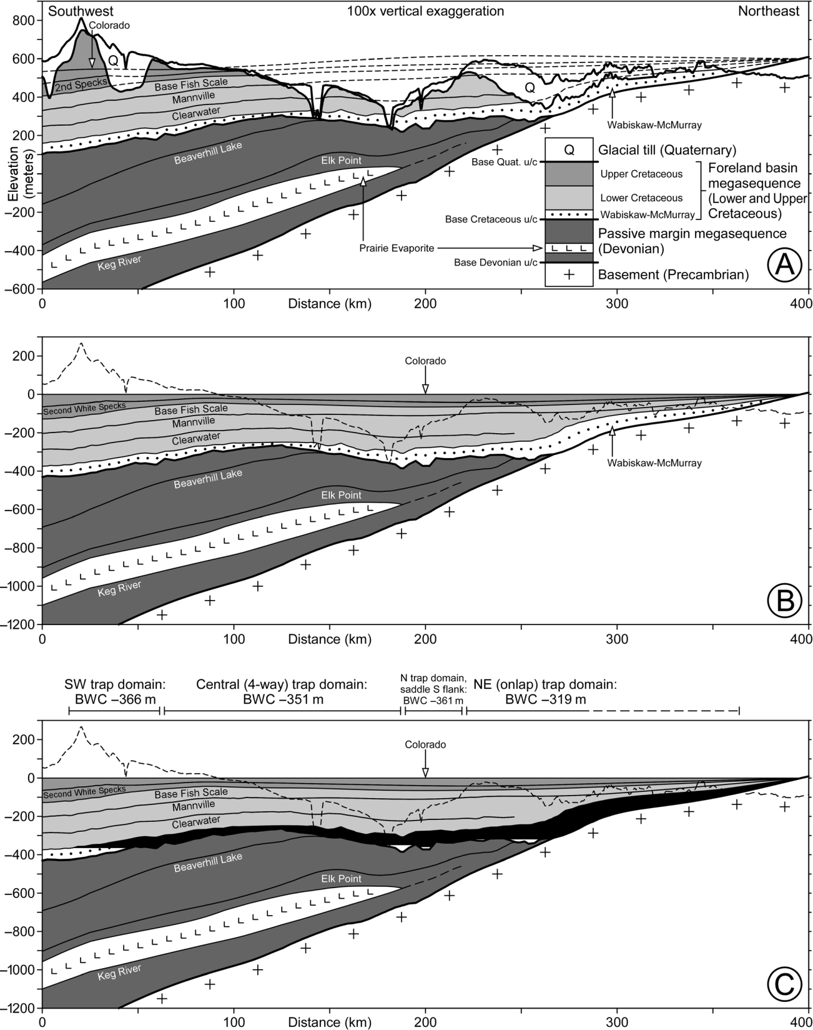
Restored Paleostructure

Slide 17
Kimberlite
Numerous Late Cretaceous and Paleocene kimberlite pipes
Radiometric dating have been determined
Spatial and temporal relationship to bitumen
3 drill holes with bitumen
“Soaked” in bitumen
Petroleum charge after intrusion of kimberlites
Age dated at 78-70 Ma
2 at almost exactly 300 m closing contour
1 at 334 m (northern trap domain)
Reinforces 84 Ma charge of anticline
Northern trap charged no earlier than 78 Ma

Slide 18
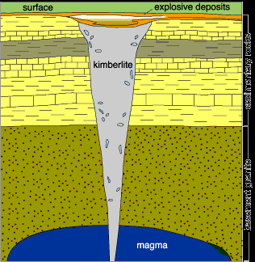
Kimberlite Pipe

Slide 19
Conclusion of events
1. Filling of the Central Athabasca four-way anticline (84 Ma)
Coeval charge and biodegradation led to impermeable bitumen (no gas cap)
2. Filling of Northeastern Athabasca onlap trap
Shallowest and first to fill after spillpoint of the anticline was breached
Shallow depth also led to gas accumulation
3. Filling of peripheral bitumen traps (No earlier than 78 Ma in north)
Updip bitumen seal
4. Erosion from Eocene to present
Preservation of trap due to rapid rate of biodegradation to bitumen
Tarry bitumen leaks onto surface where erosion has reached the reservoir and at onlap edge

Slide 20
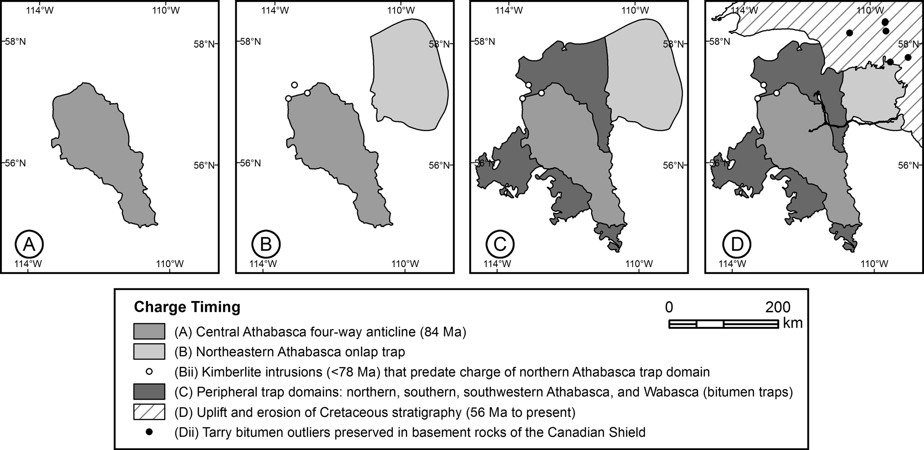
Conclusion of events

