Slide 1
Seismic geomorphological analysis and hydrocarbon potential of the Lower Cretaceous Cromer Knoll Group, Heidrun field, Norway
Paper by: Moscardelli and Wood

Slide 2
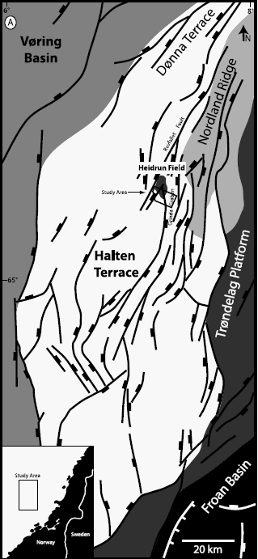
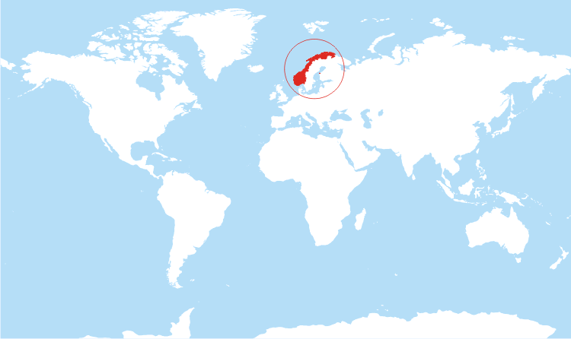
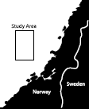

Slide 3
Main objective:
“One of the main objectives of this study is to characterize the architecture and geomorphology of the Cromer Knoll Group within the Heidrun Field to explain the tectonostratigraphic significance, paleoenviromental configuration, and reservoirs potential of this Lower Cretaceous postrift unit.” –Moscardelli and Wood

Slide 4
Things to note:
Halten Terrace was one of the first giant oil fields found in Norwegian Sea.
Narrow continental shelf due to faulting.
Has been producing from Jurassic reservoirs the last 30years.
Heidrun field in 1985 had 750 million bbl of recoverable oil.

Slide 5
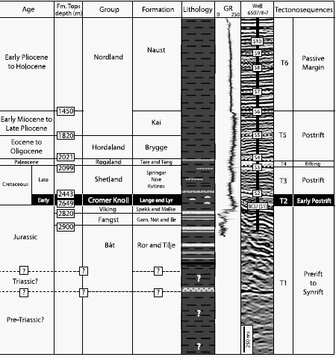
Cromer Knoll Group
Wanted to focus on Upper Cretaceous units in the Heidrun Field.
Contains thick shales that act as seals from Upper Jurassic reservoirs.

Slide 6
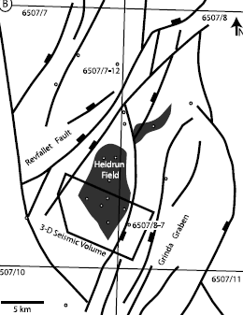
What they did:
Used 3D seismic reflection data and well data to examine Lower Cretaceous wedge.
Cromer Knoll Group is within the hanging wall of a half graben in the Halten Terrace.
This half graben has potential of high quality Cretaceous sandstones.

Slide 7
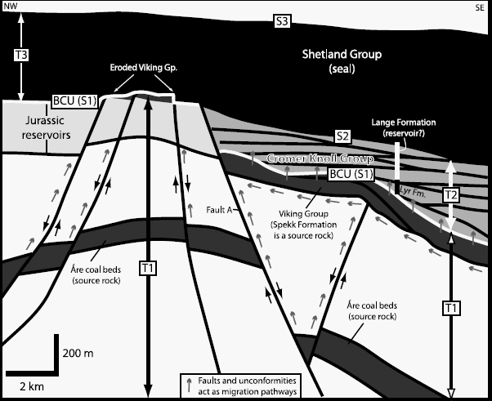

Slide 8
History of Heidrun Field
Basement of mid-Norwegian basin is Caledonian metamorphic and intrusive rocks.
Basin is affected by rifting and faults.
Accumulation of thousands of meters of sediment.
Ten unconformities have been interpreted.
Unconformities bounded six tectonosequences.

Slide 9
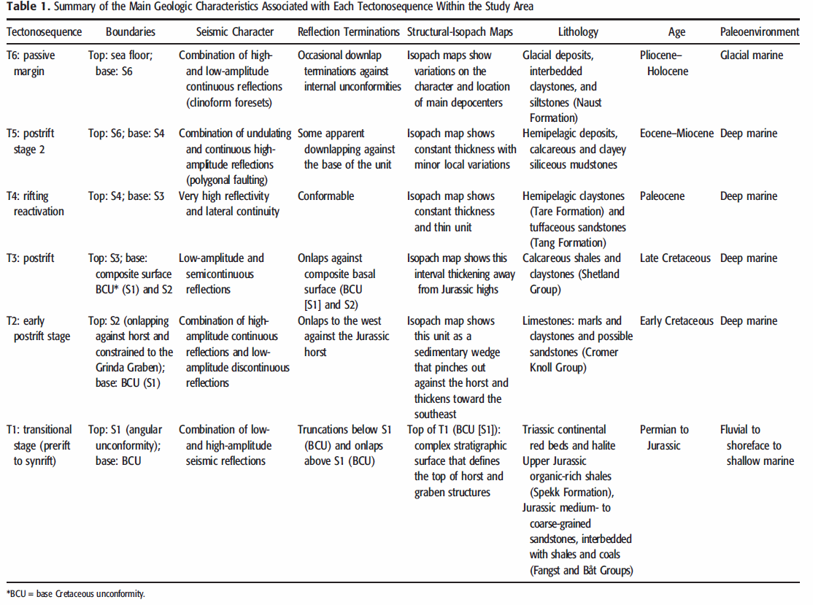

Slide 11
What they found:
T1 formed structural traps and migration paths for hydrocarbon accumulations.
T3 (Shetland Group) act as potential seals for Lower Cretaceous intervals.
Spekk Formation is the primary oil and gas source rock.
A fault connects T1 (Triassic and Jurassic) and T2 (Lower Cretaceous) and suggests that upward fluid migration might be possible.

Slide 12
In conclusion….
Although the Jurassic reservoirs are reaching their limit, there is a high possibility that hydrocarbons are in the upper part of the Cromer Knoll Group of the Heidrun Field off the shore of Norway, according to the lithological and seismic analysis.

