Slide 1
Potential role of igneous intrusions on hydrocarbon migration, West of Shetland
By: Dylan Castle

Slide 2
Overview
Locality
Igneous Intrusions
Study Methods
How intrusions influence hydrocarbon (HC) migration
  Sill
    Composition and porosity
  Proposed Models
Conclusion

Slide 3
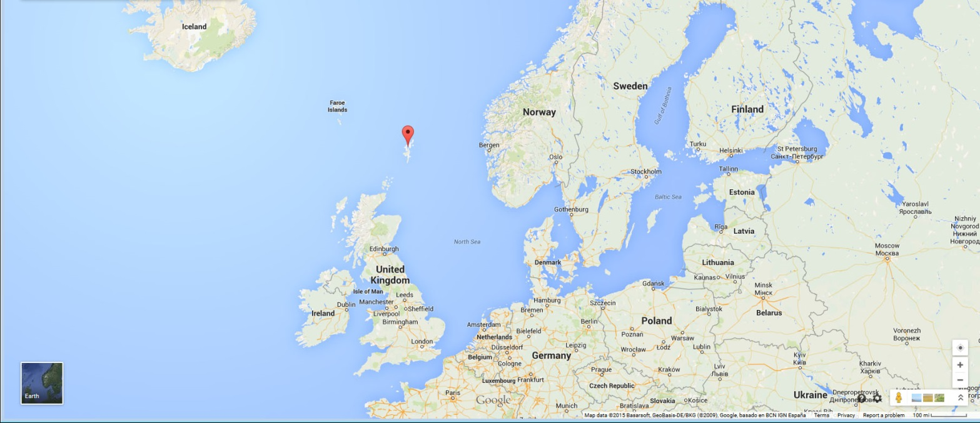
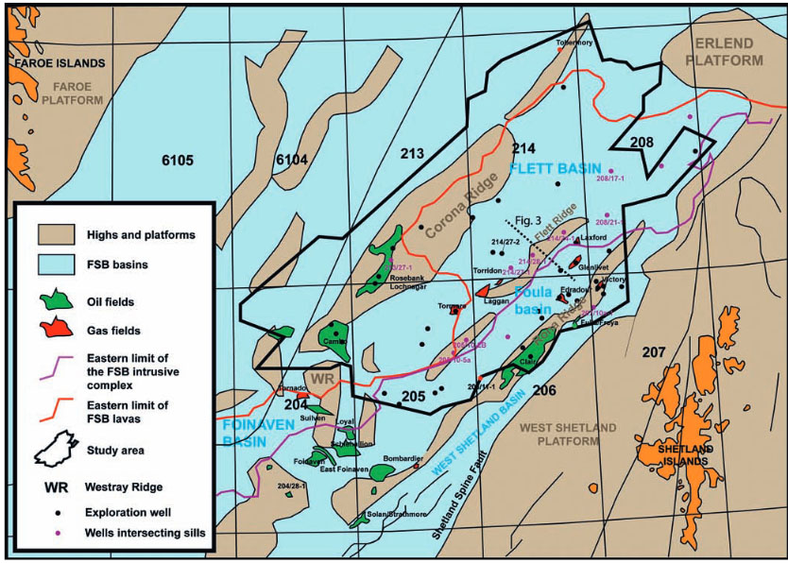
Faroe-Shetland Basin (FSB)
Shetland Islands: Northern border of North Sea
FSB: located betweem Shetland and Faroe Islands

Slide 4
Igneous Intrusions
The GSA defines intrusions as magma that cools and solidifies before reaching the surface.
  Three common types: Sills, dykes, and batholiths
The FSB contains mostly large sills
  Sills: magma intrudes between rock layers, forming a horizontal sheet of igneous rock
  Cover and area of at least 40,000km²
  Intruded between 55 and 53 Ma

Slide 5
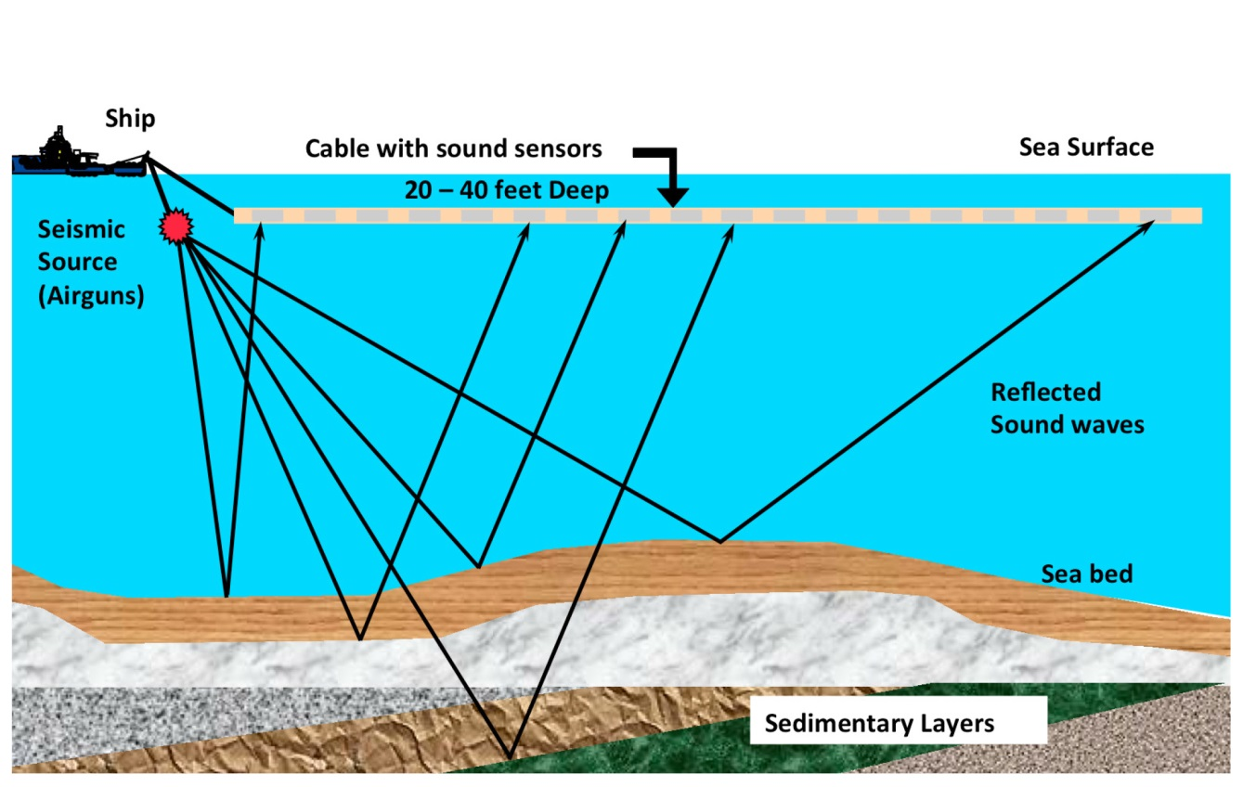
Methods
Seismic Surveys
  3D seismic cube with an area of 18,500 km²
Well Data
  13 wells
    All had mud and CPI logs
    7 of 13 wells had cores in sills

Slide 6
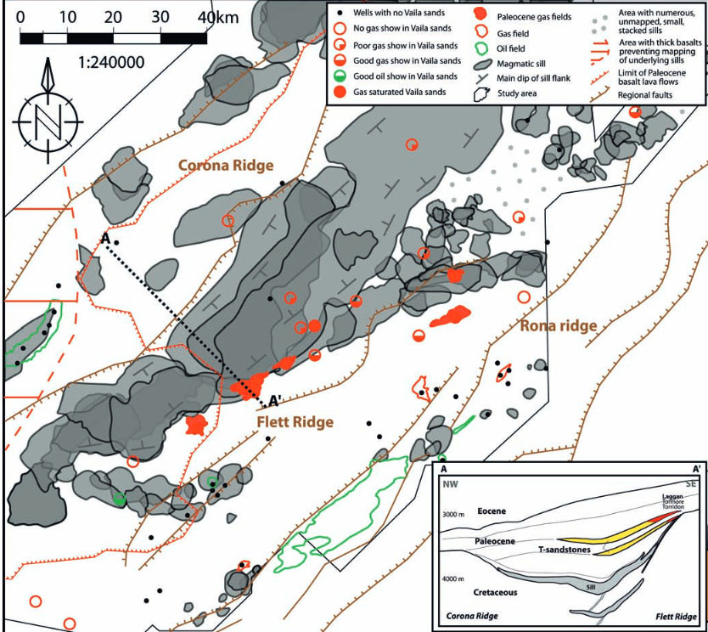

Slide 7
Intrusions; Barrier or Carrier?
Sills are composed of Dolerite
  Similar to basalt, but with larger crystals.
Factors that lead to permeability in intrusions.
  Vesicles
    Cores revealed vesicles that were low in frequency and many were cemented with secondary minerals
  Metasomatism (Hydrothermal alteration)
    Log data showed little to no dolerite alteration
  Open/cemented fractures
    Some cores had evidence of extensive fracturing

Slide 8
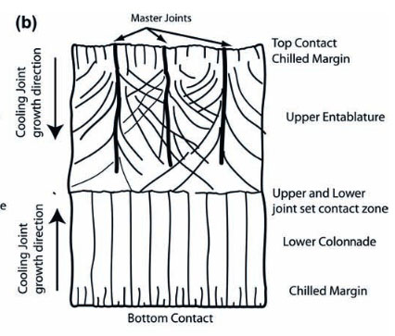
Intrusion Fracturing
Many wells with fractured cores produced high gas values
Proposed fracturing sources
  Cooling
  Post intrusion tectonic activity
Surprising due to depth (4000-5000m TVDSS (~16,400ft))
Proved migration happened post-intrusion and intrusions have a role in HC migration.

Slide 9
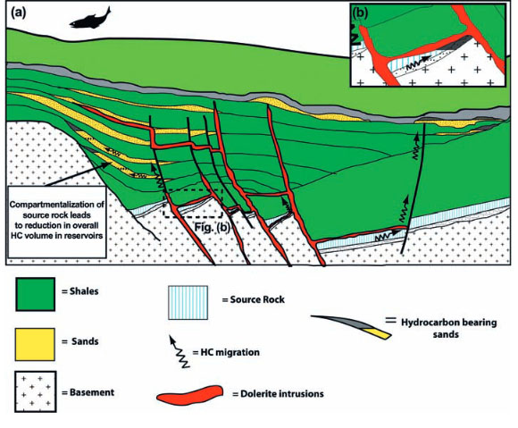
Proposed Model 1-Compartments
Compartmentalization
  Sills acting as impermeable layers
  HC’s can be trapped close to source
  Reduce source rock size, which leads to smaller volumes.

Slide 10
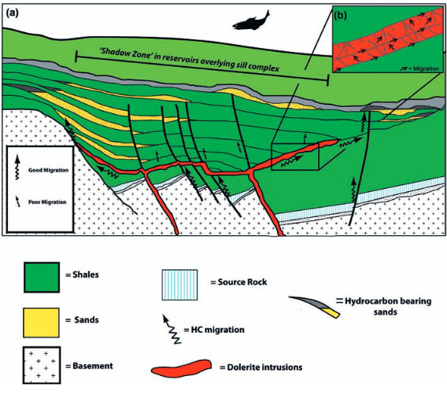
Proposed Model 2-Sills as Carriers
Carrier of HC’s
  Fractures in sills create high permeability pathway
  Most HC’s migrate past sills and escape at sill edges
  This seems to occur frequently in the FSB

Slide 11
Concluding
Intrusions in FSB may act as carriers and barriers.
Fractures appear to be major factors in sill permeability.
Hydrocarbon migration may result in HC concentration at sill edges.
Hydrocarbons could be compartmentalized by sills.

