Slide 1

Sedimentology and sequence stratigraphy of the Middle-Upper Jurassic Krossfjord and Fensfjord formations, Troll Field, northern North Sea
Richard Brown

Slide 2
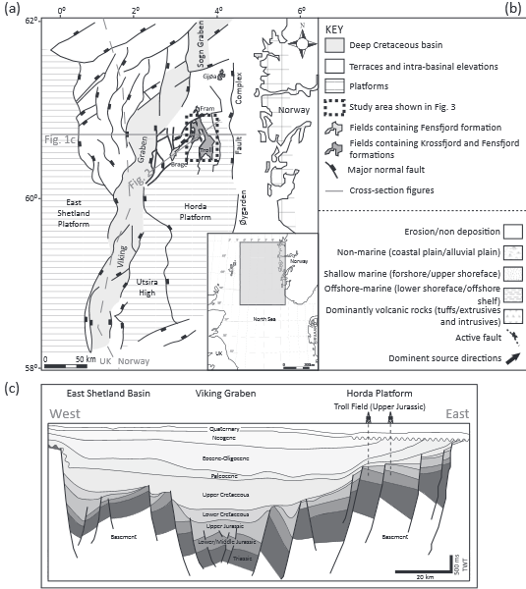
Tectonic Location
Located on the Horda Platform
This is on the eastern margin of the Viking Graben in the North Sea
Northern part of the North Sea rift basin

Slide 3
Tectonic Evolution
Initial extension in Permo-Triassic as a continental rift
Regional uplift event
Tectonic quiescence and uniform subsidence
Another regional uplift event and formation of North Sea thermal dome
More extension in Mid-Late Jurassic as a marine rift

Slide 4
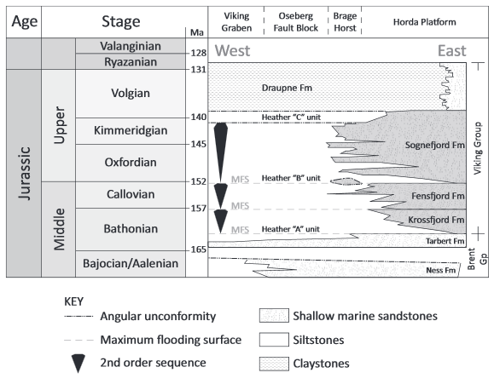
Key Units
Three major sandstone formations
  Krossfjord Fm.
  Fensfjord Fm.
  Songefjord Fm.
Each 100 – 200m thick
Pinch out into the Heather Fm.
Combined thickness is approximately 400m

Slide 5
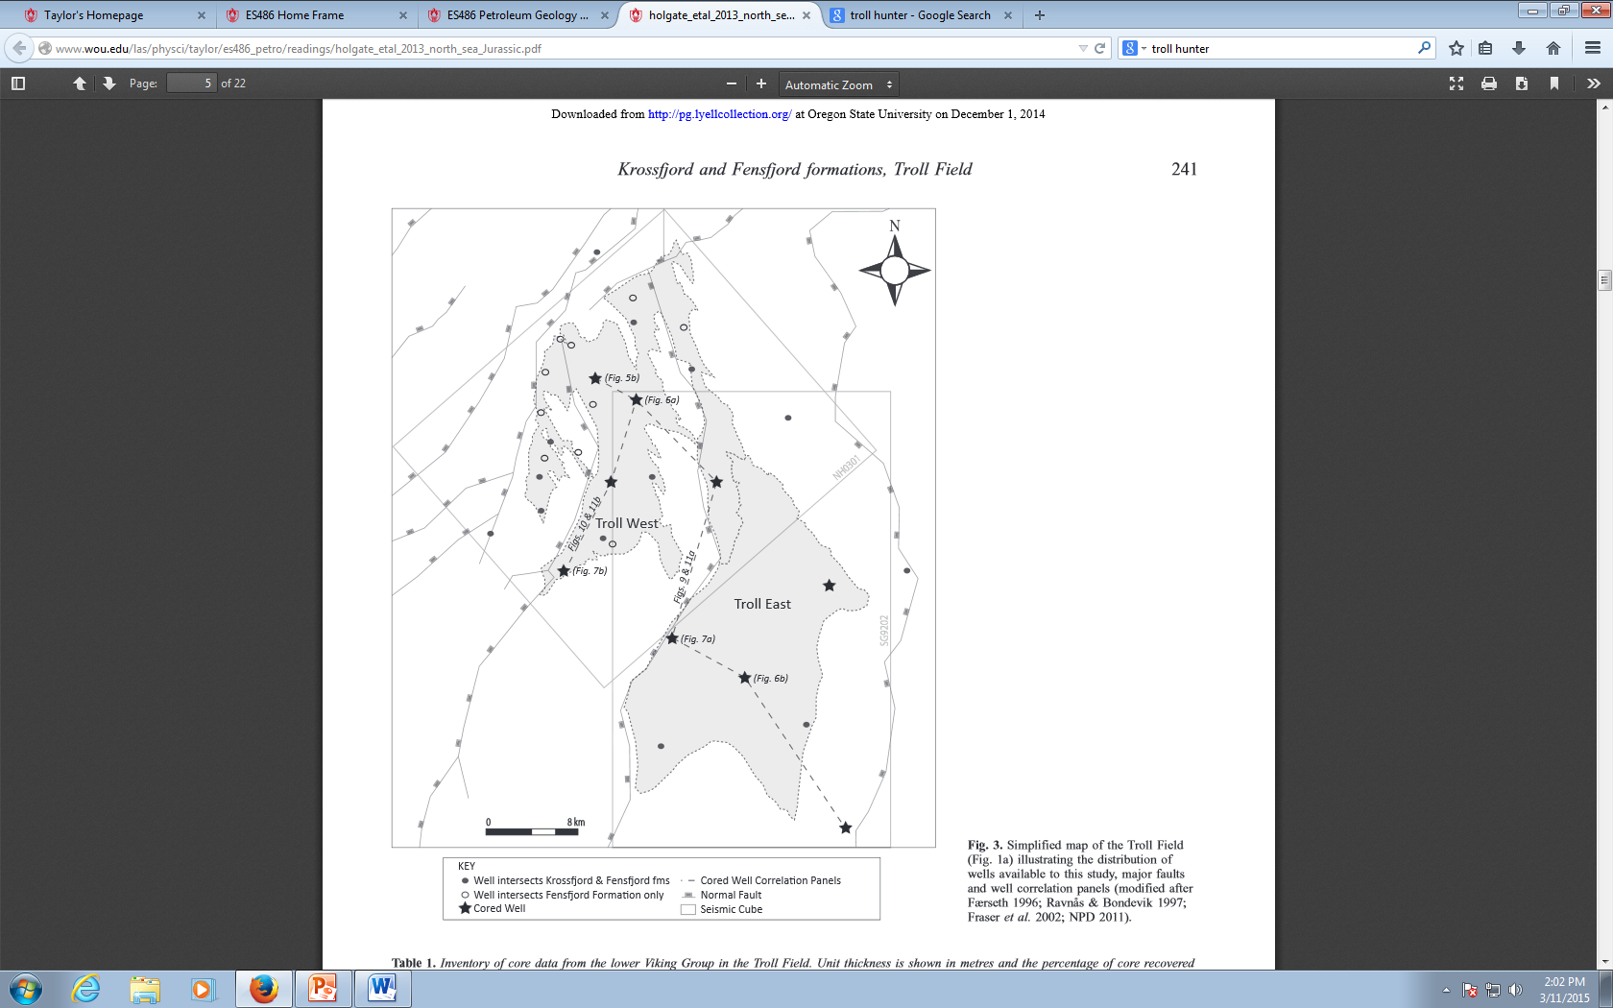
Techniques-
Wells
32 wells penetrate the Fensfjord Fm.
22 of these also penetrate the Krossfjord Fm.
Only 9 contain core within the interval of interest

Slide 6
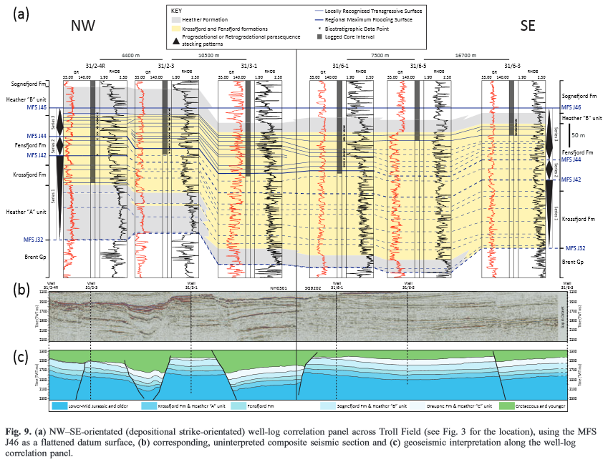
Technique-Seismic Reflection
Two regional 3D seismic reflection data sets were interpreted
One for Troll West and one for Troll East

Slide 7
Analysis
Eleven different facies were identified
Grouped into six different associations
  1: Offshore
  2: Wave-dominated lower shoreface
  3: Wave-dominated upper shoreface and foreshore
  4: Wave-dominated, tide-influenced upper shoreface
  5: Tide-dominated, wave-influenced embayment
  6: Delta Front

Slide 8
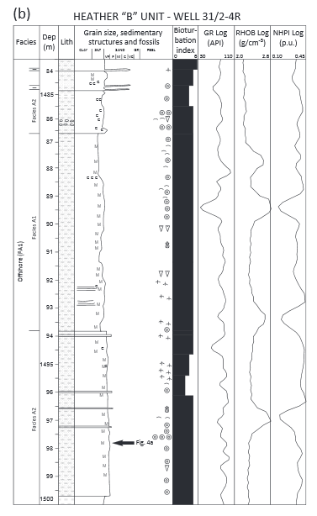
Offshore
Composed of very fine grained siltstone
Highly bioturbated with fossils and burrows present
Suggested deposition of fine material from suspension fall-out

Slide 9
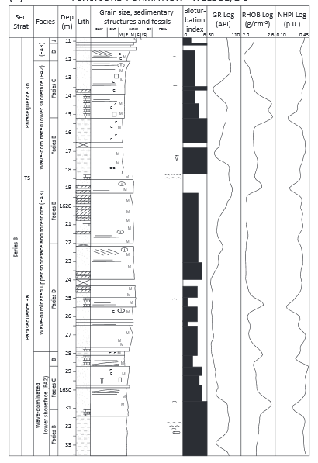
Wave-dominated lower shoreface
Composed of very-fine to medium grained sandstones in coarsening upwards sequences
Hummocky cross strata and bioturbation is present
Interpreted as a ‘transition zone’ which is above the storm base but below fair-weather base

Slide 10
Wave-dominated upper shoreface and foreshore
Composed of medium to coarse grained sandstone
Contains tabular and trough cross beds
Interpreted to be in a high energy marine environment above the fair weather wave base

Slide 11

Wave-dominated,tide-influenced upper shoreface
Composed of fine to medium grained sandsone
Contains planar and trough cross strata
Sections are highly bioturbated
Interpreted as being deposited in an environment where fair weather wave driven processes were modulated by tidal influence

Slide 12
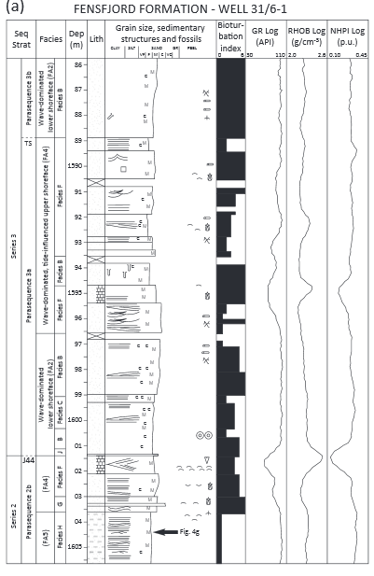
Tide-dominated, wave-influenced embayment
Composed of fine grained sandstone with lenses of siltstone and mudstone
Contains ripple cross laminations
Interpreted to be tidally dominated deposition in a sheltered environment

Slide 13

Delta front
Composed of medium to coarse grained sandstone in a fining upwards sequence
Typically structureless with some planar laminations
Interpreted to be from repeated submarine gravity flows

Slide 14
Conclusion
The formations are important sandstone tongues that form secondary reservoirs in the Troll Field
The core analysis indicate that deltaic, shoreline and shelf environments were present in the Middle Jurassic when the formations were being deposited
There was an absence of any major structural control on sedimentation during this time.

