Slide 1
Jurassic Evolution of the Gulf of Mexico
Authors: Michael R. Hudec,
Ian O. Norton, Martin P. A. Jackson and Frank J. Peel

Slide 2
Abstract: Hypothesis Intro
Callovian Salt deposition in pre-existing crustal depression
Hyperextension of lithospheric plate causing depressions
Salt deposition on hyperextended continental and transitional crust
Rifting lasting 7 -12 m.y., followed by sea floor spreading.
Postsalt crustal stretching a further 100-250 km (62-155 mi)
Sea-floor spreading dividing Gulf of Mexico, and separated by Brazos transform fault

Slide 3
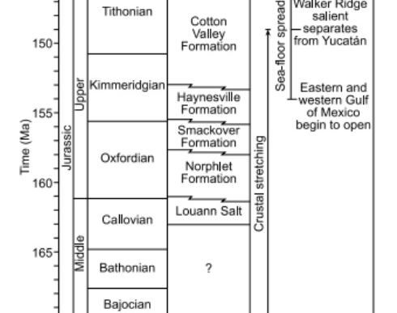
Terminology
Allochthonous – Sediment or rock that originated at a distance from its present position
Autochthonous – A deposit or formation formed in its present position
Paratochthonous – A mix between to the two prior definitions
LOC – Limit of normal oceanic crust

Slide 4
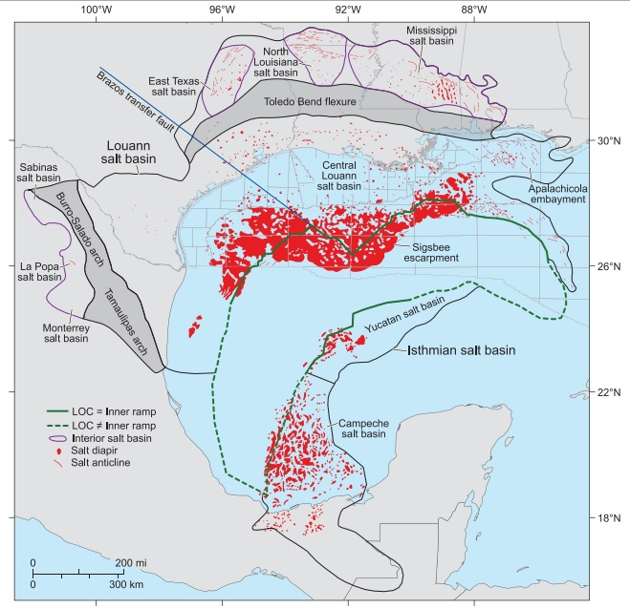
Gulf of Mexico Salt Basins

Slide 5
Introduction
The Basin began forming during the Triassic – Early Cretaceous
Rifting between the Yucatan microplate and the North American plate
Jurassic structure is obscured beneath 6-11 mi of sediment
This making early seismic technologies difficult to image deeper structures
Imaging technologies: Wide-azimuth seismic acquisition and prestack depth migration. Two dimensional seismic data.

Slide 6
Earlier Hypotheses
Salt was deposited in geosynclines around the basin margin, due to lack of deep earth seismic imaging.
Later application of plate tectonic theory leading to…
Speculation that north and south diapir provinces were once one continuous salt basin.

Slide 7
Primary Focus Points
The LOC coincides with a landward-dipping ramp near the seaward end of the salt basin
The deep salt in the deep-water Gulf of Mexico salt basin can be separated into provinces, depending on position with respect to this ramp.
Salt filled the Gulf of Mexico salt basin to near sea level
Postsalt sediments in the central Louann and Yucatan salt basins exhibit large magnitudes of late Jurassic salt-detached extension not balanced by salt-detached shortening

Slide 8
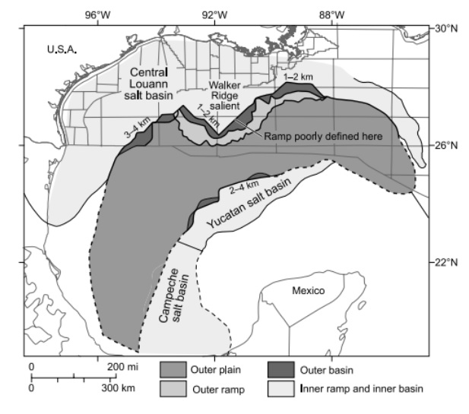
Deep-salt provinces in the Deep-water Gulf of Mexico
The Outer Plain
The Outer Ramp
The Outer Basin
The Inner Ramp
The Inner Basin

Slide 9
Salt Elevation and Basin Formation
Preformed tectonic depressions below sea level
Evaporite sumps: Adiabatic heating, favorable climate and location
World ocean isolation and source of saline water, as well as space
Filled to near sea level
Evidence of shallow-marine Norphlett Formation, and Oxfordian continental formation, followed by later marine transgression and another carbonate shelf margin

Slide 10
Louann Salt Basin Jurassic History
Phase 1: Presalt rifing (210- 163 Ma)
Phase 2: Salt Deposition (163 -161 Ma)
Late Triassic Grabens
Gulf of Mexico rifting tied to Pangea
Yucatan southeast movement
Hyperextended lithosphere
Thinned transitional crust due to ultraslow spreading
No diagnostic fossils, underlying and overlying layers used to date
Could have occurred in as little as 1 m.y. but model assumes safely as 2 m.y.
Adiabatic heating would allow for 10⁰C greater temperature
Depression at 1-1.13 km deep to allow for salt deposit of 3-4 km

Slide 11
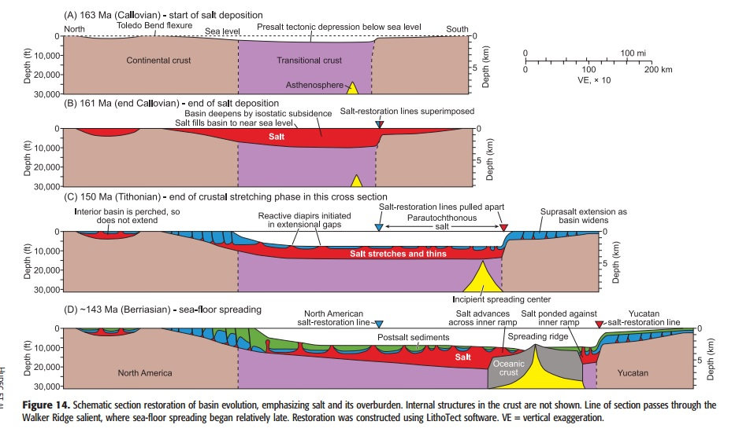
Basin Evolution Schematic

Slide 12
Louann Salt Basin Jurassic History
Phase 3: Postsalt Crustal Stretching
(161 to 154-149 Ma)
Phase 4: Sea Floor Spreading (153-149 to 137 Ma)
Crustal age based on dating sediments overlaying crust.
Rifting for 7-12 m.y. after deposition stopped.
Salt stretched and thinned as it tried to fill the basin
Stretching to 62-155mi wide and pinching out at the ends.
Pinched salt basins around the rim and stretched central Louann salt would support crustal stretching
Asymmetric LOC boundaries on opposite ends on the basin
Meaning that spreading occurred differently in the eastern and western edges before breaking apart.

