Slide 1
Marcellus Formation in the Middle Appalachian Basin
Sequence Stratigraphy and Depositional Environments
By: Elden Meeuwsen

Slide 2
Overview
Location and Setting
Objectives of the Study
Third Order Sequence
Methodology
Gamma Ray Logs
Sequence Stratigraphy
Results
Conclusion

Slide 3
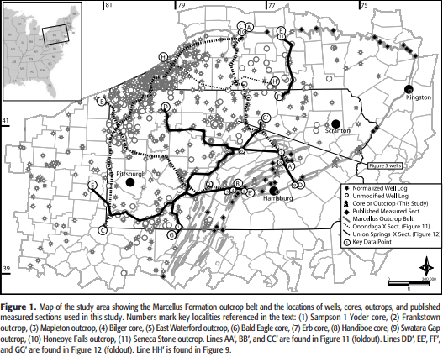
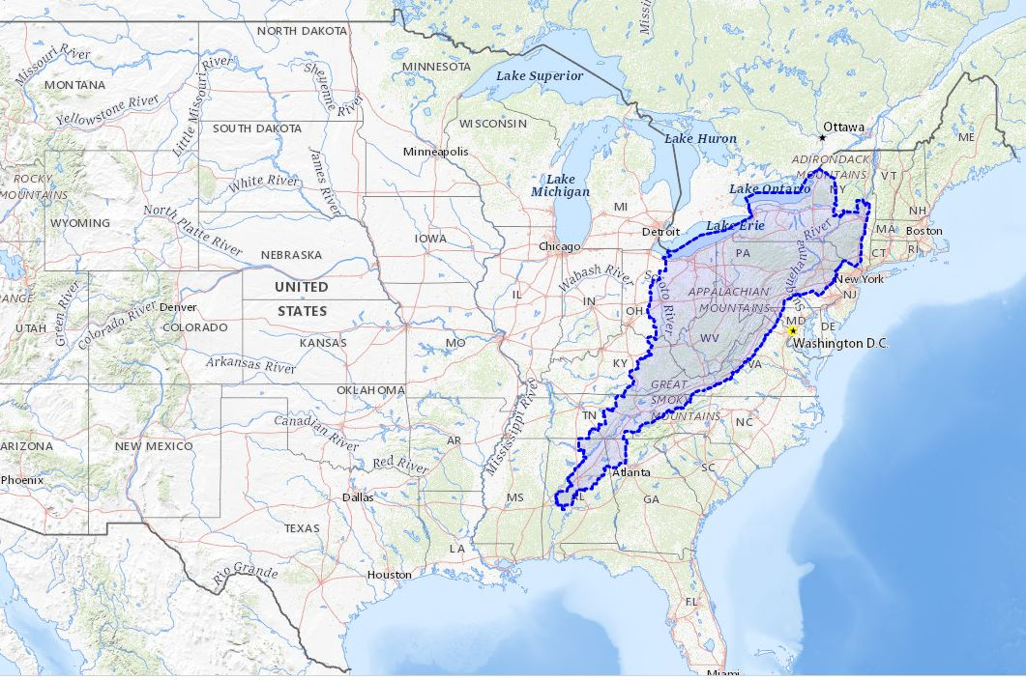
Location
Appalachian Basin
Focus on Marcellus Formation
Pennsylvania, New York, West Virginia, Ohio
Notes:
Along eastern U.S.

Slide 4
Hydrocarbon Production
Possibly contains 489 trillion cubic tons of recoverable reserves in Marcellus fm.
Advances in horizontal drilling and hydrofracturing revitalized the basin
Around 3,000 producing wells at time of study

Slide 5
Goals of the Study
Define and describe the lithofacies and associated depositional processes and systems tracts of the lower part of the Marcellus and associated formations
Construct a sequence-stratigraphic framework for predicting the lateral and vertical variability of the economically significant lithofacies in this interval

Slide 6
Third-Order
Sequence
Depositional sequence formed from changing sea level
Highstand Systems Tract (HST)
Transgressive Systems Tract (TST)
Lowstand Systems Tract (LST)
Falling Stage Systems Tract (FSST)
Erosion = falling phase of a sea level cycle
Deposition = rising phase of sea level cycle
Typical Third-Order Sequence Cross Section

Slide 7
Methodology
23 outcrops, 8 cores, and 1,000+ well logs throughout Pennsylvania and adjacent parts of New York, West Virginia, and Ohio examined
Gamma-Ray logs used to examine subsurface
Gamma-Ray log response mapped to lithofacies
High GR response heavily correlated with higher carbon content
Depositional Sequences:
Composed of systems tracts that are further subdivided into parasequences
Systems tracts composed of all deposits accumulating during one phase of sea level cycle and preserved between specific primary chronostratigraphic surfaces
Notes:
Meaning higher chances of hydrocarbon production

Slide 8
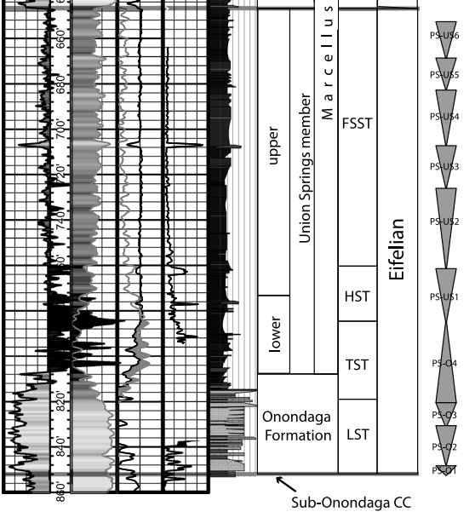
Results
10 Parasequences identified Overall
3 parasequences occur in Onondaga formation (PS-01, PS-02, and PS-03)
One parasequence spans the transition between the Onondaga and the Union Springs member (PS-04)
6 parasequences occur within the union springs member
(PS-US1 to PS-US6)
Notes:
Parasequences PS-01, PS-02, and PS-03 thicken and generally decrease in GR value to the north, west, and northeast
Reflects change from deeper water Selinsgrove member of the Needmore formation to the shallower water facies of the Onondaga formation
PS-01 represents carbonate reefal/bank environments
PS-02 and PS-03 represent a range of lithofacies including bistromal and biohermal coral facies and crinoidal grainstones, interbedded limestones, and dark gray calcareous shales
Top of PS-02 correlates with the base of the Stroud bed, which is a calcareous shale

Slide 9
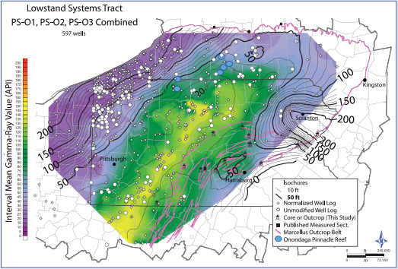
Results
Parasequences PS-01, PS-02, and PS-03 thicken and generally decrease in GR value to the north, west, and northeast
Notes:
Parasequences PS-01, PS-02, and PS-03 thicken and generally decrease in GR value to the north, west, and northeast
Reflects change from deeper water Selinsgrove member of the Needmore formation to the shallower water facies of the Onondaga formation
PS-01 represents carbonate reefal/bank environments
PS-02 and PS-03 represent a range of lithofacies including bistromal and biohermal coral facies and crinoidal grainstones, interbedded limestones, and dark gray calcareous shales
Top of PS-02 correlates with the base of the Stroud bed, which is a calcareous shale

Slide 10
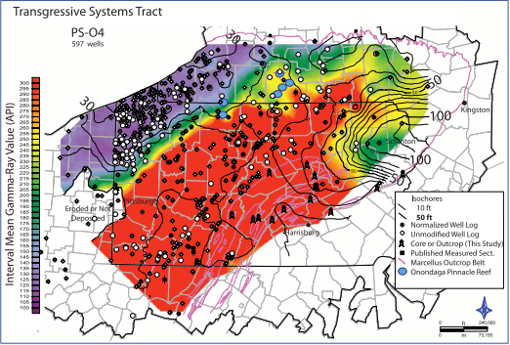
Results
PS-04 exhibits a fining upward pattern with a retrogradational stacking pattern
Central parts of basin show highest GR values
Much higher GR values overall

Slide 11
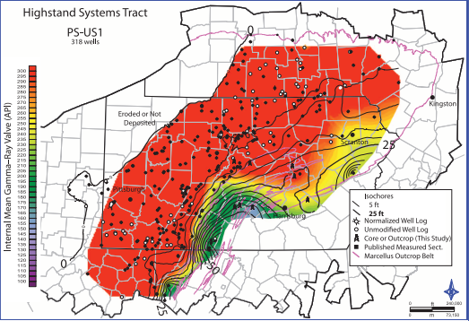
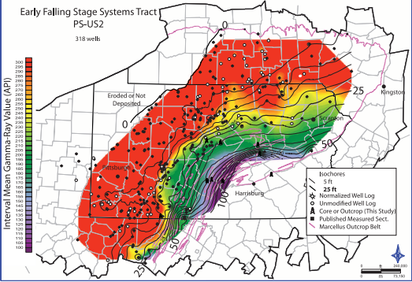
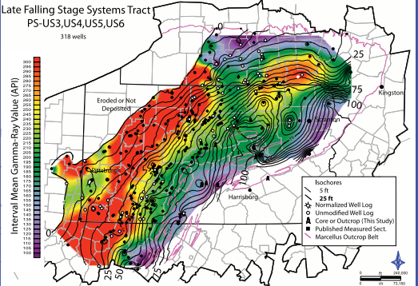

Slide 12
Conclusion
Parasequences PS-01 to PS-US6 make up a single third order depositional sequence (Eif)
PS-01 to PS-03 in LST
PS-04 in the TST
PS-US1 in the HST
PS-US2 through PS-US6 in the FFST
Notes:
The first three parasequences (PS-01, PS-02, PS-03) compose the LST. Parasequence PS-04 represents the TST, and PS-US1 represents the HST. Parasequences PS-US2 through PS-US6 compose the FSST
The overlying Purcell Member comprises the LST of the next depositional sequence

Slide 13
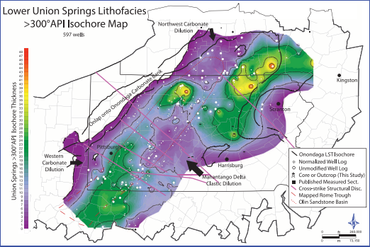
Conclusion
The thickest, high-GR Union Springs occurs in a generally northeast–southwest-trending belt across Pennsylvania
Deepest and most distal part of the basin
Water depths sufficient to maintain euxinic conditions for hundreds of thousands of years
Notes:
Interpreted to be the-
These yellow areas will be the best locations for hydrocarbon production

Slide 14
Thank You
Kohl et al., 2014, Gas Reservoirs in the Marcellus Shale, Appalachian Basin

