Slide 1
Athabasca Oil Sands
A Case Study
Davis Mackintosh
ES 486, Winter 2023

Slide 2
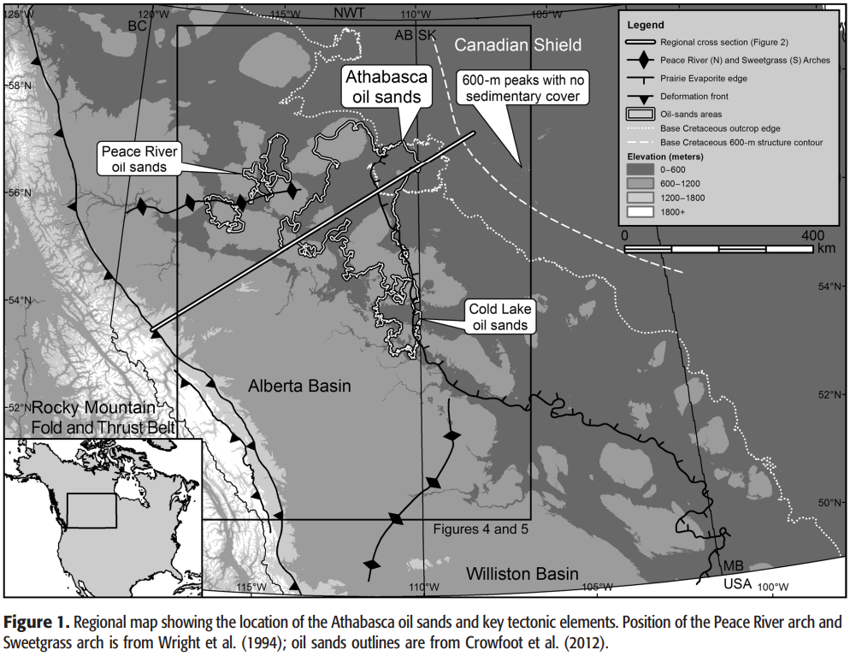
Presentation Overview
Context
Region
Reservoir
Previous studies
Problem
Methodology
Results
Conclusion

Slide 3
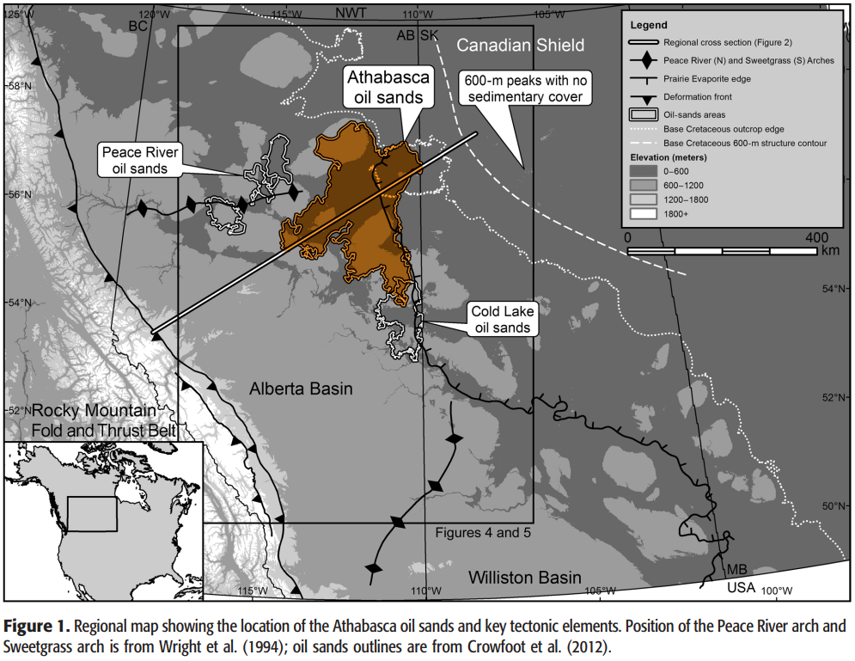
Region
Alberta Basin
East of the Rockies
West of the Precambrian Canadian Shield
Formed during Precambrian rifting
Nearby reservoirs
Peace River oil sands
Cold Lake oil sands

Slide 4
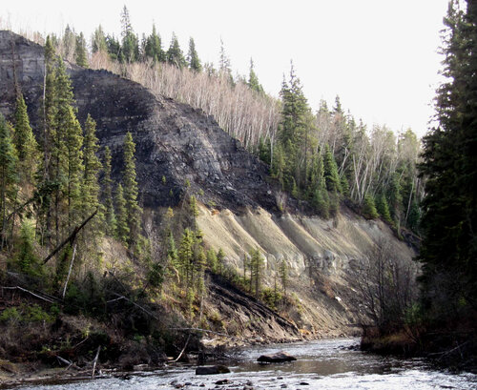
Reservoir
Sand
Water
Surrounds the sand grains
Bitumen
Fills porosity between grains
Thick, very viscous oil
Can be found in outcrops
Biodegraded form of oil
1.8 trillion barrels
Mining at surface
Steam injection to reduce viscosity
Oil sand outcrop. Photo from Oil Sands Magazine. https://www.oilsandsmagazine.com/technical/oilsands-101

Slide 5
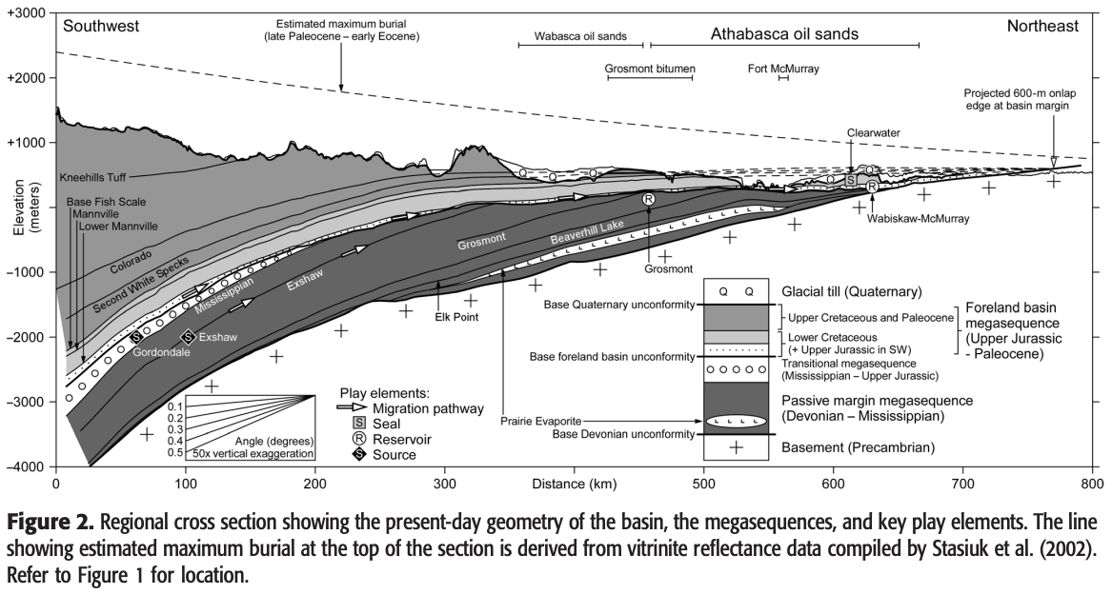
Findings of Previous Studies
Source is controversial
Gordondale Member
Exshaw Formation
Combination
Possible additional source rocks
Migration
Reservoir at shallower basin edge
Oil → Bitumen
Displacement of water hindered further biodegradation
Timing
Late Cretaceous petroleum maturation
Late Cretaceous - Paleocene: Maximum burial and flexural loading

Slide 6
The Problem
The original trap extent was destroyed.
Flexural loading of basin
Uplift and erosion
Original onlap (boundary between reservoir and shield) eroded
What did the original trap look like?
Find the answer by reconstructing the trap
Update the model

Slide 7
Methodology
Create a reconstructed model of the trap
Large, basin-scale
Map the present-day structure and shape of layers
Flatten overlying layers to original horizontality
Well and outcrop data
Thickness of layers
Identify the bitumen-water contact in well cores

Slide 8
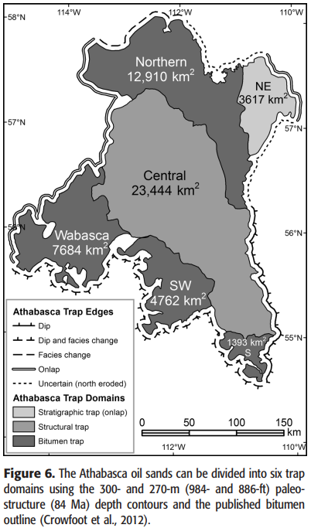
Results - trap structure
The 6 trap domains, and type of trap:
Central: 4-way anticline
Northeastern: Onlap
Bitumen traps:
Northern
Southern
Southwestern
Wabasca

Slide 9
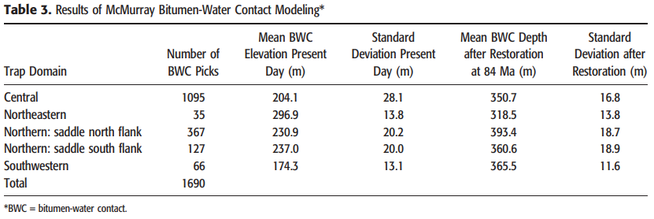
Results - trap structure
Elevation of horizons
Modern
Well data, outcrop data
84 Ma
Inferred by shifting overlying rock to a horizontal orientation

Slide 10
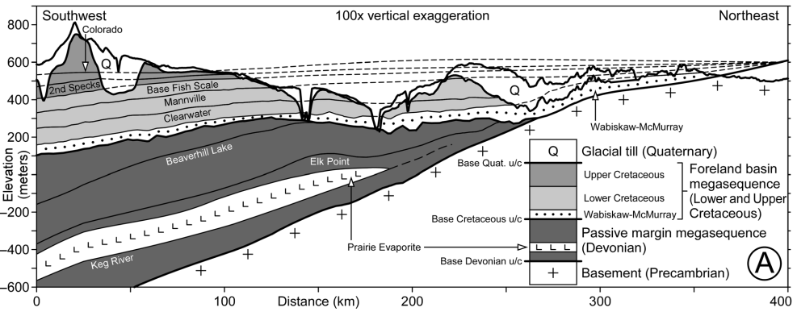
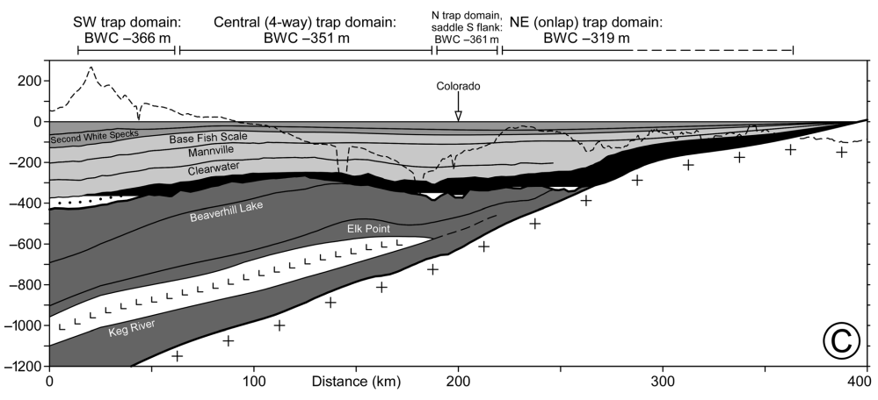
Results - models
Present day with projected contacts
84 Ma restored structure with bitumen fill

Slide 11
Conclusion
The goal was to reconstruct the structure of the trap.
The trap at 84 Ma was reconstructed, using well and outcrop data to infer the elevation of contacts.
The 6 trap domains were identified, using this restoration.

Slide 12
Thank you!
Journal article by Tozer et al.
https://people.wou.edu/~taylors/es486_petro/readings/Tozer_etal_2014_Athabasca_Oil_Sands.pdf

