Slide 1
Source rocks and Petroleum in the Danish North Sea
By: Catherine Eschman

Slide 2
Overview
Geographic location & tectonic setting
Methodology
Lithology & structure
Hydrocarbon production
Expulsion & migration
Conclusion

Slide 3
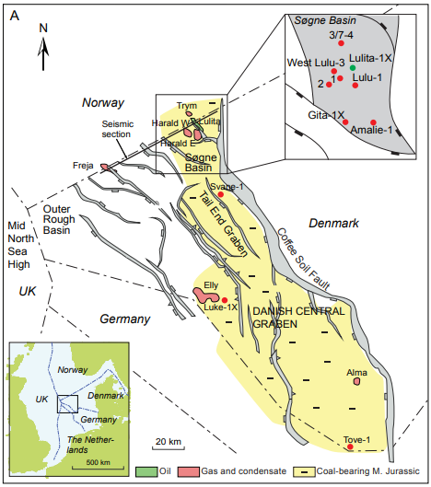
Location & Tectonic
setting
The North sea
Rift system
Danish Central Graben
Tail End Graben
Sogne Basin
West of Coffee Soil Fault

Slide 4
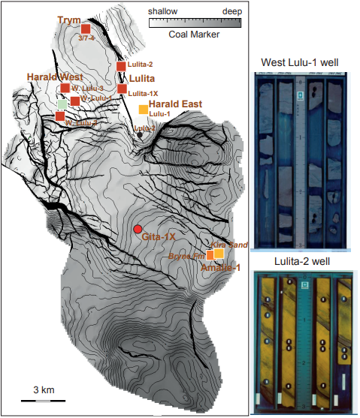
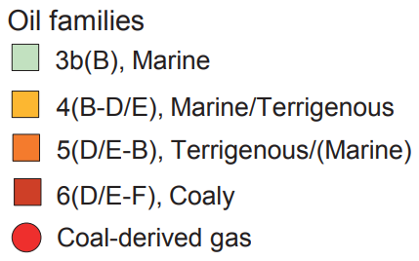
Methodology
Well logs
Seismic surveys and modelling
Model constructed using 37 seismic horizons
Facies maps

Slide 5
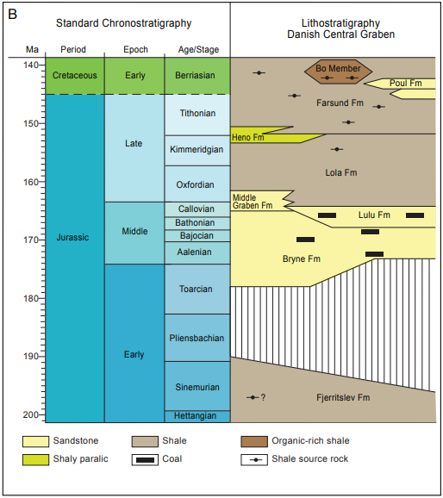
Lithology & structure
Source rocks:
Primary: Upper Jurassic- Lower Cretaceous marine shales (Hot Shales)
Middle Jurassic coals and coaly shales
Reservoirs: chalk and Middle Jurassic sandstone
Seals: chalk and shale
Traps: unconformities and faults

Slide 6
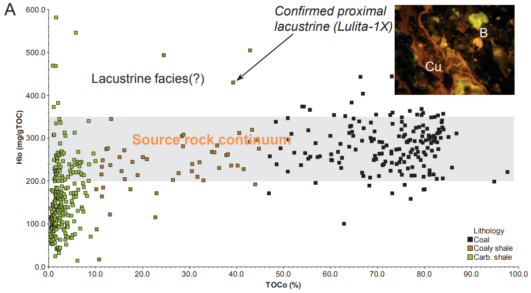
Hydrocarbon production
Oil from the Kimmeridge, Mandal, and Farsund formations (TOC 2-15%).
497 samples from Bryne and Lulu formations divided into coals (>45wt% TOC), coaly shales (10-45wt% TOC) and carbonaceous shales (<10wt% TOC)
Produce mostly natural gas, but can also produce condensate and oil due to high HI values
Oil composition: heavy stable carbon isotopes, and low sulfur content

Slide 7
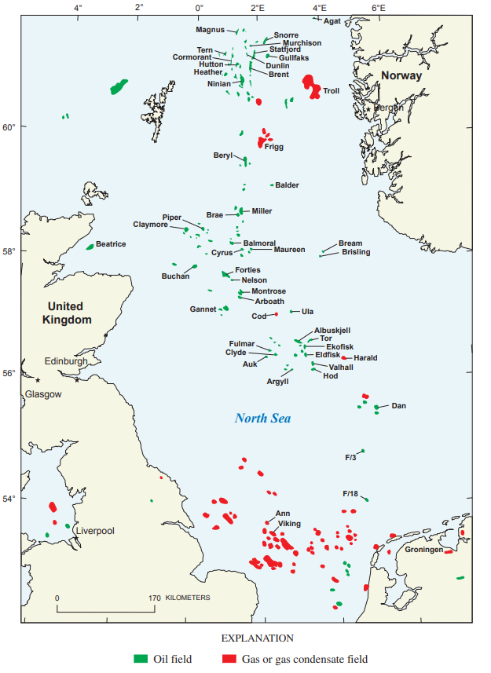
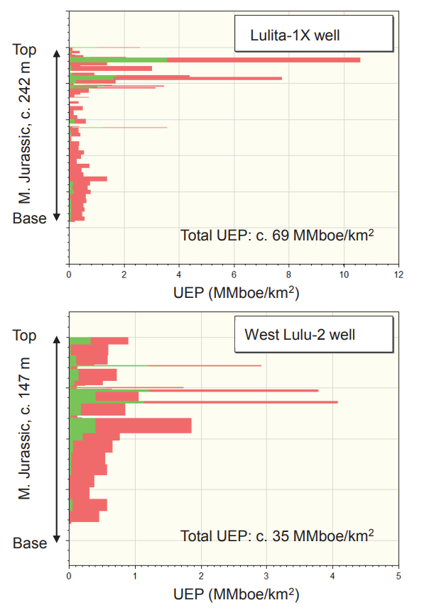

Slide 8
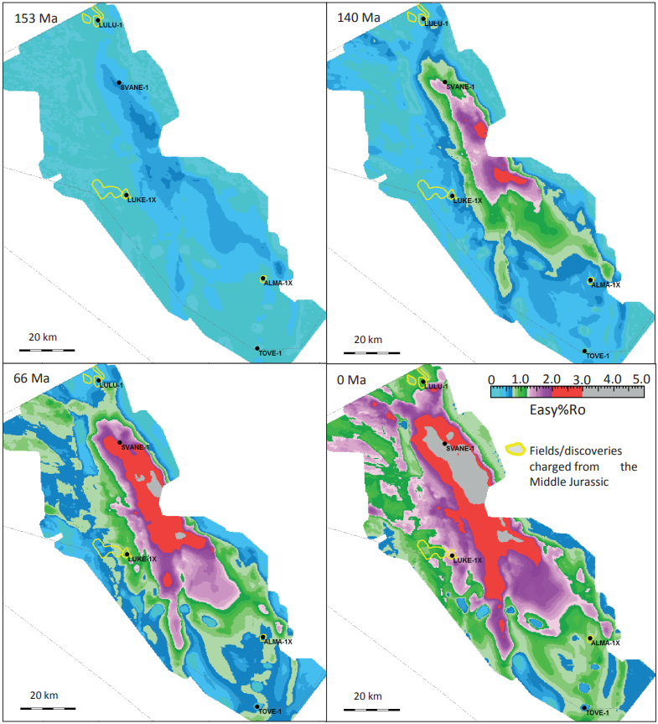
Hydrocarbon expulsion & migration
Expulsion began in the Tail End Graben 153-140 Ma
Maturation continues to expand through the cretaceous
Almost entire area matured from Cenozoic to present day
Tail End Graben overmatured

Slide 9
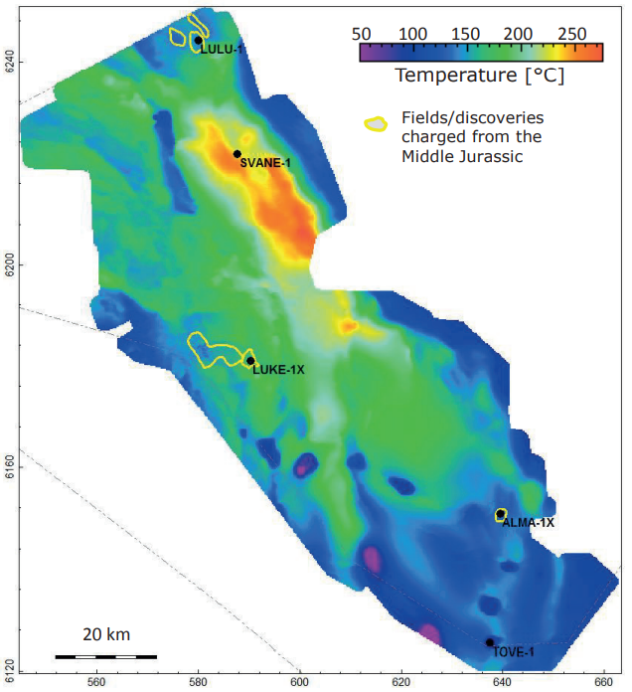

Slide 10
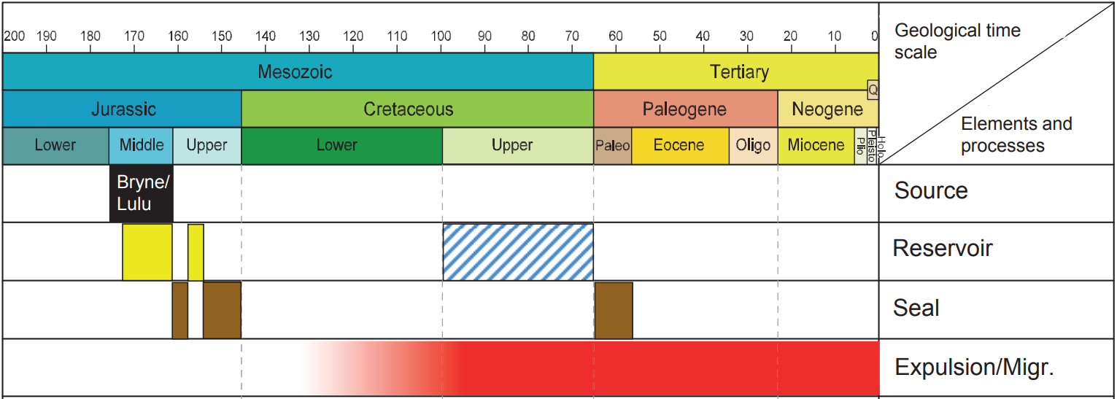
Timeline of Middle Jurassic petroleum system in the Danish Central Graben

Slide 11
Conclusions
Oil from Upper Jurassic-Lower Cretaceous marine “hot shales”
Hydrocarbons from the Middle Jurassic Bryne-Lulu “coal marker” formations are mostly gas-prone, but capable of producing oil and condensate.
“Coal marker” petroleum system proven to be economic
Coal, coaly shales, and carbonaceous shales all considered similar in source rock potential
Provides potential for further hydrocarbon exploration opportunities

Slide 12
Sources
Petersen et al., 2018, Source Rocks and Petroleum in Danish North Sea
Gautier, Donald L., 2005. Kimmeridgian Shales Total Petroleum System of the North Sea Graben Province

