Slide 1
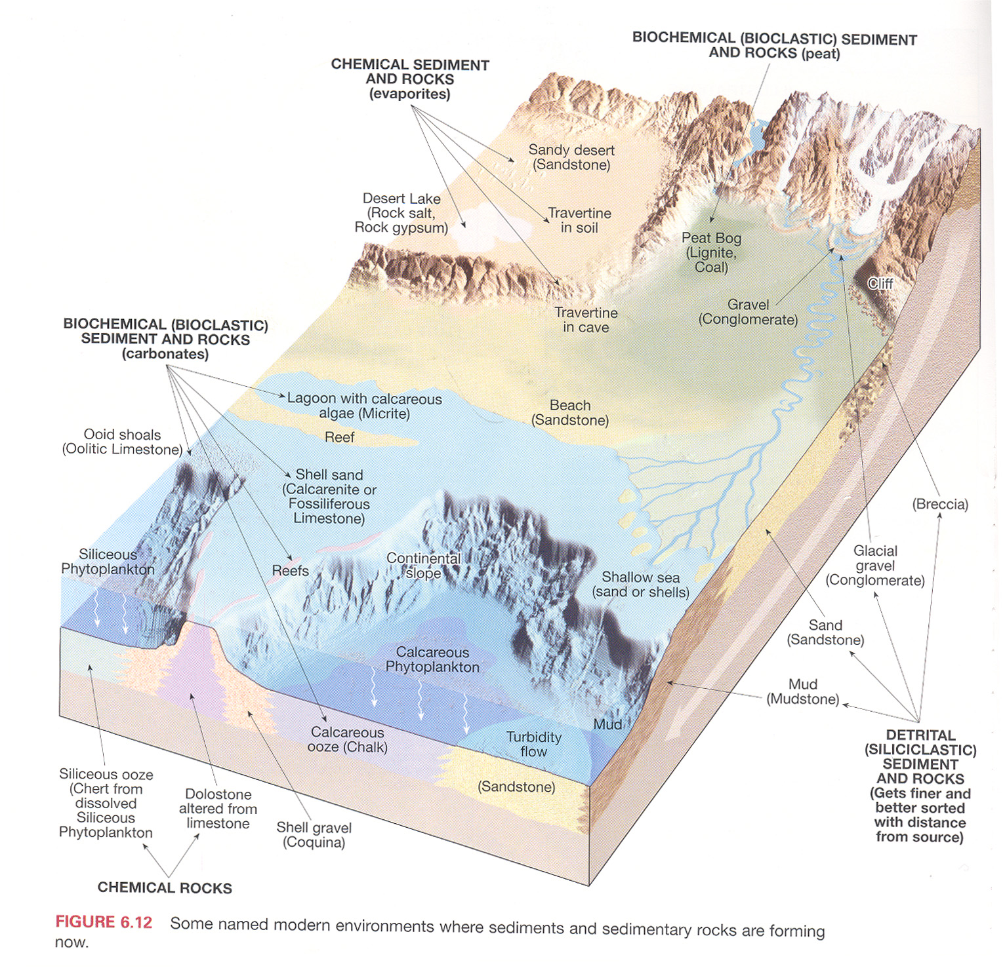

Slide 2
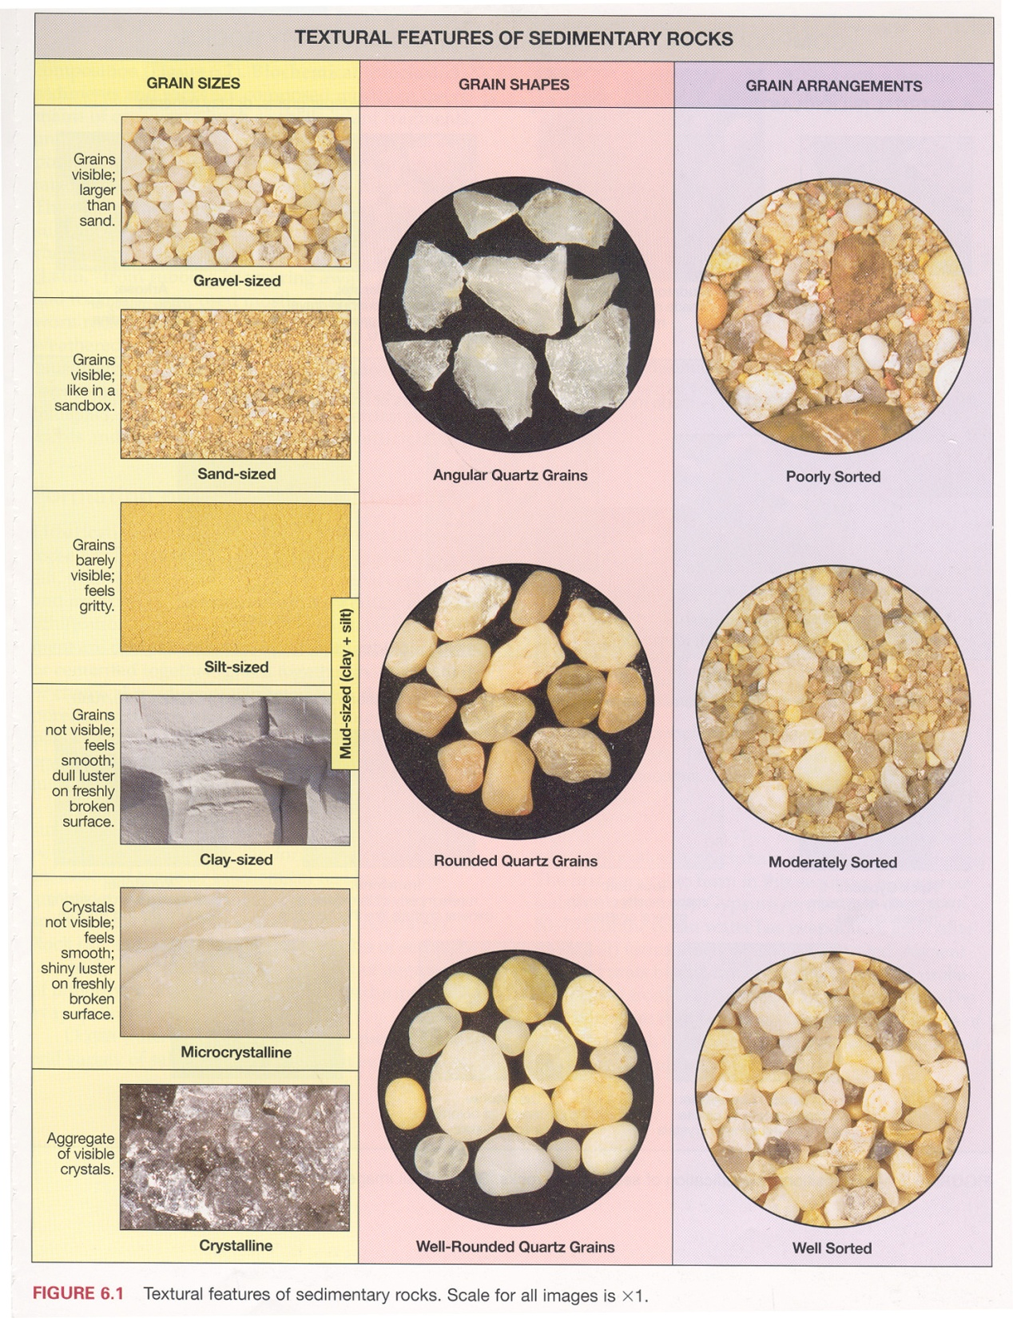

Slide 3
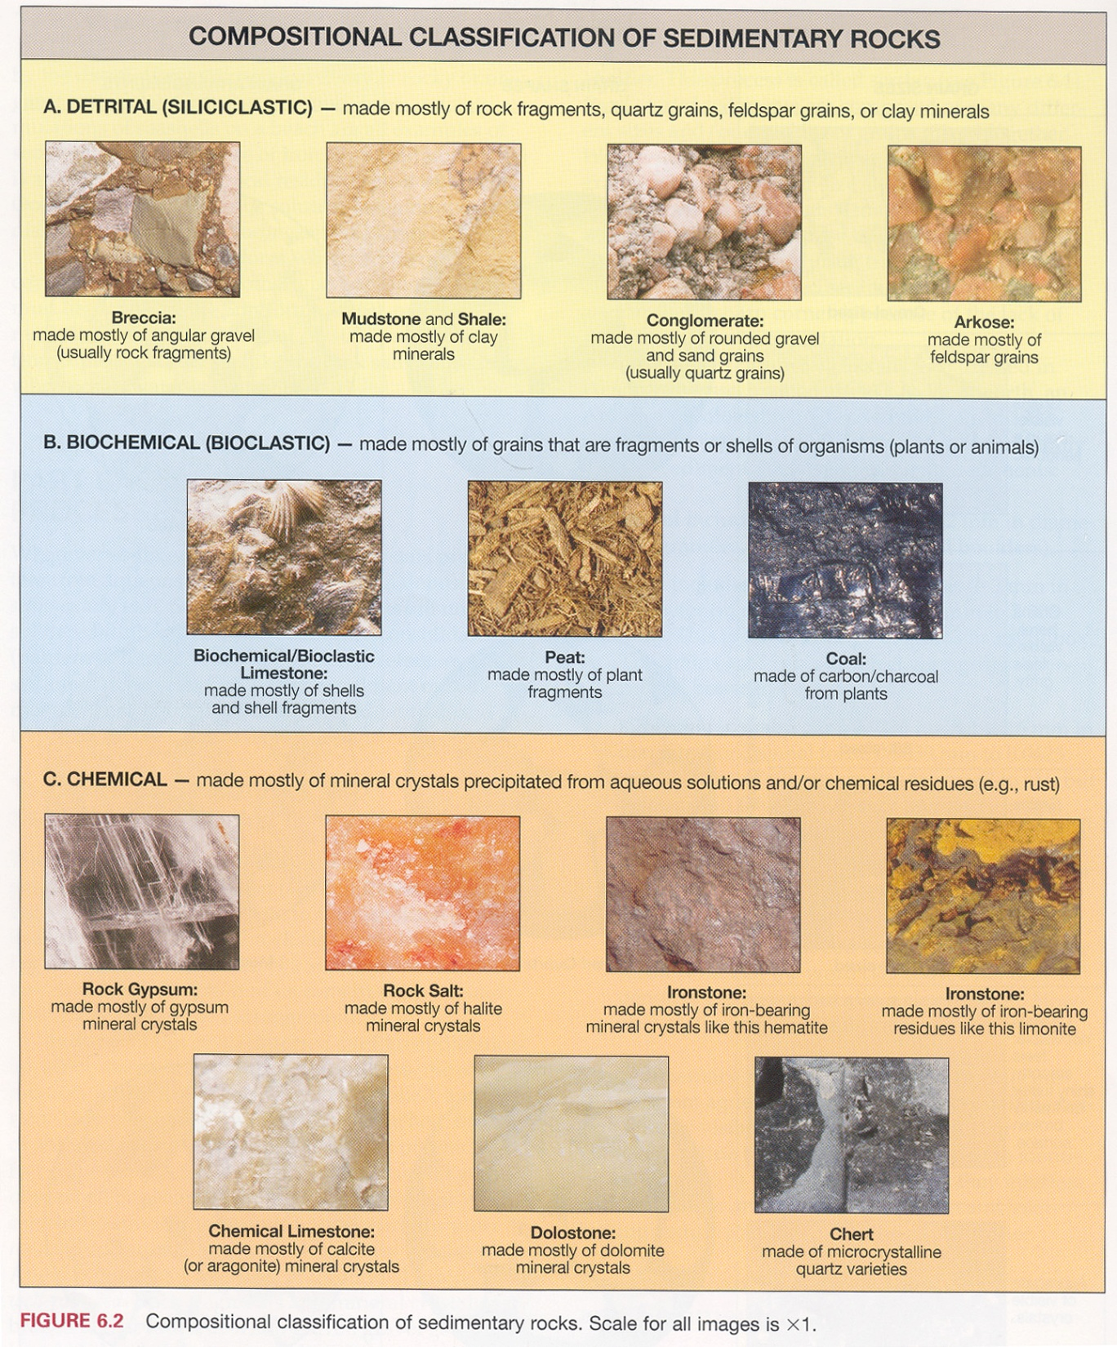

Slide 4
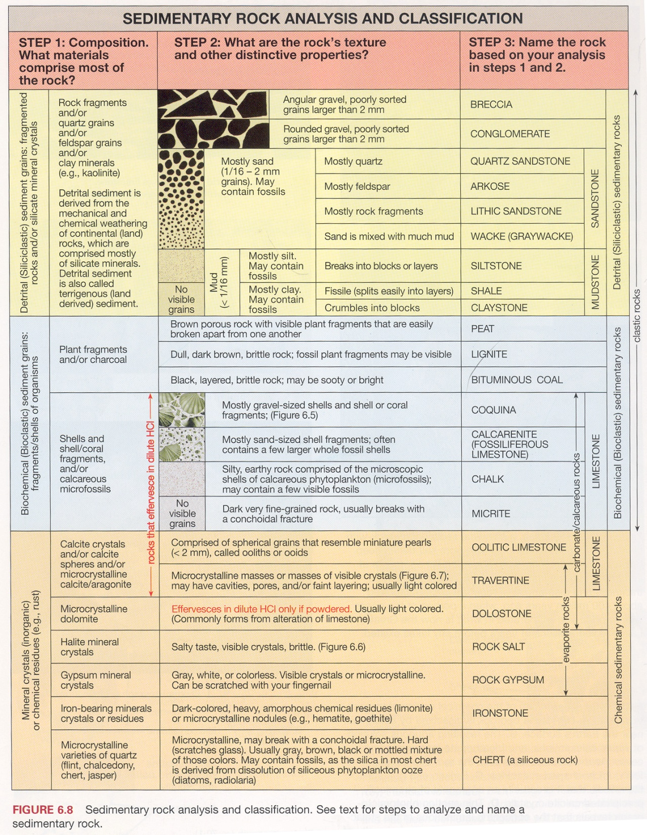

Slide 5
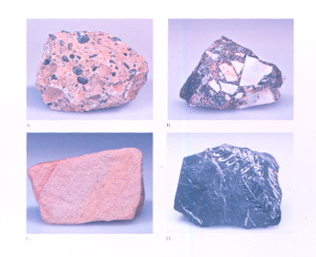

Slide 6
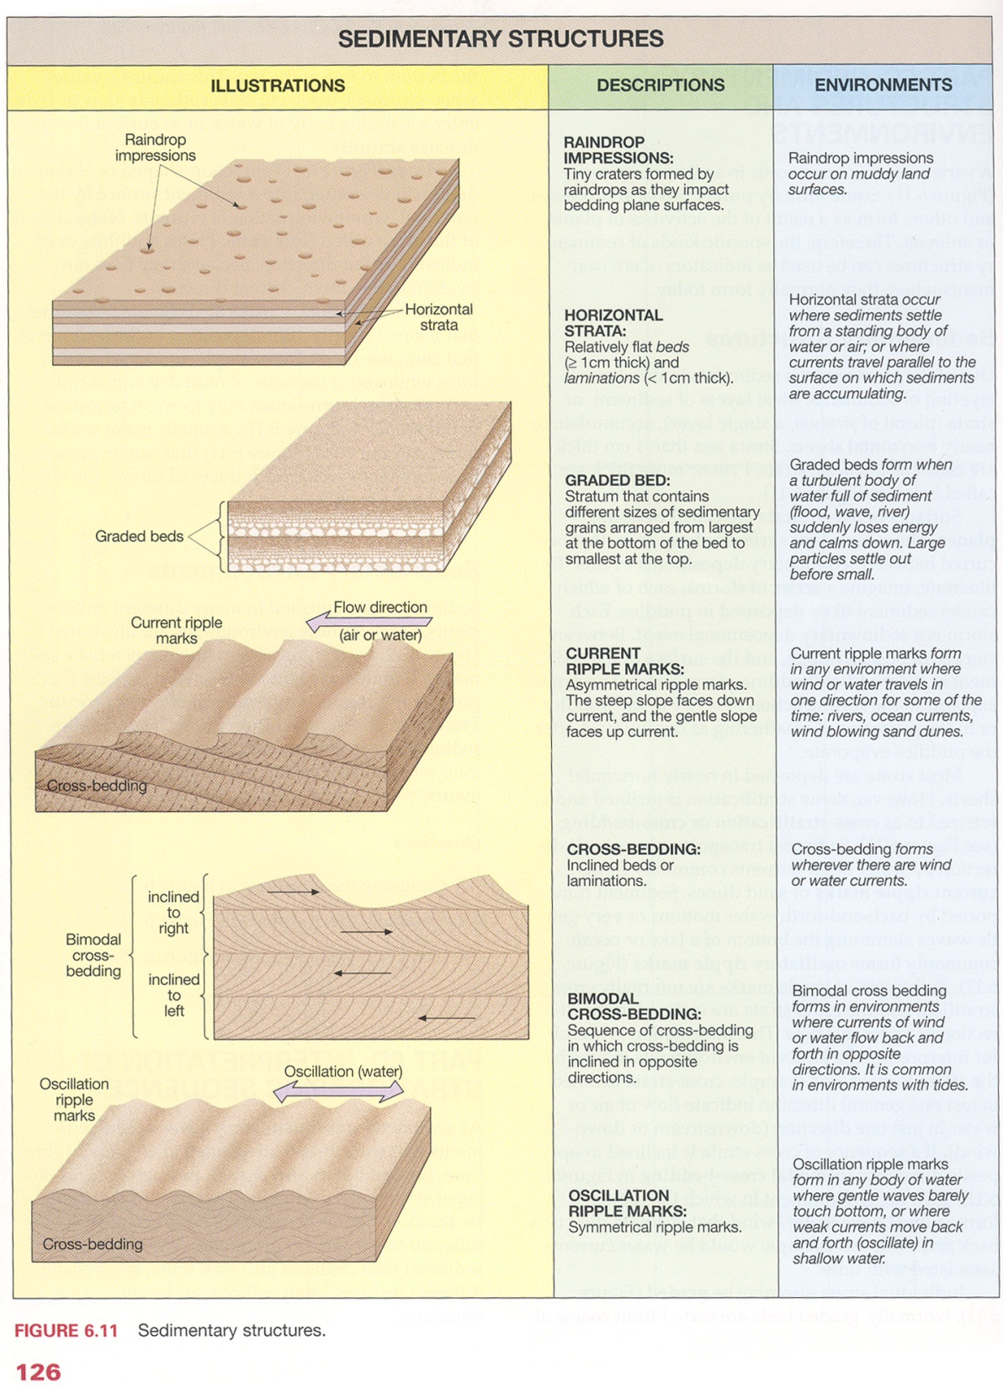

Slide 7
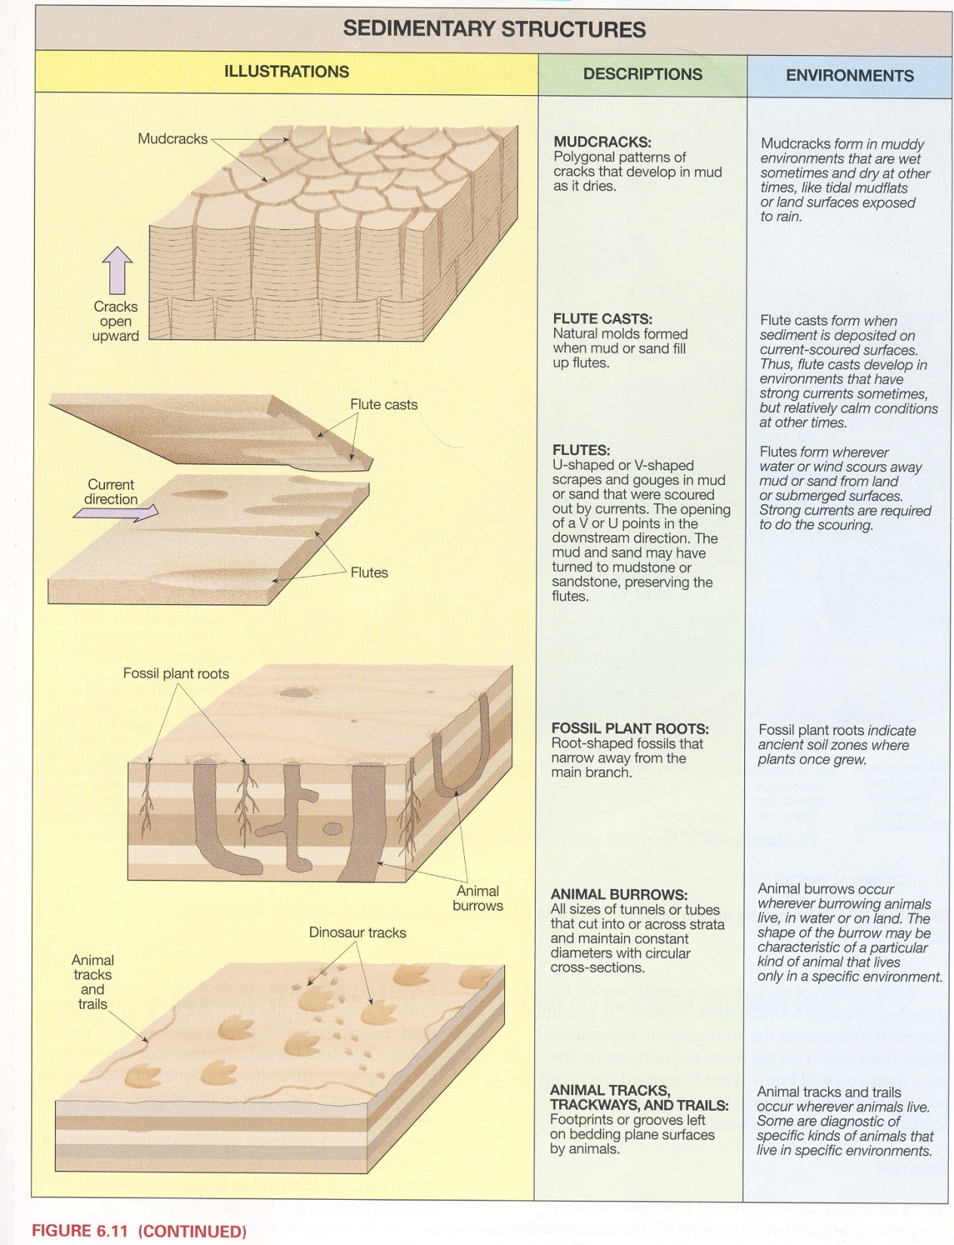

Slide 8
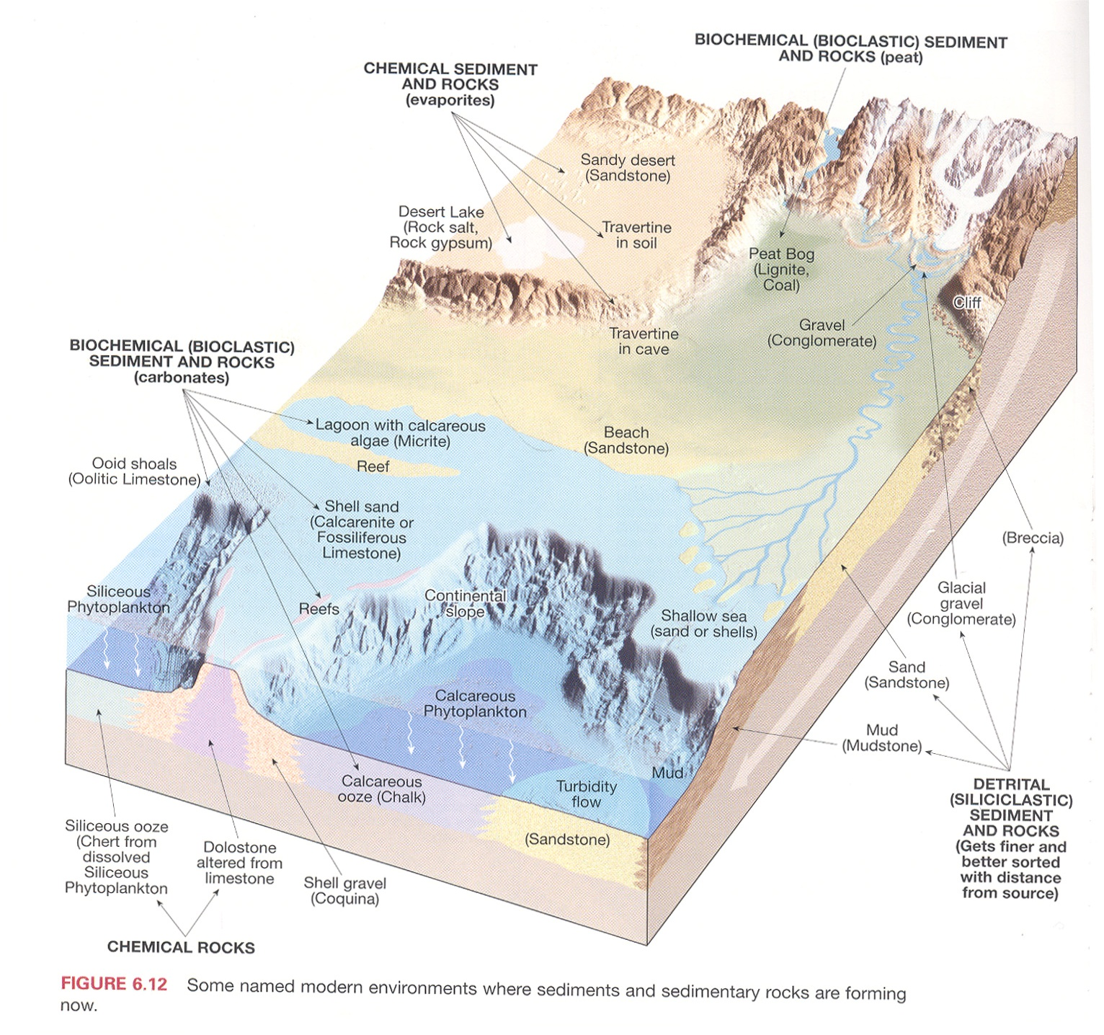

Slide 9
Relative Geologic Dating
Notes:
To view this animation, click “View” and then “Slide Show” on the top navigation bar.

Slide 10
Angular Unconformities and Nonconformities
Notes:
To view this animation, click “View” and then “Slide Show” on the top navigation bar.

