Slide 1
Earth System Science
Course Introduction

Slide 2
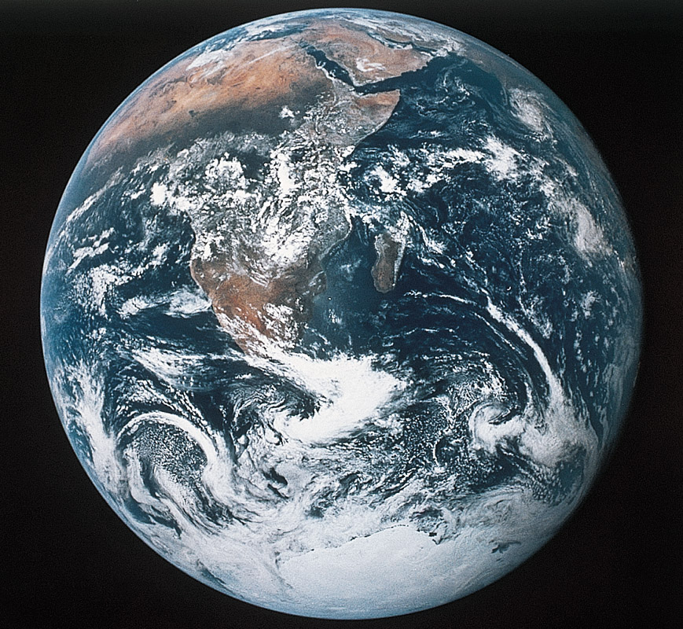
Welcome to Earth Science
Earth System Science – The study of energy, matter, and transfer processes of Planet Earth; with subdisciplines of geology, meteorology, hydrology, oceanography, and astronomy. An integrated science that dovetails with Biology and Envronmental Science.
The
Earth
Figure 1.18
Home Base Planet Earth

Slide 3
Content Topics and Learning Modules
Basics of physical science (matter, heat, energy)
Overview of Minerals-Rocks-Plate Tectonics
Sedimentary Rocks
Geologic Time and Stratigraphy
Mass Wasting and Landslides
Rivers and Fluvial Systems
Groundwater
Glaciers and Climate Change
Deserts
Coasts

Slide 4
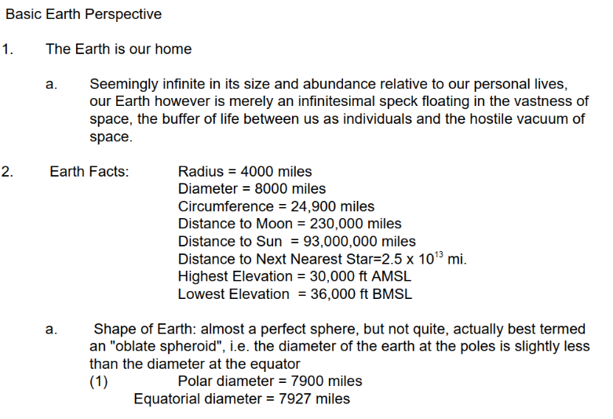
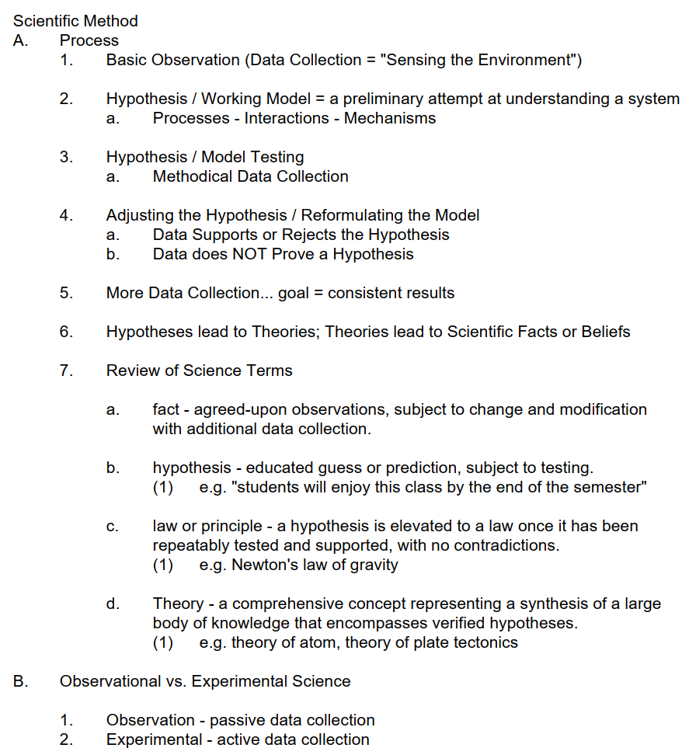
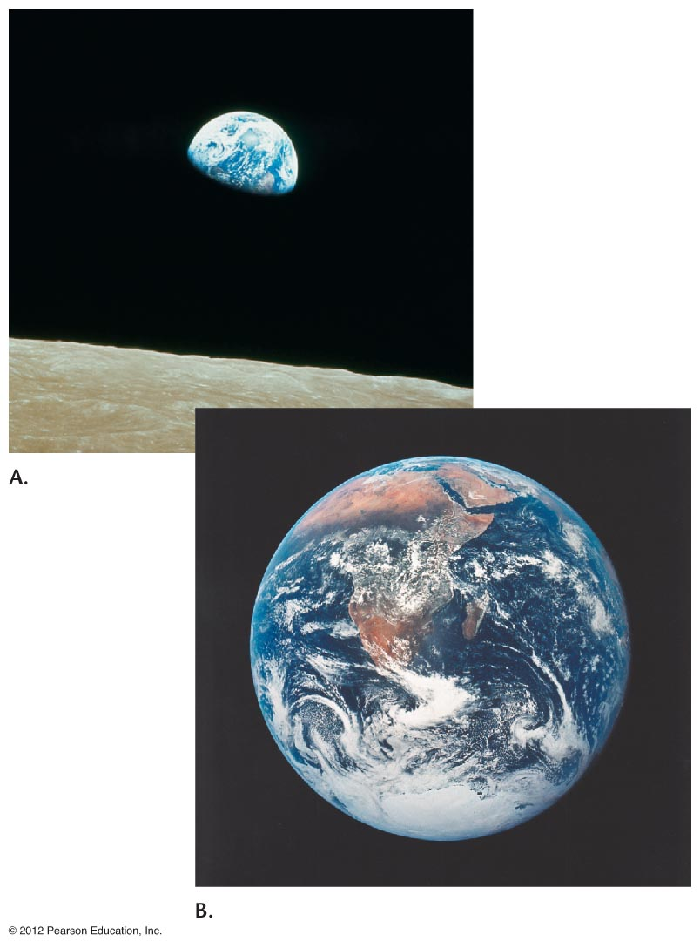
BASIC CONCEPTS

Slide 5
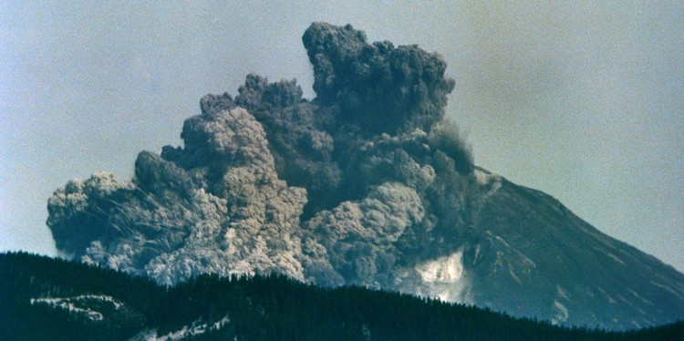
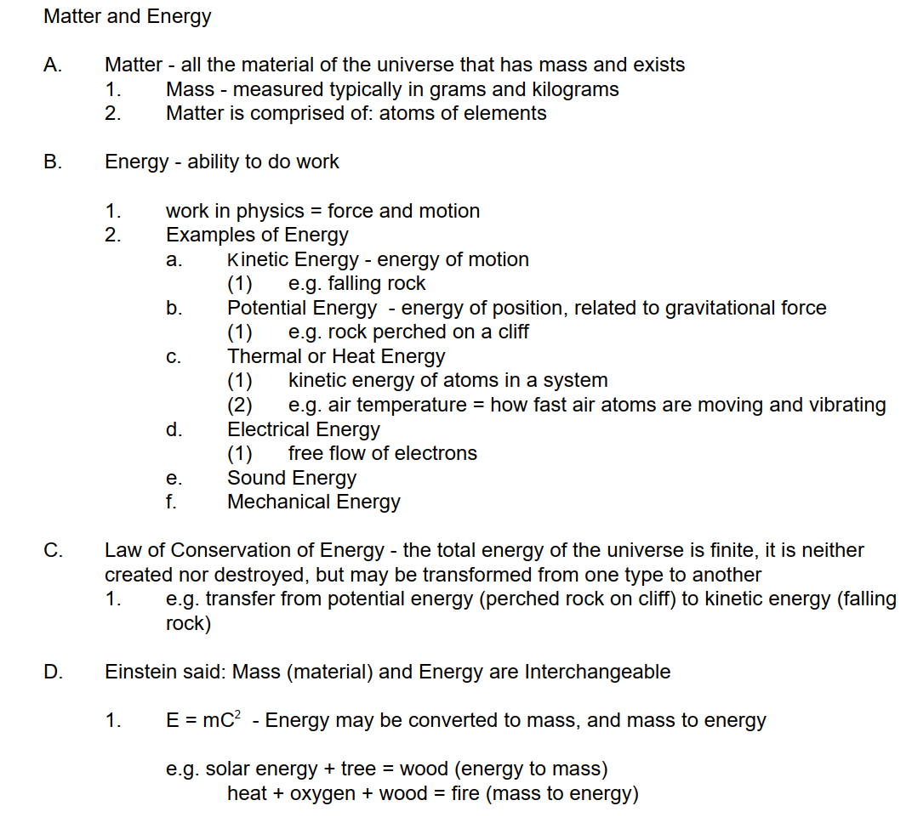
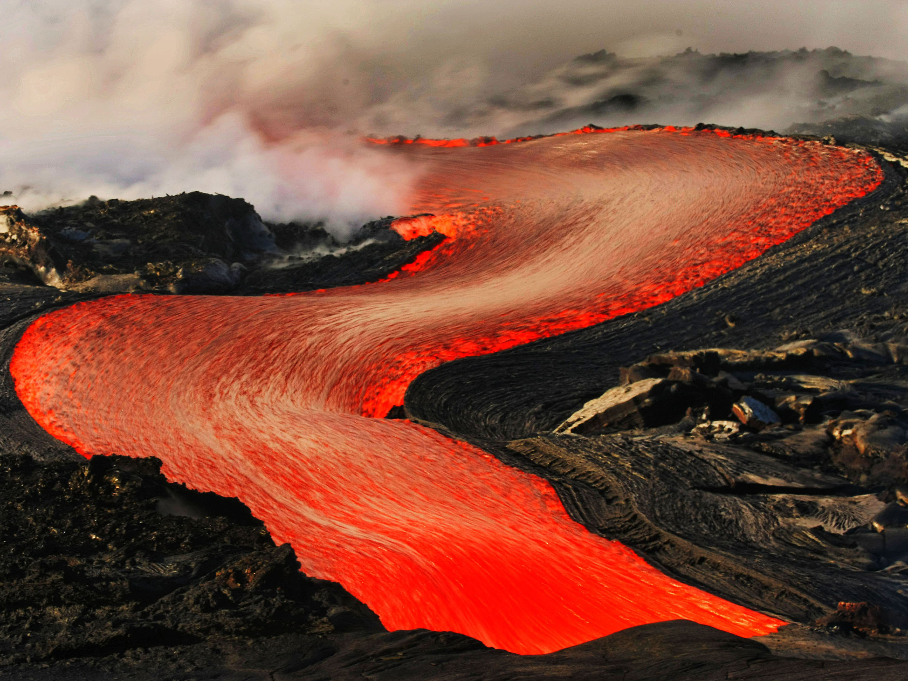
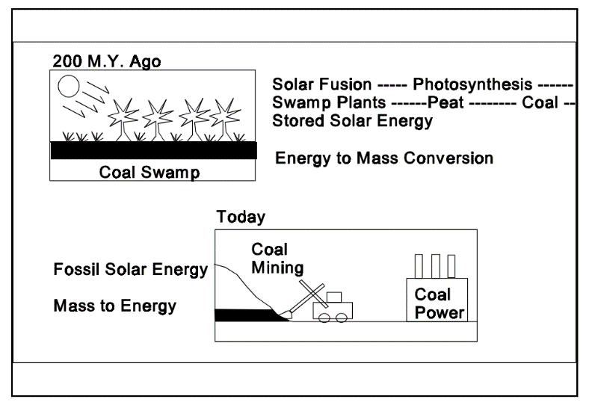
MASS AND ENERGY

Slide 6
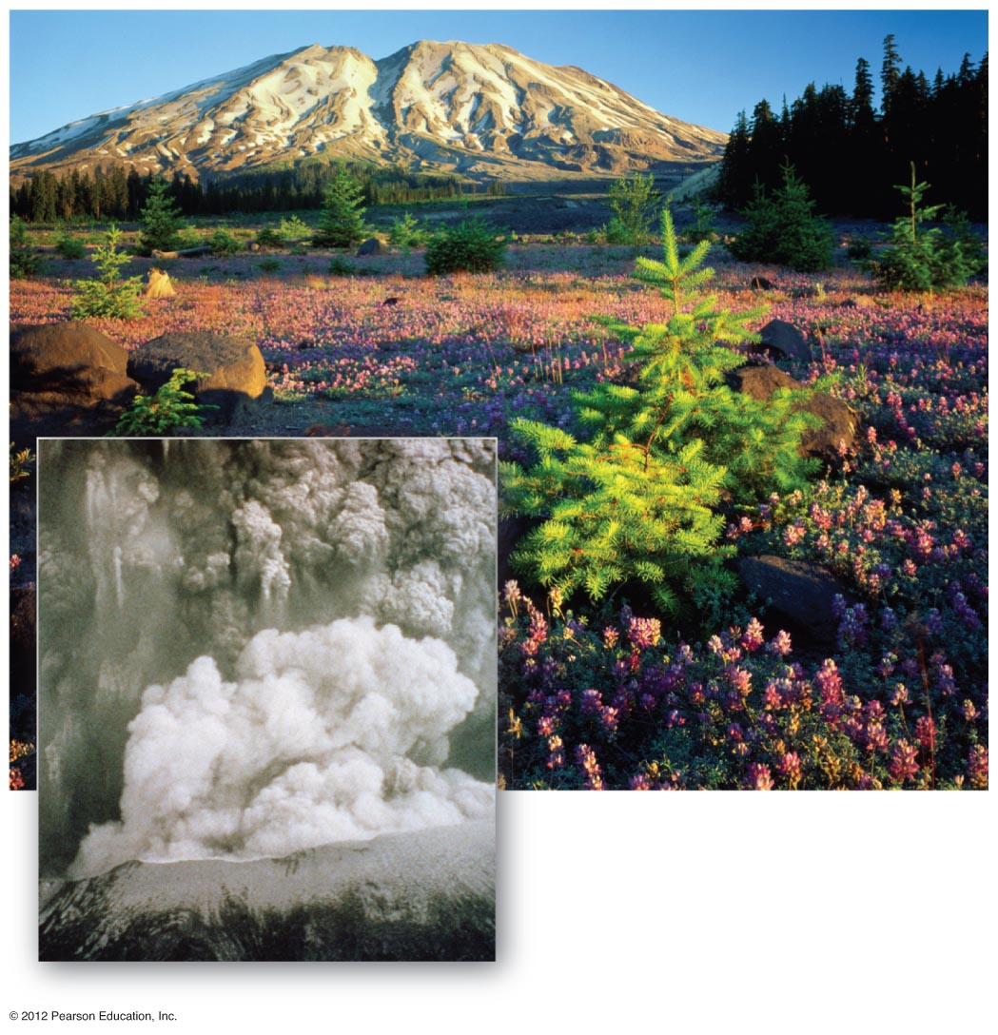
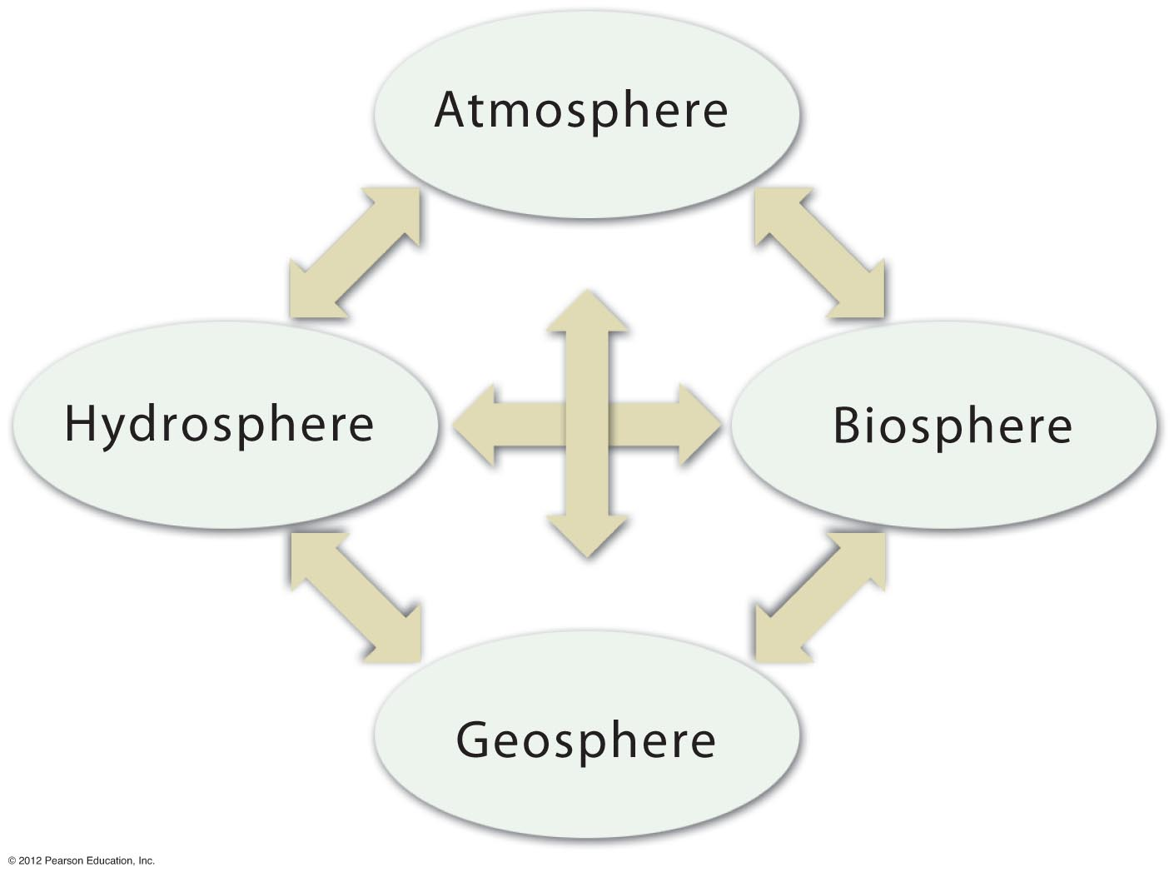
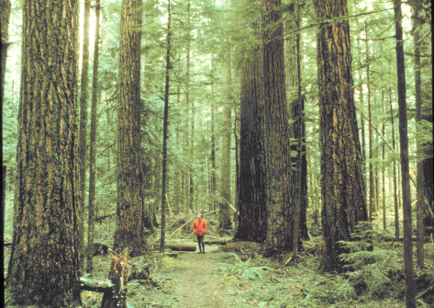
Notes:
FIGURE 1.21

Slide 7
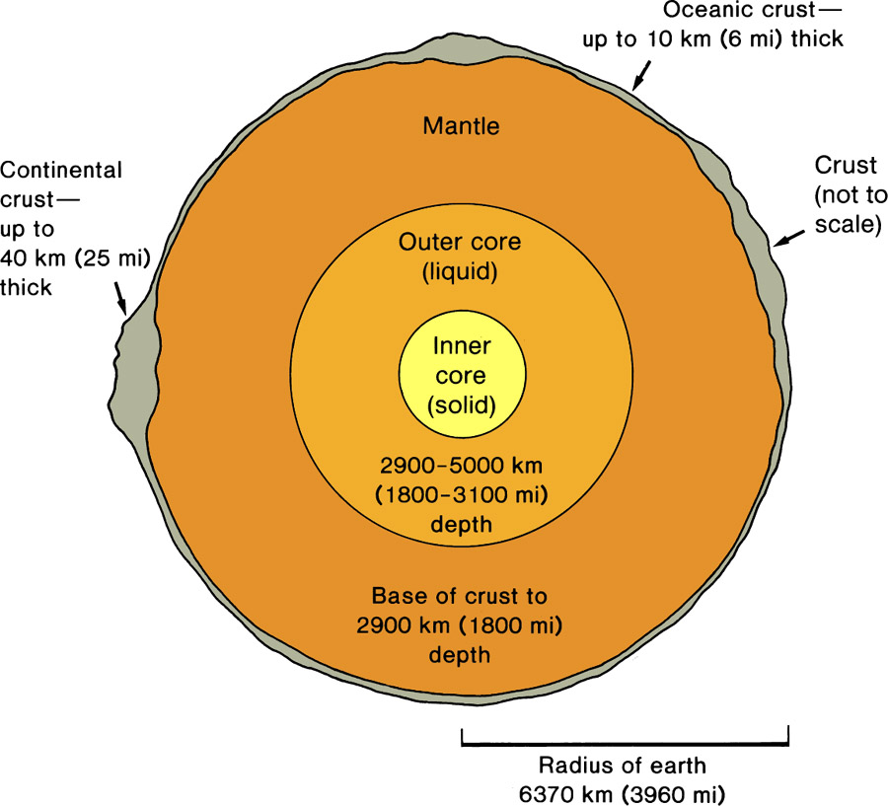
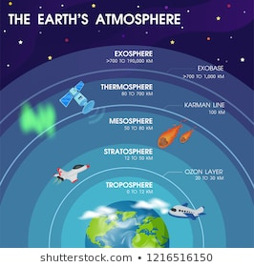
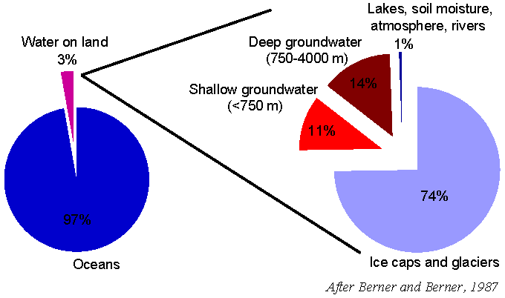
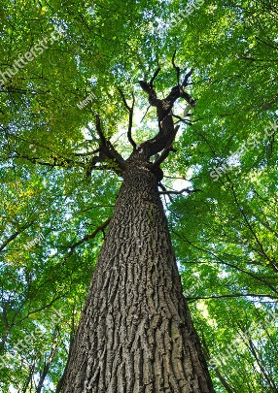
Earth System – a dynamic space ship with transfers of Mass and Energy
Four Subsystems: Geosphere (Lithosphere), Atmosphere, Hydrosphere, Biosphere
GEOSPHERE
-Solid Earth
-Near-Surface:
Minerals, Rocks
Soil
-47% Oxygen
-27% Silicon
-8% Aluminum
-18% Cations
+Others
ATMOSPHERE
-Gaseous Envelope
-78% Nitrogen
-21% Oxygen
-1% All Others
-Troposphere near
surface
HYDROSPHERE
-Water World Blue Planet
-97% H2O + dissolved ions
-Oceans
-Groundwater, Surface Water
-Glacial Ice
BIOSPHERE
-Life: Plants & Animals
-CHON – Carbon, Hydrogen,
Oxygen, Nitrogen
-Photosynthesis-Based Food
Chain
Human Habitat “Critical Zone”: surface nexus of atmosphere, hydrosphere and geosphere

Slide 8
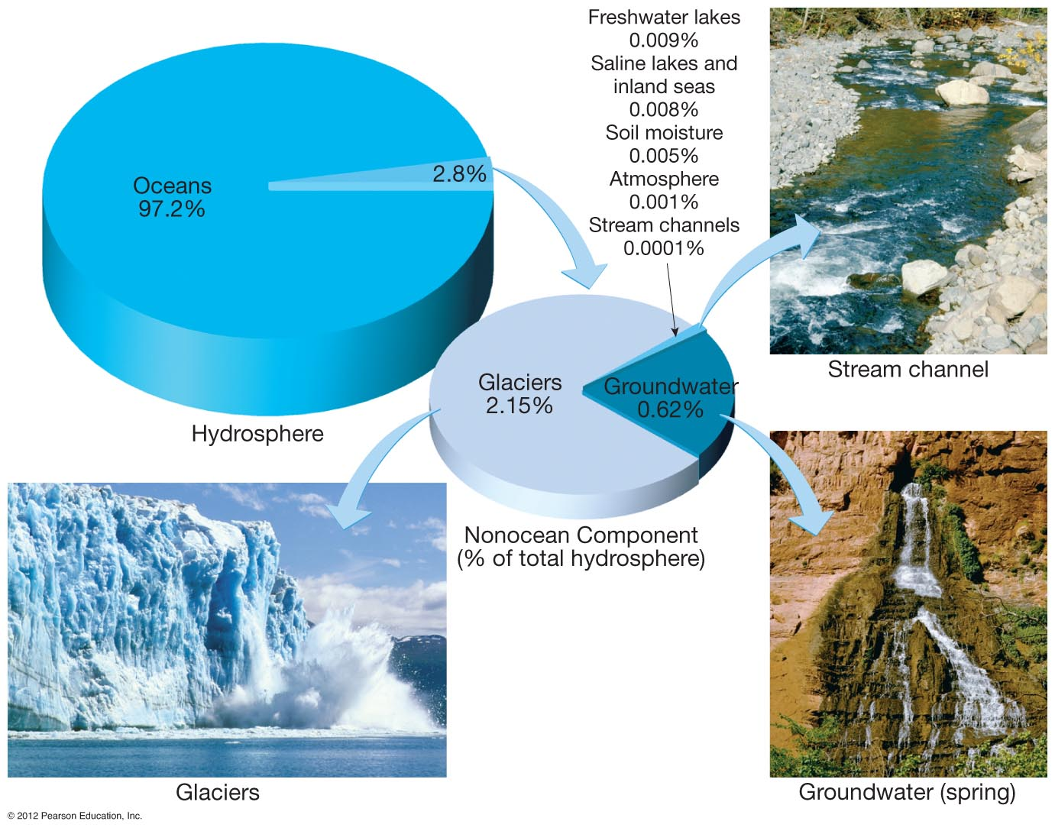
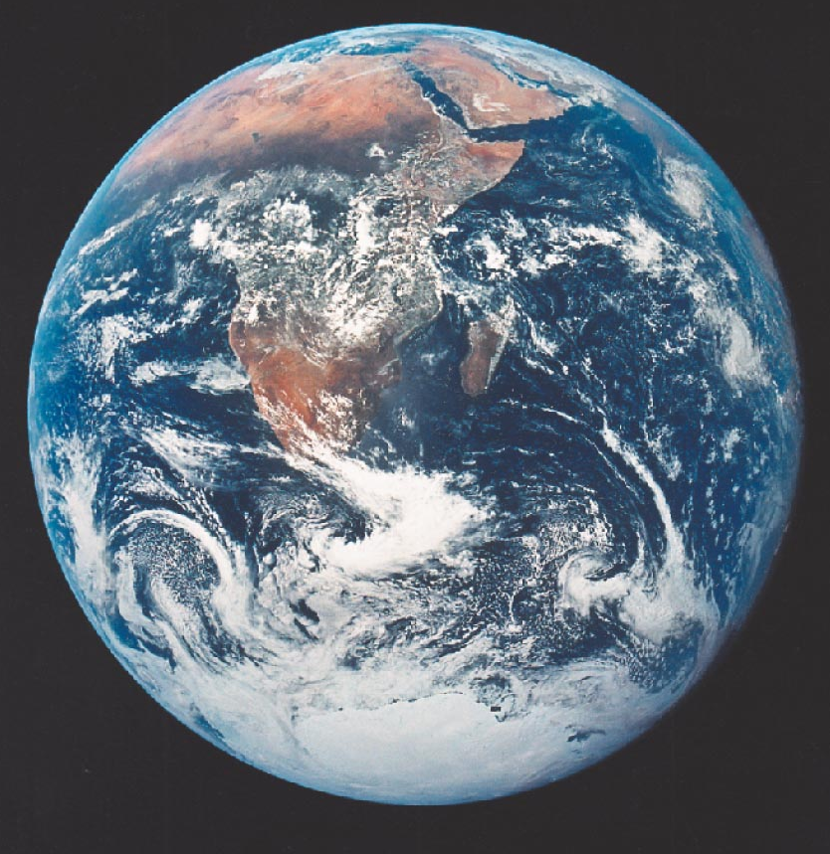
EARTH - THE “BLUE PLANET”
WATER = LIFE
Notes:
FIGURE 1.11

Slide 9
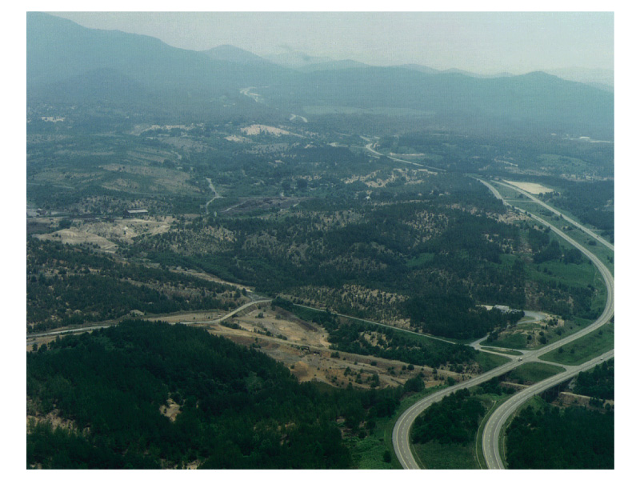
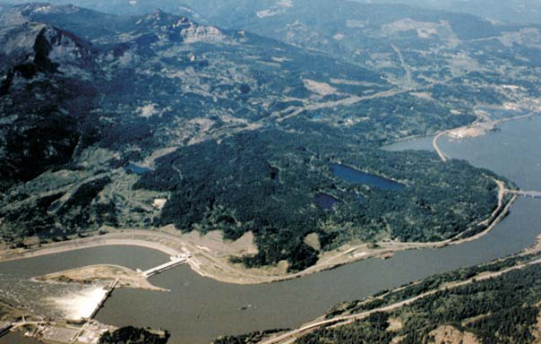
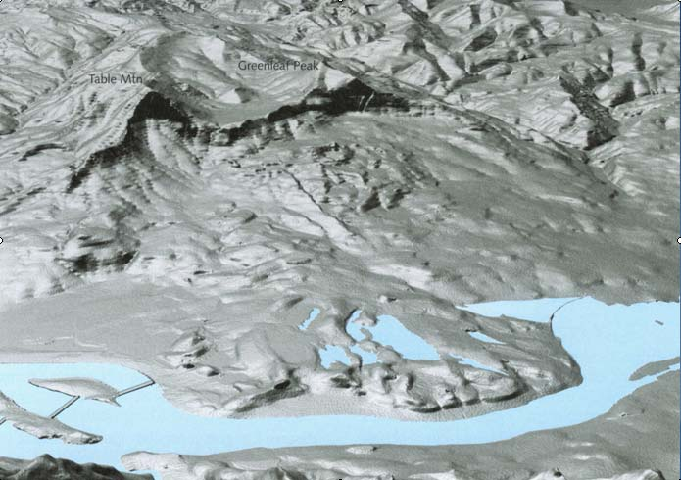
Earth System – Fundamental Driving Energy Sources: Geothermal, Solar, Gravity

Slide 10
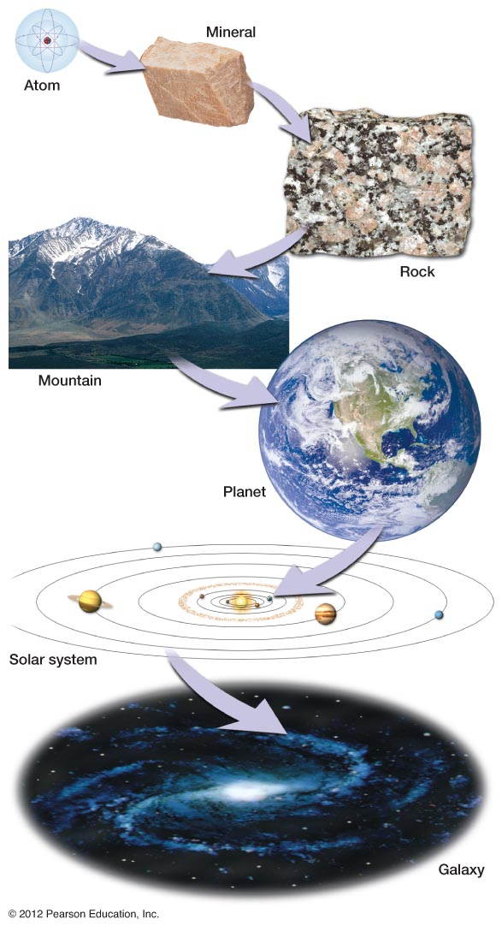
SPATIAL SCALING: The Earth in Context
Atomic = 10⁻¹⁰ meters
Rock Outcrop = 10² meters
Mountain Range = 10⁵ meters
Planet Earth 10⁷ = meters
Solar System 10¹² = meters
Milky Way Galaxy = 10²¹ meters
Notes:
FIGURE 1.6

Slide 11
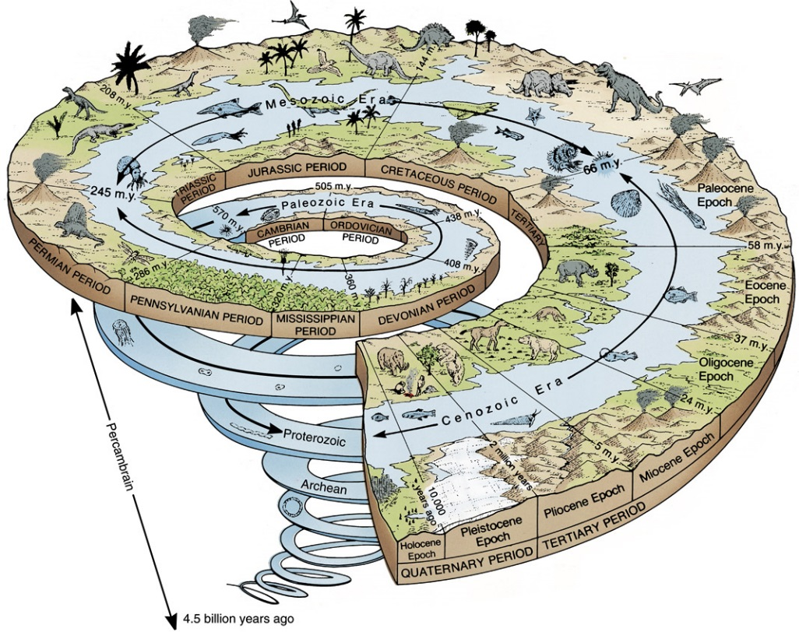
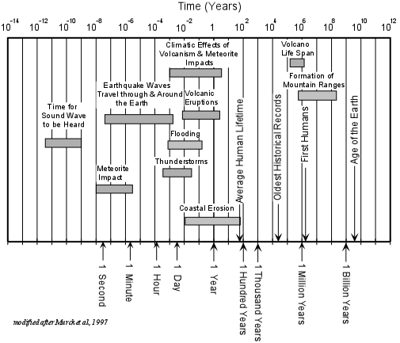
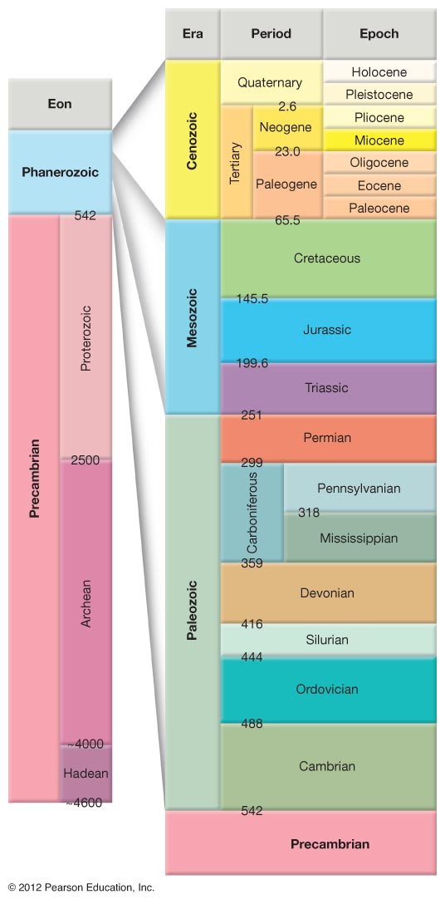
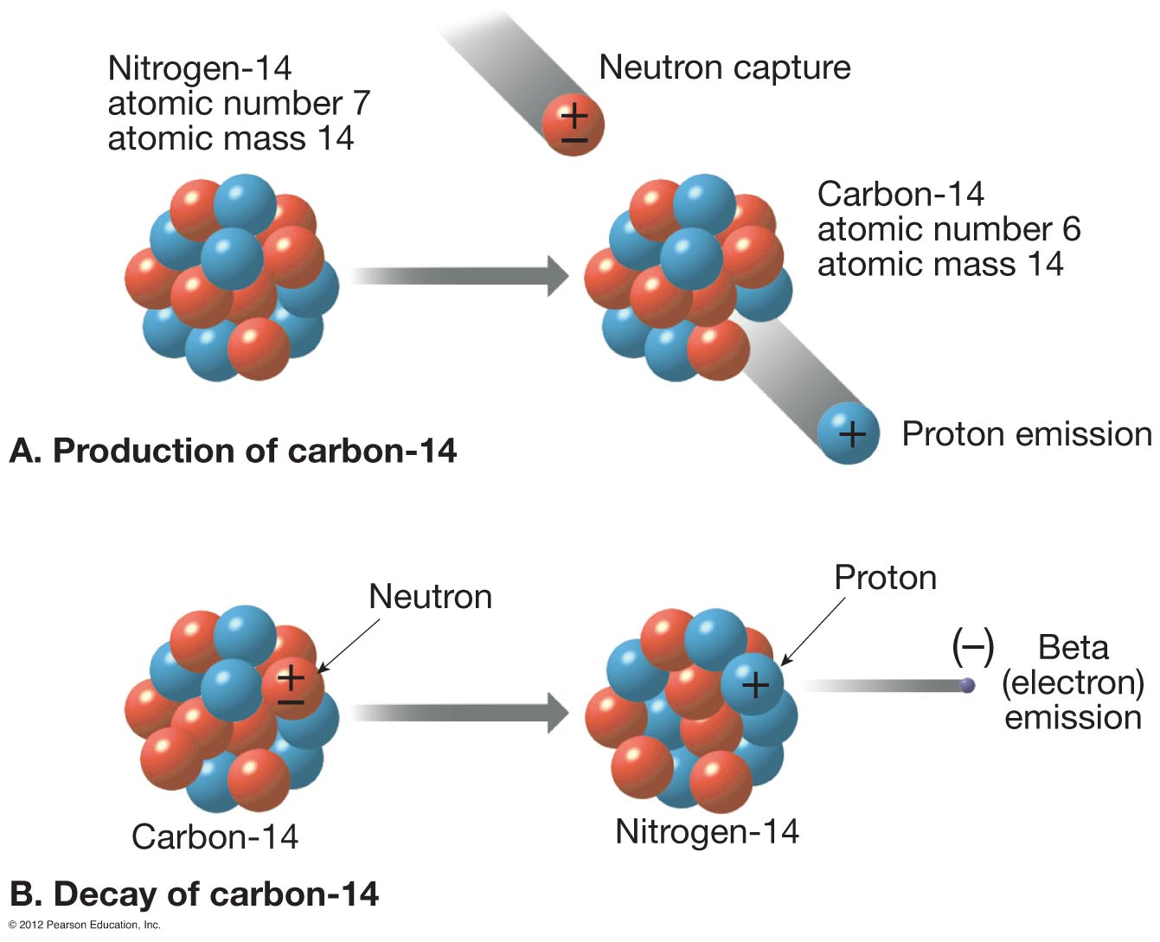
Earth Processes and Deep Geologic Time

Slide 12
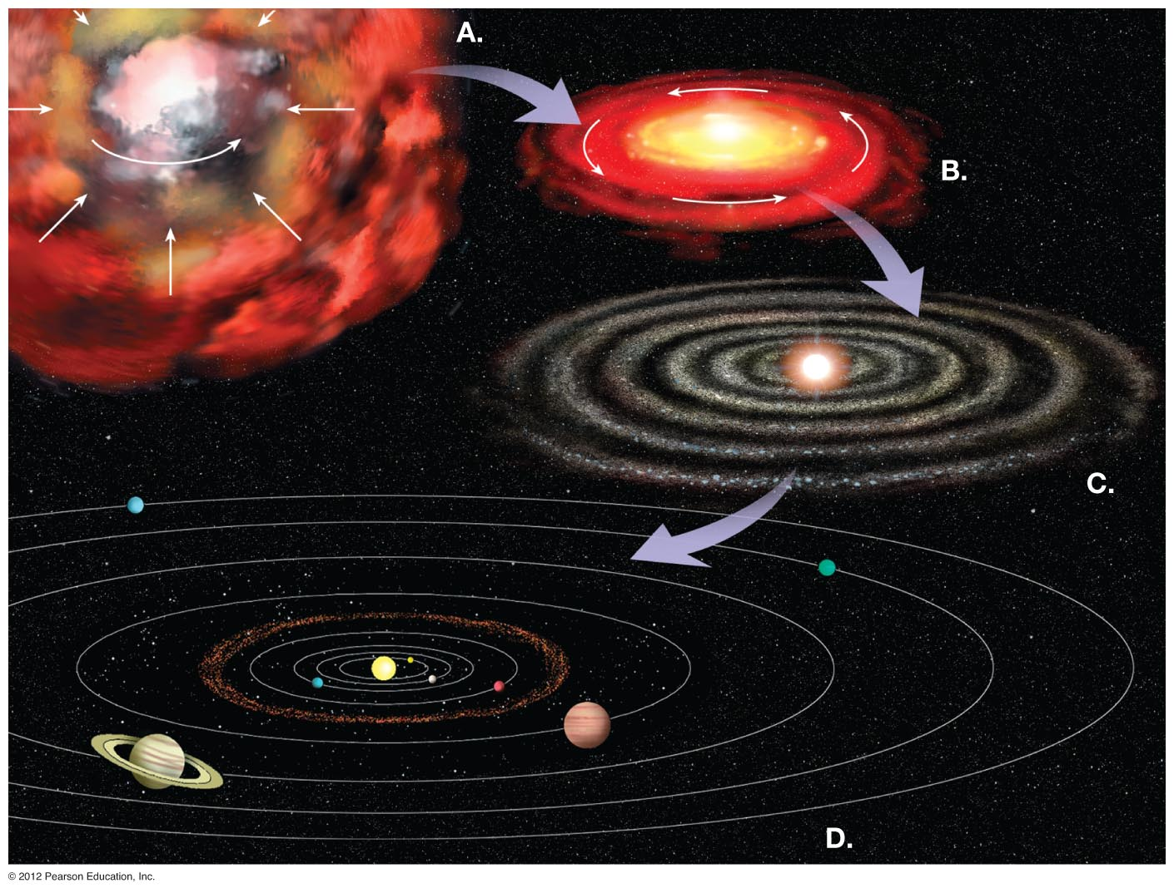
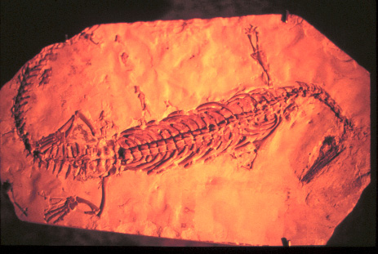
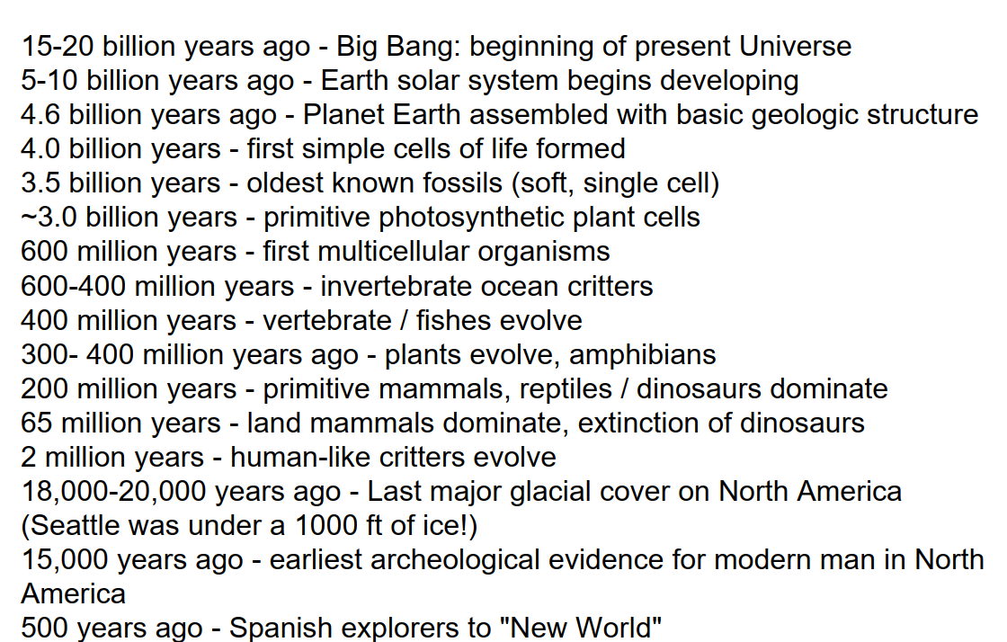
A Brief History of the Universe and Planet Earth:
Notes:
FIGURE 1.8

Slide 13
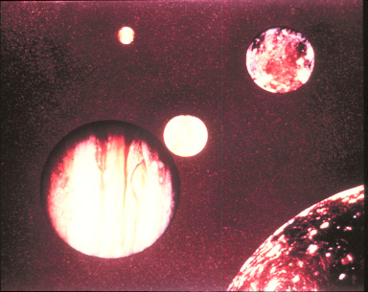
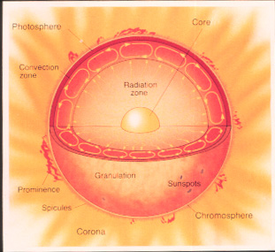
Sun and the Solar System

Slide 14
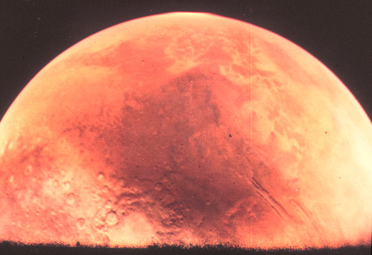
Planetary Geology – The Earth in Contrast

Slide 15
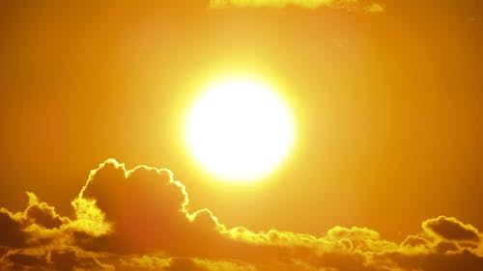
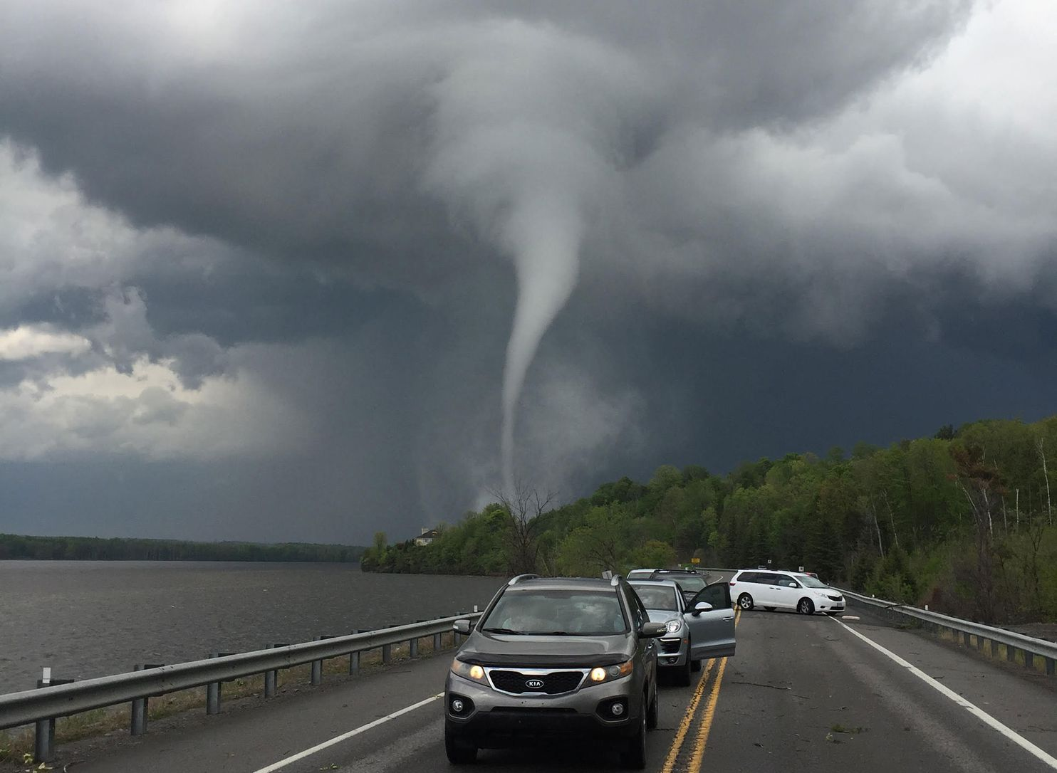
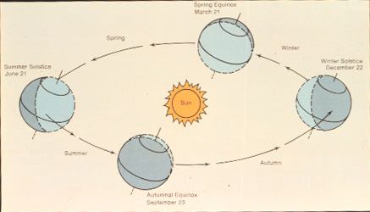
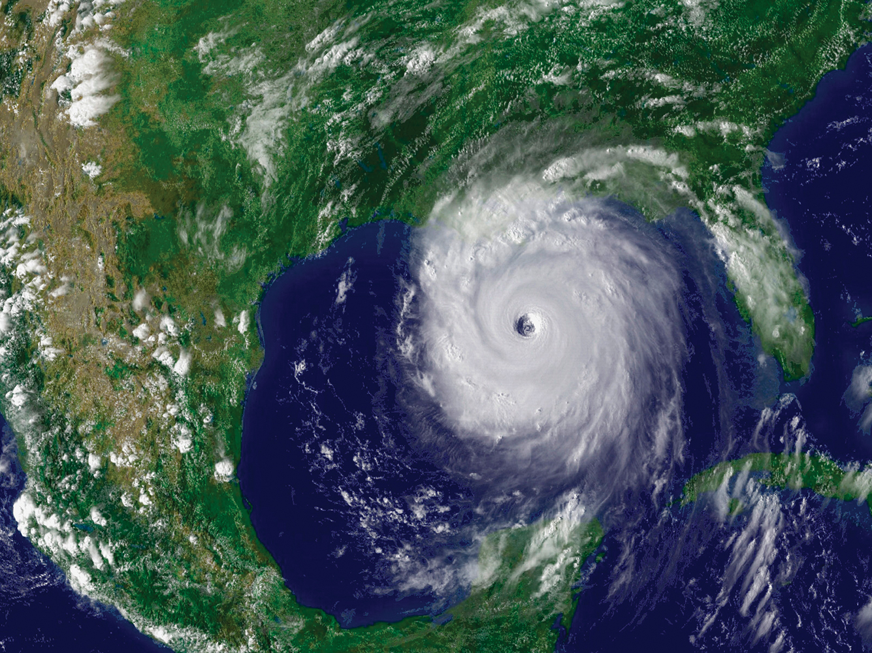
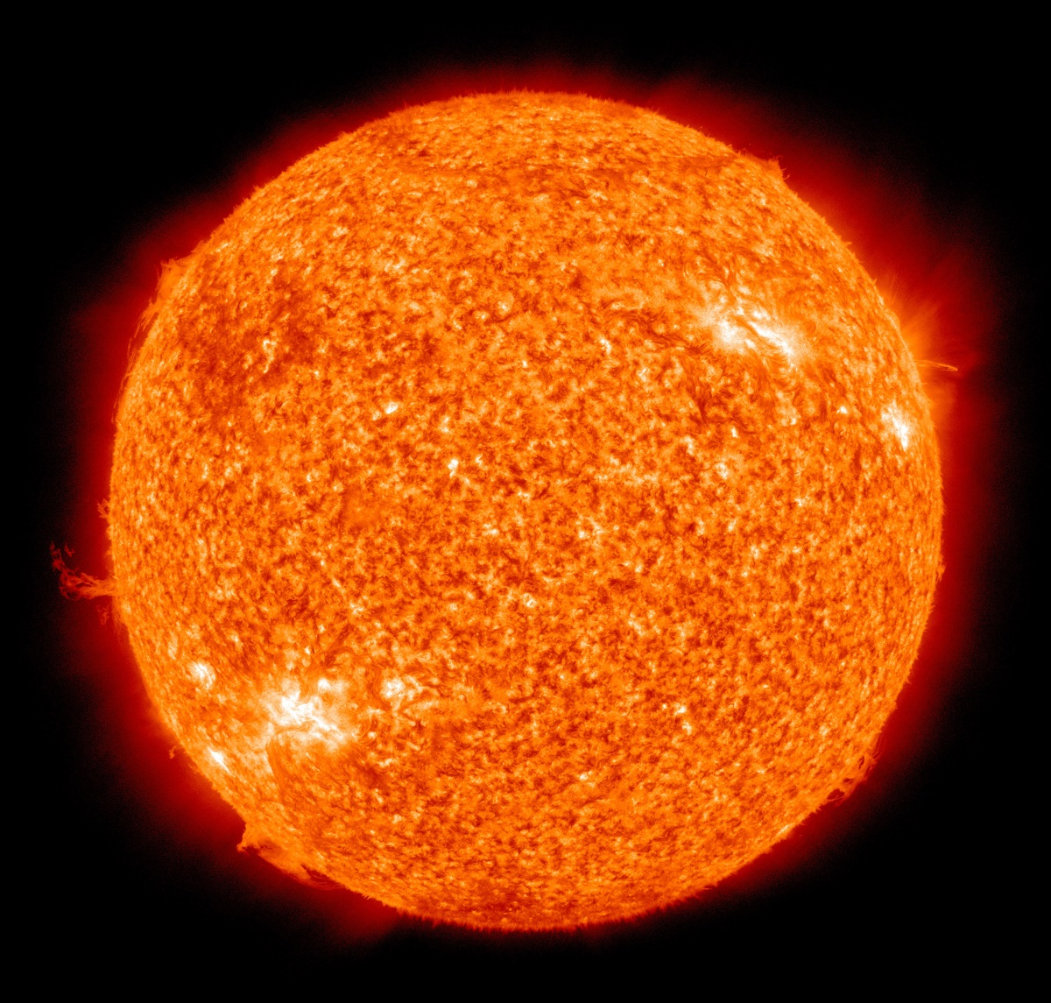
The Sun Star: Earth’s External Energy Source
Solar Heat Engine for Ocean and Atmosphere; Energy for Life

Slide 16
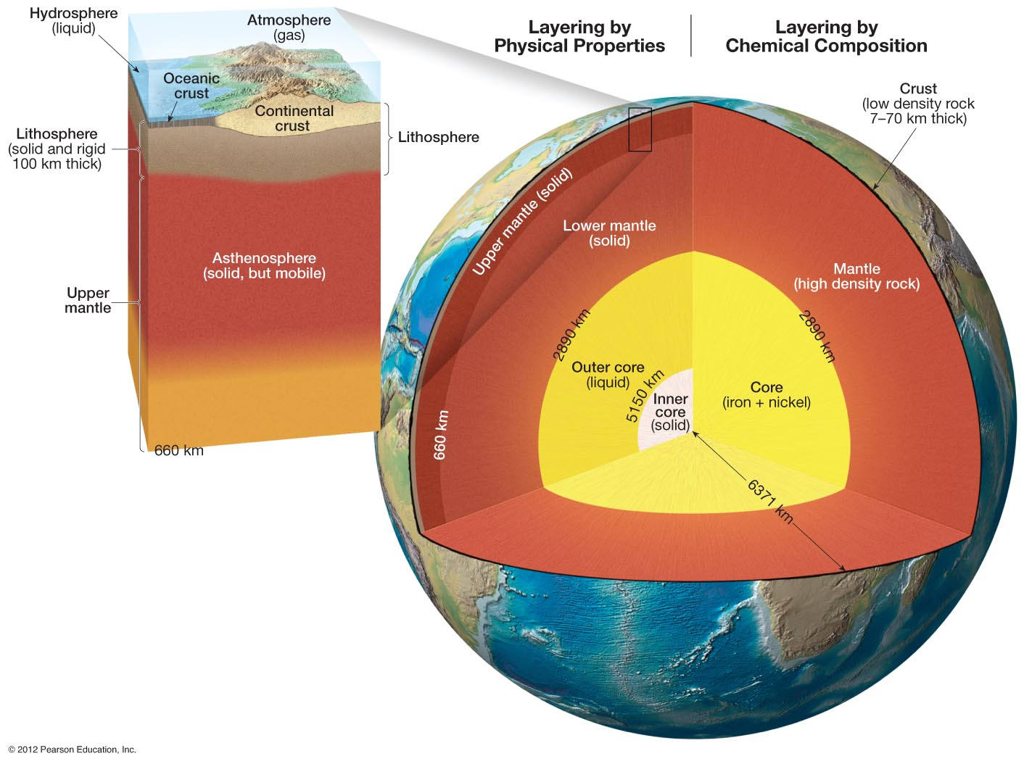
GEOSPHERE
Notes:
FIGURE 1.14

Slide 17
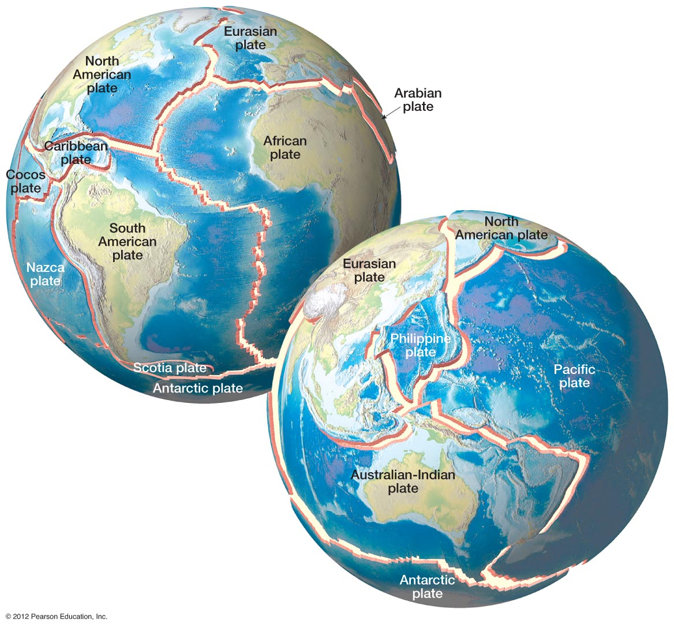
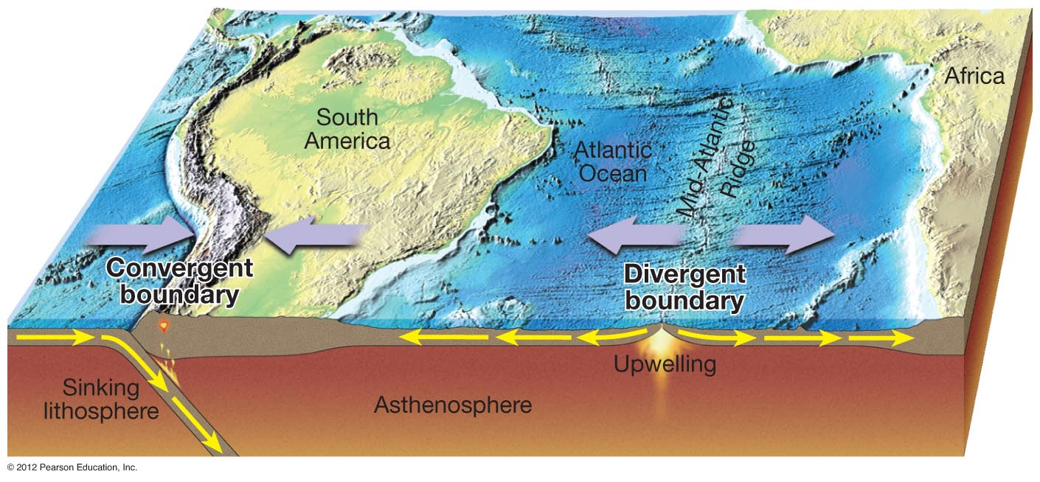
Geothermal Heat Energy
Transforms to Mechanical
Energy via Mantle Convection
Plate Tectonics: Geothermal Energy in Action
Notes:
FIGURE 1.16

Slide 18
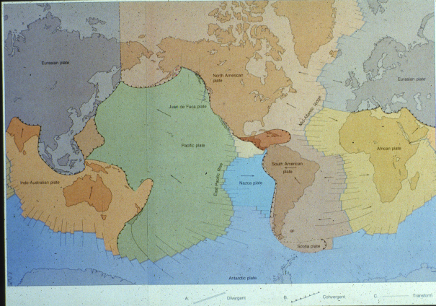
Plate Tectonics: Geothermal Energy in Action

Slide 19
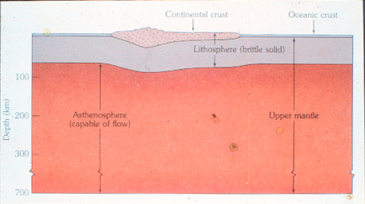
Anatomy of a Tectonic Plate

Slide 20
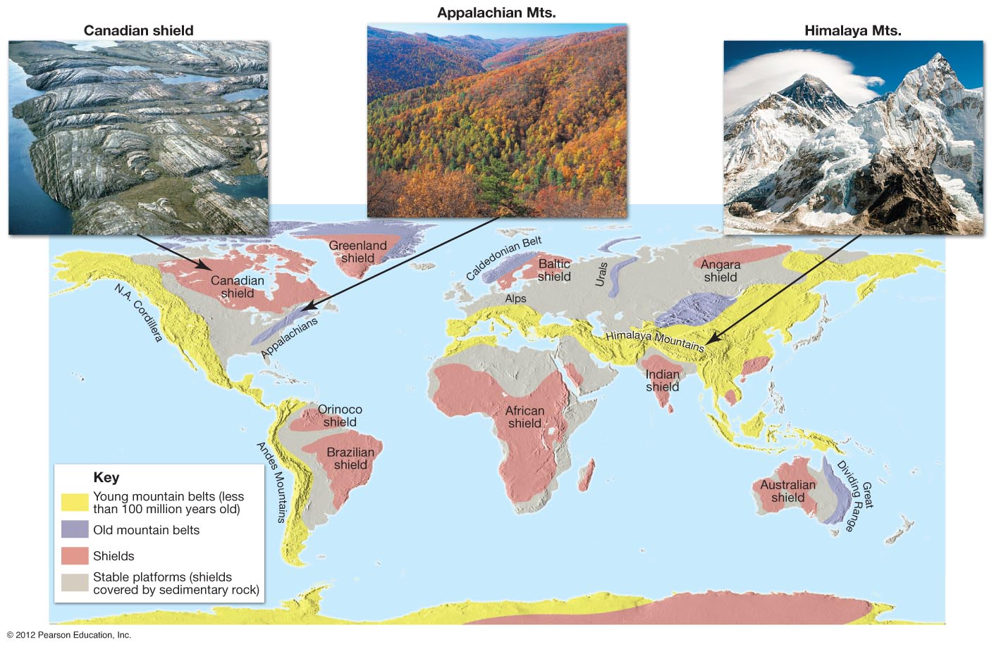
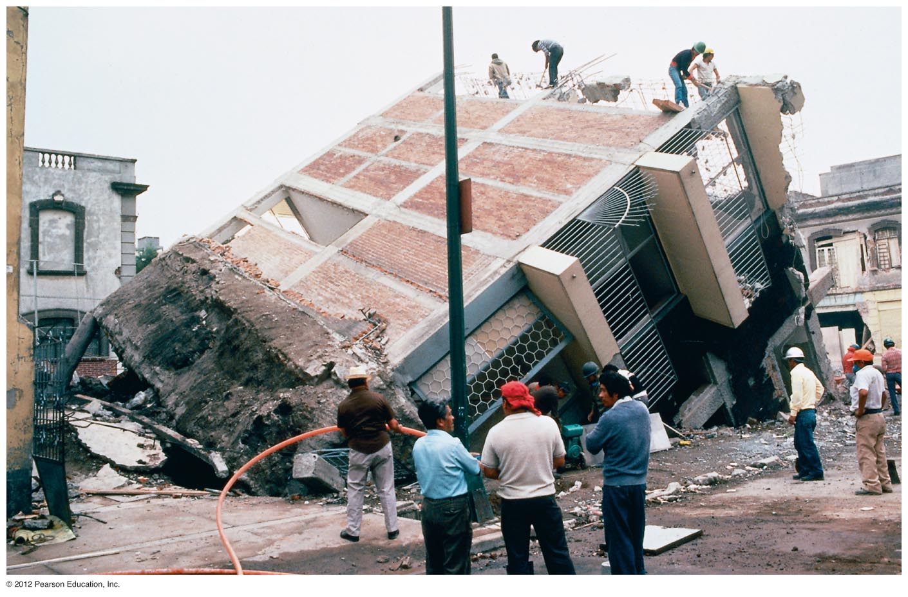
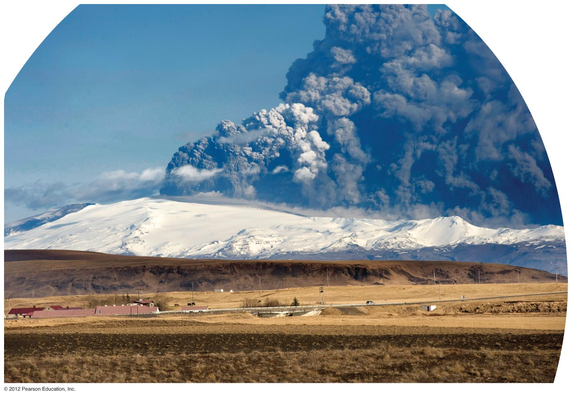
Plate Dynamics: Mountain Building-Volcanism-Earthquakes
Notes:
FIGURE 1.19

Slide 21
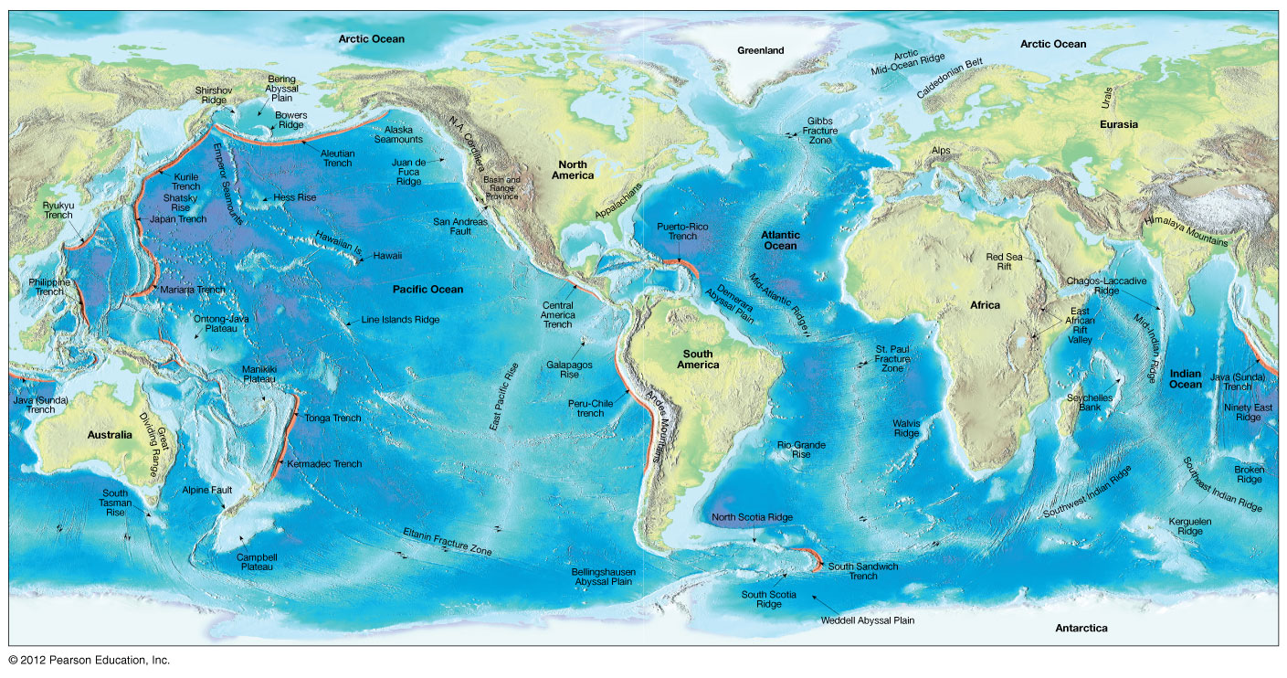
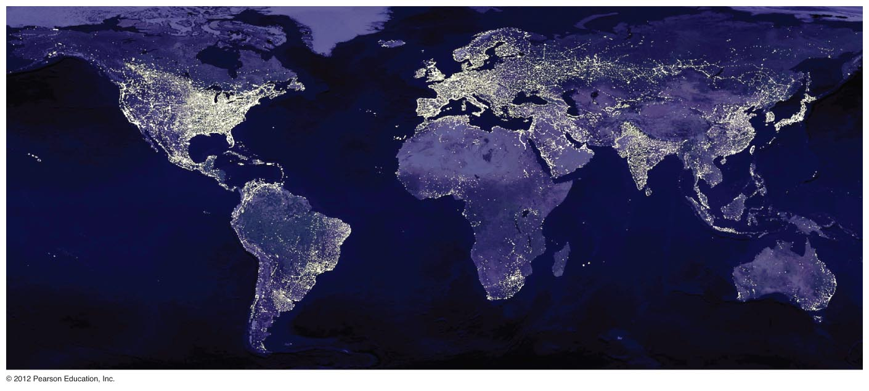
Plate Dynamics: Present-Day Global Geography
Notes:
FIGURE 1.18

Slide 22
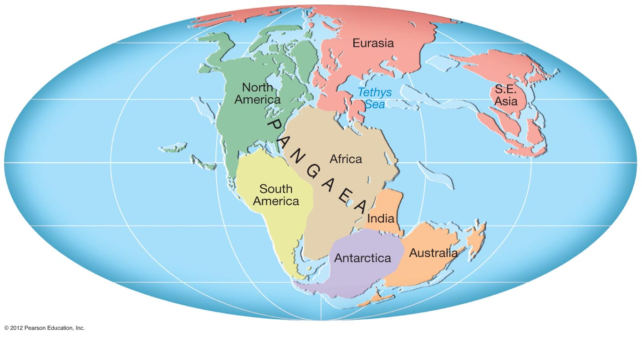
Plate Dynamics 200 m.y. Ago: Ancient Global Paleogeography
Tethys Ocean
Tethys Ocean
Notes:
FIGURE 1.15

Slide 23
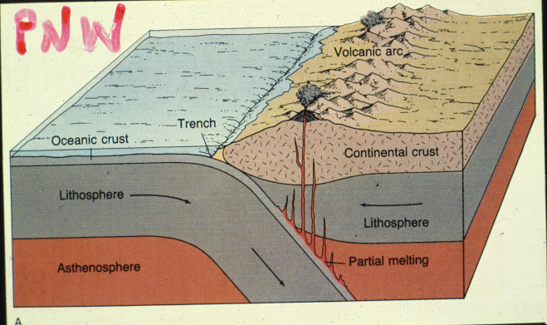
CASCADIA SUBDUCTION ZONE

Slide 24
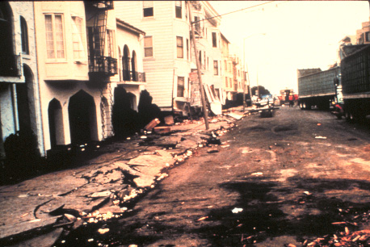
EARTHQUAKES AND SEISMIC SHAKING

Slide 25
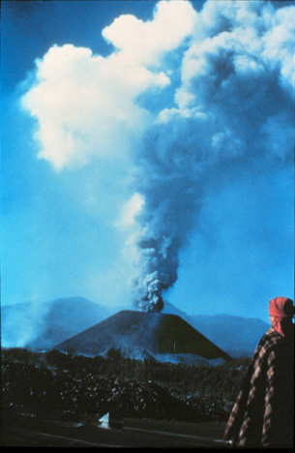

VOLCANISM (MR. SPOCK THE ANCIENT PROPHET)
Notes:
FIGURE 1.21

Slide 26



SEDIMENTARY ROCKS AND ROCK RECORD OF TIME

Slide 27




WEATHERING, SOILS AND EROSION
Notes:
FIGURE 1.21

Slide 28


MASS WASTING AND LANDSLIDES
Notes:
FIGURE 1.21

Slide 29

RIVERS AND FLUVIAL PROCESSES
Notes:
FIGURE 1.21

Slide 30



GROUNDWATER
Notes:
FIGURE 1.21

Slide 31

GLACIERS
Notes:
FIGURE 1.21

Slide 32


DESERTS
Notes:
FIGURE 1.21

Slide 33

COASTS
Notes:
FIGURE 1.21

Slide 34



EARTH RESOURCES AND
HUMAN SYSTEMS

