Slide 1
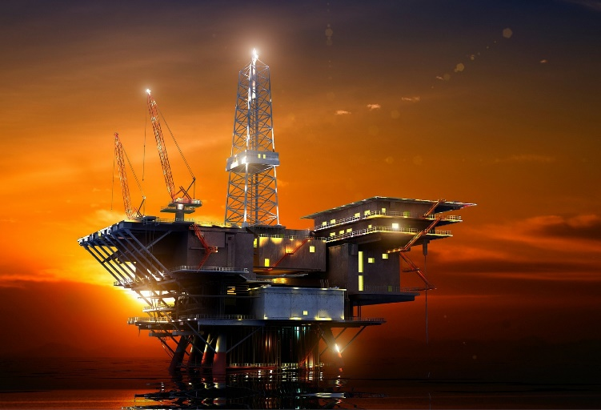
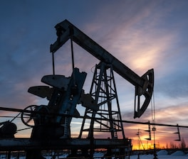
INTRODUCTION TO PETROLEUM GEOLOGY
Application of Geoscience to the exploration and development of oil and natural gas
Oil and Gas = Naturally Occurring Hydrocarbon compounds derived from biogenic sediment
Hydrocarbon fossil fuels are associated with ancient sedimentary environments and sedimentary rocks

Slide 4
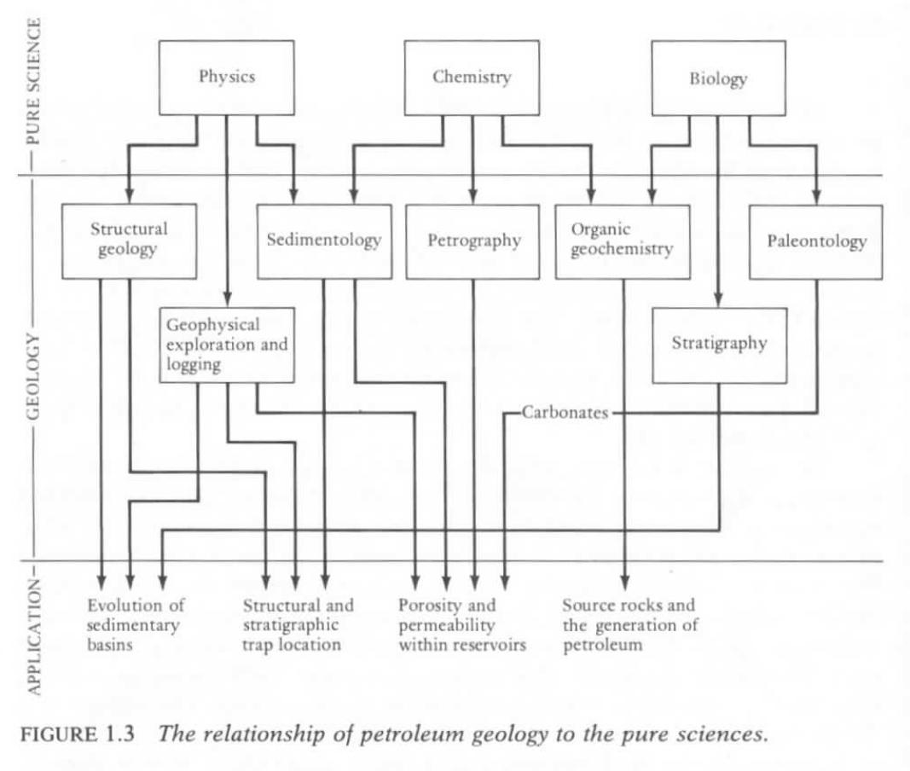

Slide 5
Organic Sediment: Marine vs. Non-Marine
Bitumen – soluble organic matter
Kerogen – insoluble organic matter
Marine Organics: algal, soft parts, petroleum generation
Terrestrial Organics: woody plants, gas generation
Mixed Marine-Terrestrial: waxy oil-gas mix
Conditions for petroleum accumulation:
Organic source rock
Sediment burial and thermal maturation (heating over time)
Permeable and Porous reservoir rock to store fluids
Cap rock or impermeable seal to contain buoyant fluids
Favorable geometric arrangement between reservoir and seal

Slide 6
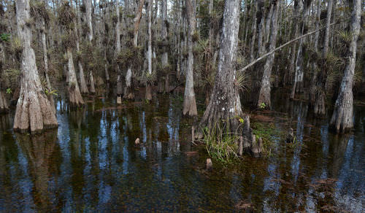
Terrestrial Environments
Fossil Fuels:
-Preserved Organic Carbon
-Ancient Fossil Life
-Sedimentary Rock Record
Marine Environments

Slide 7
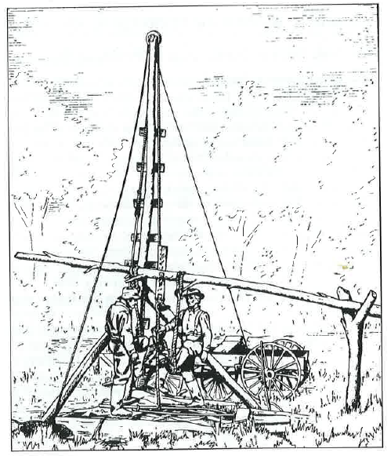
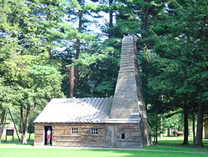
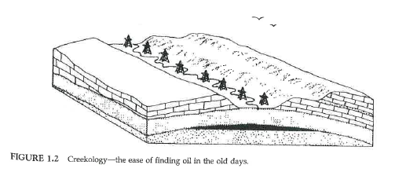
Historical Perspectives
1859 “Drakes Well” Titusville, Pennsylvania
Cable Tool Drilling
“Venango Sands Reservoir”
Greeks & Europeans through 17th century; petroleum collections at seeps and springs
Early exploration method: drill the creeks and anticlines

Slide 8
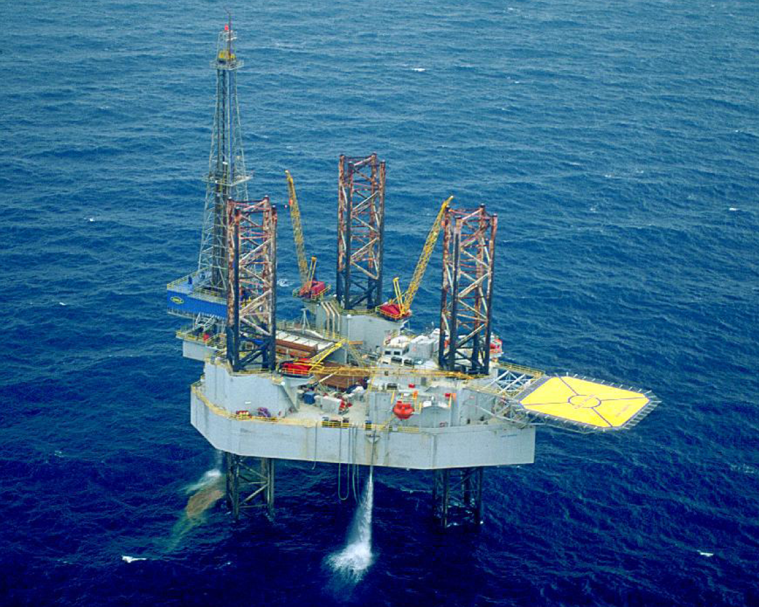

Slide 9
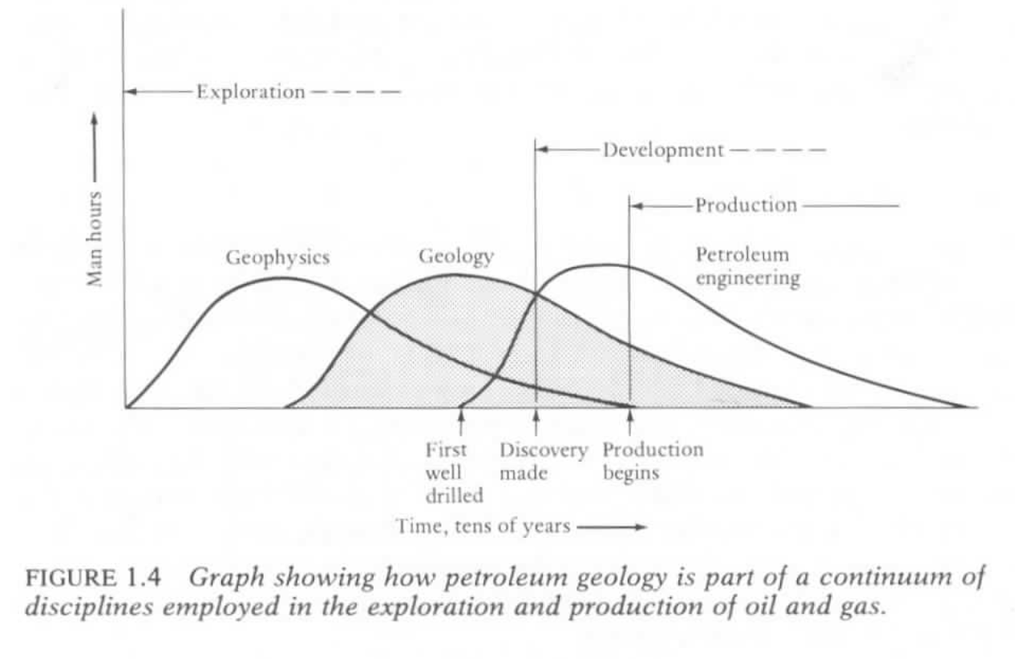

Slide 10
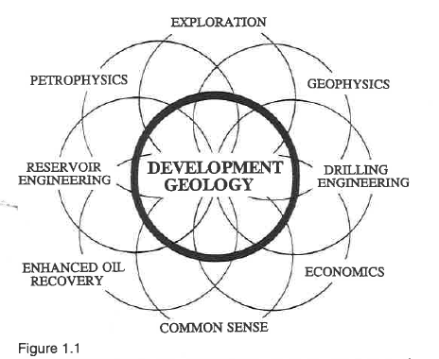

Slide 11
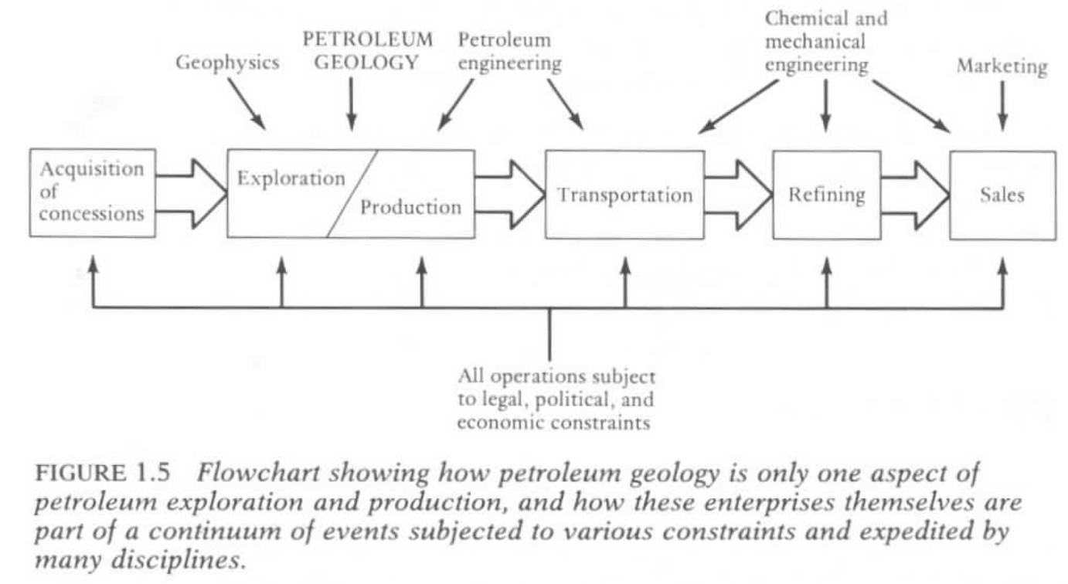

Slide 12
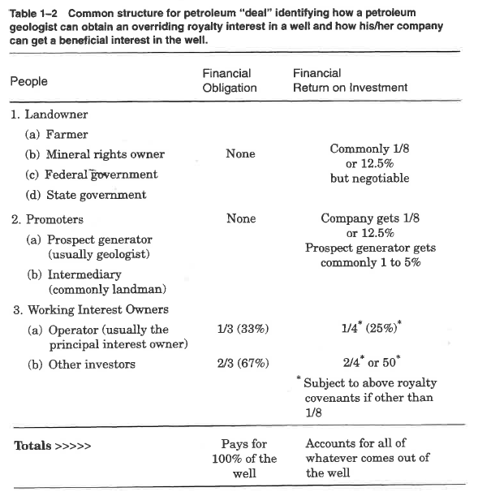

Slide 13
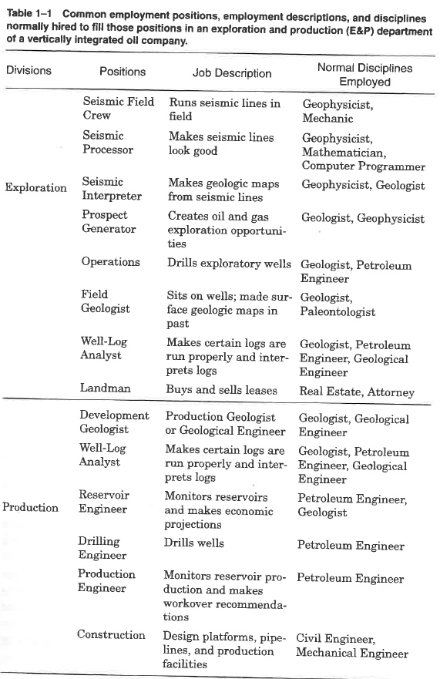

Slide 14
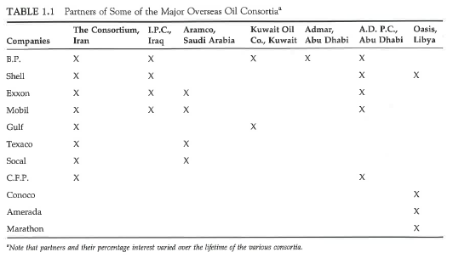

Slide 16
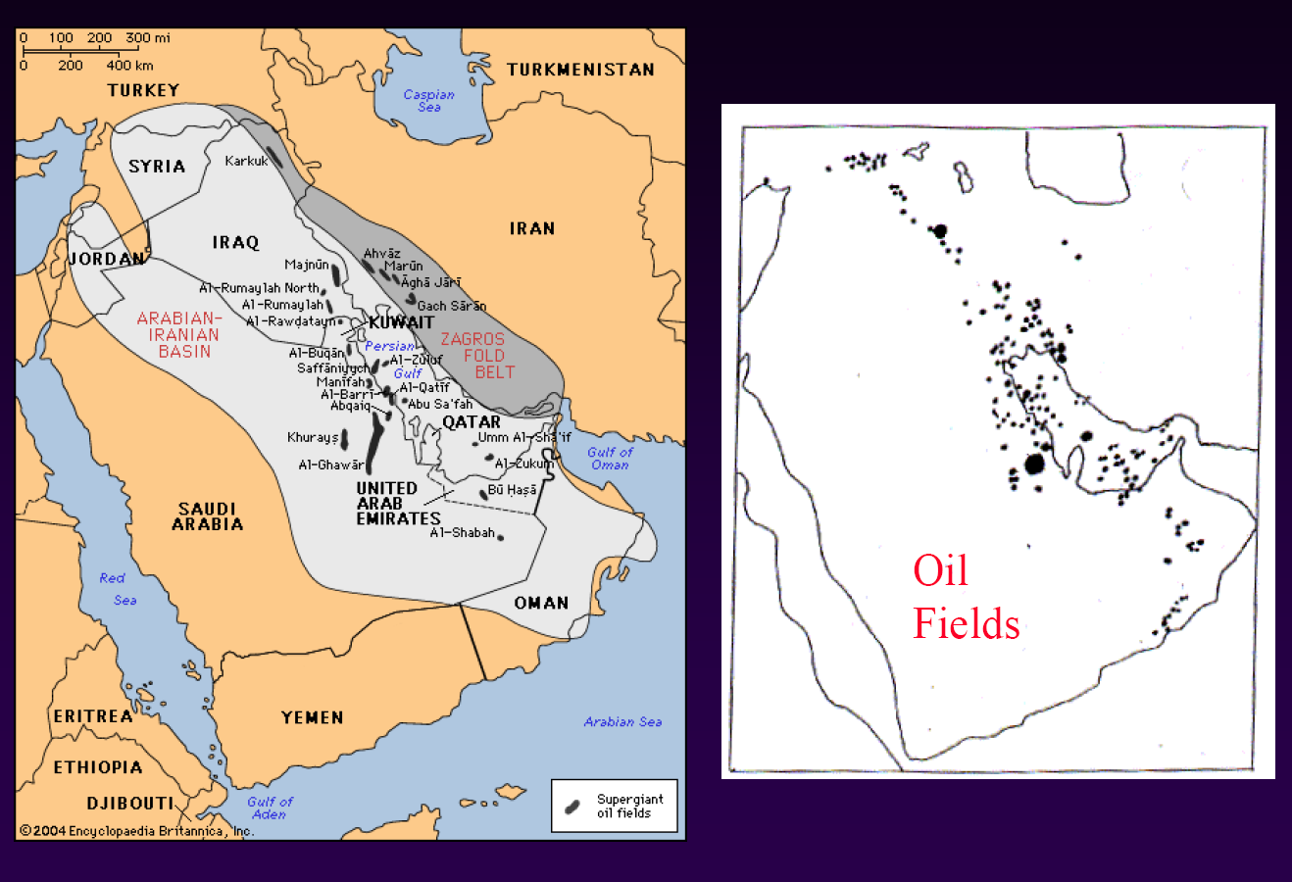

Slide 17
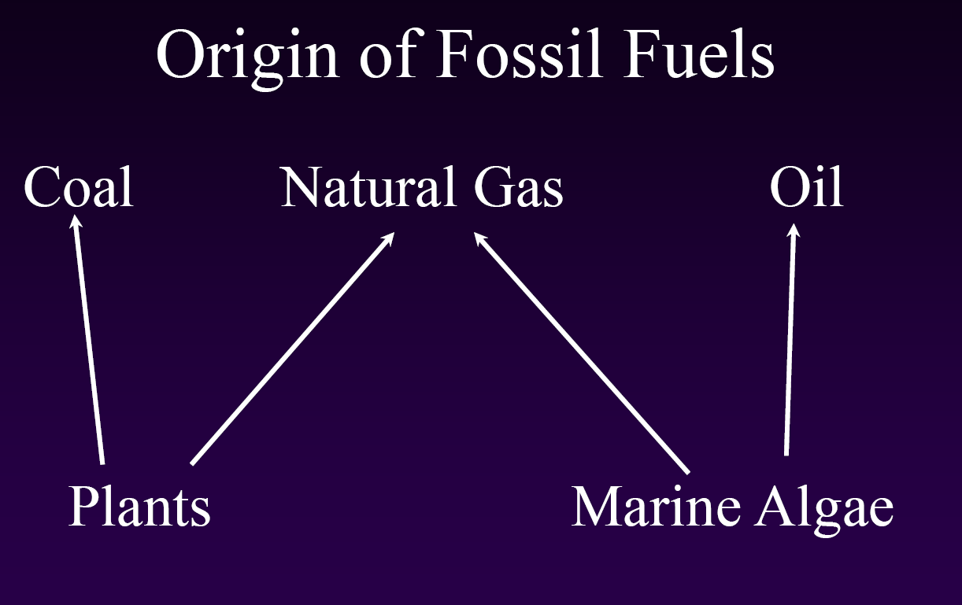
Depositional Environment
*Burial (1000’s of meters)
*Time (10^5-10^8 yrs)
*Heat (100 – 300 C)
*Pressure (MPa)

Slide 18
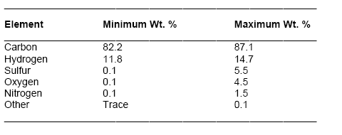
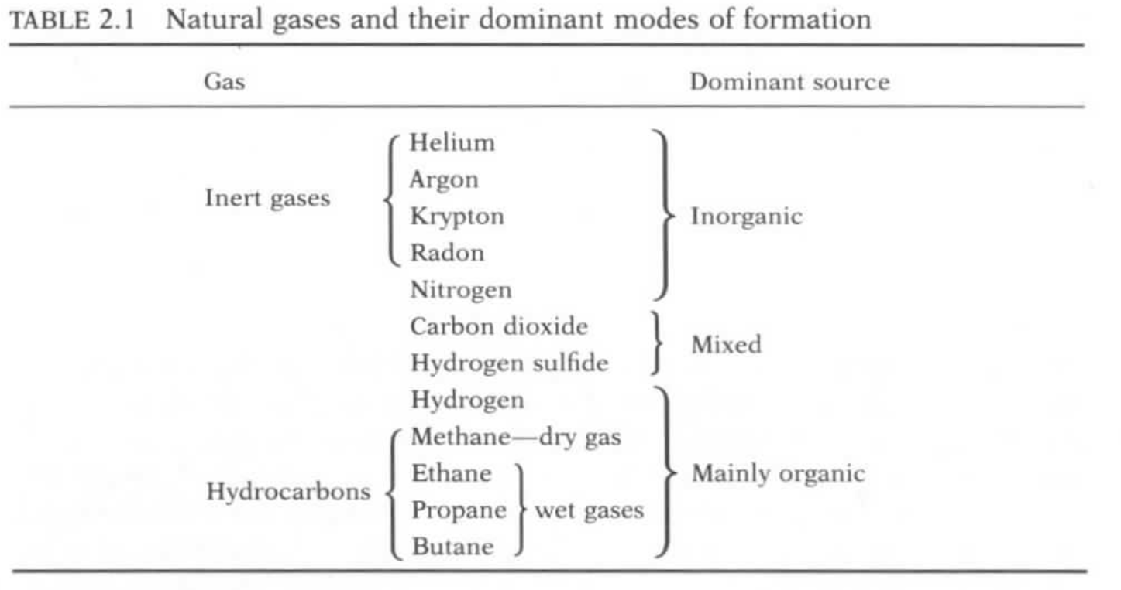
Elemental composition of crude oil by weight%

Slide 19
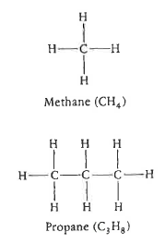
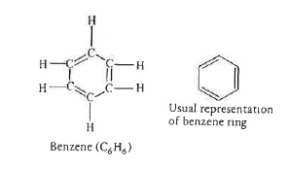
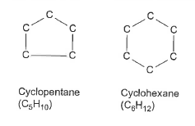
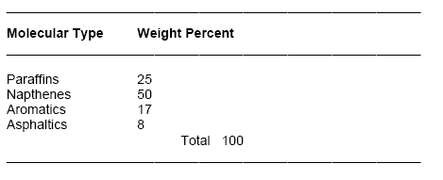
Hydrocarbon Compounds in Petroleum:
> 200 organic carbon-based compounds
Paraffins (C_{n}H_{2n+2}): trellis structure gaseous
Napthenes: simple ring structure, liquid
Aromatics: complex ring structure
Asphaltics: heavy oil and tar
Paraffins
Napthenes
Aromatics

Slide 20
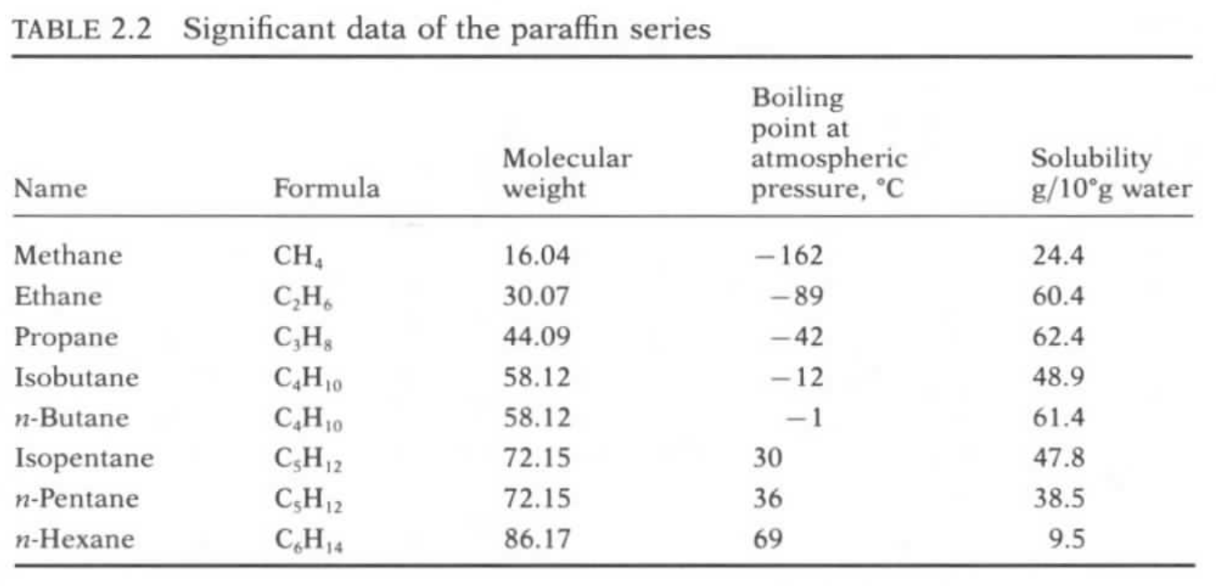
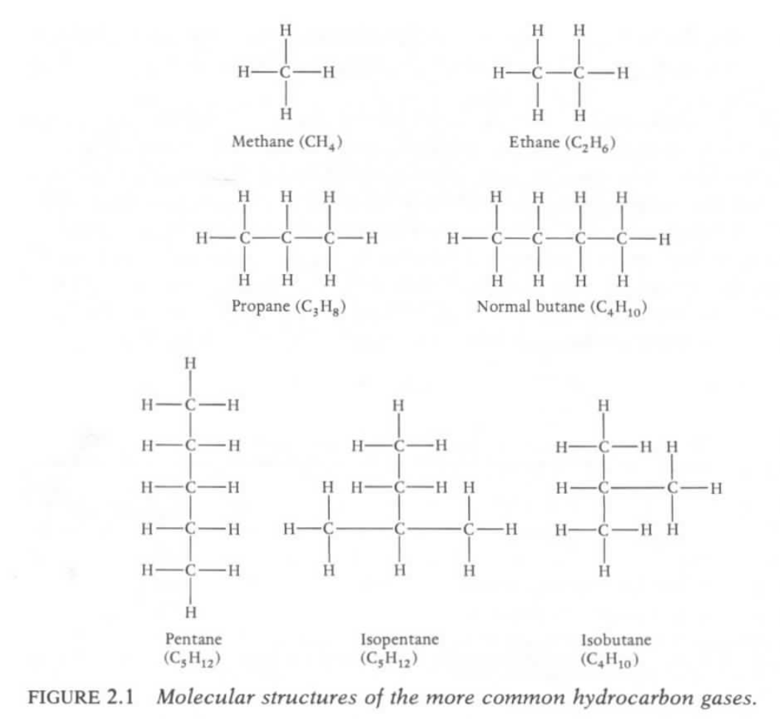
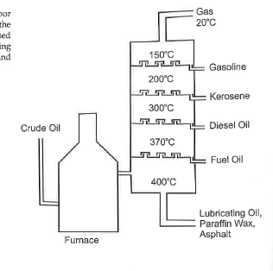

Slide 23
