Slide 1
ES486 Petroleum Geology – Hydrocarbon Properties Review
(Heat Energy, Density, Viscosity)
Heat Energy
The most common units for heat are BTU (Btu) - British Thermal Unit - also known as a "heat unit" in United States, Calorie, Joule
BTU - British Thermal Unit
The unit of heat in the imperial system - the BTU – is the amount of heat required to raise the temperature of one pound of water through 1ºF (58.5ºF - 59.5ºF) at sea level (30 inches of mercury).
1 Btu (British thermal unit) = 1055.06 J = 107.6 kpm = 2.931 10⁻⁴ kWh = 0.252 kcal = 778.16 ft.lbf = 1.05510¹⁰ ergs = 252 cal = 0.293 watt-hours
An item using one kilowatt-hour of electricity generates 3412 Btu.
one hundred thousand (10⁵) Btu are called a therm
Calorie
A calorie is commonly defined as the amount of heat required to raise the temperature of one gram of water 1ºC the kilogram calorie, large calorie, food calorie, Calorie (capital C) or just calorie (lowercase c) is the amount of energy required to raise the temperature of one kilogram of water by one degree Celsius
1 calorie (cal) = 1/860 international watthour (Wh)
1 kcal = 4186.8 J = 426.9 kp m = 1.163 10⁻³ kWh = 3.088 ft lb_{f} = 3.9683 Btu = 1000 cal
Joule
The unit of heat in the SI-system the Joule is
a unit of energy equal to the work done when a force of one newton acts through a distance of one meter 4.184 joule of heat energy (or one calorie) is required to raise the temperature of a unit weight (1 g) of water from 0ºC to 1ºC, or from 32ºF to 33.8ºF
1 J (Joule) = 0.1020 kpm = 2.778 10⁻⁷ kWh = 2.389 10⁻⁴ kcal = 0.7376 ft.lb_{f} = 1 kg.m²/s² = 1 watt second = 1 Nm = 9.478 10⁻⁴ Btu
The heat value is the amount of heat produced by combustion a unit quantity of a fuel
Gross (or high, upper) Heating Value
The gross or high heating value is the amount of heat produced by the complete combustion of a unit quantity of fuel. The gross heating value is obtained when all products of the combustion are cooled down to the temperature before the combustion the water vapor formed during combustion is condensed
Net (or lower) Heating Value
The net or lower heating value is obtained by subtracting the latent heat of vaporization of the water vapor formed by the combustion from the gross or higher heating value.
Common Units
Common units for heating value:
1 Btu/lb = 2326.1 J/kg = 0.55556 kcal/kg
1 J/kg = 0.00043 Btu/lb = 2.39x10⁻⁴ kcal/kg
1 kcal/kg = 1.80 Btu/lb = 4187 J/kg
1

Slide 2
2

Slide 3
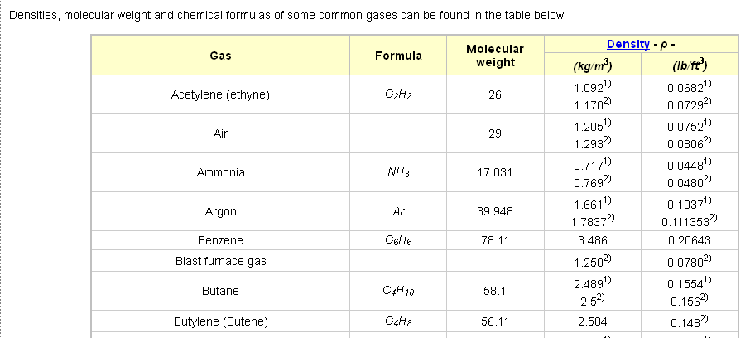
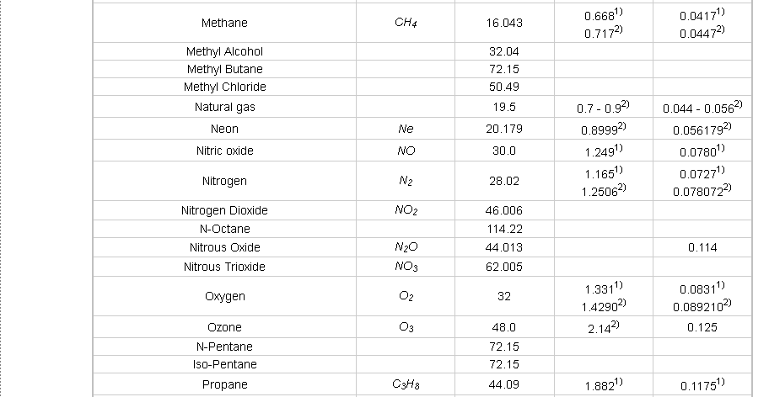
3

Slide 4
4

Slide 5
5

Slide 6
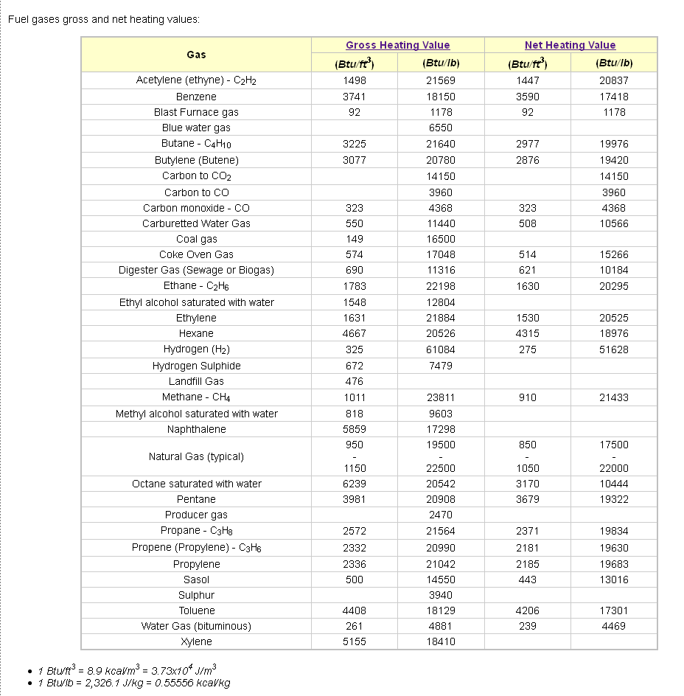
6

