Slide 1
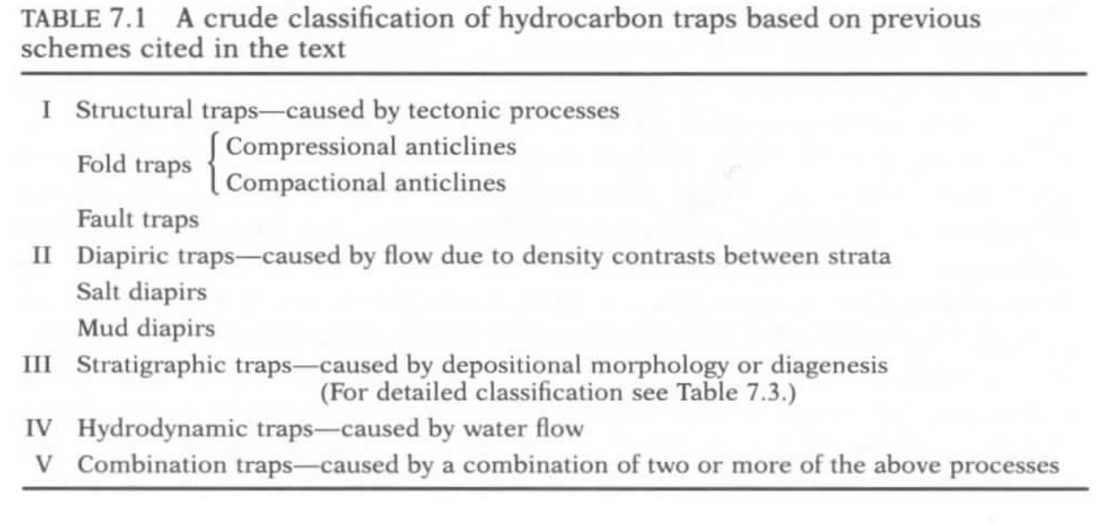

Slide 2
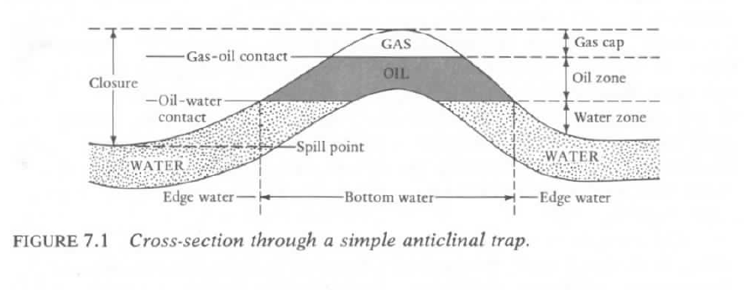
Classic Anticlinal Trap Model

Slide 3
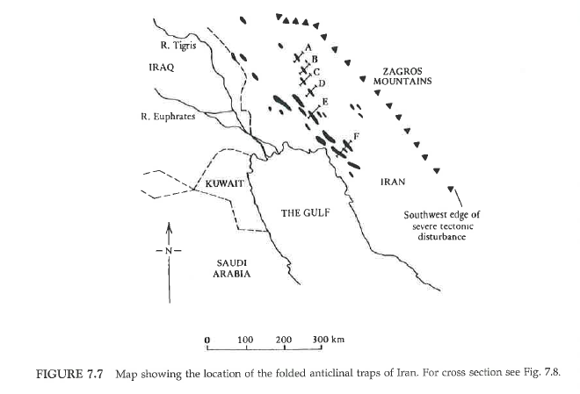
Structural Trap – Compressional Anticline

Slide 4
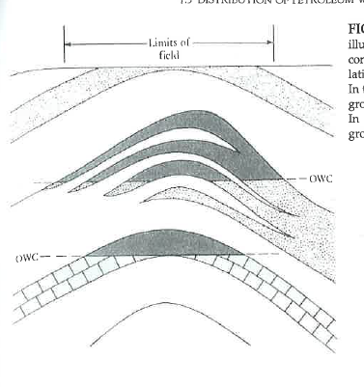

Slide 5
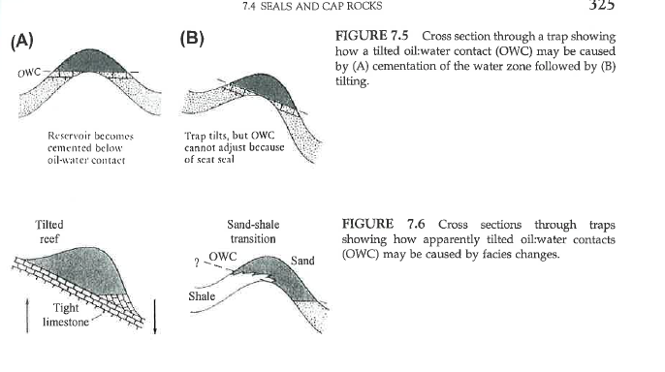

Slide 6
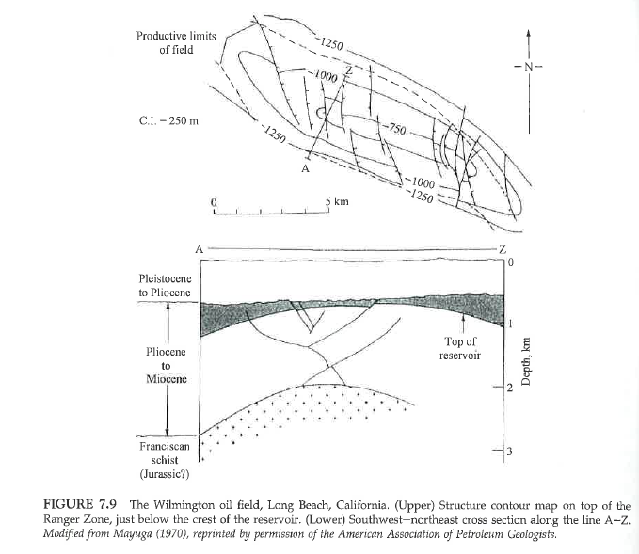
Structural Trap – Compressional Anticline

Slide 7
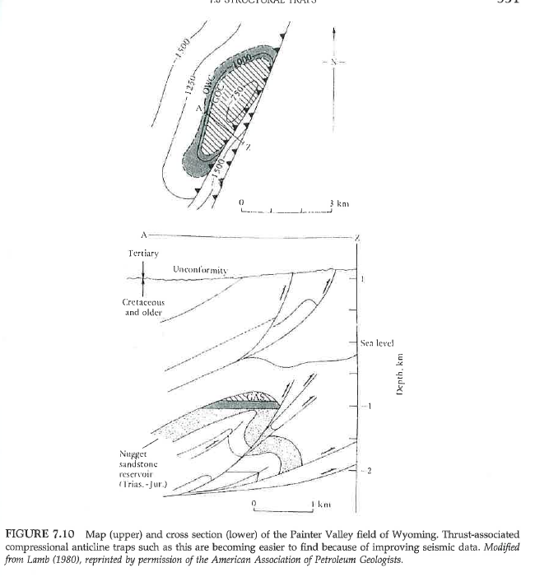
Structural Trap – Fold-Thrust Structures, Wyoming

Slide 8
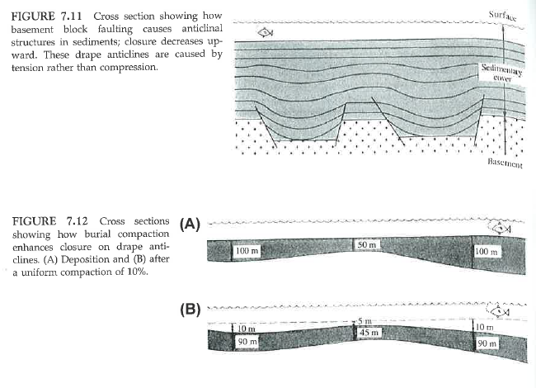
Structural Trap – Compaction Anticline

Slide 9
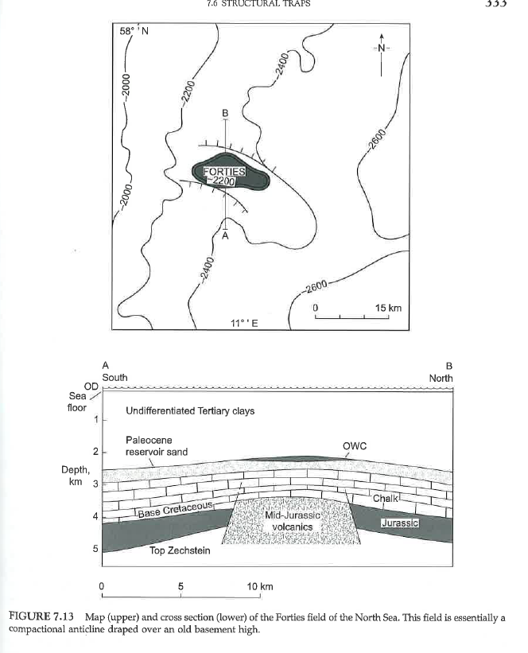
Structural Trap – Draped Anticline

Slide 10
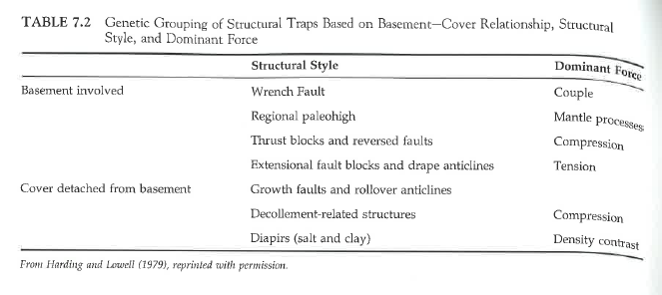
Structural Trap Classification

Slide 11
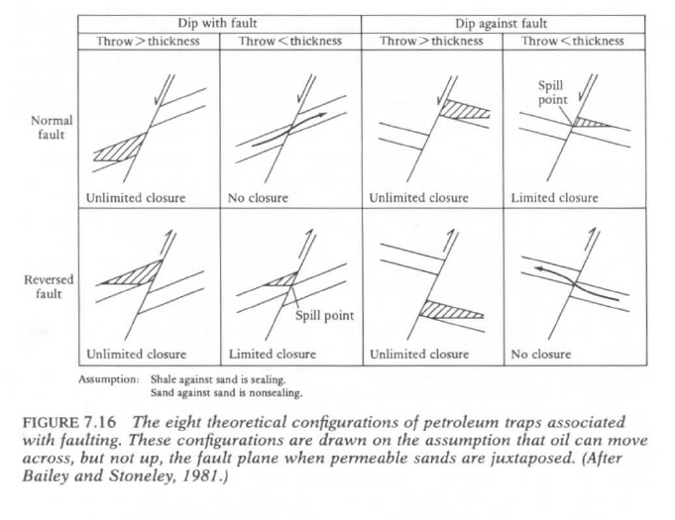
Structural Fault Traps

Slide 12
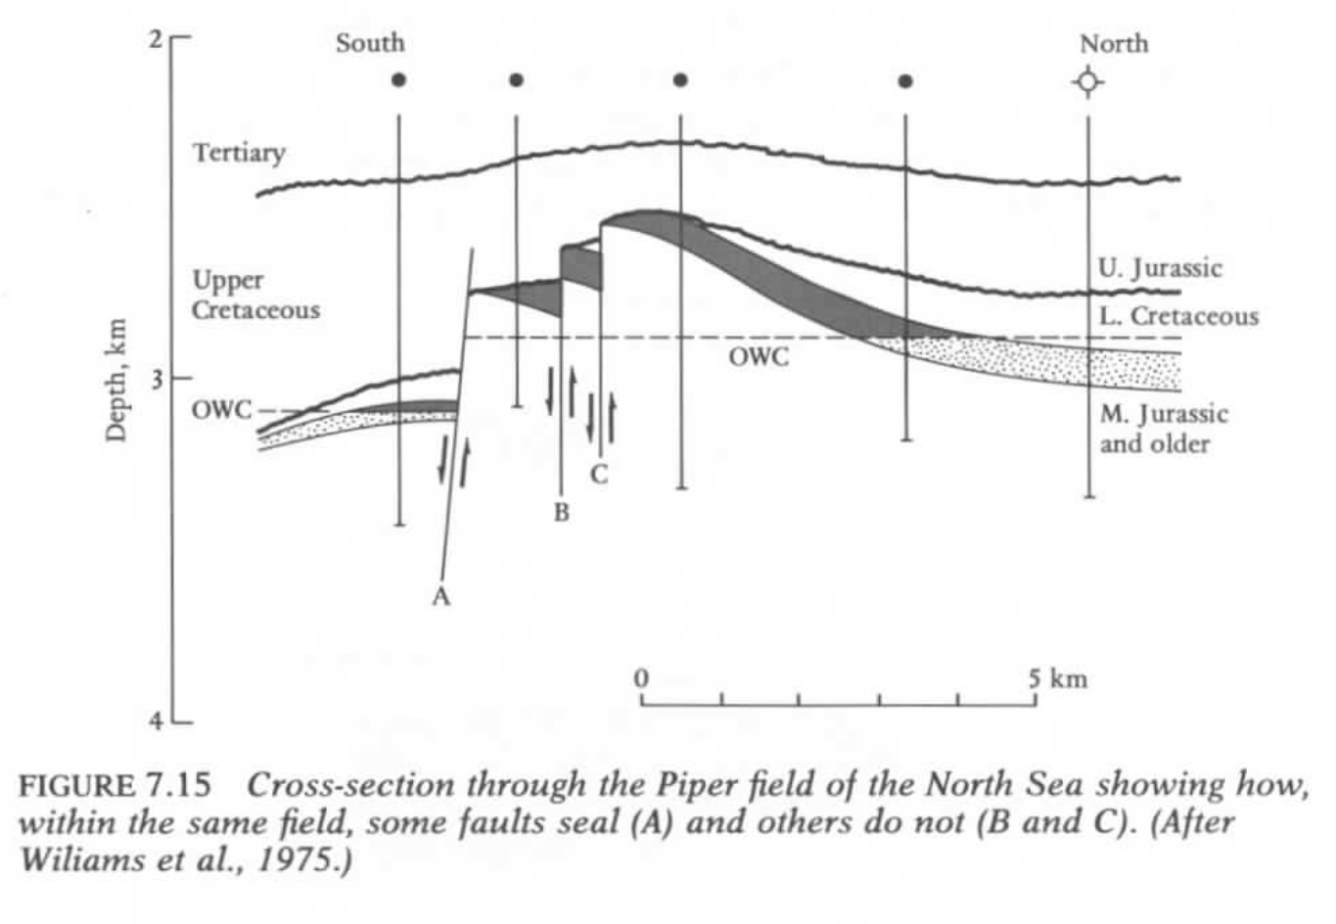
Structural Fault Traps

Slide 13
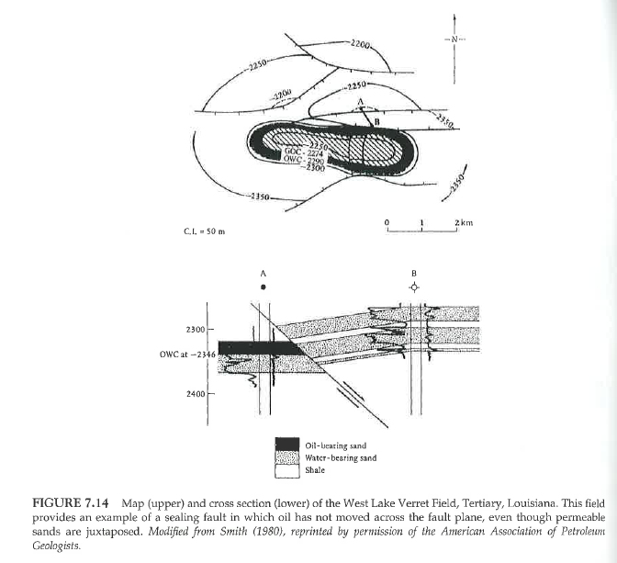
Structural Fault Traps

Slide 14
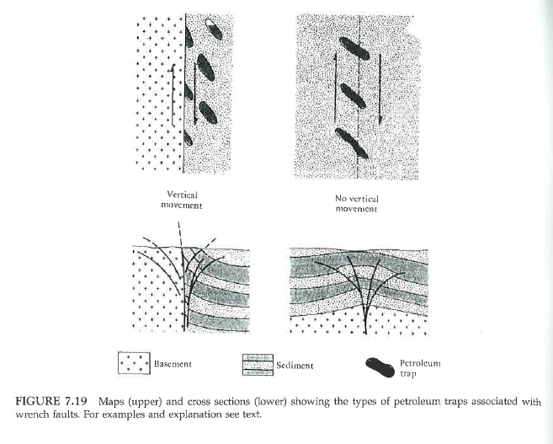
Structural Wrench Fault Traps (strike slip / transtensional faults)

Slide 15
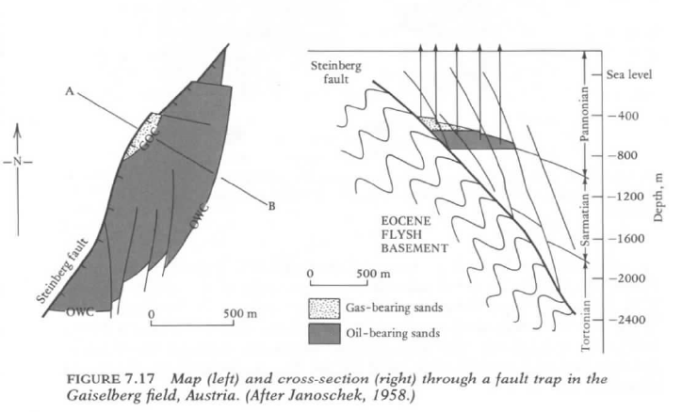
Structural Fault Traps

Slide 16
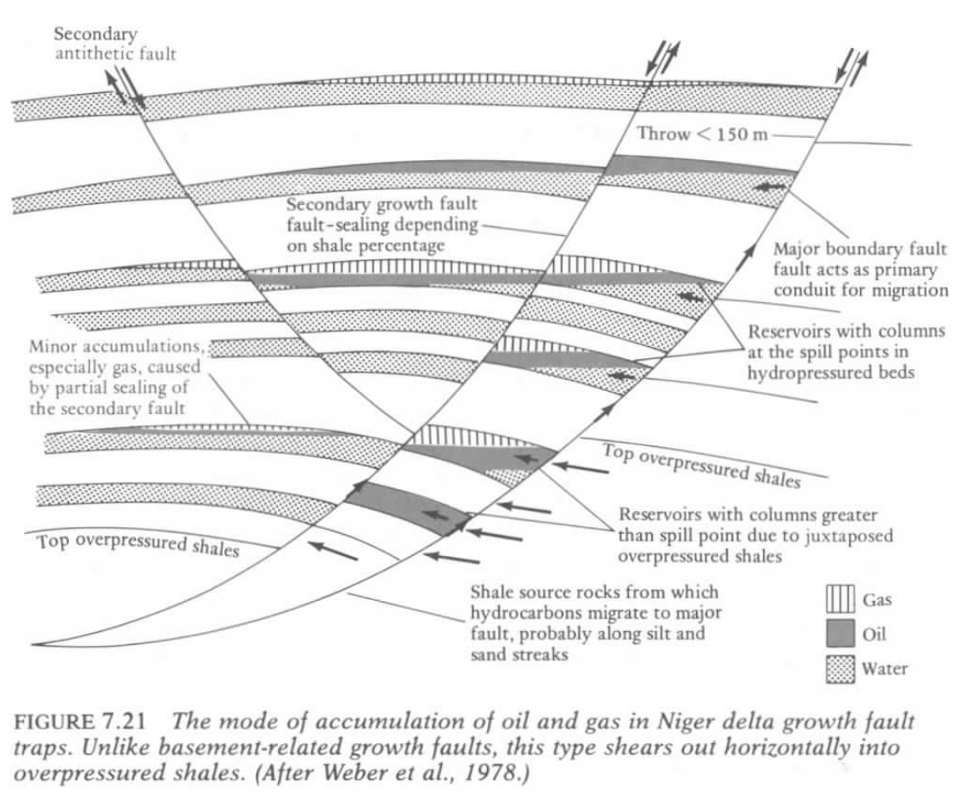
Structural Traps – Growth Faults (syndepositional faulting)

Slide 17
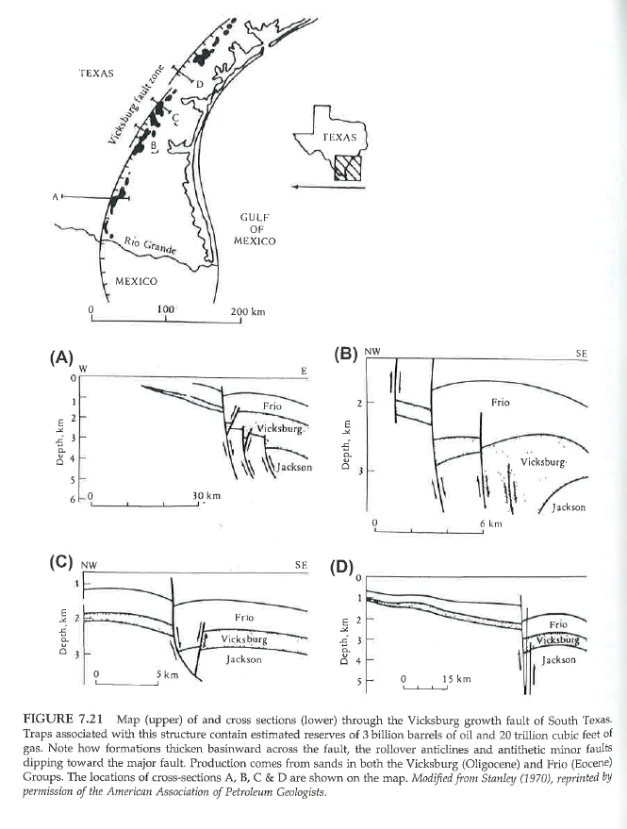
Structural Traps – Growth Faults (syndepositional faulting)

Slide 18
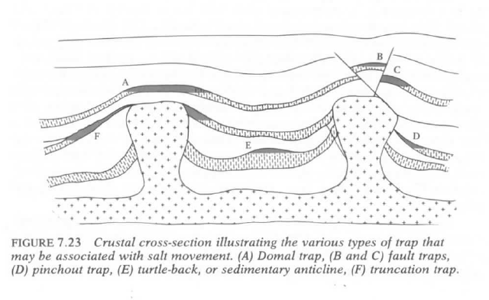
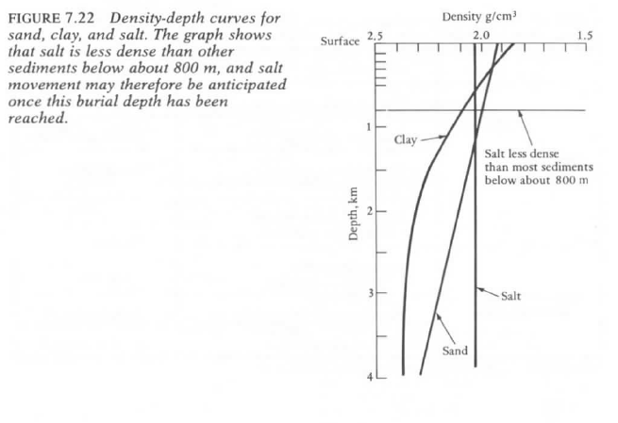
Salt and Clay Diapirs – Structural Traps

Slide 19
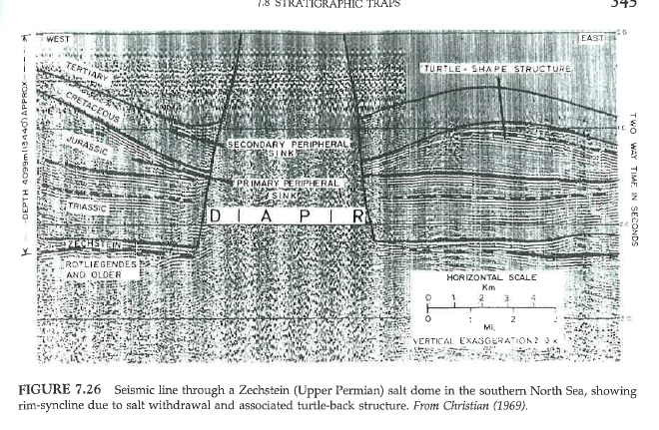
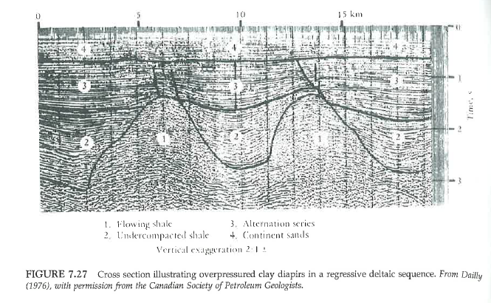
Salt and Clay Diapirs – Structural Traps

Slide 20
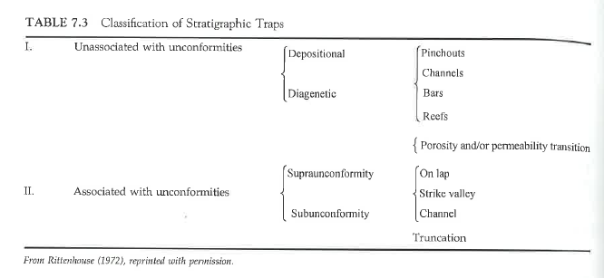
Stratigraphic Trap Classification

Slide 21
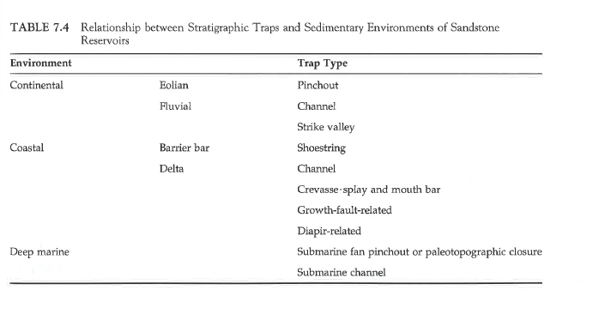
Stratigraphic Trap Classification

Slide 22
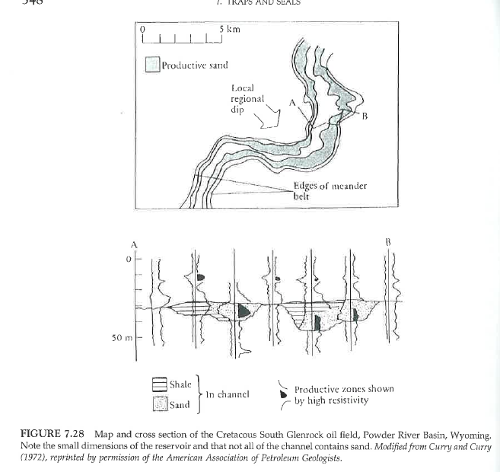
Stratigraphic – Meandering Fluvial Sandstone Traps Wyoming

Slide 23
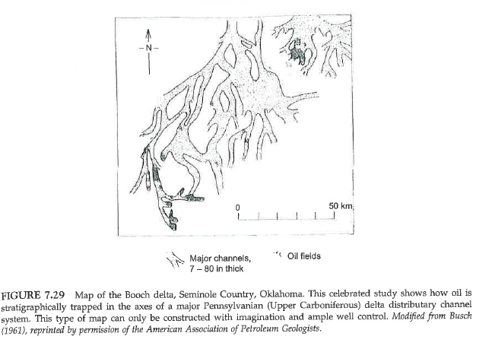
Stratigraphic – Deltaic Sandstone Traps Wyoming

Slide 24
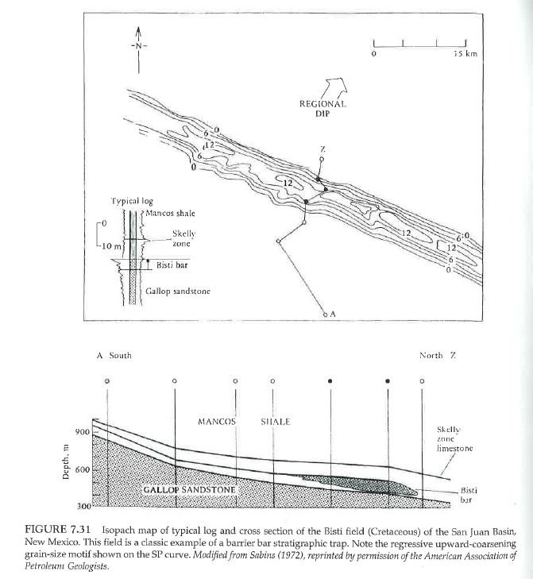
Stratigraphic – Barrier Island Trap San Juan Basin

Slide 25
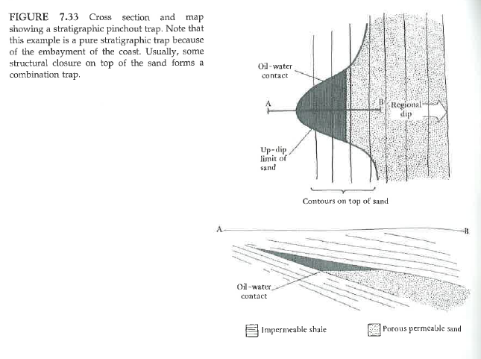
Stratigraphic Pinchout Trap

Slide 26
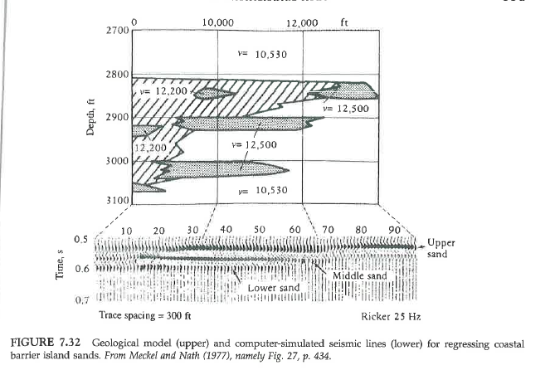
Stratigraphic Traps Regressive Barrier Island Sandstone / shale traps

Slide 27
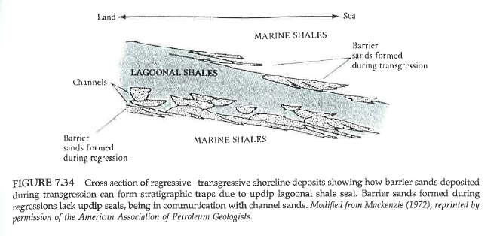
Shoreline Stratigraphic Traps – Transgressing/Regressing Barrier Island Complex

Slide 28
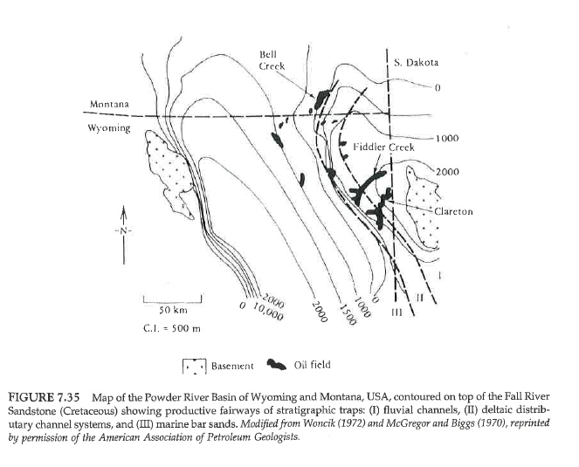
Stratigraphic – Fluvial Sandstone Traps Wyoming

Slide 29
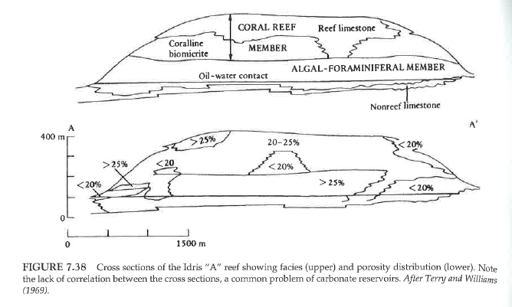
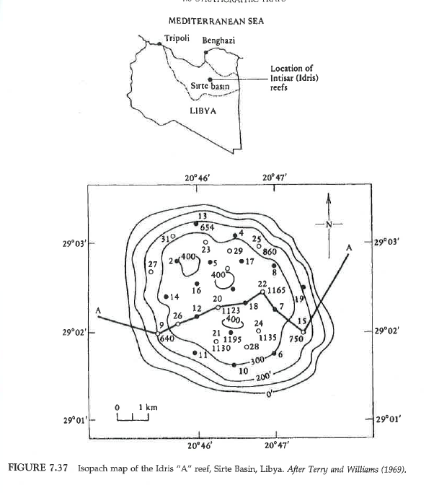
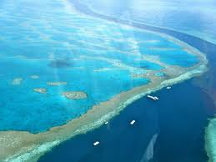
Reef Reservoirs and Trapping Mechanisms (complex facies / permeability relations)

Slide 30
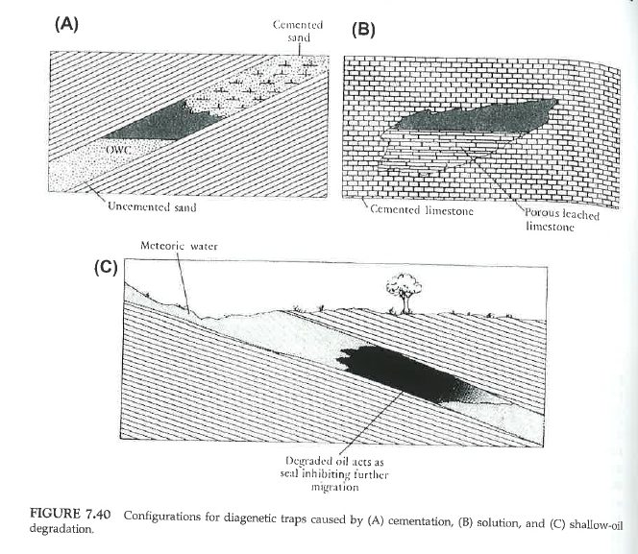
Diagenetic Traps – altered high/low permeability zones in reservoir; self sealing

Slide 31
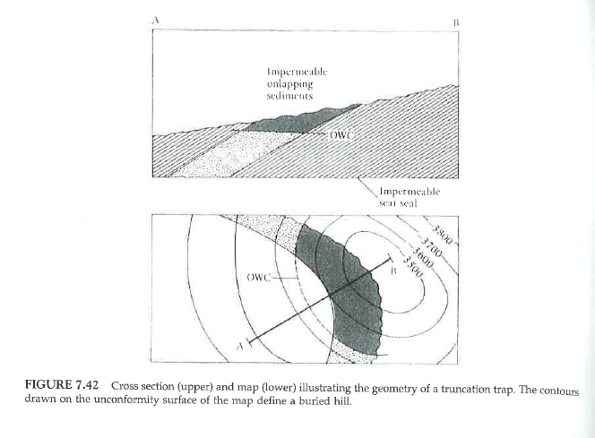
Unconformity Trap – angular, shale seal

Slide 32
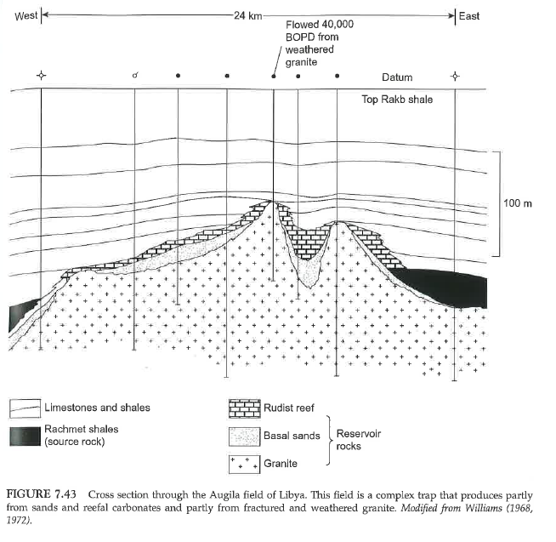
Libya - (Nonconformity) Unconformity Trap (over granite)

Slide 33
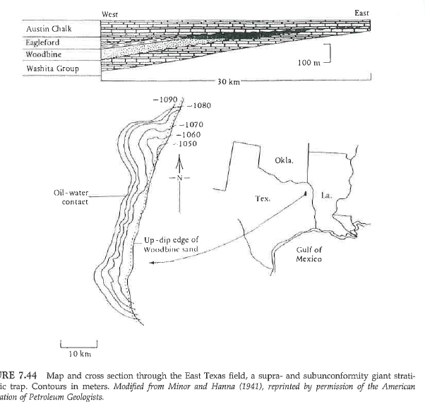
East Texas Unconformity Trap

Slide 34
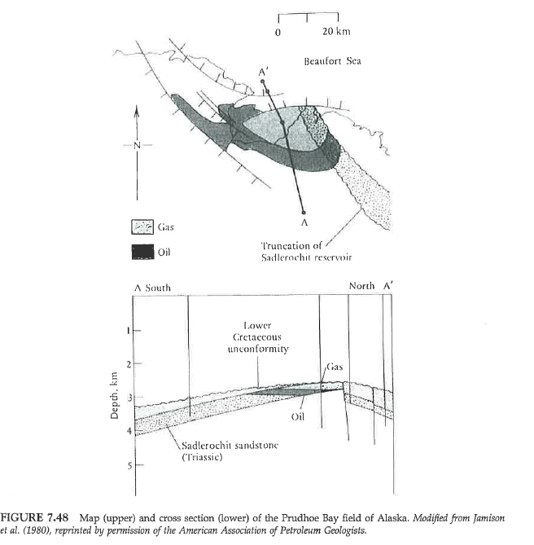
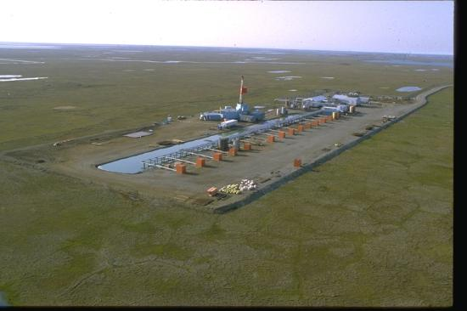
Prudhoe Bay, AK Combination Fold-Fault-Unconformity Trap

