Slide 1
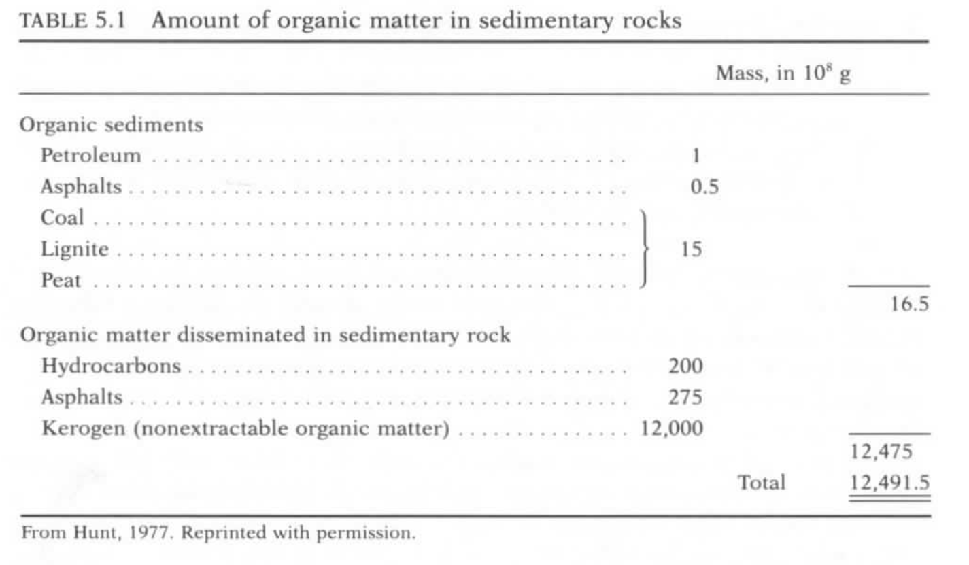
Composition and Abundance of Organic Matter in Sedimentary Rocks
Kerogen – insoluble organic (C-H-O compounds) matter derived from tissues of dead organisms
Bitumen – soluble organic (C-H-O compounds) matter derived from tissues of dead organisms
HYDROCARBON MATURATION PROCESS: Living Organisms (Carbohydrates, Proteins, Lipids, Lignins) ----Kerogen----Shallow Anerobic/Biogenic Gas Production-----Deep Thermogenic Oil /Gas Production

Slide 2
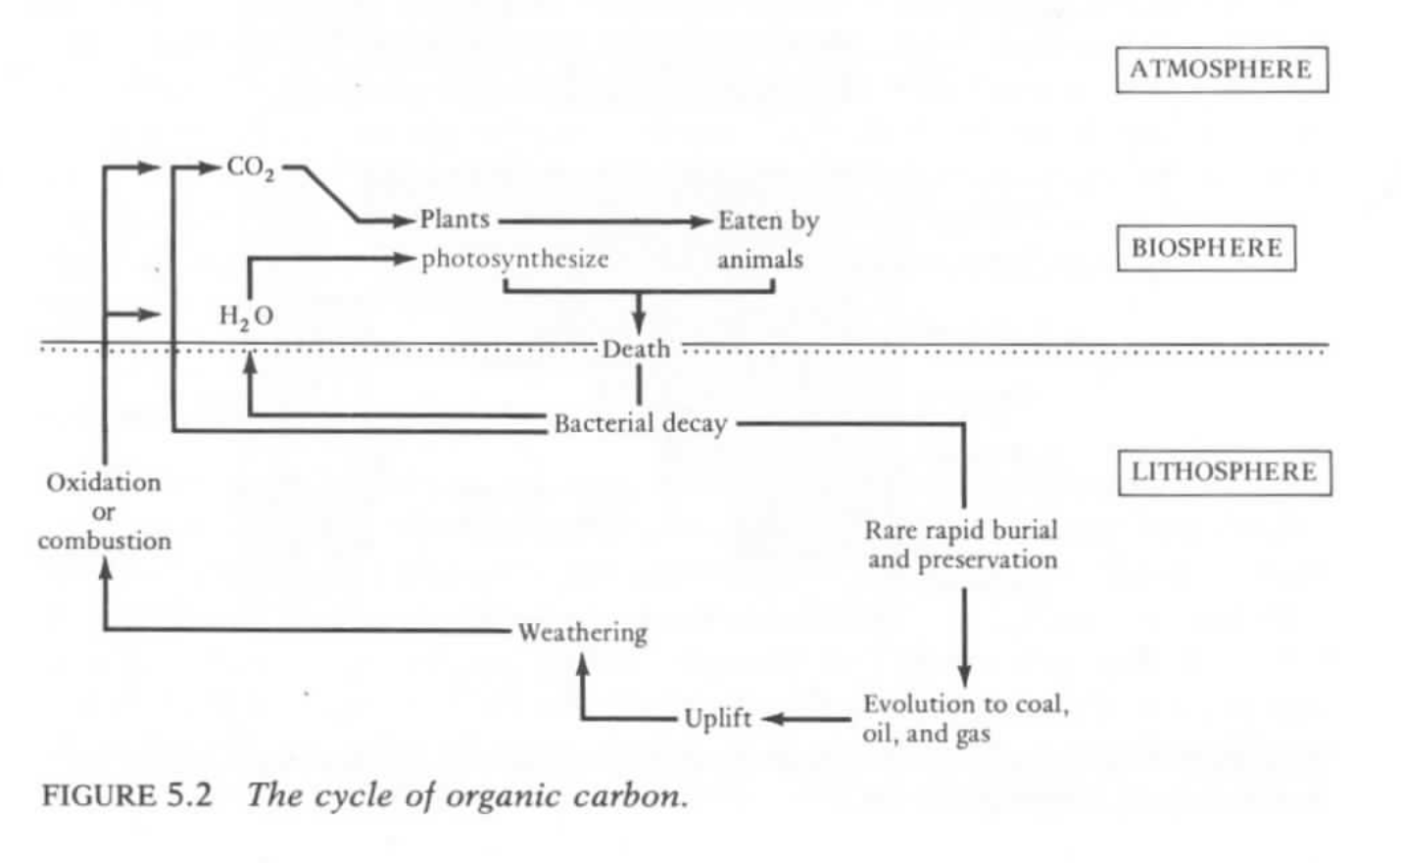
ORGANIC SOURCE MATERIAL – Basis of Carbon Cycle

Slide 3
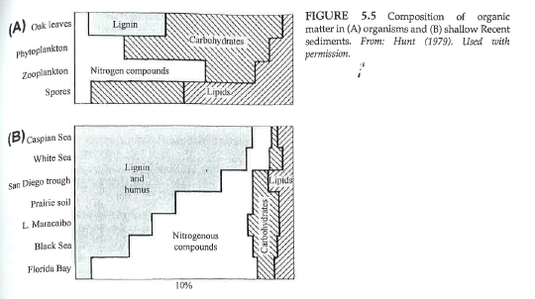
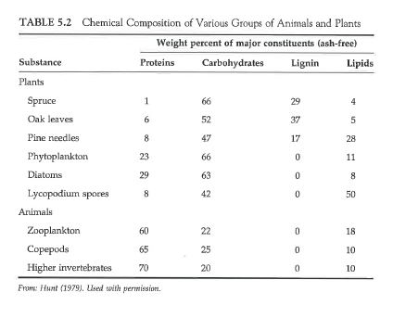
Organic Components of Living Organisms
Proteins – amino acids (animals primarily)
Carbohydrates – sugars (animals and plants)
Lignin – aromatics (higher order plants)
Lipids – insoluble fats (animals and plants)

Slide 4
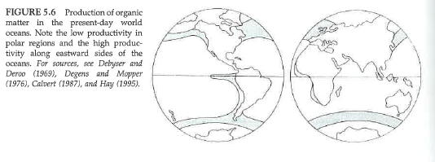
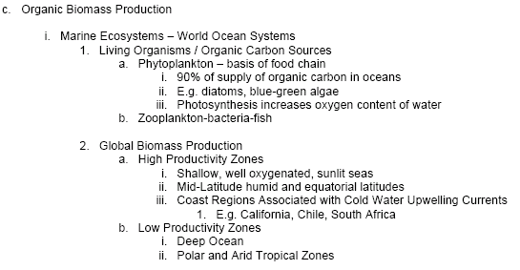
STEP 1: Biomass Production and Creation of Organic Sediments

Slide 5
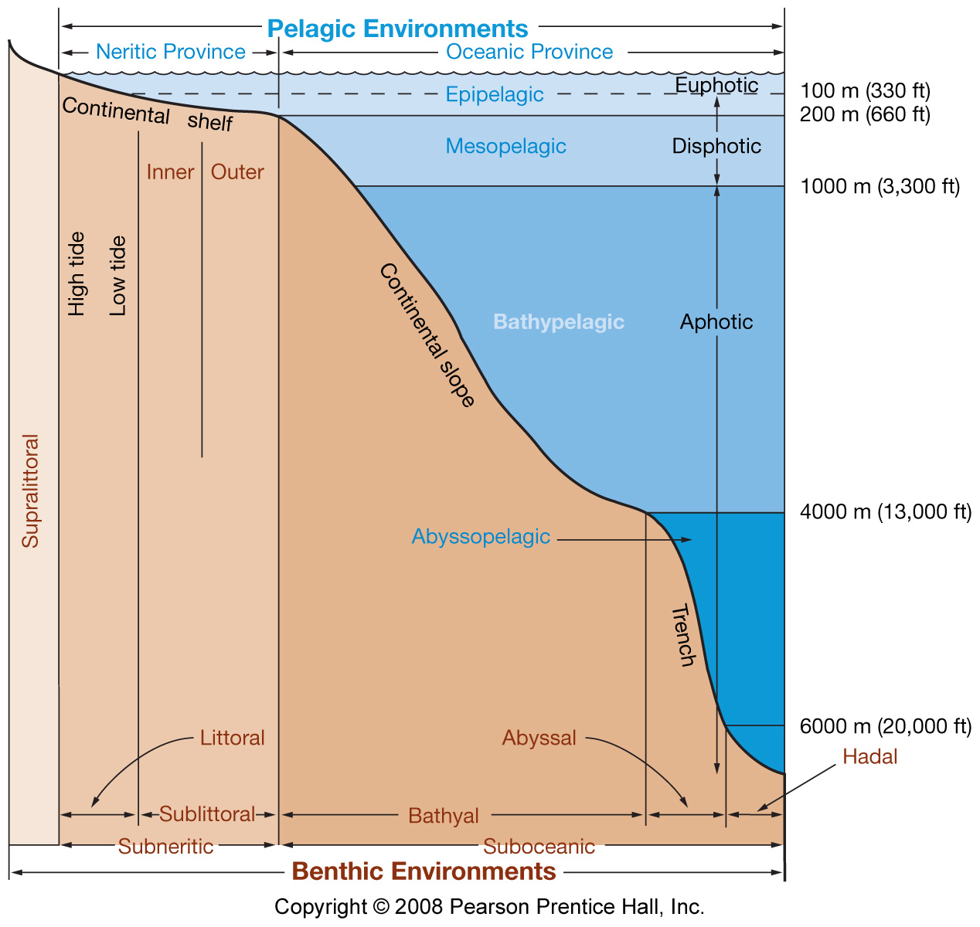
Marine BioMass Production
Photosynthesis

Slide 6
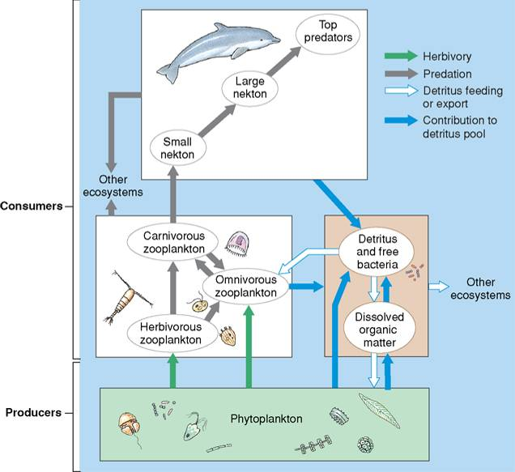
Marine food web (simplified)

Slide 7
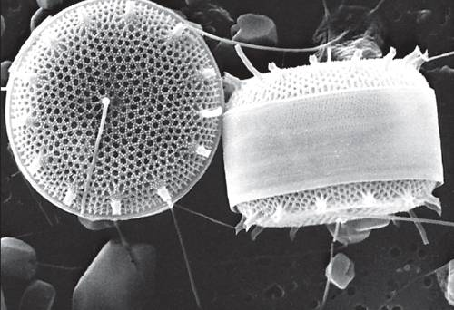
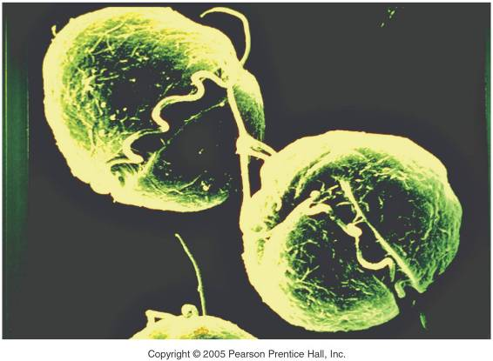
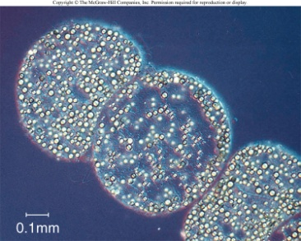
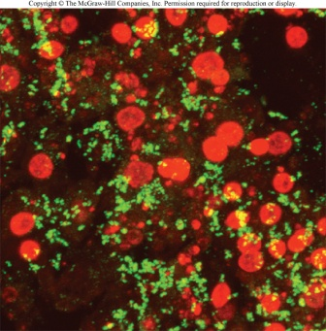
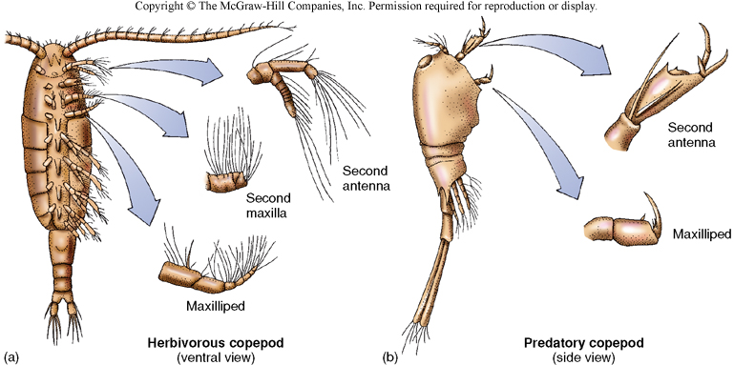
Phytoplankton
Free-floating photosynthetic
Bacteria and Archaea
Photosynthetic Protista
Diatoms
Dynoflagellates
Zooplankton
Copepods - key modern
crustacean zooplankters

Slide 8
Where are the highest rates of primary production in the ocean?

Slide 9
Primary production is generally correlated with nutrient levels
Community composition (species present) depends upon specific nutrients available as well as other aspects of the environment (Biomolecule Synthesis).
Nutrients: N, P, Si, Fe, Dissolved Organic Material
Nybakken Fig. 2.41a, March – May, 1998

Slide 10
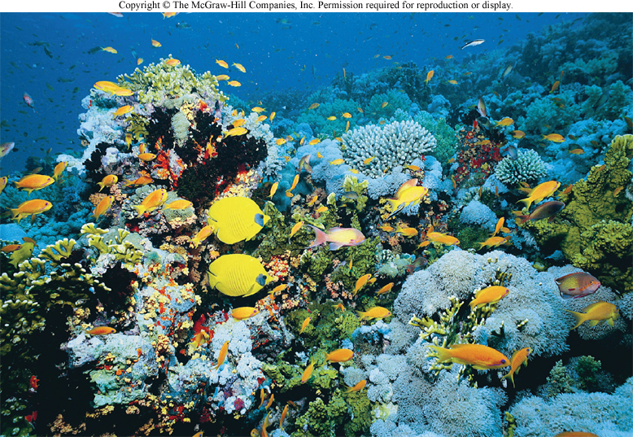
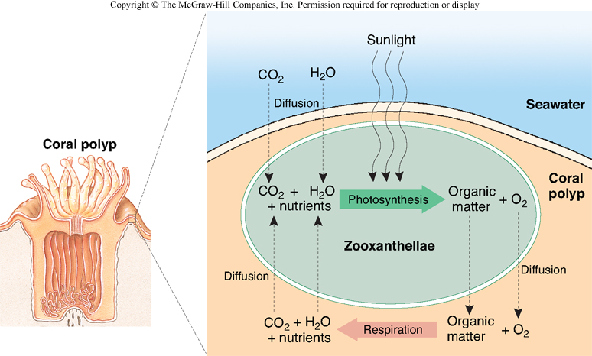
Reefs: Marine Sediment Factories
Symbiosis of coral and zooxanthellae

Slide 11
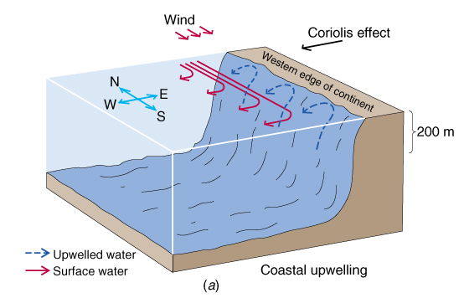
Upwelling: West coast of North America
Cold, nutrient rich water rises to the surface
Prolific biomass production

Slide 12
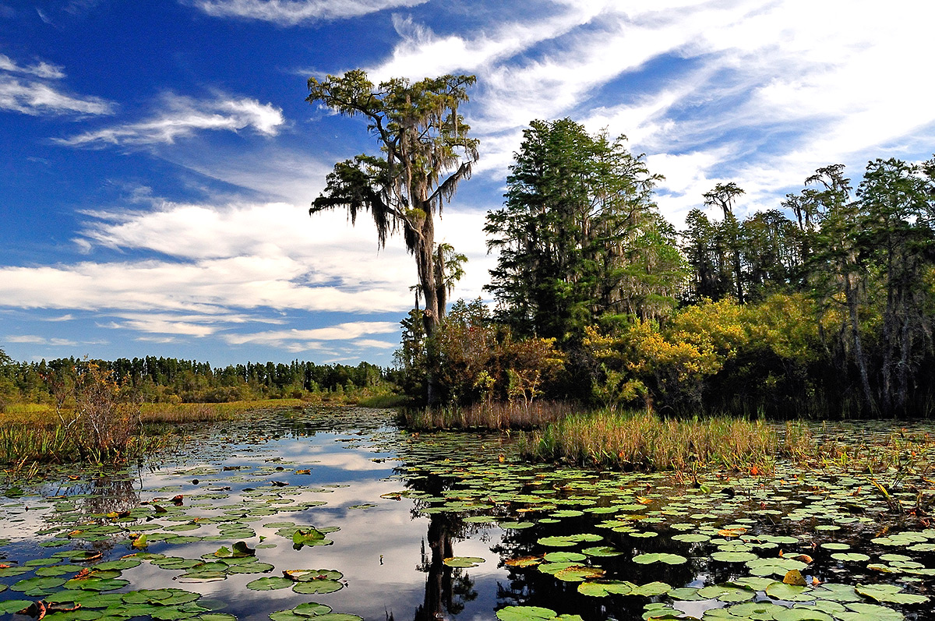
Non-Marine BioMass Production – Subtropical /
Tropical Marginal Marine Settings (Delta, Coastal Plain, Estuary)
Okefenokee Swamp, Florida – Modern Day Analog for a “Coal Swamp”

Slide 13
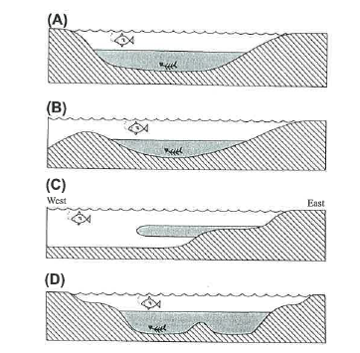
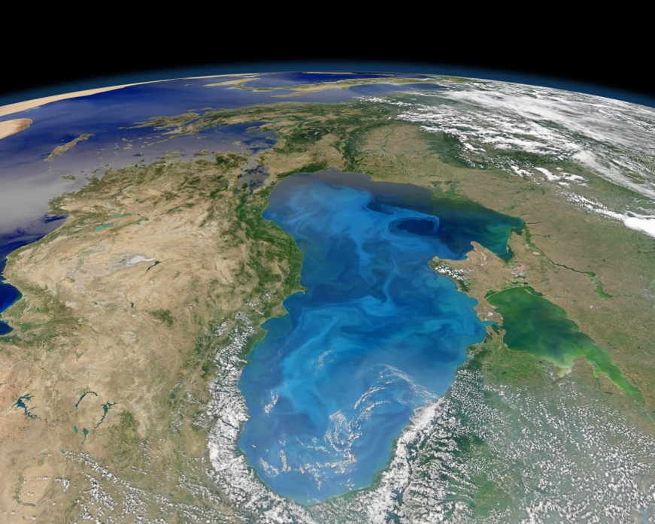
STEP 2: Accumulation and Preservation of Organic Matter in Sedimentary Basins
Anoxic / Anaerobic Environments
Limited Oxygenation and Circulation
Minimize Aerobic Bacterial Decay
Minimize Burrowing Organisms / Scavenging
Thermal Stratification of Water
Rapid Sediment / Organic Accumulation
Low Permeability
IDEAL ENVIRONMENTS: Quiet water,
“black stinking muds”
Restricted Marine Basins
Delta Settings
Lakes
Deep Water Basins
Black Sea (Ukraine, Russia, Romania)

Slide 14
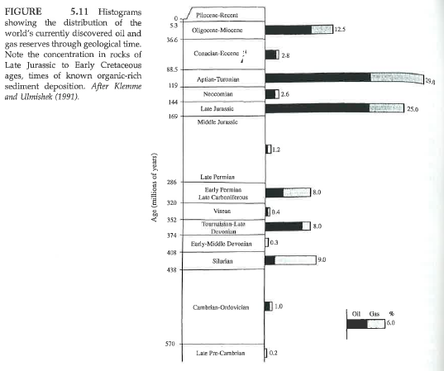
Distribution of Oil and Gas versus Stratigraphic Age of Host Rock
Extinction Event
Cretaceous
NOTE: Oldest Rocks on Seafloor ~200 M.Y. old
Extinction Event
NOTE:
Old rocks are less abundant
Due to Tectonic Recycling

Slide 15
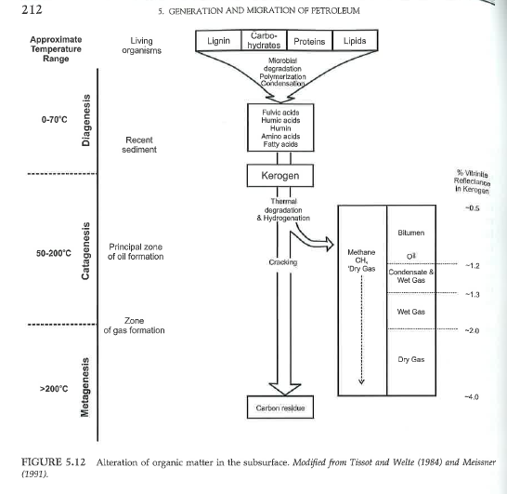
Thermal Maturation Process of Hydrocarbons from Source to Kerogen to Petroleum
Controls
Time
Depth of Burial
Geothermal Temperature Increase
Pressure Increase
Increase Carbon:Hydrogen Ratios
Shallow Biogenic
Gas Production
Deep Thermogenic
Oil/Gas Production
Pure Carbon as Graphite
Graphite Metamorphism
With depth and temperature: hydrogen and oxygen decrease (expelled as water), carbon content increases; complexity and molecular wt. of hydrocarbons increases

Slide 16
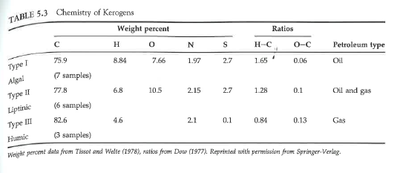
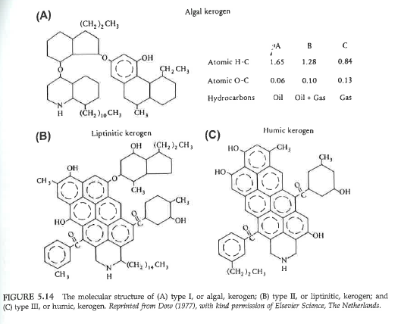
Kerogen Composition
Kerogen Types
Type I Algal ---- Oil
Type II Liptinitic ---- Oil and Gas
Type III Humic ---- Gase

Slide 17
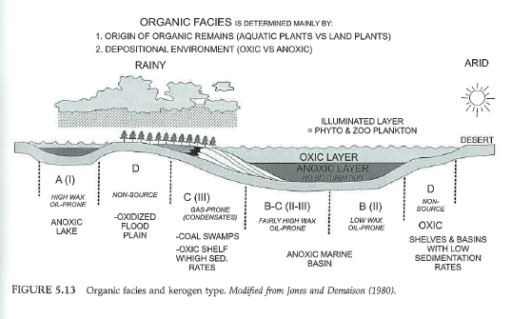
Depositional Settings versus Organic Source Material and Kerogen Types

Slide 18
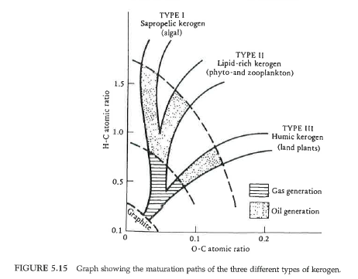
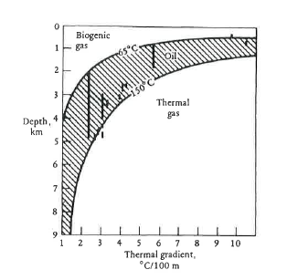
Thermal Maturation of Hydrocarbons
as a Function of Depth and Temperature
With increasing depth and temperature
Hydrogen and oxygen are expelled as water
Carbon content in organic molecules increases
Higher order / higher molecular weight
Hydrocarbons are produced

Slide 19
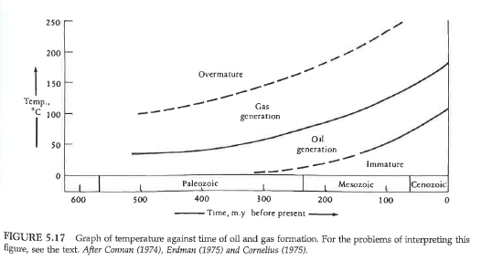
Hydrocarbon Maturation as a Function of Time and Geothermal Temperature

Slide 20
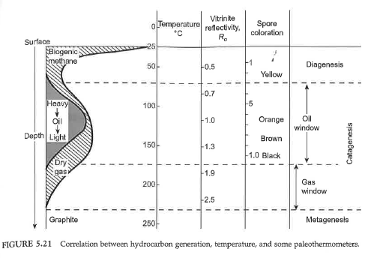
Idealized Thermal Maturation of Hydrocarbon with Depth of Burial

Slide 21
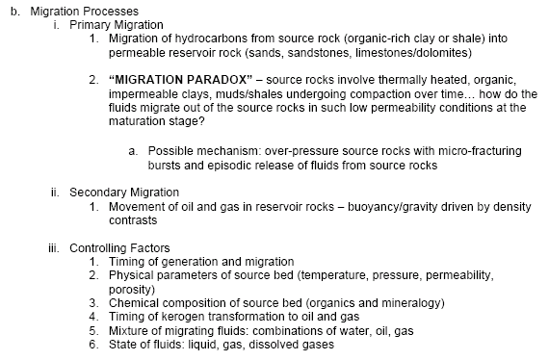
STEP 3: MIGRATION OF HYDROCARBONS FROM SOURCE TO RESERVOIR

Slide 22
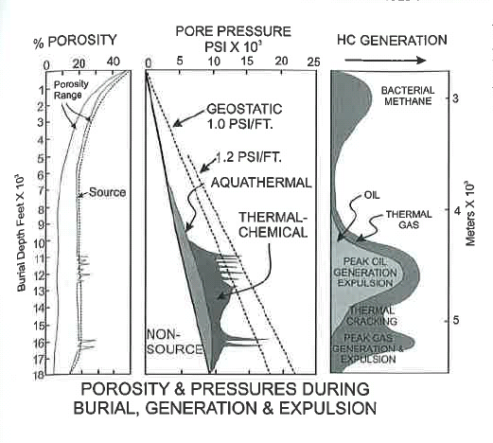
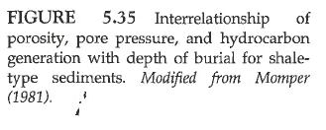
Petroleum Production in Context of Sedimentary Basin Subsidence Model
Early Phase, Shallow, Biogenic Gas Production
1000’s of Feet
Mature Phase, Deep, Thermogenic Hydrocarbon Production
With increasing depth of burial, porosity decreases,
Temperature increases, clays dewater, hydrogen-oxygen
Expelled as water, H-C ratio decreases, higher molecular
weight hydrocarbons produced

Slide 23
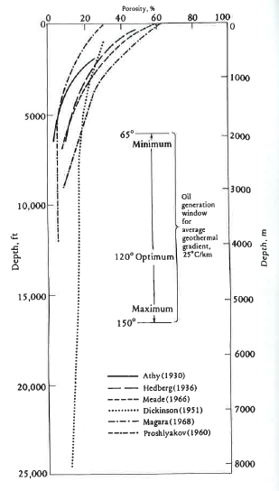
Shale Compaction Curves
With increasing depth of burial =
-Decreased porosity
-Water explusion
-Increasing pore pressure
-Increasing Temperature
-Increased hydrocarbon maturation
(<H, <O, >Carbon and > Molecular Wt.)

Slide 24
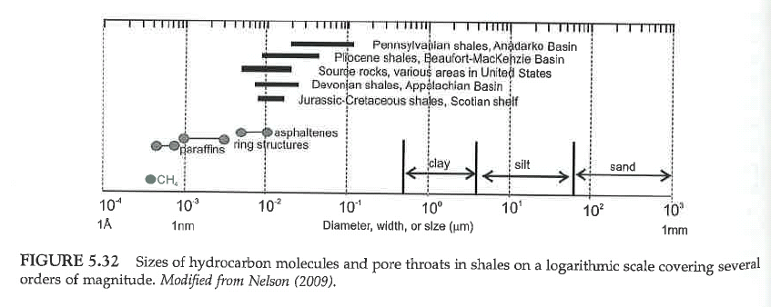
Shale Migration Paradox Issue: comparison of organic molecule diameter to
pore-throat opening diameters in fractured shales and primary sediment
Possible to squeeze petroleum drops through a fine-mess, low permeability sieve

Slide 25
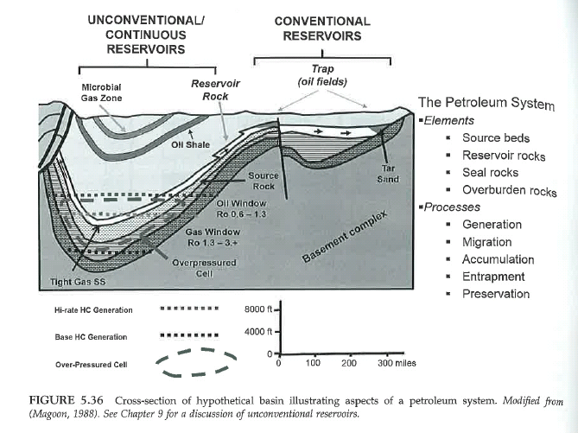
Shallow, Low T,
Low P, Anerobic, Biogenic Gas Production
Deep, Higher T,
Higher P Thermogenic Gas Production
Idealized Petroleum System (Source-Migration-Trap)

