Slide 1
INTRODUCTION TO PETROLEUM GEOLOGY
Application of Geoscience to the exploration and development of oil and natural gas
Oil and Gas = Naturally Occurring Hydrocarbon compounds derived from biogenic sediment

Slide 2
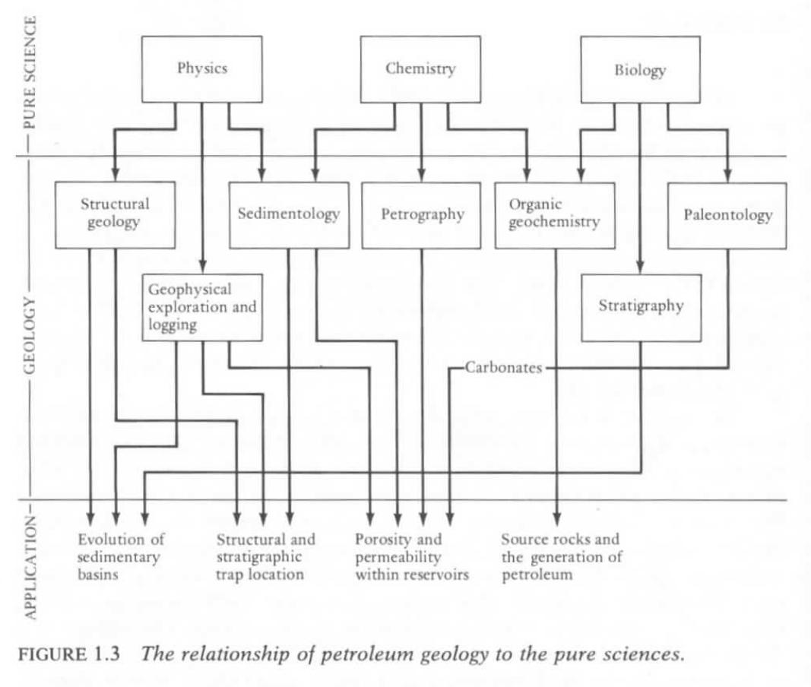

Slide 3
Organic Sediment: Marine vs. Non-Marine
Bitumen – soluble organic matter
Kerogen – insoluble organic matter
Marine Organics: algal, soft parts, petroleum generation
Terrestrial Organics: woody plants, gas generation
Mixed Marine-Terrestrial: waxy oil-gas mix
Conditions for petroleum accumulation:
Organic source rock
Sediment burial and thermal maturation (heating over time)
Permeable and Porous reservoir rock to store fluids
Cap rock or impermeable seal to contain buoyant fluids
Favorable geometric arrangement between reservoir and seal

Slide 4
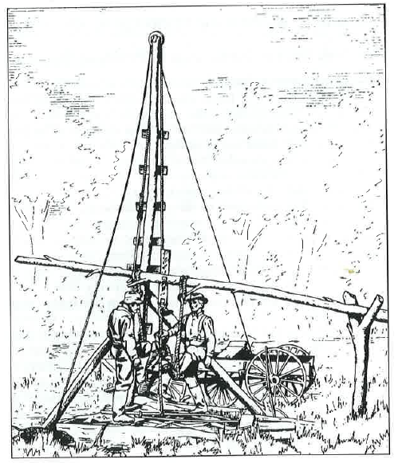
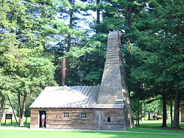
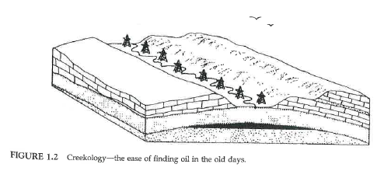
Historical Perspectives
1859 “Drakes Well” Titusville, Pennsylvania
Cable Tool Drilling
“Venango Sands Reservoir”
Greeks & Europeans through 17th century; petroleum collections at seeps and springs
Early exploration method: drill the creeks and anticlines

Slide 5
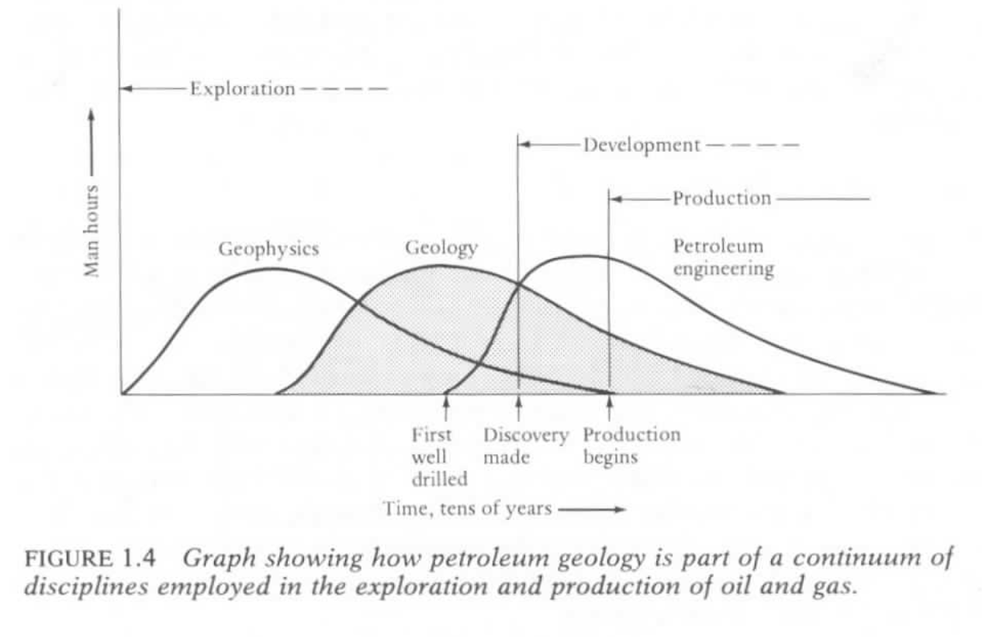

Slide 6
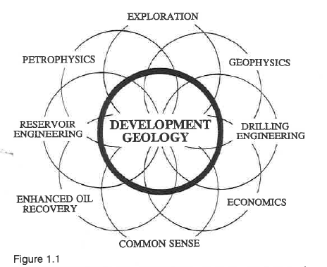

Slide 7
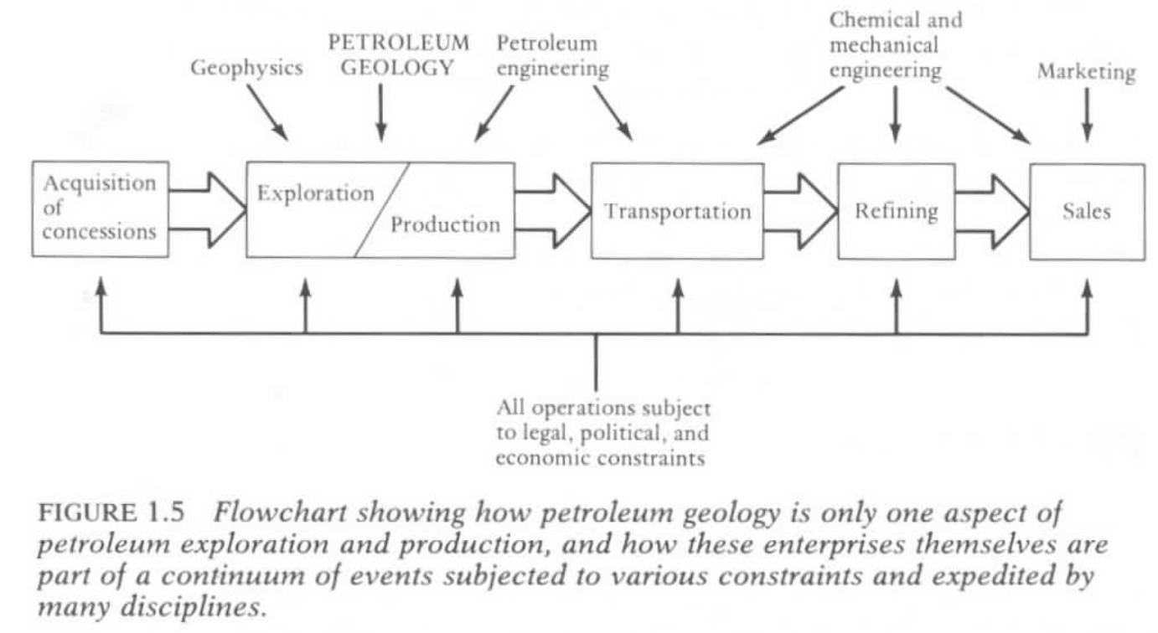

Slide 8
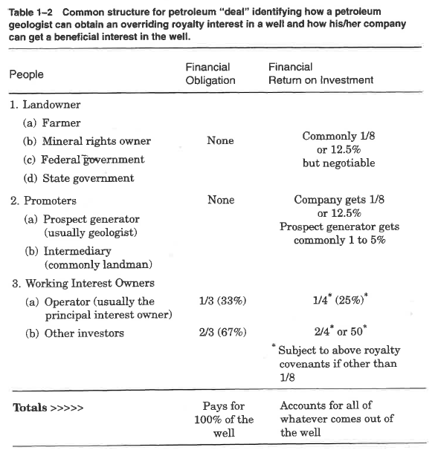

Slide 9
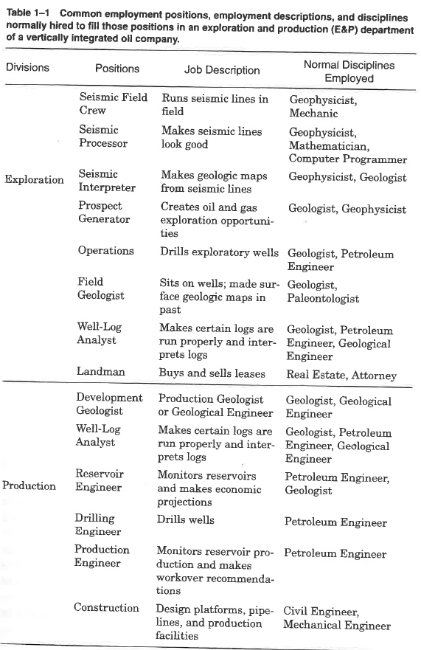

Slide 10
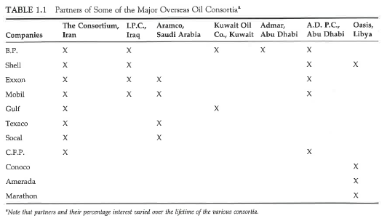

Slide 11
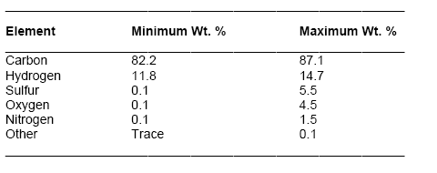
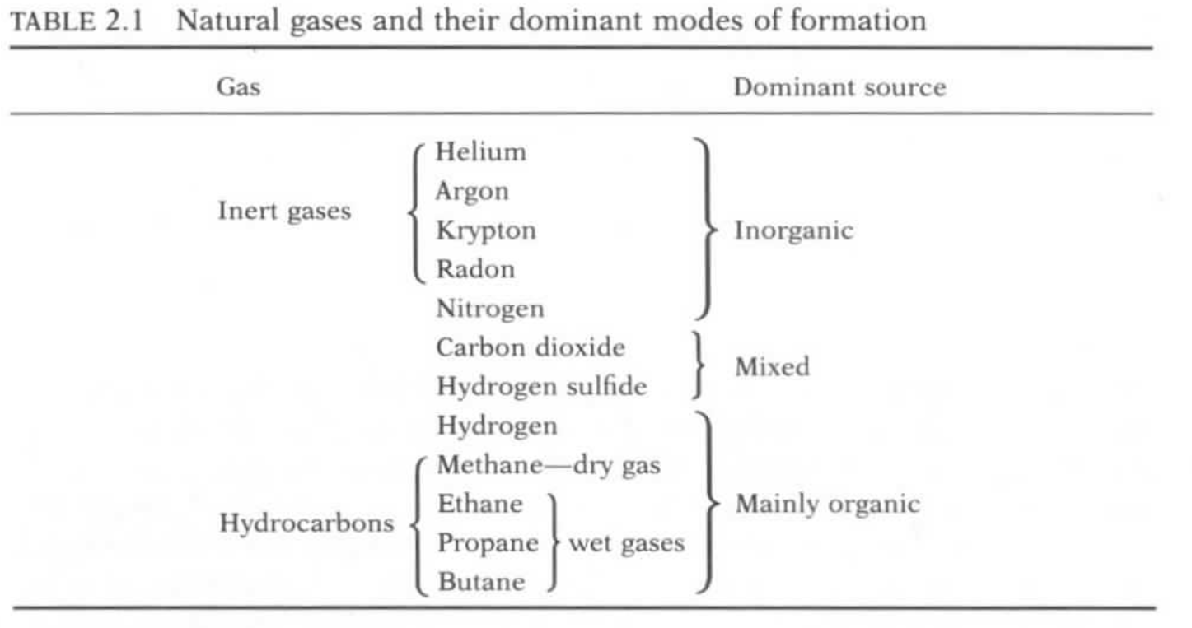
Elemental composition of crude oil by weight%

Slide 12
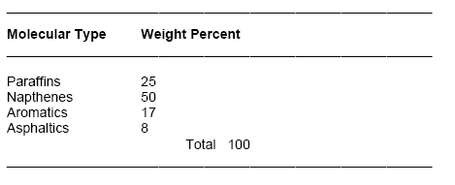
Hydrocarbon Compounds in Petroleum:
> 200 organic carbon-based compounds
Paraffins: gaseous at surface temperatures
Napthenes: liquid at surface temperatures
Aromatics: ring-based compounds
Asphaltics: heavy oil and tar

Slide 13
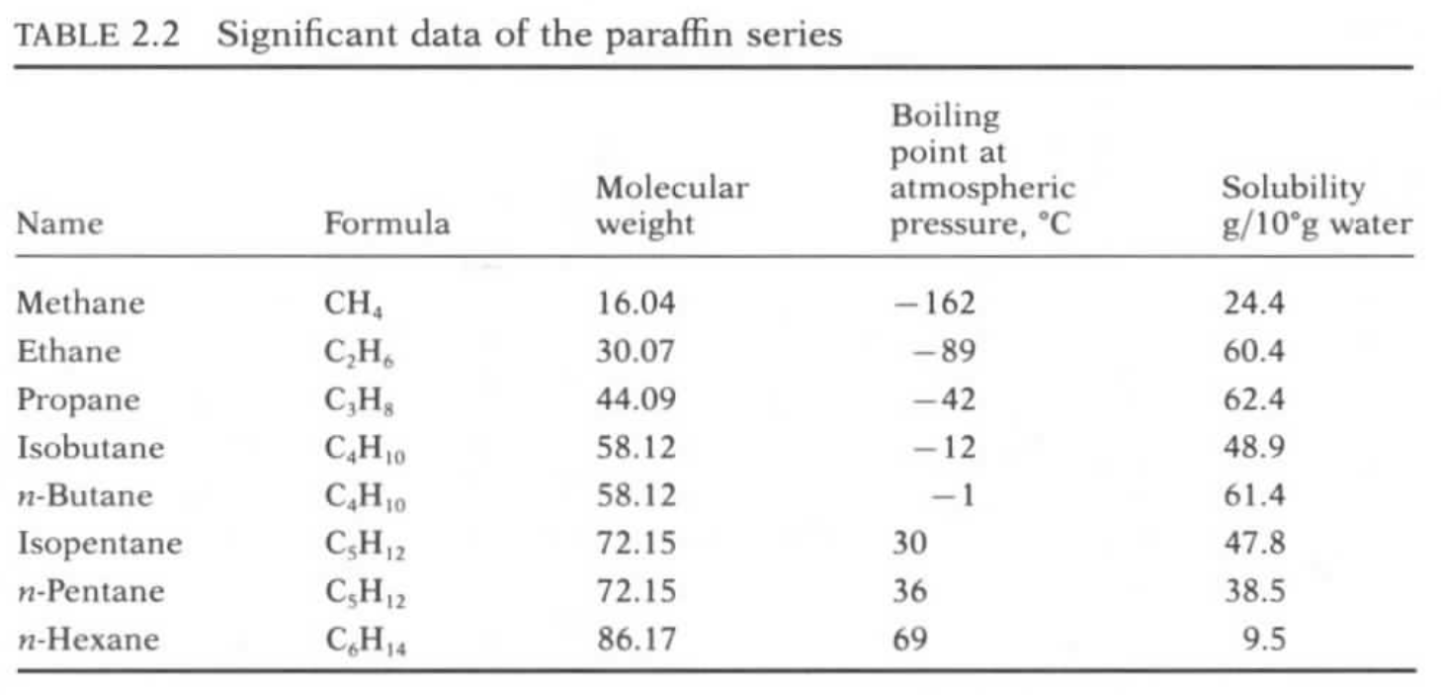
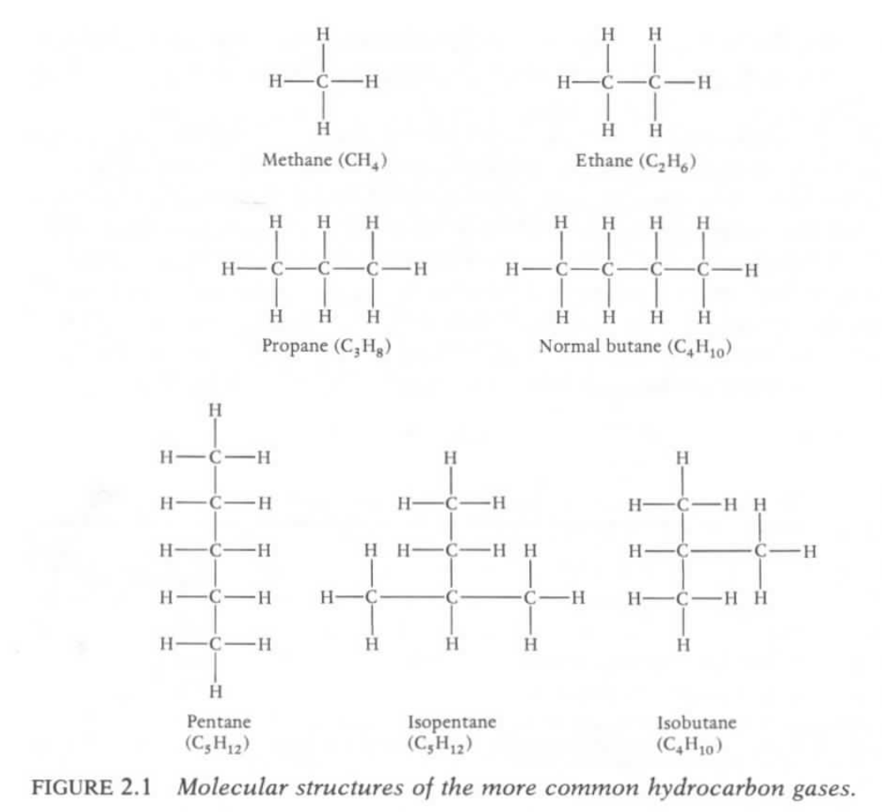
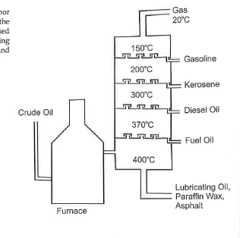

Slide 14
