Slide 1

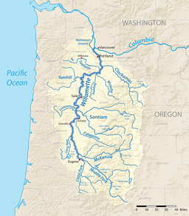
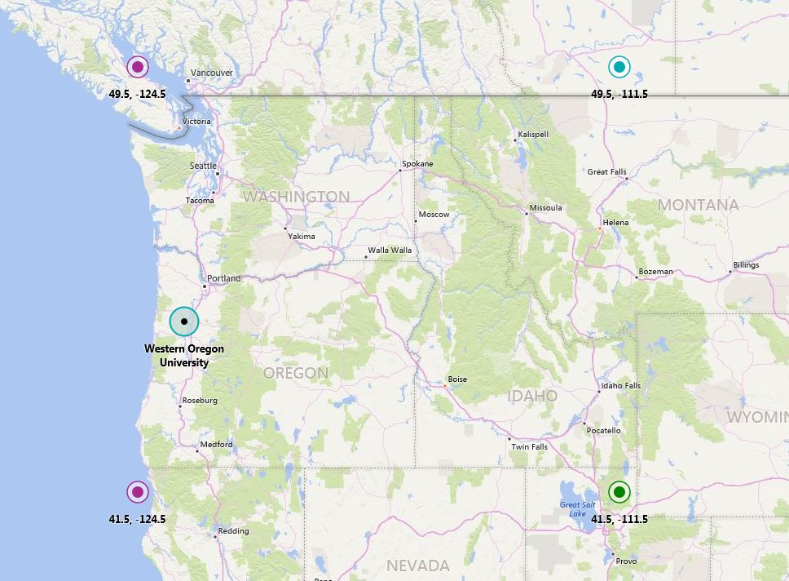
Projecting future climate of the Pacific Northwest
Kyler Freilinger, Western Oregon University email: kyler.freilinger@gmail.com
Introduction
Evaluating Global Climate Models
Results
The topic at hand is making future climate predictions. The predictions will be made using Global Climate Models (GCMs). The GMCs will be evaluated using detailed measurements. They will be used to predict the climatic condition of the Pacific Northwest (PNW) in the 21st century, using data from the 20th century.
To evaluate models, the models are used to try and recreate a past climate. For our purposes this is the climate of the PNW in the 20th century. Some of the metrics used include annual mean, seasonal mean, standard deviation, and overall trends.
Annual temperature and precipitation changes
  -Precipitation and temperature will increase
  -The rate of increase will decline over time
Seasonal temperature and precipitation changes
  -Temperature will increase in all seasons
  -Precipitation will increase in Winter, Spring, and Fall. However, precipitation will decrease in Summer.
Data Acquisition
Data was used from four periods 2000s, 2020s, 2040s, and 2080s. The data from these periods were then compared to the conditions of the 20th century. The year 2000 is used as a base line.
Location and Study Area
The PNW is defined as 41.5°N to 49.5°N and 124.5°W to 111.5°W.. This is approximately 322870 square miles. Cells are used to quantize the data. On average, cell sizes are 0.5°x0.5°. The area of the PNW is 416 cells. This is approximately 776 square miles per cell. One side of a cell is just over from WOU to OSU.
Summary
The climate of the Pacific Northwest is changing, temperatures and precipitation are both increasing. However, temperatures and precipitation, while increasing, are increasing at a slower rate. The only exception being that summers at the same rate will be getting dryer.
References
Rupp DE, Abatzoglou JT, Hegewisch KC, Mote PW. 2013. Evaluation CMIP5 20th century climate simulations for the Pacific Northwest USA. Journal of Geophysical Research: Atmospheres. 118:10,884-10,906
Mote PW, Salathé EP Jr., 2010. Future climate in the Pacific Northwest. Climate Change, 102, 29-50

