Slide 1
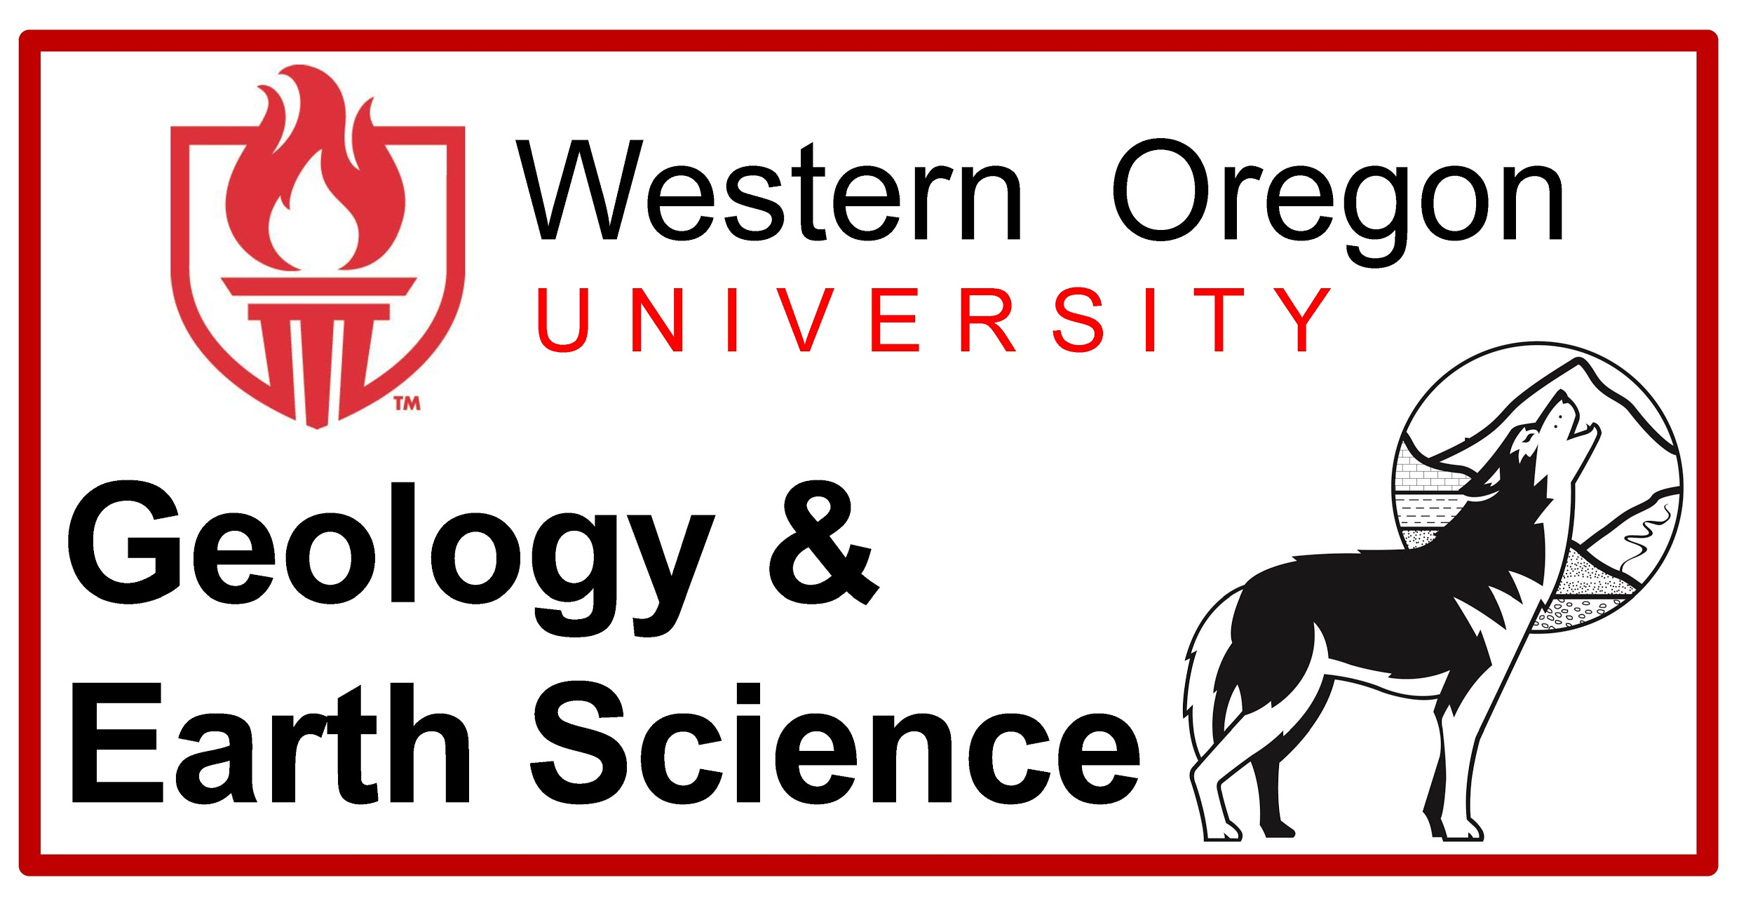
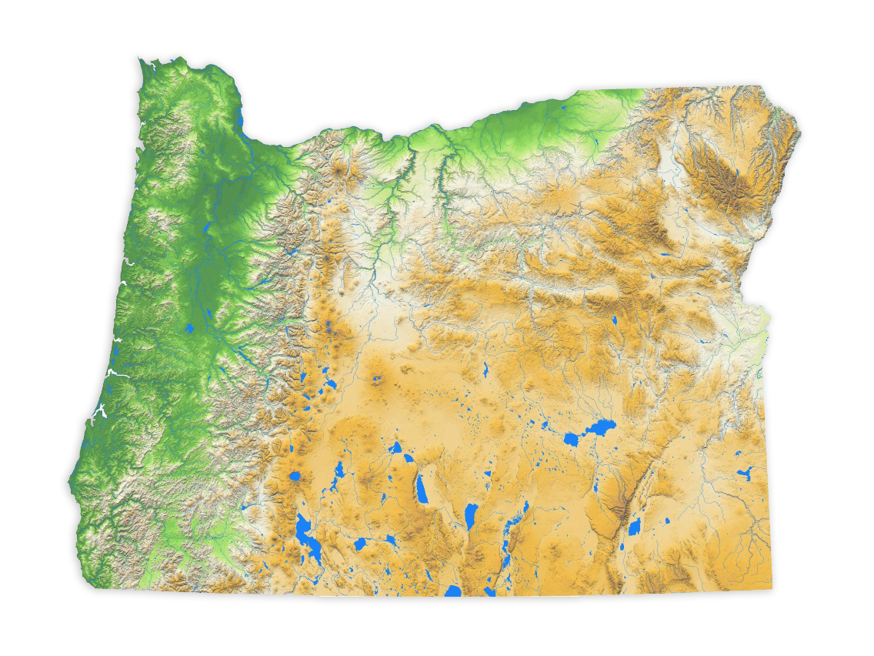
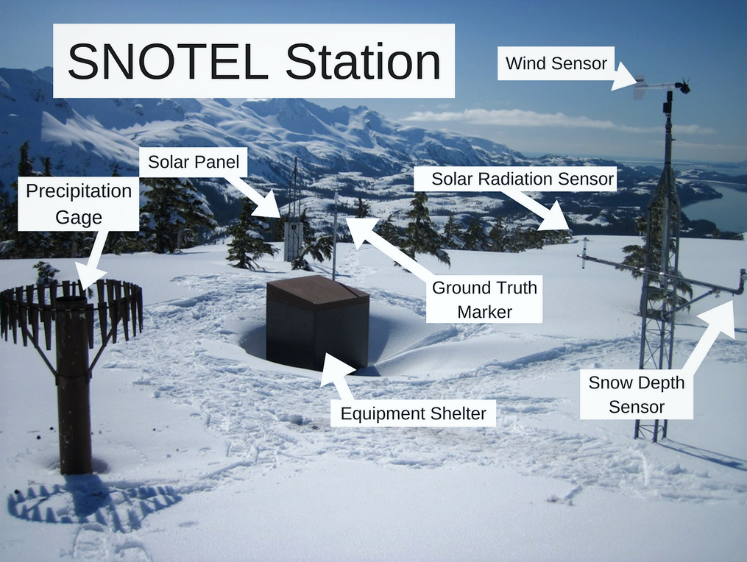
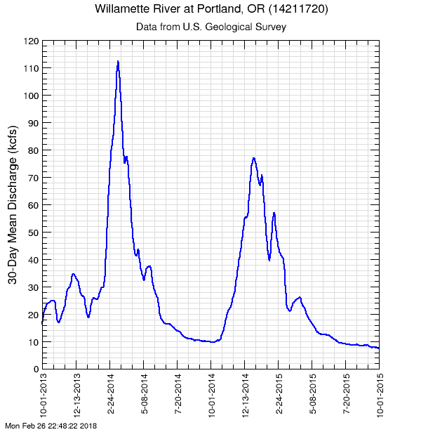
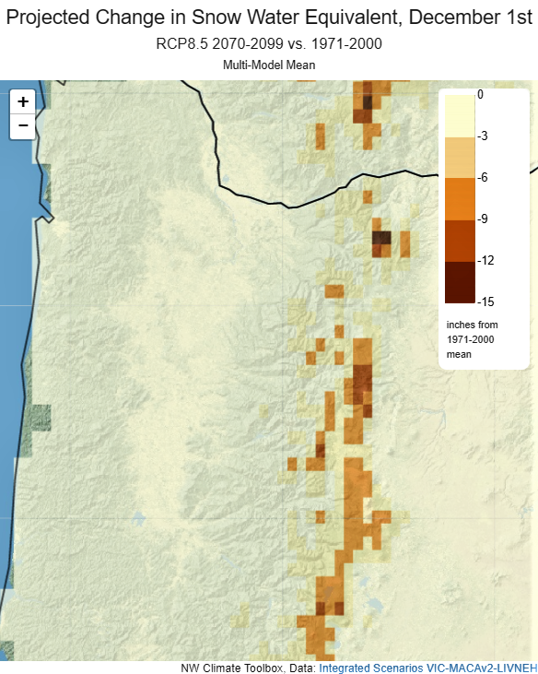
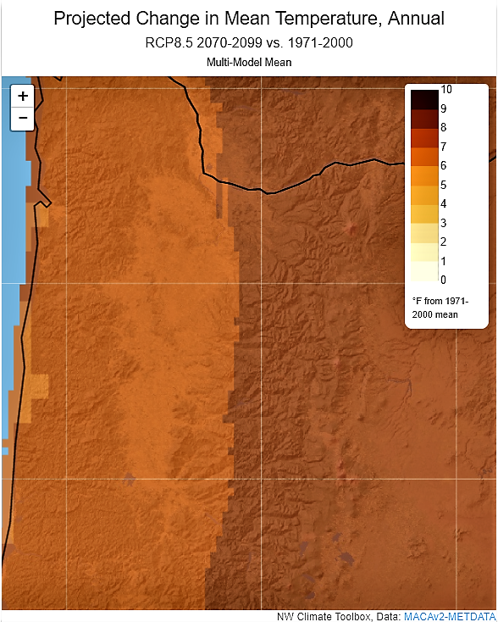
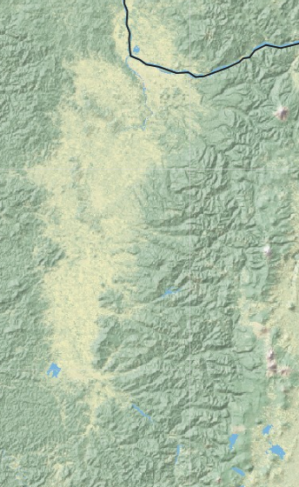
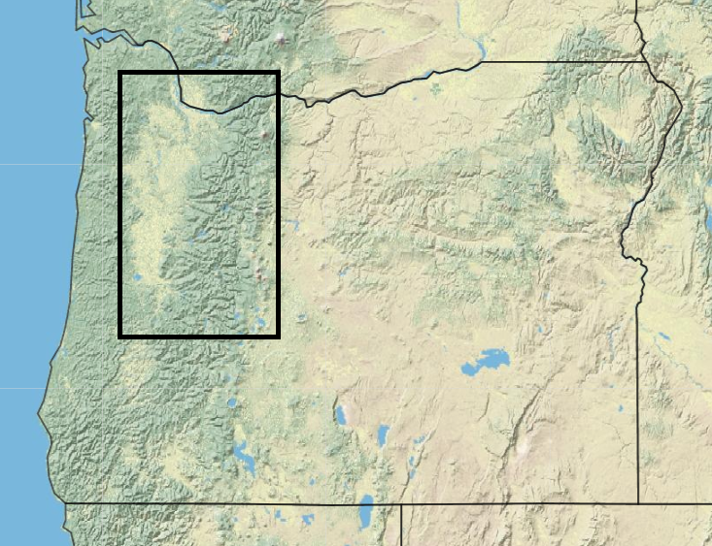
Historic Changes in Snowpack of the Oregon Cascades: Where
is all the Snow Going?
Connor Pomeroy, Earth and Physical Sciences Department, Western Oregon University, Monmouth, Oregon, 97361 email: cpomeroy13@mail.wou.edu
Introduction
Methodology
Discussion
Two of the last ten years have had extraordinarily low snowpacks.
Water-Year 2014 and 2015 both recorded less than 50% of the historic median value for snow storage (Mote, 2016)
Rising temperatures have resulted in an increase of rainfall and a decrease in snowfall.
The Snowpack Telemetry Network (SNOTEL) run by the Natural Resources Conservation Service (NRCS) monitors weather conditions throughout the Pacific Northwest.
Snow Water Equivalent (SWE) measures the amount of water contained within snowpacks.
Precipitation and snowfall amounts are gathered every year and compared to the running average of the local environment.
Future climates are estimated by comparing over 47 Coupled Model Intercomparison Project (CMIP) phase 3 and 5 climate models that take into account local and regional data-sets
Even though there is a measurable decrease in snowpacks, this is not caused by sizable decrease in precipitation, but by an increase in atmospheric temperatures; this causes the snow zone to retreat higher up the slopes and rain in its place.
When comparing WY-2014 and WY-2015 against historical data, warm weather shrinking the snowpacks in favor of rain leads to higher chances of flooding in the wet season, and a lower water-table in the dry season.
If the dry season does not have adequate snowpacks to supply the rivers and tributaries, groundwater depletion is hastened. Even if the region receives the normal amount of precipitation (with an abnormal distribution pattern), the region could be greatly affected by drought.
Despite data that support warming temperatures and shrinking snowpacks from WY-2014 and WY-2015, scientists will not know the extent of impact on groundwater resources until at the earliest 2022 due to the 7-year mean transit time of groundwater infiltration in the Willamette Basin.
Toolkit.climate.gov
Results
The average Snow Water Equivalent relative to cumulative precipitation (SWE:P) dropped to 0.20 (20% snow, 80% rain) in WY-2014 at an elevation of 1500m while the historic average SWE:P at 1500m is 0.58. In WY-2015 the 0.20 SWE:P was not met until reaching 1750m.
At the elevation in which snowpacks normally form, WY-2014 recorded a temperature 2.7*C warmer than the historic average, and WY-2015 reached 3.3*C warmer than average for the same elevation.
Rainfall in WY-2014 was 102% the historical average, and WY-2015 was 81% the historic average.
By the end of the century the temperature is projected to increase between 2-5*C (4-9*F)
General setting
The Willamette Water 2100 study looks primarily at the Willamette River basin and includes not only the Willamette River but also the smaller rivers and tributaries that feed into it.
Rainfall provides most of the water during the winter and spring, with snowpacks supplementing groundwater in the summer and fall which are relatively dry seasons.
Summary
The Willamette Valley has been warming since 1901 on average 0.056-0.076*C per decade and shows no signs of slowing down..
Some areas record temperatures 3.3*C higher than the historic average.
If we do not change our actions, by the year 2100, the snowpacks will be absent from all but the highest of peaks, temperatures could be 5*C warmer, and groundwater may be all but depleted.
The Willamette River Basin
References
Sproles, E.A., Roth, T.R., and Nolin, A.W., 2016, Future Snow? A Spatial-Probabilistic Assessment of the Extraordinarily Low Snowpacks of 2014 and 2015 in the Oregon Cascades: The Cryosphere Discussions, p. 1–21, doi: 10.5194/tc-2016-66.
Abatzoglou, J.T., Rupp, D.E., and Mote, P.W., 2014, Seasonal Climate Variability and Change in the Pacific Northwest of the United States: Journal of Climate, v. 27, no. 5, p. 2125–2142, doi: 10.1175/jcli-d-13-00218.1.
Climatetoolbox.org
Notes:
1

