Slide 1
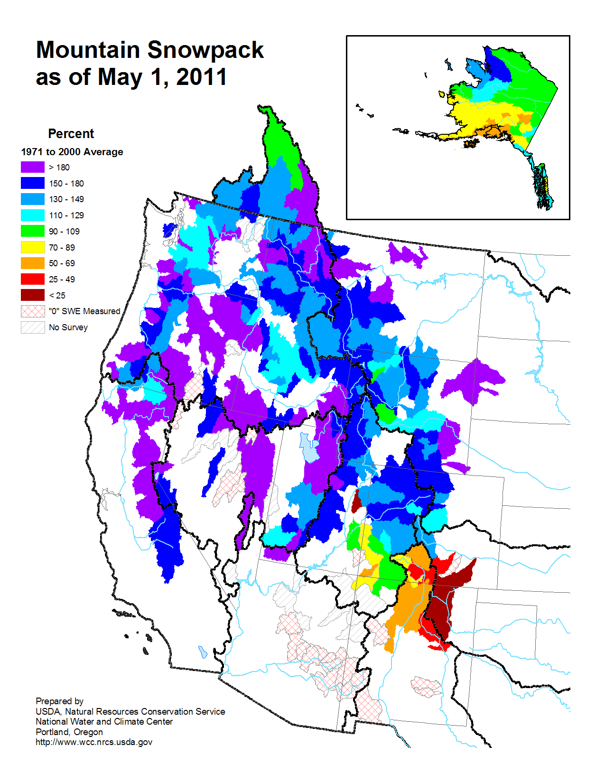
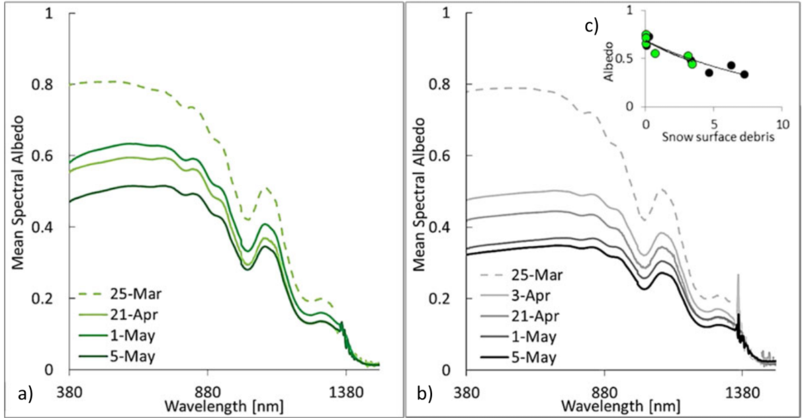
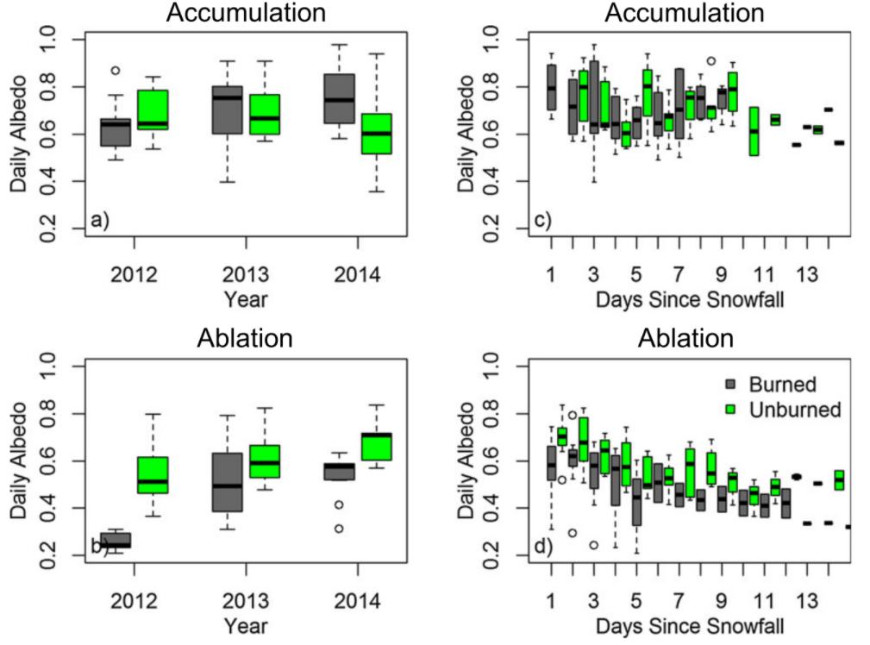
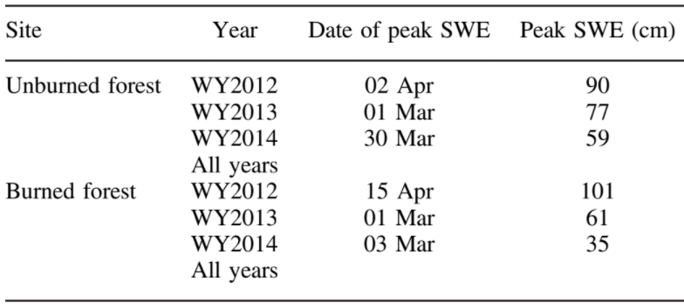
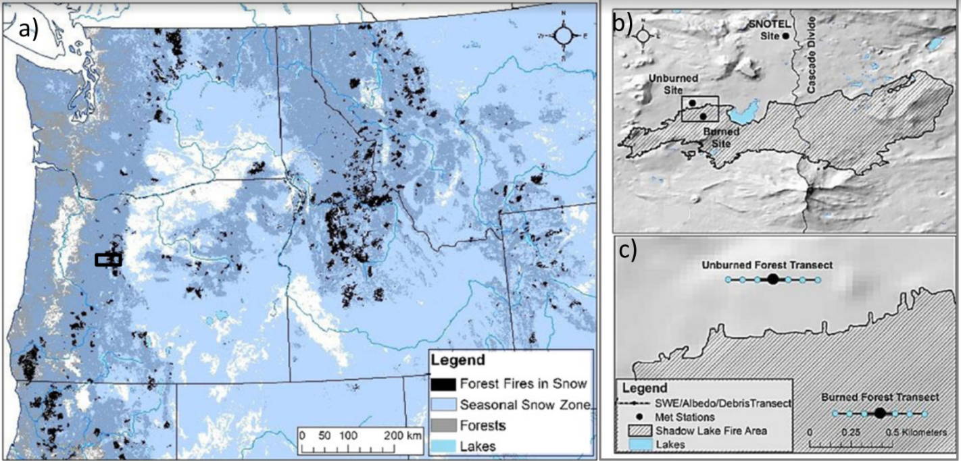
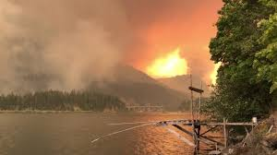
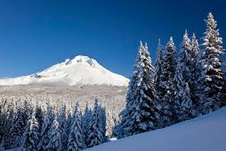
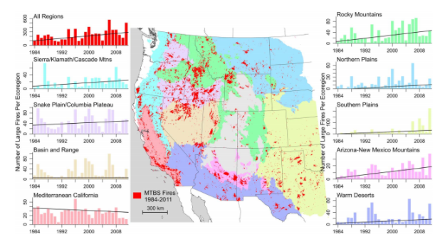
Snow and the Fire Cycle in Western Oregon
Walter Schoen, Earth and Physical Sciences Department, Western Oregon University, Monmouth, Oregon, 97361 Email: wschoen14@mail.wou.edu
Abstract
Evidence has been documented of increasingly warmer temperatures through gaging stations around the United States. Increasing temperatures makes the probability of forest fires far more likely. A study has shown that each year, the United States forest fire occurrence rate increases by around 7 per year (Dennison, 1984-2011).Large forests near mountainous regions in particular are susceptible to climate change. Forest like these are susceptible since most of the water they receive is derived from snow melt. Snow is affected by climate change but another contributing factor of snowpack is its albedo. The albedo, or ability snow has to reflect solar radiation, is affected by forest fires declining whenever there is a blaze close to the snow. This was determined by measuring and comparing the reflectivity of areas with snow that had a fire, to those that hadn't been burned. Areas with low albedo melt faster and with a quickly dwindling snowpack and many areas will experience drought in the later months raising the probability of another fire.
Conclusion
Research Methods
Areas with snowpack are delicate environments that three years following a forest fire see higher melting. This melting was analysed, mapped, and modeled using many different methods to reveal that radiation in burned areas is more easily trapped. This albedo decay caused melting is caused by albedo decay in the snow caused by the dark ashy soil trapping solar radiation causing the snow to melt earlier in the year. Gleason (2016) suggested that the annual fire occurrence is increasing by a rate of around 7 large fires combined per year. This fire occurrence is predicted to worsen in coming years due to drought caused by early mountain snowpack melting. If multiple drought occurrence increase the likelihood for large fires we will see more fires and droughts in the days to come.
FIGURE 2.
Researchers used a unique variety of tools in order to make field measurements. Measurements like these are necessary in order to characterize snow albedo decay and model its patterns. Tools like the Analytical Spectral Devices Full-Range Portable Field Spectroradiometer which allowed the researchers to measures up to 1 nanometer spectral resolution of light. The field was divided into 20 m sections along a 200 m transect through the area (Gleason, 2016). Each year many measurements were made during the times of accumulation and ablation of the snow. Along each course the snow depth and surface debris concentrations were recorded on a monthly basis and every 2 weeks during ablation and accumulation. Figure 2 shows a simplified version of their snowpack thickness results showing the pack diminishing from .3 to .1 in similar areas and Figure 3 looks closely at the accumulation and ablation data.
Fire Cycle
FIGURE 3.
A pattern can be drawn between forest fires, Albedo decay, and the increasing number of forest fires in America. Figure 3 shows forest fires in America are increasing by around 7 per year (Dennison, 1984-2011). When forest fires occur in mountain areas they increase the melting rate of snow. When snowpack melts early it is known that drought follows as the water from some rivers dry up. Droughts like these effect any surrounding forests that haven't been burned drying them up and increasing the probability that a forest fire can start and spread. A cyclical pattern can be seen as the fires cause snow to melt early, which cause drought, which dry out forests leading to more fires.
FIGURE 1.
Introduction
The Oregon Cascades, where a deep snowpack occurs, is the site used to study because large scale forest fires have occured. Researchers used a variety of methods in order to connect burned areas with higher albedo rates. Evidence was found that shows that snow albedo is a major driver of ablation in both burned and unburned zones. The Albedo was found to strongly correlate to days since snowfall and surface debris concentrations (Gleason, 2016). Our study area (fig 1) which is at an elevation of 1450m contains both burned and unburned forested area and the border in between. Over a period of 3 years information was collected about the albedo in these two areas in association with surface debris measurements.
FIGURE 5.
References Cited
Dennison, Phillip E., 1984-2011, Large Wildfire Trends in the Western United States, AGU Publications, 2928-2933
Gleason, Kelly E., Nolin, Anne W., 2016, Charred forests accelerate snow albedo decay: parameterizing the post-fire radiative forcing on snow for three years following fire, Wiley Online Library, 3855-3870
FIGURE 4.

