Slide 1
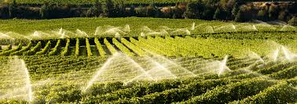
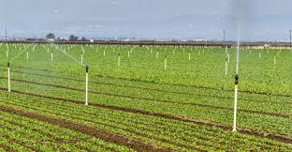
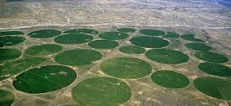
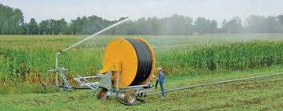
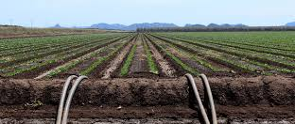
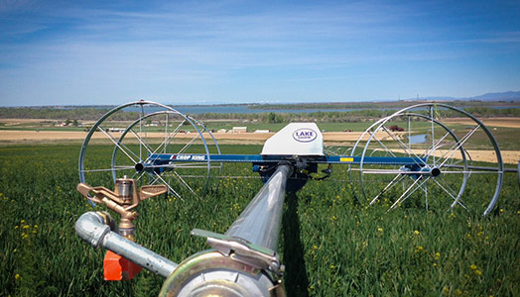
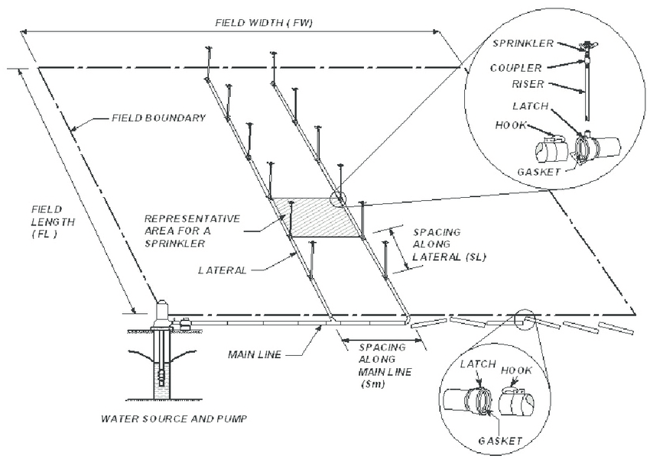
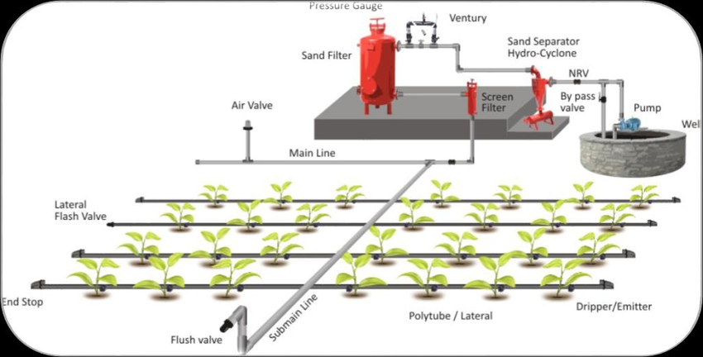
Irrigation Decisions for Major West Coast Crops: Water Scarcity, Climate Determinants and Costs
Maddie Peterson, Earth and Physical Sciences Dept., Western Oregon University, Monmouth, Oregon, 97361 email: mpeterson17@mail.wou.edu
Introduction
Methodology
Discussion
Drought and water scarcity are becoming increasingly major issues for agriculturally significant regions, making irrigation management a necessary step in adapting to water scarcity and climate change. This includes Washington, Oregon, and California agriculture. Extreme weather, physical and economic water shortages, and climate all significantly impact producer’s irrigation decisions in all regions (Olen, Wu, Langpap 2015). Producers currently use sprinkler technologies or other methods of water application to mitigate potential crop damage or loss from extreme weather and climate. Analyzing variables of water pricing policies and climate change in the West Coast provides valuable information about the impact of water scarcity on regional agricultural and how irrigational water use in the West Coast can be adapted to better serve the producers of crops. Including how producers would respond to changing water prices, scarcity and climate change without significant production or economic loss.
Data analyzed and modeled from the 2007 Farm and Ranch Irrigation Survey database (FRIS) and from the U.S Department of Agriculture provides the most complete irrigation management model for major crops in the regions of Washington, Oregon, and California while accounting for the largest quantity of variables (Olen, Wu, and Langpap 2015). Equations that represent usage per individual farms water shares, as well as the individual crop categories in respect to adopted technology and water application rates were utilized. Sprinkler technology and water application rates also influence irrigation decisions. The effects of water scarcity on irrigation choices also depends on the crop grown, which includes energy prices and acreage allocation. Climate and extreme weather events (including droughts, temperature extremes and frost) are expected to increase in frequency and scale with each passing year. Snowpack melt is also predicted to increase, heightening the dry seasons further. All of these climate variables impact producers irrigation decisions. Socioeconomic factors must be considered in addition to environmental ones; increasing demand for water by urban populations, coupled with the difficulty of developing new water supplies, is forcing farmers in the West Coast to cope with reduced access to surface water (Sunding 2002). The cost of improving water access depends vitally on how the reductions are allocated among users. This requires further methodology that measures the impacts of water supply policy changes on irrigated agriculture to understand how reforms would impact producers.
The research suggests that incentive structures, which encourage adoption of water saving technologies, will not actually reduce agricultural water use because the water savings could be used to further expand cropland (Olen, Wu, and Langpap 2015). Significant changes in well depth would be needed to create economically significant changes in irrigation decisions. Irrigation decisions are more responsive to temperature than precipitation, meaning producers respond vastly differently to climate change by region. Lastly, improved groundwater regulation would provide the signal to producers to adopt methods of irrigation that conserve water resources, which a version of has been implemented in California under the Sustainable Groundwater Management Act of 2014 (Sunding 2002). The results of this study provide information needed for developing future water pricing policies and groundwater regulations. The research provides detailed information about how producers might respond and subsequently adapt to shifting climate and variability in the agricultural industry in the West Coast.
Results
A number of technologies are employed to mitigate water scarcity and climate issues, with degrees of effectiveness depending upon the compatibility of the crop with the irrigation technology. Some examples include sprinkler systems (Figure 1) and drip systems (Figure 2). Effectiveness of water saving applications depends upon the crop grown, the size of growing area, and the amount of water consumed by a crop, all of which are affected by climate and weather events, while the risk of damage by extreme weather and climate depend upon the type of crop. However, water saving application methods are not effective for orchards and vineyards, due to the groundwater well depth needed to effectively irrigate them. Producers who grow multiple crops who experience a diversity of extreme weather, are limited in what technology they can adopt. This has important policy consequences, as water pricing policies are advocated as a means of adopting water saving irrigation technology. It is noted that in some cases this would actually cost producers. While drip irrigation is the most effective water saving irrigation method, sprinklers are the necessary choice, for example, it is widely used in areas of California to prevent frost damage to large vineyards. In that case, producers would not adopt the most cost effective method (drip) and imposing water policy pricings would actually increase costs for producers.
Agriculture in the West Coast
Agriculture accounts for 80% to 90% of total water usage in the West Coast annually (Olen, Wu and Lanpap 2015). Agricultural specifics vary from region to region and state to state, however the entirety of the West Coast is subject to the same issues of increased water scarcity and changing climate, particularly California. Additionally, socioeconomic factors such as population growth and industrialization contribute to water scarcity. In the West Coast, a variety of specialty and forage crops are grown including wheat, alfalfa and soybeans, as well as extensive orchard and vineyard production. How producers modify irrigation practices in response to climate and water resource issues differ due to a host of variables. Individual crops require different water application rates and technology adoption, with some less responsive to water saving application rates than others, such as orchards. Whether a producer receives water resources from a federal source also affects rates of water application, with those who do less likely to use water saving methods for crops as well as having higher mean water application rates per crop (Olen, Wu and Langpap 2015). Due to the significance of agricultural production in the West Coast, it is economically and socially necessary to consider the future of water resource management in agriculture and how that impacts the surrounding regions.
Rising temperatures and decreasing and shifting precipitation patterns are predicted to impact both the production and quality of agricultural commodities in the West Coast with each passing year. As well as increased occurrence of extreme weather events over time. Producers have options for water saving irrigation methods available, and effectiveness depends upon a number of crop and weather variables. Water saving irrigation also depends upon water pricing policies by region and supplies of surface water from federal agencies. The ultimate goal of this research into water scarcity and its associated factors is to provide a model as to how crop producers, government agencies and municipal bodies in the region may respond and adapt to changing climate and water pricing policies in the future.
Conclusions and Summary
Outside supply institutions that control and supply water also influence irrigation decisions for crop producers. Those who receive water from federal agencies are less likely to implement more water saving irrigation methods for crops, and have higher mean water application rates than those who do not receive surface water from federal sources. Water application rates are more responsive to surface water costs if the water cost per unit area is lower. Surface water cost per unit is reduced for producers paying a fee for surface water or those using a surface water supply only (Olen, Wu and Langpap).
Olen, B., Wu JJ., Langpaper C., 2015, Irrigation decisions for major west coast crops: water scarcity and climate determinants:
American Journal of Agriculture Economics. 98(1):21
Sunding, D., D. Zilberman, R. Howitt, A. Dinar, and M. MacDougall. 2002. Measuring the costs of reallocating water from agriculture: a multi-model approach. Natural Resource Modeling. 15 (2): 201-225
https://www.researchgate.net/figure/A-typical-layout-of-the-drip-irrigation-system_fig1_305491620
https://www.researchgate.net/figure/Components-and-general-layout-of-sprinkler-irrigation-systems_fig1_43265028
References

