Slide 1
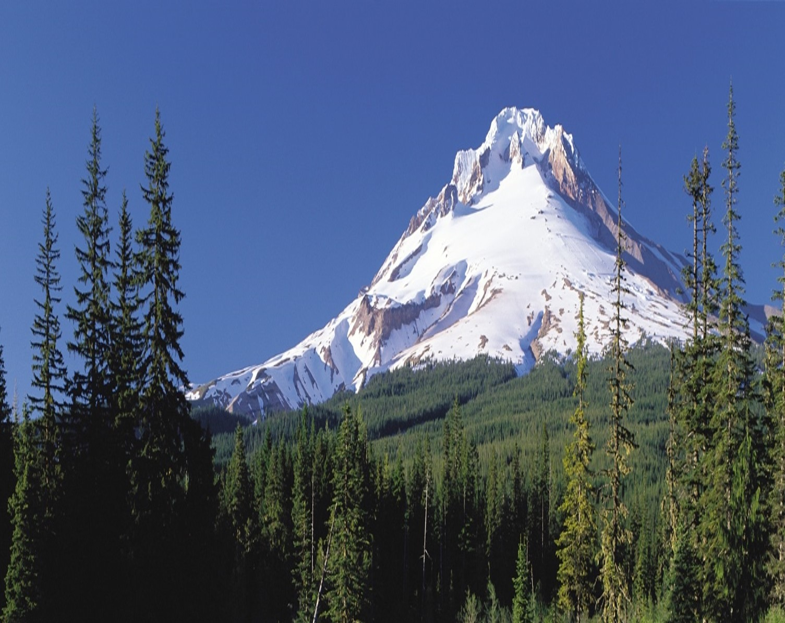
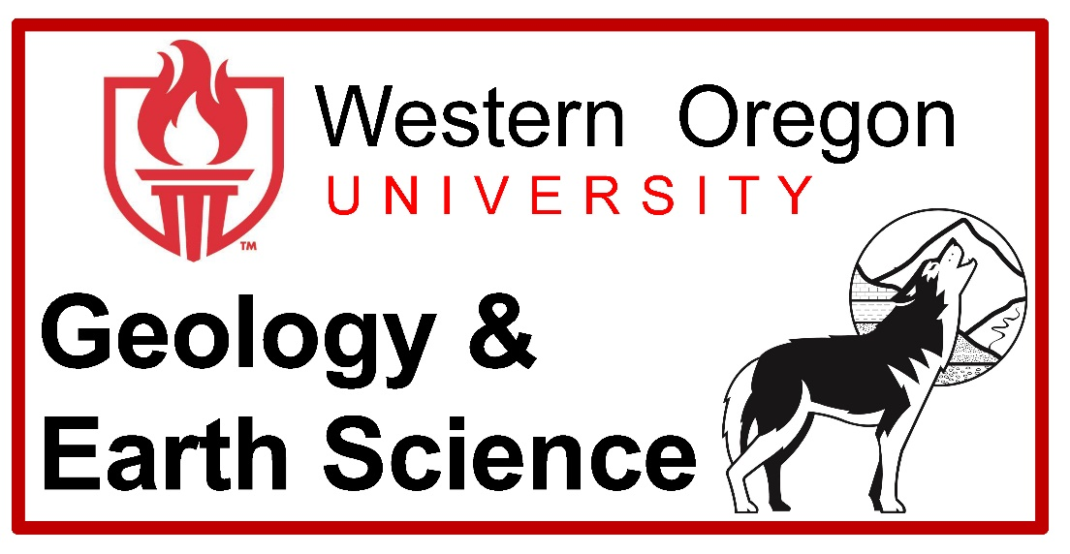
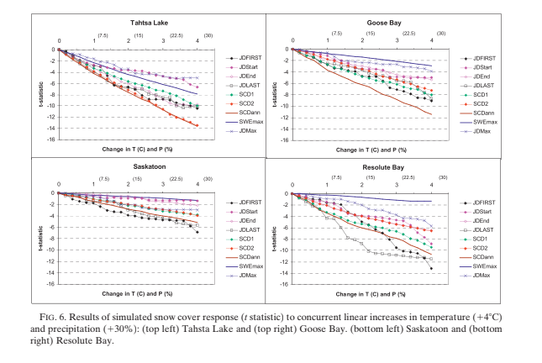
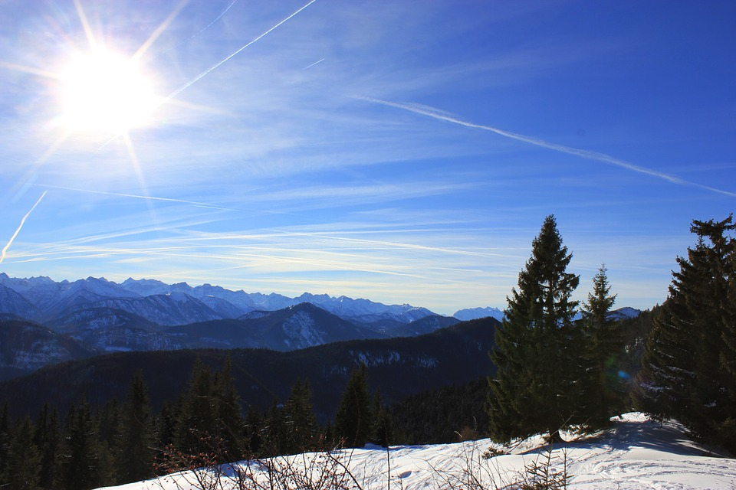
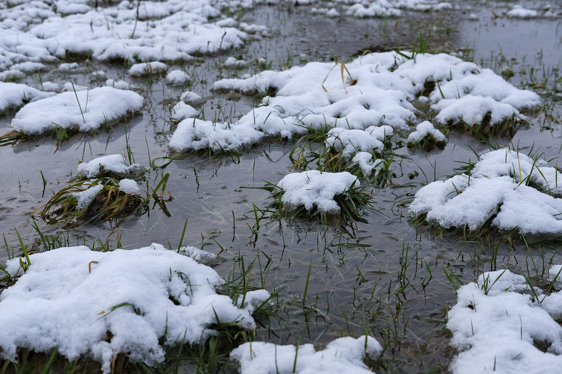
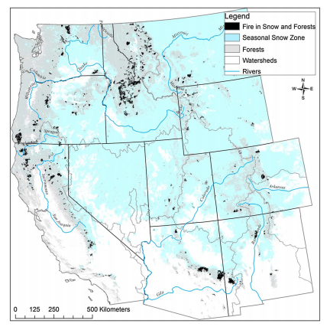
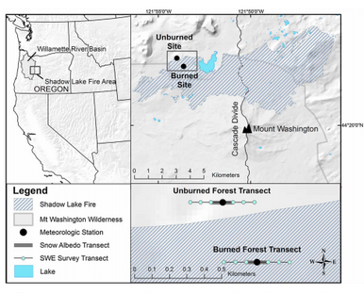
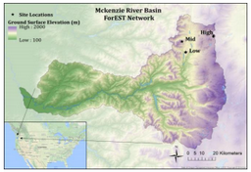
The Effects of Forest Fire on Snow Albedo
ES476 Hydrology Journal Review by Emily Carlston | Western Oregon University
Introduction
Methods
Results
In the Pacific Northwest there is a high demand for water year round due to the ever increasing uses. The Willamette Valley gets the majority of water resources through snowpack that builds up gradually during the winter and melts slowly over the summer creating a steady input of water. One of the sources of these snowpack is found on the Cascade range, but something changes when the natural processes of forest fires come into effect. The dynamic relationship of ablation, albedo, and forest fires triggers a relentless feedback loop. These three papers will explore the possible ramifications of forest fires and their role in water resources and climate change.
The Response of Northern Hemisphere Snow Cover to a Changing Climate* Ross D. Brown and Philip W. Mote
There are a lot of different data sources for the western hemisphere. This study used for data sources to look at the change in time over specific areas of study. The data sources were collected from:
  The Climate Station data from four Canadian sites from 1961-1990
  NOAA Satellite Snow Cover Extent that examined snow cover trends from 1966-2007
  World Climate Research Program’s CMIP3 Multi-model Dataset
  Northern Hemisphere Snow Water Equivalent Climatology
The datasets were then examined individually to provide a potential indicator for climate change based on the properties of snowmelt.
The Response of Northern Hemisphere Snow Cover to a Changing Climate* Ross D. Brown and Philip W. Mote
Throughout all of the datasets there was a heavy implication put on the amount of snow coverage present at various given areas in the Northern Hemisphere. Statistical analysis was then used to correlate the increases in air temperature and the amount of precipitation. In the first dataset Tahtsa Lake exhibited the strongest temperature sensitivity. Significant reductions in snow water equivalent max are more likely to occur in the lower elevations of maritime climates. From these results possible projections were made for the upcoming years.
Background Information
Results of simulated snow cover response
(t statistic) to concurrent linear increases in temperature (148C) and precipitation (130%): (top left) Tahsta Lake and (top right) Goose Bay. (bottom left) Saskatoon and (bottom
right) Resolute Bay.
In order to discuss this feedback loop, the parts of the feedback loop must be identified.
Albedo is defined as the reflective properties of snow.
Ablation is the removal of snow through any method such as melting or sublimation.
Forest fires are an expanse of unrestrained fire occurring in a natural area.
The snowpack as a water resource has a large impact on not only the local environment, but also the local economy. If the snowpack continues to disappear over a larger region it will begin to have a higher impact on the interlinked global climates. A forest fire’s effect on both the albedo and the ablation through reduced canopy cover, as well as increased debris and a darkening of the area, create an acceleration of snowpack melt. The stress of not only forest fires, but also other natural and anthropogenic forces will speed up this impact.
Rising Temperatures
Higher Rates of Ablation
Lower Albedo
More Solar Radiation Absorption
Charred forests increase snowmelt: Effects of Burned Woody Debris and Incoming Solar Radiation on Snow Ablation Kelly E. Gleason, Anne W. Nolin, and Travis R. Roth
The McKenzie headwaters river basin is the main focus of this study, with around 50% of the area burned with a moderate-high burn severity leaving a near total loss of forest canopy coverage, this locality on the Oregon High Cascades was the perfect spot to observe the snowmelt. This particular river basin, with an elevation of 1750 m, is a tributary to the Willamette River and receives around 300 cm of precipitation between November and April.
The hourly mean incoming and outgoing solar radiation was collected and used to calculate the ratio of snow albedo in areas were accumulation exceed 30 cm. Inside of the plot, sample areas 0.5 km transect were made. Within the transect snow depth and snow water equivalent were measured at the lowest resolution of 100m monthly with increasing frequency towards the end of melt season. At each data collection location for snow water equivalent, a sample of surface snow was taking to look at debris filtration. Within each transect a Riegl VZ400TM terrestrial laser scanner was used to collect information about tree high, crown radius and overall forest density. This data was then combine with areal visualizations created by CycloneTM and ArcGISTM. Using
Charred forests increase snowmelt: Effects of Burned Woody Debris and Incoming Solar Radiation on Snow Ablation Kelly E. Gleason, Anne W. Nolin, and Travis R. Roth
During accumulation there was no difference in albedo, but as time went on there was a significant difference. Areas with burned woody debris had a decrease in albedo around 40% and the mean solar radiation was around 60% greater than that of unburned forest. Burned areas were also likely to hold than double the mean debris concentration. Debris concentration is defined as the grams of debris per kilogram of snow. Forest fires were found to be larger inside of the season snow zone than outside of it and after 2000 there have been over 44,000 square kilometers of forests burned in these areas.
Forest fire area overlapping the seasonal snow zone in the western United States (2000–2012).
Forest Impacts on Snow Accumulation and Ablation Across an Elevation Gradient in a Temperate Montane Environment Travis R. Roth and Anne W. Nolin
During a water year in this watershed, substantial differences in accumulation and ablation can be seen when combining the various factors of altitude and forest cover. Results from the water years of 2012 to 2015 shows that canopy interception efficiency was significantly lower in higher altitudes while remaining fairly similar between the lower ones. Net radiation was a key factor in all areas, with the shortwave radiation being dominate where as longwave radiation only being seen in open areas. The forest canopy coverage has a great impact of the distribution of solar radiation onto an area. Solar shading has a relevant position in decreasing the amount of solar inputs.
Discussion
Burned and unburned forest sites are located in the Shadow Lake Fire area.
In comparison, all of these different studies were going about tackling the same problem from different views and combined identify the different aspects of the overall feedback loop. Forest fires increase this feedback loop and can inversely trigger changes in the overall climate change. Higher rate of ablation are seen from the decrease of forest canopy cover due to forest fires. Dark debris generated by the fires also create a decrease in albedo, increasing the overall solar radiation. This leads to an overall decrease in snowpack, further edging along the feedback loop do to an increase in temperatures. In the high cascades this decrease in snow can lead to more drought and stricter rules on water resources.
The Oregon ForEST network sites of the McKenzie River basin.
Forest Impacts on Snow Accumulation and Ablation Across an Elevation Gradient in a Temperate Montane Environment Travis R. Roth and Anne W. Nolin
Taking place in the McKenzie River basin (MRB), this study used six different sampling sites that used two different forest covers, low forest density 20% canopy cover and high forest density 60 % canopy cover, at three different elevations: Low (1150 m), Mid (1325 m), and High (1465 m). The canopy cover requirements were based on the 2001 National Vegetation Cover Database. The forest density was determined by the plotless density estimator approach and hemispherical photographs taken with a Nikon Coolpix 990 digital camera using a FC-E8 fisheye converter gave a 180◦ field-of-view. A Gap Light Analyzer 2.0 was then applied to measure leaf area index (LAI) and canopy closure (CC). The snow water equivalent was measured along a 900 m transect and were collect monthly with an increase in collection rates near the snow disappearance date.
Conclusion
References
Brown, R.D., and Mote, P.W., 2009, The Response of Northern Hemisphere Snow Cover to a Changing Climate*: Journal of Climate, v. 22, no. 8, p. 2124–2145, doi: 10.1175/2008jcli2665.1.
Gleason, K.E., Nolin, A.W., and Roth, T.R., 2013, Charred forests increase snowmelt: Effects of burned woody debris and incoming solar radiation on snow ablation: Geophysical Research Letters, v. 40, no. 17, p. 4654–4661, doi: 10.1002/grl.50896.
Roth, T.R., and Nolin, A.W., 2017, Forest impacts on snow accumulation and ablation across an elevation gradient in a temperate montane environment: Hydrology and Earth System Sciences, v. 21, no. 11, p. 5427–5442, doi: 10.5194/hess-21-5427-2017.
If this feedback loop continues, ablation and albedo will only continue to reinforce each other, eventually leading to an increase in temperatures and drought frequency. The inability to have a closed system that can be controlled in every aspect only drives a larger need for preventative fire safety, such as controlled burns and expansive comprehension on our local water budget. There needs to be a drastic intervention in the way we think about our water budget and the natural and anthropogenic processes that affect it.

