Slide 1

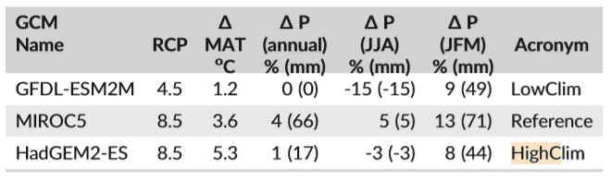
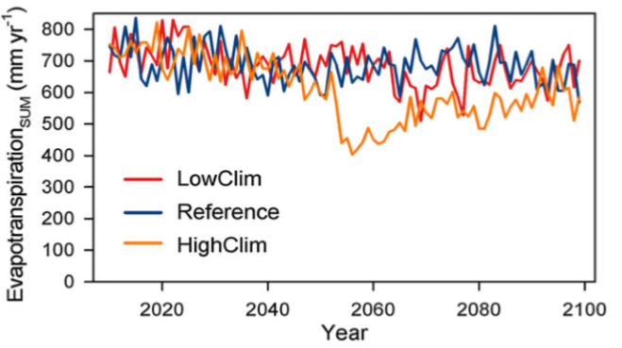
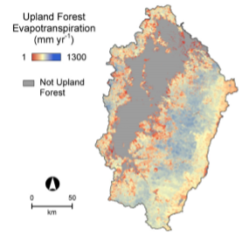
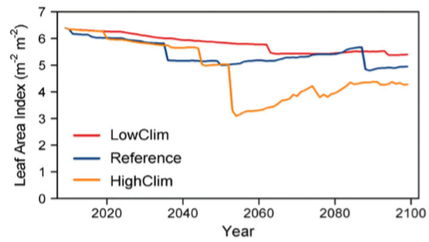
The Effect of Climate Change and Other Biological factors on the Willamette River
Basin’s (WRB) Future Water Balance
Curt Knott, cknott16@wou.edu, Natural Science Department, Western Oregon University, Monmouth, 97361
Climate change is currently one of the largest issues that scientists and researchers have been combating over the last decade. These issues will lead to consequences if not carefully monitored. Climate change as a whole has been and will be affecting the US and the world
In the Willamette River Valley (Oregon), there are two primary causes for concern regarding future transpiration of water ; Increase in Carbon dioxide (CO₂), which closes the stomata of plants, and the increase in temperature, which in turn lowers the snow pack in the higher elevated areas of the basin. The program Envision was used to map many factors that contribute this assumption.
Approaching such a complex problem, many different sources of data are required. The Envision program was one of the mapping programs used, it mapped the land use and disturbances from human use. Another program was used to model all non-human occurrences. This includes rainfall, snowfall, canopy rain evaporation, canopy snow sublimation, transpiration, infiltration and runoff.
The Results of mapping the aforementioned variables and using a program to predict the future mean temperature, along with estimated rainfall as affected by climate change and changes in relatable variables, such as evapotranspiration (ET) yielded the following results. The model average showed increases in total precipitation and rainfall by 3% and 13% respectively (Turner, DP., see references) . On the other hand, ET, canopy rain evaporation decreased by 4% (Turner, DP., see references). The largest impacts where on Snowfall and canopy snow sublimation, which both decreased by more than 45% (Turner, DP., see references).
Section 3: WRB Watershed Hydrology Model
Section 5: Model Analysis
Section 1: Abstract
The Watershed hydrology model is a concept that simplifies the complicated processes of a real world system. For the provided model, the following algorithms where used to simplify the individual variables (All formulas by Turner, DP., See References)
Precipitation (Rain and Snow): All P=S when temperature is below -2 Celsius, all P=R when temperature is above 6 Celsius, where S = Snow and R = Rain
Canopy Transpiration and Soil Evaporation: VPD_{scalar} = (1-((VPD-VPD_{min})/(VPD_{max}-VPD_{min}))) where the VPD_{min} = .61 MPa and VPD_{max}= 3.10 MPa. VPD_{scalar} was set to be 1.0 below VPD_{min} and set to a minimum of .02 as VPD approaches VPD_{max}. VPD is the Vapor-pressure differential mentioned in Section 2 . This is used to include conifer trees in the WRB.
Snow Melt: SW­_{t} = e^{(LAI(-k))} is the formula used to calculate the transmittance through the canopy and the absorbability of snow. SW_{t} = Canopy radiation transmittance and the absorbance of snow, K = extinction coefficient which varies with latent heat of fusion variables.
TABLE 5.1: Average Changes in Temperature, and different forms of precipitation
- The model to the right shows the raw change in data over the entire simulated timeframe. The Reference includes the average expected values.
FIGURE 5.2: The estimated rates of Evapotranspiration totals per year for each of the modeled situations
- As seen in Figure 5.2, the HighClim has the lowest evapotranspiration, while the reference and the LowClim are reasonably close to one another. Evapotranspiration on HighClim gets as low as 400mm/yr.
Section 4: Discussion and Analysis
The effects of climate change on the ET and thus the water balance are extensive. The ET_{total} is declining due to decreasing amount of transpiration. CO₂ , one of the most condemned molecules on the planet, is also the culprit of the lowered transpiration in the plants. Stomata are small pores on the bottom of leaves that release water and oxygen during photosynthesis. The stomata in plants close under two conditions.
The first is if water is scarce, such as a hot summer day or in desert environments. This is caused by osmosis, which is the movement of water from a high concentration to a low concentration. Water concentration inside the plant is higher, which naturally causes the plant to release some of its water to the atmosphere. To prevent this, the plant closes its stomata.
The second reason for the closing of stomata is CO₂. Carbon dioxide is one of the required molecules for photosynthesis. However, when CO₂ concentration is to high, the stomata stop absorbing carbon dioxide to conserve water, since it is also one of the photosynthetic molecules.
This affect on the stomata causes plants to not function at their most efficient rate. As a result, some plants will no longer reproduce as well, or might even die out entirely. Lower vegetative density leads to a lower leaf area index (see introduction). The decrease in LAI from climate change greatly lowers the nightly ET, thus lowering the amount of water in the air at night. LAI also can be tied directly to the total number of plants in the area, and in the WRB highlands, trees have the highest biomass of any plant. This means that these trees are the most affected by this change in LAI.
Lower tree populations leads to
lowered canopy rain transpiration and
snow sublimation because there are
less trees to catch the precipitation
from rainfall or snowfall. When the
tree intercepts this precipitated water,
it absorbs some of the caught water.
This water is later released through transpiration, but this is not the only way water is returned to the atmosphere, it also evaporates directly off the tree due to increased sun exposure.
Considering the models, it is likely that the future climate of the Willamette River Basin will become warmer during the winter, which will be accompanied by higher rates of precipitation in the form of rain. Similarly, the summers will also experience an increase in temperature. Unlike in winter, the summer will probably experience a decrease in precipitation due to the lower rate of evapotranspiration from CO₂ increases.
Although naturally, the vegetative density should be similar to the way it is now, logging increases and the threat of fire will cause a gradual decrease in the leaf area density. Decreases in Leaf Area Index will be one of the leading influence on evapotranspiration, canopy rain evaporation, and canopy snow sublimation. Canopy snow sublimation will likely already be extremely hindered by the increase in temperature.
Vapor-pressure deficit and high CO₂ values will also influence the evapotranspiration when vegetation is taken into consideration. The Vapor-pressure deficit will increase as the CO₂ concentration increases. CO₂ closes the stomata in leaves when the concentrations are to high, this lowers the amount of transported water, and thus lowers the Vapor-pressure deficit.
The predicted decrease in evapotranspiration due to lower leaf area index and increased Vapor-pressure deficit is an issue that needs to be attended. The increase in human activity is one of the most solvable problem. Logging is can be kept more constant instead of increasing demand, fire safety can be implemented more firmly to decrease the risk of fires, and hopefully these lesser impacts from humans can keep the leaf area index and the vapor-pressure deficit constant so that the WRB highlands remain forested, healthy, and abundant in water.
Section 6: Conclusion
The Highlands within the Willamette River Basin (WRB) are the primary focus of this investigation. Considering that the highlands are the primary wooded area, it is important to consider total amount of transpiration that takes place within this part of the valley. The Leaf Area Index (LAI) is one of the methods of calculating the amount of leaves cover a certain amount of ground. LAI is defined as the one-sided leaf or needle per ground area. This is critical in calculating the Evapotranspirative rates of the trees within the region (see figure 2.1). Evapotranspiration is one of the key contributors to precipitation in the WRB highlands. Evapotranspiration (ET) is defined as sum of evaporation and plant transpiration from the earths surface (Wikipedia). The ET from plants is crucial in keeping the Vapor-pressure deficit low. The Vapor-pressure deficit (VPD) is the difference in the amount of water the air is currently capable of holding and the actual amount of water the air is currently holding. These three concepts are key terms that will be used
throughout the investigation.
The Human impacts also need to be taken
into consideration when looking at future
environmental changes, especially with the
exponential rise in human population. Fire has
been a menace in Oregon over the past few
years due to fires. According to article one (see
references, Turner, DP.), the amount of burned
area could increase up to 9 times over.
Section 2: Introduction
FIGURE 2.1: The Evapotranspiration and Area of the Upland Forest within the Willamette River Basin
FIGURE 4.1: The three different generated models for Leaf Area Index for the next 100 years
Section 7: References
Turner, DP., Conklin, DR., Vache, KB., Schwartz, C, Nolin, AW., Chang, Climate Change Impact on the Upland Forest Water Balance of the Willamette River Basin, Oregon. Ecohydrol. 2017;10:e1776. Doi:10.1002/eco.1776
Evapotranspiration. (2018, February 25). Retrieved February 27, 2018, from https://en.wikipedia.org/wiki/Evapotranspiration
H., Watson, E., Bolte, JP. Assessing Mechanisms of

