Slide 1
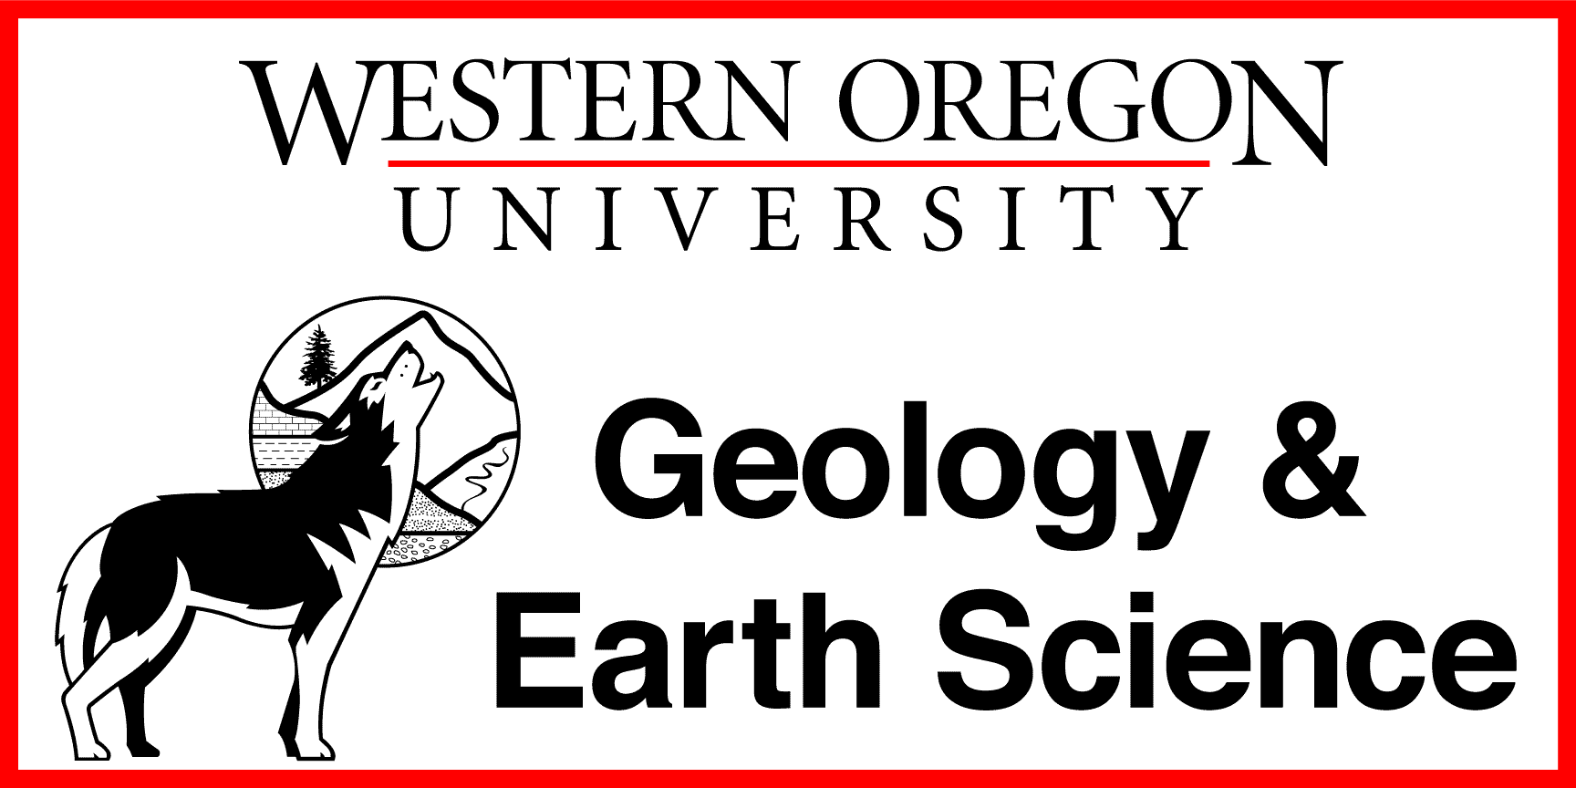
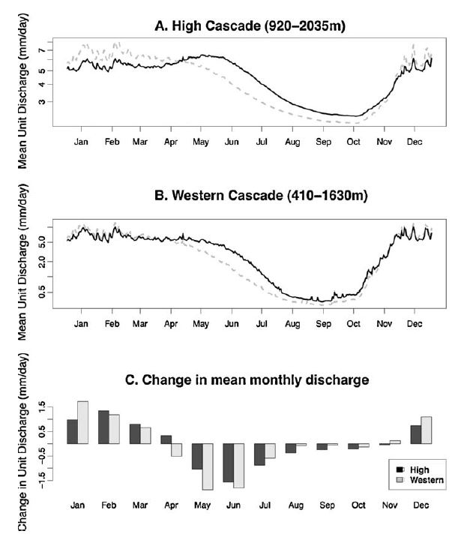
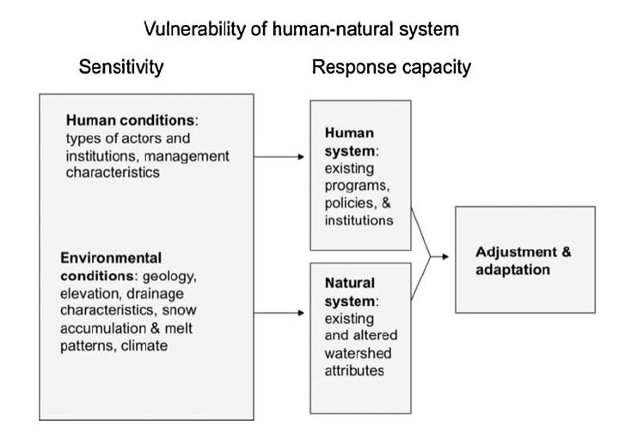
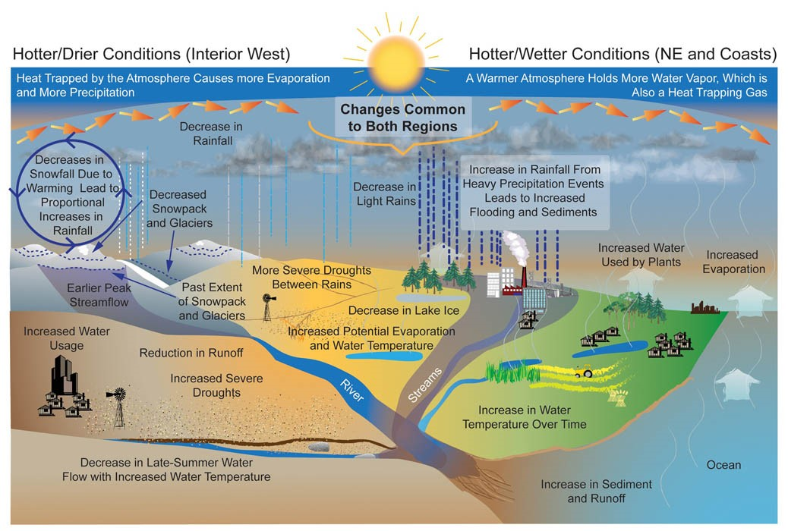
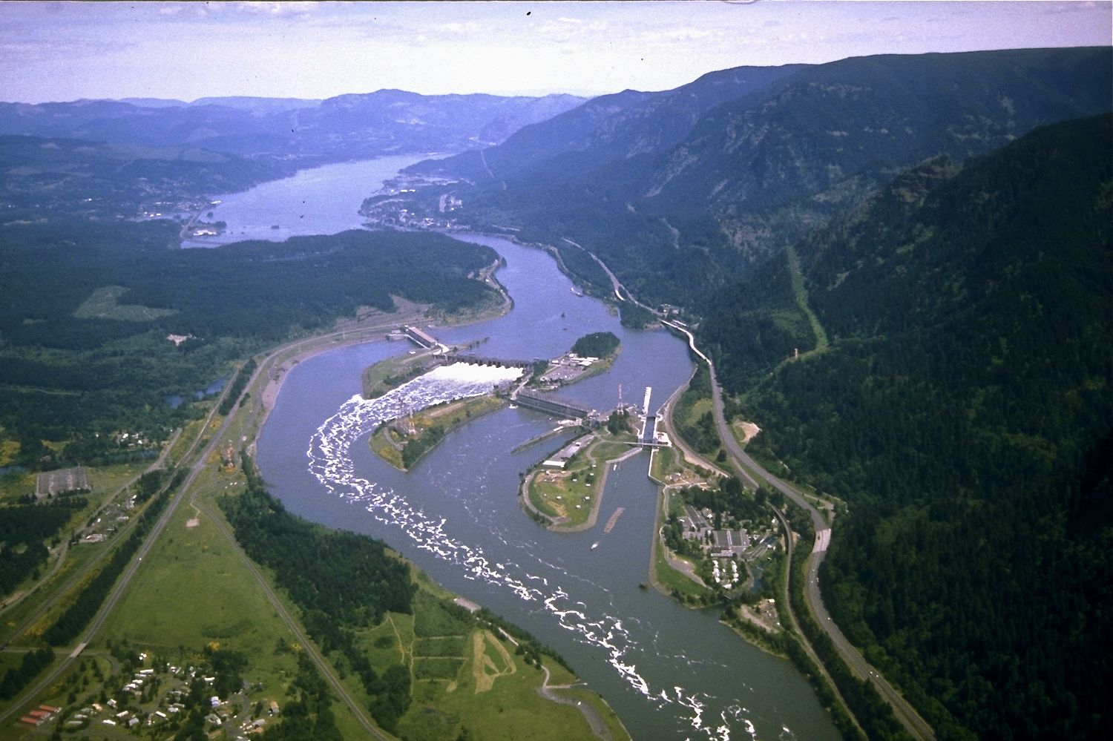
Vulnerability of Water Supply and Climate Change in the Oregon Cascades
Scott Warren, Earth and Physical Sciences Department, Western Oregon University, Monmouth, Oregon, 97361
email: swarren11@mail.wou.edu
Abstract
Climate Trends
Demand and Industry
Understanding the effects of climate change on various environments is challenging at best, especially the Columbia and McKenzie rivers which rely on snow melt for flow. The rivers are relied on heavily for fresh water resources and play a pivotal role in the marine ecosystem. The average warming for the 20th century is +0.82 C. Models show an increase of +0.5 to 2.5 C increase by 2020’s and +1.5-3.2 C increase by 2040. Effects on stream flow are expected to include reduced snowpack from snow falling as rain and from an earlier melting season. Consequences for forests may include migration of tree species, invasion of other species, water competition from lack of groundwater recharge. Ecological effects are not understood, but marine environments will face more challenges. Reduced stream flow and temperature increases, urbanization and stream modification threatens salmon activity and habitat.
A clear picture is difficult as data is lacking in regards to salmonids in their open sea environment. Current trends could possibly push the Salmon further north out of the Northwest. Additionally, Competing business interests create another array of policies, politics, and administrative issues. Many business own overlapping geographic sections along the Columbia and McKenzie rivers. Resource managers are reluctant to use new data as it is not in the “scope” of their interest, yet many acknowledge climate change. The need to recognize sensitivity, plan, create policies are paramount to adaptability.
Observed average climate warming during the 20th century was +0.82 C. The Pacific Northwest has experienced 6 multi-year droughts since 1900. 5 of which occurred during warm phases of PDO. Using new collected data, 20th century warming rates and model predictions were projected into the 2020’s and 2040’s. By the 2020’s, the Pacific Northwest will be facing temperature increase of +0.5-2.5 C and +1.5-3.2 C by 2040’s. Many resources are affected by climate change, water being most affected. Rivers such as the Columbia and McKenzie are snowmelt driven rivers and show greatest change when dealing with freshwater resources.
Smaller streams tend to become flooded and inundated with rainfall, thus not producing an accurate insight into streamflow and snowpack. Warming seems to be associated with the warm phase of the Pacific Decadal Oscillation (PDO) which have an average of 20-30 year life span. Warm phases of El Nino/South Decadal have be implicated in causing warming, but in a much shorter time frame. Ultimate effects will be demonstrated by increased streamflow in the winter season because increasing quantities of snow falling as rain. Lack of snow reduces the amount of water in storage as snowpack. Coupled with an earlier melting season, streamflow is reduced in the summer causing strain on the resources and others that depend on it.
Freshwater is a serious issue when regarding municipal uses. Gcrops, watering lawns, washing cars, and general use have a massive impact. Localities like Portland, a +2.0C increase can decrease minimum storage by 1.3 billion gallons, creating a deficit of 1.5 billion gallons. This leads to issues regarding how to reduce unnecessary usage.
Institutions and resource managers are reluctant to use seasonal forecasts, or additional data in conjunction with what they already have. Reasons varied, some of which said it outside the “scope” of their interests. The Army Corps of Engineers set how reservoirs are managed along with congressional guidelines they must follow. This puts the question of who should be in control, state or federal?
Further complications include competition during scarce times and overlapping geographic regions. The need to recognize what's most sensitive to clime change, create plans for adjustments and policies, then adapt. See figure below:
Figure 2. Projected effects of a 1.5 C uniform temperature increase in the A.) High Cascades, B.) Western Cascades, and C.) Change in mean monthly discharge (Farley, K.A., et. Al 2010)
Introduction
Climate Change and Environment
The Pacific Northwest is showing evidence that the region is undergoing a warm phase from the Pacific Decal Oscillation (PDO) and from CO2 emissions, most notably anthropogenic. Understanding of climate change has substantially improved in last few decades. The question of how climate change will affect natural resources is not understood and is lacking in research. The intent of this study is to understand current stresses to predict future stresses in order to help mitigate effects. Oregon is home to both the Columbia and McKenzie rivers driven by snowmelt. An area of industrialization, residence, recreation, and ecological habitat. Plans lacking in planning to deal with the consequences of global warming on such a vital resource.
Climate change can have a heavy influence on our regional environment in the Pacific Northwest. Forests are likely to experience effects of climate change. Reduction in snow pack and groundwater recharge creates competition for water, invasion of species, migration of species, and health. Plants are most vulnerable during their seedling and young phases. Resulting stress will likely influence tree lines. Plants that require more water may move up in elevation where water is more plentiful. This can lead to further reduction in streamflow from snowpack. Already stressed plants and trees may succumb to illness, parasites, insect infestations, or have poor fire resistance. An increase in forest fires and their severity will destroy forests to the point where re-establishment takes much longer. Human fire and forest intervention has allowed tinder to accumulate to a level causing fires to burn longer and hotter.
Figure 4. Conceptual model to recognize, predict, and plan for increasing adaptability (Farley, K.A., et. Al 2010)
Conclusion
Observed warming trends of the 20th century was +0.82°C showing increasing temperatures due to climate change. Models project possible warming of +0.5-2.5°C by 2020’s and +1.5-3.2°C by 2040’s. The regional effect on resources such as salmon, forests, and freshwater will be strained due to less snowpack as more winter snow falls as rain and earlier melting in the spring. Politics, institutional interests, and policies present complicated barriers in improving forecasting, recognizing sensitivities, and creating a plan for adaptability. The time to expand research, plan, and adjust policies regarding climate change is now and should be of high priority.
Figure 3. Diagram showing the over all hydrologic cycle and effects of climate change due to increasing temperatures emissions, mainly CO2 and Sulfate Aerosols. Diagram created by Environmental Protection Agency (EPA)
References
Environmental Protection Agencey. (n.d.). Climate Imapcts On Water. Retrieved from Climate Change Impacts: https://19january2017snapshot.epa.gov/climate-impacts/climate-impacts-water-resources_.html
Farley, K. A. (2010). Vulnerability of water supply from Oregon Cascades to changing climate: Linking science to users and policy. Global Environmental Change, 13.
Parson, E. A. (2003). Preparing for Climatic Change: The Water, Salmon, and Forests of the Pacific Northwest. 45.
Wikipedia. (n.d.). Columbia River - Wikipedia. Retrieved from Wikipedia: https://en.wikipedia.org/wiki/Columbia_River
Marine environments, specifically salmonids are at risk. Salmon already face environmental challenges from urbanization, dams, competing stock from hatcheries, and etc. Salmon have a low thermal gradient and rising stream temperatures could pose risks. Migration patterns of salmon to and from the ocean is not fully understood. There is a strong correlation between PDO warm phase and “signaling” migration. Salmon interaction with open ocean environment is scarce and adds difficulty in further studies. It may be possible that salmonids will migrate to environments they are not adapted for. In the last 100 years, approx. 40% of Pacific Salmon have disappeared from usual breeding grounds. It is possible to have migration away from the Northwest. While not favorable to salmon, it could be possible to have adaptability, unless there is a failure in another related food web or ecosystem that affects salmonid resources. Understanding ecological adaptability is a topic needing further research as it is currently limited.
Figure 1. Photo of Bonneville Dam on the Columbia River. This image shows both industrialization, modification of stream flow, and residences. Photo by US Army Corps of Engineers via Wikipedia

