Slide 1
Process-based Principles for Restoring River Ecosystems
John Doe
Earth and Physical Science Department
Western Oregon University
Monmouth, Oregon
Email: jdoe@wou.edu

Slide 2
Outline
Introduction
Subtopic 1
  Discussion Item A
  Discussion Item B
Subtopic 2
  Discussion Item A
Subtopic 3
Summary

Slide 3
INTRODUCTION

Slide 4
Example Bullet Slide
Subtopic 1
Subtopic 2
  Discussion Item A
  Discussion Item B
Subtopic 3
  Discussion Item A
Subtopic 4

Slide 5
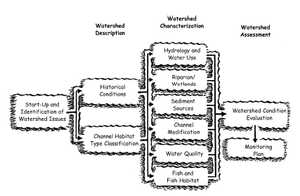
Example slide background for black and white figures, with caption, cite reference (OWEB, 2002)

Slide 6
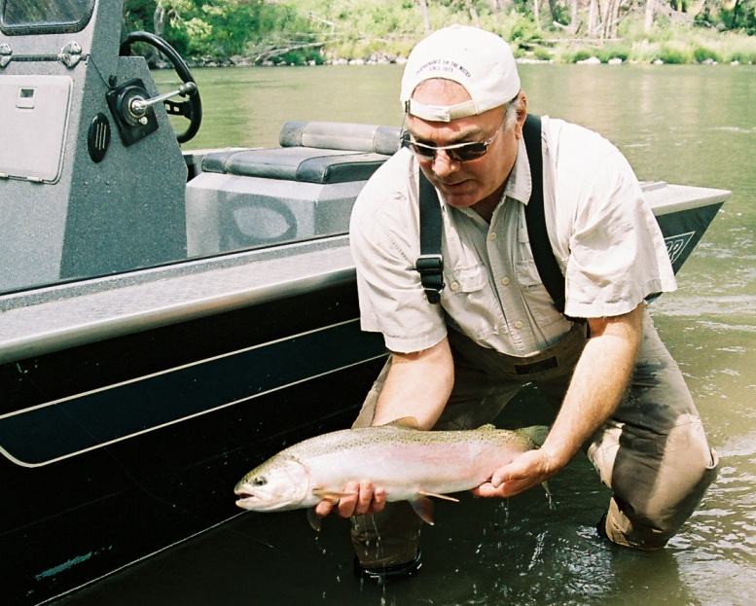

Slide 7
SUBTOPIC 1

Slide 8
SUBTOPIC 2

Slide 9
SUBTOPIC 3

Slide 10
SUMMARY

