Slide 1
Evaluation of Fish Passage Improvement Projects in the South Coast and Rogue River Basins
Duck Creek Associates
Dylan Castle

Slide 2
Overview
Purpose of Surveys
Types of Projects Surveyed
Methods of Evaluation
Results
Discussion
Surveyed Sites
Conclusion

Slide 3
Purpose
Contracted by OWEB to evaluate various fish passage enhancement projects (2009)
Projects were carried out from 1992-2001
Field assessments at 64 project sites
Objective 1; determine if fish passage improvement projects provided adequate passage
Objective 2; determine if juvenile salmonids utilize habitat above the projects.

Slide 4
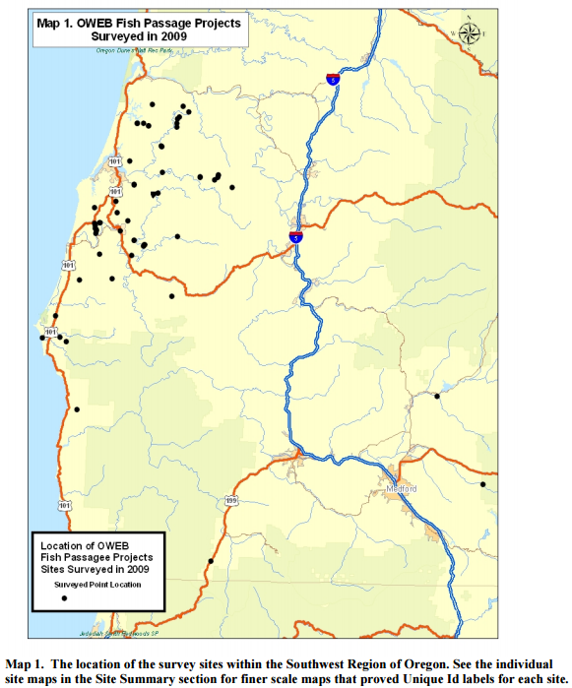
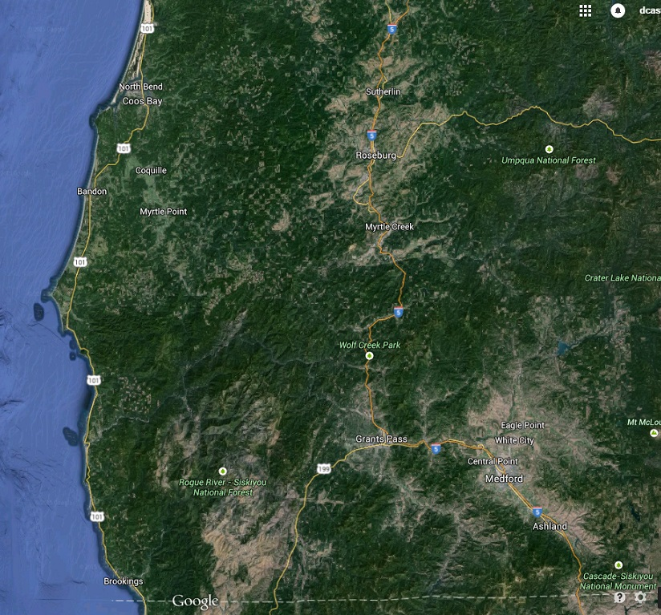
Study Area

Slide 5
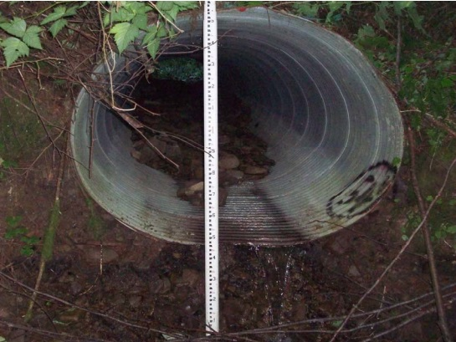
Types of Projects
Replacing existing non-functional culverts and dams
  Bridges
  Stream simulated culverts
  Culverts with baffles
  Fish ladders

Slide 6
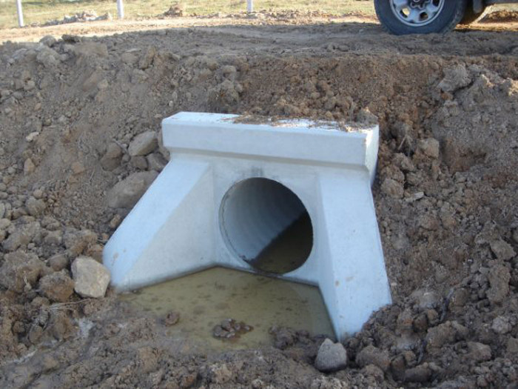
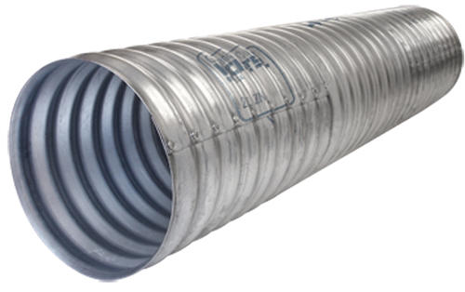
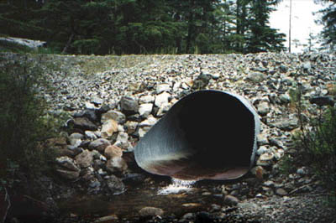
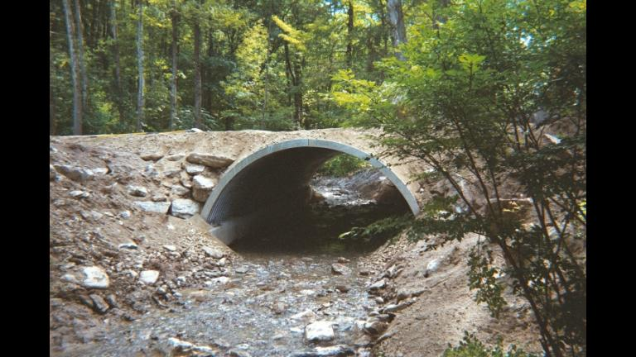
Types of Culverts
Corrugated Steel Culvert
Concrete Culvert
Open Arch Culvert
Flat-Bottom Culvert

Slide 7
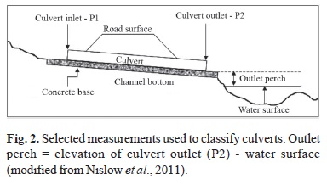
Methods
Culverts
  Longitudinal Survey for morphology and gradient
  Typically 30-35m above and below area
  Culvert Dimensions
  Substrate size of channel and size within culvert
  Water Velocity before, in, and after culvert

Slide 8
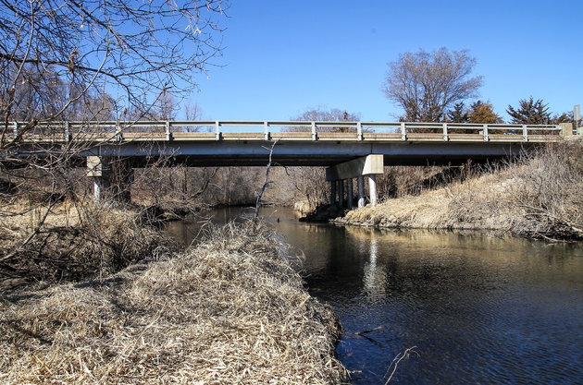
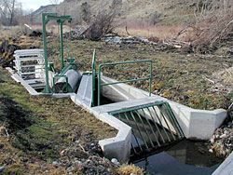
Methods
Snorkeling
  Pools upstream within 135m of site
  Weather, visibility, depth, width, and length
Bridges
  Longitudinal profile
  Dimensions of bridge
  Material
  Channel Substrate
Fish Screens
  Keep fish from
  entering irrigation ditches

Slide 9
FishXings
Software Package used to design and assess culverts for fish passage
Built-in information about fish species
  Speed, jumping, swimming strength, and other abilities
Provides range of discharge rates that a particular fish could pass through a culvert

Slide 10
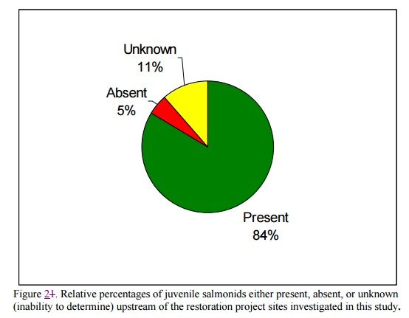
Results
42 Culverts, 14 Bridges, and 8 other projects
Juvenile salmon present in majority of sites
Lack of habitat, pools, and flowing water noted in cases where juveniles were missing
Some sites were unknown due to water visibility

Slide 11
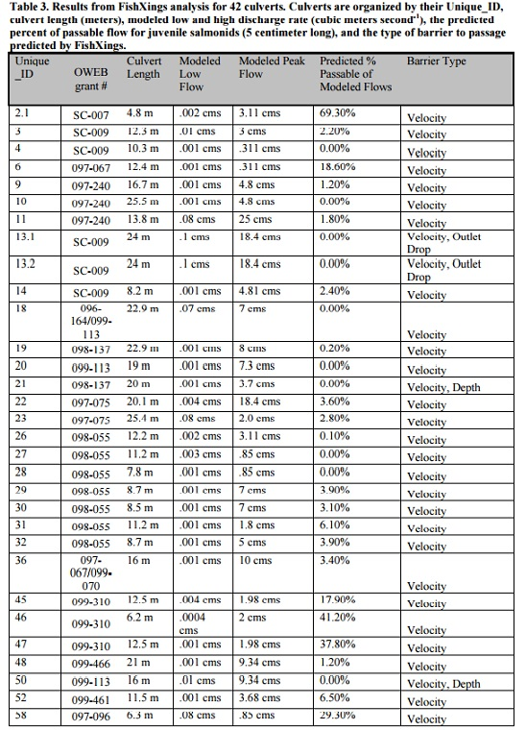
Results
FishXings Data
  16 rated impassable by velocity
  3 impassable by velocity and outlet drop
  Rest considered passable through varying flow rates
Note: 13 sites had juveniles upstream of site deemed 100% impassable by FishXings

Slide 12
Discussion
84% of sites showed juvenile salmonids
  Passage at culverts limited to small percent of flow rates
  Most passable flow rates occur during times of salmon migration
20 culverts designed specifically for salmonids were predicted to be barriers
  These predicted barriers had salmonids upstream
  May not have migrated through culvert.

Slide 13
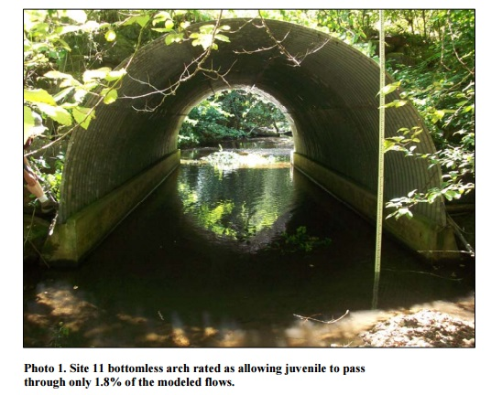
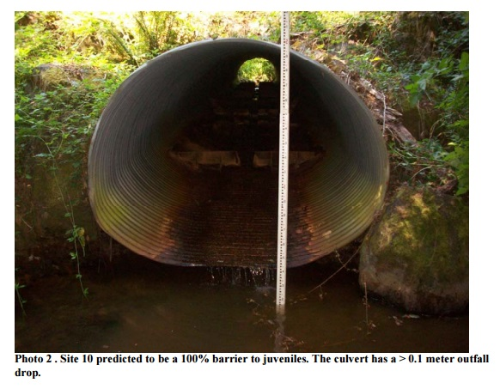
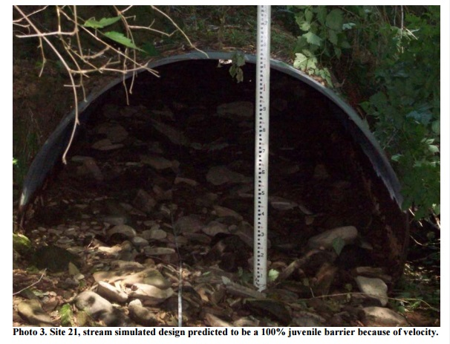
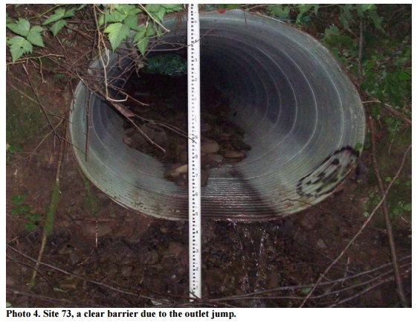

Slide 14
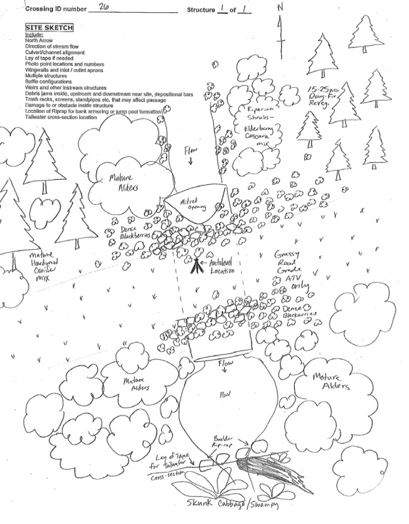
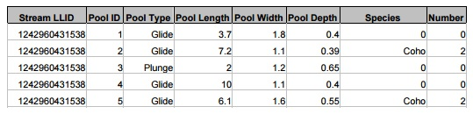
Site #26
20-50 year old alders and conifers
Skunk cabbage, salmon berry and bulrush
Silt, gravel, and boulders
0.1% passable flows
  No substrate in culvert, velocity barrier

Slide 15
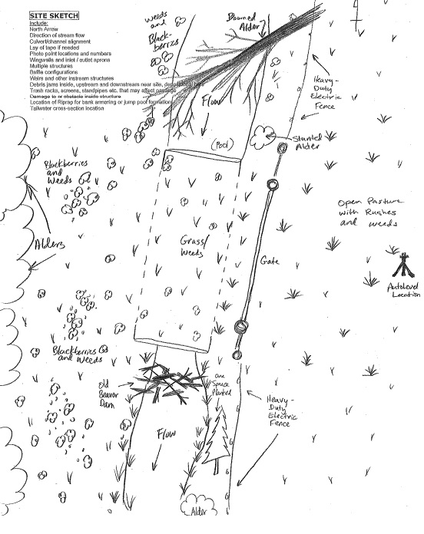
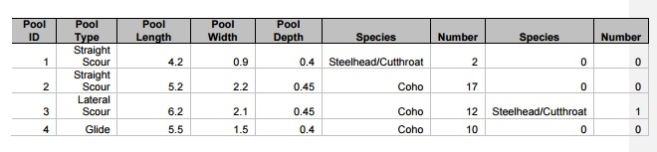
Site #29
Channel substrate 100% silt
Channel confined to dredged ditch
4% passable flows, velocity barrier

Slide 16
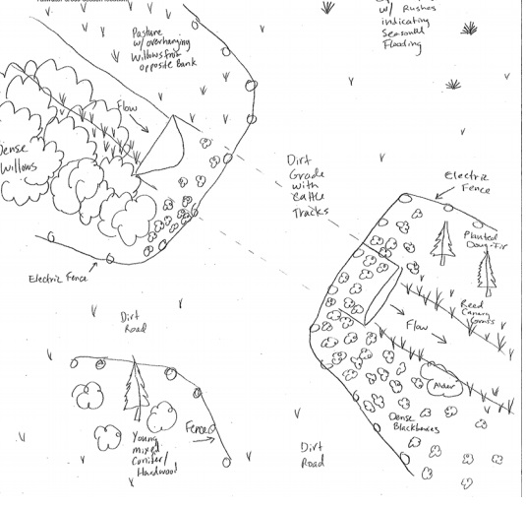
Site 31
Channelized, incised, and lined with rip-rap
Impacted by agriculture
Silt, cobbles, gravel, and boulders
6% passable flows, velocity barrier

Slide 17
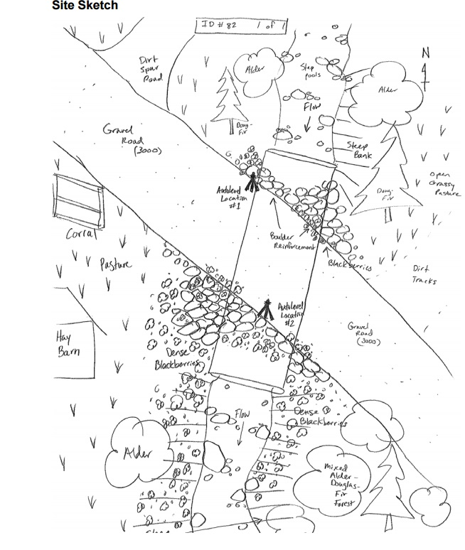
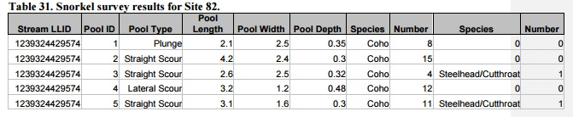
Site # 82
Excellent spawning gravels
Many small pools
Inside managed forest
100% block to juveniles by FishXings
Salmonids still found in pools

Slide 18
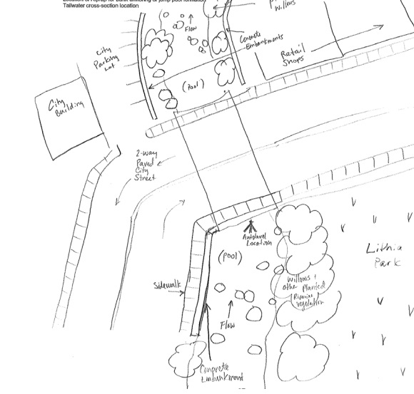
Site 66
Downtown Ashland
Bridge site
Boulders, cobbles, and gravels
Creek was not snorkeled, but juveniles were observed
Boulders artificially placed

Slide 19
Conclusion
Objective 1; determine if fish passage improvement projects provided adequate passage
Objective 2; determine if juvenile salmonids utilize habitat above the projects.
Replacing existing non-functional culverts and dams
Longitudinal surveys of site areas.
Juveniles observed in 82% of sites
Salmonids can flourish in a variety of areas with proper care of habitat and water.

