Slide 1
Ground-Water Flow and Fluctuation of the Willamette Basin
Katherine Wallace
Hydrology ES 476
Dr. Steve Taylor

Slide 2
A Little Background
80% of precipitation falls between October and March while less than 5% falls in July and August, the peak growing season.
Ground water is most likely the source for meeting future water demand.
Basin recharge is ~22 inches.
Discharge of groundwater is mainly to streams.
Most groundwater withdrawals occur within the low-land.
In the central Willamette Basin, seasonal water fluctuations have increased by up to 55 feet because of increased summer pumpage.

Slide 3
Ground-Water elevations and Flow Directions
Ground water flows from areas of high hydraulic head to areas of low head (high water-level elevation to low water-level elevation.)
A contour map of the water table represents the elevation of the top of the saturated part of the uppermost unconfined aquifer.

Slide 4
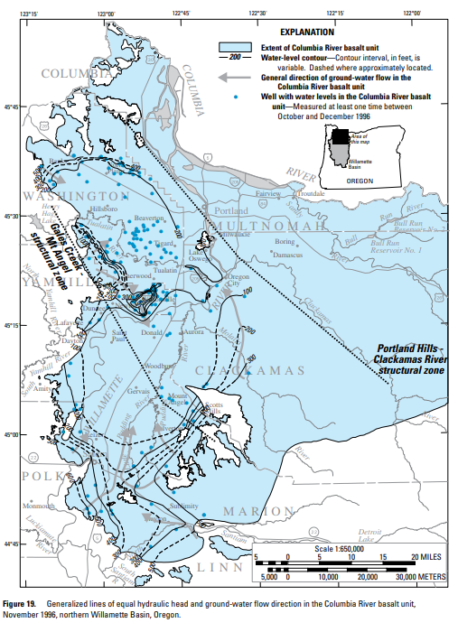
Horizontal Ground-Water Flow

Slide 5
Shallow Basin-Fill Sediments
In the southern Willamette Basin average annual water levels are generally within 10 feet of land surface.
In the central Willamette Basin water levels can be 10 to 25 feet higher than those in shallow wells.
Regional pattern of ground-water flow is from the margins of lowland toward the major streams.
Older ground-water was generally found to the west while young ground-water was found in the upper sedimentary unit at the end of the flow path.
In the Tualatin Basin water levels are generally less than 20 feet deep.
Average annual water levels have generally remained constant in this area since 1935 despite the large annual increase in ground-water pumping.

Slide 6
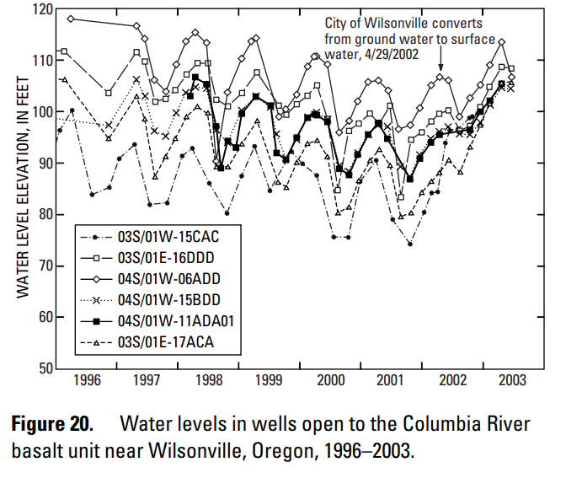
Deep Basin-Fill Sediments
Central Willamette Basin
Columbia River Basalt Unit
Change in water levels with depth is gradual.
The middle sedimentary unit if confined where the Willamette silt is present.
Ground-water generally moves from upland areas toward basin interiors.
Rate of regional discharge is low.
Upland area horizontal gradients are less than 10 feet/mile while valley floor horizontal gradients are less than 6 feet/mile.
Direct connection between deep interflow zones in the uplands and the basin flow system beneath the valley floor.

Slide 7
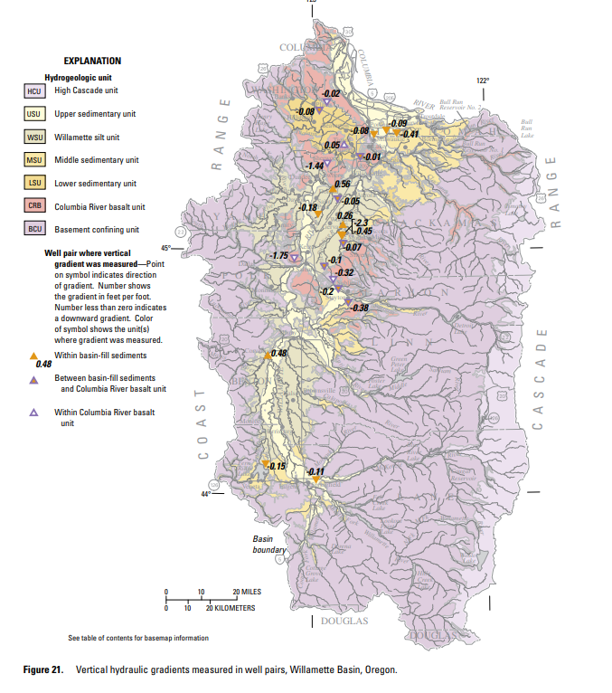
Vertical Ground-Water Flow
Vertical flow in this region is generally downward.

Slide 8
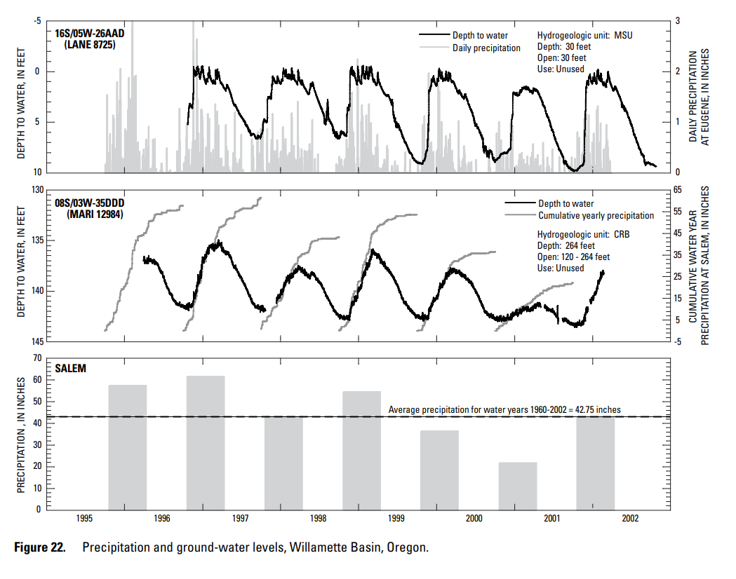
Fluctuations in Ground-Water Levels

Slide 9
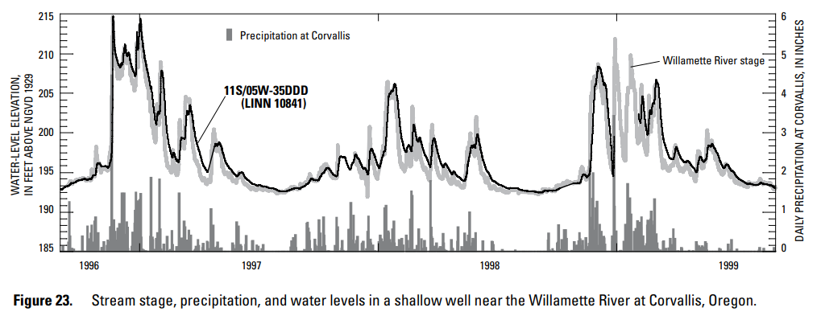
Response to Precipitation
Response to Stream Stage
Direct, rapid response to short-term precipitation events such as winter storms indicate a tap into unconfined aquifers at shallow depths.
Rise is steeper in fall than in spring.
Response to rainfall at the beginning of the rainy season is generally delayed several days or weeks.
Indirect responses to precipitation are common throughout the basin in wells that tap unconfined aquifers at great depths (over 40 ft.)
Water levels in wells adjacent to large streams commonly show a close correlation to stream stage.

Slide 10
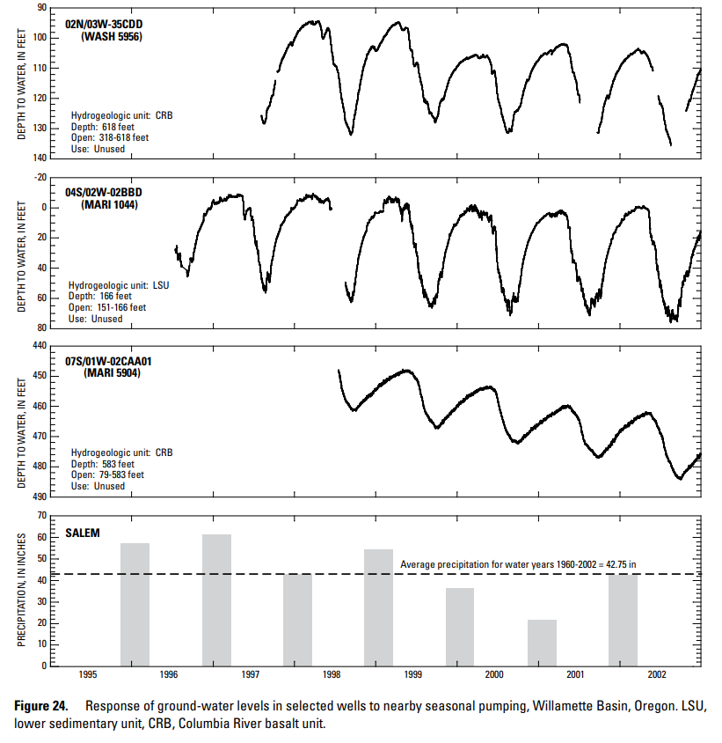
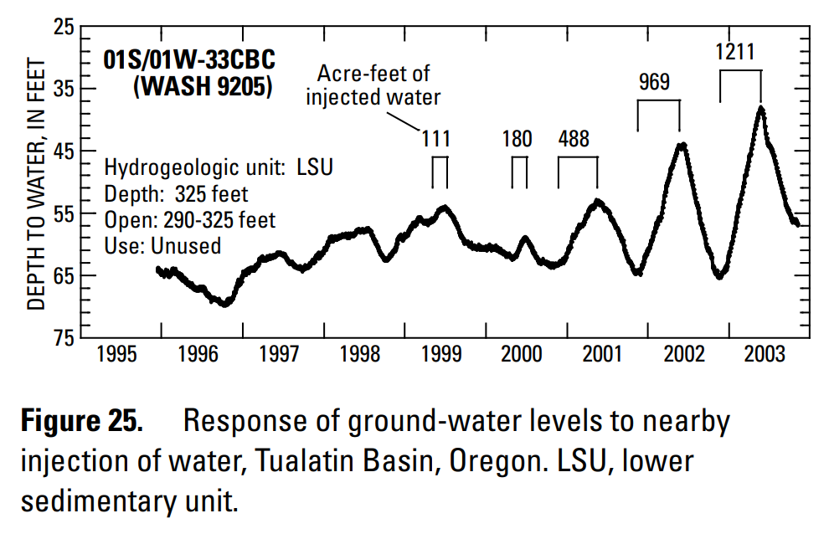
Response to Pumping
Response to Injection
Pumping from wells causes water levels to decline in areas surrounding the well.
Several municipal water utilities are developing aquifer storage and recovery projects.
Abnormal water-levels in the hydrograph correspond to yearly injections in the basalt well that began in 1999.

Slide 11
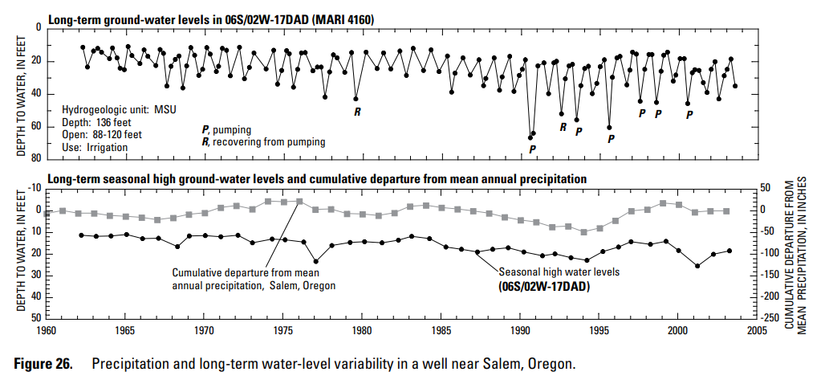
Long-Term Water-Level Variability

Slide 12
Changes in Ground-Water Storage from Ground-Water Withdrawals
Changes are assessed by tracking water-level fluctuations in wells over time.
In basin-fill sediments, average annual ground-water levels have remained constant over the past 70 years.
In contrast, long-term changes are common in the Columbia River Basalt unit.
Basin lowland: declines due to irrigation or public supply wells
Central Willamette: declining over a broad area along the eastern valley floor

Slide 13


