Slide 1
Fluvial Introduction

Slide 2
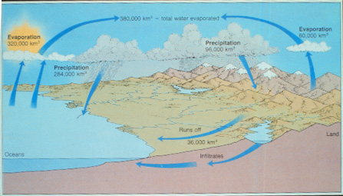
Hydrologic Cycle

Slide 3
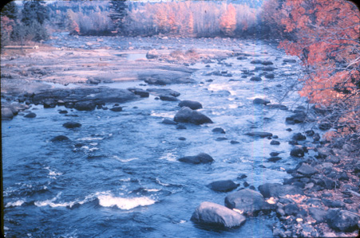

Slide 4
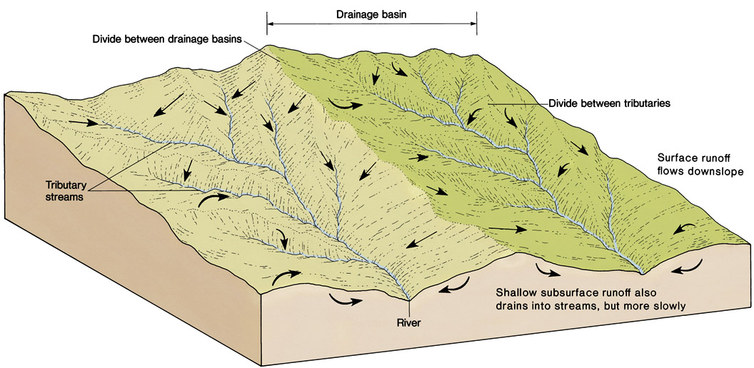
Streams and Drainage Basins
Figure 6.2

Slide 5
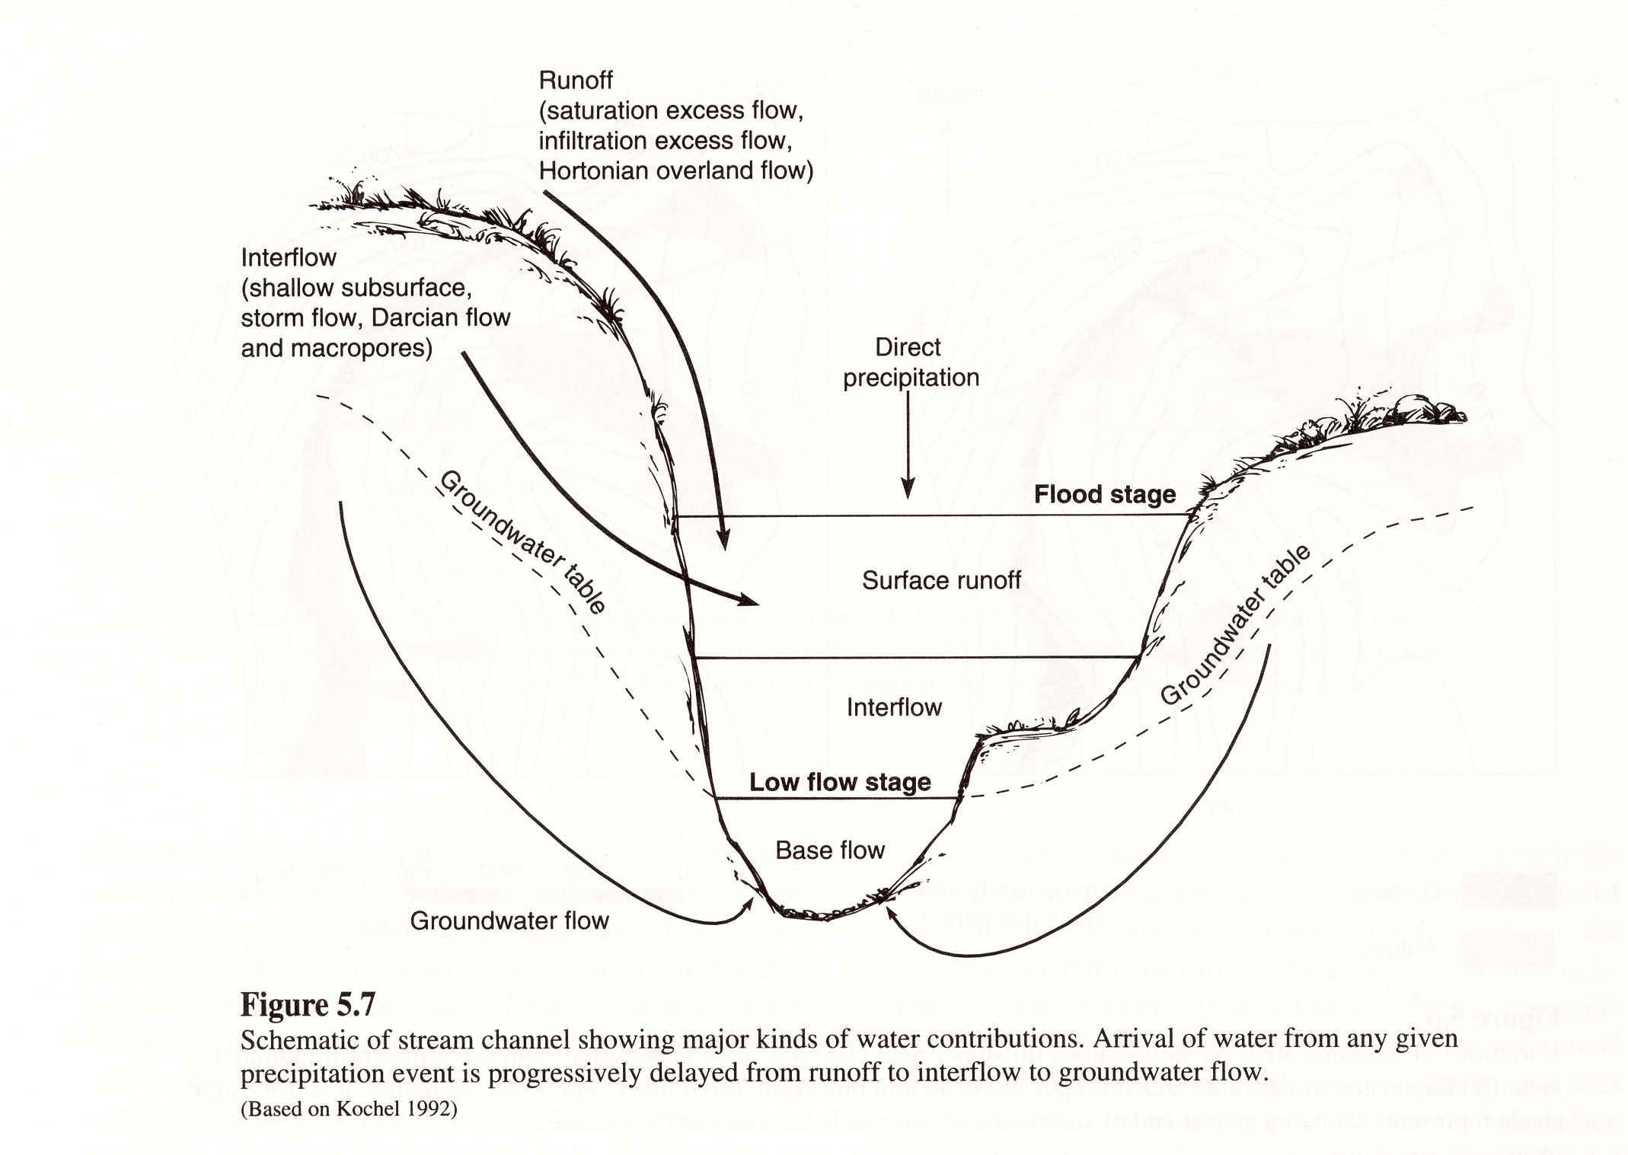

Slide 6
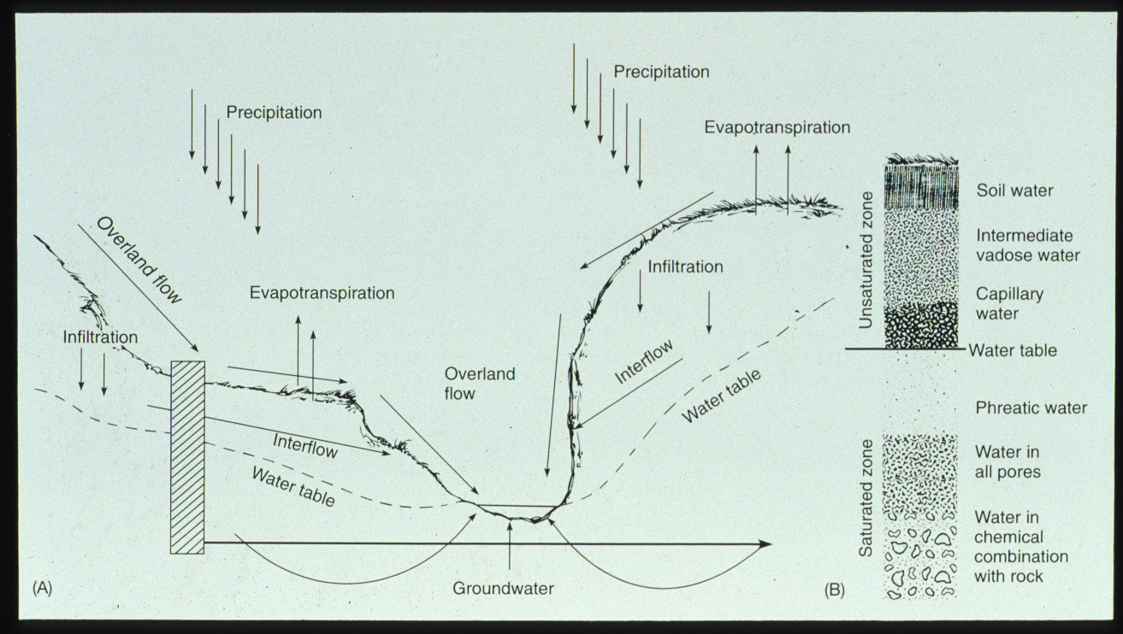

Slide 7
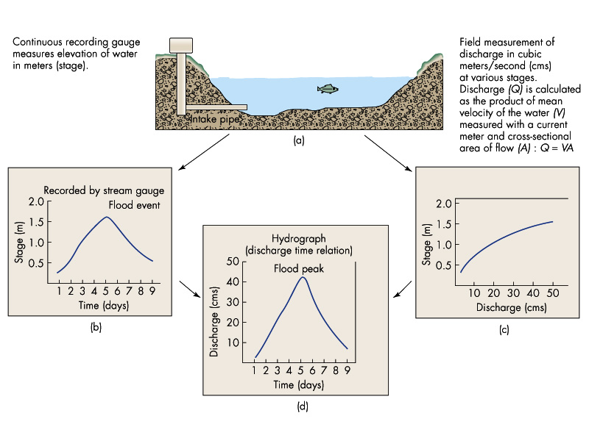

Slide 8
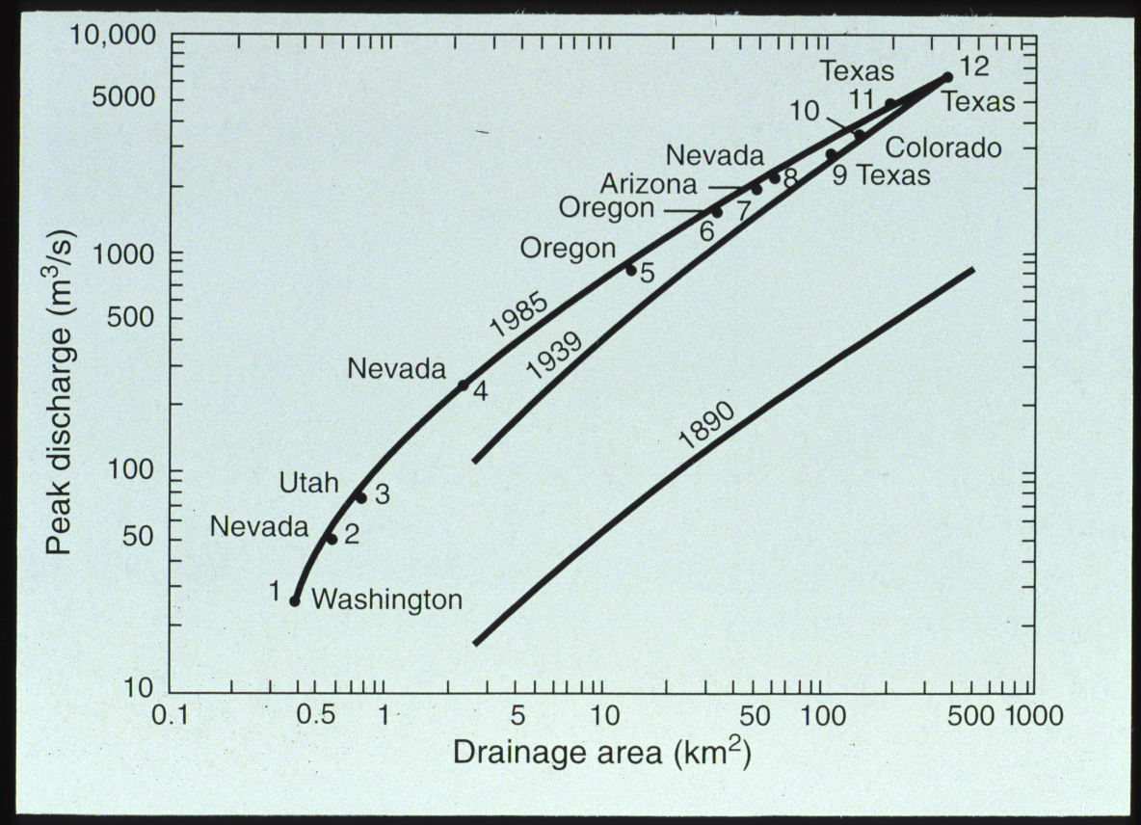

Slide 9
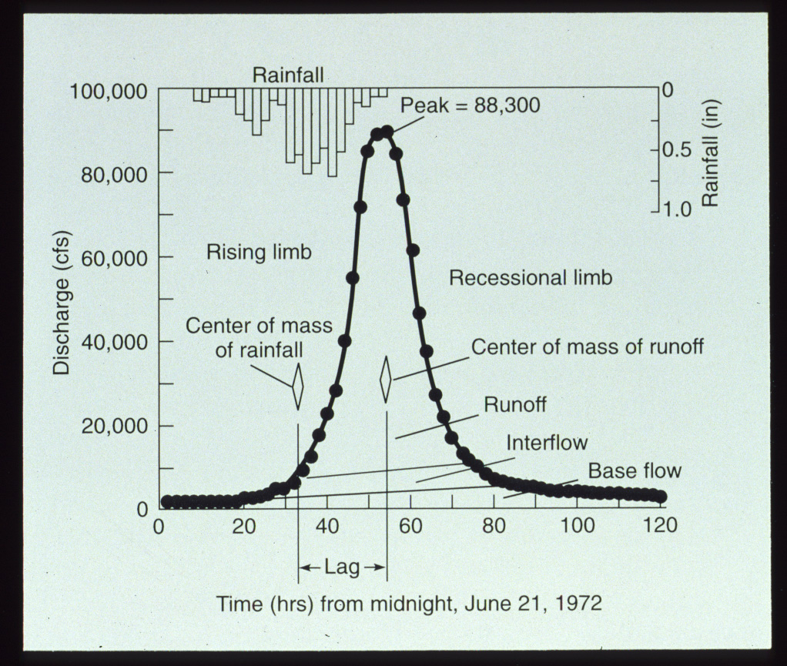

Slide 10
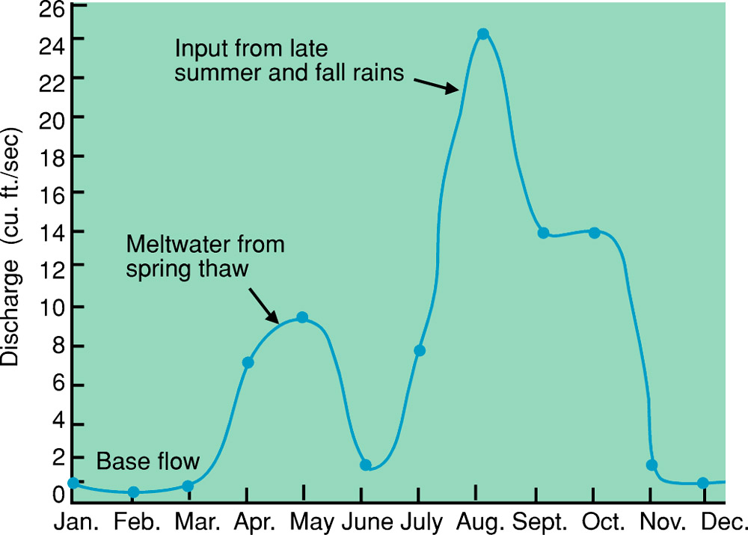
Hydrograph
Figure 6.11
U. S. Geological Survey Open-File Report 79-681

Slide 11
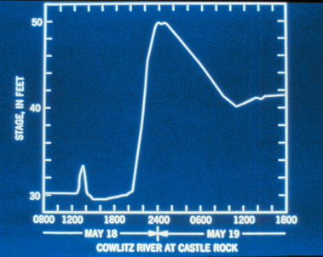

Slide 12
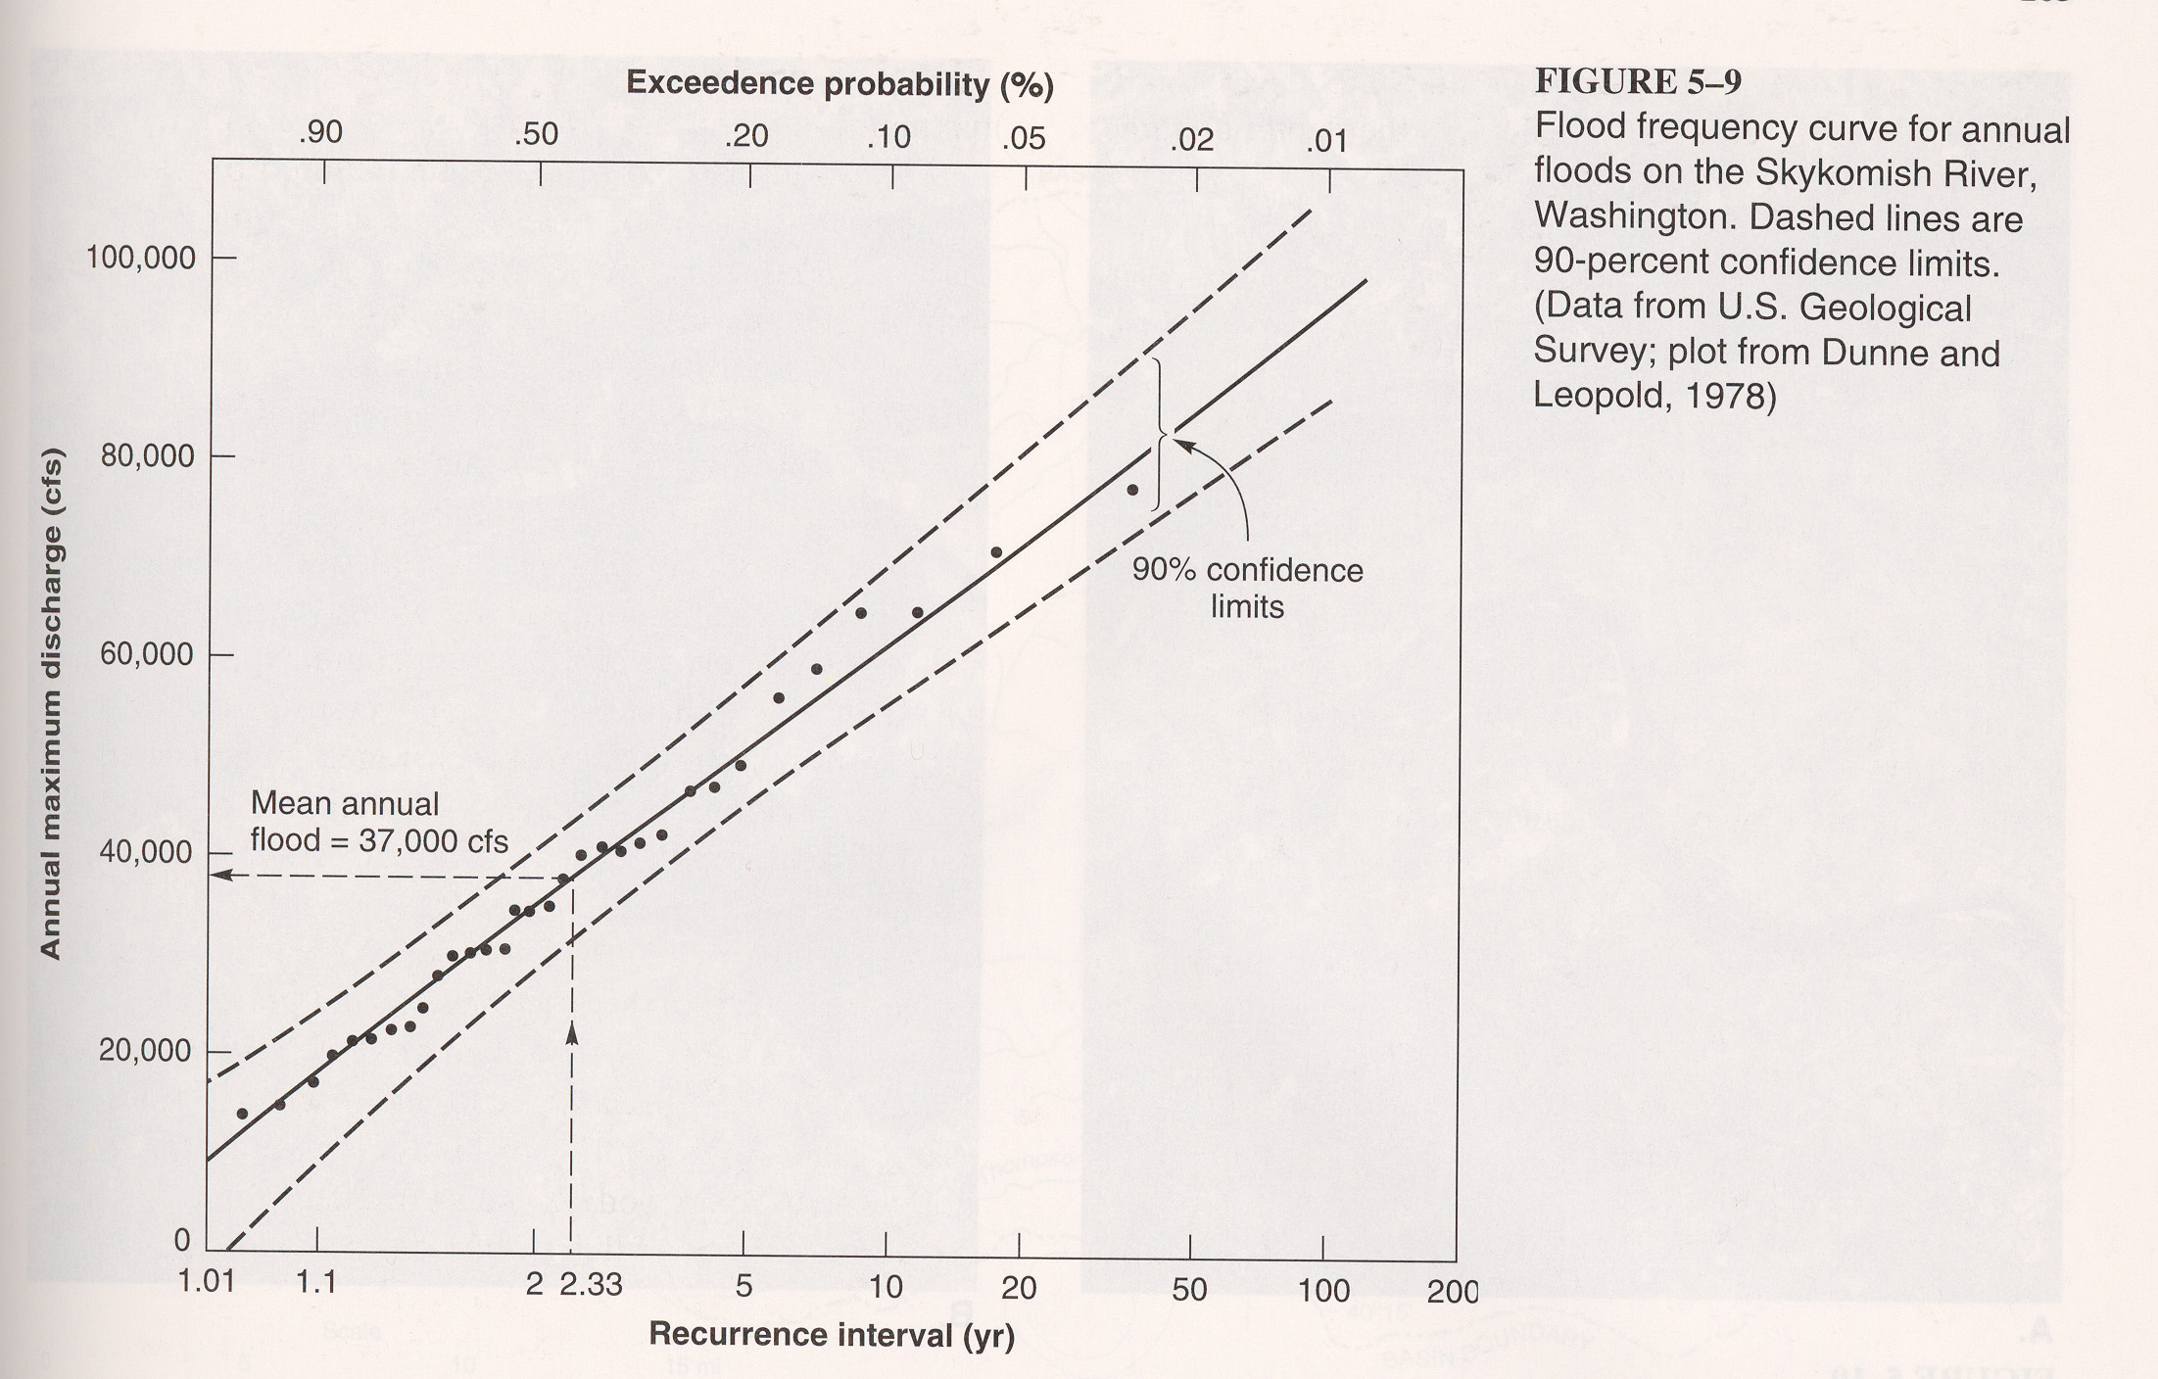

Slide 13
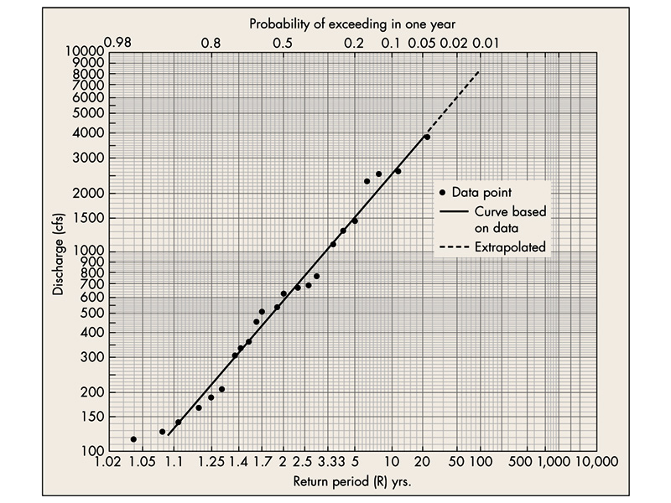

Slide 14
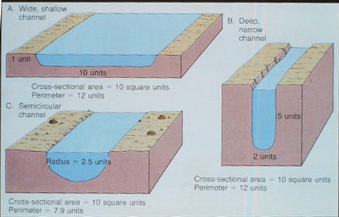
Q=AV

Slide 15
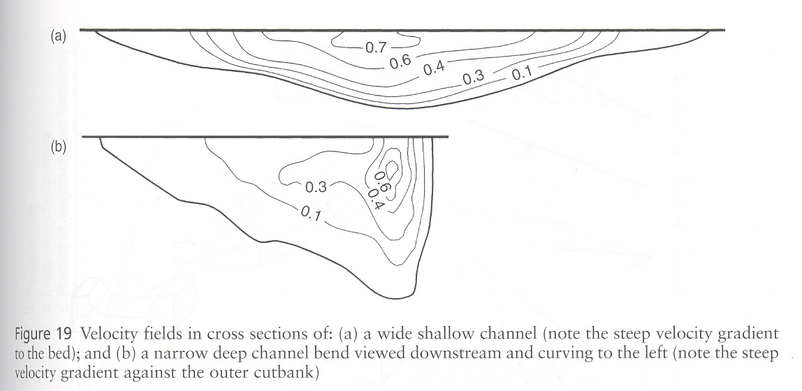

Slide 16
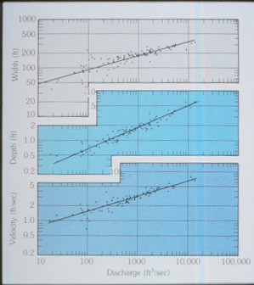

Slide 17
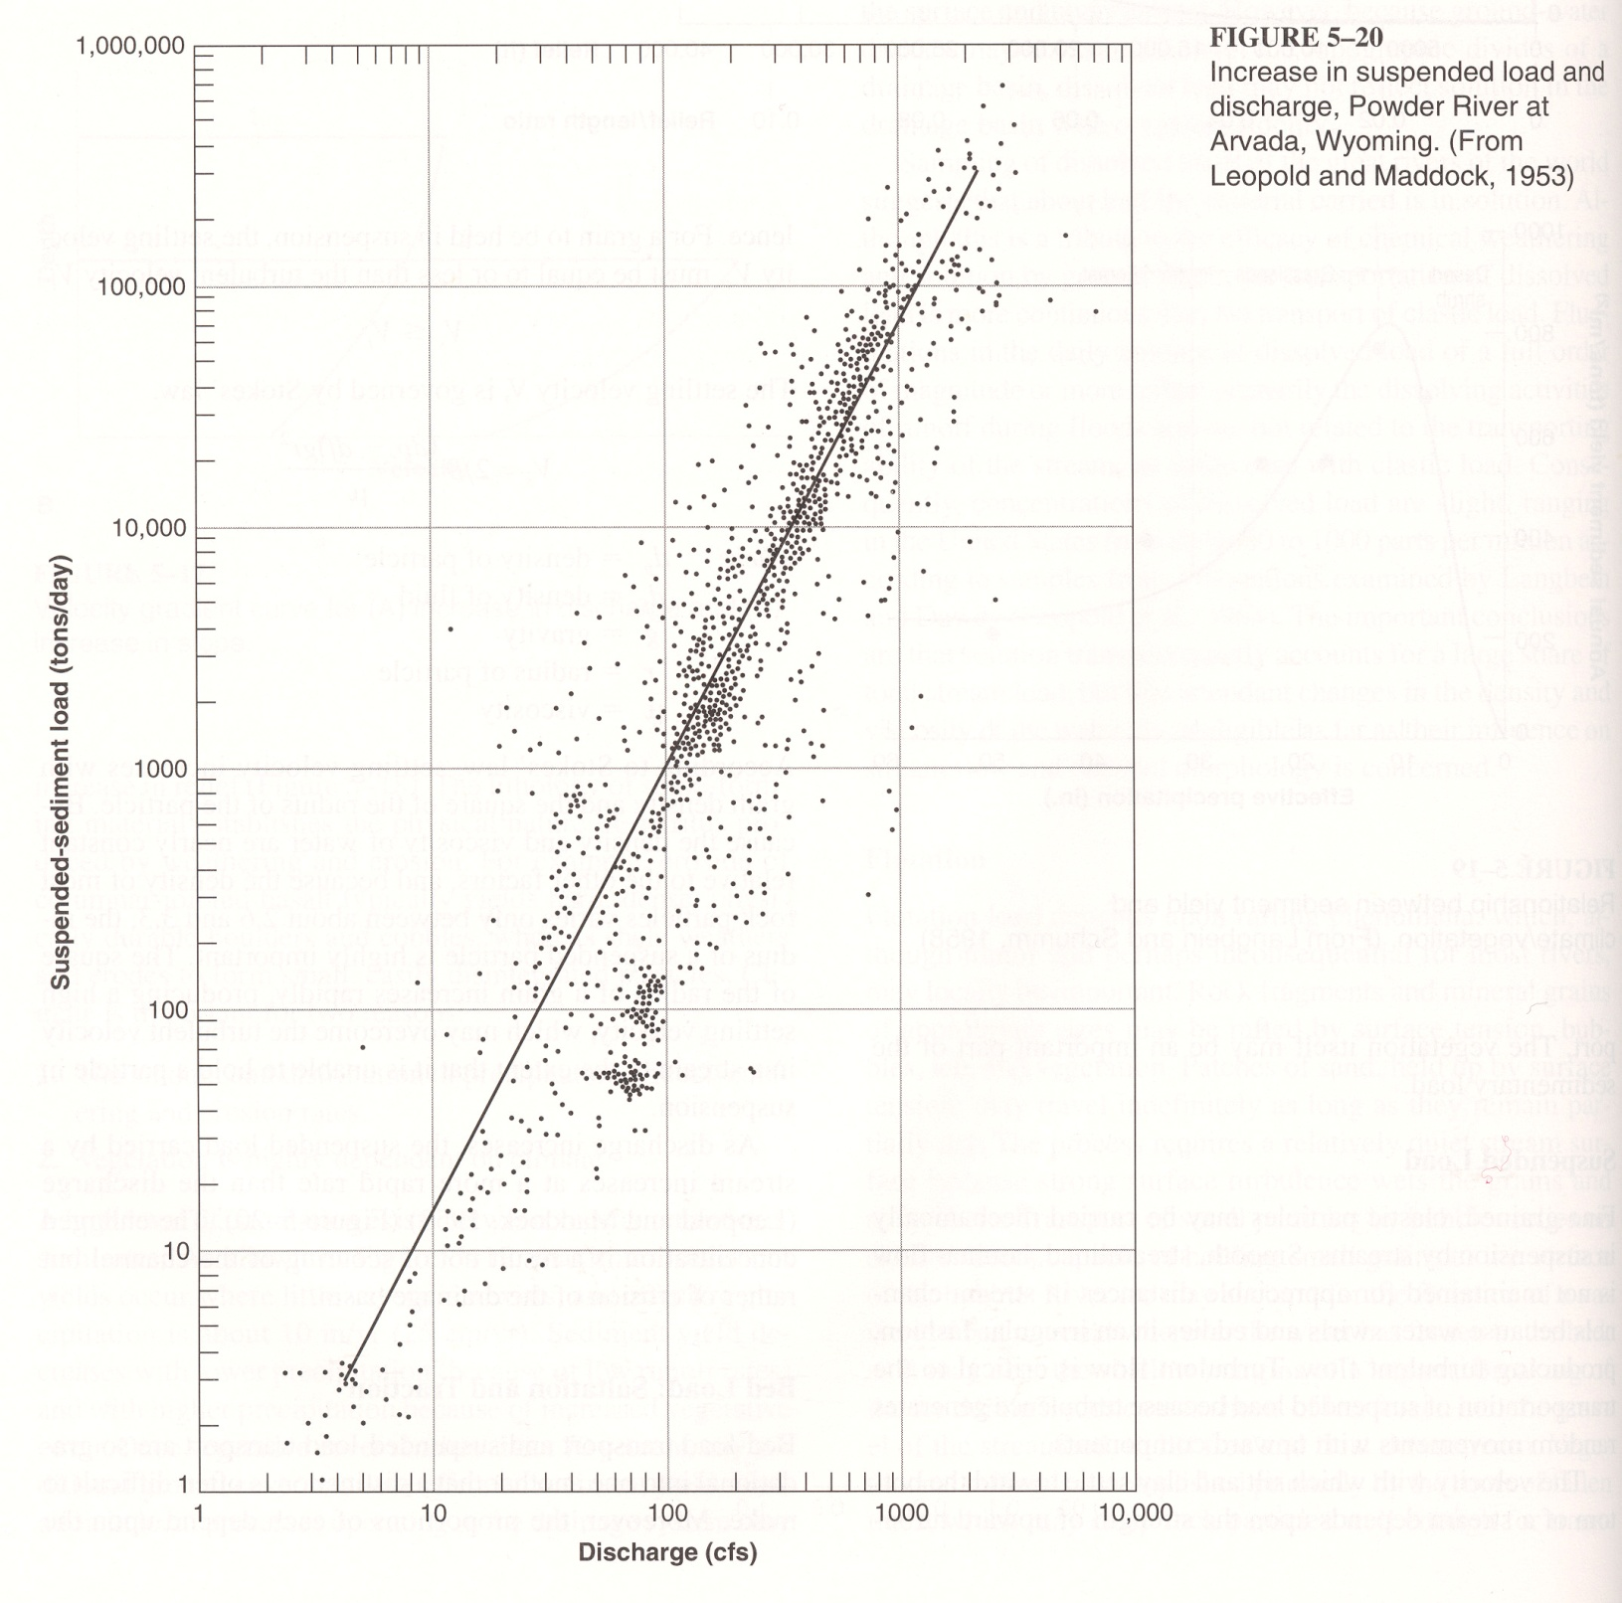

Slide 18
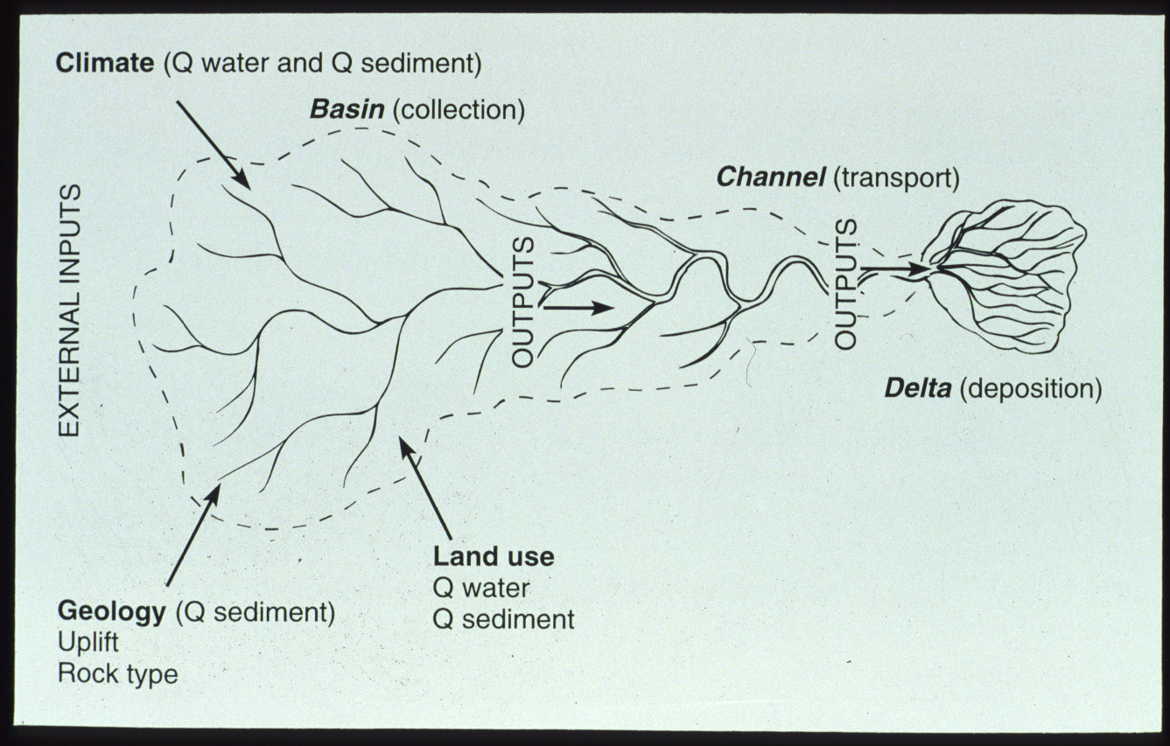

Slide 19
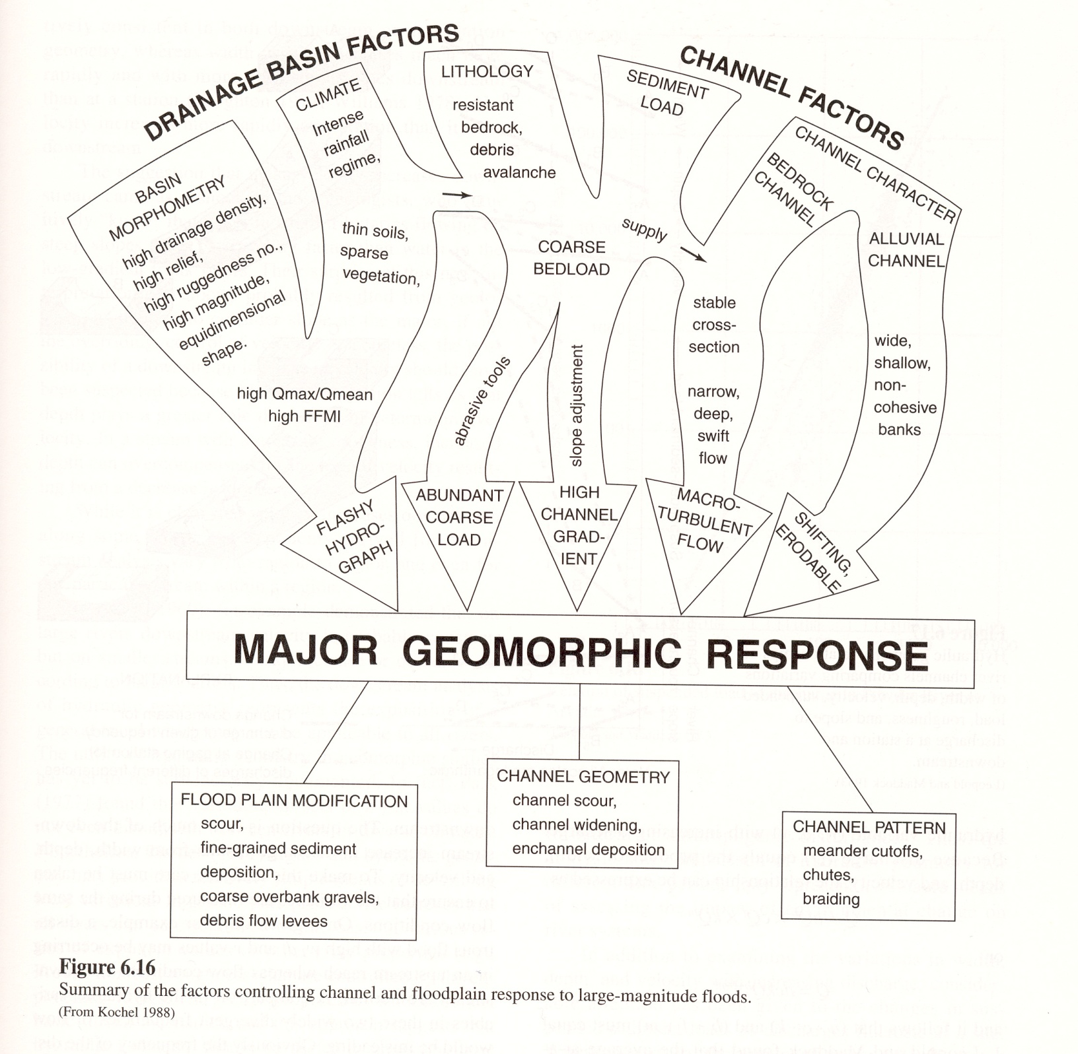
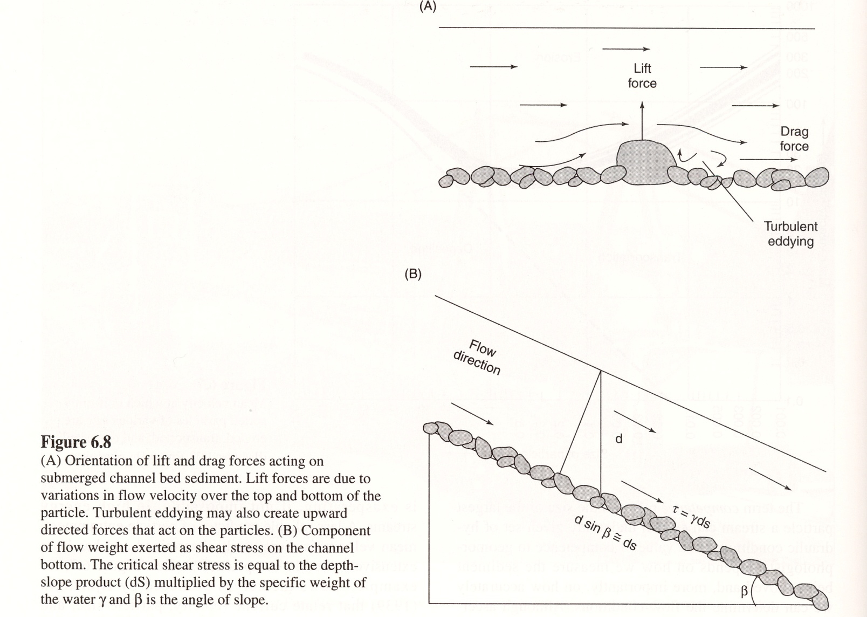
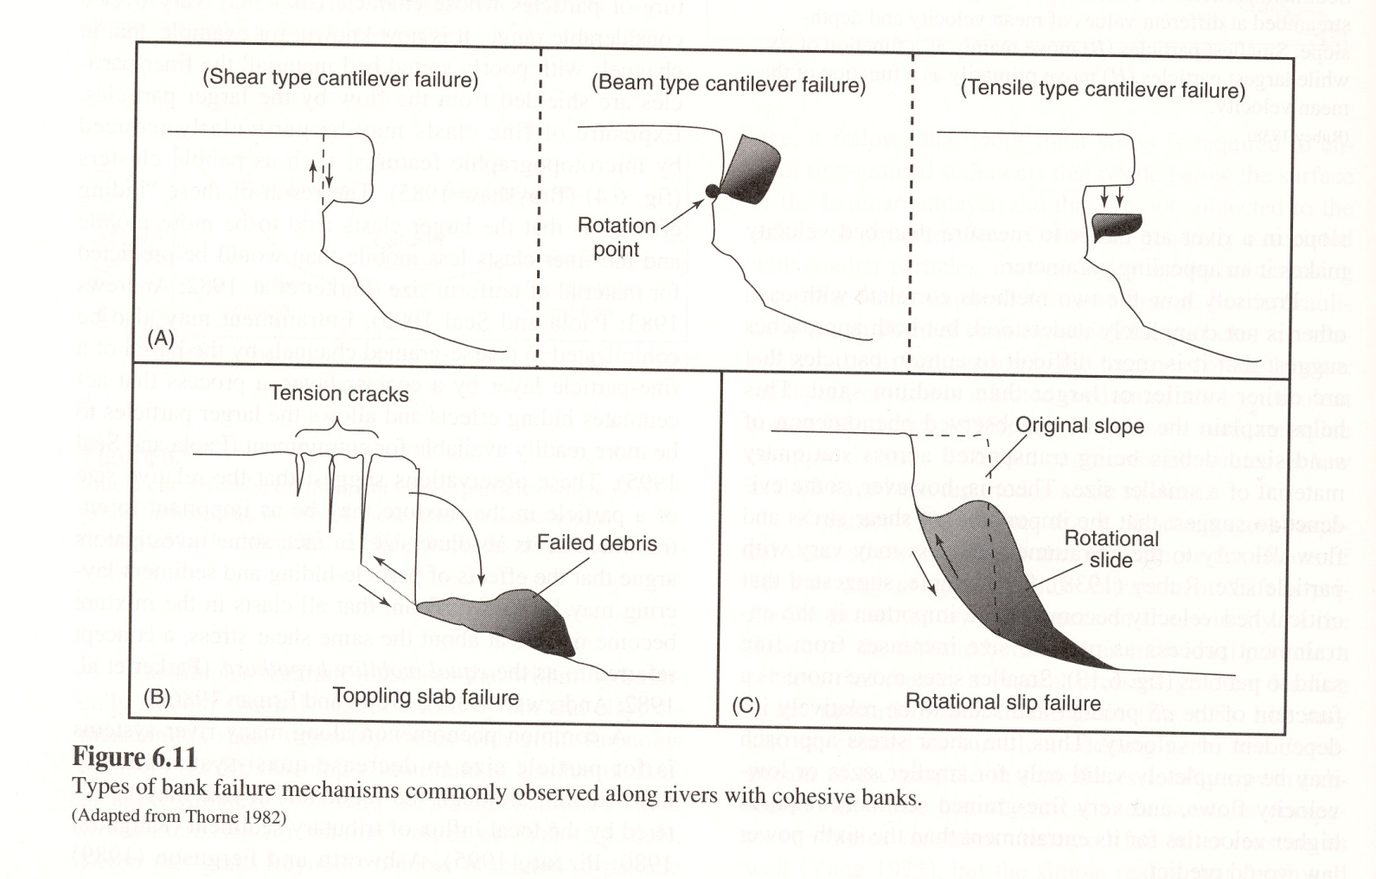
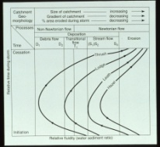

Slide 20
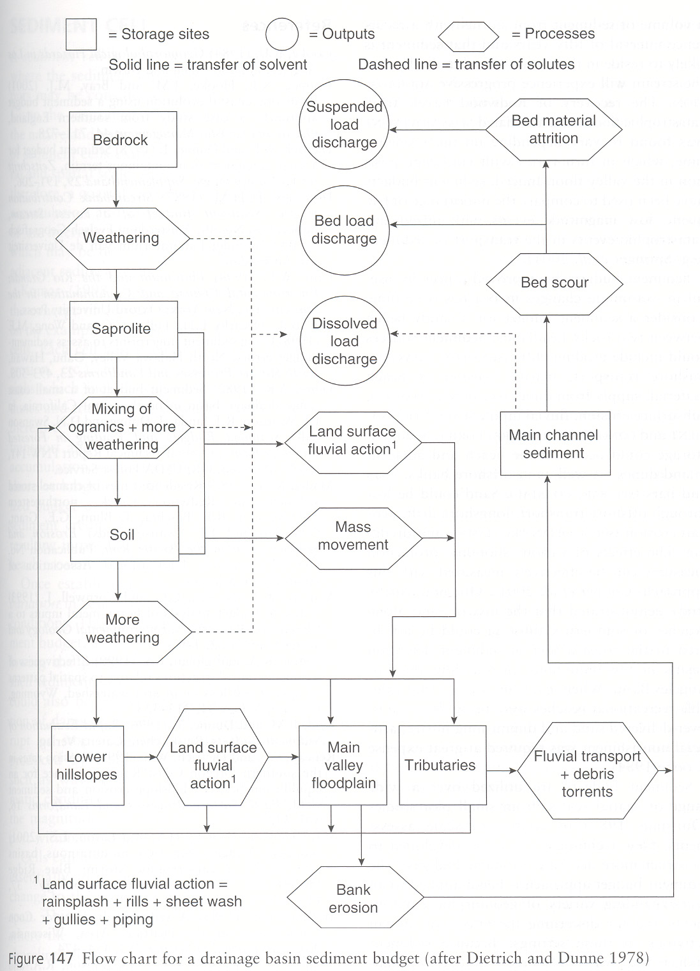

Slide 21
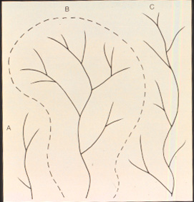
Drainage Network (watersheds)

Slide 22
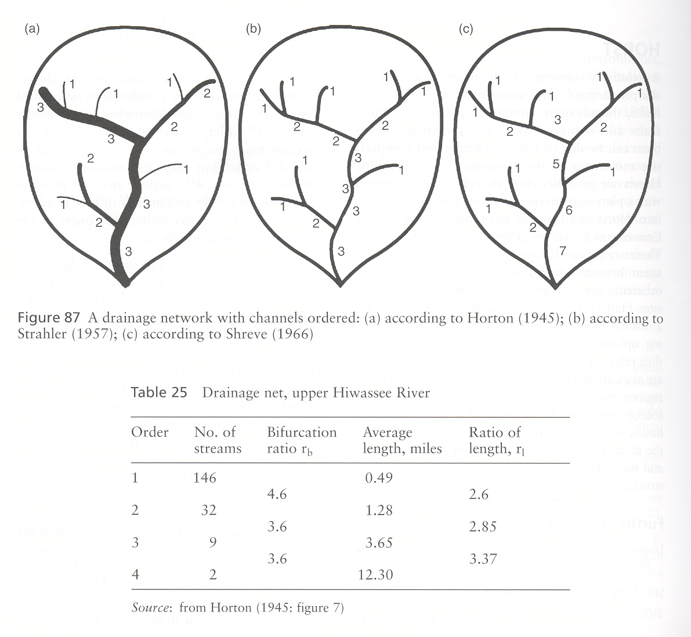

Slide 23
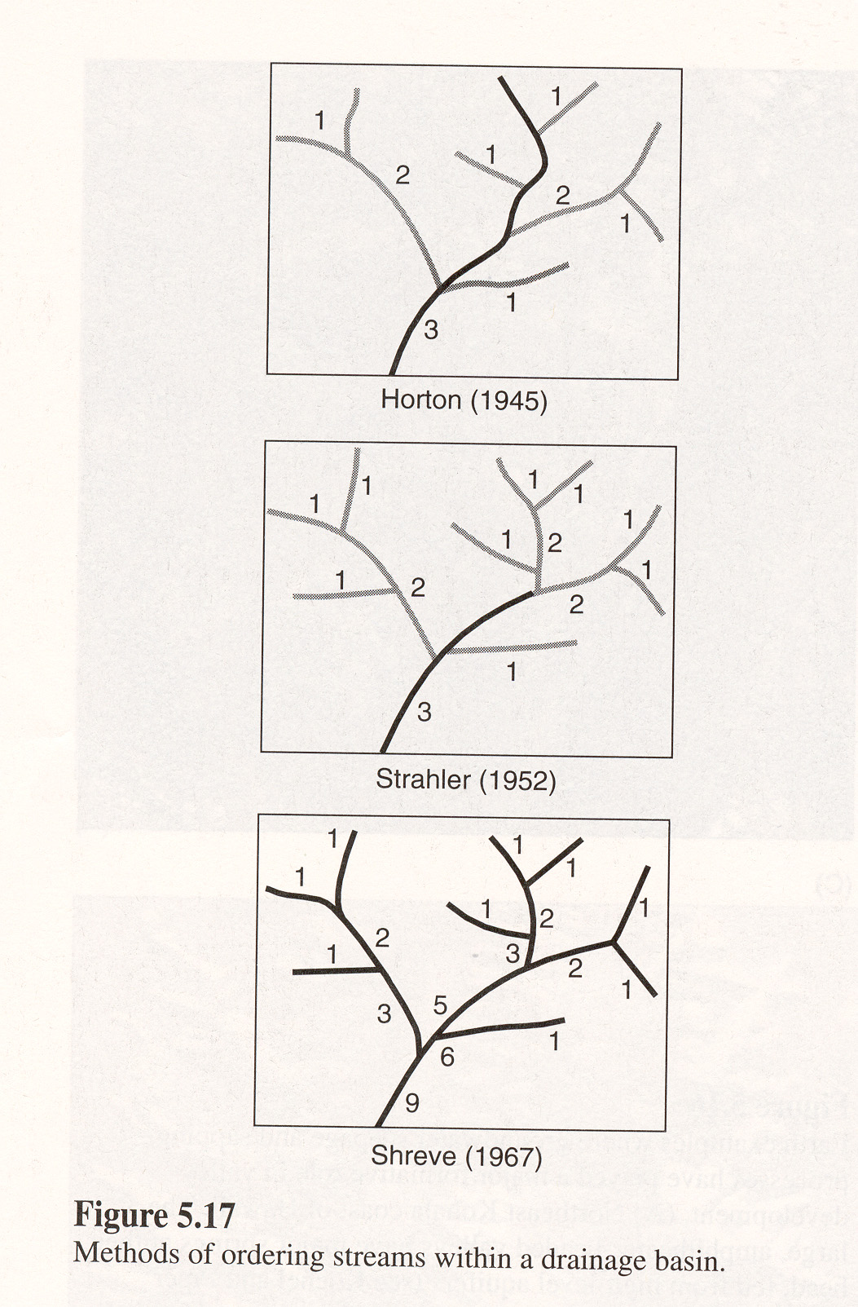

Slide 24
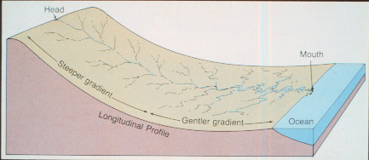

Slide 25
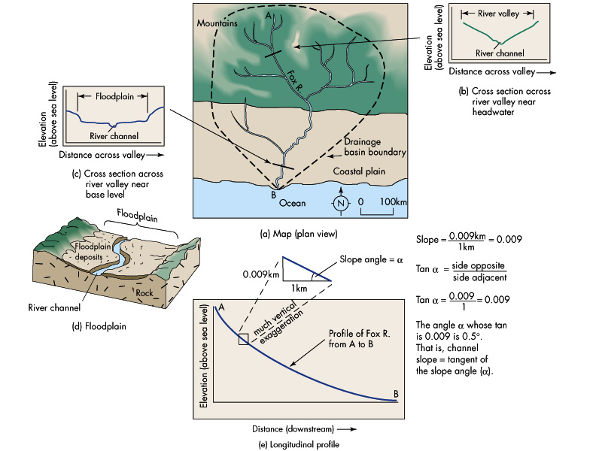

Slide 26
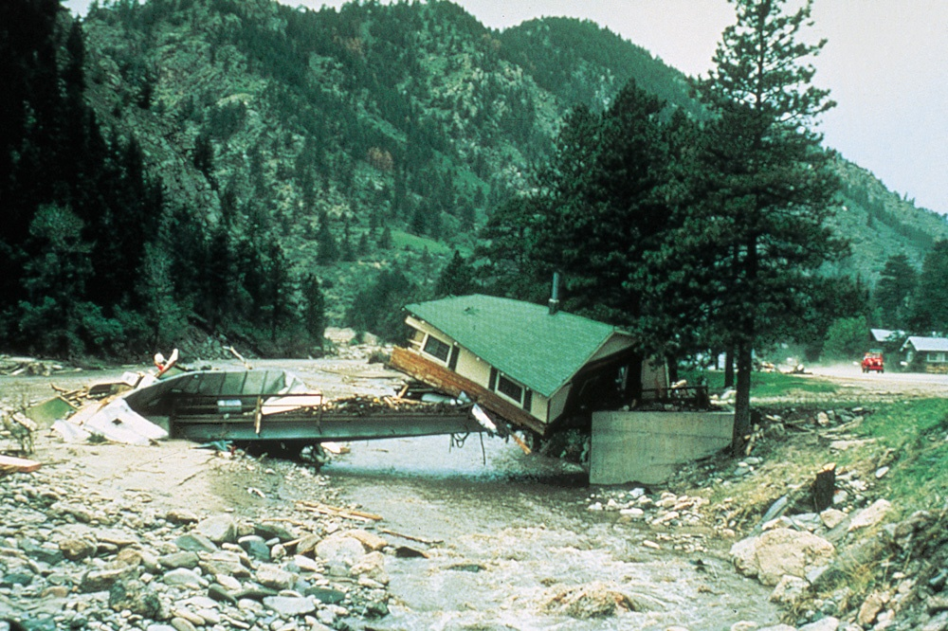
Damage from Flood in Colorado
Figure 6.10

Slide 27
Hydrograph
Figure 6.11
U. S. Geological Survey Open-File Report 79-681

Slide 28
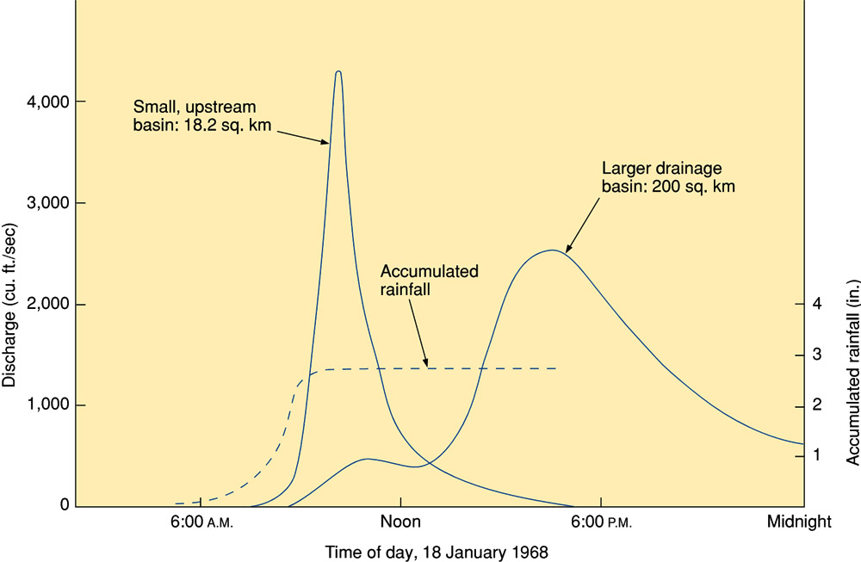
Flood Hydrograph and Mudflow
Figure 6.12a
Water Resources Division, U. S. Geological Survey

Slide 29
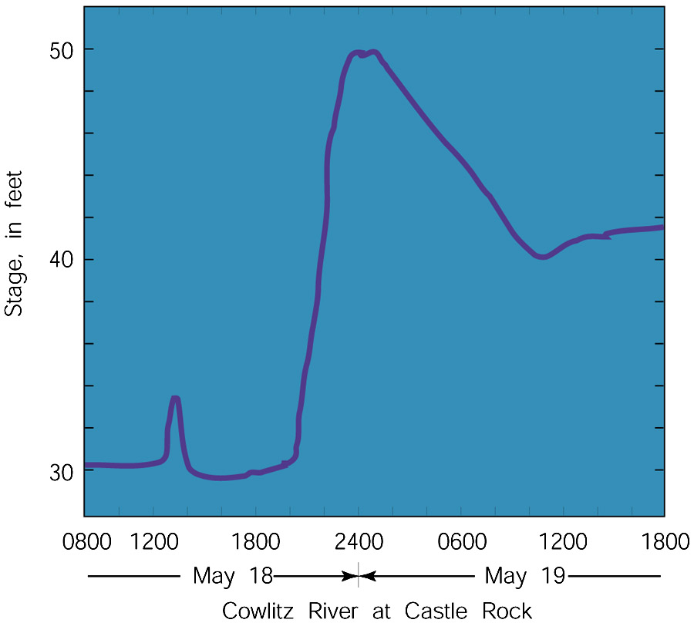
Flood Hydrograph and Mudflow
Figure 6.12b
After U. S. Geological Survey

Slide 30
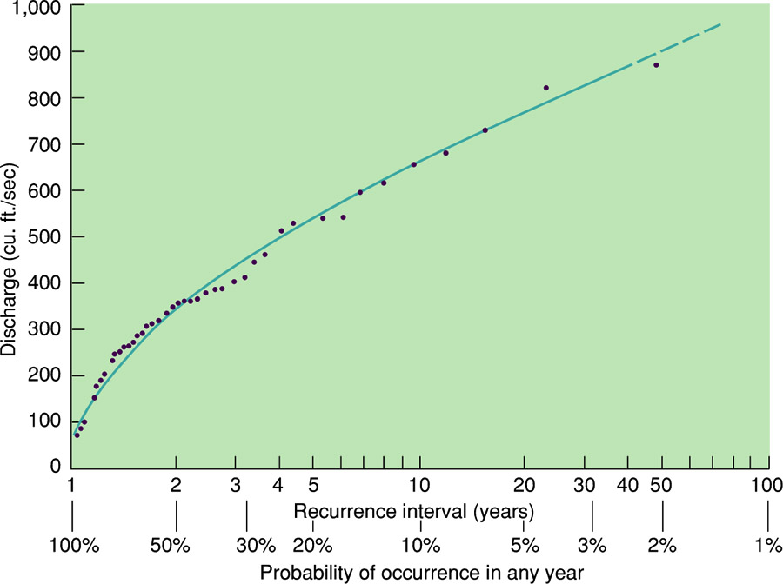
Flood-Frequency Curve
Figure 6.13
U. S. Geological Survey Open-File Report 79-1060

Slide 31
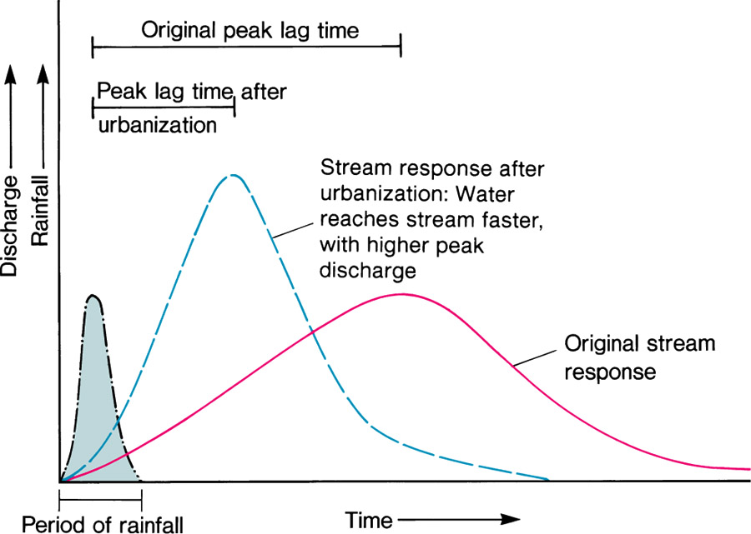
Hydrograph Reflecting Modification
Figure 6.14

Slide 32
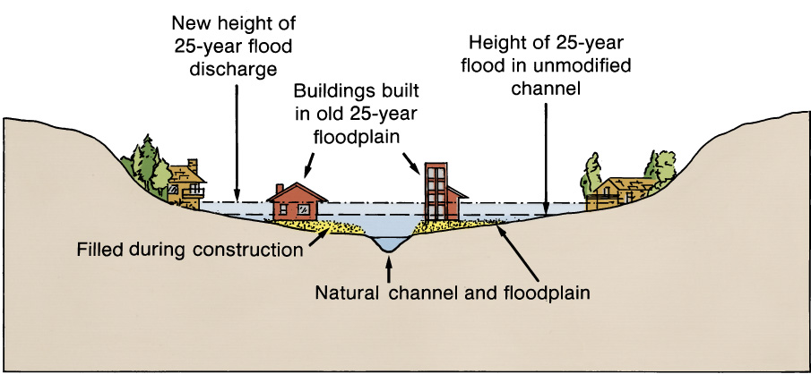
Increase in Flood Stage
Figure 6.15

Slide 33
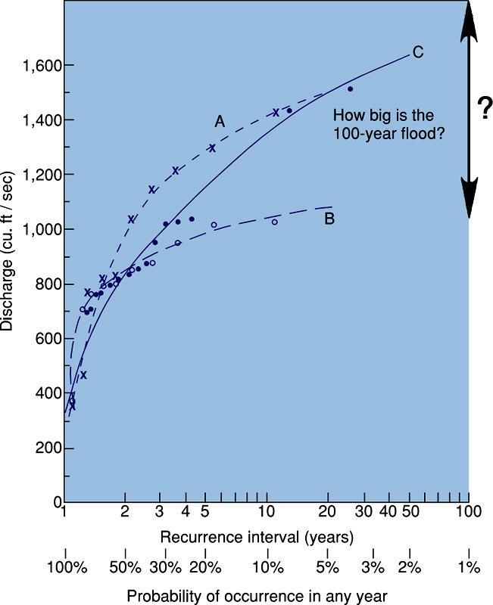
Flood-Frequency
Curve
Box 6.1 Figure 1

Slide 34
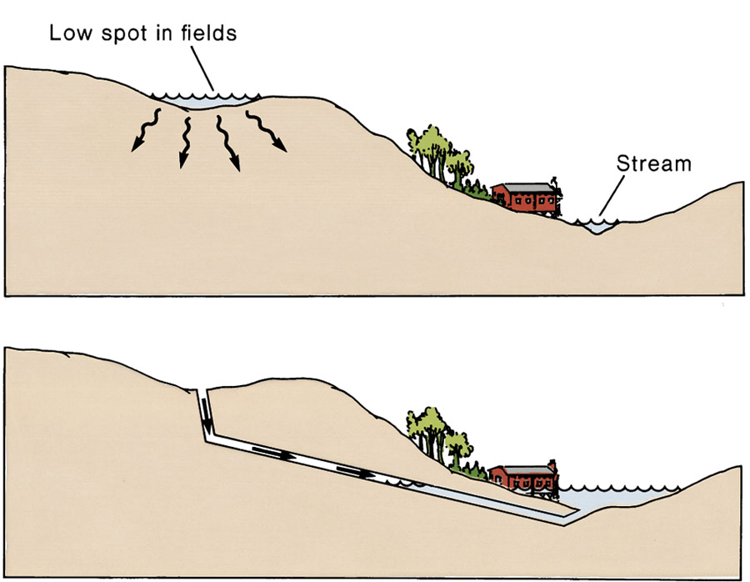
Farmland Drainage
Figure 6.16a, b
A
B

Slide 35
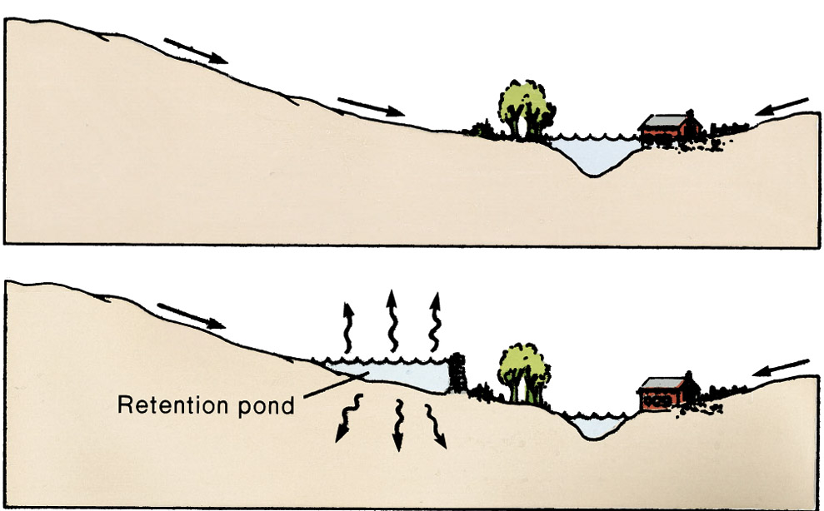
Retention Pond
Figure 6.17a, b
A
B

Slide 36
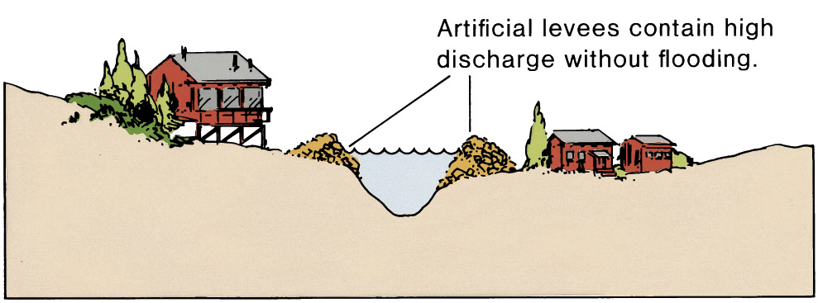
Levees
Figure 6.18

