Slide 1
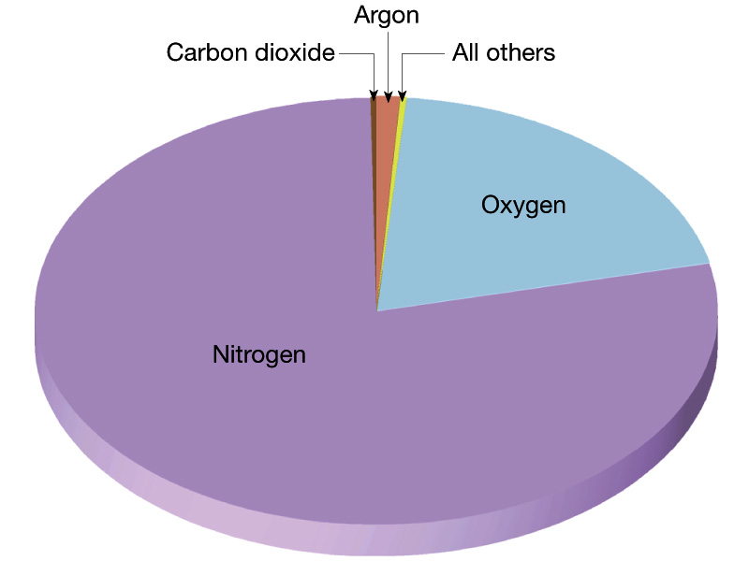
Composition of the Earth Atmosphere

Slide 2
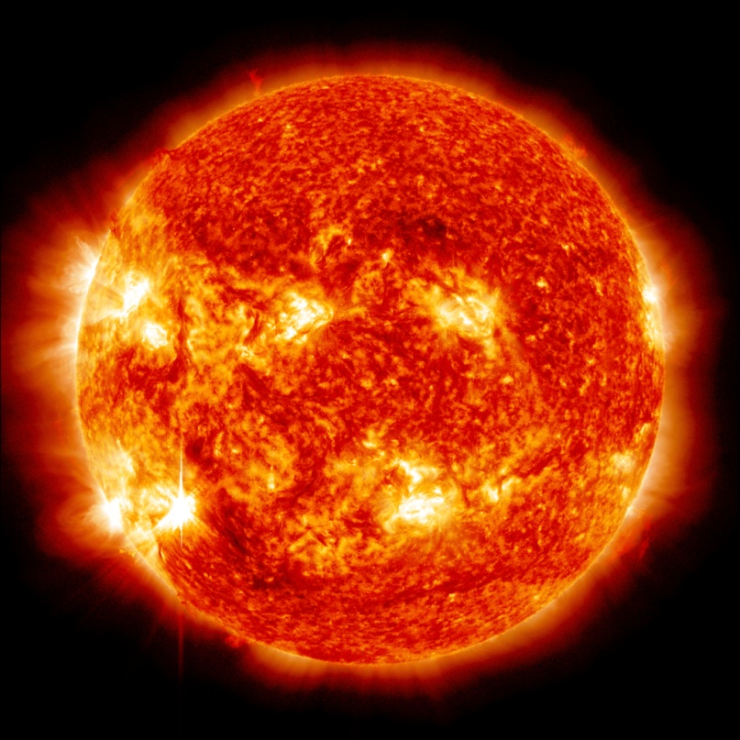
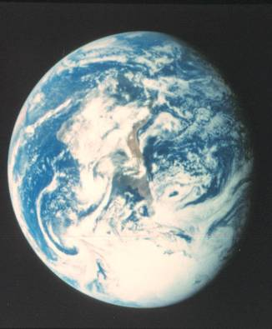
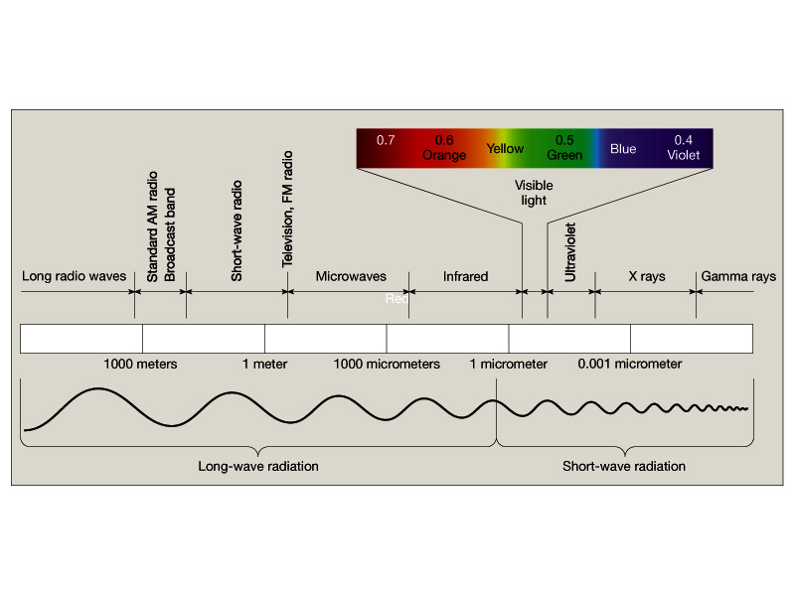

Slide 3
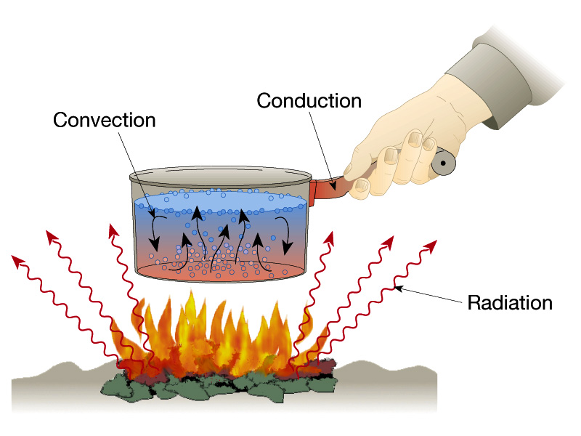
Mechanisms of heat transfer
(Oceans/Atmosphere)
(Geothermal)
(Solar)

Slide 4
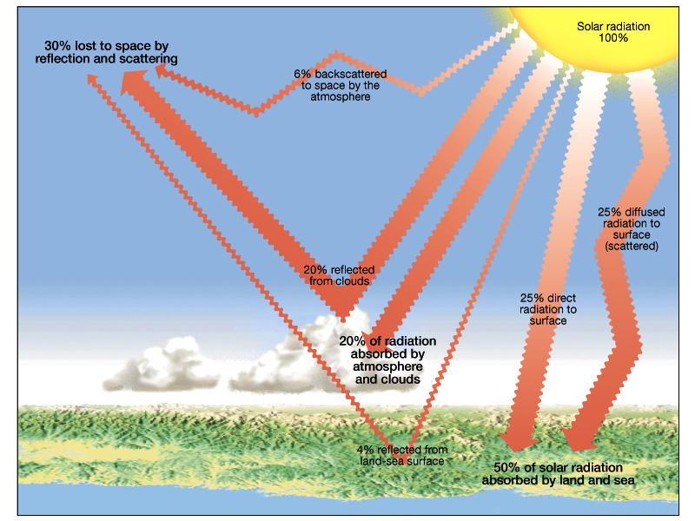
Earth solar energy budget

Slide 5
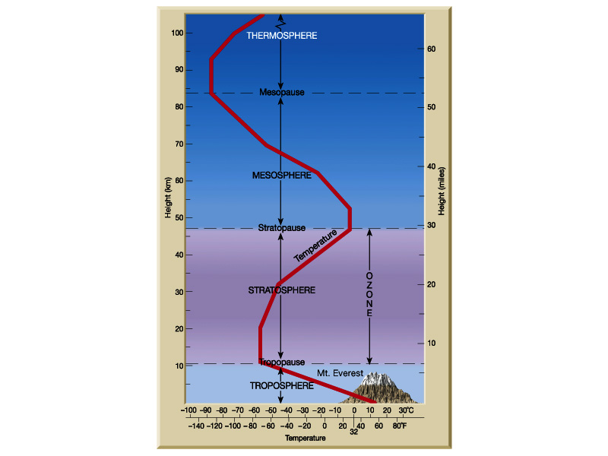
Structure of the
Earth atmosphere

Slide 6
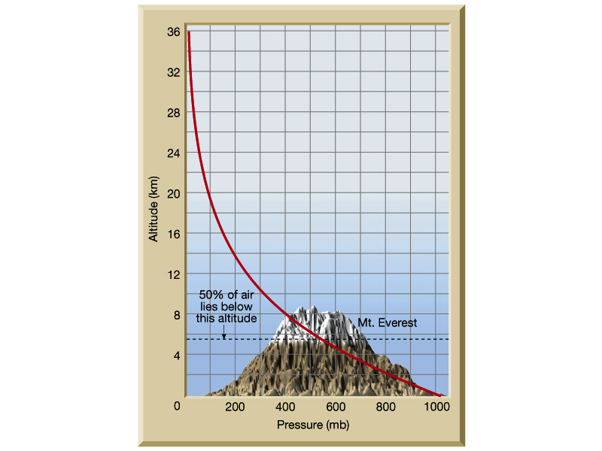
Pressure-altitude relationships
in troposphere

Slide 7
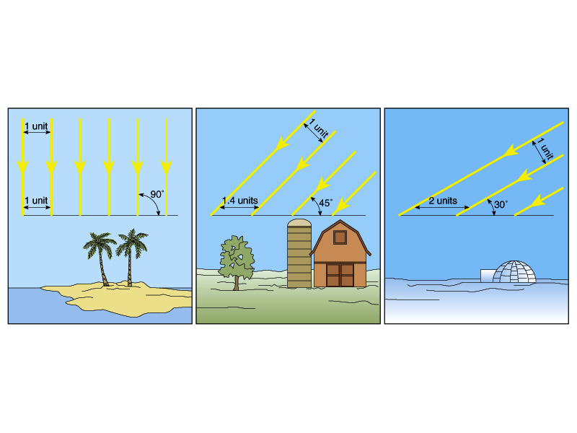
Low Latitude-----------------------------------------High Latitude
Latitudinal heating effects as related to solar ray angle of
incidence

Slide 8
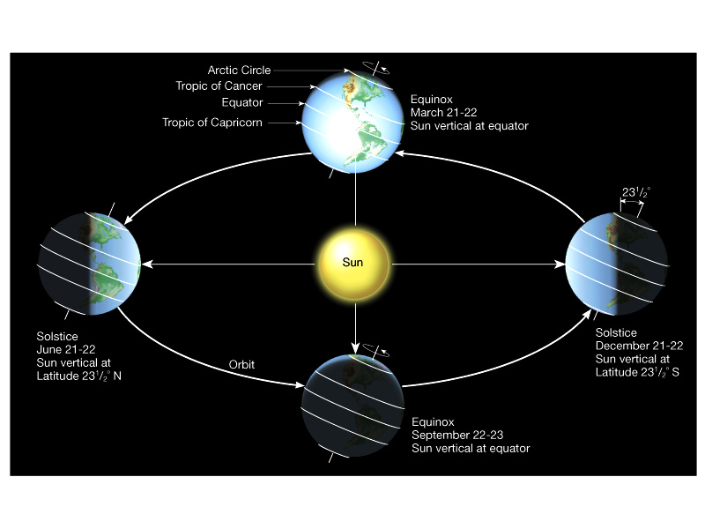
Seasonal heating and cooling of Earth atmosphere

Slide 9
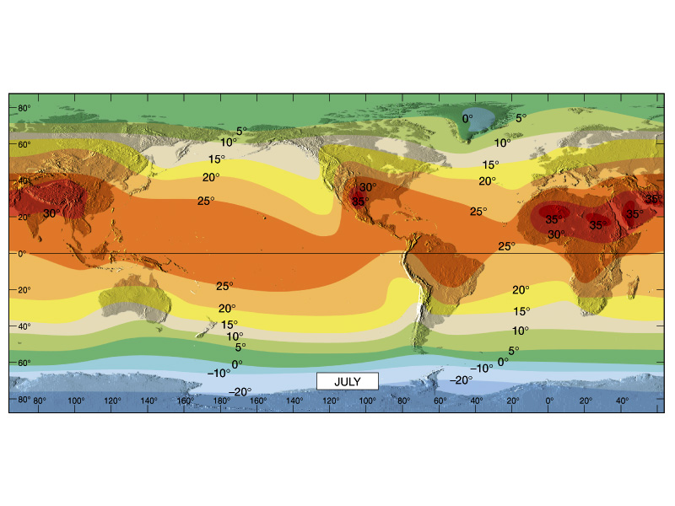
Global temperature trends – July (deg. Celsius)

Slide 10
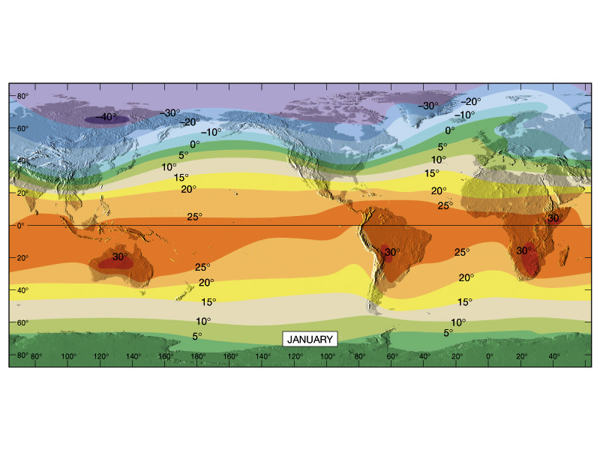
Global temperature trends – January (deg. Celsius)

Slide 11
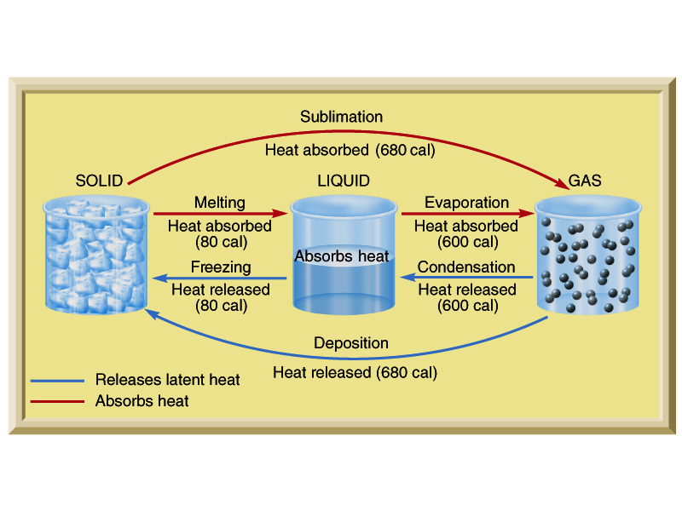
Heat exchange and phase transformation for water

Slide 12
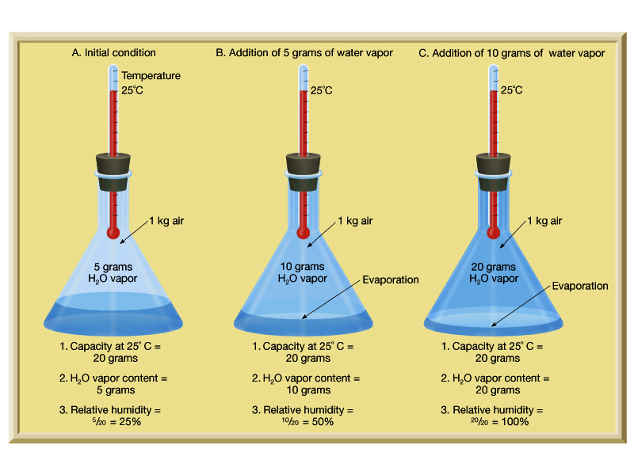
Absolute vs. relative humidity (as controlled by air temperature)

Slide 13
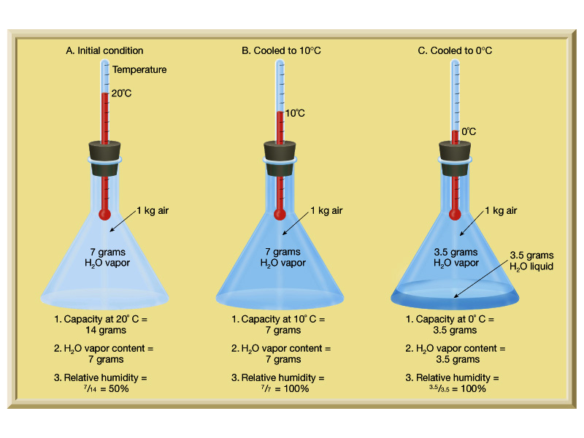
Absolute vs. relative humidity (as controlled by air temperature)

Slide 14
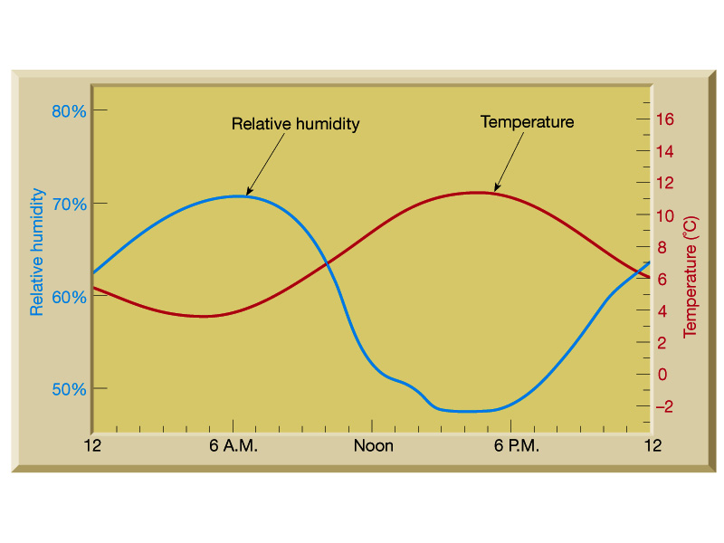
Diurnal fluctuation of relative humidity vs. time of day

Slide 15
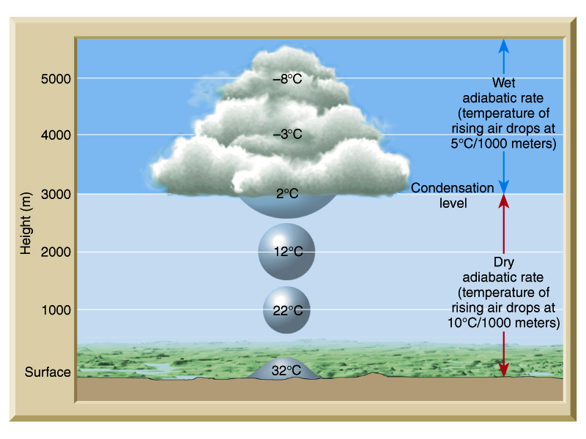
Dew point, cloud formation, and lifting levels

Slide 16
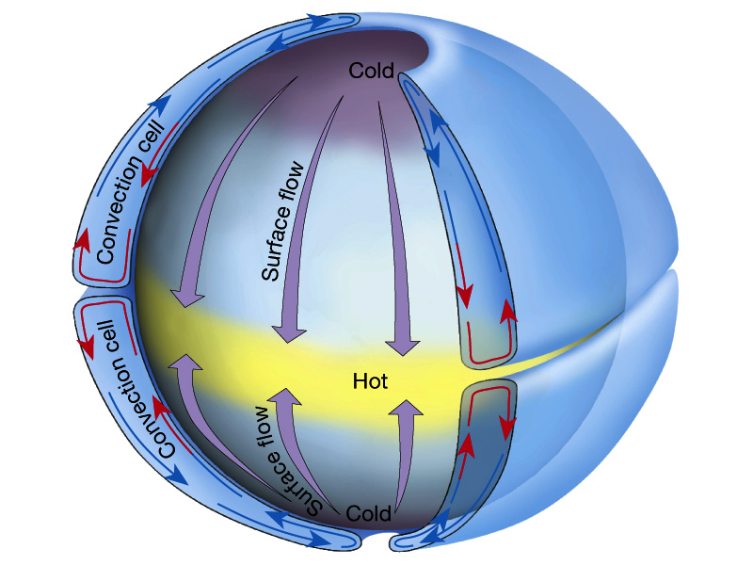
Global atmospheric circulation model

Slide 17
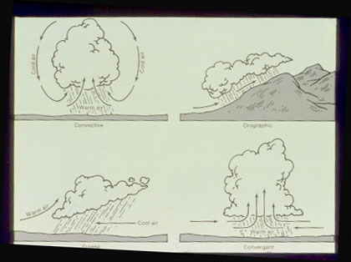

Slide 18
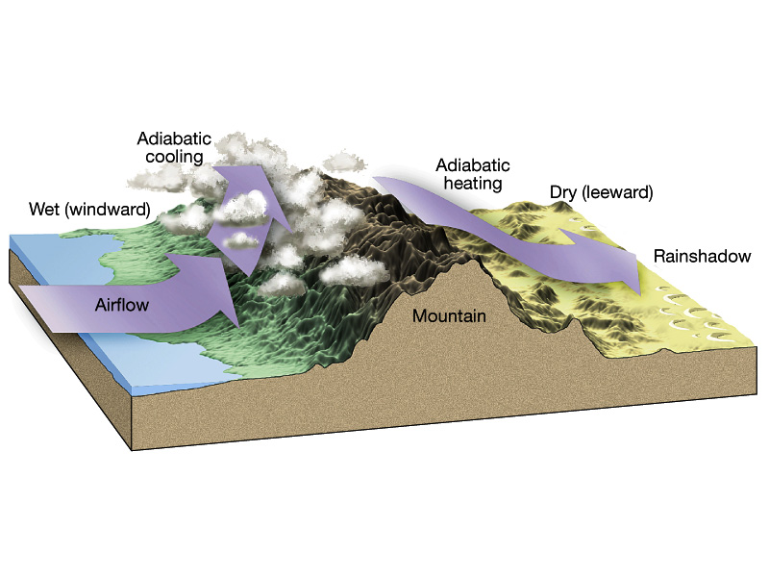
Forceful lifting: orographic

Slide 19
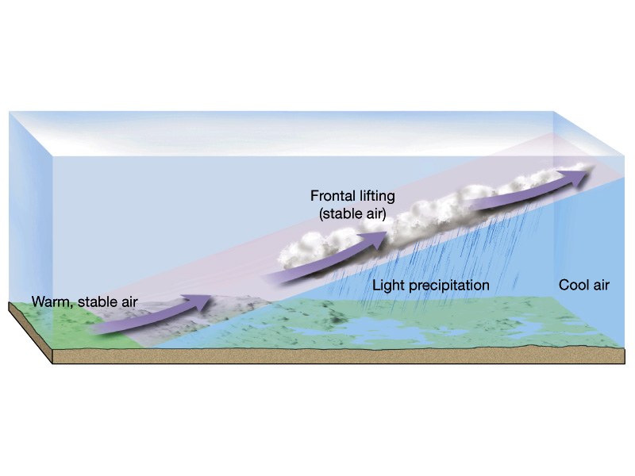
Forceful lifting: frontal wedging
Warm front

Slide 20
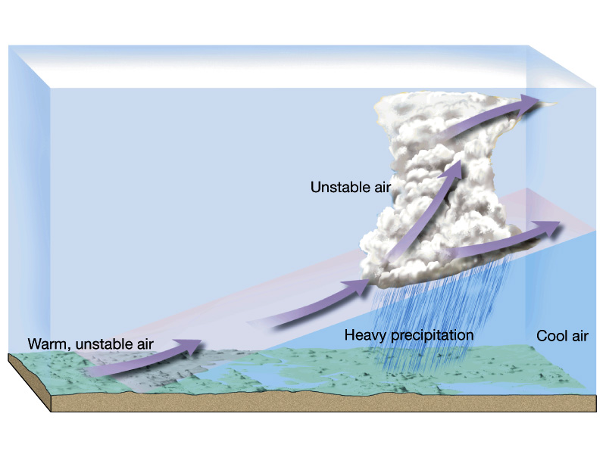

Slide 21
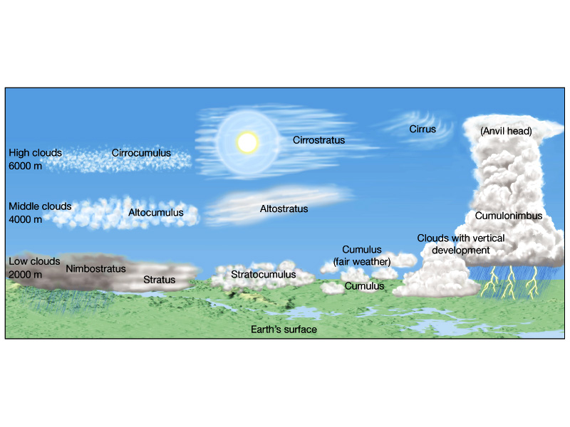
Cloud classification system (type, altitude, height)

Slide 22
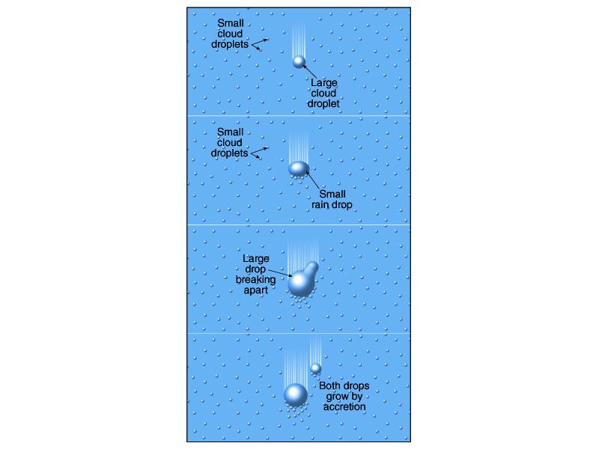
Rain droplet
formation

Slide 23
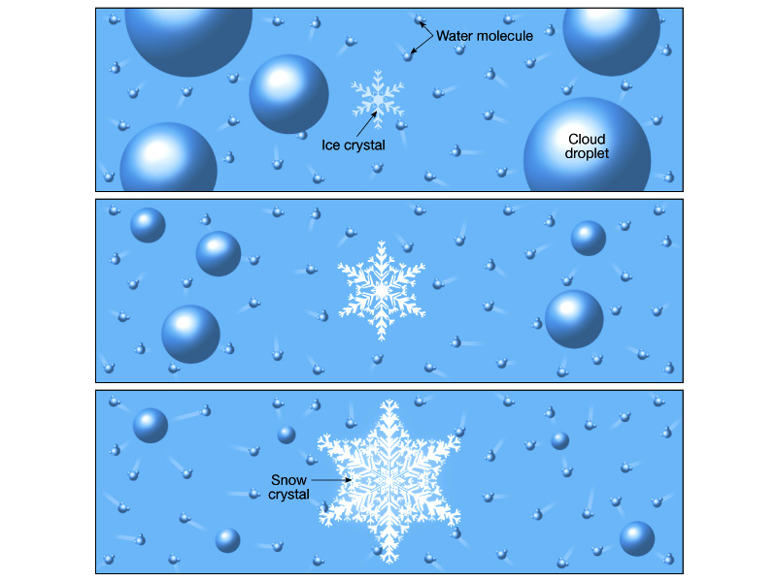
Snow formation

Slide 24
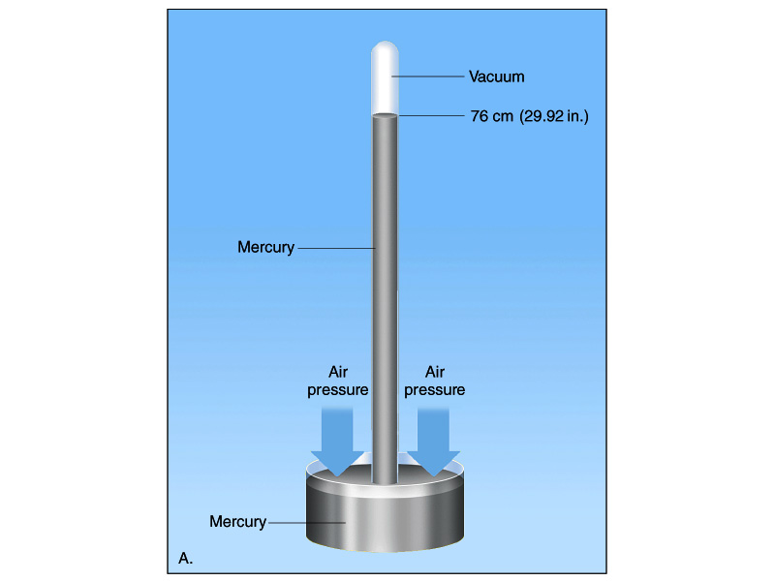
Toricelli’s Barometer

Slide 25
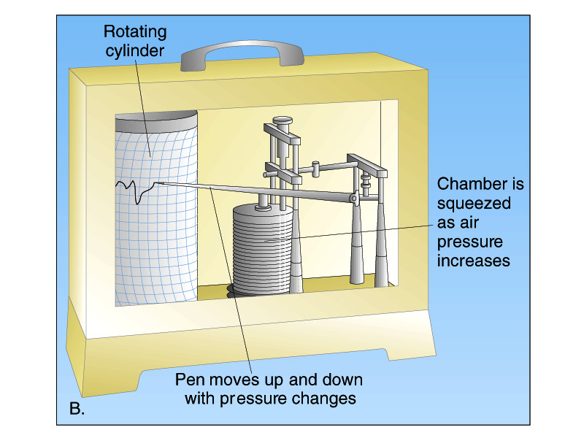

Slide 26
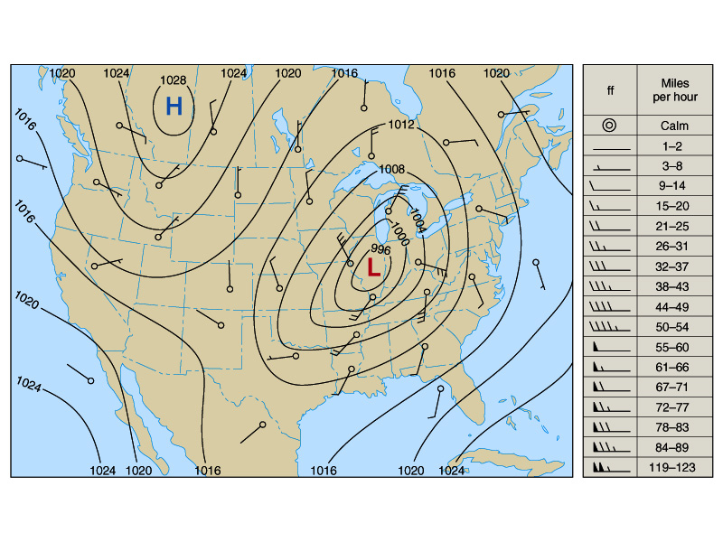
Air pressure map of U.s.

Slide 27
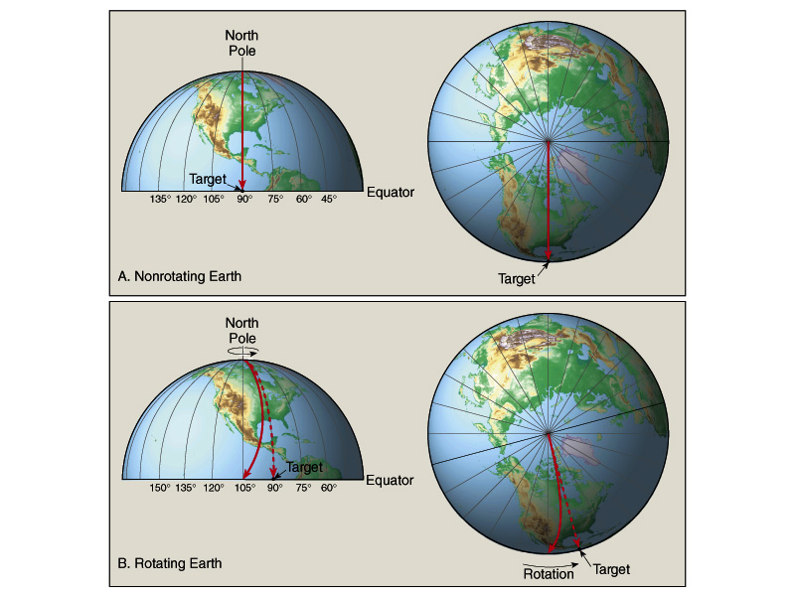
N. Hemisphere =
Hook right
S. Hemisphere =
Hook left
Coriolis

Slide 28
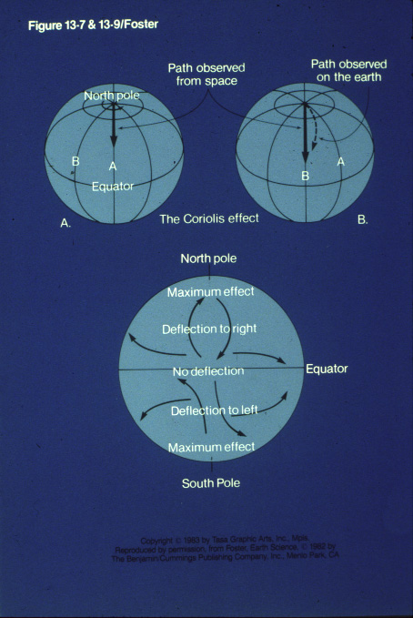

Slide 29
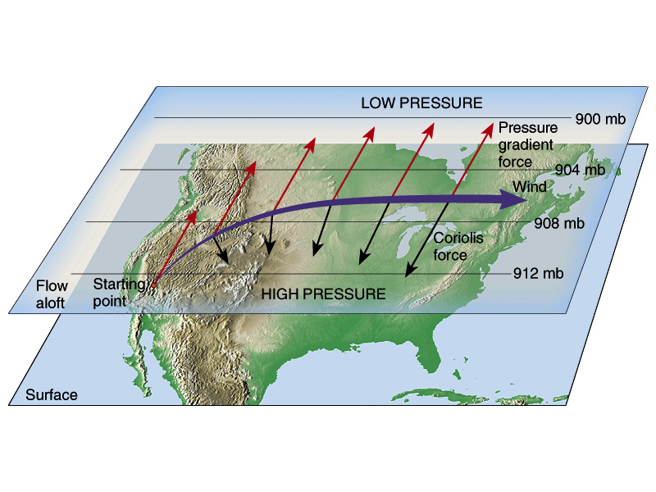
Isobars / Air flow / Coriolis

Slide 30
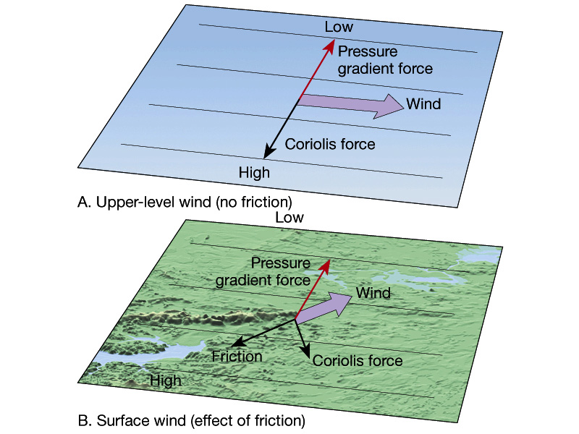
Jet Stream

Slide 31
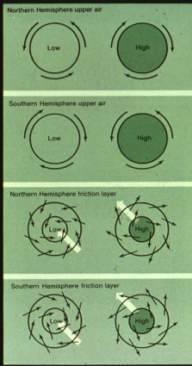

Slide 32
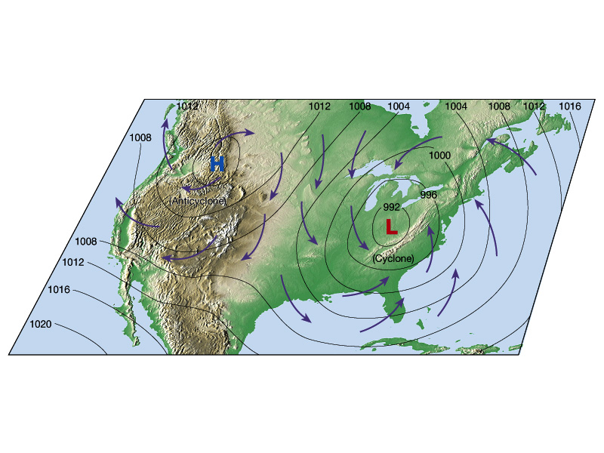

Slide 33
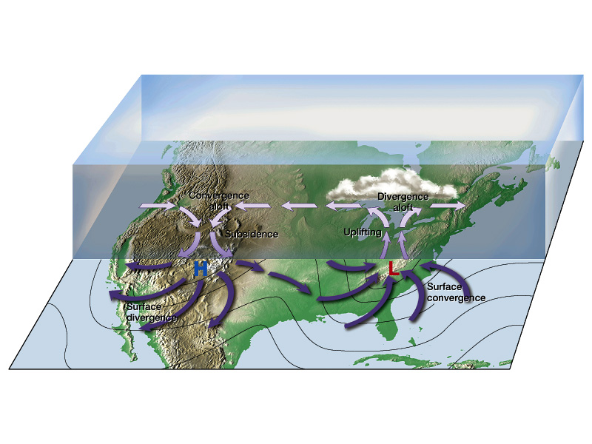
Cyclone
Anti-Cyclone

Slide 35
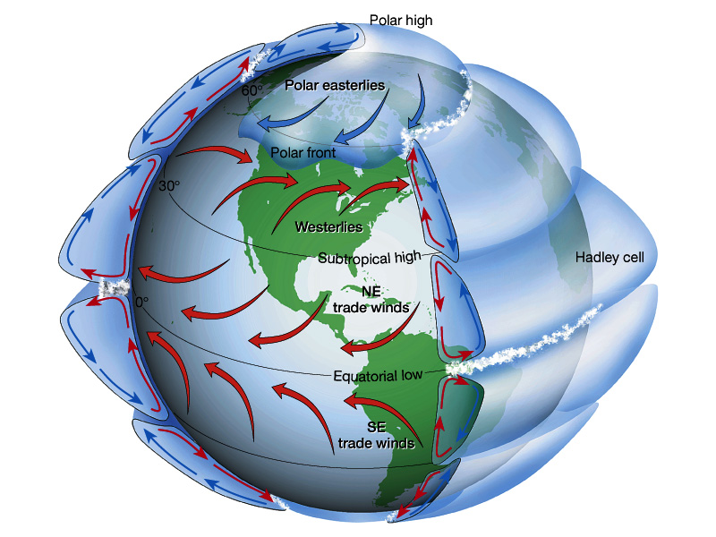

Slide 36
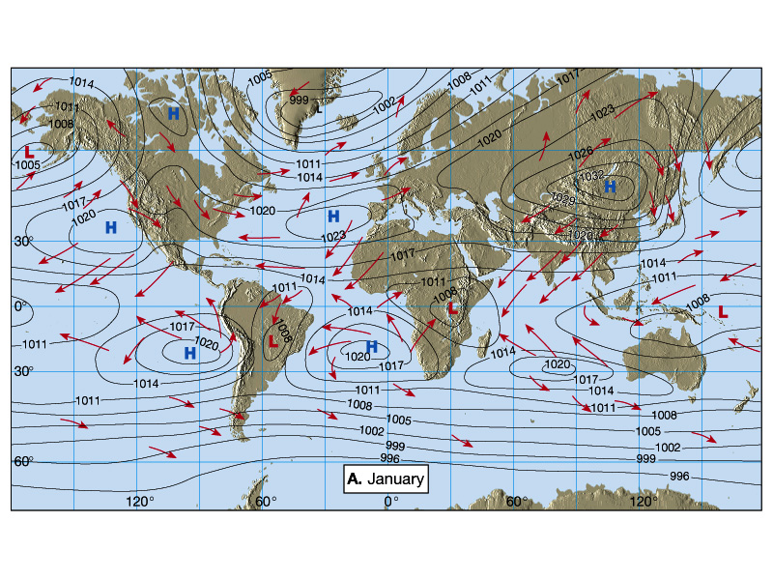

Slide 37
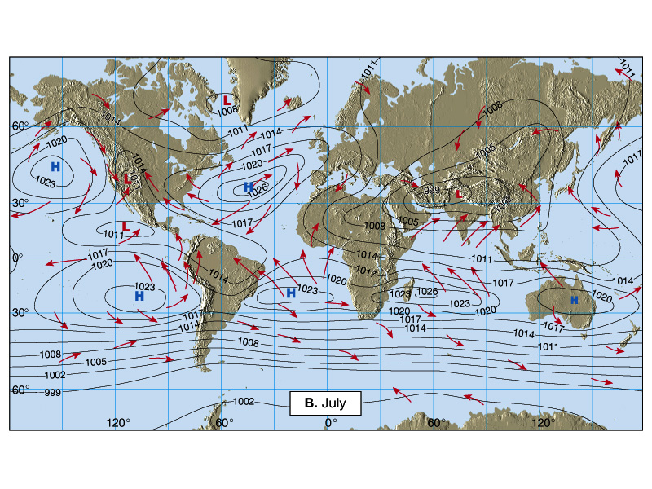

Slide 38
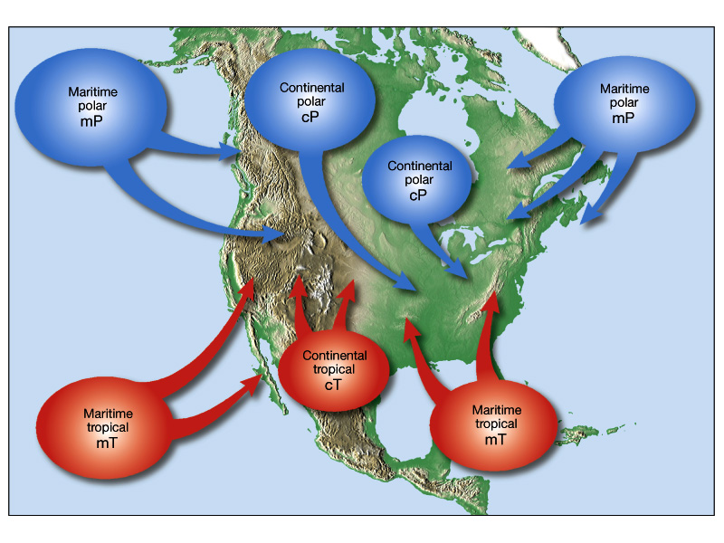
Sources of Air / Air Masses

Slide 39
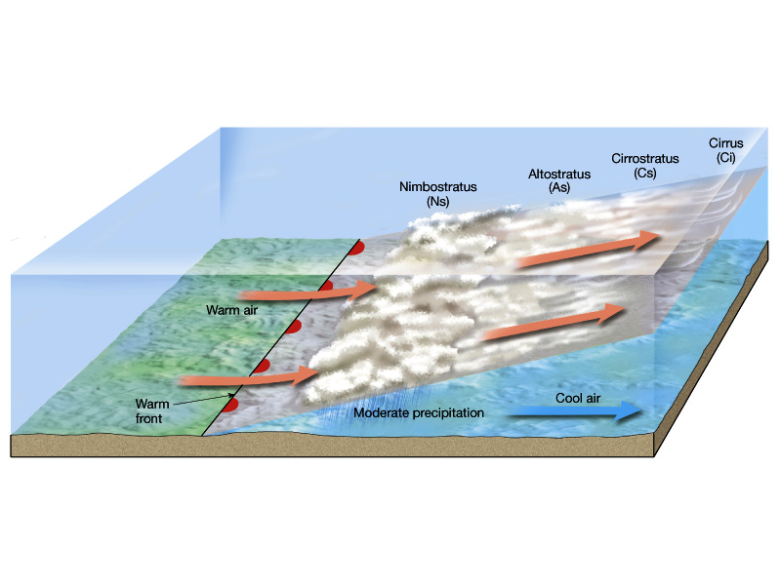
Warm Front Weather

Slide 40
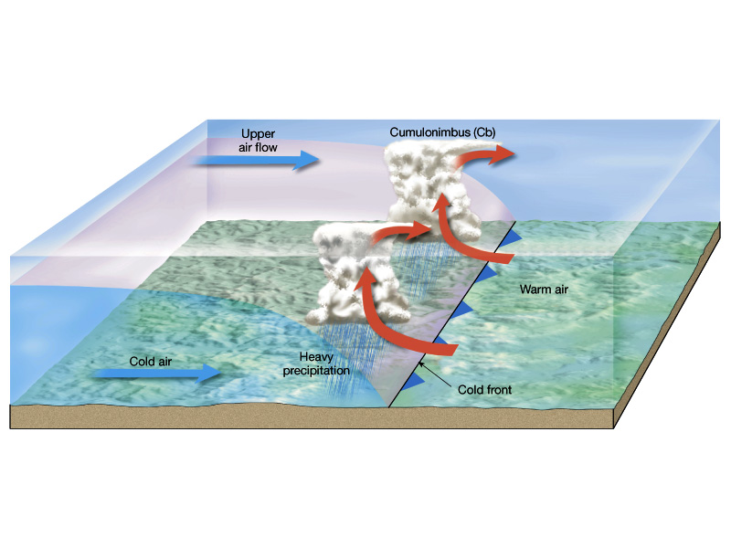
Cold Front Weather

Slide 41
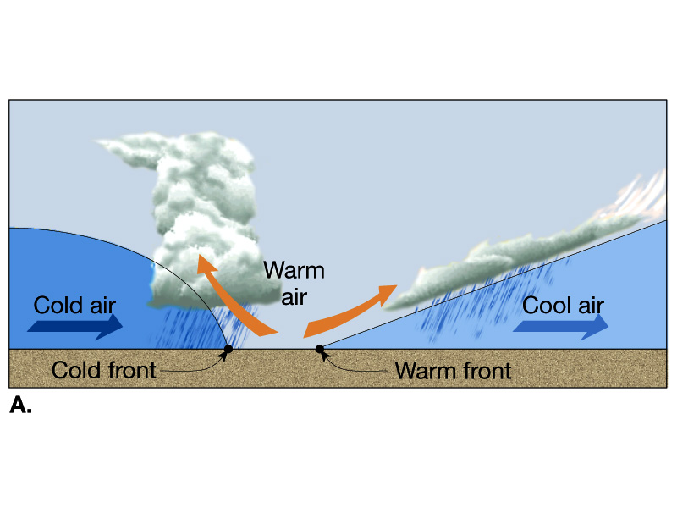
Impending Occluded Front

Slide 42
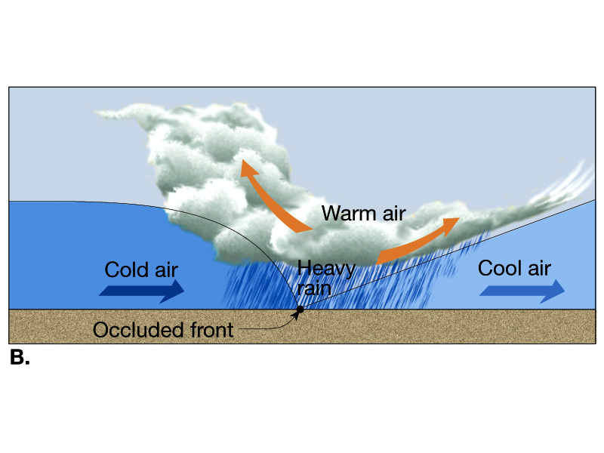
Occluded Front

Slide 43
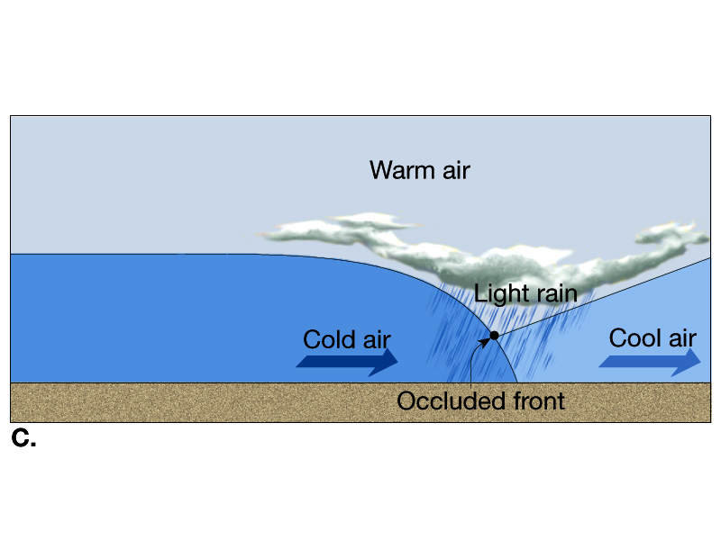

Slide 44
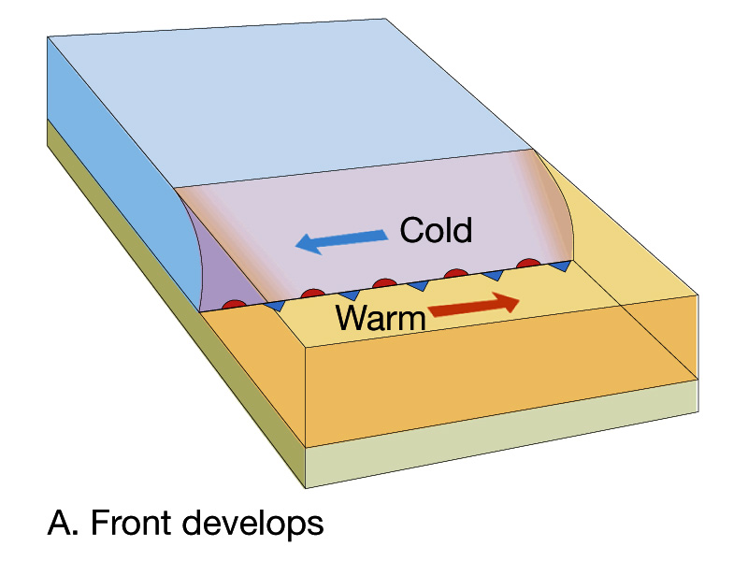
Stage 1: cyclonic occlusion
process

Slide 45
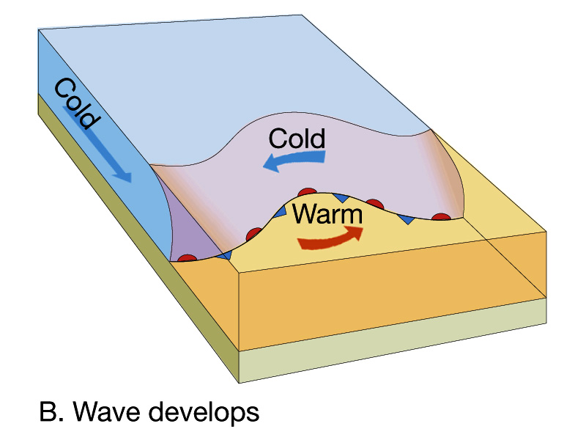
Stage 2: cyclonic occlusion
process

Slide 46
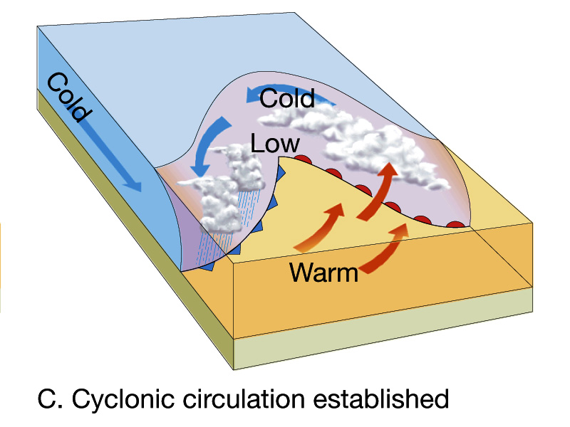
Stage 3: cyclonic occlusion
process

Slide 47
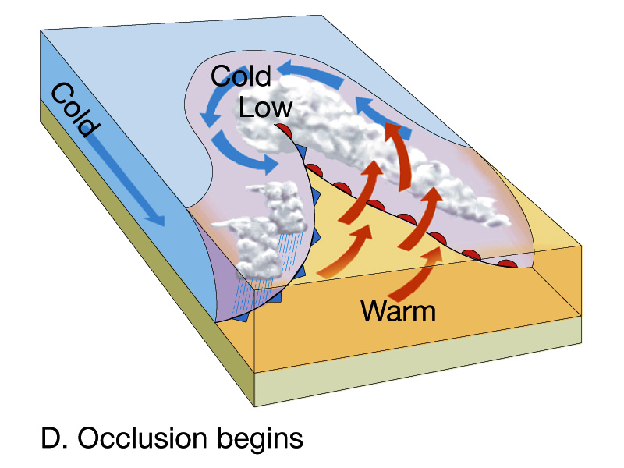
Stage 4: cyclonic occlusion
process

Slide 48
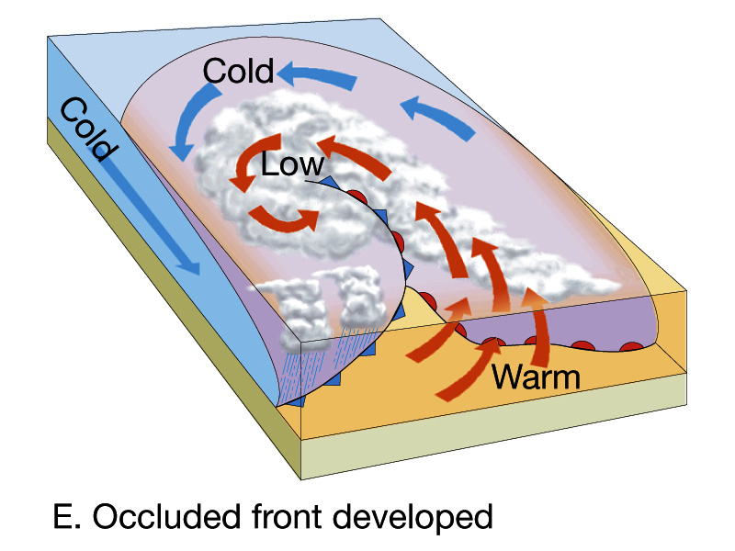

Slide 49
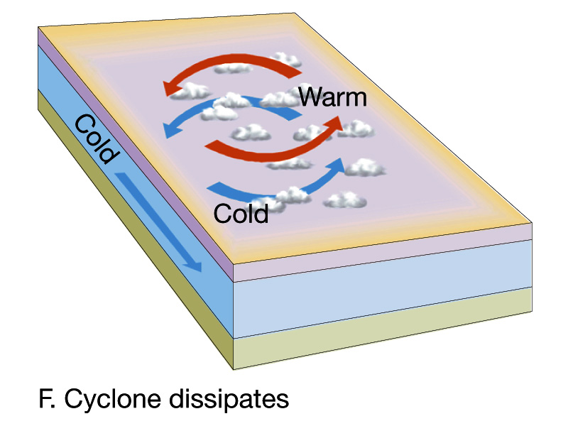

Slide 50

Effect of Jetstream on U.S. weather

Slide 51


Slide 52


Slide 53

Convective Thunderstorm development

Slide 54

Hurricane

Slide 55


Slide 56


Slide 57

Hurricane in 3D

Slide 58

Normal Trade Wind/Sea Temp Conditions in Pacific

Slide 59

El Nino conditions

Slide 60

Satellite Image of El Nino Sea Surface Conditons

Slide 61


Slide 65



