Slide 1
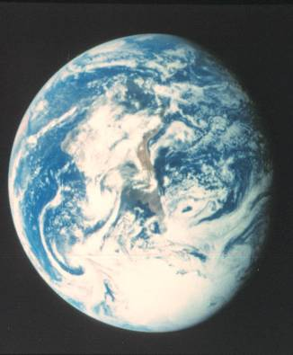
EARTH SYSTEM
Mass + Energy
Lithosphere
O, Si, Al, cations
Heat: geothermal
Atmosphere
N, O, others
Heat: solar
Hydrosphere
H, O
Heat: solar
Biosphere
C, H, O, N
Food/energy: solar

Slide 2
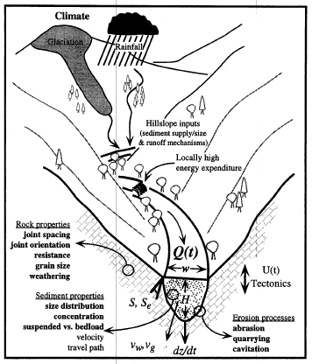
FUNDAMENTAL PRINCIPLES
Energy Sources in the
Earth System
Gravitational
Solar (Climate)
Geothermal (Tectonics)
Transfer of Energy
Transfer of Mass
Force (push or pull)
Energy (potential, kinetic, heat)
Work = Transfer of mass, energy use
Flux = Transfer per unit time
Length, Mass, Time
Area, Volume, Density
Heat, Solids-Liquids-Gases

Slide 3
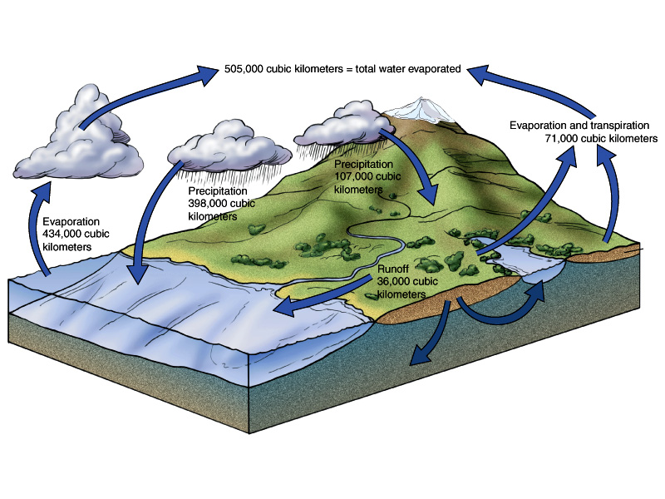

Slide 4
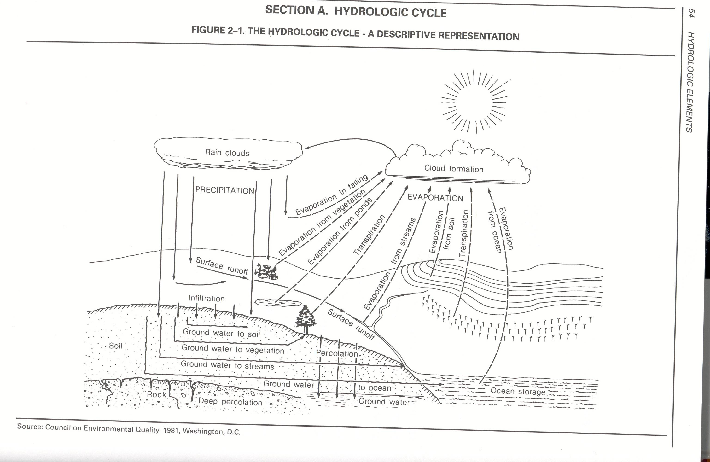

Slide 5
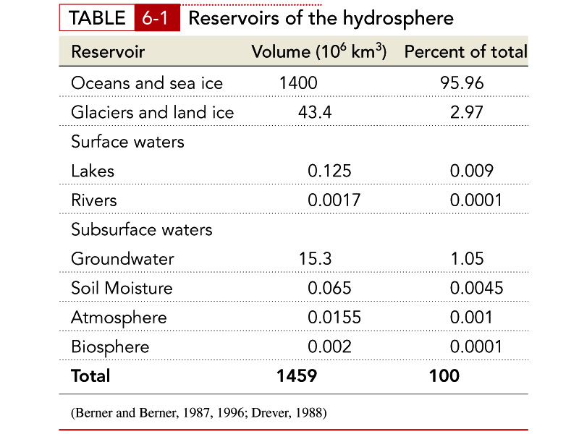

Slide 6
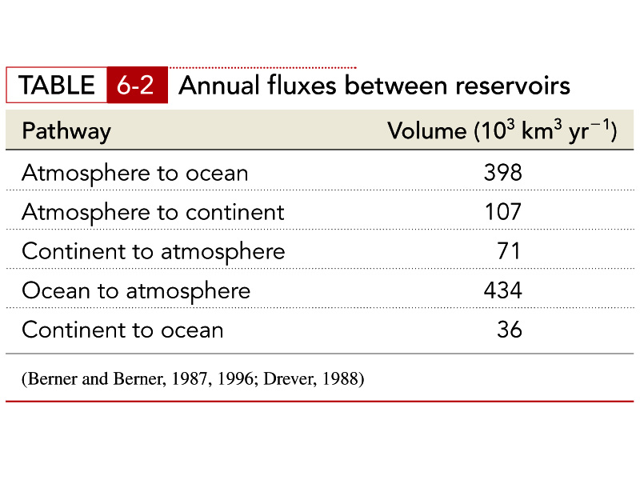

Slide 7
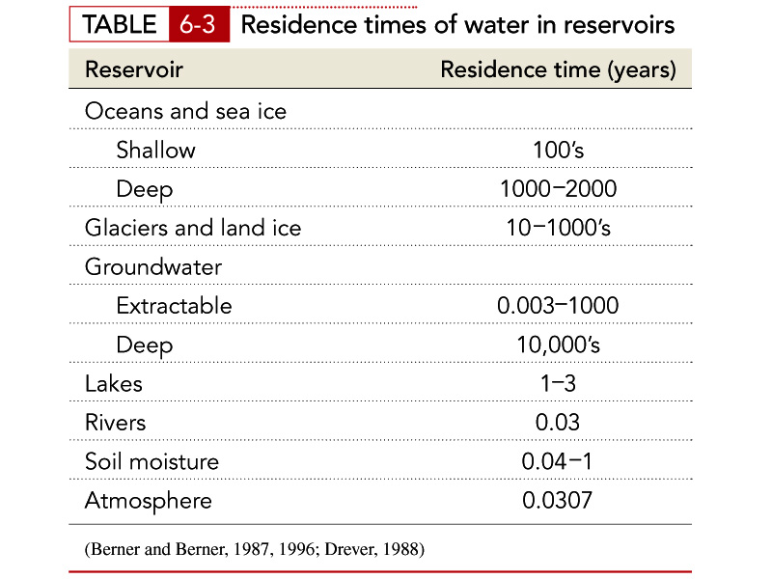

Slide 8
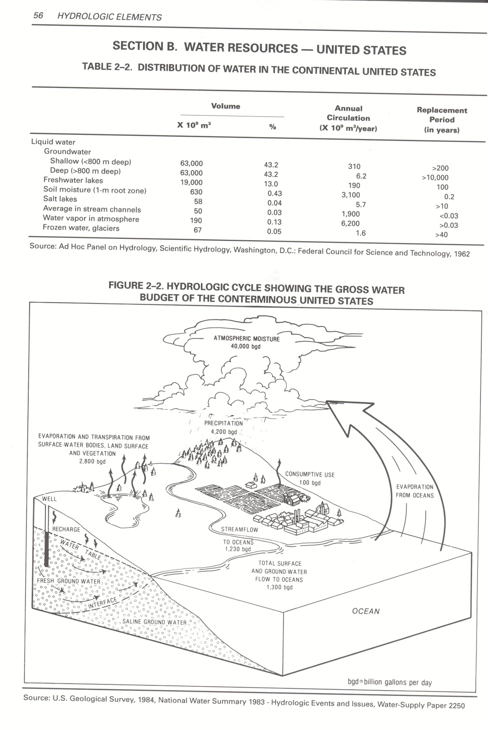

Slide 9
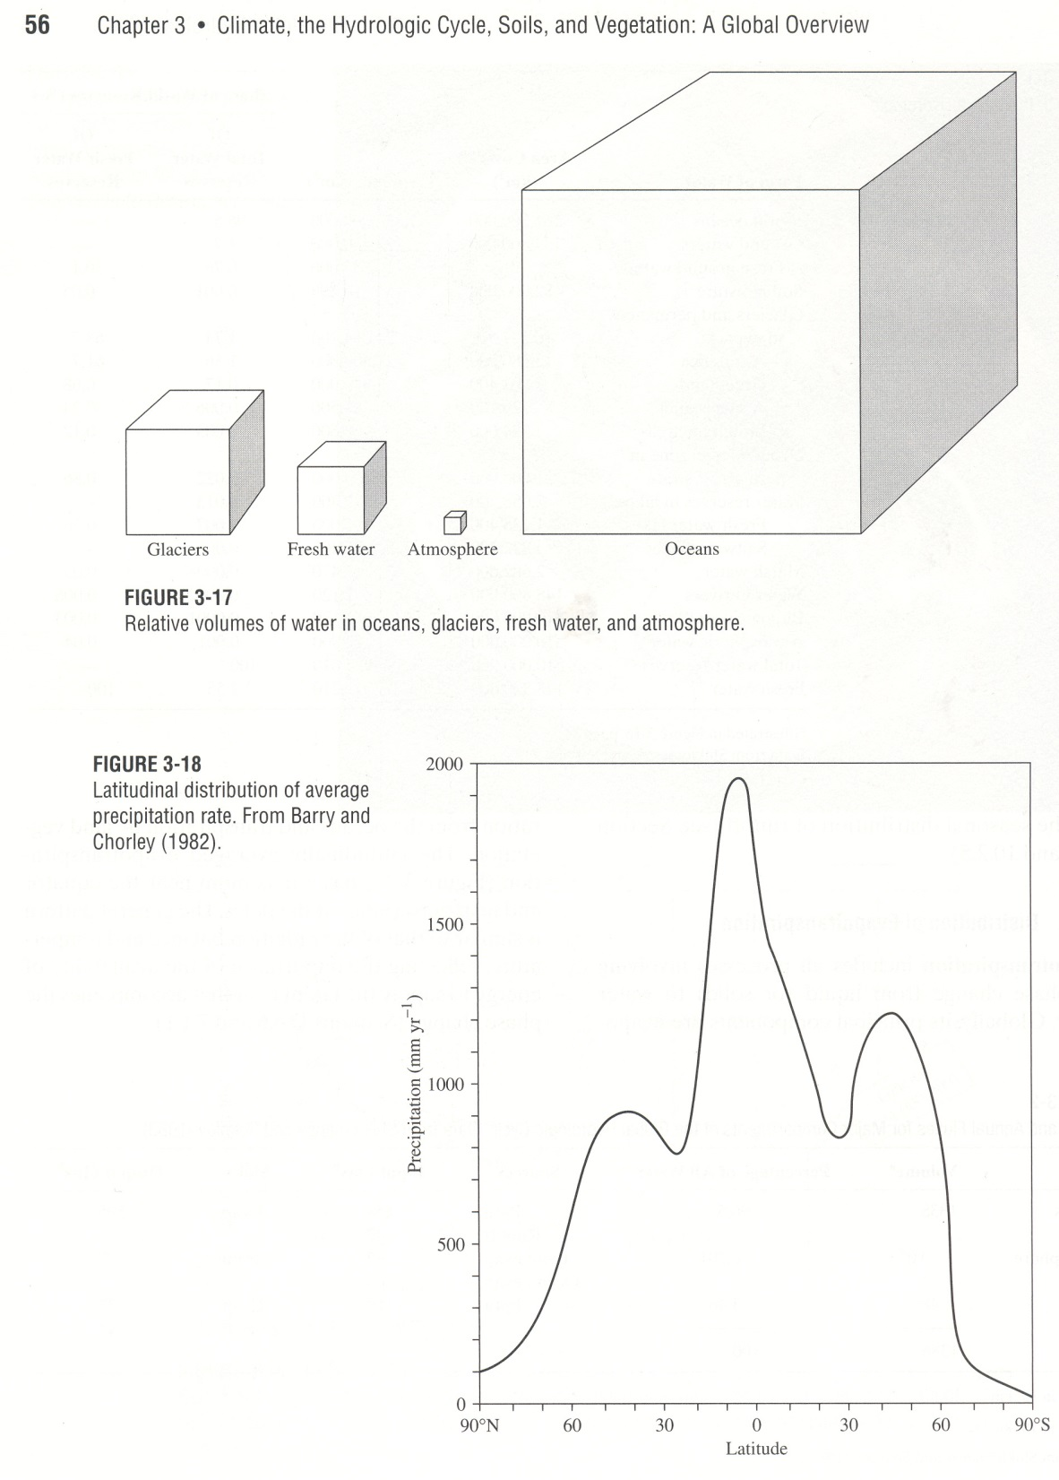

Slide 10
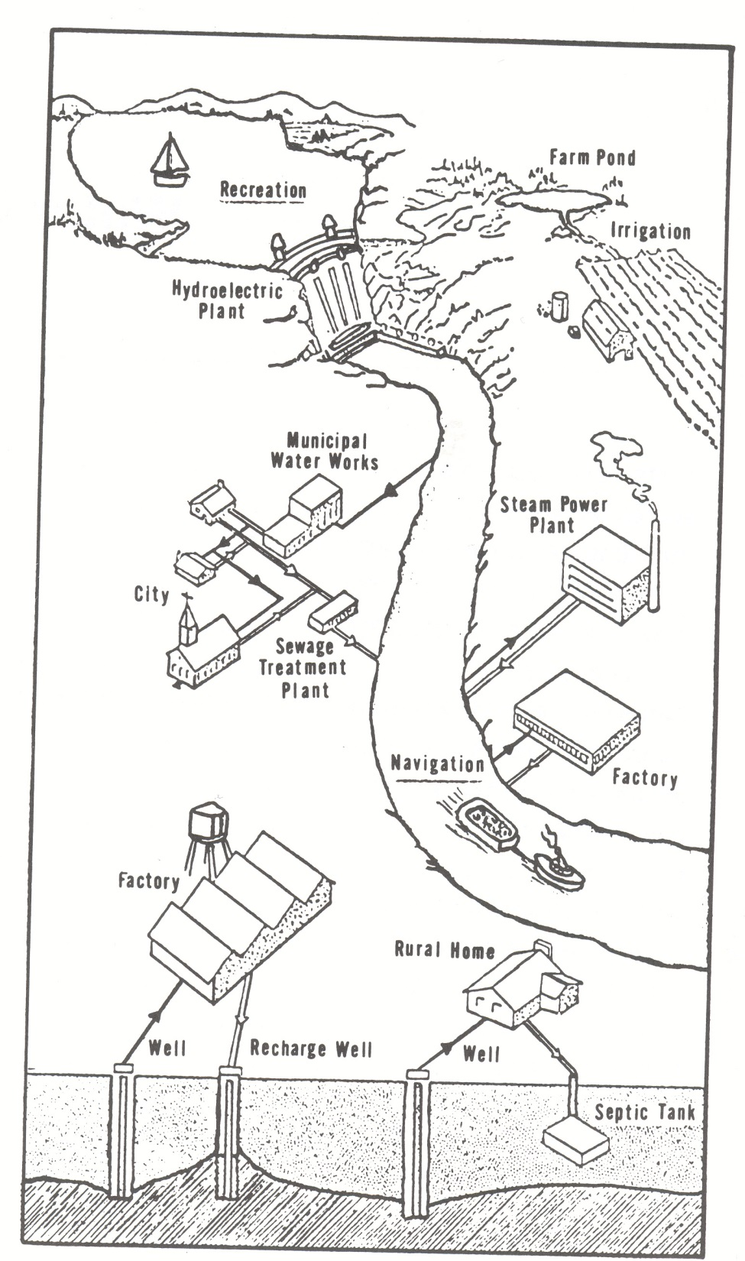

Slide 11
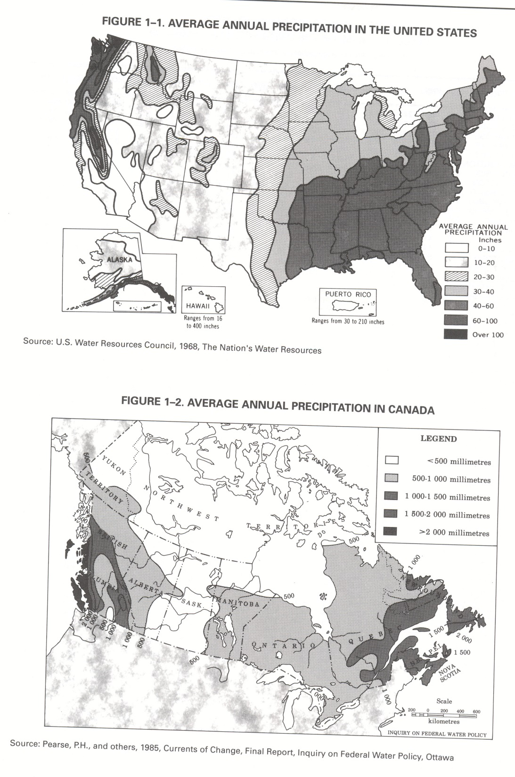

Slide 12
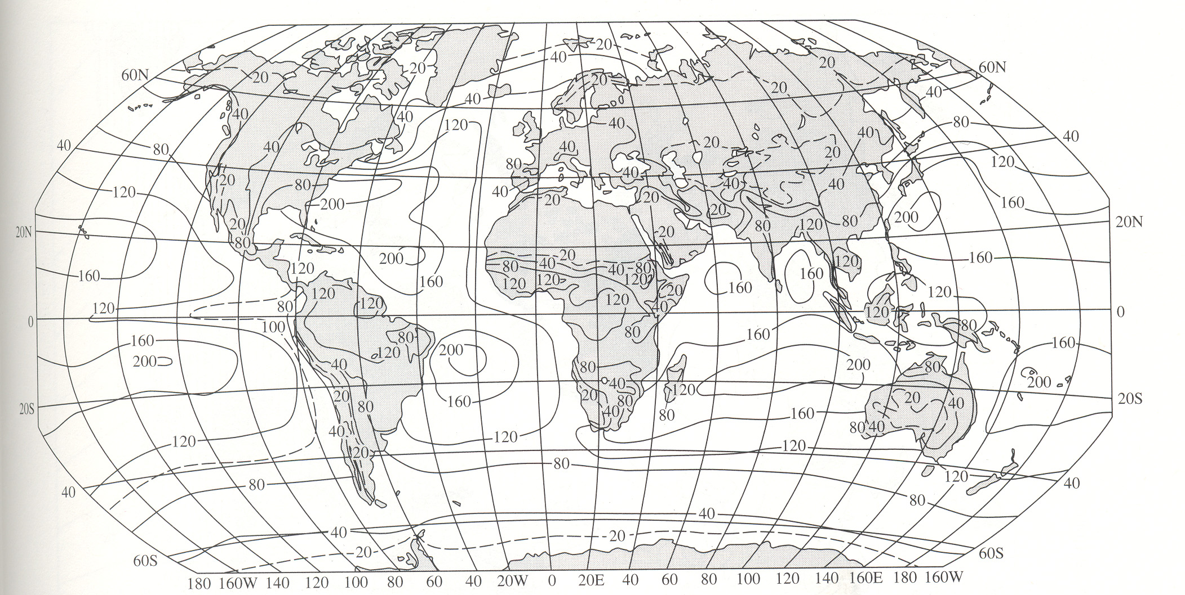

Slide 13
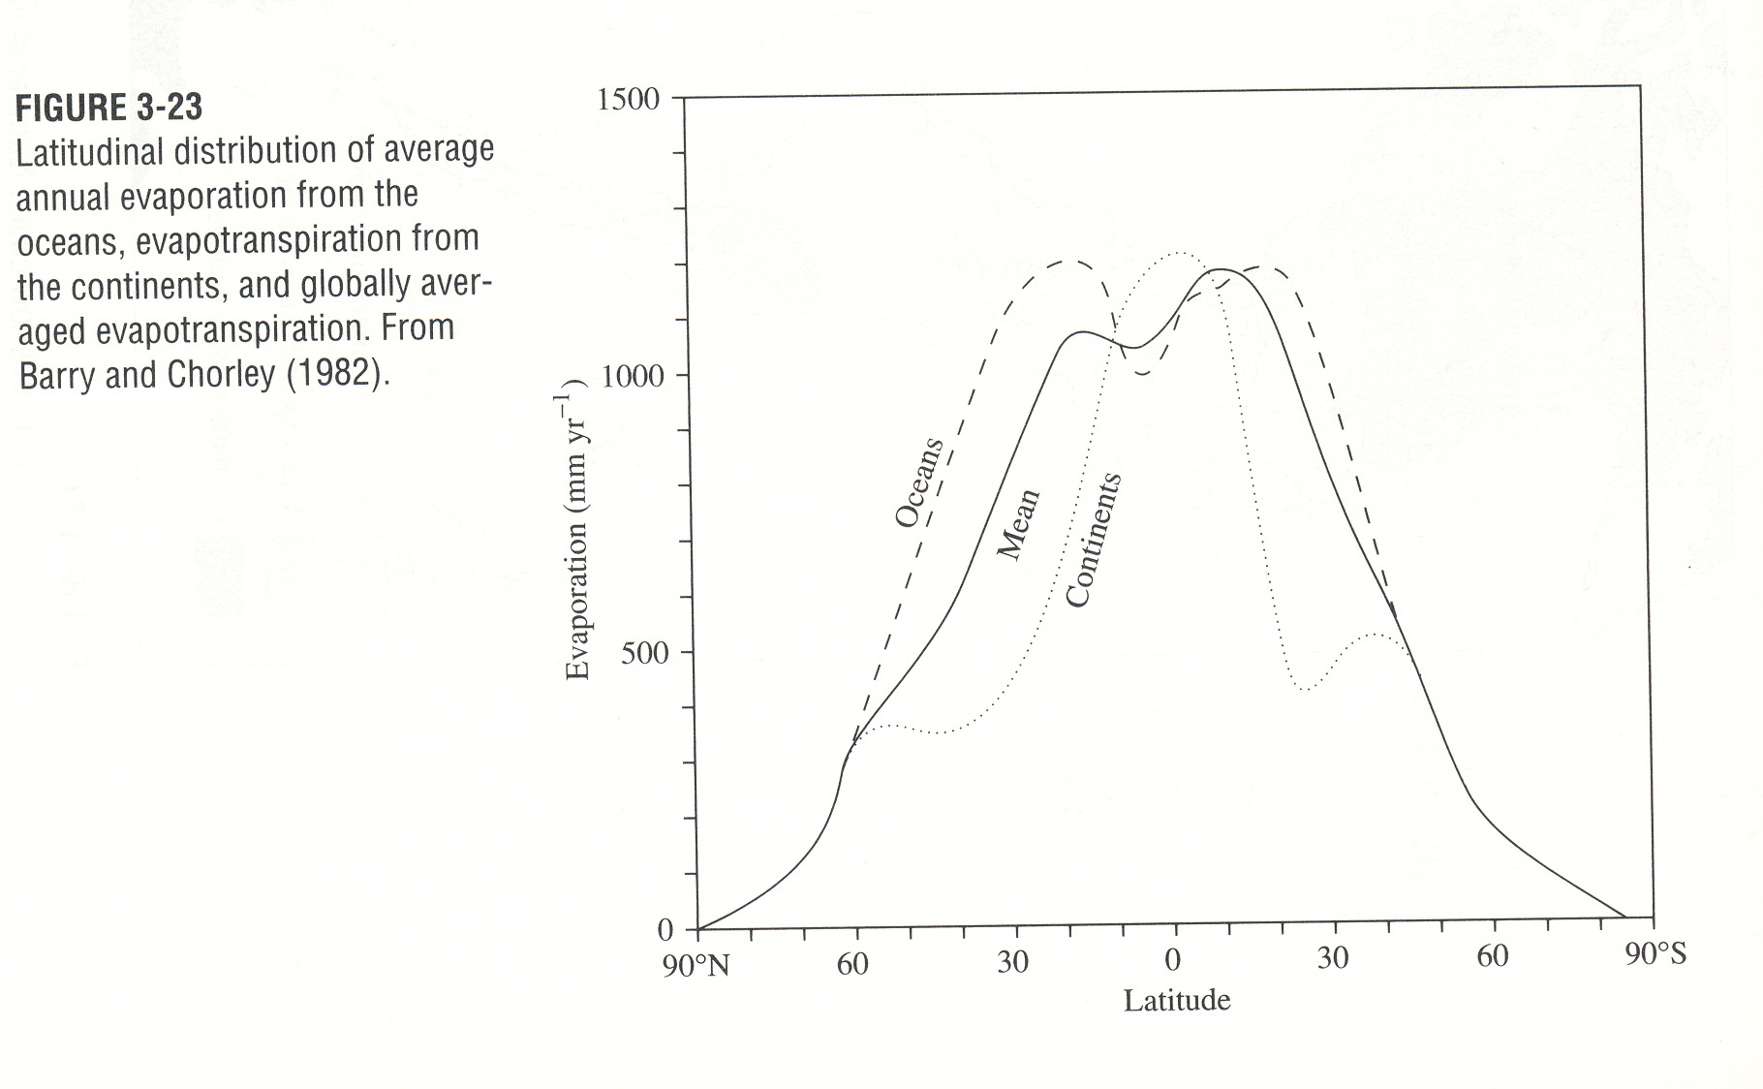

Slide 14
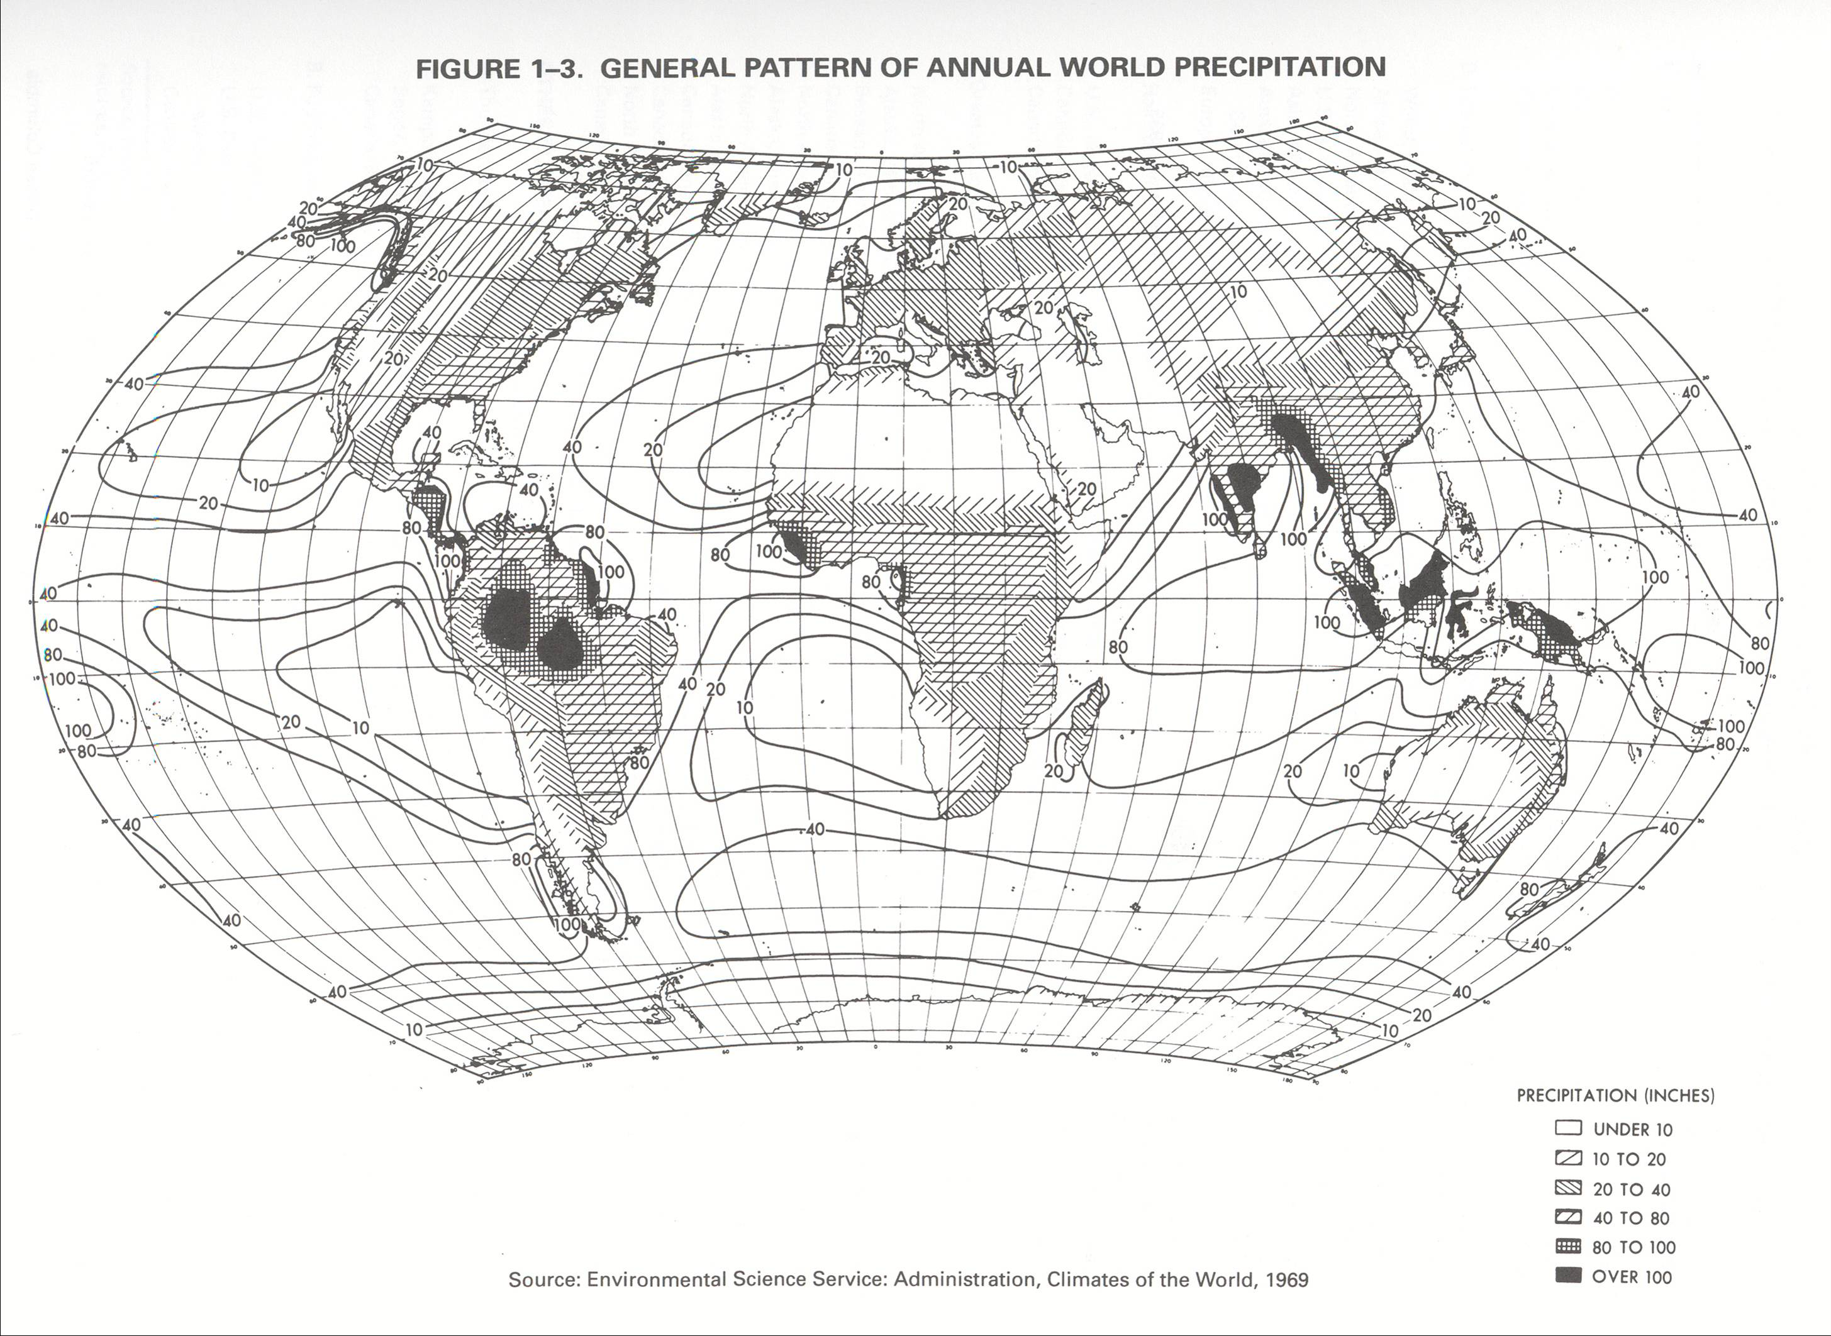

Slide 15
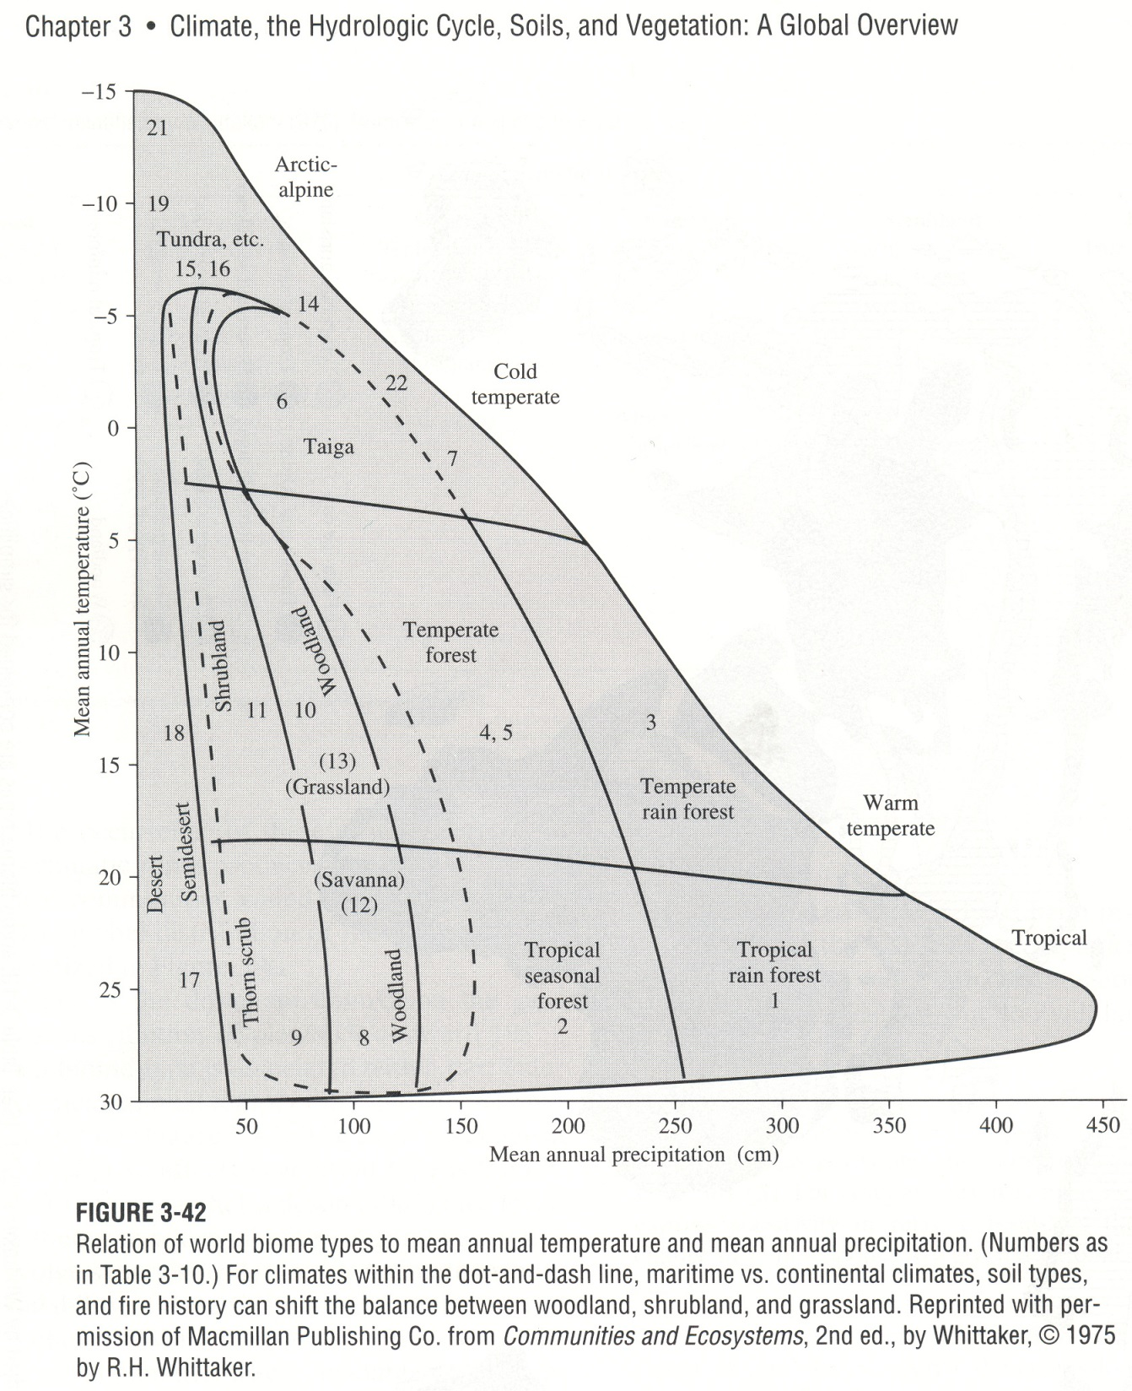

Slide 16
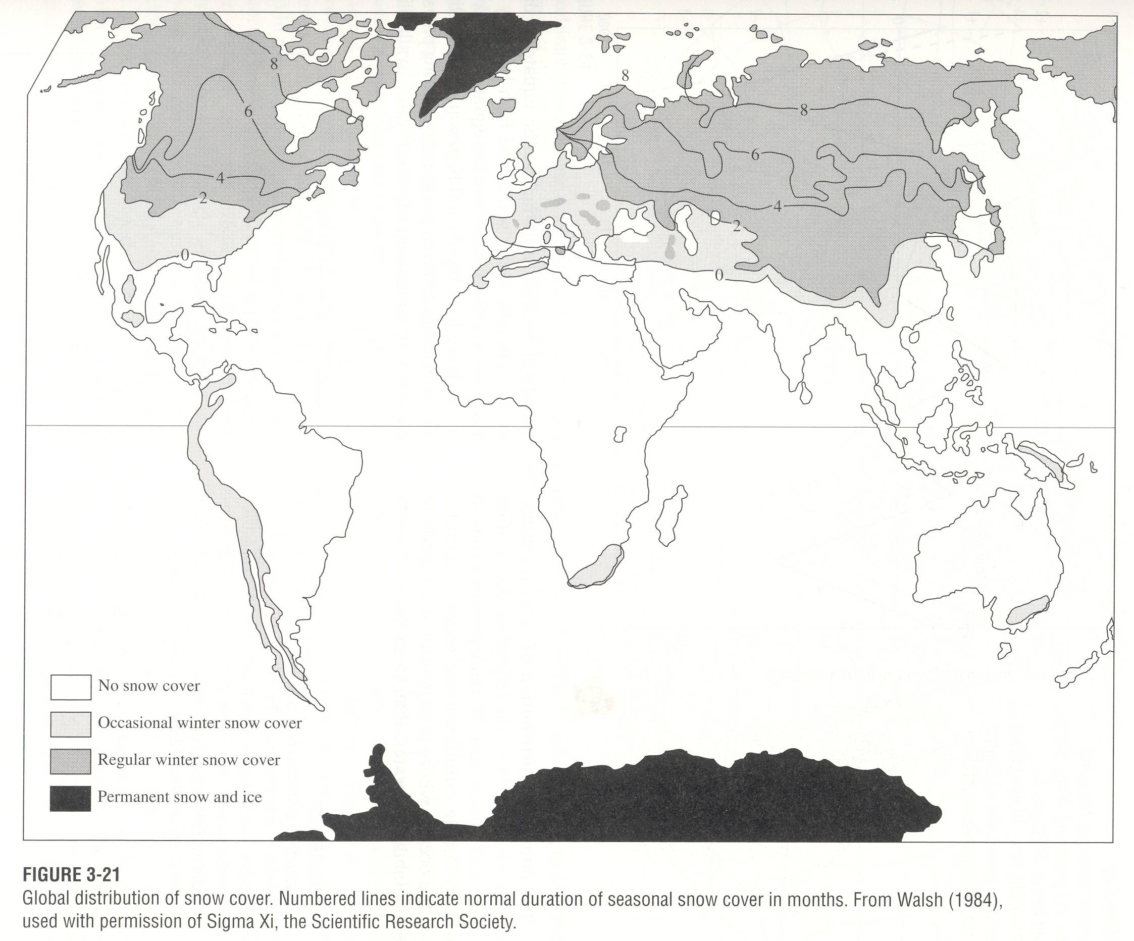

Slide 17
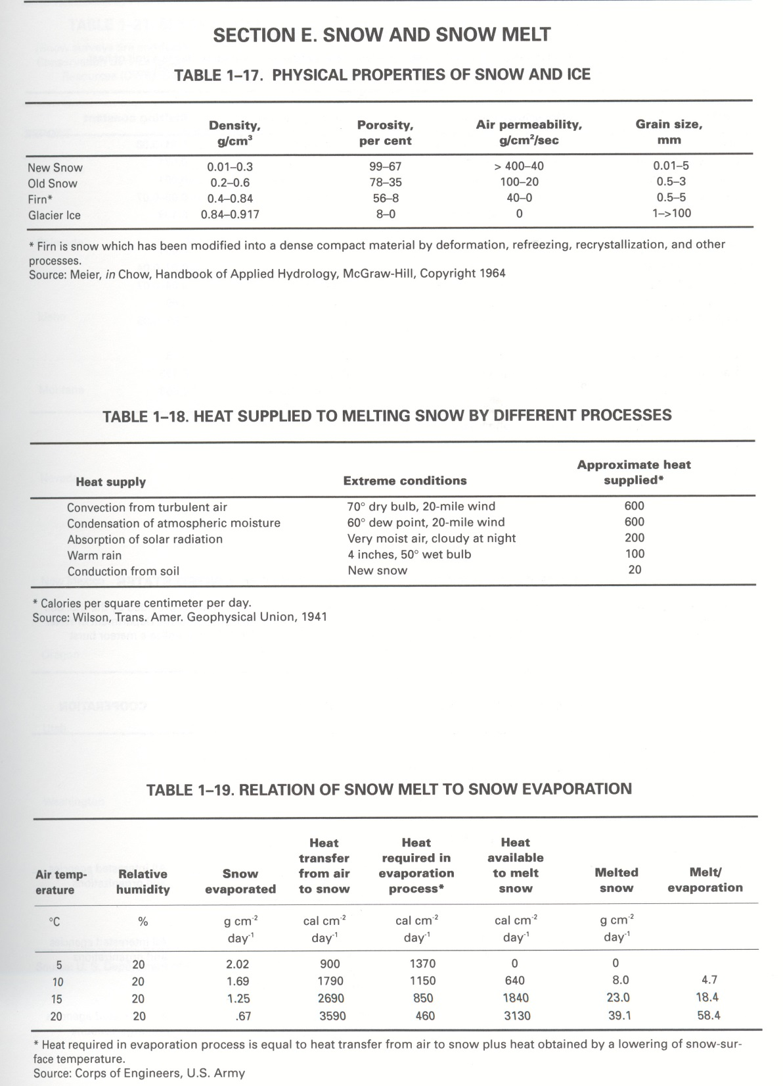

Slide 18
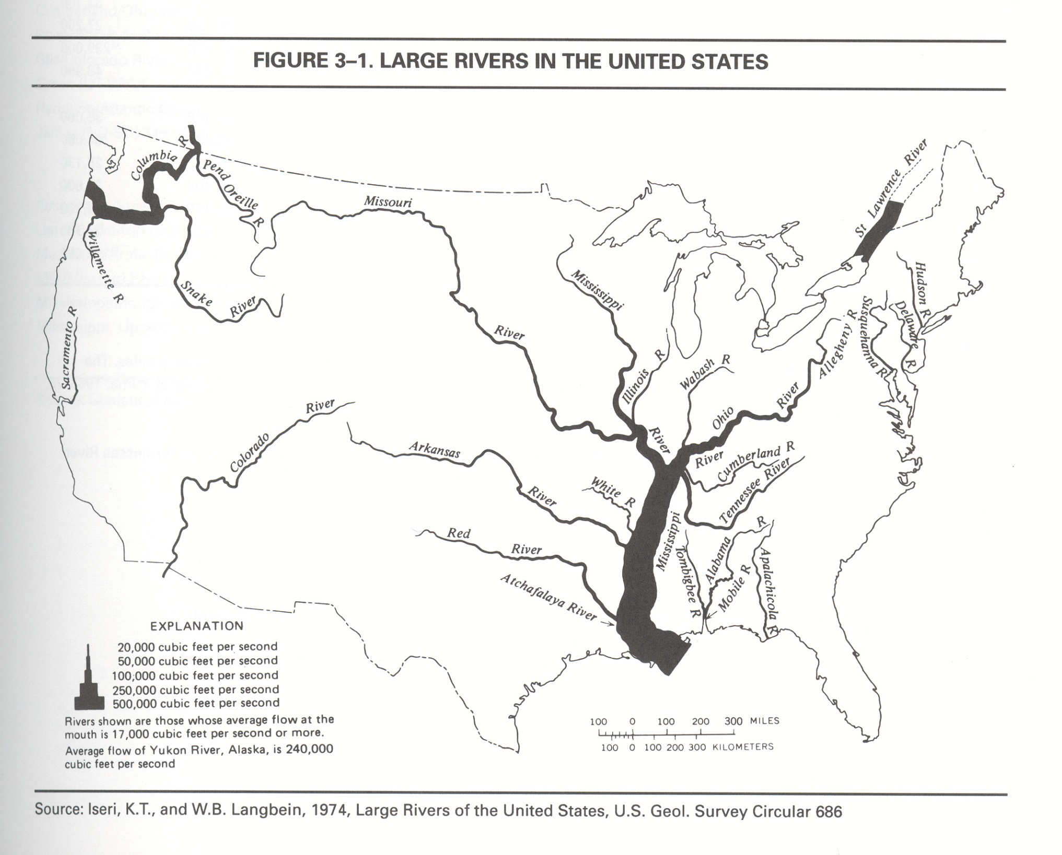

Slide 19
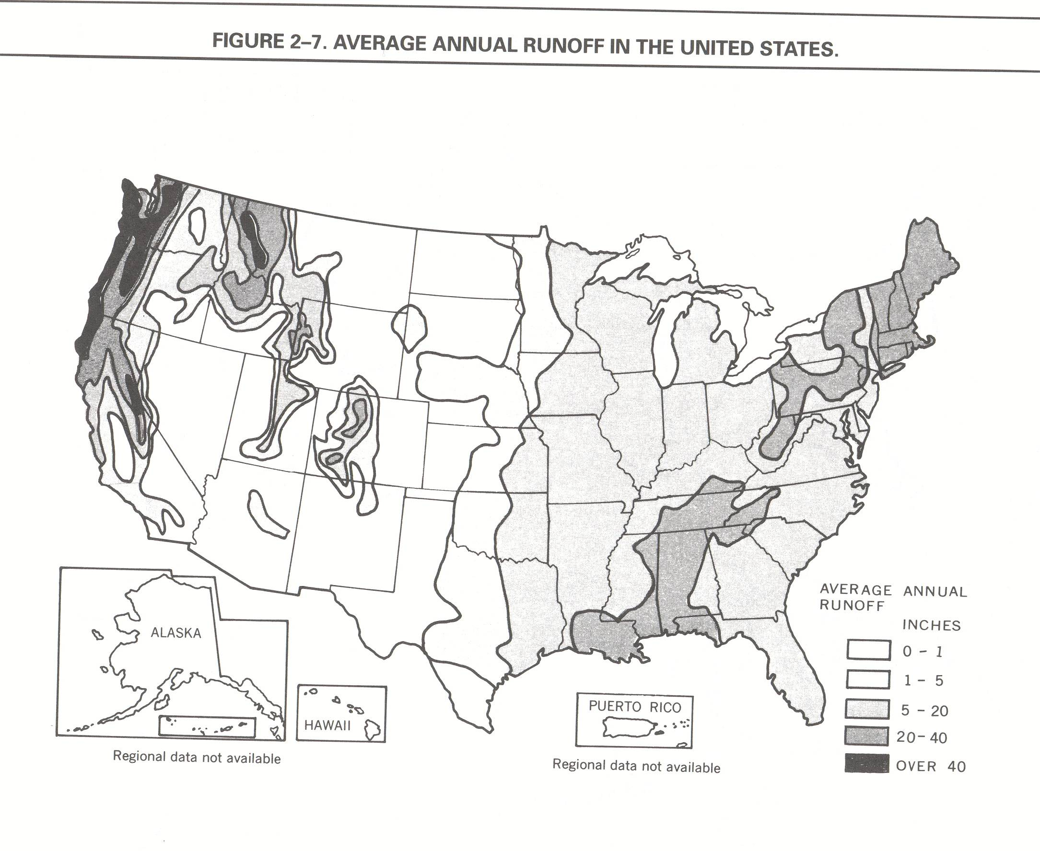

Slide 20
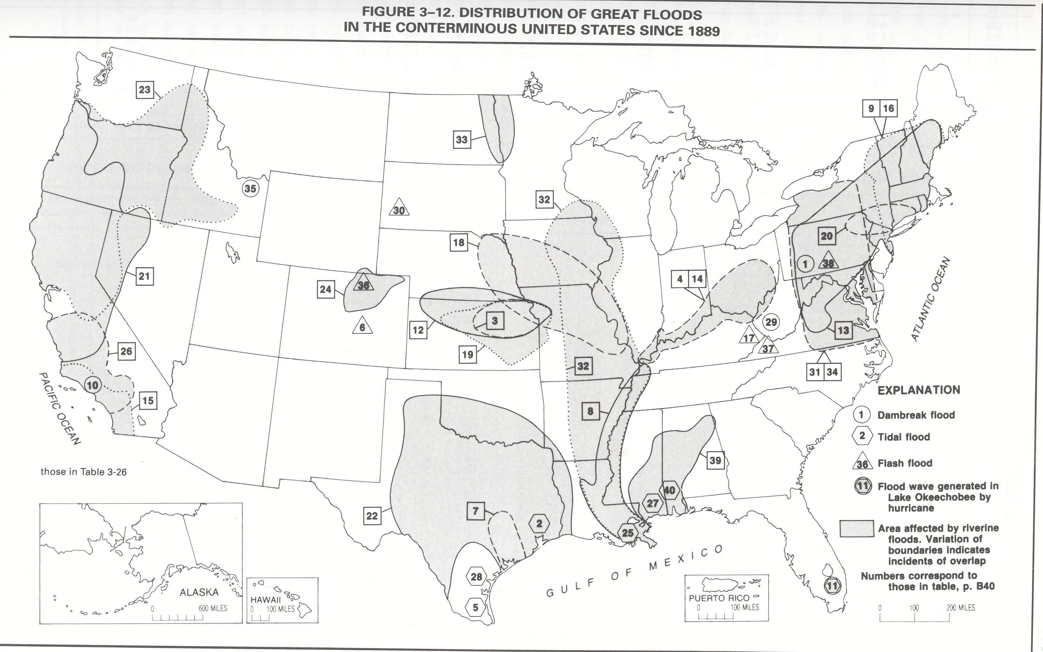

Slide 21
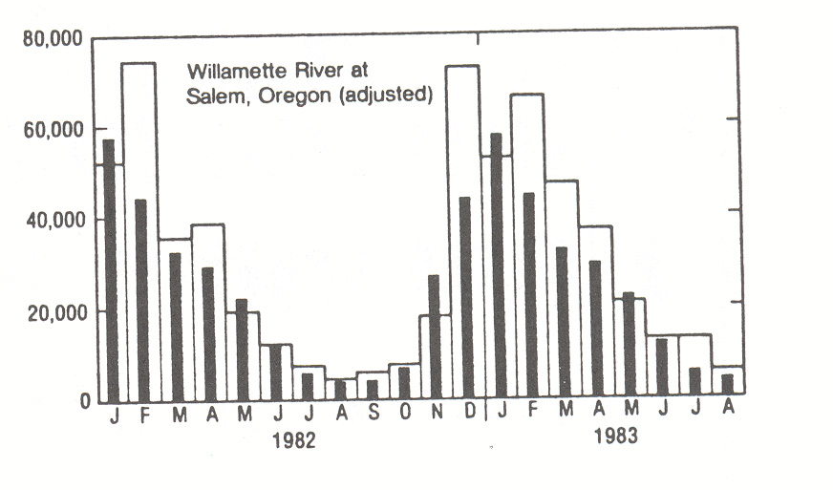

Slide 22
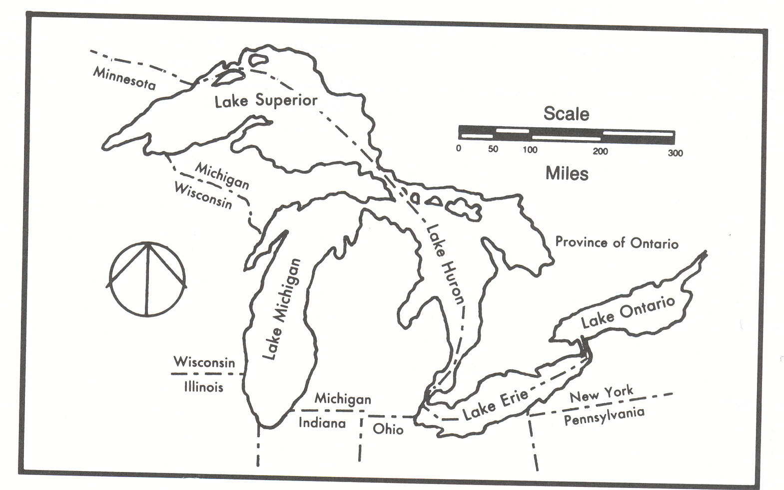

Slide 23
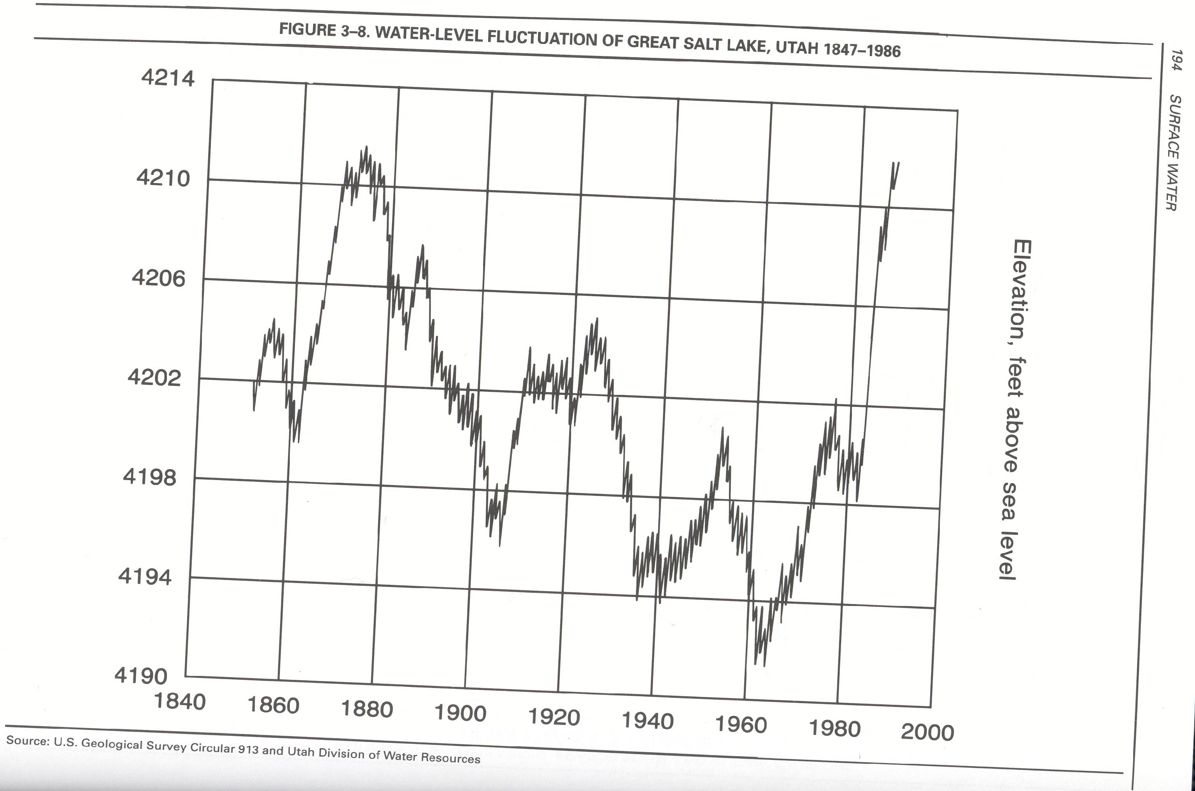

Slide 24
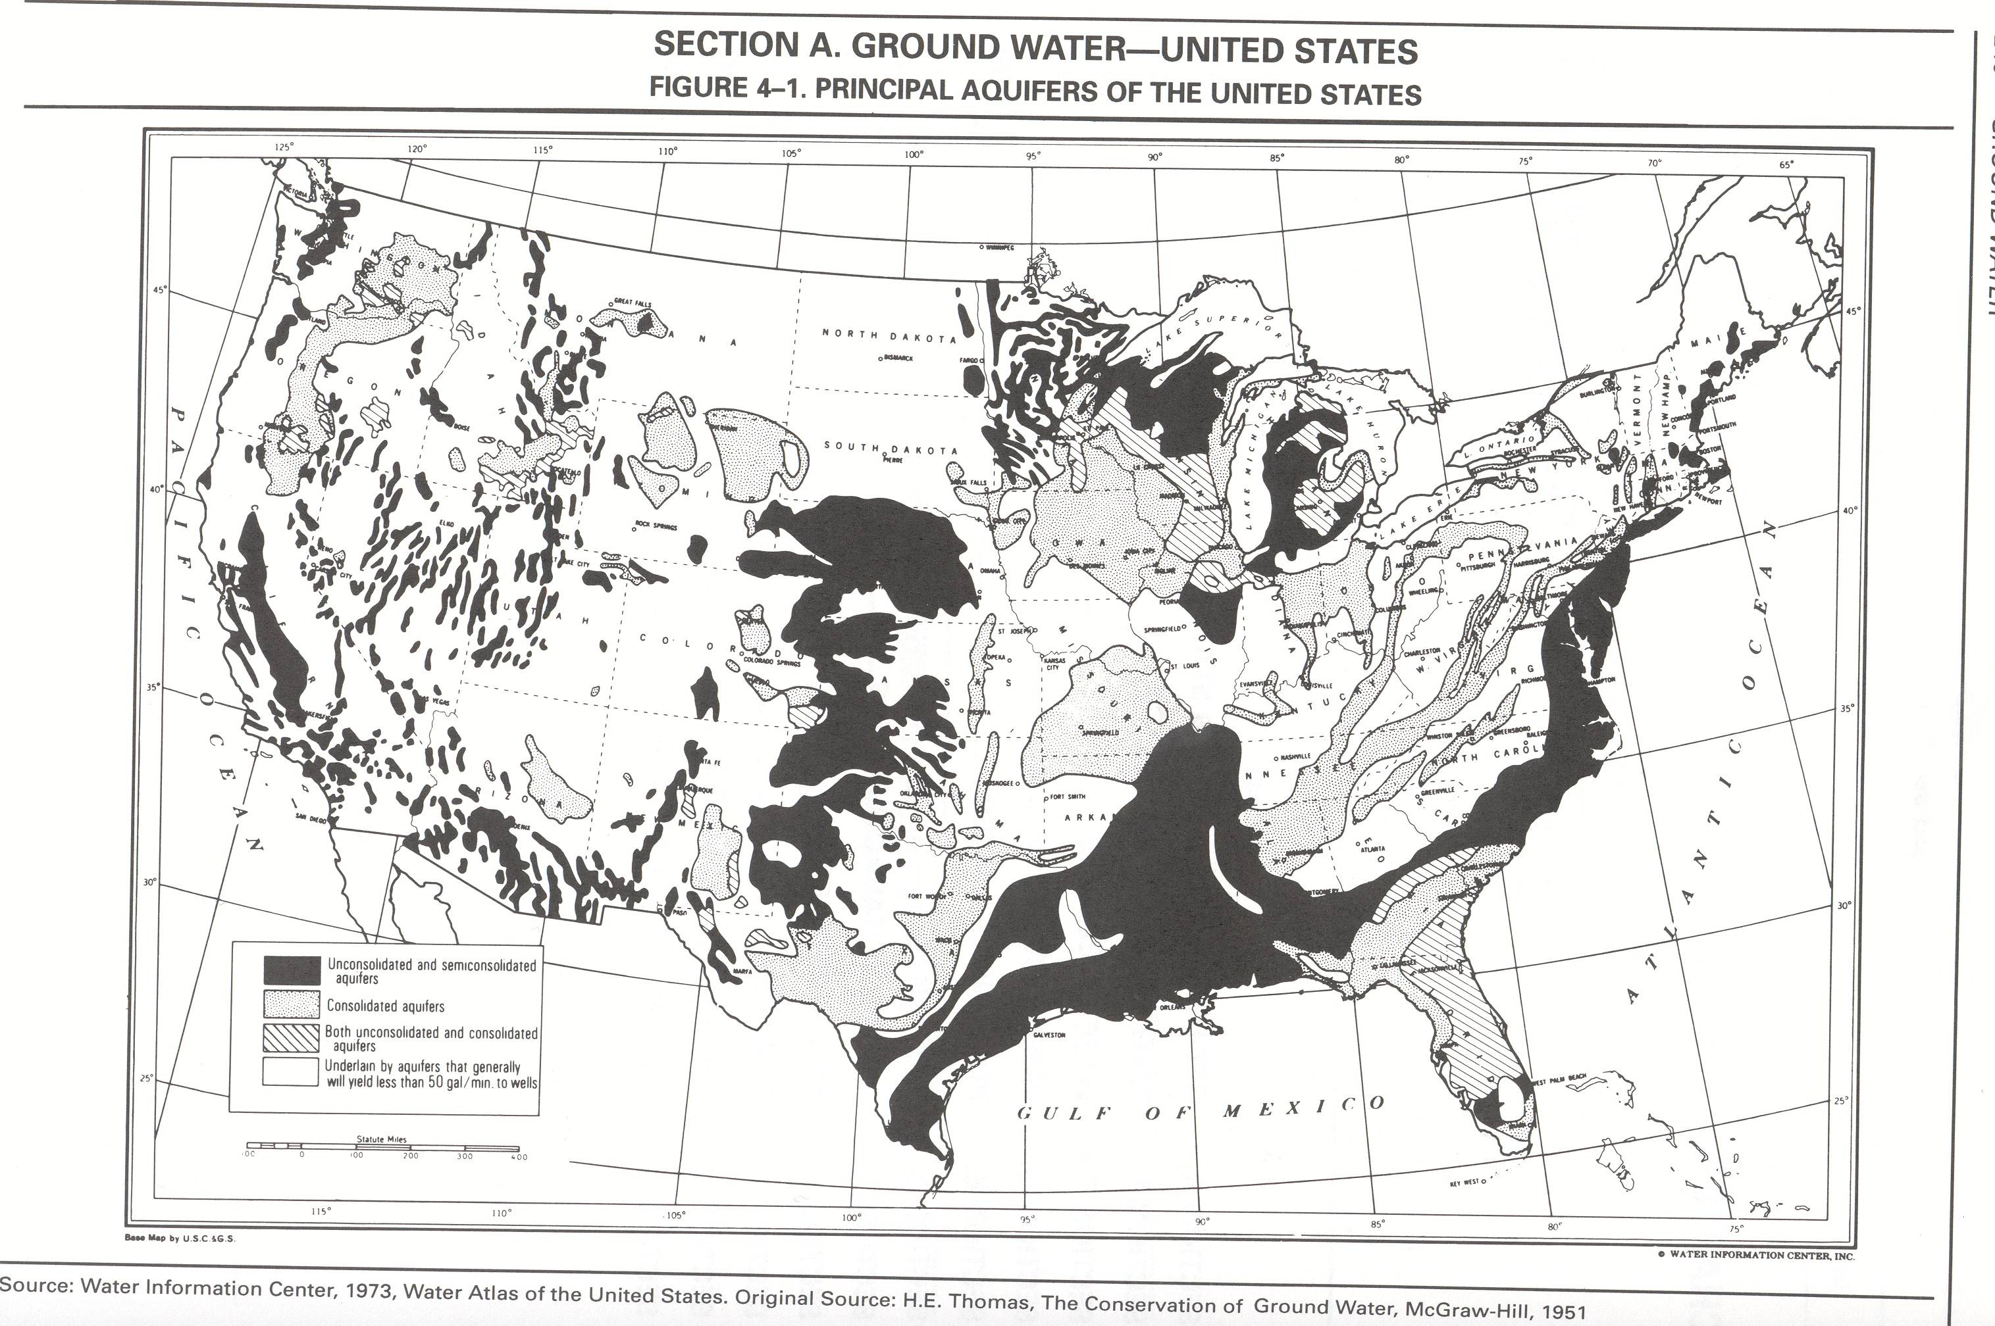

Slide 25
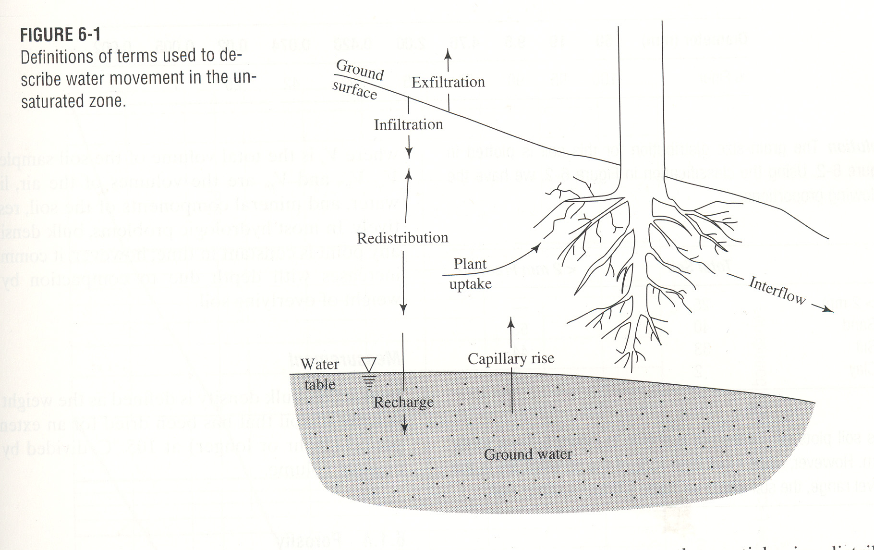

Slide 26
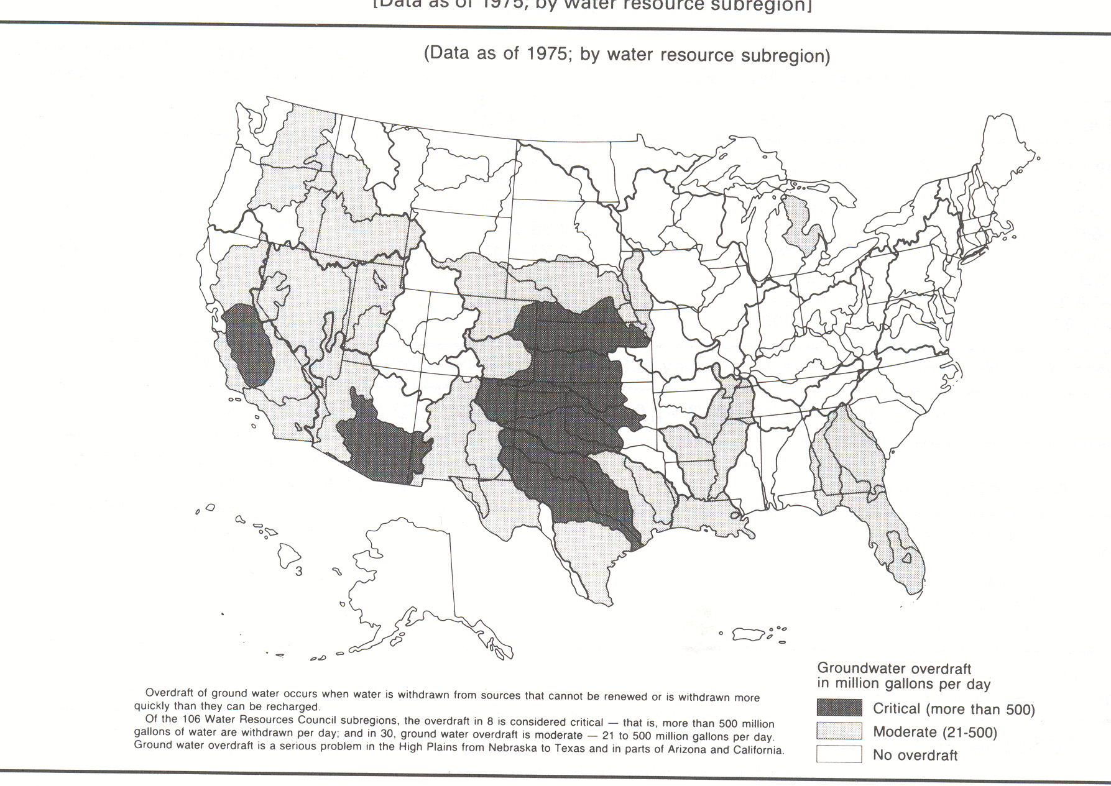

Slide 27
