Slide 1

ES420 Medical Geology
Western Oregon University
Curriculum Overview
Steve Taylor, RG, PhD, Professor of Geology
Earth and Physical Science Department

Slide 2
Introduction
ES420 Med Geo Class Format
Thematic Topics
Conclusion

Slide 3
INTRODUCTION
Medical Geology: the study of the impacts of geologic
materials and processes on human health
  Interdisciplinary field involving geoscience, biomedicine,
  and public health with a focus on environmental health
ES420 Medical Geology Course History
+
  Spring 2010 - ES473 Academic Showcase Poster Session
  Summer 2012 & 2013 – Online upper division seminar
  reading class for WOU Earth Science Students
  Fall 2014 – Hybrid team building & online seminar class
  targeting OHSU-Monmouth nursing students
  Fall 2019 – ES420 re-aligned with the Integrating Knowledge
  component of the revised WOU General Education Program
Notes:
Invasive plants are a pervasive problem and have been for a long time
In western Oregon
disruption of native habitats and annual economic losses
In the United States
annual losses of over $130 billion
Vegetative disturbance of natural ecosystems
soil substrate conditions, nutrient availability, canopy shading (solar influx), and riparian hydrology
Most abundant concentrations of invasive species
typically associated with human-related disturbance
disturbed zones on the landscape act as primary conduits
understanding the controls on spatial distribution of invasive plants in the context of disturbance regime is critical for designing effective watershed conservation and restoration plans

Slide 4

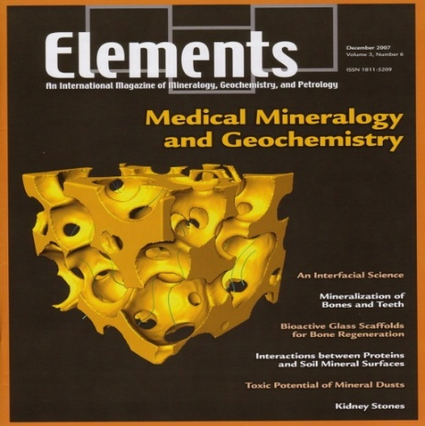


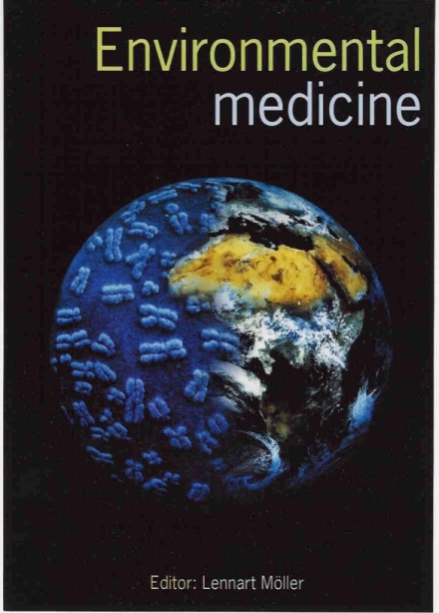
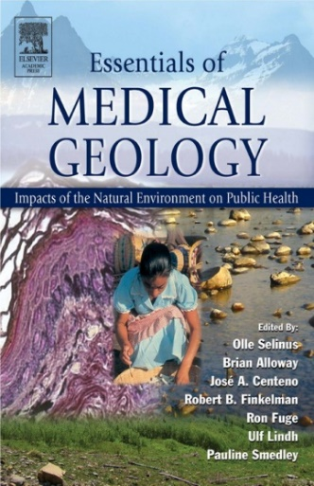
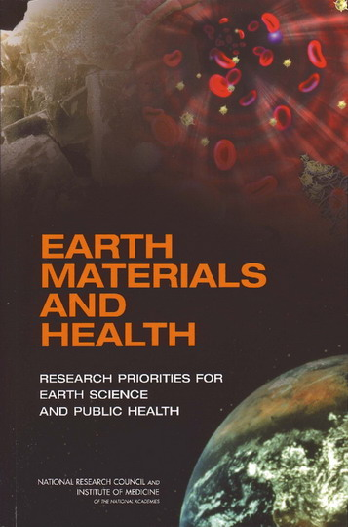
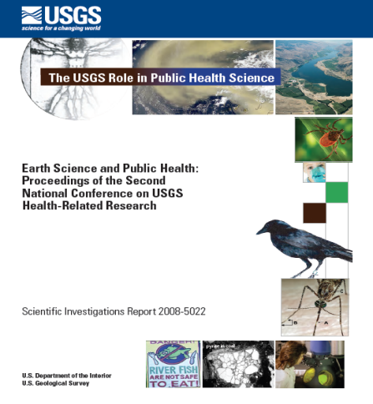
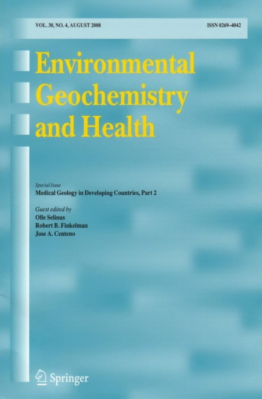


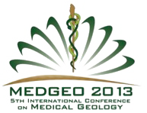
Medical Geology as a Specialty Discipline
Naturally Occurring Asbestos Symposium
December 18, 2014 Oakland, California

Slide 5
Goals of Medical Geology
To identify geochemical anomalies in sediment, air, and water that impact human and animal health.
To identify the environmental causes of known health problems and seek remedial solutions.
To evaluate the beneficial health effects of geologic materials and processes.
To inform the public of environmental health risks associated with geologic materials or processes.
To forge global links between countries to find solutions for environmental health problems.
Bunnell et al. (2007)

Slide 6
ES420 Medical Geology Format
Online Course Curriculum
  Journal readings and written summaries
  Synthesis review questions
  Group Discussions
  Capstone case study seminar presentations
Notes:
Invasive plants are a pervasive problem and have been for a long time
In western Oregon
disruption of native habitats and annual economic losses
In the United States
annual losses of over $130 billion
Vegetative disturbance of natural ecosystems
soil substrate conditions, nutrient availability, canopy shading (solar influx), and riparian hydrology
Most abundant concentrations of invasive species
typically associated with human-related disturbance
disturbed zones on the landscape act as primary conduits
understanding the controls on spatial distribution of invasive plants in the context of disturbance regime is critical for designing effective watershed conservation and restoration plans

Slide 7
ES420 Thematic Units
Introduction to Medical Geology
Public Health and Geological Processes
Natural Distribution of Elements
Anthropogenic Influence
Environmental Exposure and Health Risk
Geological Impacts on Nutrition
Geologic Hazards and Public Health
Water Quality and Soil Nutrient Influences
Anthropogenic Pollution
Effects of Dust and Volcanic Emissions
Notes:
Invasive plants are a pervasive problem and have been for a long time
In western Oregon
disruption of native habitats and annual economic losses
In the United States
annual losses of over $130 billion
Vegetative disturbance of natural ecosystems
soil substrate conditions, nutrient availability, canopy shading (solar influx), and riparian hydrology
Most abundant concentrations of invasive species
typically associated with human-related disturbance
disturbed zones on the landscape act as primary conduits
understanding the controls on spatial distribution of invasive plants in the context of disturbance regime is critical for designing effective watershed conservation and restoration plans

Slide 8
ES420 Seminar Reading Summaries – Fall 2020
Week 1 - Introduction to Medical Geology
Bunnell et al., 2007, Medical Geology: A globally emerging discipline
Komatina, 2004, Chapter 1 - Introduction and Overview
Centeno et al., 2016, Medical Geology and Health - Status Overview
Week 2 - Public Health and Geological Processes
Cook, 2013, Public Health and Geological Processes
National Research Council, 2007, Chapter 6 - Earth Perturbations and Public Health Impacts
Bunnell et al., 2013, GIS and Health
Week 3 - Natural Distribution of Elements
Alloway, 2005, Bioavailability of Elements in Soil, in Selinus
Edmunds and Smedley, 1996, Groundwater geochemistry and health: an overview
Fordyce, 2005, Selenium Deficiency and Toxicity, in Selinus, 2005
Week 4 - Anthropogenic Impacts
Komatina, 2004, Chapter 4 - Anthropogenic (man-made) Factors
Eggers et al., 2015, Health Risk Associated with Uranium Mining on Tribal Lands
Finkelman et al., 2003, Case Study: Coal Combustion and Human Health in China
Week 5 - Environmental Exposure and Health Risk
Centeno et al., 2013, Environmental Pathology
Nielsen and Jensen, 2005, Environmental Epidemiology
Fowles et al., 2013, Environmental Medicine

Slide 9
ES420 Seminar Reading Summaries – Fall 2020
Week 6 - Geological Impacts on Nutrition
Combs, 2013, Geological Impacts on Nutrition
Knez and Graham, 2013, Nutrient Deficiencies and Soils
Oliver and Gregory, 2015, Soil-Food Security-Public Health
Week 7 - Geologic Hazards and Public Health
Appleton, 2005, Radon in Air and Water, in Selinus, 2005
Thornton, 1996, Sources and pathways of arsenic in the geologic environment
Grattan et al., 2003, Case Study: Human Sickness and Volcanic Eruptions,
Week 8 - Water Quality and Soil Nutrient Influences
National Research Council, 2007, Chapter 4 - What we drink
Rubenowitz and Hiscock, 2005, Water Hardness and Health,
Brevik and Sauer, 2015, Soils and Human Health
Week 9 - Antropogenic Pollution
Fuge, 2005, Anthropogenic Sources, in Selinus, 2005
Burke, 2016, Cadmium and Public Health, Balochistan, Case Study
Werner et al., 2015, Unconventional Natural Gas Development and Health Effects
Week 10 - Atmospheric Processes; Effects of Dust and Volcanic Emissions
National Research Council, 2007, Chapter 3 - What we breathe
Derbyshire, 2005, Natural Dust and Human Health
Weinstein and Cook, 2005, Volcanic Emissions and Health

Slide 10
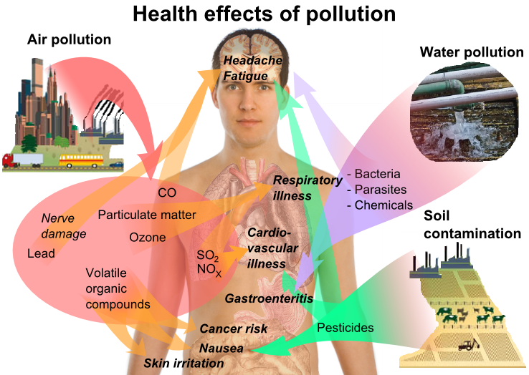
Geologic Pathways and Environmental Health

Slide 11
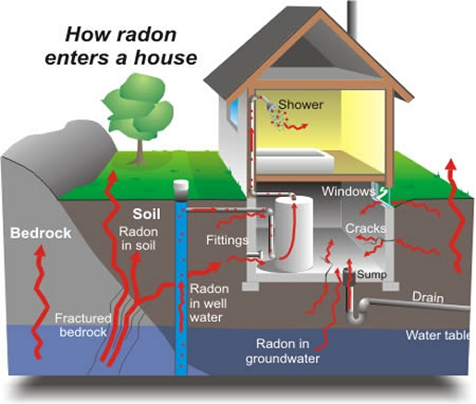
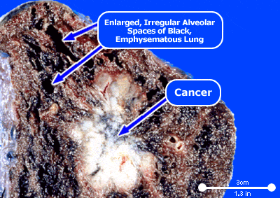
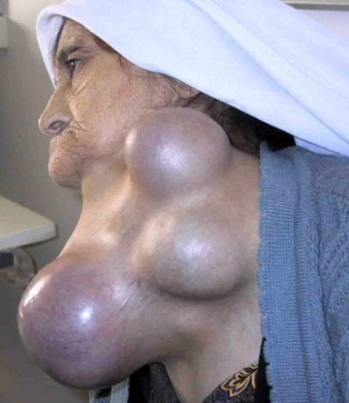

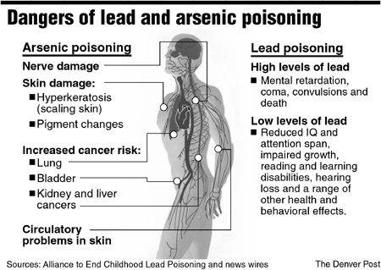
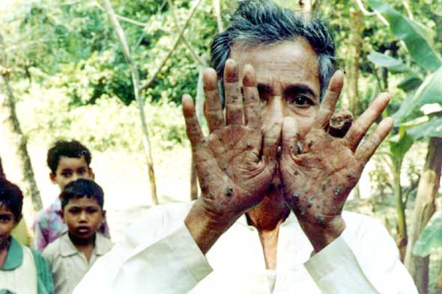

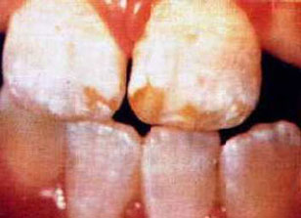

Geochemistry and Health
Radon and Lung Cancer
Iodine and Selenium
Deficiency
Arsenic and Groundwater
Fluorosis
Mercury and Lead Poisoning

Slide 12
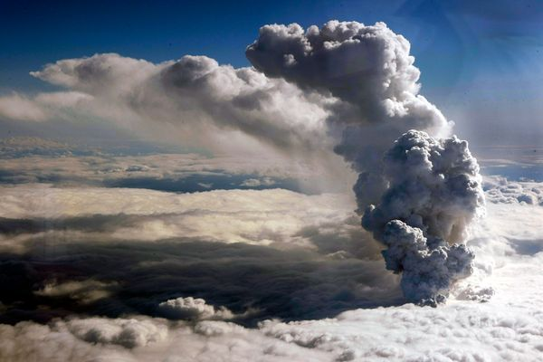
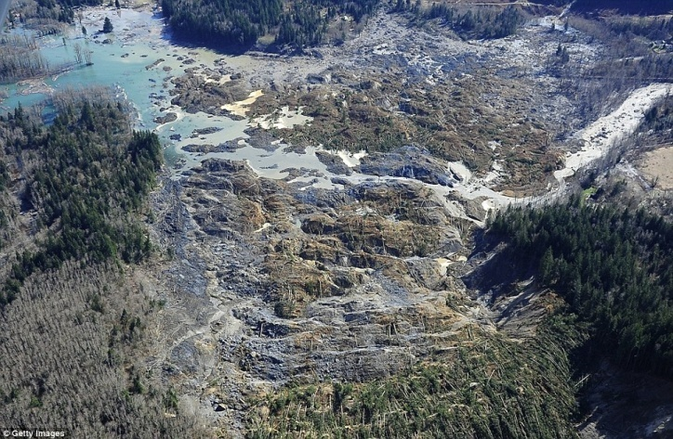
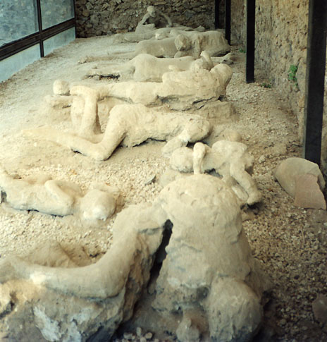
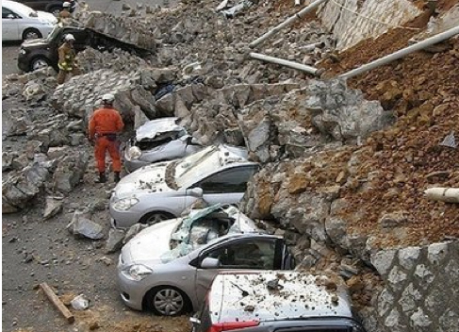
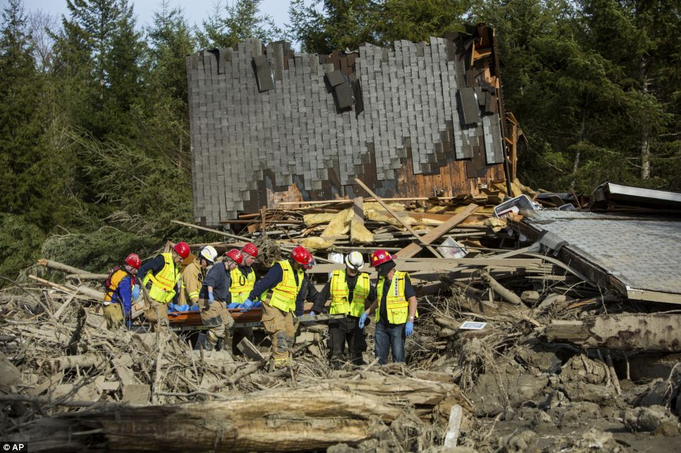
Geologic Processes and Health
Dust Storms
Volcanic
Eruptions
Landslides and
Flooding
Earthquakes

Slide 13
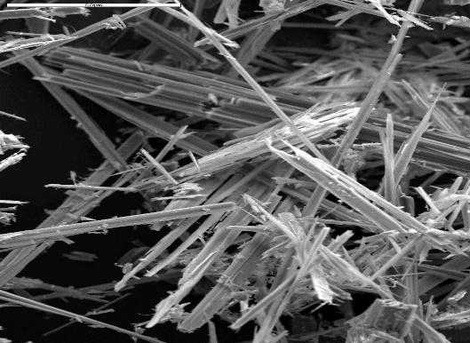

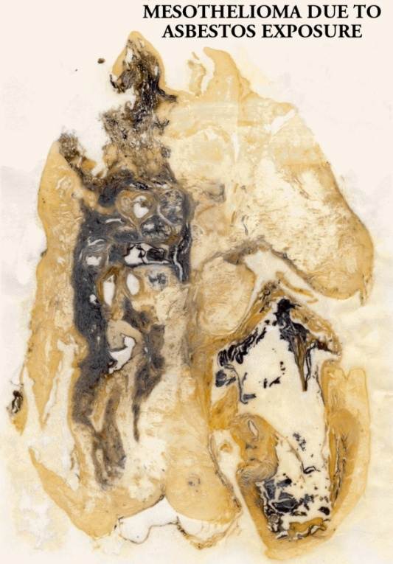
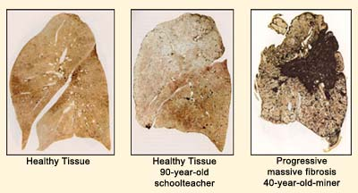
Environmental Exposure
Asbestosis
Coal Dust and
Black Lung

Slide 14
CONCLUSION
Medical Geology is a rapidly emerging discipline that involves aspects of Geoscience, Environmental Medicine, and Public Health
ES420 Medical Geology at Western Oregon University is offered as a hybrid online course involving seminar style, self-paced reading assignments and written summaries
ES420 Medical Geology serves as upper division elective aligned with the Integrating Knowledge component of the WOU General Education curriculum
For more information contact: Dr. Steve Taylor taylors@wou.edu

