Slide 1
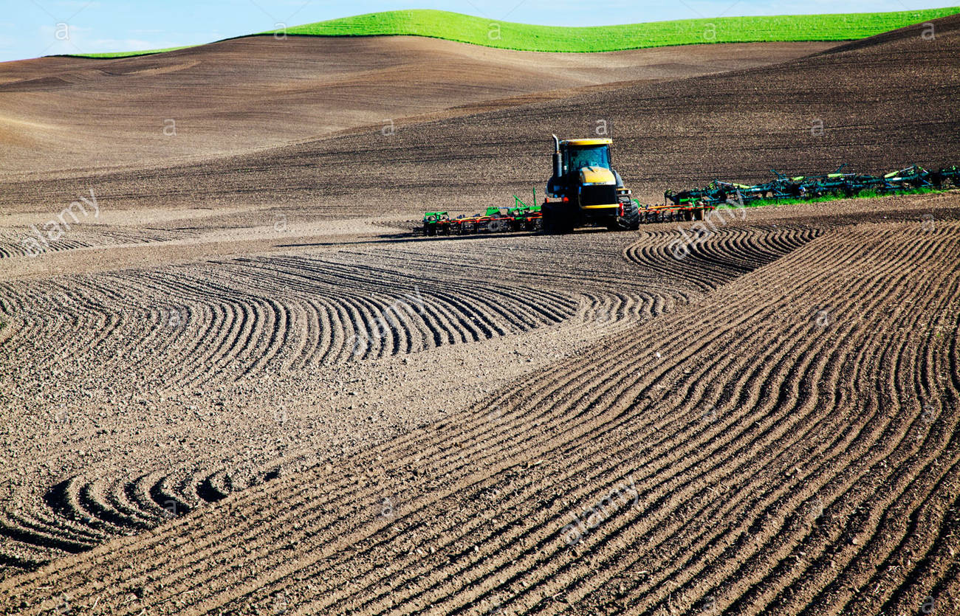
FYS207 WOU Earth Corps
Introduction to Soil Science

Slide 3
Pedogenesis – the process of physical and chemical decomposition (“weathering”) of rock material into regolith and soil at Earth’s surface over geologic time

Slide 4
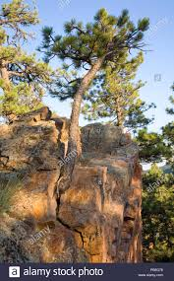

Slide 5
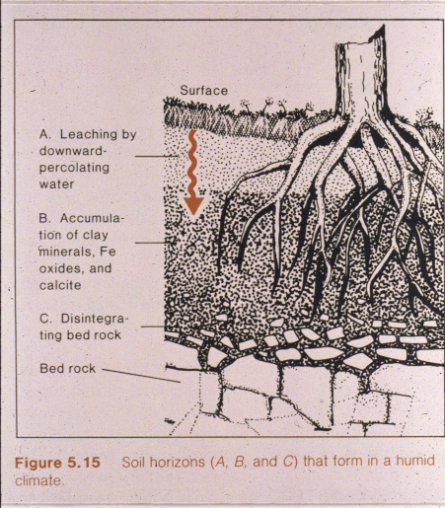
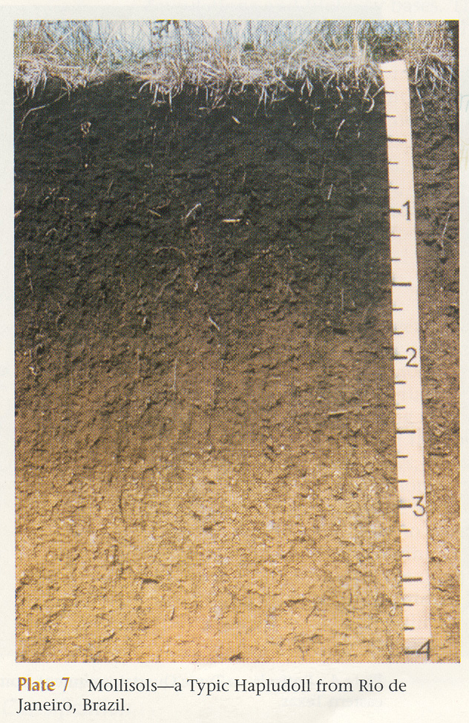
Pedogenesis and Soil Horizons
GRAVITY + WATER PERCOLATION + TIME

Slide 6
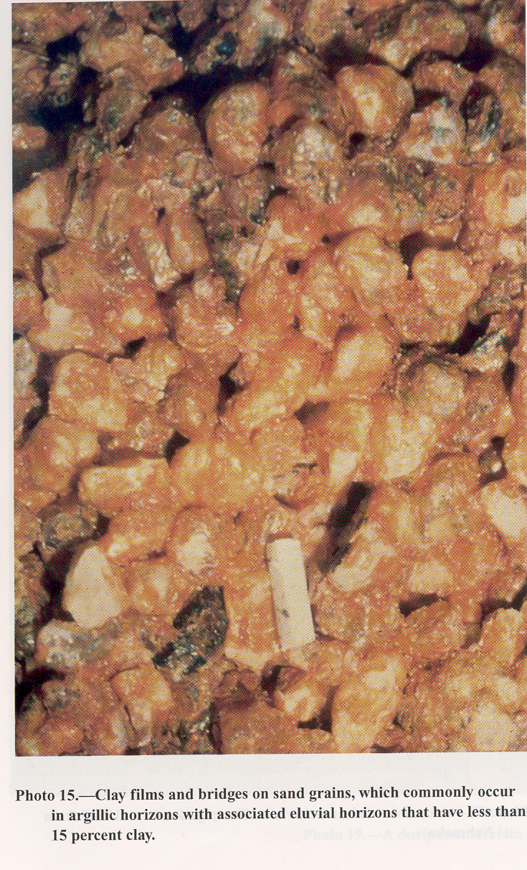
A Horizon – Zone of Leaching
B Horizon – Zone of Accumulation
A
B
C

Slide 7
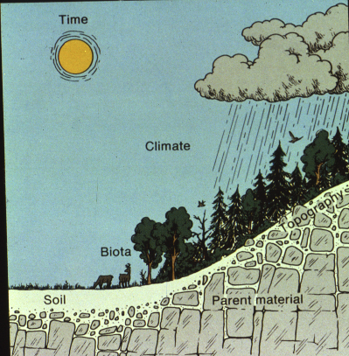
Soil Forming Factors – Cl, O, R, P, T
Climate, Organic Biota, Relief / Topography, Parent Materials, Time

Slide 8
Soil Catena – Different Soil Types Develop on Different Parts of the Landscape according to Cl,O,R,P,T

Slide 9
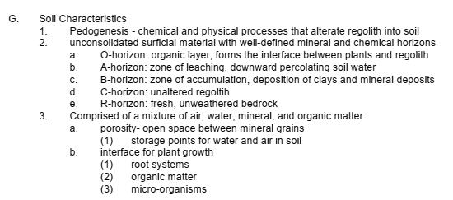
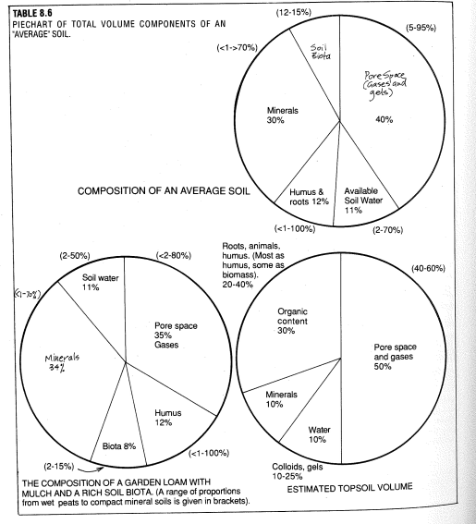
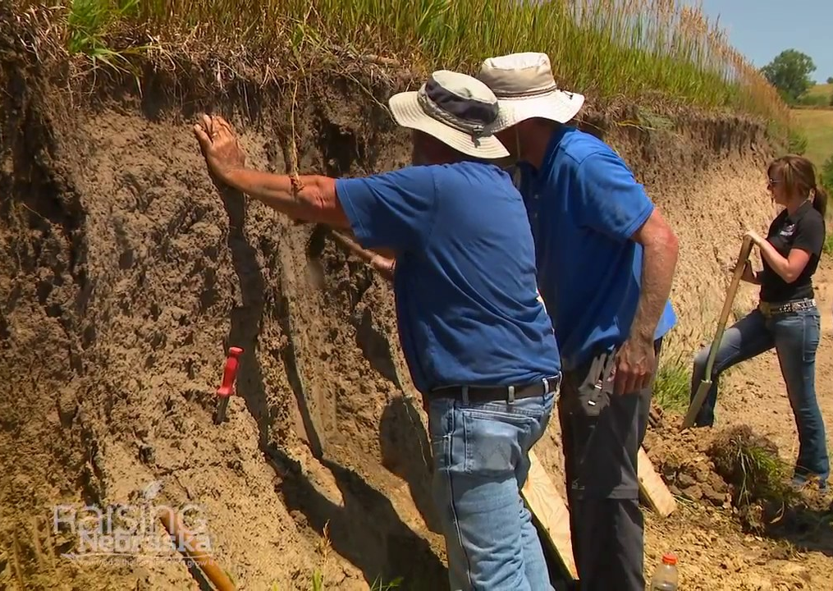

Slide 10
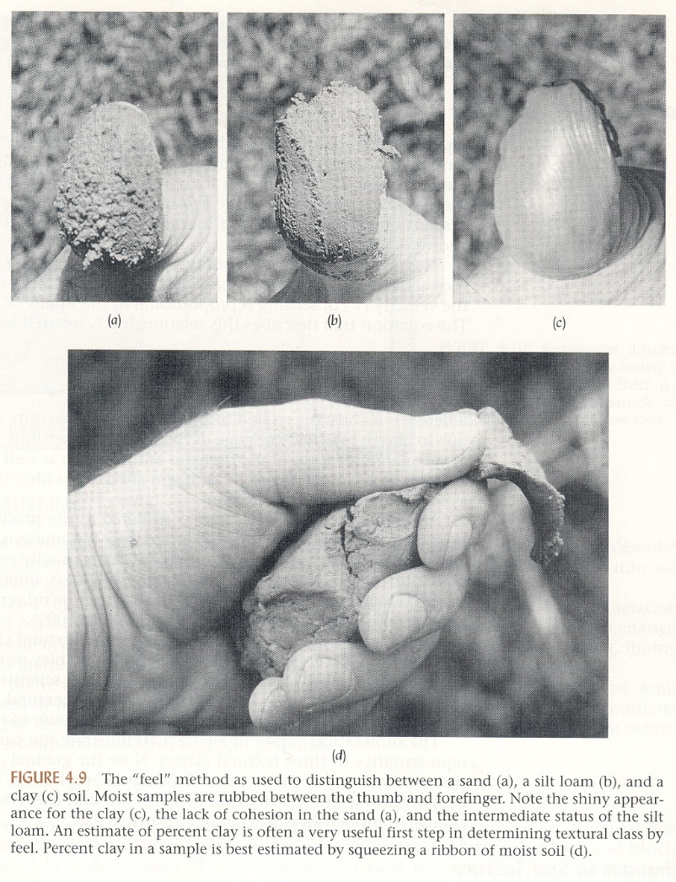
Soil Texture – Fragment Size (Sand, Silt, Clay)

Slide 11
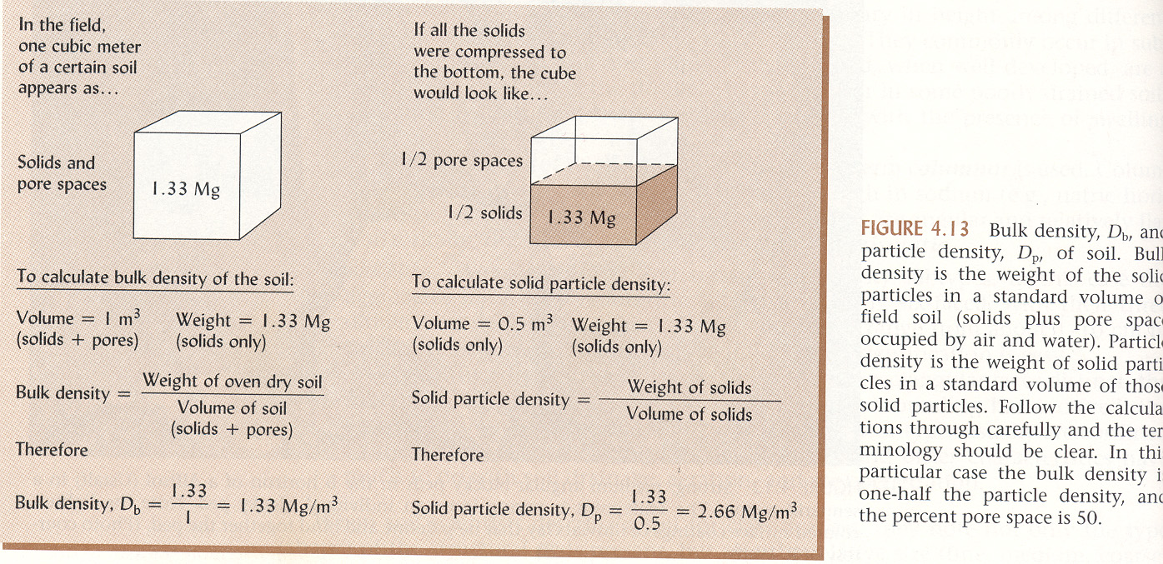
Soil Density = Mass / Volume

Slide 12
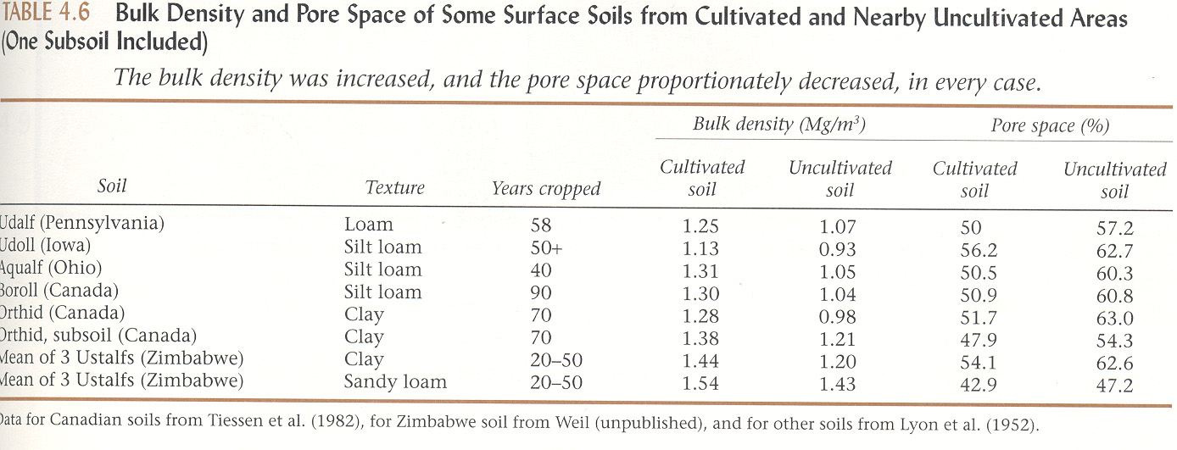

Slide 13
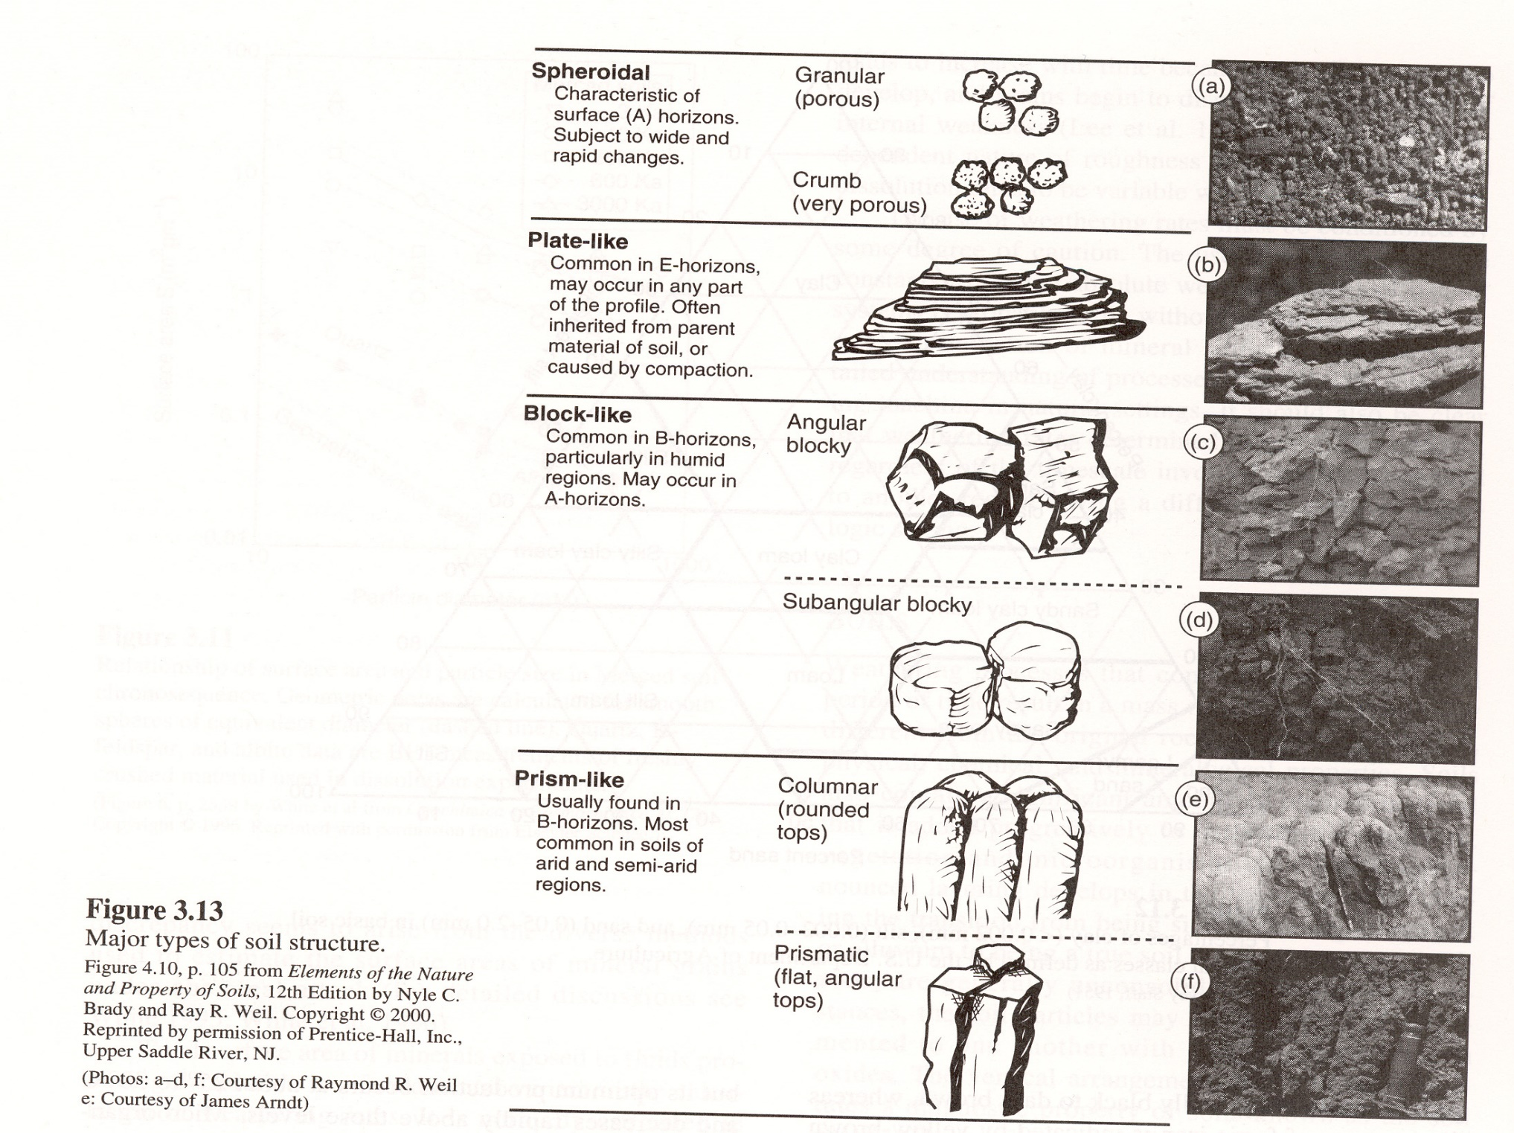
Soil Structure = Shape of “Clumps and Clods”

Slide 14
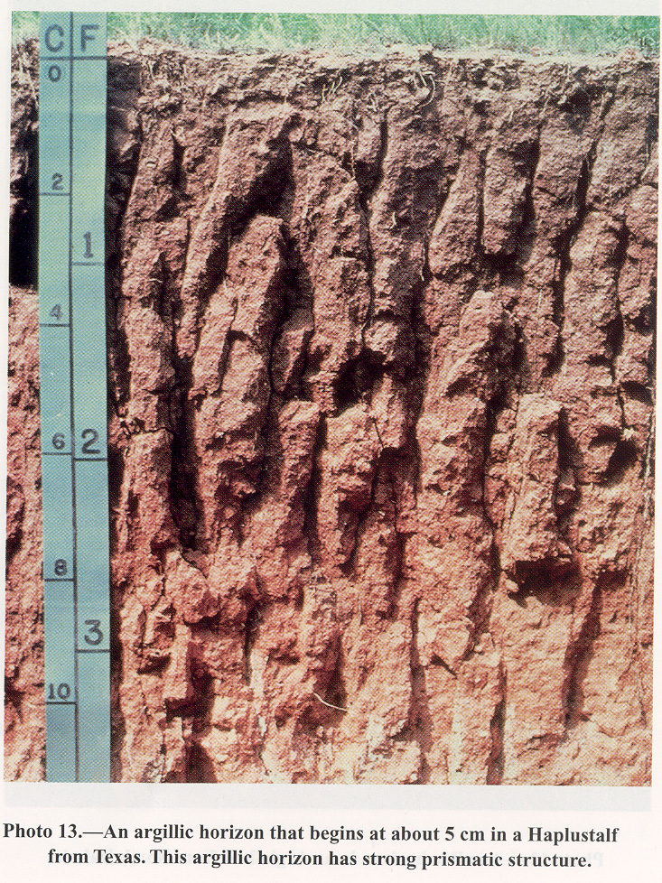

Slide 15
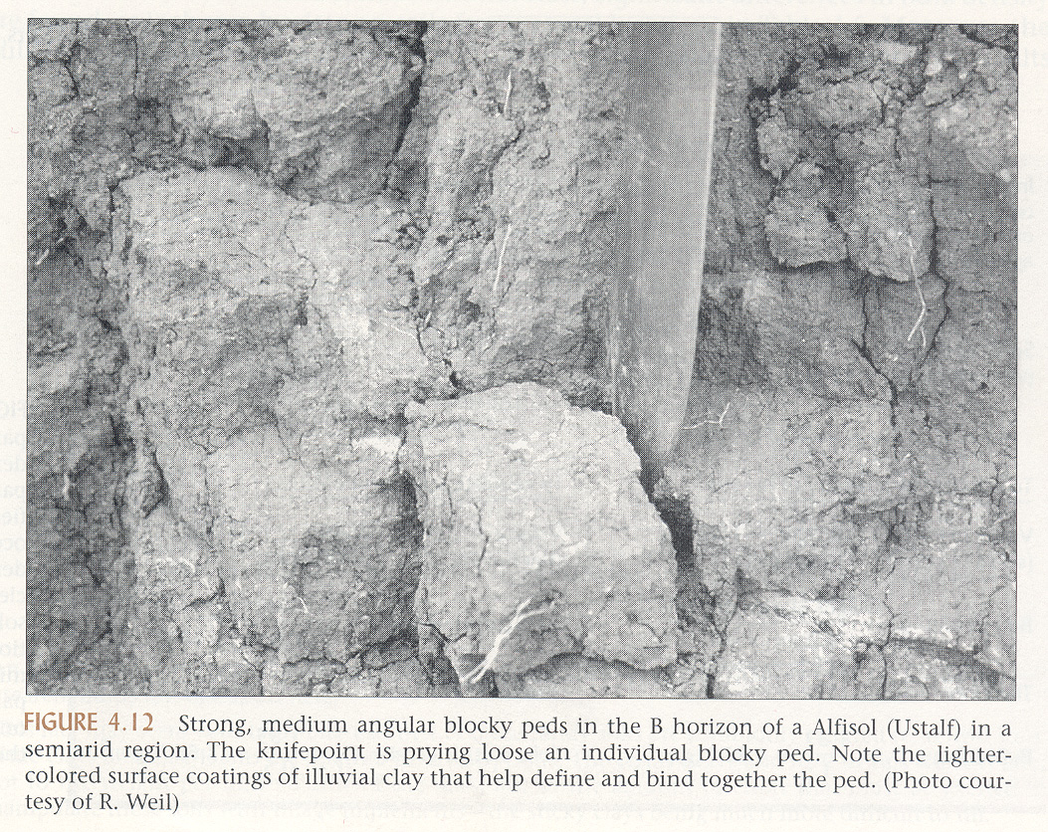

Slide 16
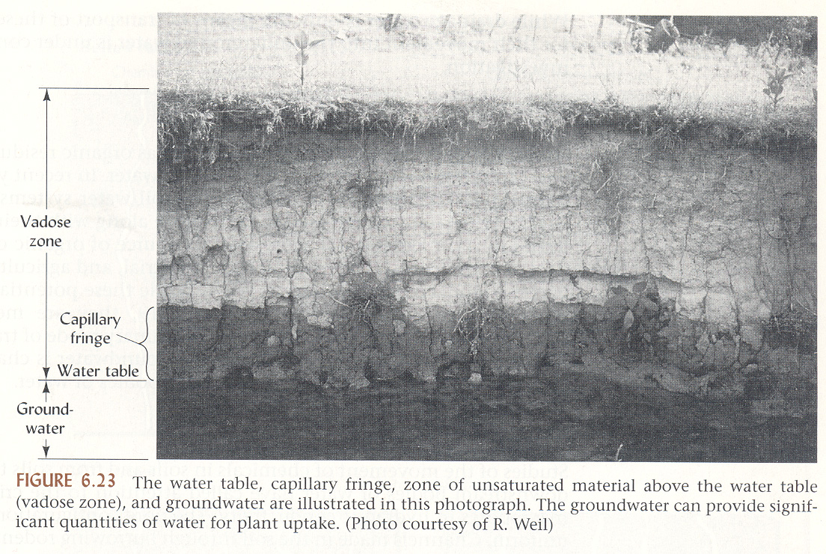

Slide 24
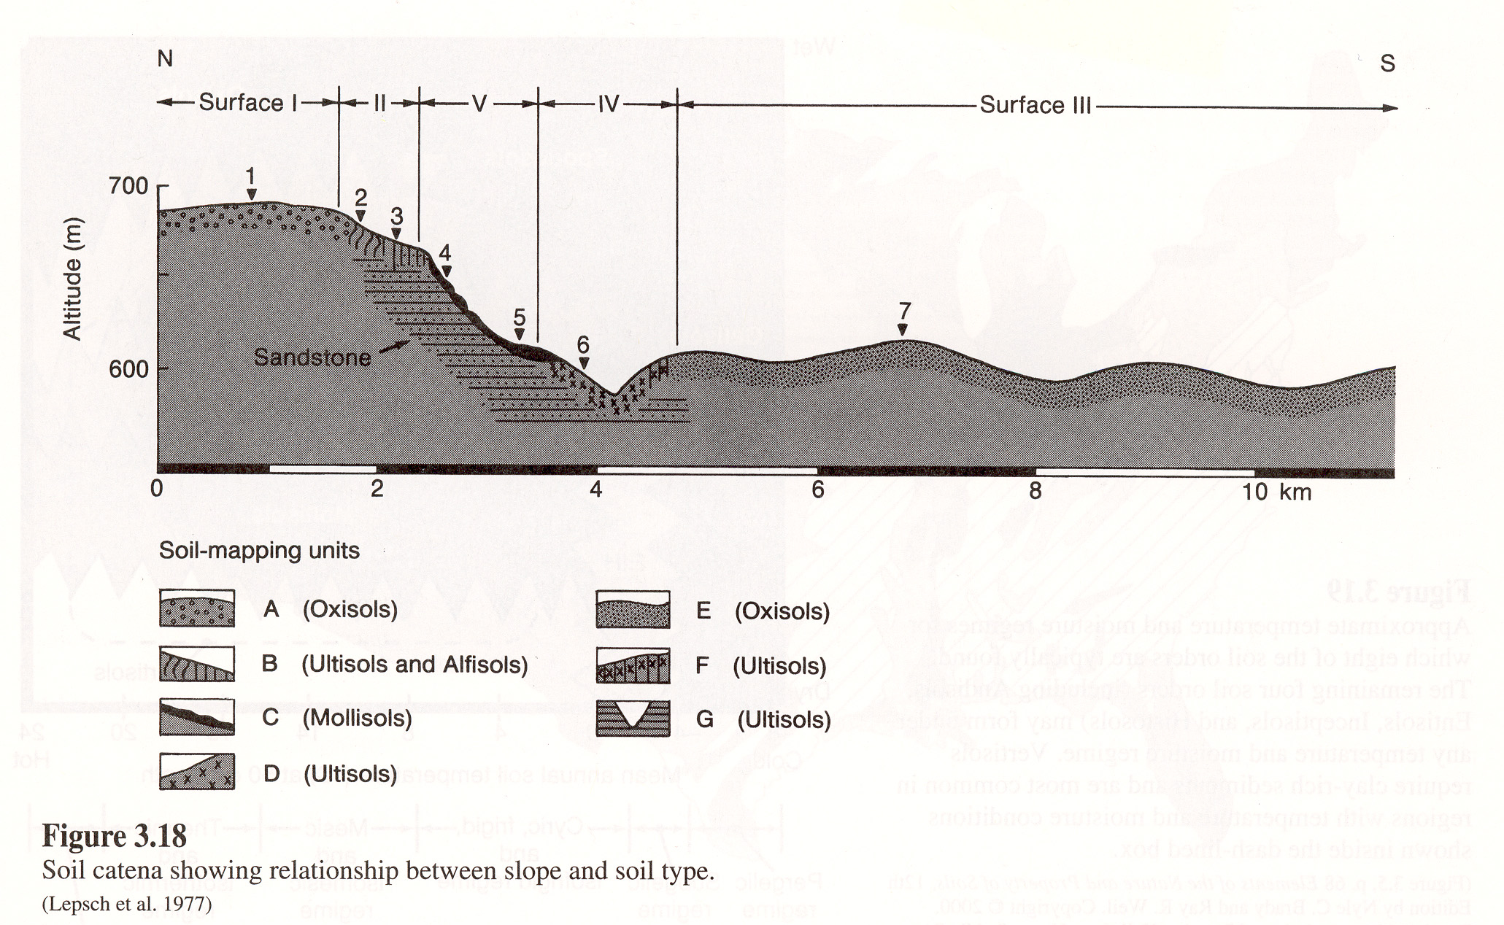

Slide 25
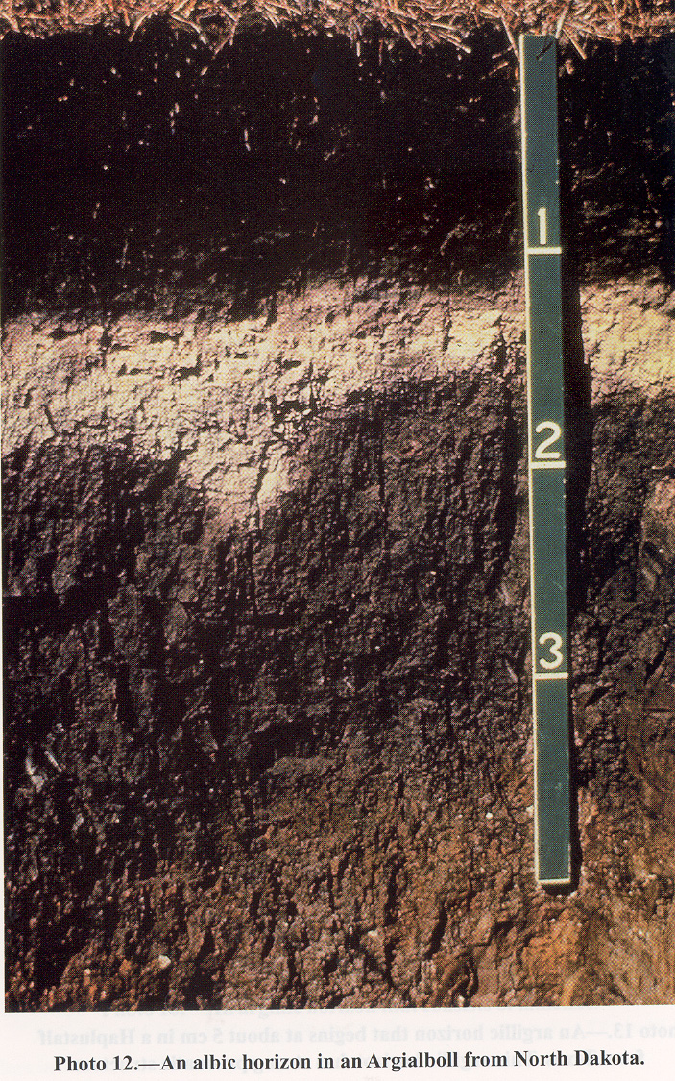

Slide 26
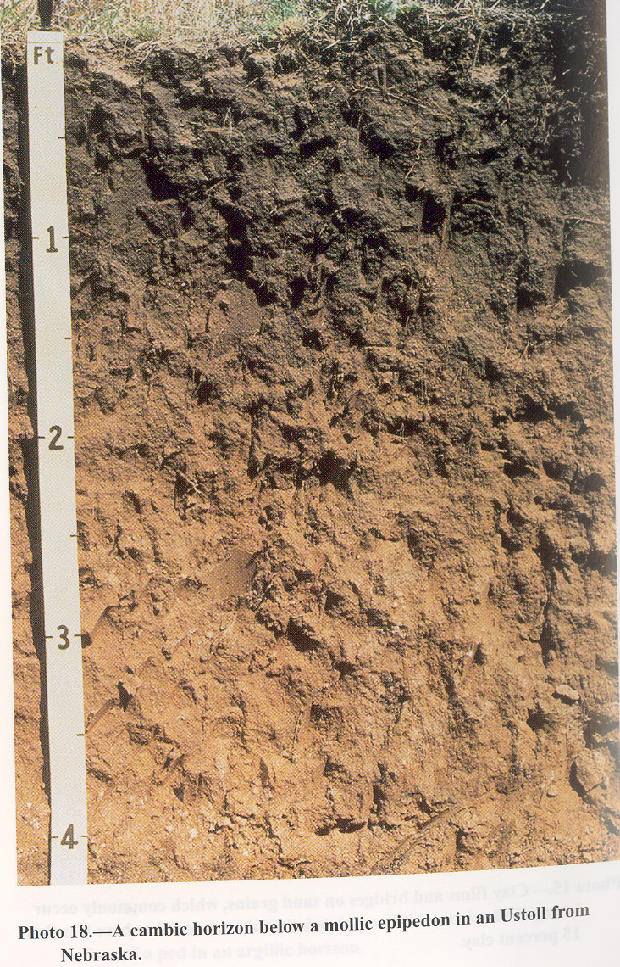

Slide 27
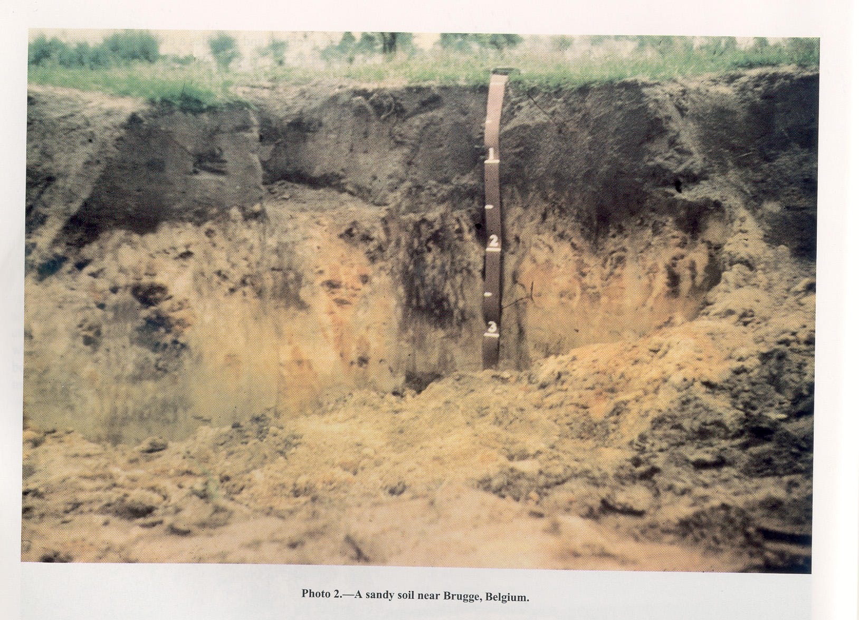

Slide 28
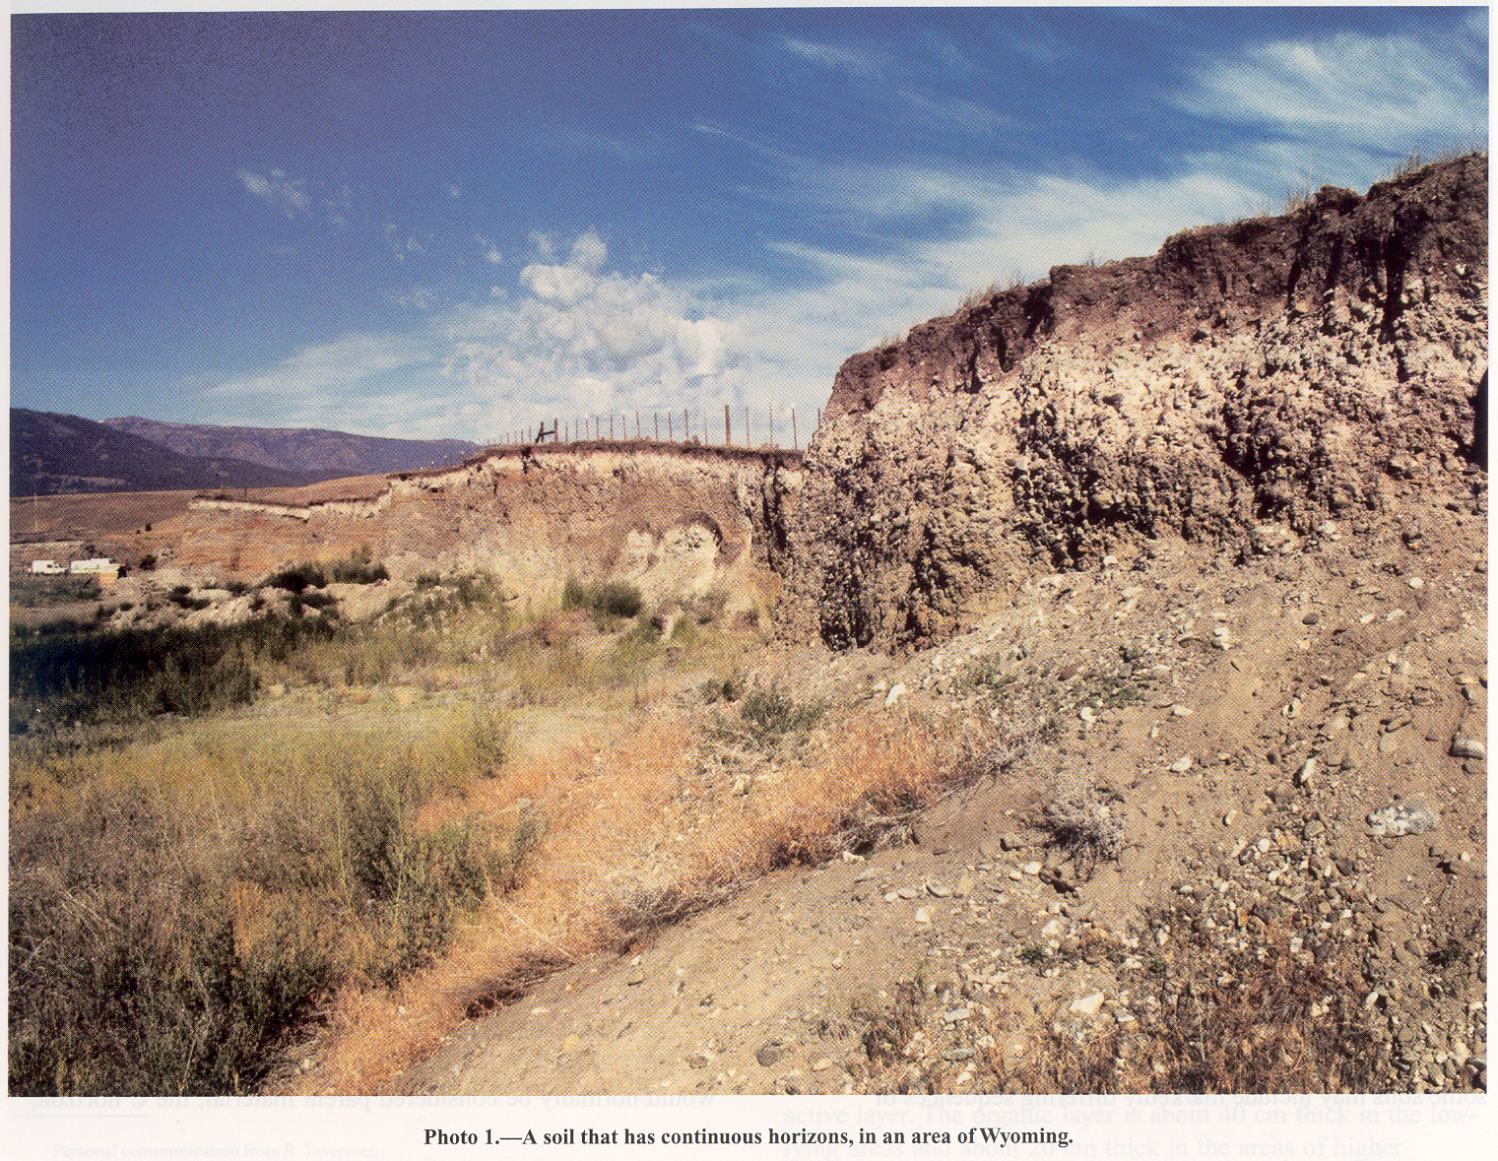

Slide 29
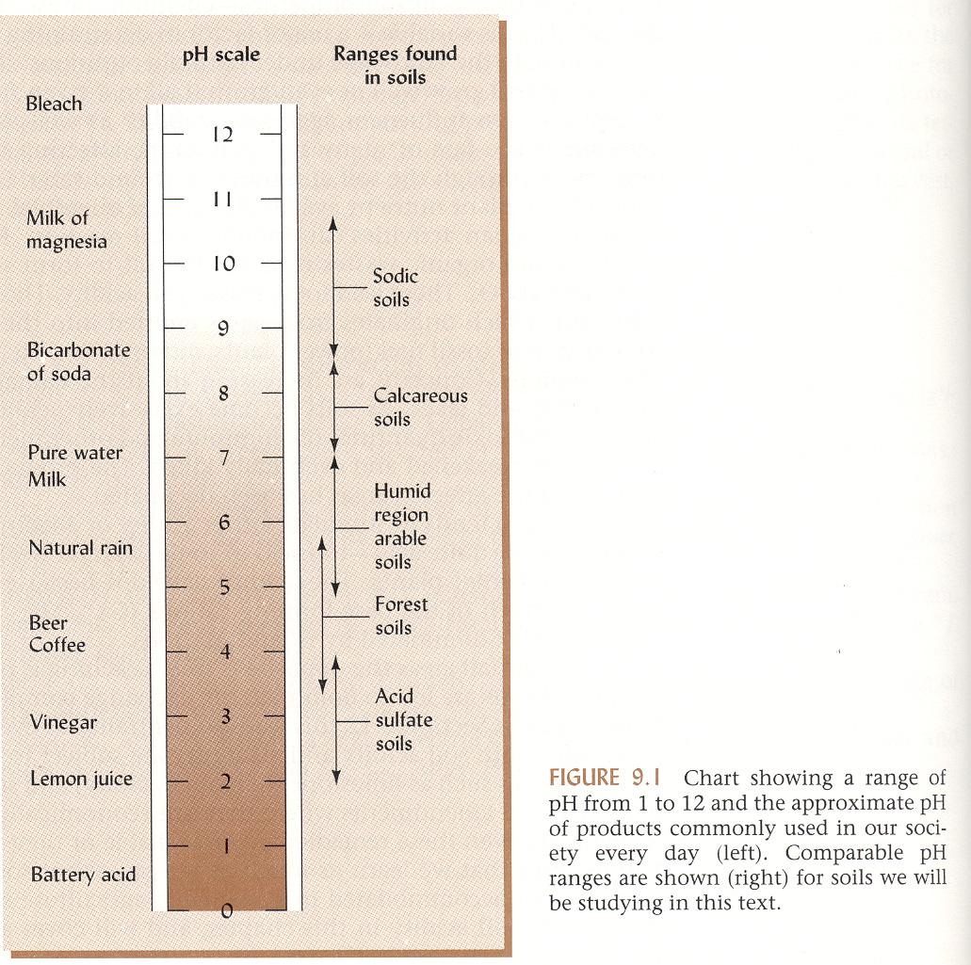

Slide 30
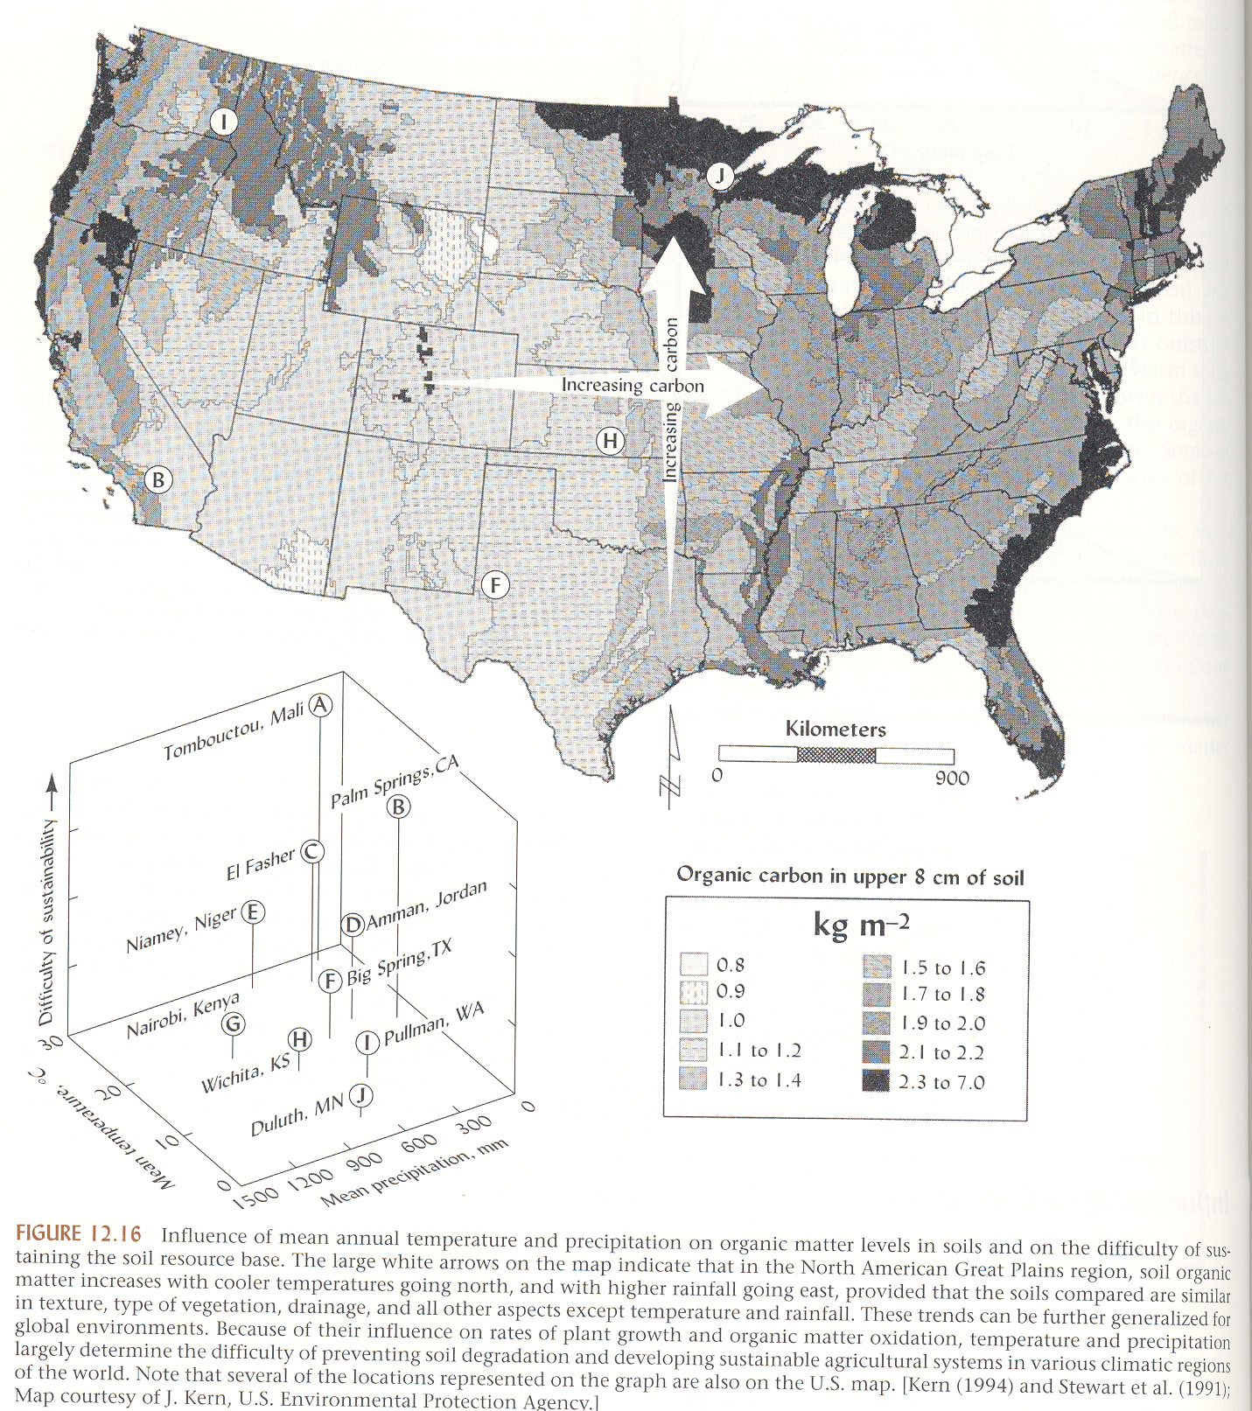

Slide 34
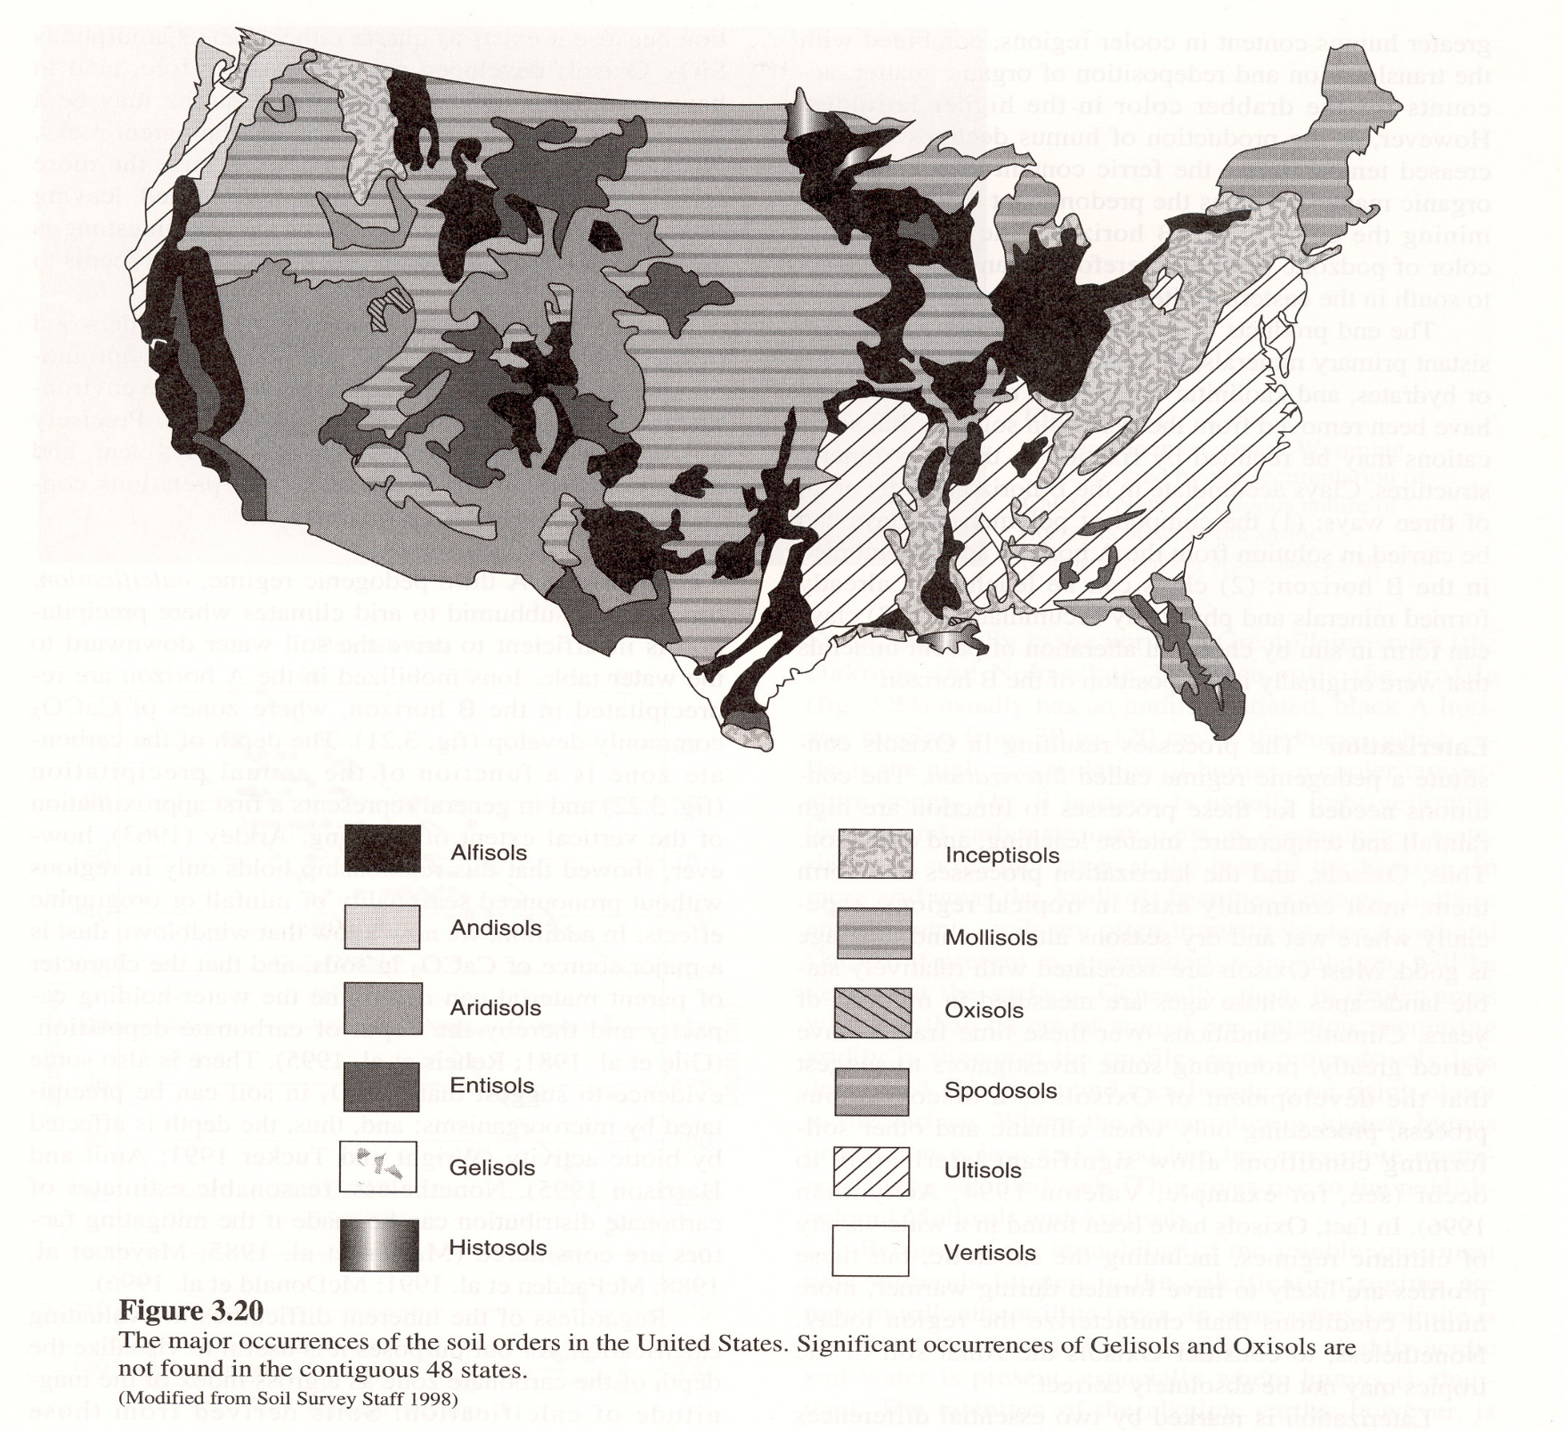

Slide 36
