Slide 1
FYS207 WOU Earth Corps
Introduction to the Earth System

Slide 2
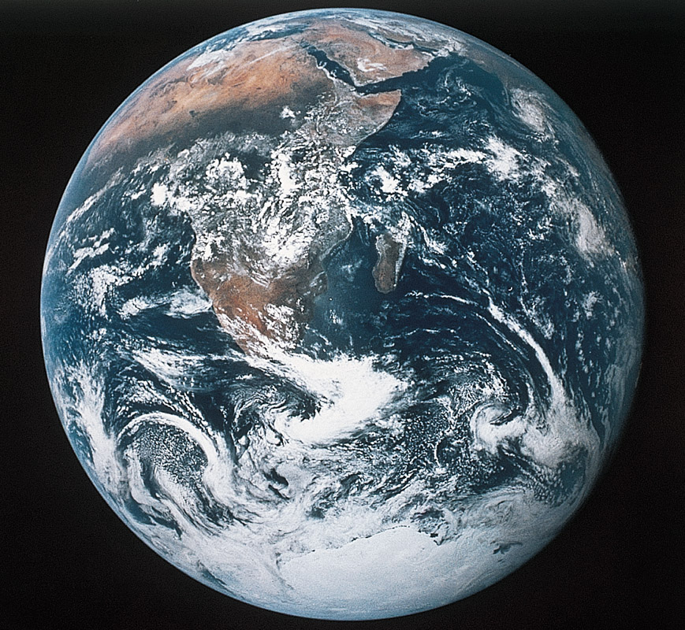
Welcome to FYS207 – Introduction to the Earth System
Earth System Science – The study of energy, matter, and transfer processes of Planet Earth; with subdisciplines of geology, meteorology, hydrology, oceanography, and astronomy. An integrated science that dovetails with Biology and Envronmental Science.
The
Earth
Figure 1.18
Home Base Planet Earth

Slide 3
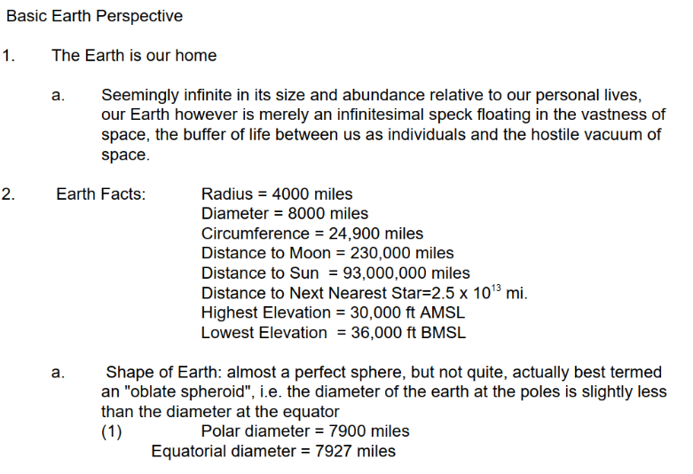
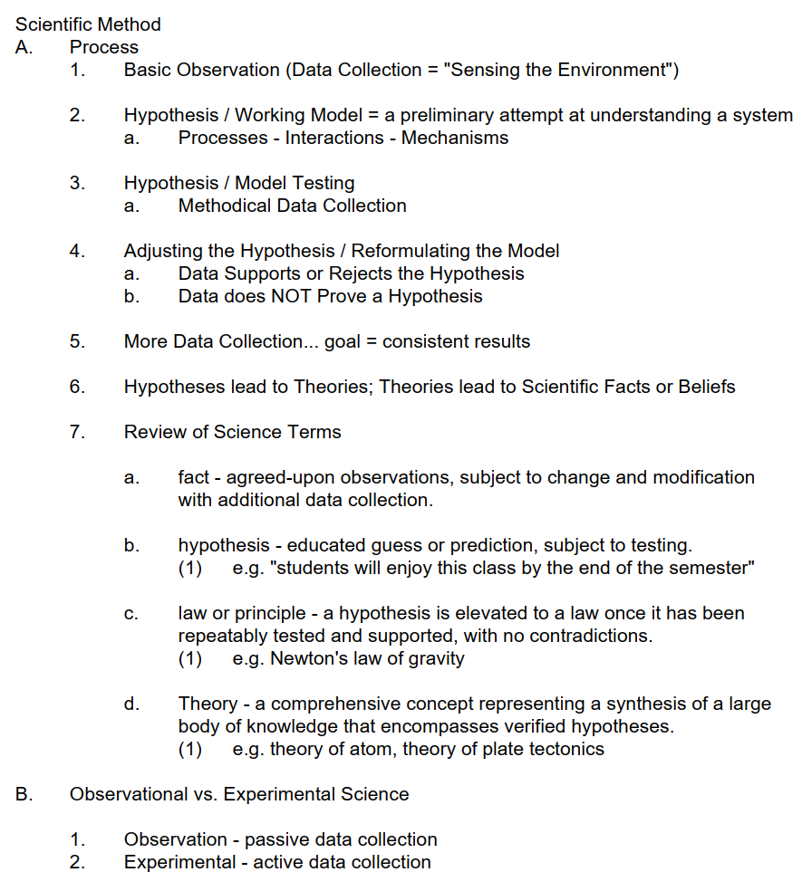
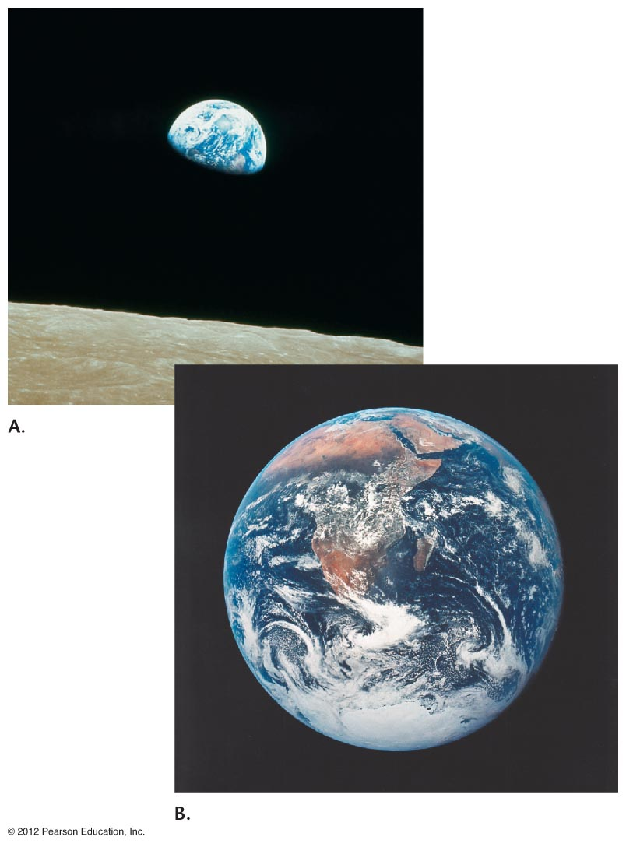
BASIC CONCEPTS

Slide 4
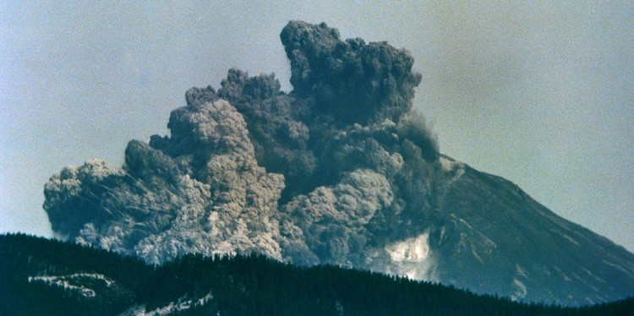
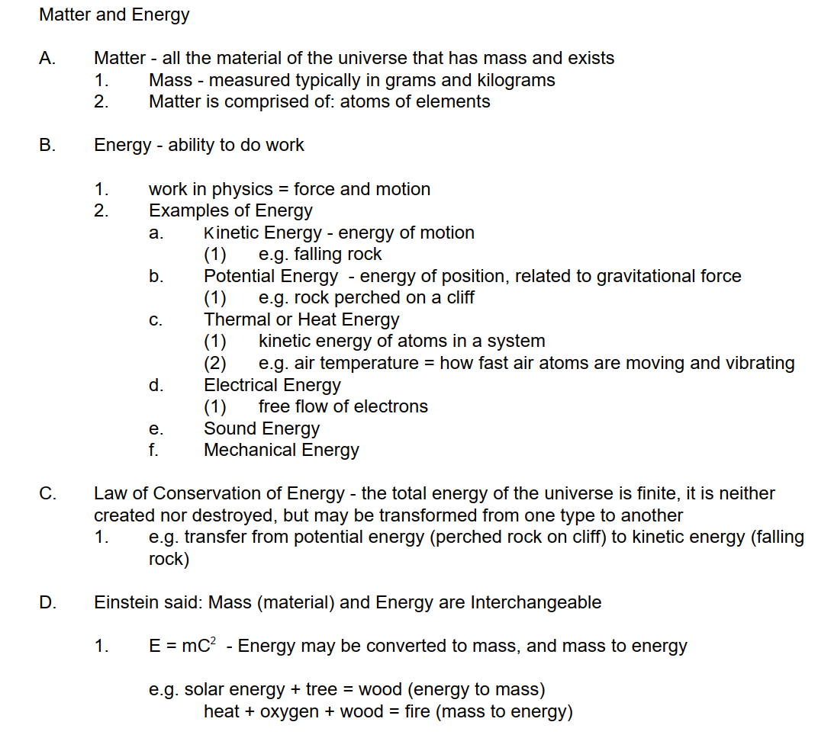
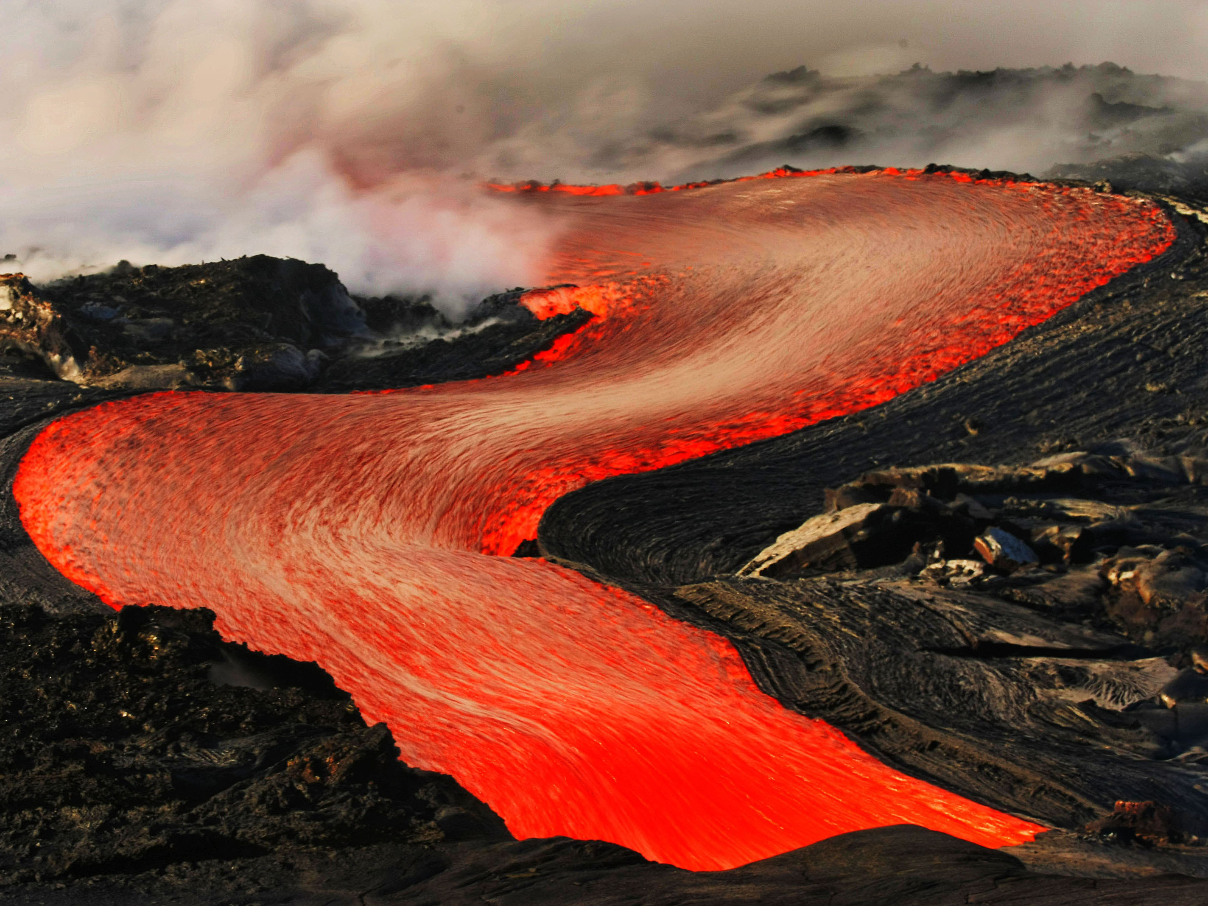
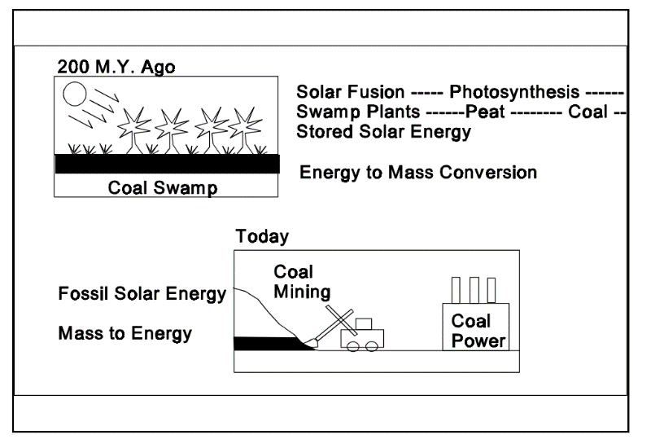
MASS AND ENERGY

Slide 5
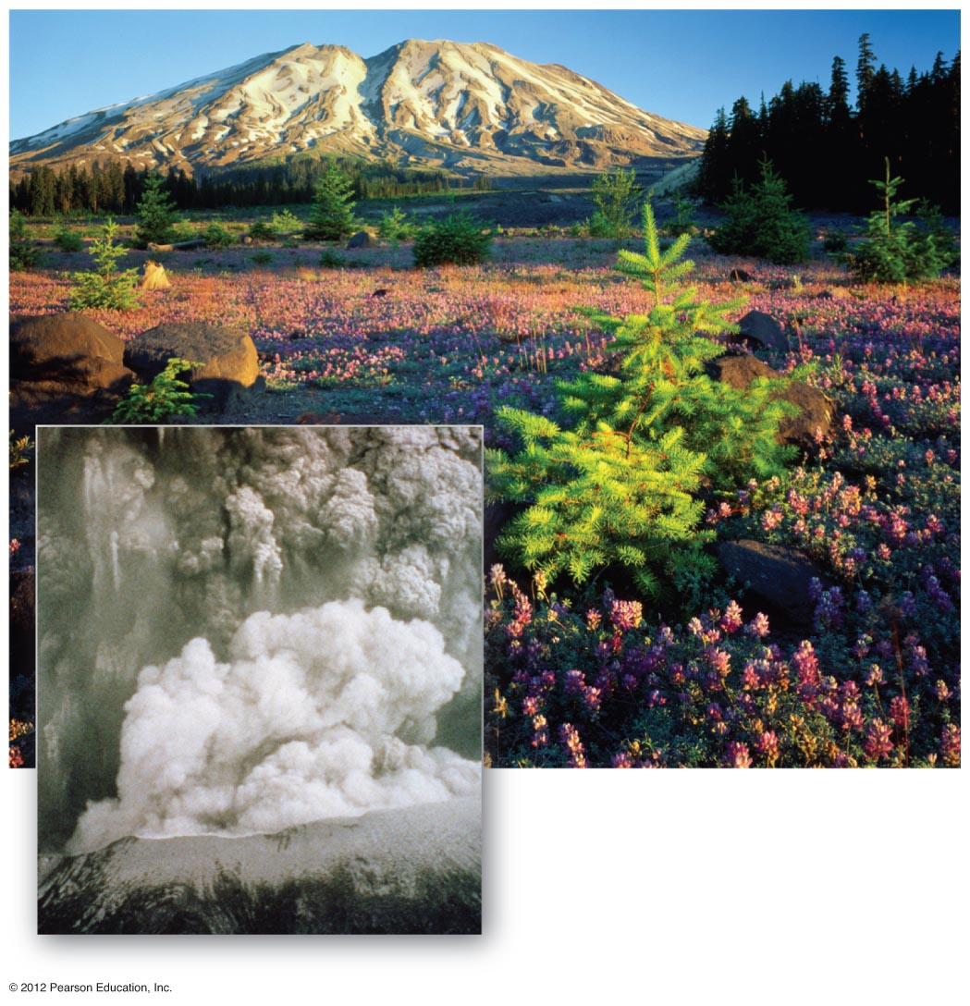
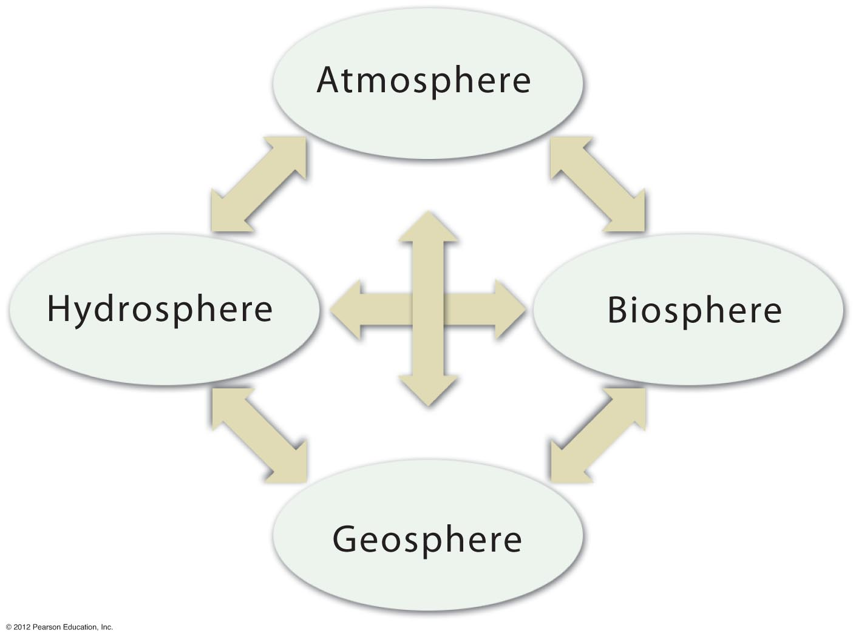
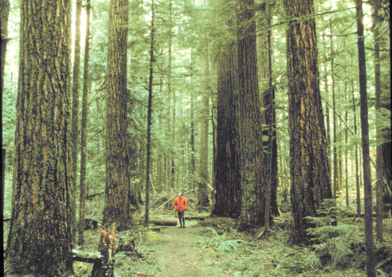
Notes:
FIGURE 1.21

Slide 6
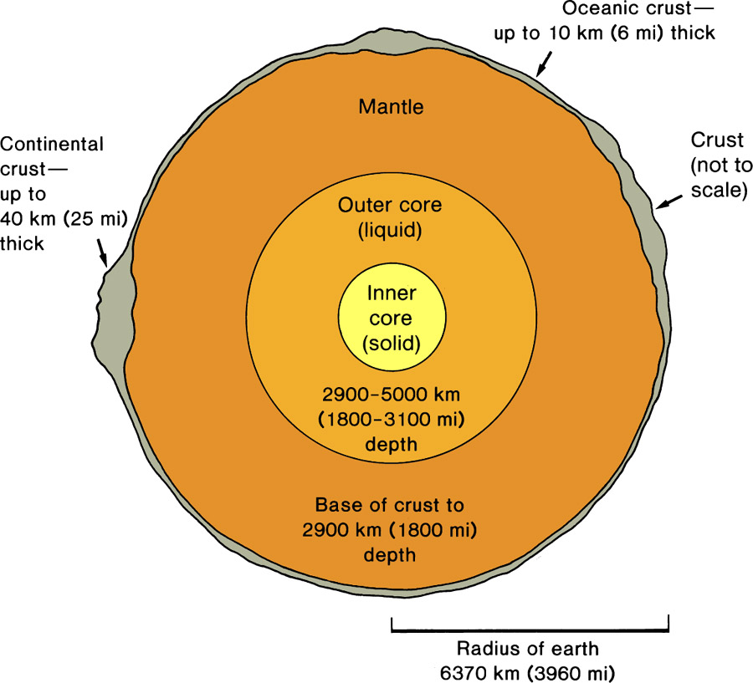
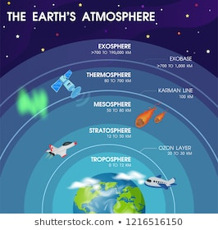
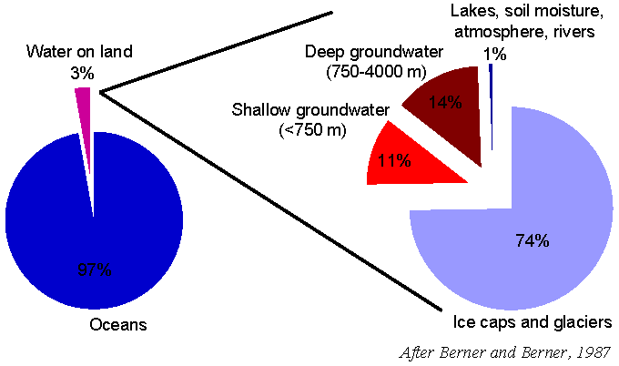
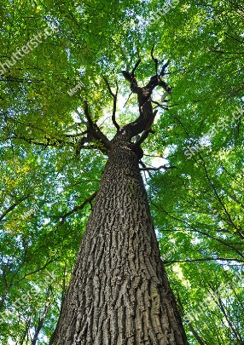
Earth System – a dynamic space ship with transfers of Mass and Energy
Four Subsystems: Geosphere (Lithosphere), Atmosphere, Hydrosphere, Biosphere
GEOSPHERE
-Solid Earth
-Near-Surface:
Minerals, Rocks
Soil
-47% Oxygen
-27% Silicon
-8% Aluminum
-18% Cations
+Others
ATMOSPHERE
-Gaseous Envelope
-78% Nitrogen
-21% Oxygen
-1% All Others
-Troposphere near
surface
HYDROSPHERE
-Water World Blue Planet
-97% H2O + dissolved ions
-Oceans
-Groundwater, Surface Water
-Glacial Ice
BIOSPHERE
-Life: Plants & Animals
-CHON – Carbon, Hydrogen,
Oxygen, Nitrogen
-Photosynthesis-Based Food
Chain
Human Habitat “Critical Zone”: surface nexus of atmosphere, hydrosphere and geosphere

Slide 7
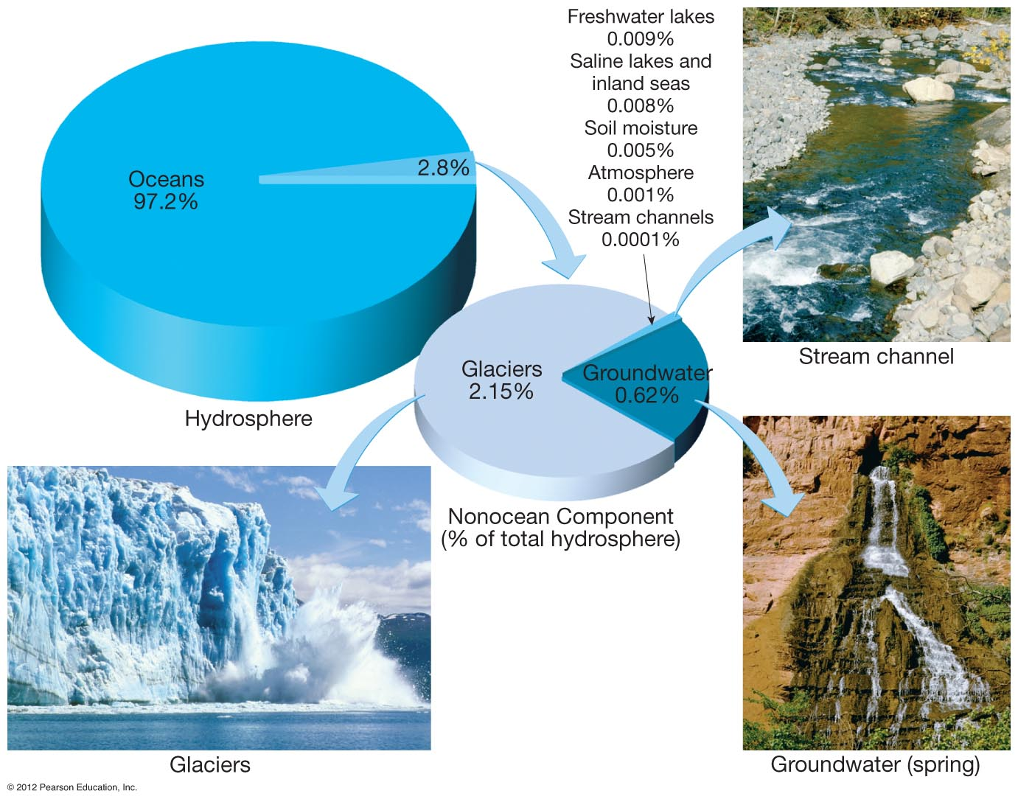
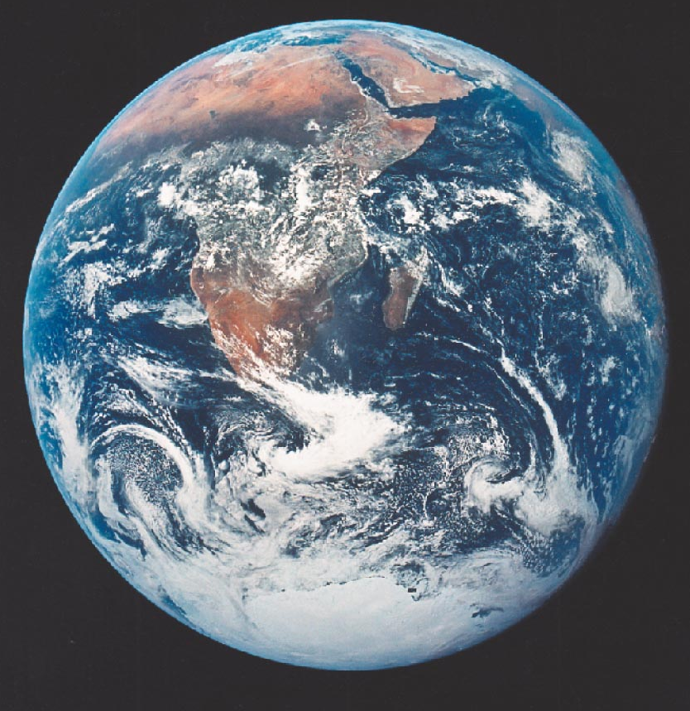
EARTH - THE “BLUE PLANET”
WATER = LIFE
Notes:
FIGURE 1.11

Slide 8
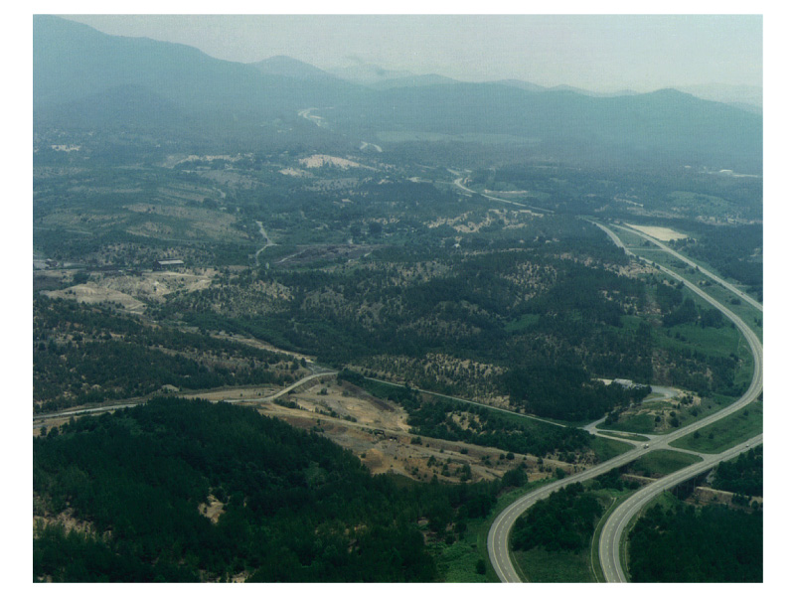
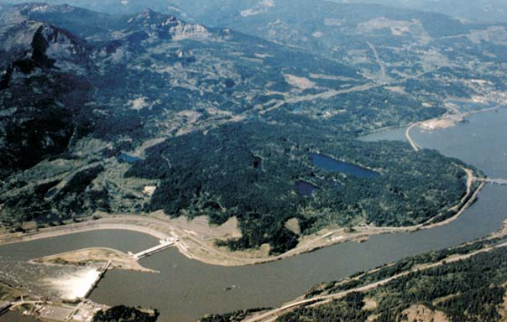
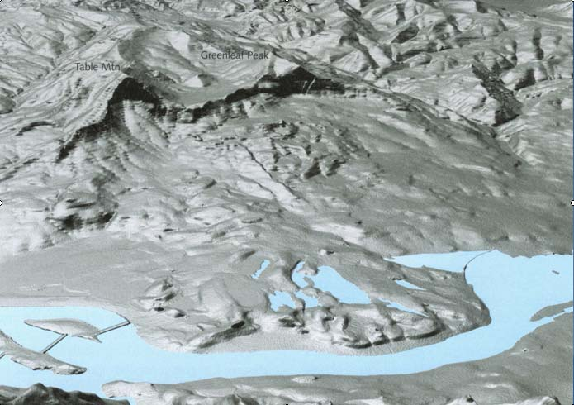
Earth System – Fundamental Driving Energy Sources: Geothermal, Solar, Gravity

Slide 9
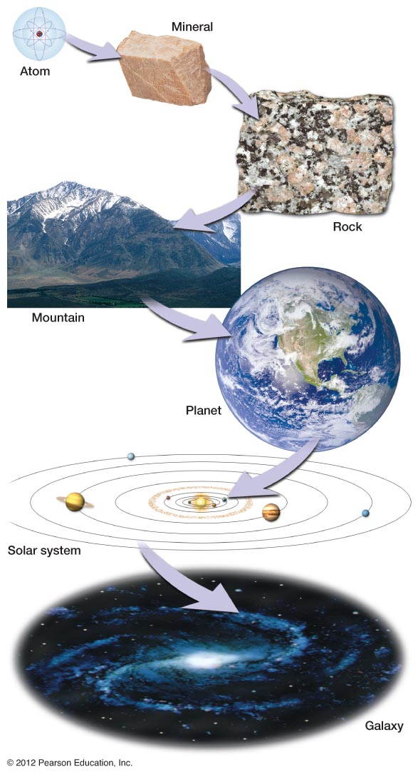
SPATIAL SCALING: The Earth in Context
Atomic = 10⁻¹⁰ meters
Rock Outcrop = 10² meters
Mountain Range = 10⁵ meters
Planet Earth 10⁷ = meters
Solar System 10¹² = meters
Milky Way Galaxy = 10²¹ meters
Notes:
FIGURE 1.6

Slide 10
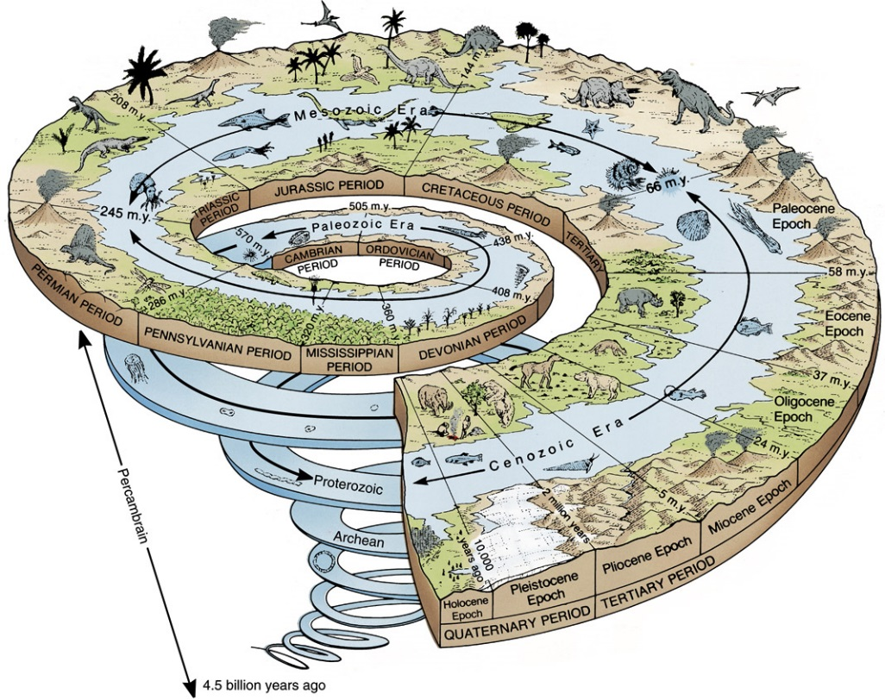
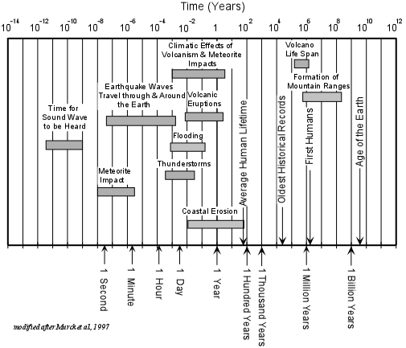
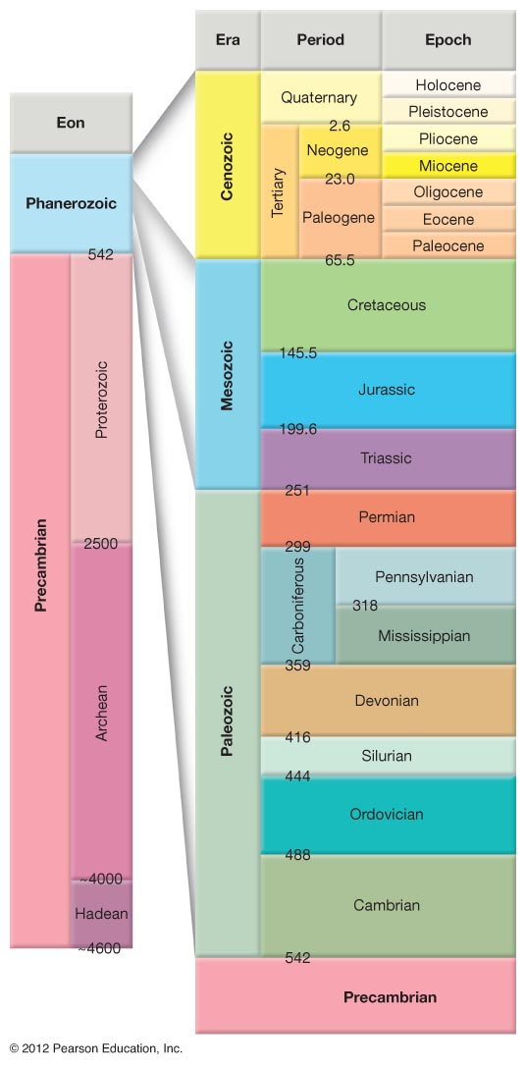
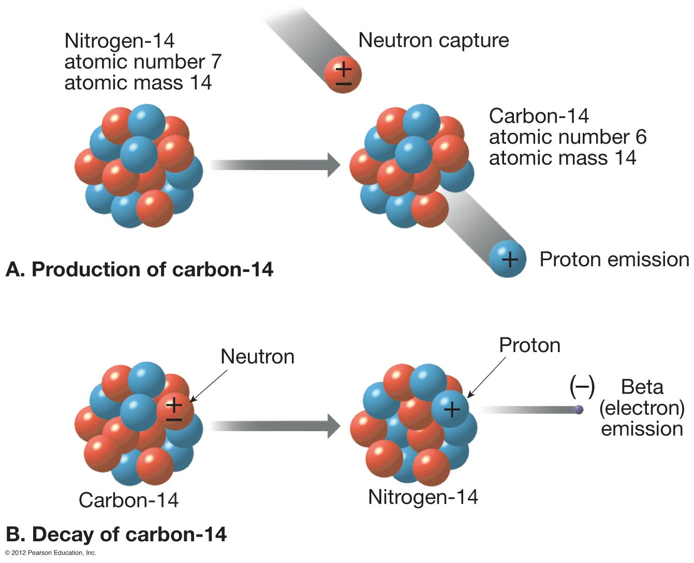
Earth Processes and Deep Geologic Time

Slide 11
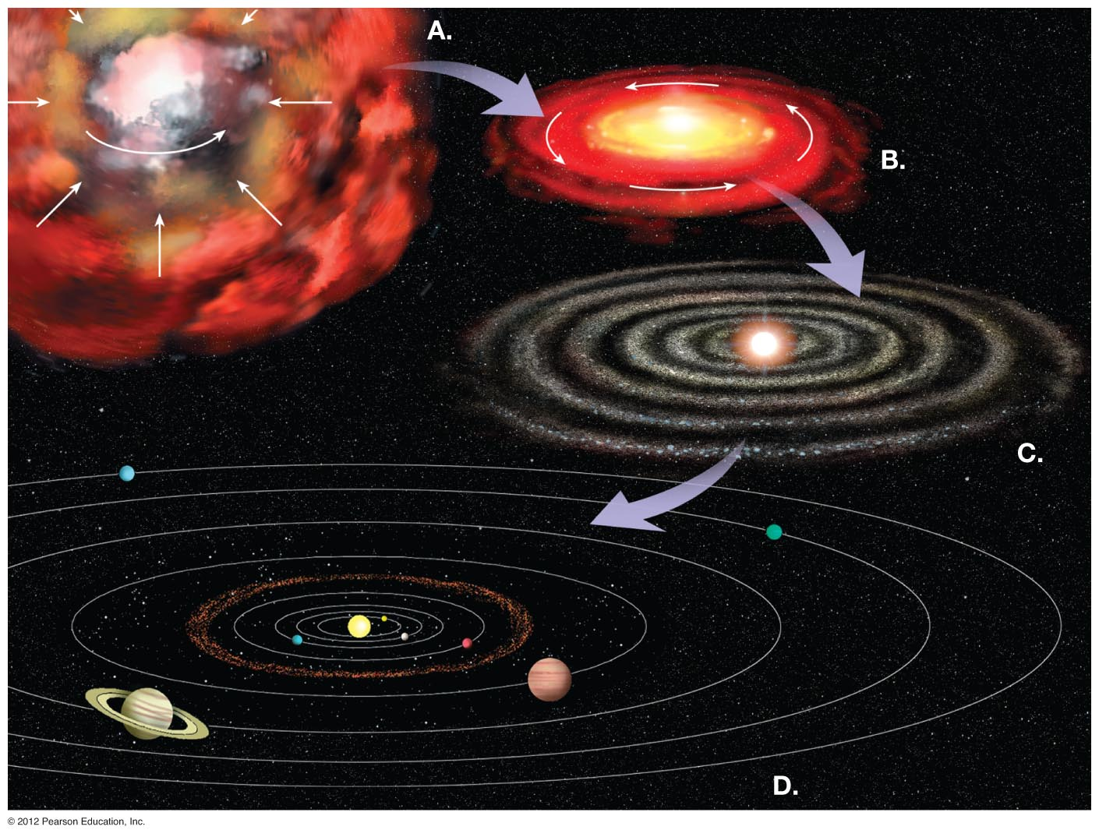
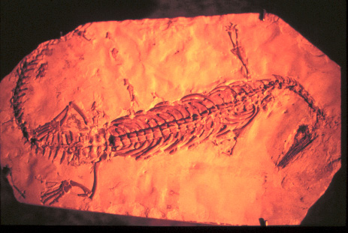
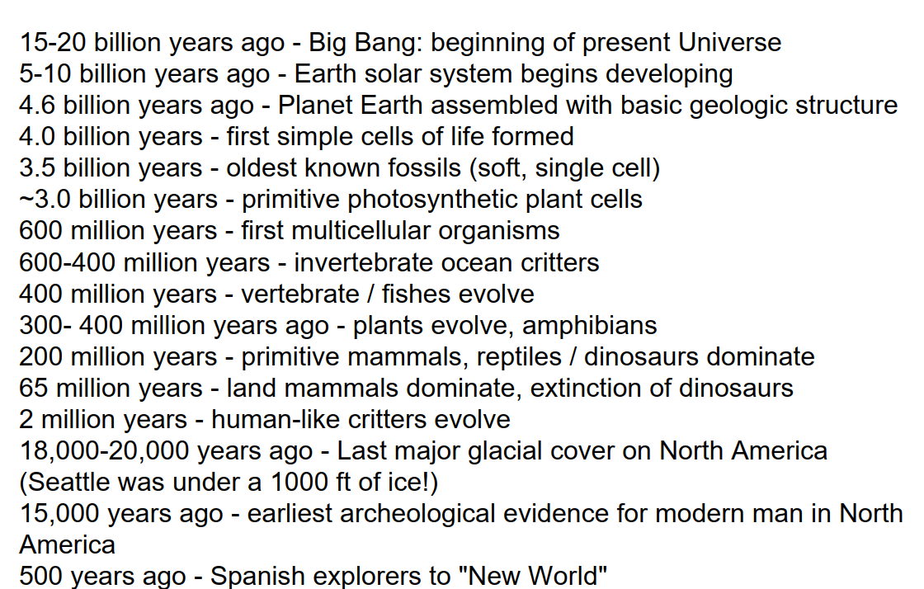
A Brief History of the Universe and Planet Earth:
Notes:
FIGURE 1.8

Slide 12
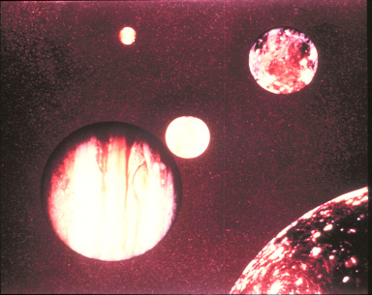
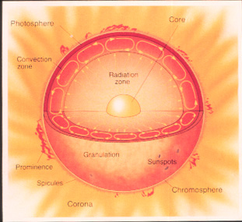
Sun and the Solar System

Slide 13
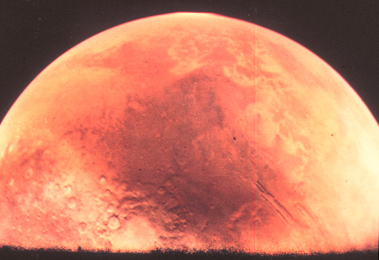
Planetary Geology – The Earth in Contrast

Slide 14
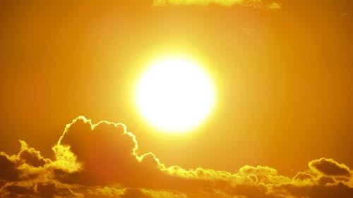
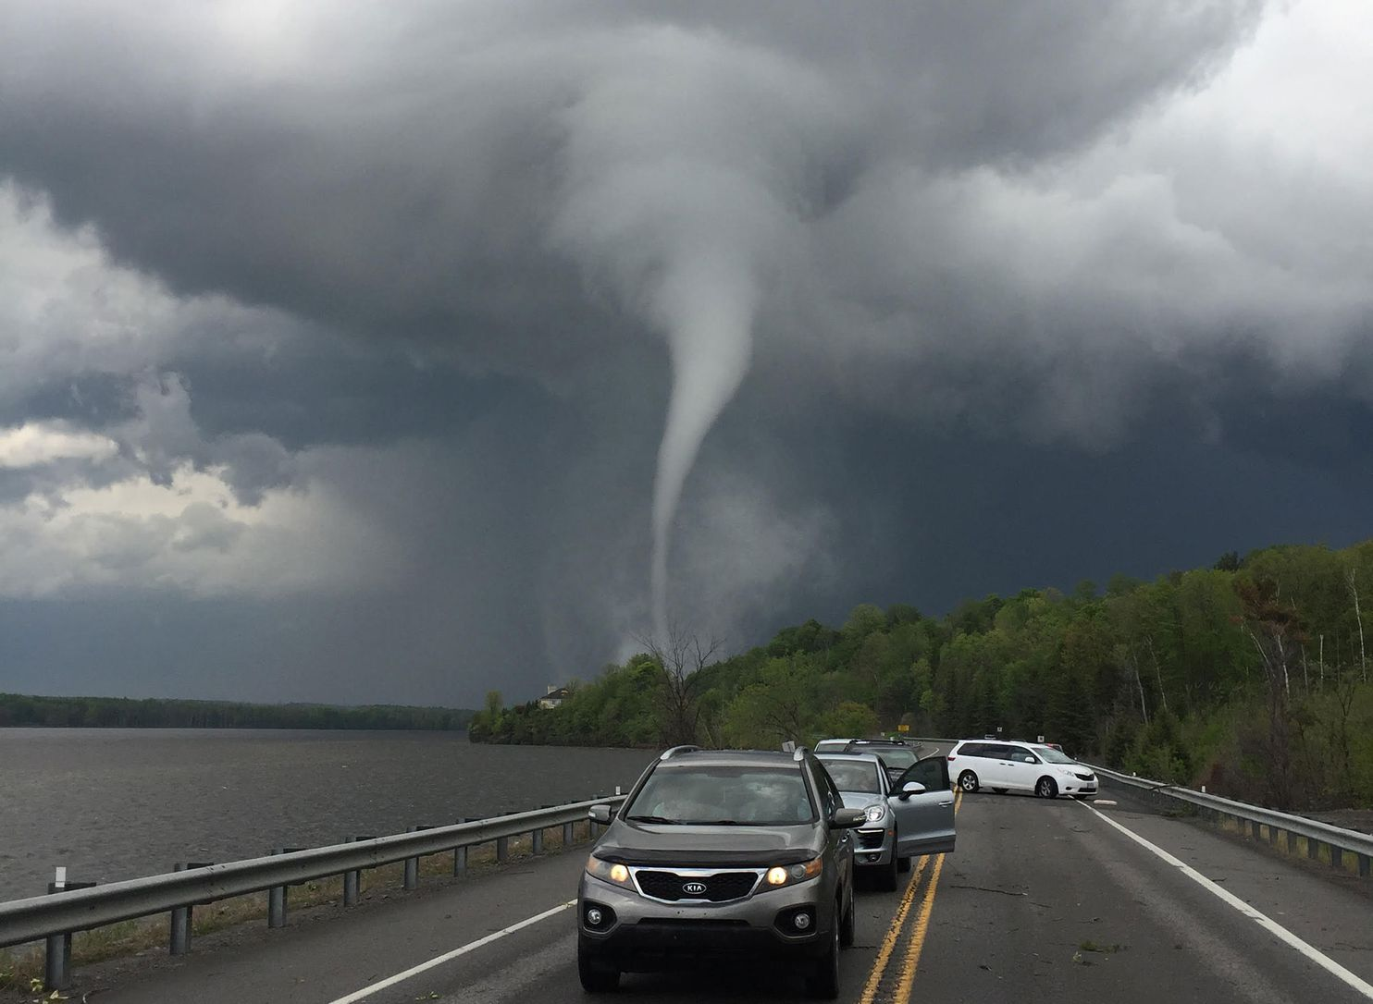
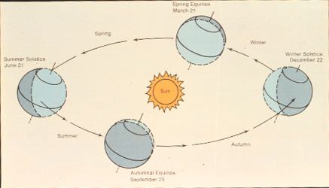
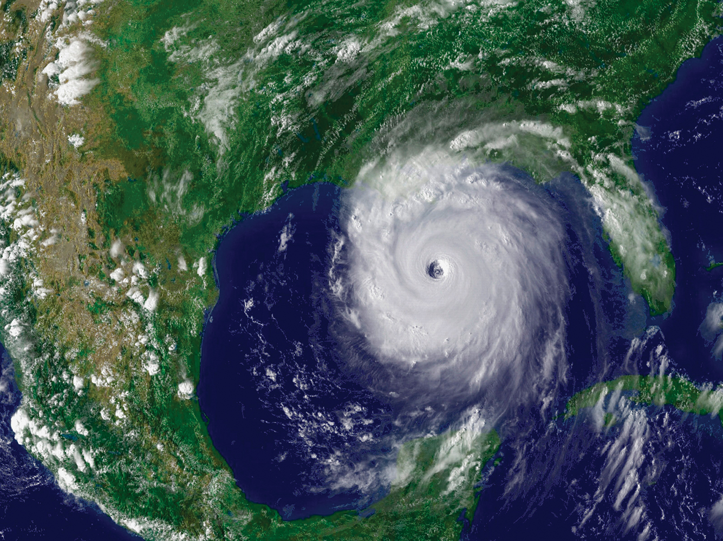
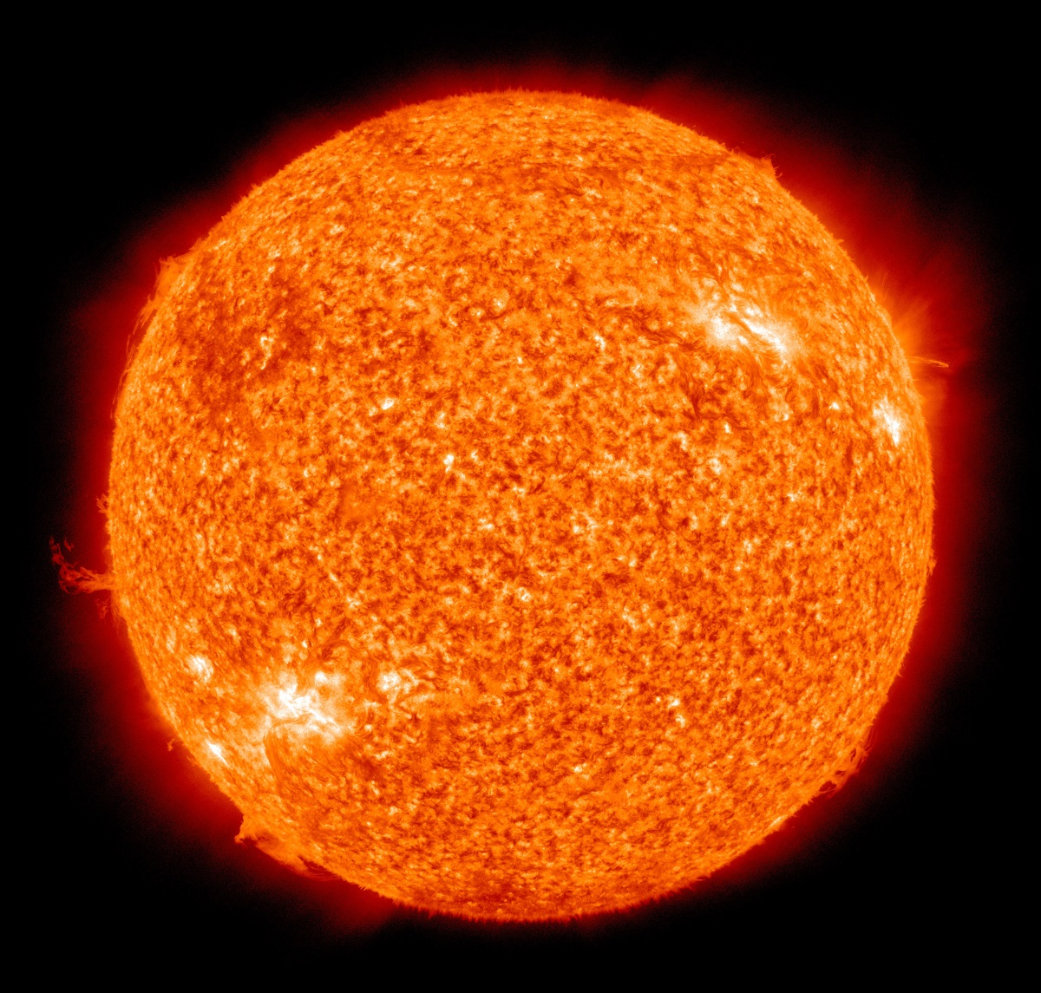
The Sun Star: Earth’s External Energy Source
Solar Heat Engine for Ocean and Atmosphere; Energy for Life

Slide 15
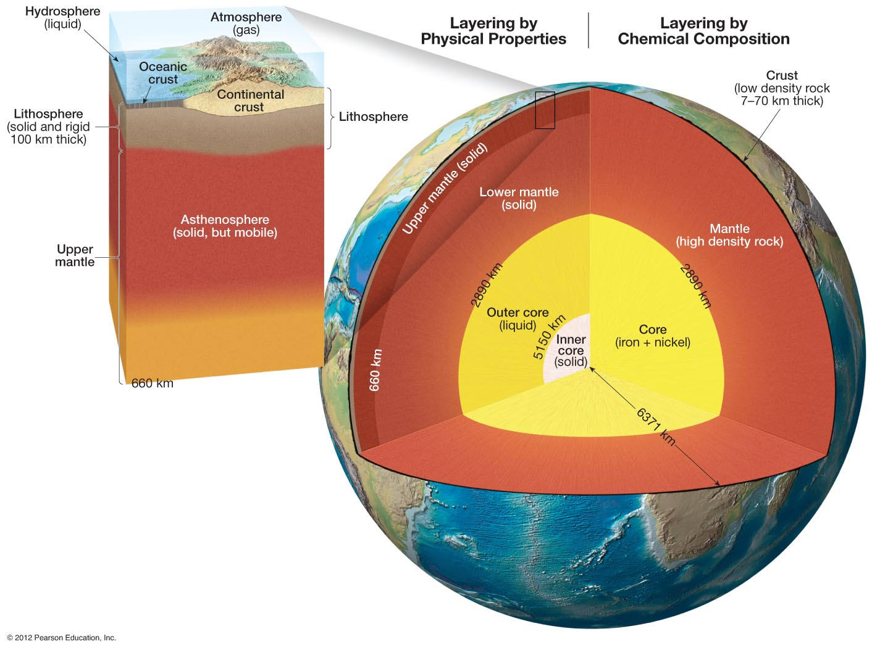
GEOSPHERE
Notes:
FIGURE 1.14

Slide 16
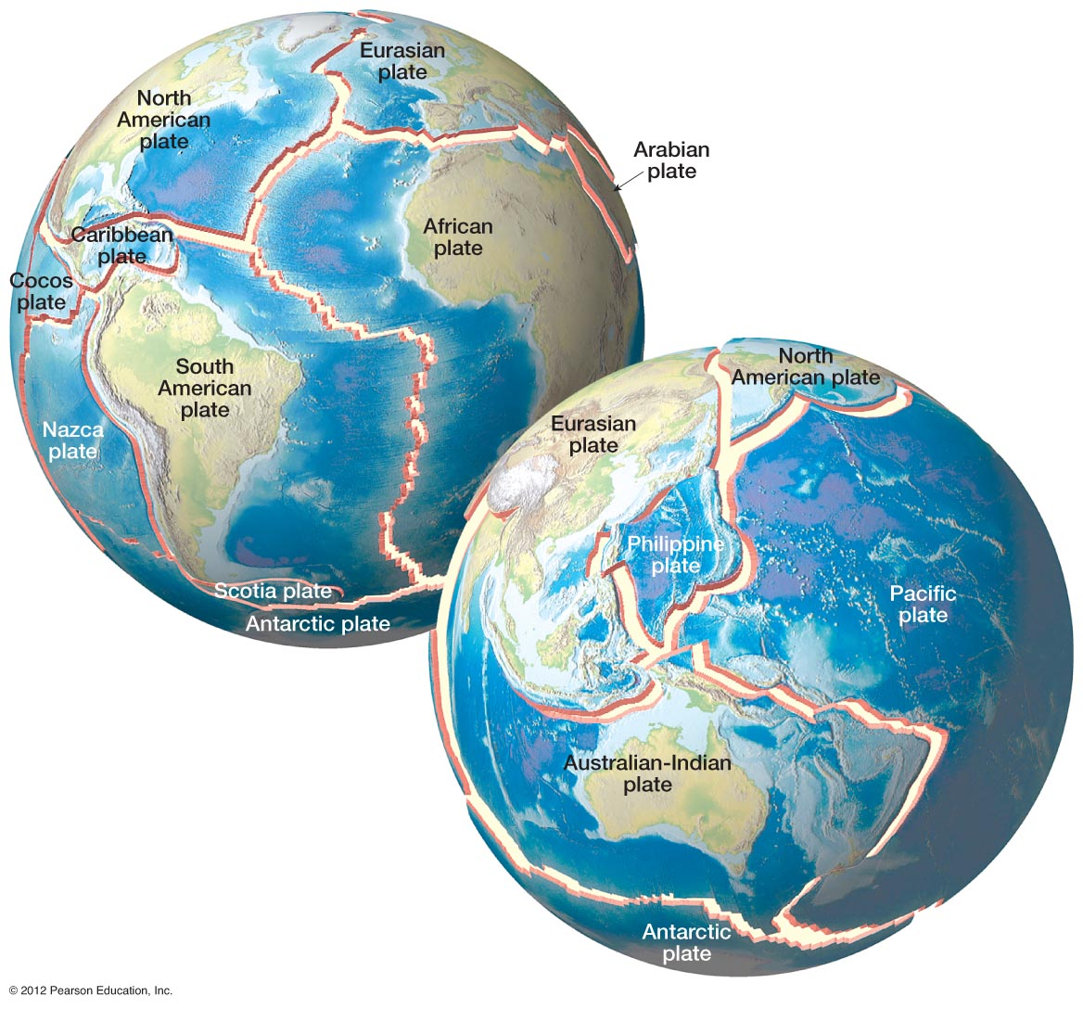
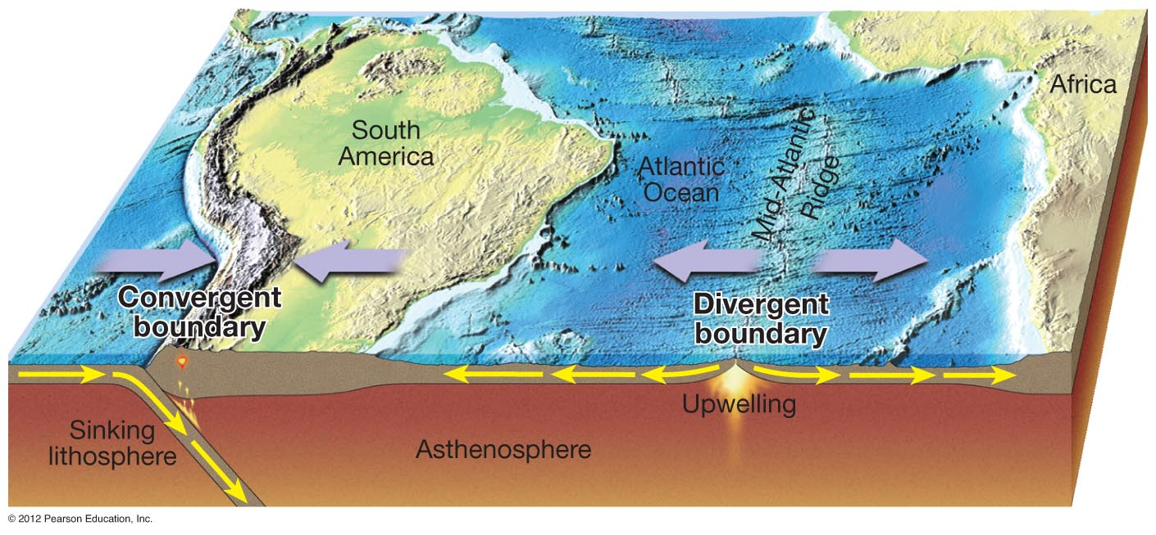
Geothermal Heat Energy
Transforms to Mechanical
Energy via Mantle Convection
Plate Tectonics: Geothermal Energy in Action
Notes:
FIGURE 1.16

Slide 17
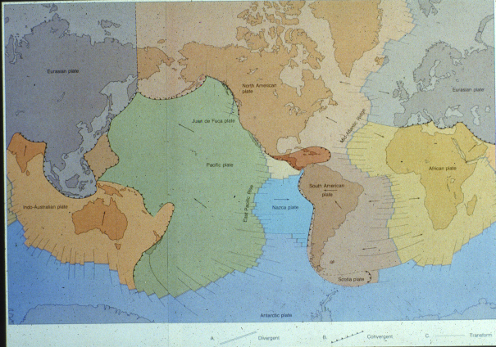
Plate Tectonics: Geothermal Energy in Action

Slide 18
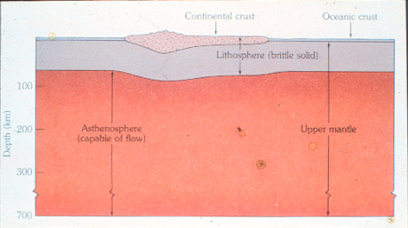
Anatomy of a Tectonic Plate

Slide 19
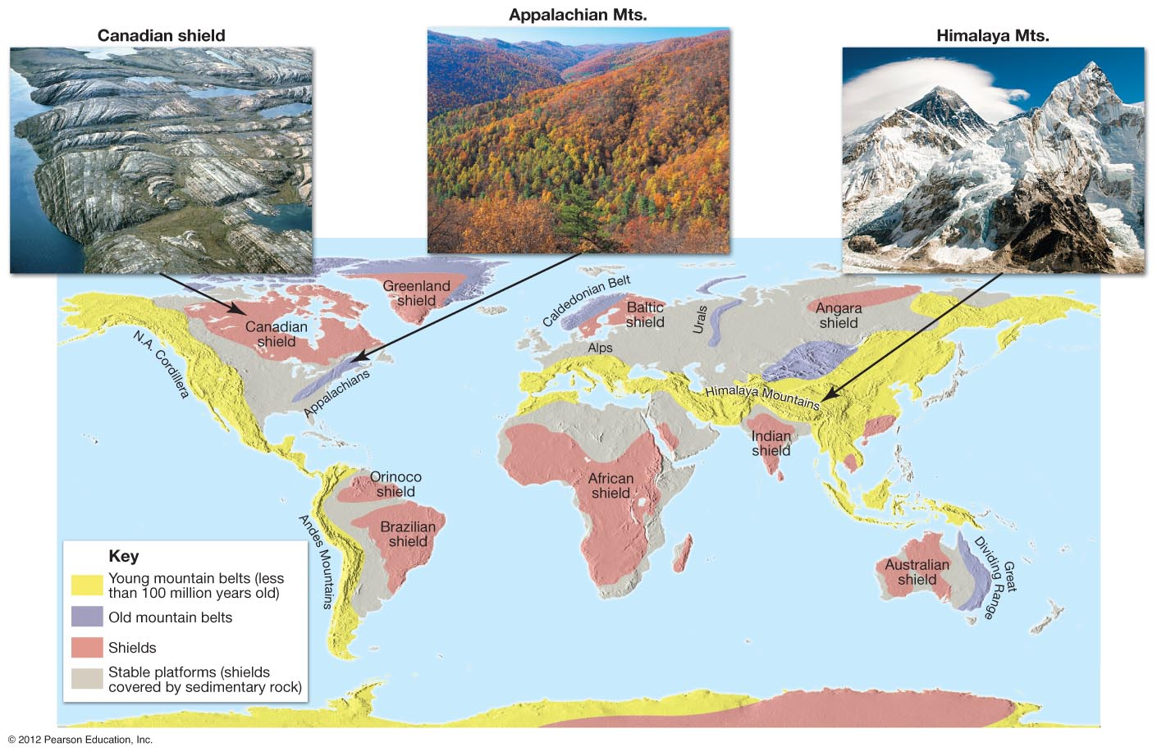
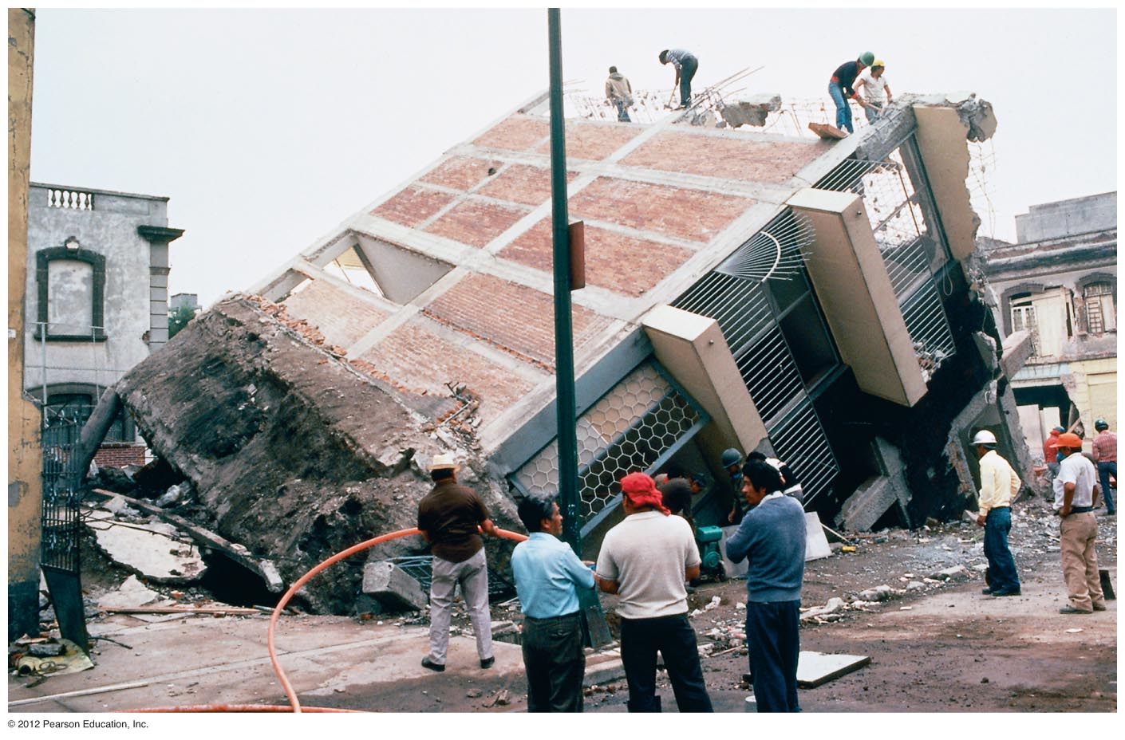
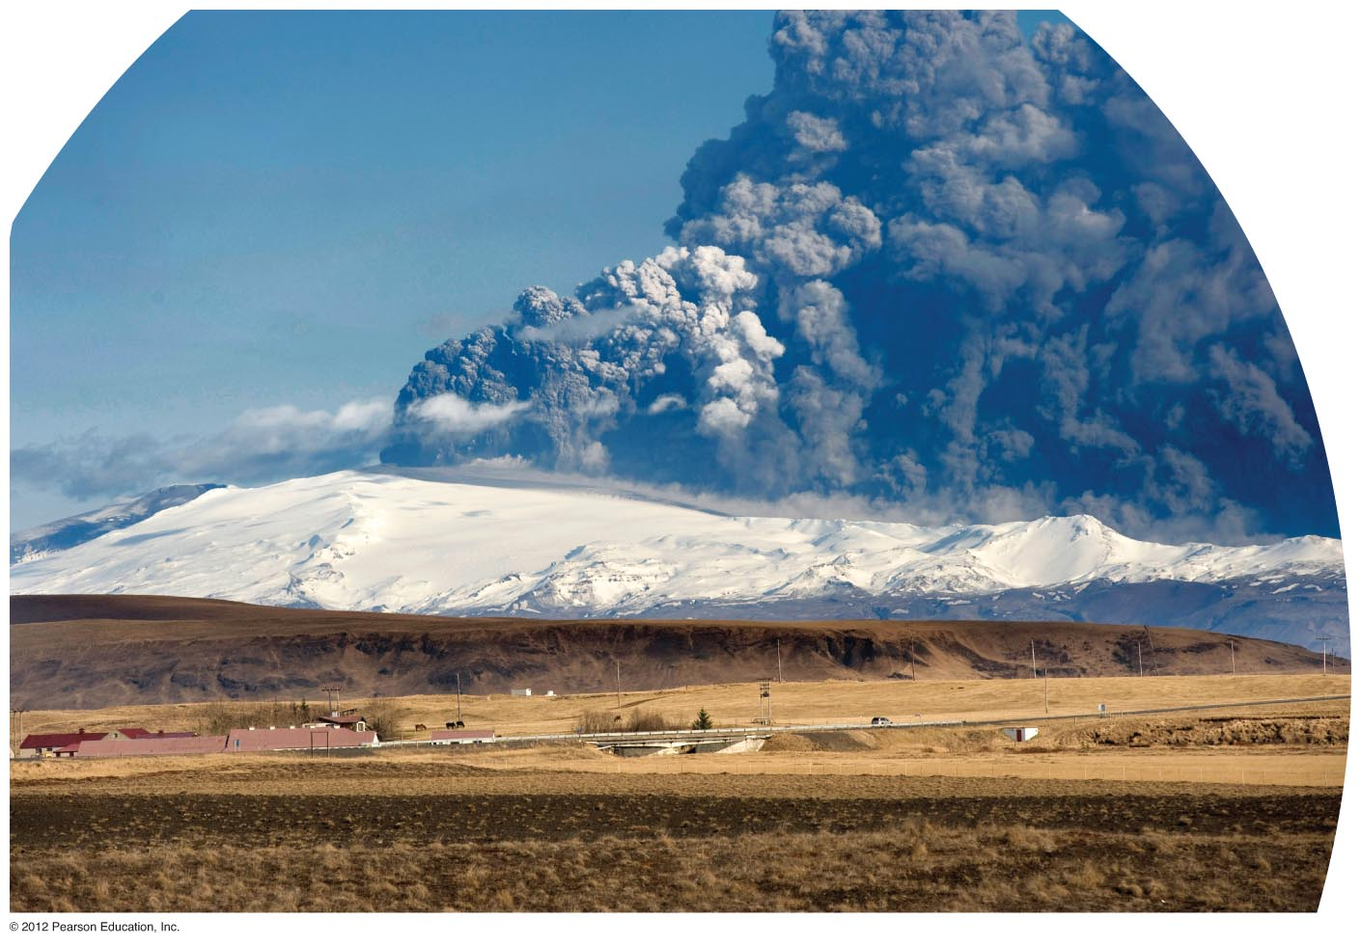
Plate Dynamics: Mountain Building-Volcanism-Earthquakes
Notes:
FIGURE 1.19

Slide 20
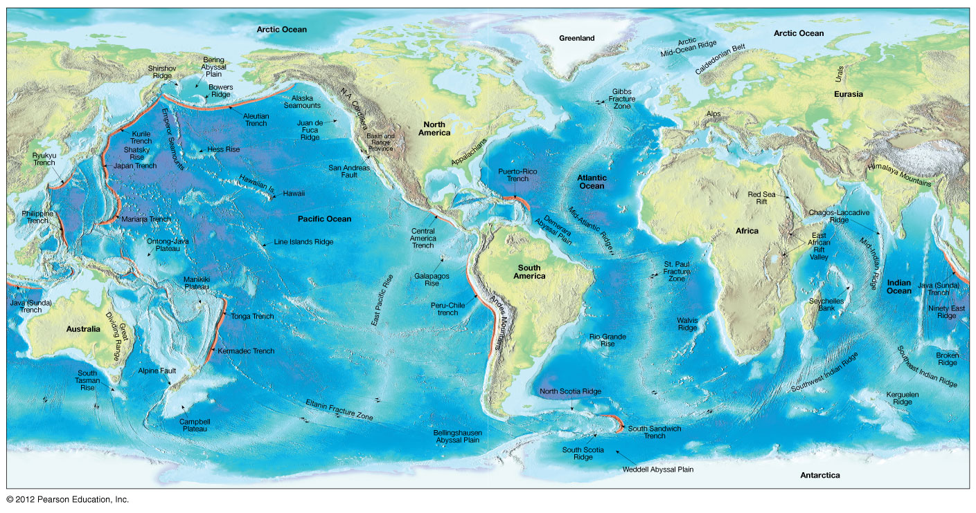
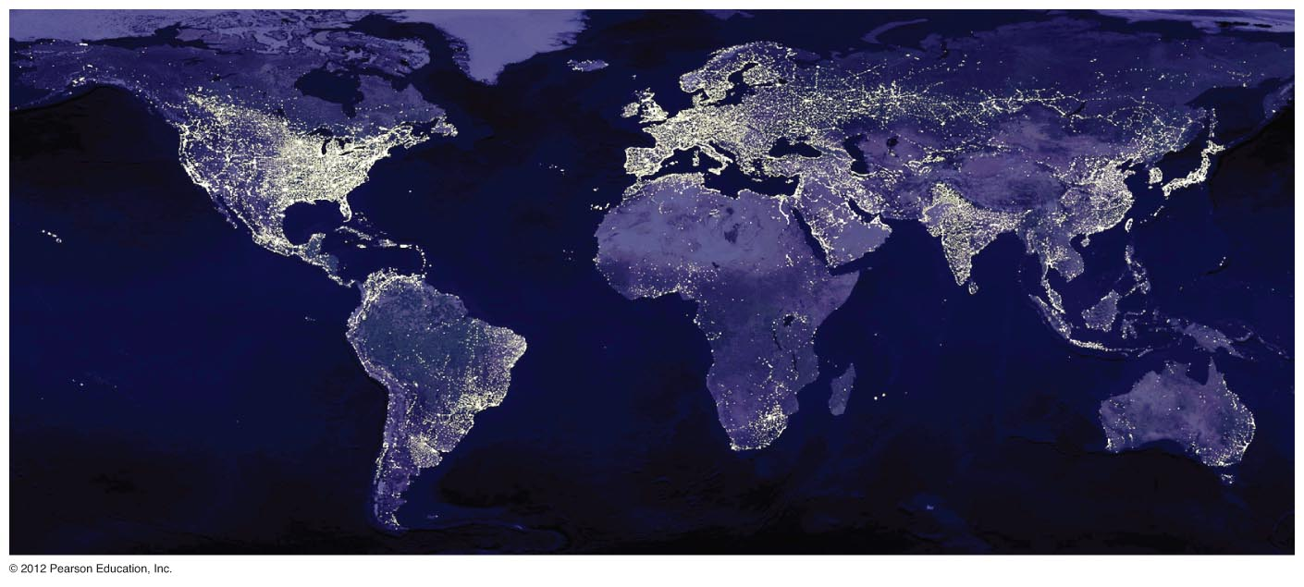
Plate Dynamics: Present-Day Global Geography
Notes:
FIGURE 1.18

Slide 21
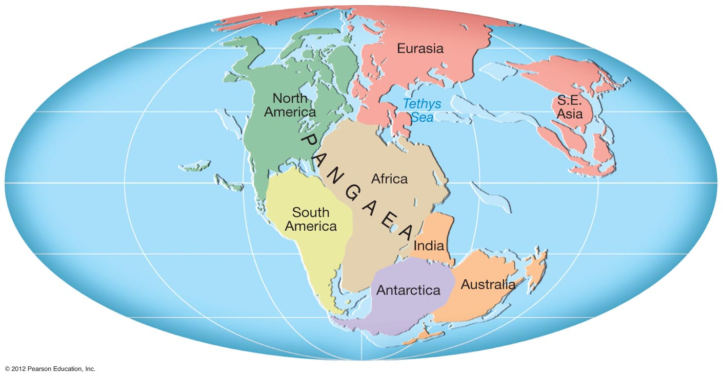
Plate Dynamics 200 m.y. Ago: Ancient Global Paleogeography
Tethys Ocean
Tethys Ocean
Notes:
FIGURE 1.15

Slide 22
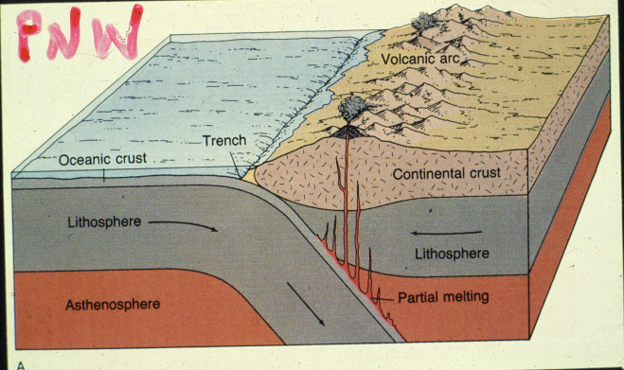
CASCADIA SUBDUCTION ZONE

Slide 23
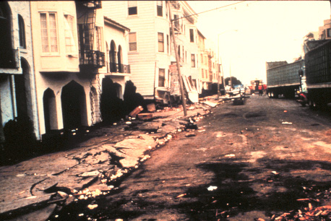
EARTHQUAKES AND SEISMIC SHAKING

Slide 24
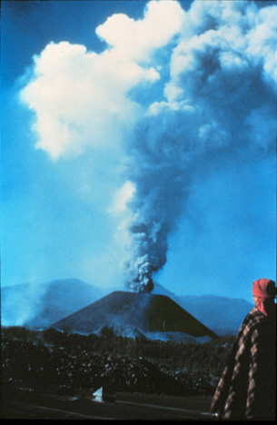

VOLCANISM (MR. SPOCK THE ANCIENT PROPHET)
Notes:
FIGURE 1.21

Slide 25


IGNEOUS LANDSCAPES – MAGMATIC PROCESSES

Slide 26



EARTH RESOURCES AND
HUMAN SYSTEMS

