Slide 1
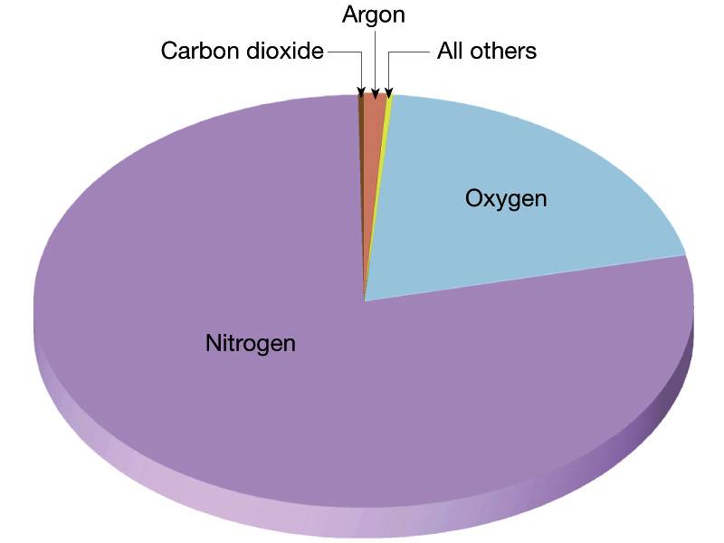
Composition of the Earth Atmosphere

Slide 2
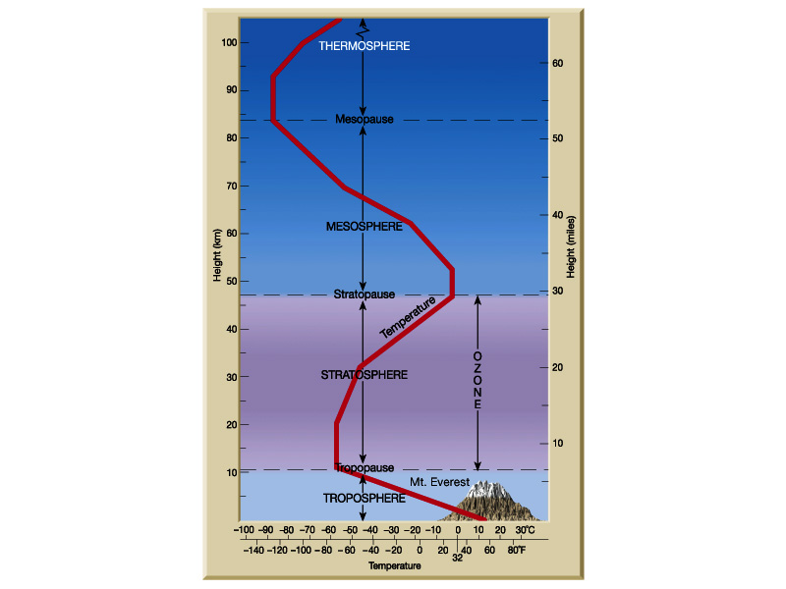
Structure of the
Earth atmosphere

Slide 3
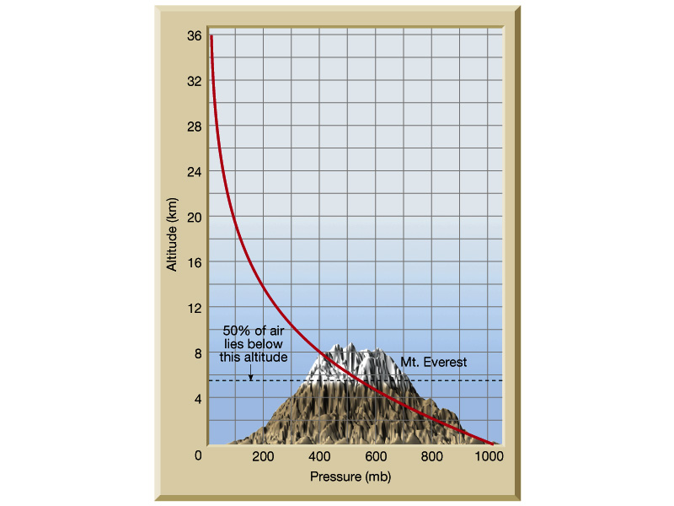
Pressure-altitude relationships
in troposphere

Slide 4
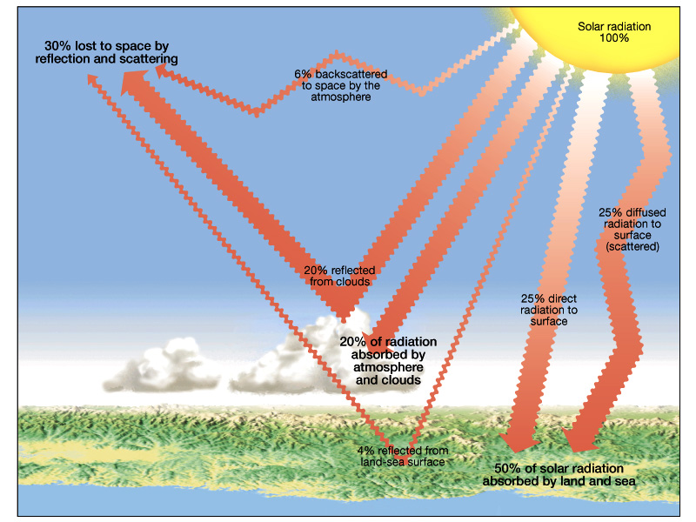
Earth solar energy budget

Slide 5
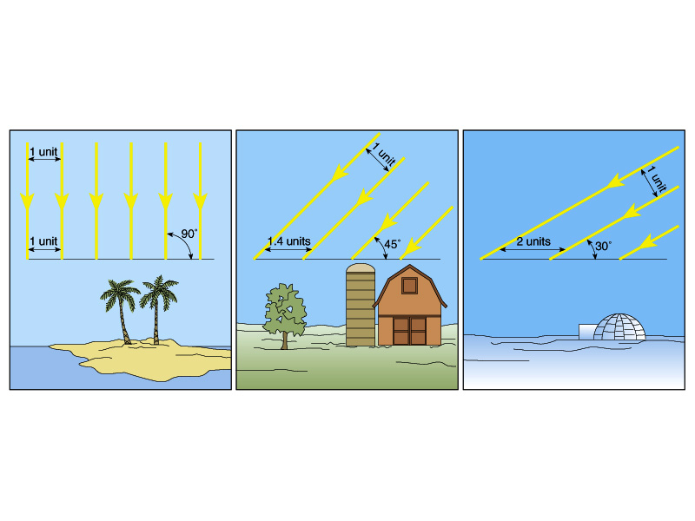
Low Latitude-----------------------------------------High Latitude
Latitudinal heating effects as related to solar ray angle of
incidence

Slide 6
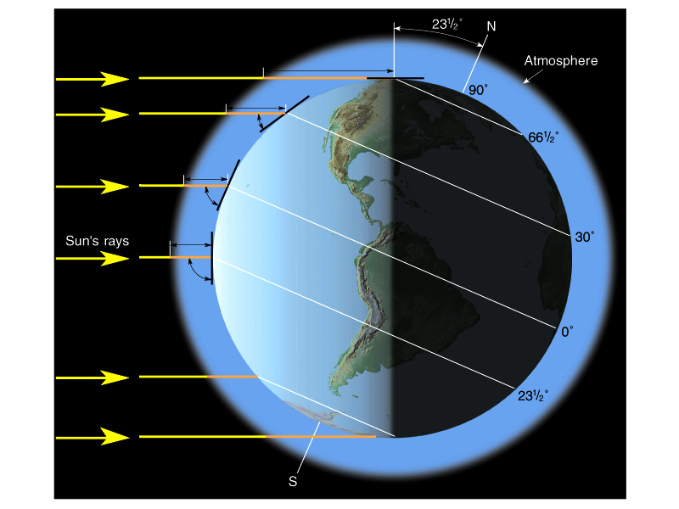

Slide 7
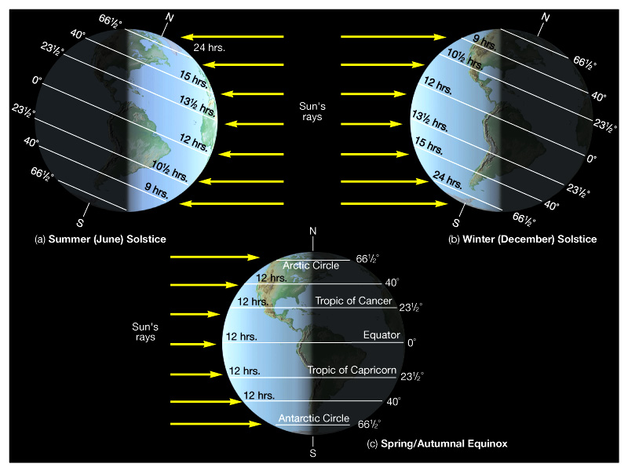

Slide 8
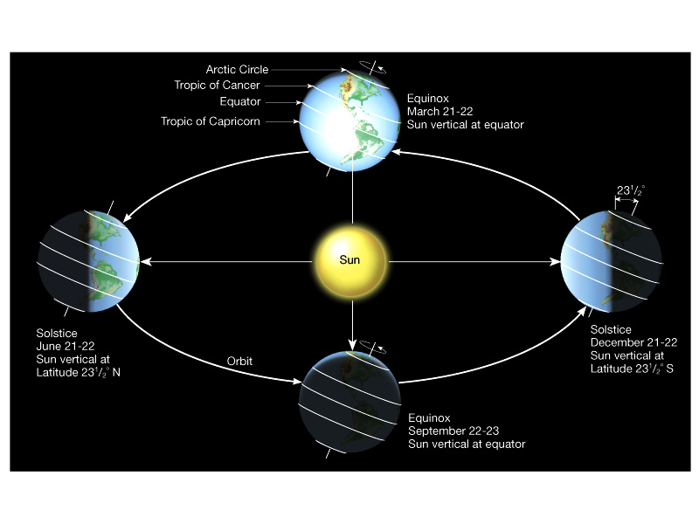
Seasonal heating and cooling of Earth atmosphere

Slide 9
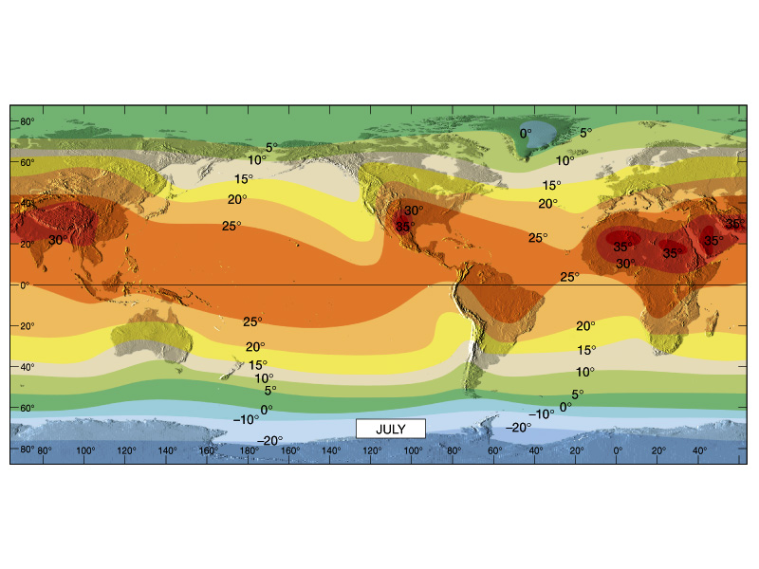
Global temperature trends – July (deg. Celsius)

Slide 10
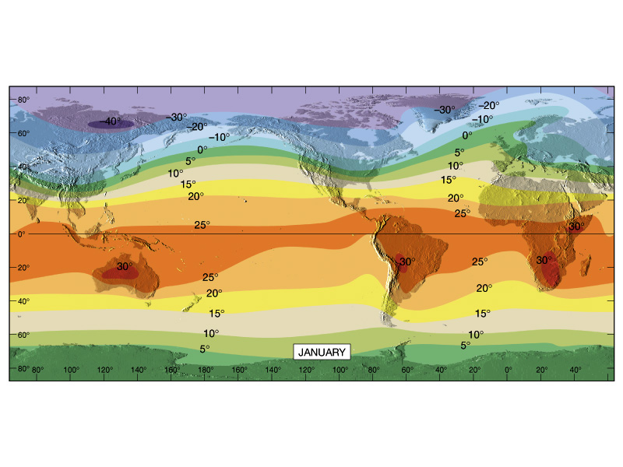
Global temperature trends – January (deg. Celsius)

Slide 11
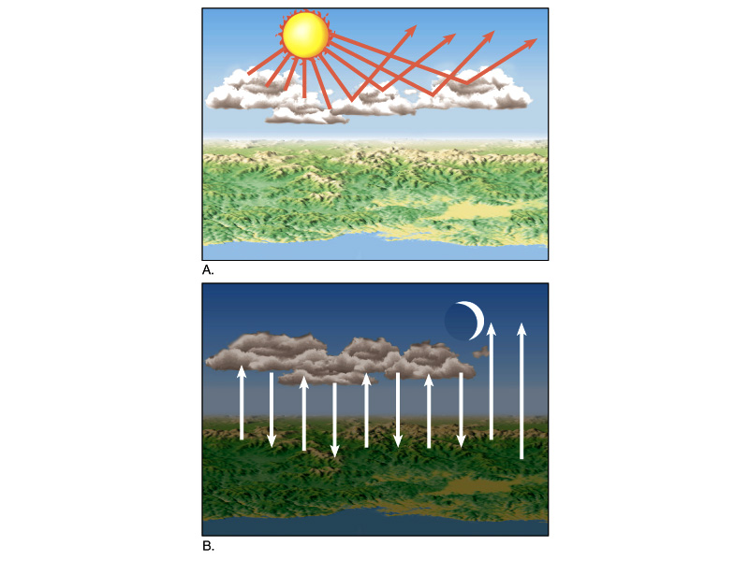
Effects of cloud
cover on surface
heating

Slide 12
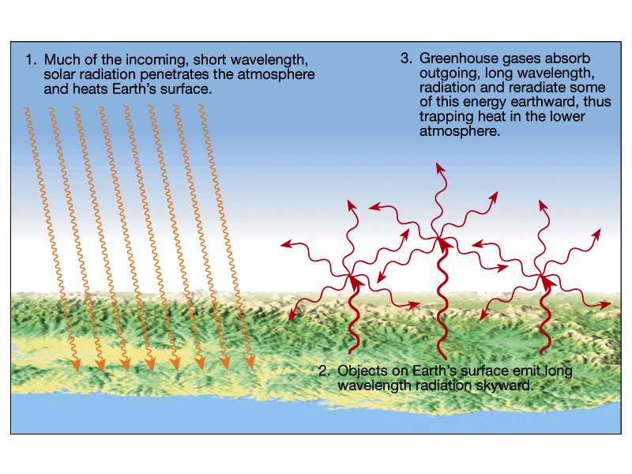
Greenhouse effect in Earth atmosphere

Slide 13
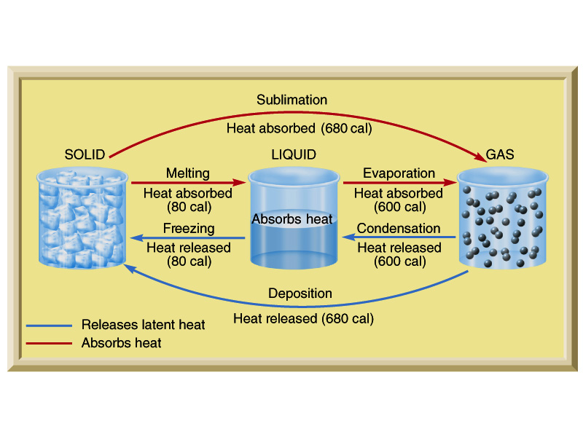
Heat exchange and phase transformation for water

Slide 14
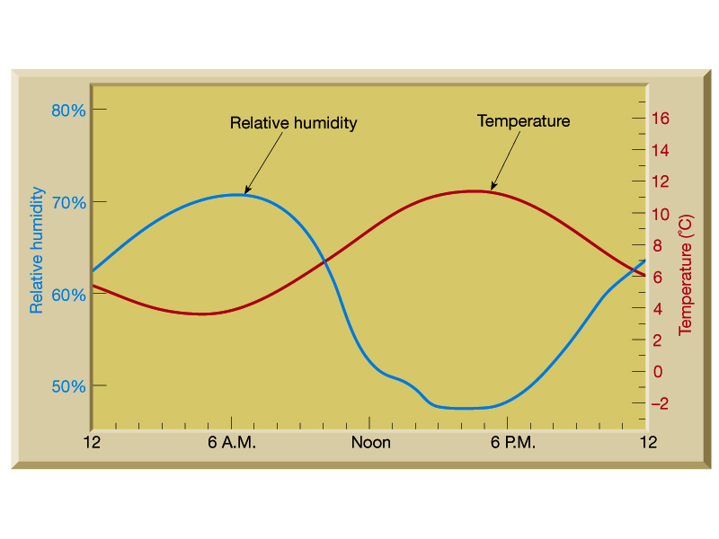
Diurnal fluctuation of relative humidity vs. time of day

Slide 15
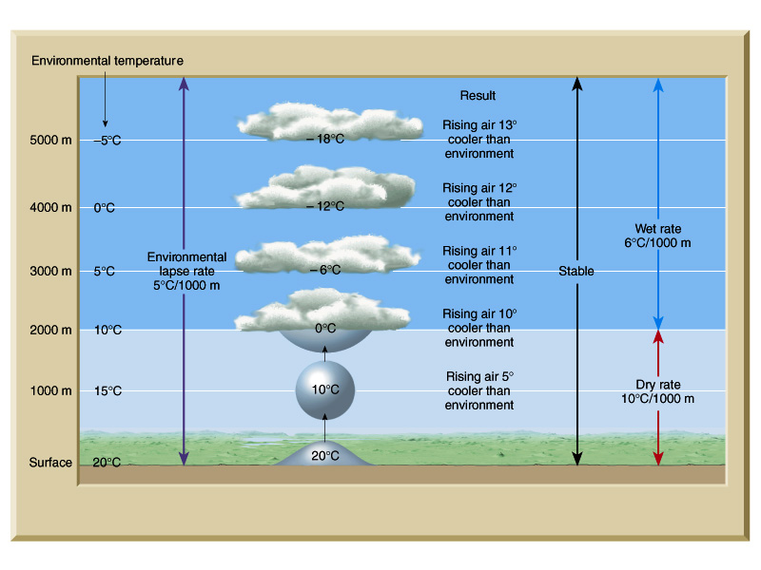

Slide 17
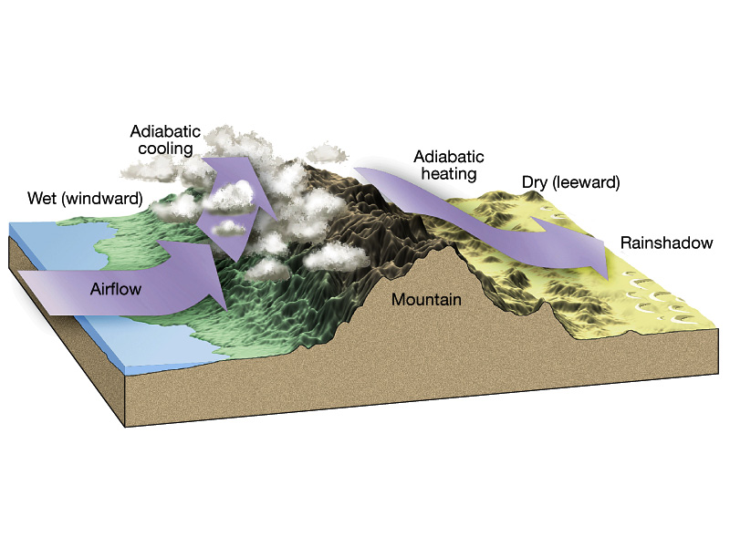
Forceful lifting: orographic

Slide 18
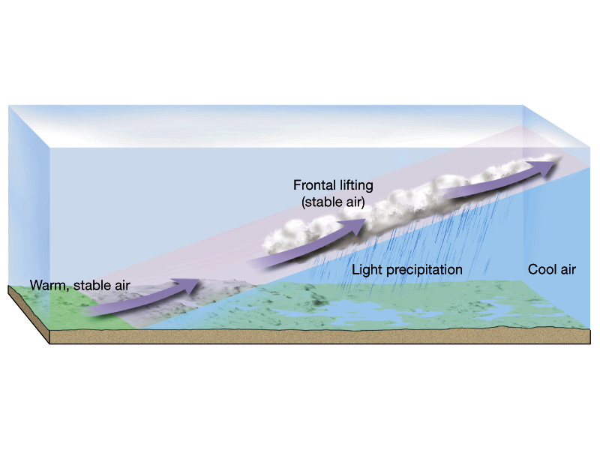
Forceful lifting: frontal wedging
Warm front

Slide 19
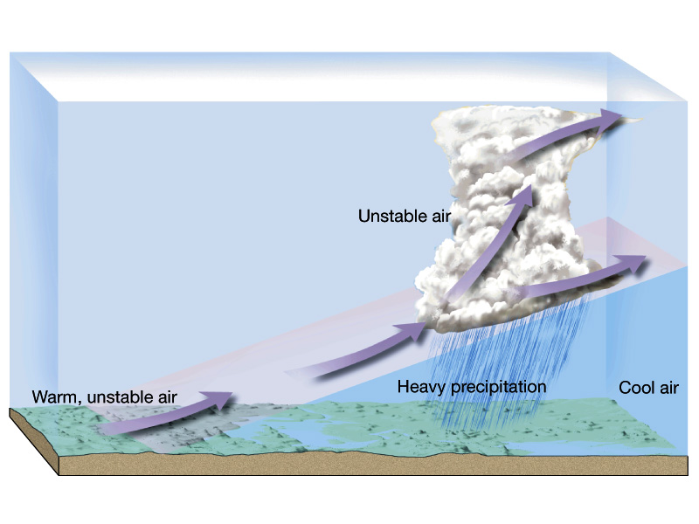

Slide 20
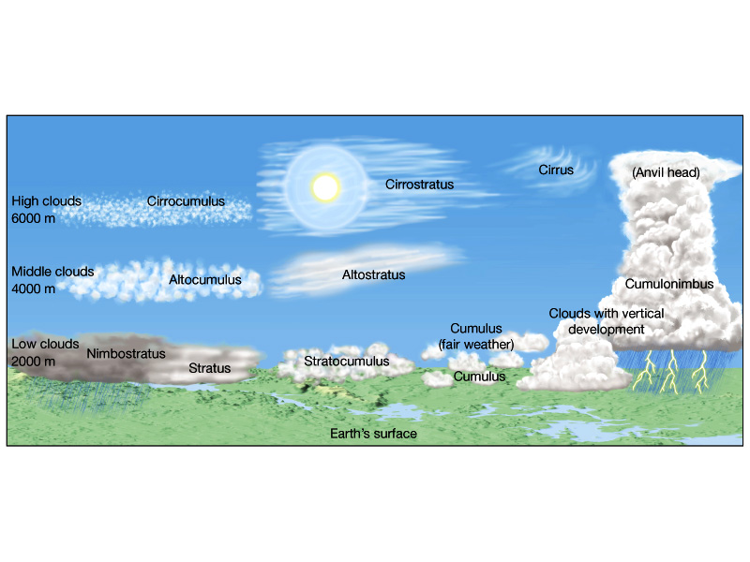
Cloud classification system (type, altitude, height)

Slide 21
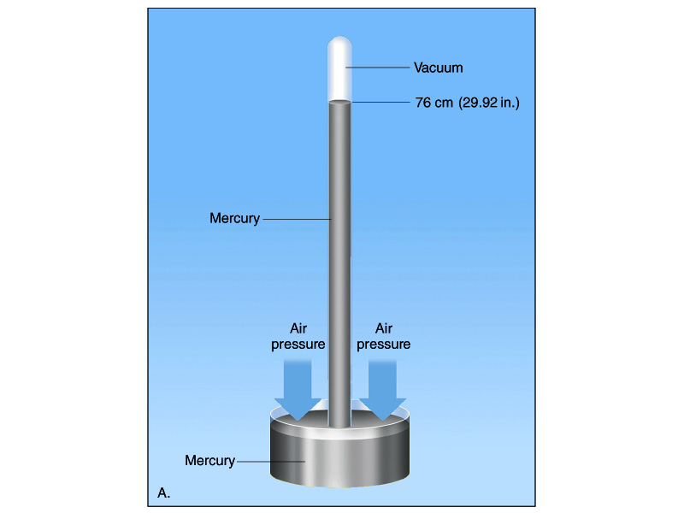
Toricelli’s Barometer

Slide 22
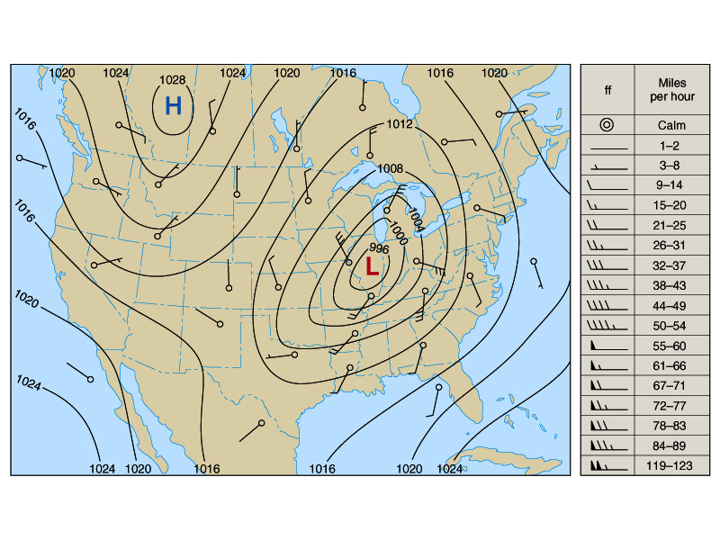
Air pressure map of U.s.

Slide 23
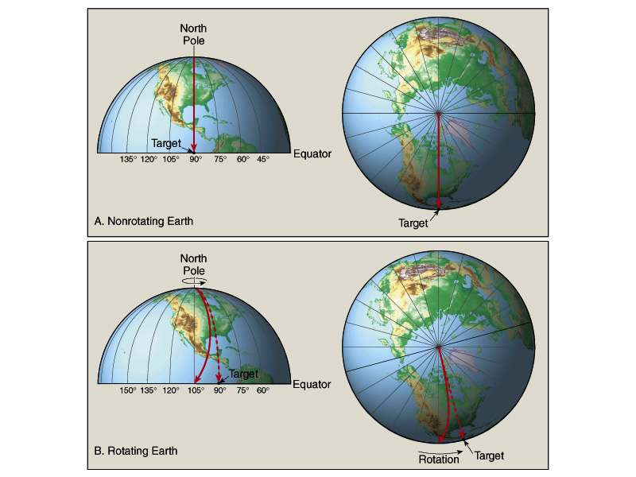
N. Hemisphere =
Hook right
S. Hemisphere = Hook left
Coriolis

Slide 24
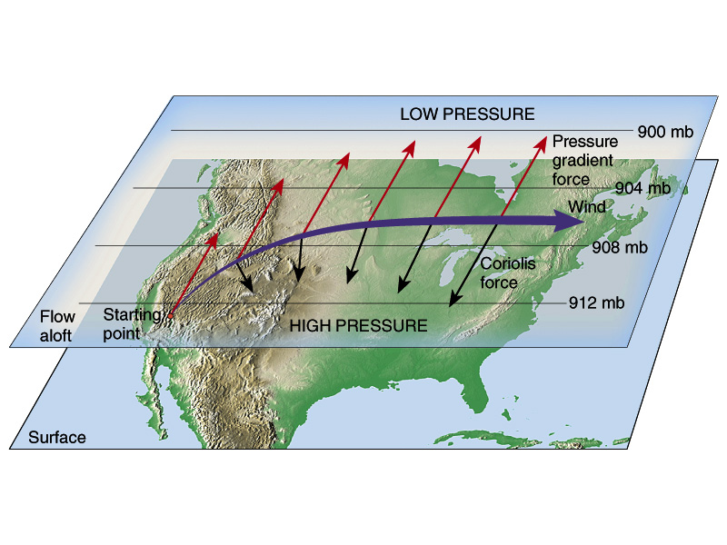
Isobars / Air flow / Coriolis

Slide 25
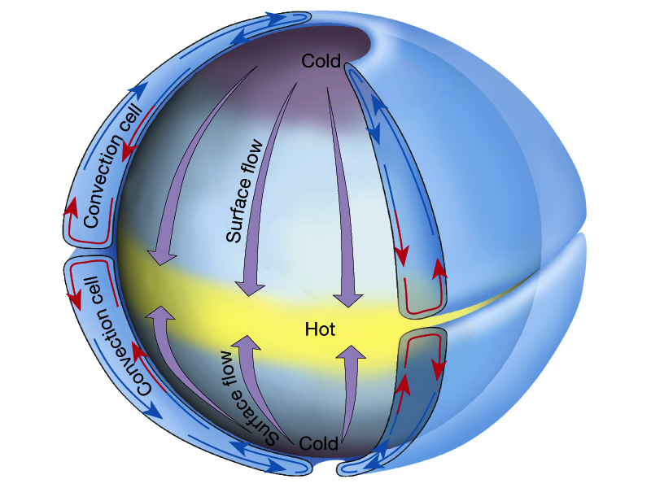

Slide 26
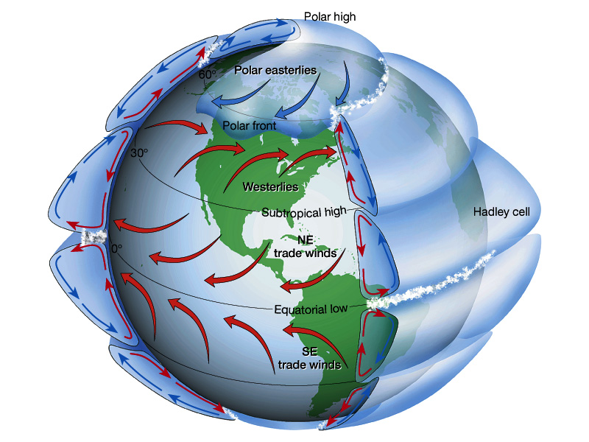

Slide 27
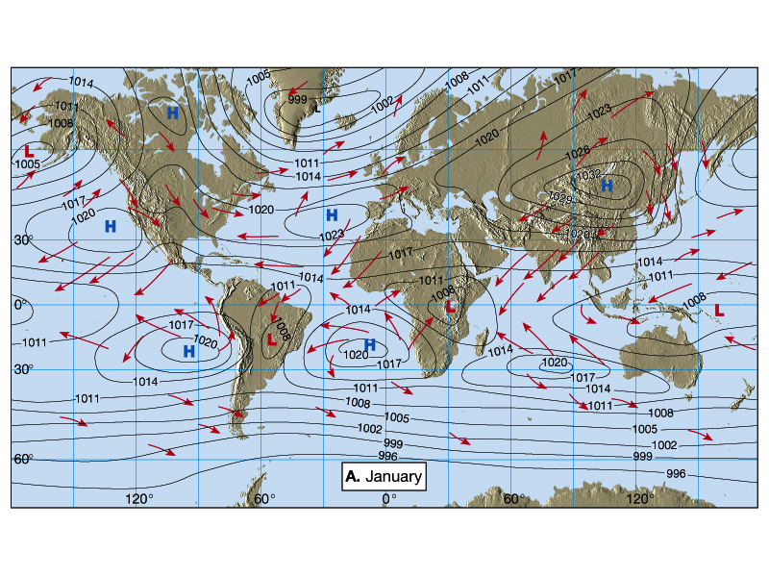

Slide 28
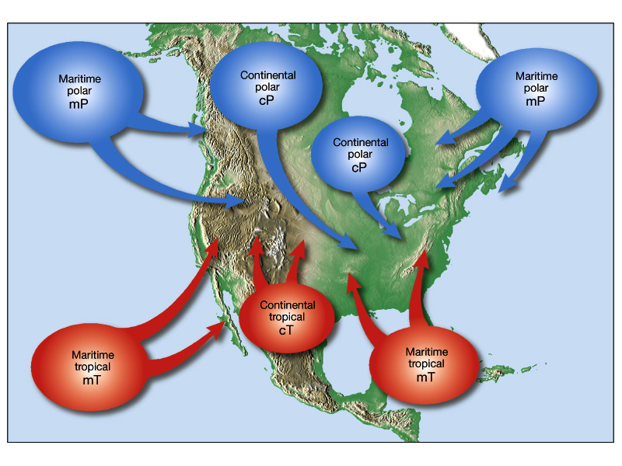
Sources of Air / Air Masses

Slide 29
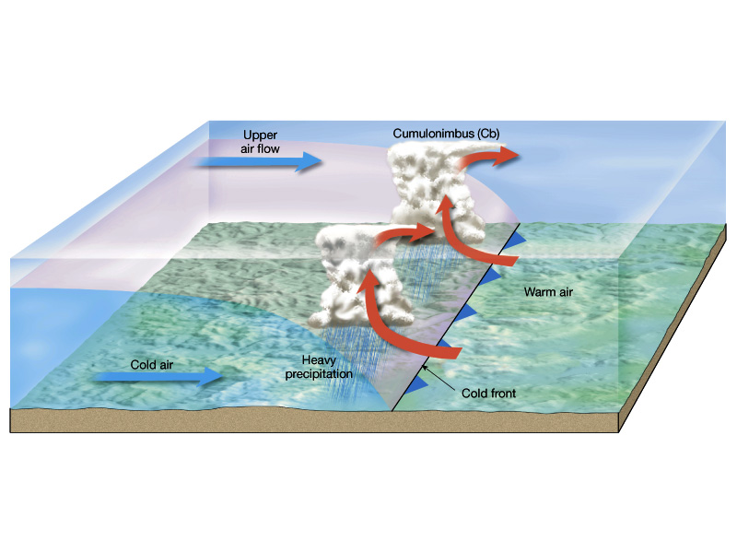
Cold Front Weather

Slide 30
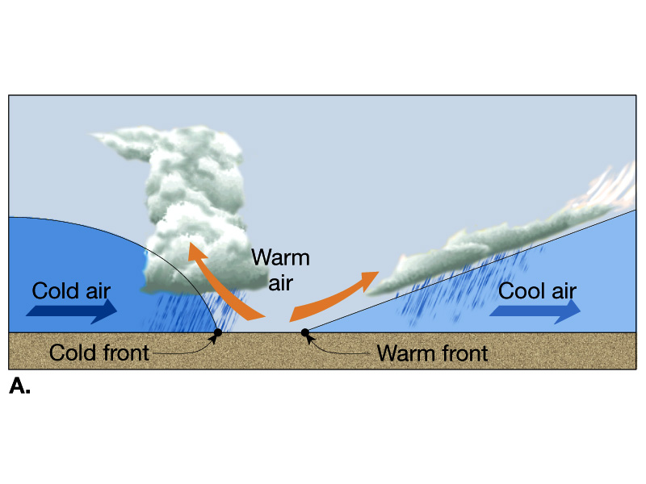
Impending Occluded Front

Slide 31
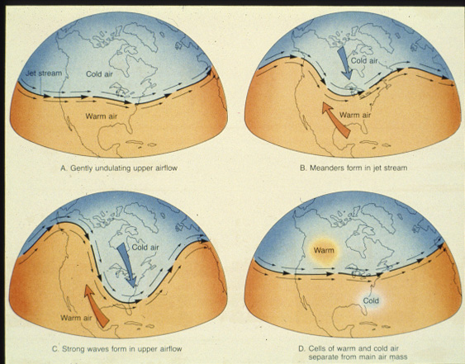
Effect of Jetstream on U.S. weather

Slide 32
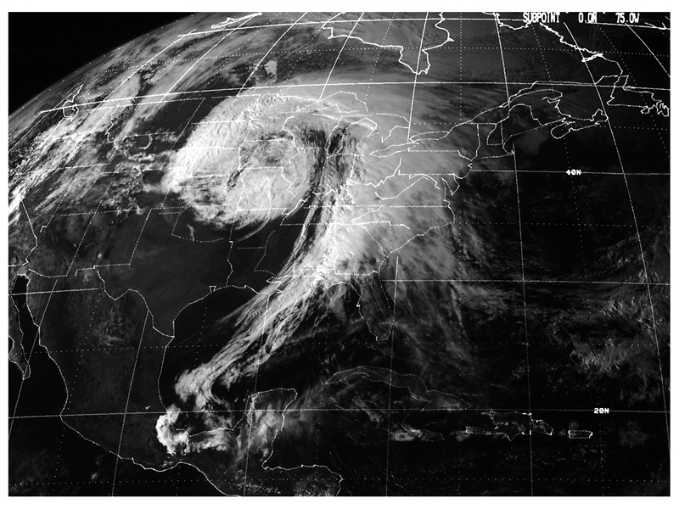

Slide 33
